Slide 1
PHYS 1441 – Section 001 Lecture #7
Thursday, June 12, 2014
Dr. Jaehoon Yu
Projectile Motion
Maximum Range and Height
What is the Force?
Newton’s Second Law
Free Body Diagram
Newton’s Third Law
Categories of forces
Today’s homework is homework #4, due 11pm, Tuesday, June 17!!

Slide 2
Announcements
Reading Assignment
CH4.1 – 4.3
Mid-term exam
In the class coming Tuesday, June 17
Comprehensive exam
Covers CH1.1 to what we finish Monday, June 16+ Appendix A
Bring your calculator but DO NOT input formula into it!
Your phones or portable computers are NOT allowed as a replacement!
You can prepare a one 8.5x11.5 sheet (front and back) of handwritten formulae and values of constants for the exam ➔ no solutions, derivations or definitions!
No additional formulae or values of constants will be provided!

Slide 3
Reminder: Special Project #2
Show that the trajectory of a projectile motion is a parabola!!
20 points
Due: Monday, June 16
You MUST show full details of your OWN computations to obtain any credit
Beyond what was covered in this lecture note and in the book!

Slide 4
Ex.3.5 The Height of a Kickoff
A placekicker kicks a football at an angle of 40.0 degrees and
the initial speed of the ball is 22 m/s. Ignoring air resistance,
determine the maximum height that the ball attains.

Slide 5
First, the initial velocity components

Slide 6
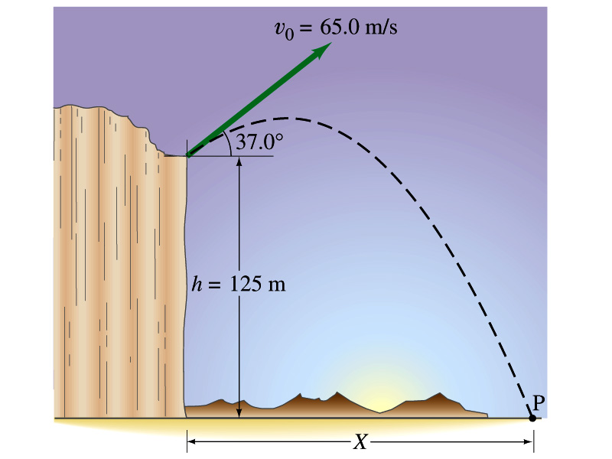
Example for a Projectile Motion
A stone was thrown upward from the top of a cliff at an angle of 37º to horizontal with initial speed of 65.0m/s. If the height of the cliff is 125.0m, how long is it before the stone hits the ground?
Becomes
Since negative time does not exist.
6

Slide 7
Example cont’d
What is the speed of the stone just before it hits the ground?
What are the maximum height and the maximum range of the stone?
Do these yourselves at home for fun!!!
7

Slide 8
Horizontal Range and Max Height
Based on what we have learned previously, one can analyze the projectile motion in more detail
Maximum height an object can reach
Maximum range
For a projectile fired with initial speed v₀ at angle θ₀, the time for it to reach maximum height can be obtained:
What happens at the maximum height?
At the maximum height the object’s vertical motion stops to turn around!!
g=9.8m/s²
Solve for t_{A}
Time to reach to the maximum height!!

Slide 9
Horizontal Range and Max Height
Since no acceleration is in x direction, it still flies even if v_{y}=0.
Range
Height

Slide 10
Maximum Range and Height
What are the conditions that give maximum height and range of a projectile motion?
This formula tells us that the maximum height can be achieved when θ₀=90º!!!
This formula tells us that the maximum range can be achieved when 2θ₀=90º, i.e., θ₀=45º!!!

