Slide 1
PHYS 1441 – Section 001
Lecture #8
Monday, June 16, 2014
Dr. Jaehoon Yu
What is the Force?
Newton’s Second Law
Free Body Diagram
Newton’s Third Law
Categories of forces
Application of Newton’s Laws
Uniform Circular Motion
Today’s homework is homework #5, due 11pm, Friday, June 20!!

Slide 2
Announcements
Mid-term exam
  In the class tomorrow, Tuesday, June 17
  Comprehensive exam
    Covers CH1.1 to what we finish today + Appendix A
  Bring your calculator but DO NOT input formula into it!
    Your phones or portable computers are NOT allowed as a replacement!
  You can prepare a one 8.5x11.5 sheet (front and back) of handwritten formulae and values of constants for the exam ➔ no solutions, derivations or definitions!
    No additional formulae or values of constants will be provided!
Quiz #2 results
  Class average: 26.8/45
    Equivalent to: 59.6/100
    Previous quiz: 69.3/100
  Top score: 45

Slide 3
Force
We’ve been learning kinematics; describing motion without understanding what the cause of the motion is. Now we are going to learn dynamics!!
FORCE is what causes an object to move.
Can someone tell me what FORCE is?
The above statement is not entirely correct. Why?
Because when an object is moving with a constant velocity no force is exerted on the object!!!
FORCEs are what cause changes to the velocity of an object!!
What does this statement mean?
When there is force, there is change of velocity!!
What does the force cause?
An acceleration.!!
What happens if there are several forces being exerted on an object?
Forces are vector quantities, so vector sum of all forces, the NET FORCE, determines the direction of the acceleration of the object.
F₁
F₂
NET FORCE, F= F₁+F₂
When the net force on an object is 0, it has constant velocity and is at its equilibrium!!

Slide 4
More Forces
There are various types of forces
Contact Forces: Forces exerted by physical contact of objects
Examples of Contact Forces: Baseball hit by a bat, Car collisions
Field Forces: Forces exerted without physical contact of objects
Examples of Field Forces: Gravitational Force, Electro-magnetic force
What are possible ways to measure strength of a force?
A calibrated spring whose length changes linearly with the force exerted .
Forces are vector quantities, so the addition of multiple forces must be done following the rules of vector additions.

Slide 5
Newton’s First Law and Inertial Frames
Aristotle (384-322BC): A natural state of a body is rest. Thus force is required to move an object. To move faster, ones needs larger forces.
Galileo’s statement on natural states of matter: Any velocity once imparted to a moving body will be rigidly maintained as long as the external causes of retardation are removed!!
Galileo’s statement is formulated by Newton into the 1st law of motion (Law of Inertia): In the absence of external forces, an object at rest remains at rest and an object in motion continues in motion with a constant velocity.
What does this statement tell us?
When no net force is exerted on an object, the acceleration of the object is 0.
Any isolated object, the object that do not interact with its surroundings, is either at rest or moving at a constant velocity.
Objects would like to keep its current state of motion, as long as there are no net force that interferes with the motion. This tendency is called the Inertia.
A frame of reference that is moving at a constant velocity is called the Inertial Frame
Is a frame of reference with an acceleration an Inertial Frame?
NO!

Slide 6
Mass
Mass: A measure of the inertia of an object or the quantity of matter
Independent of the object’s surroundings: The same no matter where you go.
Independent of the method of measurement: The same no matter how you measure it.
The heavier the object, the bigger the inertia !!
It is harder to make changes of motion of a heavier object than a lighter one.
The same forces applied to two different masses result in different acceleration depending on the mass.
Note that the mass and the weight of an object are two different quantities!!
Weight of an object is the magnitude of the gravitational force exerted on the object.
Not an inherent property of an object!!!
Weight will change if you measure on the Earth or on the moon but the mass won’t!!
Unit of mass?

Slide 7
Newton’s Second Law of Motion
The acceleration of an object is directly proportional to the net force exerted on it and is inversely proportional to the object’s mass.
How do we write the above statement in a mathematical expression?
From this we obtain
Newton’s 2nd Law of Motion
Since it’s a vector expression, each component must also satisfy:

Slide 8
Unit of the Force
From the vector expression in the previous page, what do you conclude the dimension and the unit of the force are?
The dimension of force is
The unit of force in SI is
For ease of use, we define a new derived unit called, Newton (N)

Slide 9
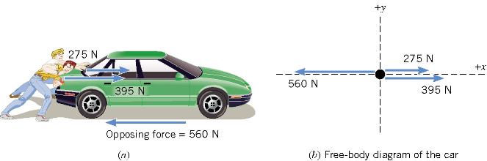
Free Body Diagram
A free-body-diagram is a diagram that represents the object and the forces that act on it.

Slide 10
Ex. Pushing a stalled car
What is the net force in this example?
F=
275 N
+ 395 N
– 560 N =
+110 N
Which direction?
The + x axis of the coordinate system.

Slide 11
What is the acceleration the car receives?
If the mass of the car is 1850 kg, then by Newton’s second law, the acceleration is
Since the motion is
in 1 dimension
Now we solve this
equation for a

Slide 12
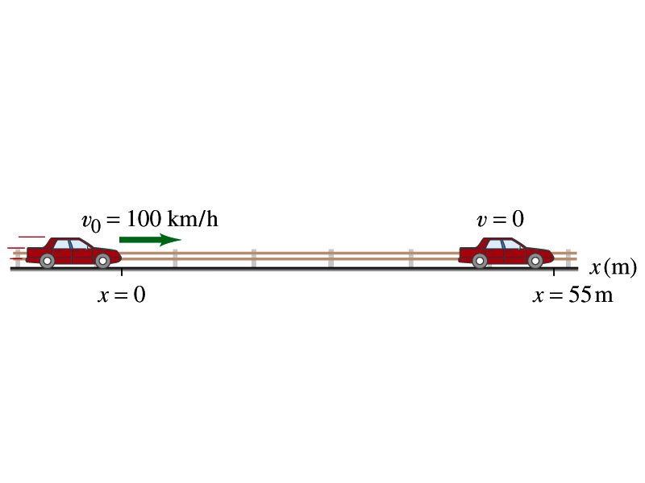
Example 4.3
What constant net force is required to bring a 1500kg car to rest from a speed of 100km/h within a distance of 55m?
What do we need to know to figure out the force?
Acceleration!!
What are given?
Initial speed:
Final speed:
Displacement:
This is a one dimensional motion. Which kinetic formula do we use to find acceleration?
Acceleration
Thus, the force needed to stop the car is
Linearly proportional to the mass of the car
Squarely proportional to the speed of the car
Inversely proportional to the force by the brake
Given the force how far does the car move till it stops?

Slide 13
Vector Nature of the Force
The direction of the force and the acceleration vectors can be taken into account by using x and y components.
is equivalent to

Slide 14
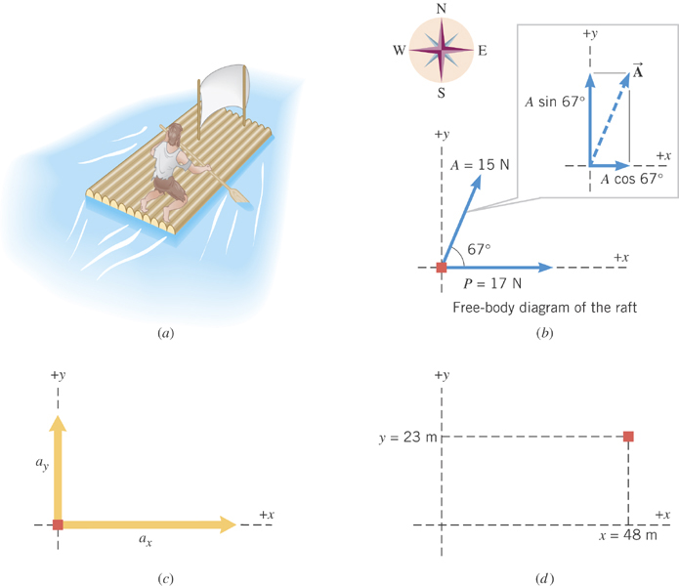
Ex. Stranded man on a raft
A man is stranded on a raft (mass of man and raft = 1300kg) as shown in the figure. By paddling, he causes an average force P of 17N to be applied to the raft in a direction due east (the +x direction). The wind also exerts a force A on the raft. This force has a magnitude of 15N and points 67º north of east. Ignoring any resistance from the water, find the x and y components of the rafts acceleration.

Slide 15
First, let’s compute the net force on the raft as follows:
Force | x component | y component
+17 N
0 N
+(15N)cos67º
+(15N)sin67º
+17+15cos67^{o=}
+15sin67º=
+23(N)
+14(N)

Slide 16
Now compute the acceleration components in x and y directions!!
And put them all together for the overall acceleration:

Slide 17
Example for Newton’s 2nd Law of Motion
Determine the magnitude and direction of the acceleration of the puck whose mass is 0.30kg and is being pulled by two forces, F1 and F2, as shown in the picture, whose magnitudes of the forces are 8.0 N and 5.0 N, respectively.
Components of F₁
F₁
θ₁=60^{ο}
Components of F₂
θ₂=−20^{ο}
F₂
Components of total force F
Magnitude and direction of acceleration a
Acceleration
Vector a
17

Slide 18
Newton’s Third Law (Law of Action and Reaction)
If two objects interact, the force F₂₁ that object 2 exerts on object 1 is equal in magnitude and opposite in direction to the force F₁₂ object 1 exerts on object 2.
F₁₂
F₂₁
2
1
The reaction force is equal in magnitude to the action force but in opposite direction. These two forces always act on different objects.
What is the reaction force to the force of a free falling object?
The gravitational force the object exerts on the Earth!
Stationary objects on top of a table has a reaction force (called the normal force) from table to balance the action force, the gravitational force.
18

Slide 19
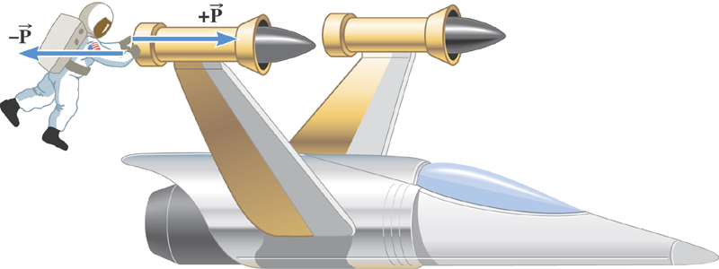
Ex. The Accelerations Produced by Action and Reaction Forces
Which one do you think will get larger acceleration?
Suppose that the magnitude of the force P is 36 N. If the mass of the spacecraft is 11,000 kg and the mass of the astronaut is 92 kg, what are the accelerations?

Slide 20
Ex. continued
Force exerted on the space craft by the astronaut
Force exerted on the astronaut by the space craft
space craft’s acceleration
Astronaut’s acceleration

Slide 21
Example of Newton’s 3rd Law
A large man and a small boy stand facing each other on frictionless ice. They put their hands together and push against each other so that they move apart. a) Who moves away with the higher speed and by how much?
F₁₂
F₂₁= - F₁₂
m
M
Since
and
Establish the
equation
Divide by m
21

Slide 22
Example of Newton’s 3rd Law, cnt’d
Man’s velocity
Boy’s velocity
So boy’s velocity is higher than man’s, if M>m, by the ratio of the masses.
b) Who moves farther while their hands are in contact?
Boy’s displacement
Man’s displacement
Given in the same time interval, since the boy has higher acceleration and thereby higher speed, he moves farther than the man.
22

Slide 23
Categories of Forces
Fundamental Forces: Truly unique forces that cannot be derived from any other forces
  Total of three fundamental forces
    Gravitational Force
    Electro-Weak Force
    Strong Nuclear Force
Non-fundamental forces: Forces that can be derived from fundamental forces
  Friction
  Tension in a rope
  Normal or support forces

Slide 24
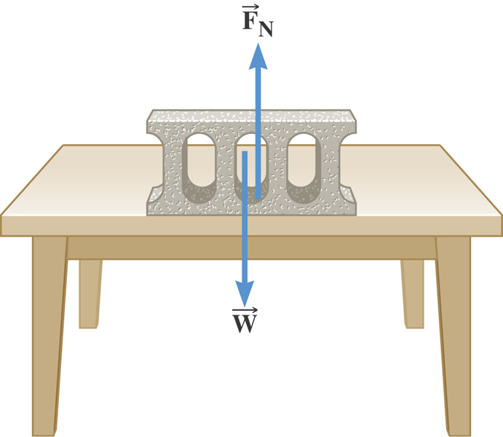
The Normal Force
The normal force is one component of the force that a surface exerts on an object with which it is in contact – namely, the component that is perpendicular to the surface.

Slide 25
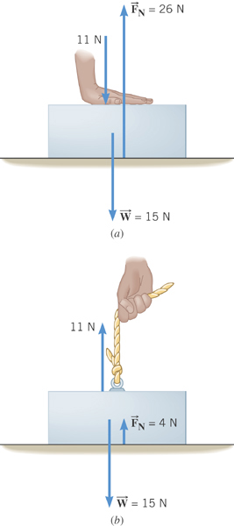
Some normal force exercises
Case 1: Hand pushing down on the book
Case 2: Hand pulling up the book

Slide 26
Some Basic Information
When Newton’s laws are applied, external forces are only of interest!!
Because, as described in Newton’s first law, an object will keep its current motion unless non-zero net external force is applied.
Why?
The force that reacts to action forces due to the surface structure of an object. Its direction is perpendicular to the surface.
Normal Force, n:
Tension, T:
The reactionary force by a stringy object against an external force exerted on it.
A graphical tool which is a diagram of external forces on an object and is extremely useful analyzing forces and motion!! Drawn only on an object.
Free-body diagram

Slide 27
Applications of Newton’s Laws
Suppose you are pulling a box on frictionless ice, using a rope.
What are the forces being exerted on the box?
M
T
Gravitational force: F_{g}
n= -F_{g}
Normal force: n
Free-body diagram
T
Tension force: T
n= -F_{g}
Total vector force: F=F_{g}+n+T=T
F_{g}=-Mg
T
If T is a constant force, a_{x}, is constant
F_{g}= -Mg
What happened to the motion in y-direction?

Slide 28
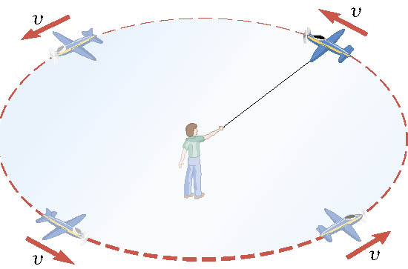
Definition of the Uniform Circular Motion
Uniform circular motion is the motion of an object traveling at a constant speed on a circular path.

Slide 29
Speed of a uniform circular motion?
Let T be the period of this motion, the time it takes for the object to travel once around the complete circle whose radius is r.

Slide 30
Ex. : A Tire-Balancing Machine
The wheel of a car has a radius of 0.29m and is being rotated at 830 revolutions per minute on a tire-balancing machine. Determine the speed at which the outer edge of the wheel is moving.

