Slide 1
PHYS 1441 – Section 001 Lecture #10
Thursday, June 19, 2014
Dr. Jaehoon Yu
Uniform Circular Motion
Centripetal Acceleration
Unbanked and Banked highways
Today’s homework is homework #6, due 11pm, Tuesday, June 24!!

Slide 2
Announcements
Quiz 3
Beginning of the class Monday, June 23
Covers CH 4.7 to what we finish today
Bring your calculator but DO NOT input formula into it!
Your phones or portable computers are NOT allowed as a replacement!
You can prepare a one 8.5x11.5 sheet (front and back) of handwritten formulae and values of constants for the exam ➔ no solutions, derivations or definitions!
No additional formulae or values of constants will be provided!
Mid-term result
Class average: 67/97
Equivalent to 69.1/100
Previous exam: 61.8/100
Top score: 89/97
Mid-term grade discussion bottom half of the class (CPB342)

Slide 3
Reminder: Special Project #3
Using the fact that g=9.80m/s² on the Earth’s surface, find the average density of the Earth.
Use the following information only but without computing the volume explicitly
The gravitational constant
The radius of the Earth
20 point extra credit
Due: Monday, June 23
You must show your OWN, detailed work to obtain any credit!! Much more than in this lecture note!

Slide 4
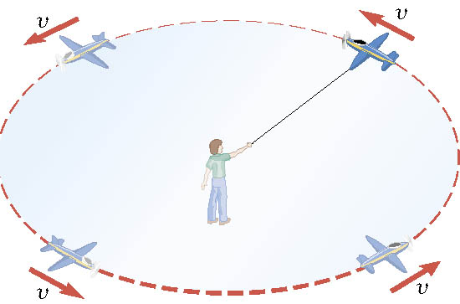
Definition of the Uniform Circular Motion
Uniform circular motion is the motion of an object traveling at a constant speed on a circular path.

Slide 5
Speed of a uniform circular motion?
Let T be the period of this motion, the time it takes for the object to travel once around the complete circle whose radius is r.

Slide 6
Ex. : A Tire-Balancing Machine
The wheel of a car has a radius of 0.29m and is being rotated at 830 revolutions per minute on a tire-balancing machine. Determine the speed at which the outer edge of the wheel is moving.

Slide 7
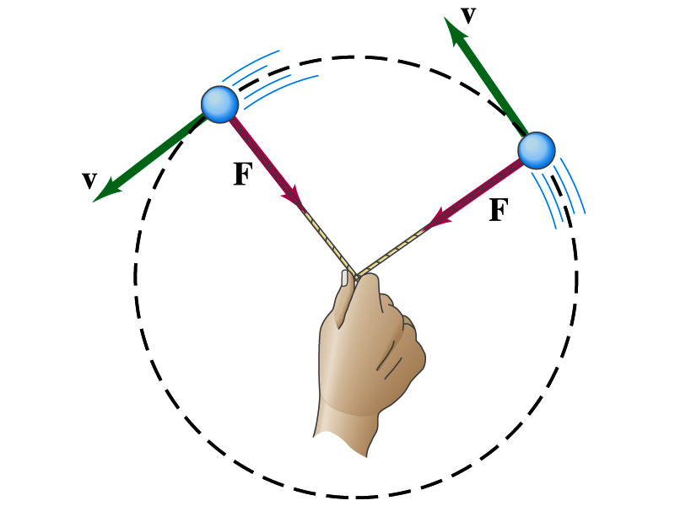
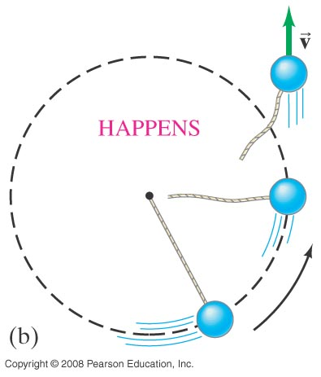
Newton’s Second Law & Centripetal Force
The centripetal * acceleration is always perpendicular to the velocity vector, v, and points to the center of the axis (radial direction) in a uniform circular motion.
Are there forces in this motion? If so, what do they do?
The force that causes the centripetal acceleration acts toward the center of the circular path and causes the change in the direction of the velocity vector. This force is called the centripetal force.
What do you think will happen to the ball if the string that holds the ball breaks?
The external force no longer exist. Therefore, based on Newton’s 1st law, the ball will continue its motion without changing its velocity and will fly away following the tangential direction to the circle.
*Mirriam Webster: Proceeding or acting in the direction toward the center or axis

Slide 8
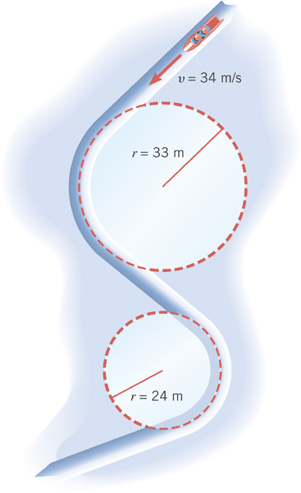
Ex. Effect of Radius on Centripetal Acceleration
The bobsled track at the 1994 Olympics in Lillehammer, Norway, contain turns with radii of 33m and 23m. Find the centripetal acceleration at each turn for a speed of 34m/s, a speed that was achieved in the two–man event. Express answers as multiples of g=9.8m/s².
Centripetal acceleration:
R=33m
R=24m

Slide 9
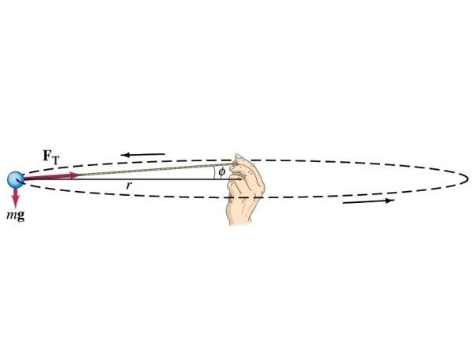
Example 5.1: Uniform Circular Motion
A ball of mass 0.500kg is attached to the end of a 1.50m long cord. The ball is moving in a horizontal circle. If the string can withstand maximum tension of 50.0 N, what is the maximum speed the ball can attain before the cord breaks?
Centripetal acceleration:
When does the string break?
when the required centripetal force is greater than the sustainable tension.
Calculate the tension of the cord when speed of the ball is 5.00m/s.

Slide 10
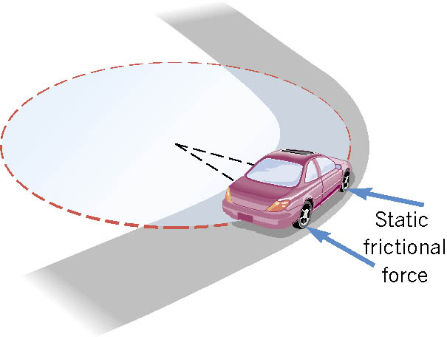
Unbanked Curve and Centripetal Force
On an unbanked curve, the static frictional force provides the centripetal force.

Slide 11
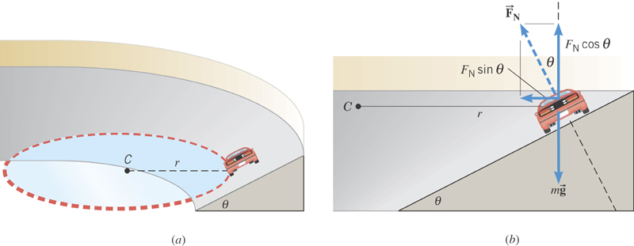
Banked Curves
On a frictionless banked curve, the centripetal force is the
horizontal component of the normal force. The vertical
component of the normal force balances the car’s weight.

Slide 12
Ex. The Daytona 500
The Daytona 500 is the major event of the NASCAR season. It is held at the Daytona International Speedway in Daytona, Florida. The turns in this oval track have a maximum radius (at the top) of r=316m and are banked steeply, with θ=31º. Suppose these maximum radius turns were frictionless. At what speed would the cars have to travel around them?
x comp.
y comp.
y
x

