Slide 1
PHYS 1441 – Section 001
Lecture #11
Monday, June 23, 2014
Dr. Jaehoon Yu
Newton’s Law of Universal Gravitation
  Weightlessness
  Work done by a constant force
  Multiplication of Vectors
  Work-Kinetic Energy Theorem

Slide 2
Announcements
Term exam #2
  In class this Wednesday, June 25
  Non-comprehensive exam
  Covers CH 4.7 to what we finish tomorrow, Tuesday, June 24
  Bring your calculator but DO NOT input formula into it!
    Your phones or portable computers are NOT allowed as a replacement!
  You can prepare a one 8.5x11.5 sheet (front and back) of handwritten formulae and values of constants for the exam ➔ no solutions, derivations or definitions!
    No additional formulae or values of constants will be provided!

Slide 3
Newton’s Law of Universal Gravitation
People have been very curious about the stars in the sky, making observations for a long~ time. The data people collected, however, have not been explained until Newton has discovered the law of gravitation.
Every object in the Universe attracts every other object with a force that is directly proportional to the product of their masses and inversely proportional to the square of the distance between them.
How would you write this law mathematically?
With G
G is the universal gravitational constant, and its value is
Unit?
This constant is not given by the theory but must be measured by experiments.
This form of forces is known as the inverse-square law, because the magnitude of the force is inversely proportional to the square of the distances between the objects.

Slide 4
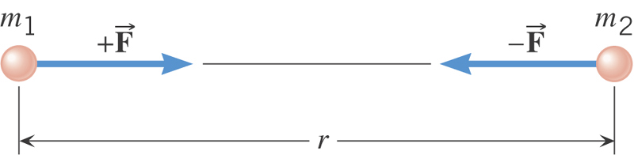
Ex. Gravitational Attraction
What is the magnitude of the gravitational force that acts on each particle in the figure, assuming m₁=12kg, m₂=25kg, and r=1.2m?

Slide 5
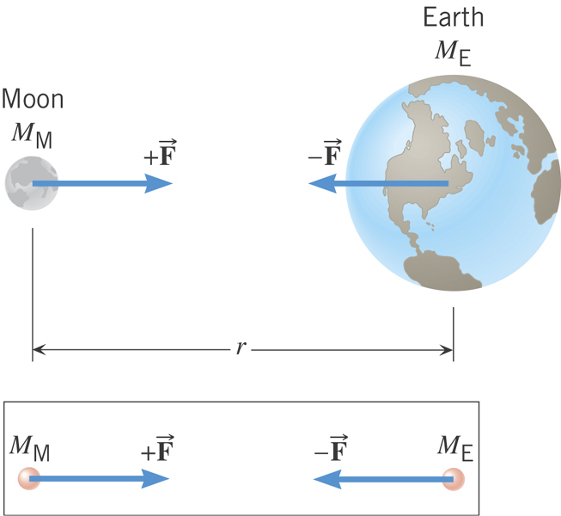
Why does the Moon orbit the Earth?

Slide 6
Gravitational Force and Weight
The attractive force exerted on an object by another object
Gravitational Force, F_{g}
Weight of an object with mass M is
What is the SI unit of weight?
N
Since weight depends on the magnitude of gravitational acceleration, g, it varies depending on geographical location.
By measuring the forces one can determine masses. This is why you can measure mass using the spring scale.

Slide 7
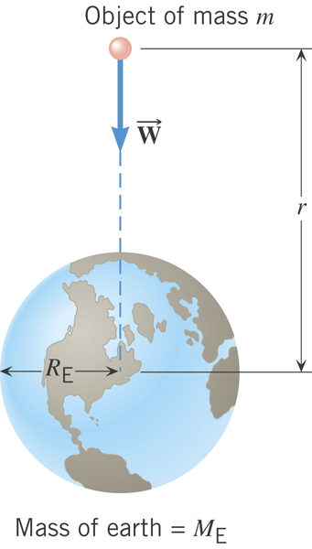
Gravitational Acceleration
Gravitational acceleration at distance r from the center of the earth!
What is the SI unit of g?
m/s²

Slide 8
Magnitude of the gravitational acceleration on the surface of the Earth
Gravitational force on the surface of the earth:

Slide 9
Example for Universal Gravitation
Using the fact that g=9.80m/s² on the Earth’s surface, find the average density of the Earth.
Since the gravitational acceleration is
Solving for g
Solving for M_{E}
Therefore the density of the Earth is

Slide 10
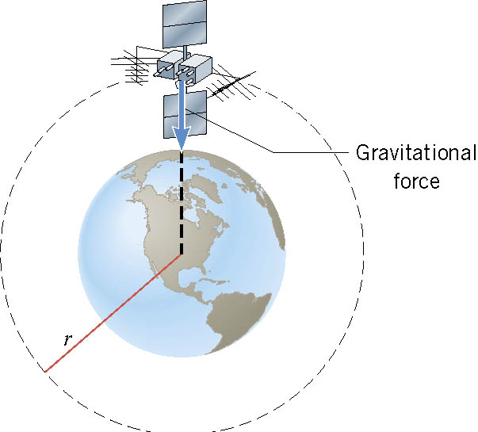
Satellite in Circular Orbits
There is only one speed that a satellite can have if the satellite is to remain in an orbit with a fixed radius.
What acts as the centripetal force?
The gravitational force of the earth pulling the satellite!

Slide 11
Ex. Orbital Speed of the Hubble Space Telescope
Determine the speed of the Hubble Space Telescope orbiting at a height of 598 km above the earth’s surface.

Slide 12
Period of a Satellite in an Orbit
Speed of a satellite
Square either side and solve for T2
Period of a satellite
Kepler’s 3rd Law
This is applicable to any satellite or even for planets and moons.

Slide 13
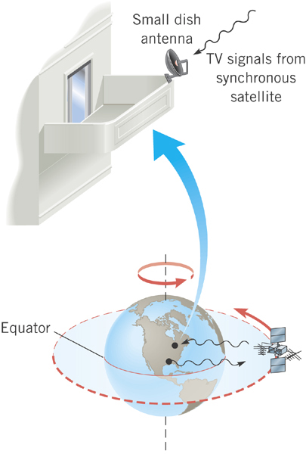
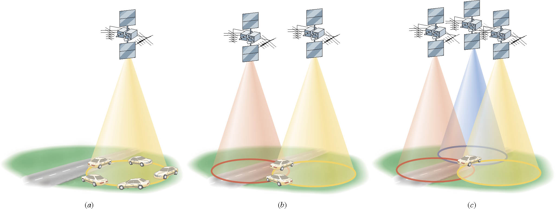
Geo-synchronous Satellites
Global Positioning System (GPS)
Satellite TV
What period should these satellites have?
The same as the earth!!
24 hours

Slide 14
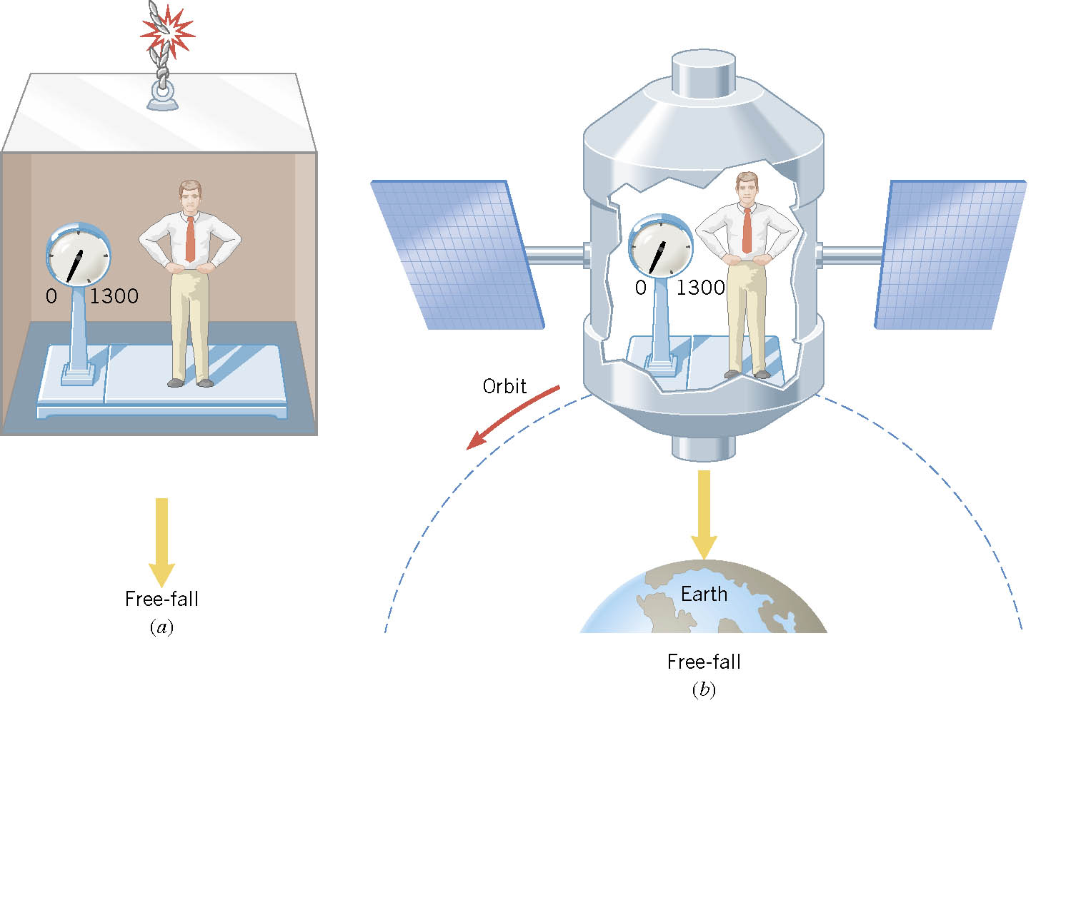
Ex. Apparent Weightlessness and Free Fall
0
0
In each case, what is the weight recorded by the scale?

Slide 15
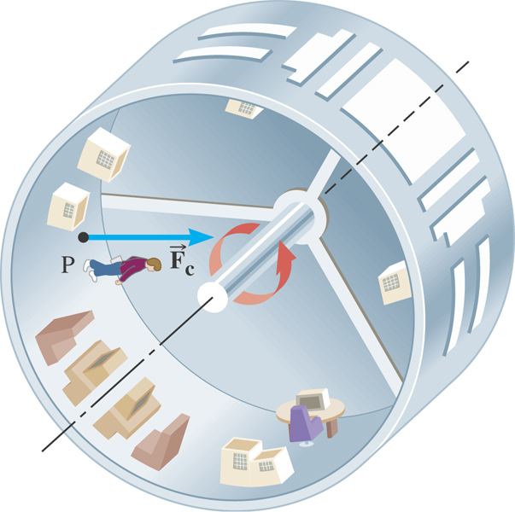
Ex. The Artificial Gravity
At what speed must the surface of the space station move so that the astronaut experiences a push on his feet equal to his weight on earth? The radius is 1700 m.

