Slide 1
PHYS 1441 – Section 001
Lecture #13
Thursday, June 26, 2014
Dr. Jaehoon Yu
Potential Energy
  Gravitational Potential Energy
  Elastic Potential Energy
  Mechanical Energy Conservation
  Power
  Linear Momentum
  Linear Momentum and Impulse
Today’s homework is homework #8, due 11pm, Tuesday, July 1!!

Slide 2
Special Project #4
A ball of mass M at rest is dropped from the height h above the ground onto a spring on the ground, whose spring constant is k. Neglecting air resistance and assuming that the spring is in its equilibrium, express, in terms of the quantities given in this problem and the gravitational acceleration g, the distance x of which the spring is pressed down when the ball completely loses its energy. (10 points)
Find the x above if the ball’s initial speed is v_{i}. (10 points)
Due for the project is this Monday, June 30
You must show the detail of your OWN work in order to obtain any credit.

Slide 3
Potential Energy
Energy associated with a system of objects ➔ Stored energy which has the potential or the possibility to work or to convert to kinetic energy
In order to describe potential energy, U, a system must be defined.
What does this mean?
The concept of potential energy can only be used under the special class of forces called the conservative force which results in the principle of conservation of mechanical energy.
What are the forms of energies in the universe?
Mechanical Energy
Chemical Energy
Biological Energy
Electromagnetic Energy
Nuclear Energy
Thermal Energy
These different types of energies are stored in the universe in many different forms!!!
If one takes into account ALL forms of energy, the total energy in the entire universe is conserved. It just transforms from one form to another.

Slide 4
Gravitational Potential Energy
This potential energy is given to an object by the gravitational field in the system of Earth by virtue of the object’s height from an arbitrary zero level
When an object is falling, the gravitational force, mg, performs the work on the object, increasing the object’s kinetic energy. So the potential energy of an object at a height y, the potential to do work, is expressed as
m
h_{i}
mg
m
The work done on the object by the gravitational force as the brick drops from y_{i} to y_{f} is:
h_{f}
(since )
What does this mean?
Work by the gravitational force as the brick drops from y_{i} to y_{f} is the negative change of the system’s potential energy
➔ Potential energy was spent in order for the gravitational force to increase the brick’s kinetic energy.

Slide 5
Example for Potential Energy
A bowler drops a bowling ball of mass 7kg on his toe. Choosing the floor level as y=0, estimate the total work done on the ball by the gravitational force as the ball falls on the toe.
Let’s assume that the top of the toe is 3cm from the floor and the hand was at 50cm above the floor.
M
The kinetic energy of a 60g bullet flying at 33m/s (100fts) or 119km/hr.
b) Perform the same calculation using the top of the bowler’s head as the origin.
What has to change?
First we must re-compute the positions of the ball in his hand and on his toe.
Assuming the bowler’s height is 1.8m, the ball’s original position is –1.3m, and the toe is at –1.77m.

Slide 6
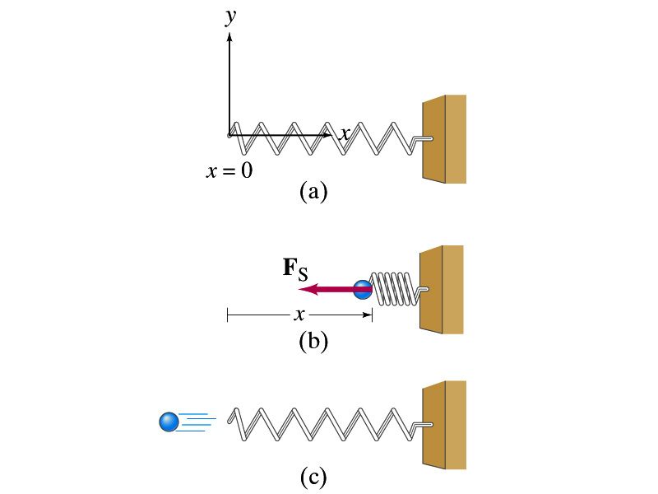
Elastic Potential Energy
Potential energy given to an object by a spring or an object with elasticity in the system that consists of an object and the spring.
The force spring exerts on an object when it is distorted from its equilibrium by a distance x is
Hooke’s Law
The work performed on the object by the spring is
The potential energy of this system is
What do you see from the above equations?
The work done on the object by the spring depends only on the initial and final position of the distorted spring.
Where else did you see this trend?
The gravitational potential energy, U_{g}
So what does this tell you about the elastic force?
A conservative force!!!

Slide 7
Conservative and Non-conservative Forces
The work done on an object by the gravitational force does not depend on the object’s path in the absence of a retardation force.
N
When directly falls, the work done on the object by the gravitation force is
m
l
h
When sliding down the hill of length l, the work is
mg
θ
How about if we lengthen the incline by a factor of 2, keeping the height the same??
Still the same amount of work☺
So the work done by the gravitational force on an object is independent of the path of the object’s motion. It only depends on the difference of the object’s initial and final position in the direction of the force.
Forces like gravitational and elastic forces are called the conservative force
If the work performed by the force does not depend on the path.
If the work performed on a closed path is 0.
Total mechanical energy is conserved!!

Slide 8
Conservation of Mechanical Energy
Total mechanical energy is the sum of kinetic and potential energies
Let’s consider a brick of mass m at the height h from the ground
What is the brick’s potential energy?
m
h
mg
What happens to the energy as the brick falls to the ground?
m
The brick gains speed
By how much?
h₁
So what?
The brick’s kinetic energy increased
And?
The lost potential energy is converted to kinetic energy!!
The total mechanical energy of a system remains constant in any isolated systems of objects that interacts only through conservative forces: Principle of mechanical energy conservation
What does this mean?

Slide 9
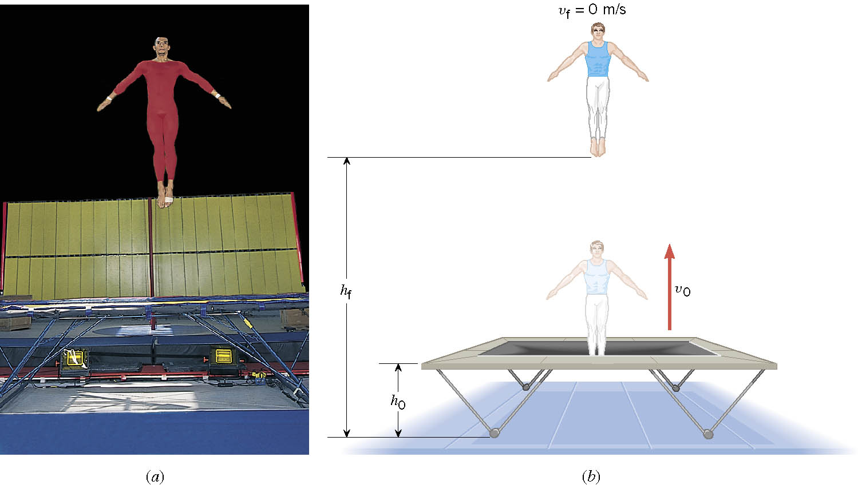
Ex. A Gymnast on a Trampoline
A gymnast leaves the trampoline at an initial height of 1.20 m and reaches a maximum height of 4.80 m before falling back down. What was the initial speed of the gymnast?

Slide 10
Ex. Continued
From the work-kinetic energy theorem
Work done by the gravitational force
Since at the maximum height, the final speed is 0. Using work-KE theorem, we obtain

Slide 11
Example
A ball of mass m at rest is dropped from the height h above the ground. a) Neglecting the air resistance, determine the speed of the ball when it is at the height y above the ground.
PE
KE
Using the principle of mechanical energy conservation
m
mgh
0
mv_{i}²/2
h
mg
m
mgy
mv²/2
mv_{f}²/2
b) Determine the speed of the ball at y if it had initial speed v_{i} at the time of the release at the original height h.
y
Again using the principle of mechanical energy conservation but with non-zero initial kinetic energy!!!
0
This result look very similar to a kinematic expression, doesn’t it? Which one is it?

Slide 12
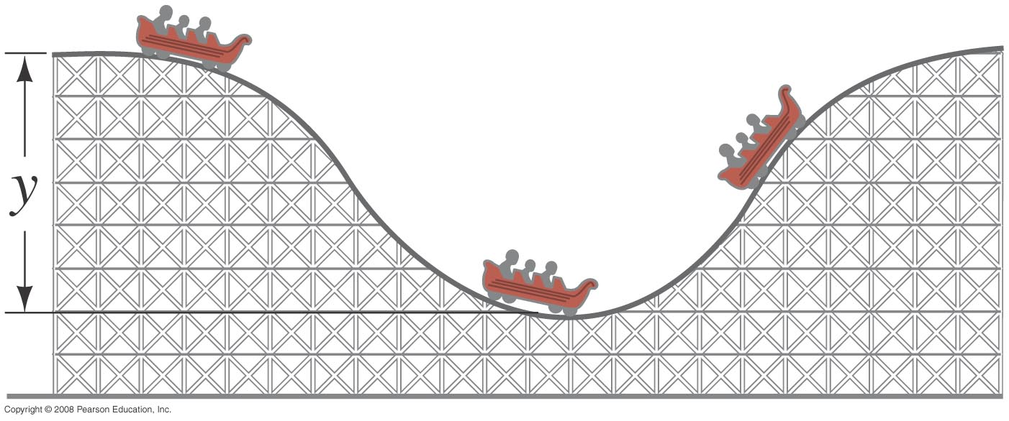
Ex. 6 – 8
Assuming the height of the hill in the figure is 40m, and the roller-coaster car starts from rest at the top, calculate (a) the speed if the roller coaster car at the bottom of the hill and
Using mechanical energy conservation
h
h₂
h₀
b) Determine at what height (h2) of the second hill it will have half the speed at the bottom?
Again using the principle of mechanical energy conservation but with non-zero initial kinetic energy!!!
Reorganize the terms
Solving for h₂-h₀

Slide 13
Power
Rate at which the work is done or the energy is transferred
  What is the difference for the same car with two different engines (4 cylinder and 8 cylinder) climbing the same hill?
  ➔ The time… 8 cylinder car climbs up the hill faster!
Is the total amount of work done by the engines different?
NO
Then what is different?
The rate at which the same amount of work performed is higher for 8 cylinders than 4.
Average power
Scalar quantity
Unit?
What do power companies sell?
Energy

Slide 14
Energy Loss in Automobile
Automobile uses only 13% of its fuel to propel the vehicle.
Why?
67% in the engine:
Incomplete burning
Heat
Sound
16% in friction in mechanical parts
4% in operating other crucial parts such as oil and fuel pumps, etc
13% used for balancing energy loss related to moving the vehicle, like air resistance and road friction to tire, etc
Two frictional forces involved in moving vehicles
Coefficient of Rolling Friction; μ=0.016
Air Drag
Total Resistance
Total power to keep speed v=26.8m/s=60mi/h
Power to overcome each component of resistance

Slide 15
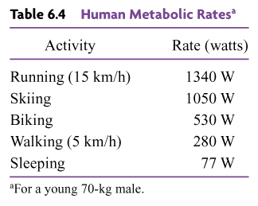
Human Metabolic Rates

Slide 16
Ex. The Power to Accelerate a Car
A 1.10x10³kg car, starting from rest, accelerates for 5.00s. The magnitude of the acceleration is a=4.60m/s². Determine the average power generated by the net force that accelerates the vehicle.
What is the force that accelerates the car?
Since the acceleration is constant, we obtain
From the kinematic formula
Thus, the average speed is
And, the average power is

