Slide 1
PHYS 1441 – Section 001 Lecture #14
Monday, June 30, 2014
Dr. Jaehoon Yu
Linear Momentum
Linear Momentum, Impulse and Forces
Linear Momentum Conservation
Linear Momentum Conservation in a Two -body System
Collisions; Elastic and Perfectly Inelastic
Concept of the Center of Mass
Fundamentals of the Rotational Motion

Slide 2
Announcements
Reading assignment: CH7.7
Quiz #4
Beginning of the class tomorrow, Tuesday, July 1
Covers CH 6.4 to what we finish today
Bring your calculator but DO NOT input formula into it!
Your phones or portable computers are NOT allowed as a replacement!
You can prepare a one 8.5x11.5 sheet (front and back) of handwritten formulae and values of constants for the exam ➔ no solutions, derivations or definitions!
No additional formulae or values of constants will be provided!
Student survey ➔ bring your devices tomorrow
Term 2 results
Class average: 58.5/102
Equivalent to: 57.4/100
Previous results: 61.8/100 and 72.6/100
Top score: 87/102

Slide 3
Extra-Credit Special Project #5
Derive express the final velocities of the two objects which underwent an elastic collision as a function of known quantities m₁, m₂, v₀₁ and v₀₂ in a far greater detail than the note.
20 points extra credit
Show mathematically what happens to the final velocities if m₁=m₂ and describe in words the resulting motion.
5 point extra credit
Due: Monday, July 7, 2014

Slide 4
Linear Momentum
The principle of energy conservation can be used to solve problems that are harder to solve just using Newton’s laws. It is used to describe motion of an object or a system of objects.
A new concept of linear momentum can also be used to solve physical problems, especially the problems involving collisions of objects.
Linear momentum of an object whose mass is m and is moving at the velocity of v is defined as
What can you tell from this definition about momentum?
Momentum is a vector quantity.
The heavier the object the higher the momentum
The higher the velocity the higher the momentum
Its unit is kg.m/s
What else can use see from the definition? Do you see force?
The change of momentum in a given time interval

Slide 5
Impulse and Linear Momentum
Net force causes change of momentum ➔ Newton’s second law
The quantity impulse is defined as the change of momentum
Effect of the force F acting on an object over the time interval Δt=t_{f}-t_{i} is equal to the change of the momentum of the object caused by that force. Impulse is the degree of which an external force changes an object’s momentum.
So what do you think an impulse is?
The above statement is called the impulse-momentum theorem and is equivalent to Newton’s second law.
What are the dimension and unit of Impulse? What is the direction of an impulse vector?
Defining a time-averaged force
Impulse can be rewritten
If force is constant
Impulse is a vector quantity!!

Slide 6
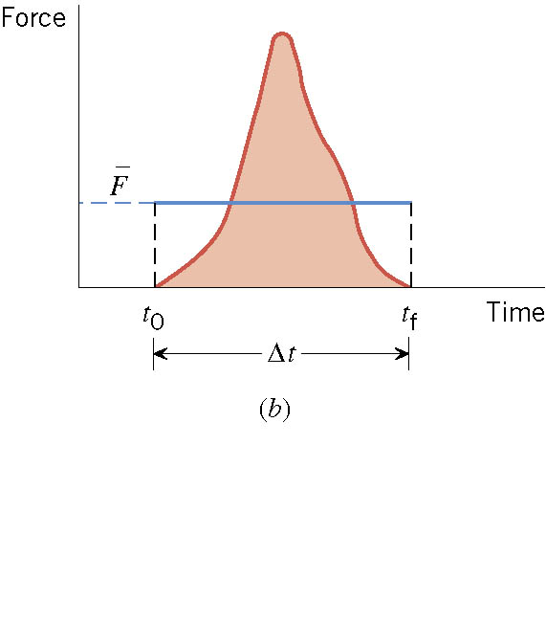
Impulse
There are many situations when the force on an object is not constant.

Slide 7
Ball Hit by a Bat
Multiply either side by Δt

Slide 8
Ex. A Well-Hit Ball
A baseball (m=0.14kg) has an initial velocity of v₀=-38m/s as it approaches a bat. We have chosen the direction of approach as the negative direction. The bat applies an average force F that is much larger than the weight of the ball, and the ball departs from the bat with a final velocity of v_{f}=+58m/s. (a) determine the impulse applied to the ball by the bat. (b) Assuming that the time of contact is Δt=1.6x10⁻³s, find the average force exerted on the ball by the bat.
What are the forces involved in this motion?
The force by the bat and the force by the gravity.
Since the force by the bat is much greater than the weight, we ignore the ball’s weight.
(a) Using the impulse-momentum theorem
(b)Since the impulse is known and the time during which the contact occurs are know, we can compute the average force exerted on the ball during the contact
How large is this force?

Slide 9
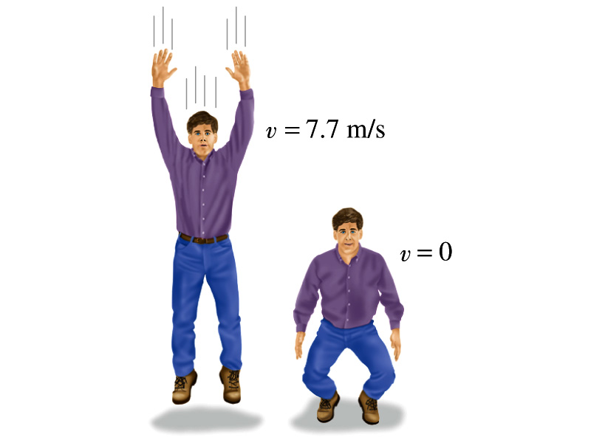
Example on Impulse
(a) Calculate the impulse experienced when a 70 kg person lands on firm ground after jumping from a height of 3.0 m. Then estimate the average force exerted on the person’s feet by the ground, if the landing is (b) stiff-legged and (c) with bent legs. In the former case, assume the body moves 1.0cm during the impact, and in the second case, when the legs are bent, about 50 cm.
We don’t know the force. How do we do this?
Obtain velocity of the person before striking the ground.
Solving the above for velocity v, we obtain
Then as the person strikes the ground, the momentum becomes 0 quickly giving the impulse

Slide 10
Example cont’d
In coming to rest, the body decelerates from 7.7m/s to 0m/s in a distance d=1.0cm=0.01m.
The average speed during this period is
The time period the collision lasts is
Since the magnitude of impulse is
The average force on the feet during this landing is
How large is this average force?
If landed in stiff legged, the feet must sustain 300 times the body weight. The person will likely break his leg.
For bent legged landing:

Slide 11
Linear Momentum and Forces
What can we learn from this force-momentum relationship?
The rate of the change of particle’s momentum is the same as the net force exerted on it.
When the net force is 0, the particle’s linear momentum is a constant as a function of time.
If a particle is isolated, the particle experiences no net force. Therefore its momentum does not change and is conserved.
Something else we can do with this relationship. What do you think it is?
The relationship can be used to study the case where the mass changes as a function of time.
Can you think of a few cases like this?
Motion of a meteorite
Motion of a rocket

Slide 12
Conservation of Linear Momentum in a Two Particle System
Consider an isolated system of two particles that do not have any external forces exerting on it. What is the impact of Newton’s 3rd Law?
If particle#1 exerts force on particle #2, there must be a reaction force that the particle #2 exerts on #1. Both the forces are internal forces, and the net force in the entire SYSTEM is still 0.
Now how would the momenta of these particles look like?
Let say that the particle #1 has momentum p₁ and #2 has p₂ at some point of time.
Using momentum-force relationship
and
And since net force of this system is 0
Therefore
The total linear momentum of the system is conserved!!!

Slide 13
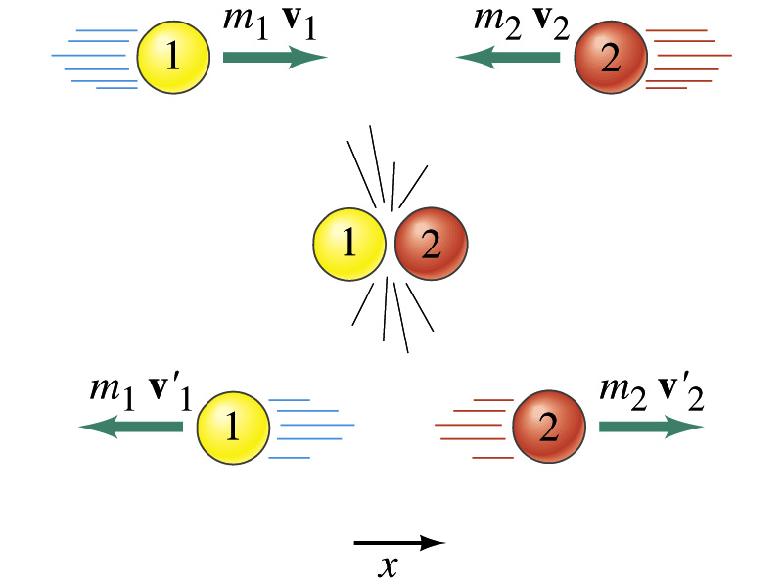
Linear Momentum Conservation
Initial
Final

Slide 14
More on Conservation of Linear Momentum in a Two Body System
From the previous slide we’ve learned that the total momentum of the system is conserved if no external forces are exerted on the system.
What does this mean?
As in the case of energy conservation, this means that the total vector sum of all momenta in the system is the same before and after any interactions
Mathematically this statement can be written as
This can be generalized into conservation of linear momentum in many particle systems.
Whenever two or more particles in an isolated system interact, the total momentum of the system remains constant.

Slide 15
How do we apply momentum conservation?
Define your system by deciding which objects would be included in it.
Identify the internal and external forces with respect to the system.
Verify that the system is isolated.
Set the final momentum of the system equal to its initial momentum. Remember that momentum is a vector.

Slide 16
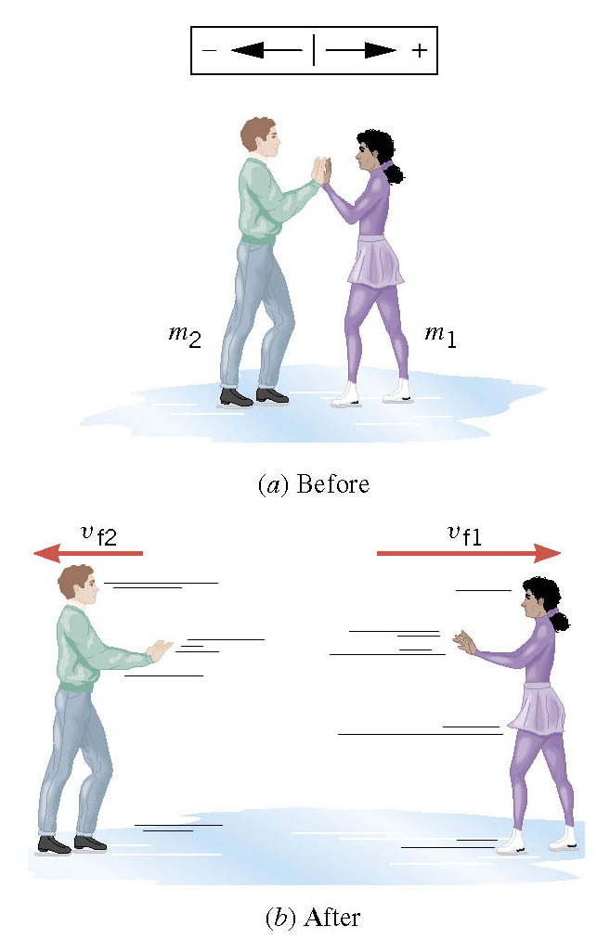
Ex. Ice Skaters
Starting from rest, two skaters push off against each other on ice where friction is negligible. One is a 54-kg woman and one is a 88-kg man. The woman moves away with a velocity of +2.5 m/s. Find the recoil velocity of the man.
No net external force ➔ momentum conserved
Solve for V_{f2}

Slide 17
Collisions
Generalized collisions must cover not only the physical contact but also the collisions without physical contact such as that of electromagnetic ones in a microscopic scale.
The collisions of these ions never involve physical contact because the electromagnetic repulsive force between these two become great as they get closer causing a collision.
Consider a case of a collision between a proton on a helium ion.
F
F₁₂
Assuming no external forces, the force exerted on particle 1 by particle 2, F₂₁, changes the momentum of particle 1 by
t
F₂₁
Likewise for particle 2 by particle 1
Using Newton’s 3rd law we obtain
So the momentum change of the system in the collision is 0, and the momentum is conserved

Slide 18
Elastic and Inelastic Collisions
Momentum is conserved in any collisions as long as external forces are negligible.
Collisions are classified as elastic or inelastic based on whether the kinetic energy is conserved, meaning whether the KE is the same before and after the collision.
Elastic Collision
A collision in which the total kinetic energy and momentum are the same before and after the collision.
Inelastic Collision
A collision in which the total kinetic energy is not the same before and after the collision, but momentum is.
Two types of inelastic collisions: Perfectly inelastic and inelastic
Perfectly Inelastic: Two objects stick together after the collision, moving together at a certain velocity.
Inelastic: Colliding objects do not stick together after the collision but some kinetic energy is lost.
Note: Momentum is constant in all collisions but kinetic energy is only in elastic collisions.

Slide 19
Elastic and Perfectly Inelastic Collisions
In perfectly inelastic collisions, the objects stick together after the collision, moving together. Momentum is conserved in this collision, so the final velocity of the stuck system is
How about the elastic collision?
In elastic collisions, both the momentum and the kinetic energy are conserved. Therefore, the final speeds in an elastic collision can be obtained in terms of initial velocities as
From momentum
conservation above
What happens when the two masses are the same?

Slide 20
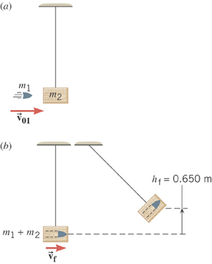
Ex. 7.9 A Ballistic Pendulum
The mass of the block of wood is 2.50-kg and the mass of the bullet is 0.0100-kg. The block swings to a maximum height of 0.650 m above the initial position. Find the initial velocity of the bullet.
What kind of collision?
Perfectly inelastic collision
No net external force ➔ momentum conserved
Solve for V₀₁
What do we not know?
The final speed!!
How can we get it?
Using the mechanical energy conservation!

Slide 21
Ex. A Ballistic Pendulum, cnt’d
Now using the mechanical energy conservation
Solve for V_{f}
Using the solution obtained previously, we obtain

