Slide 1
PHYS 1441 – Section 001 Lecture #15
Tuesday, July 1, 2014
Dr. Jaehoon Yu
Concept of the Center of Mass
Fundamentals of the Rotational Motion
Rotational Kinematics
Equations of Rotational Kinematics
Relationship Between Angular and Linear Quantities
Rolling Motion of a Rigid Body
Today’s homework is homework #9, due 11pm, Saturday, July 5!!

Slide 2
Announcements
Planetarium Extra Credit
Tape all ticket stubs on a sheet of paper
Tape one side of each ticket stub with the title on the surface so that I can see the signature on the other side
Put your name on the extra credit sheet
Bring the sheet coming Monday, July 7, at the final exam
Final exam
10:30am – 12:30pm, Monday, July 7
Comprehensive exam, covers from CH1.1 – what we finish this Thursday, July 3, plus appendices A1 – A8
Bring your calculator but DO NOT input formula into it!
Your phones or portable computers are NOT allowed as a replacement!
You can prepare a one 8.5x11.5 sheet (front and back) of handwritten formulae and values of constants for the exam ➔ no solutions, no derived formulae, derivations or definitions!
No additional formulae or values of constants will be provided!

Slide 3
Extra-Credit Special Project #5
Derive express the final velocities of the two objects which underwent an elastic collision as a function of known quantities m₁, m₂, v₀₁ and v₀₂ in a far greater detail than in the lecture note. (20 points)
Show mathematically what happens to the final velocities if m₁=m₂ and describe in words the resulting motion. (5 points)
Due: Monday, July 7, 2014

Slide 4
Center of Mass
We’ve been solving physical problems treating objects as sizeless points with masses, but in realistic situations objects have shapes with masses distributed throughout the body.
Center of mass of a system is the average position of the system’s mass and represents the motion of the system as if all the mass is on that point.
What does above statement tell you concerning the forces being exerted on the system?
The total external force exerted on the system of total mass M causes the center of mass to move at an acceleration given by as if the entire mass of the system is on the center of mass.
Consider a massless rod with two balls attached at either end.
m₁
m₂
x₁
x₂
The position of the center of mass of this system is the mass averaged position of the system
x_{CM}
CM is closer to the heavier object

Slide 5
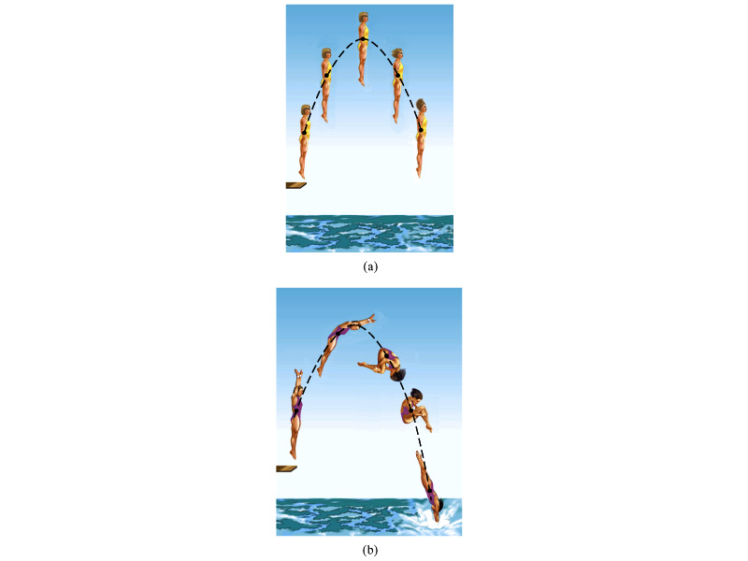
Motion of a Diver and the Center of Mass
Diver performs a simple dive.
The motion of the center of mass follows a parabola since it is a projectile motion.
Diver performs a complicated dive.
The motion of the center of mass still follows the same parabola since it still is a projectile motion.
The motion of the center of mass of the diver is always the same.

Slide 6
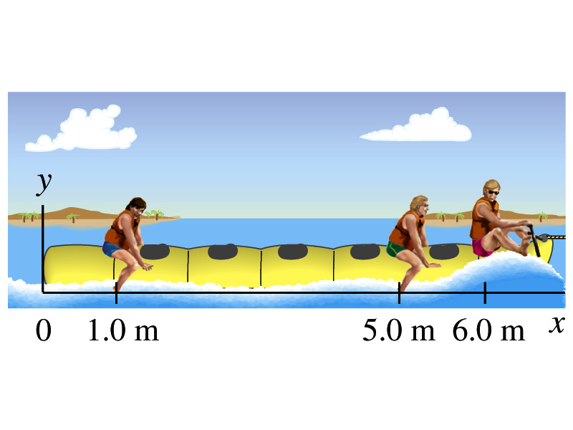
Ex. 7 – 12 Center of Mass
Thee people of roughly equivalent mass M on a lightweight (air-filled) banana boat sit along the x axis at positions x₁=1.0m, x₂=5.0m, and x₃=6.0m. Find the position of CM.
Using the formula for CM

Slide 7
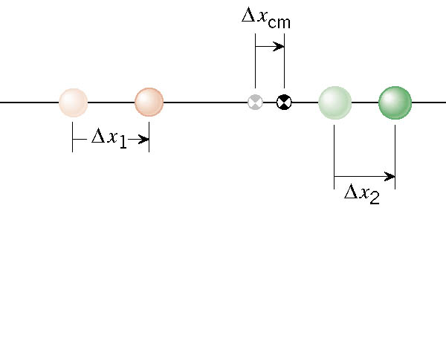
Velocity of the Center of Mass
In an isolated system, the total linear momentum does not change, therefore the velocity of the center of mass does not change.

Slide 8
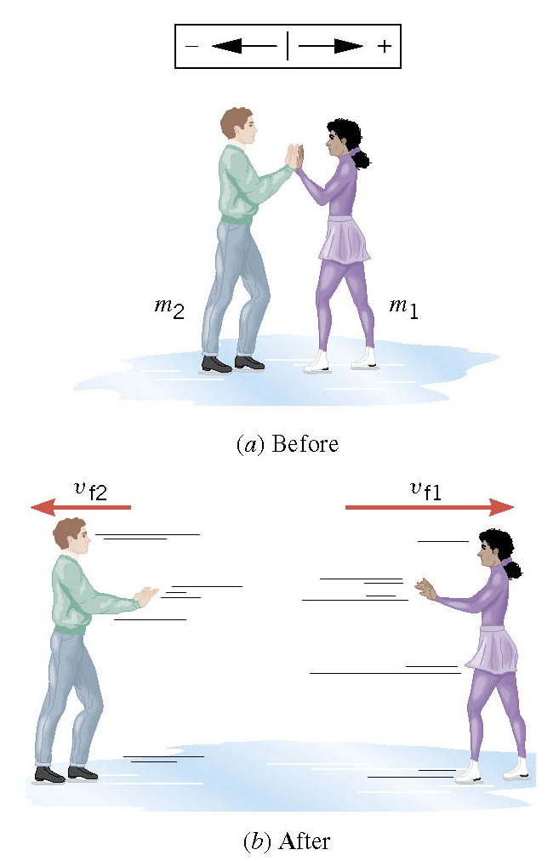
Another Look at the Ice Skater Problem
Starting from rest, two skaters push off against each other on ice where friction is negligible. One is a 54-kg woman and one is a 88-kg man. The woman moves away with a velocity of +2.5 m/s.

Slide 9
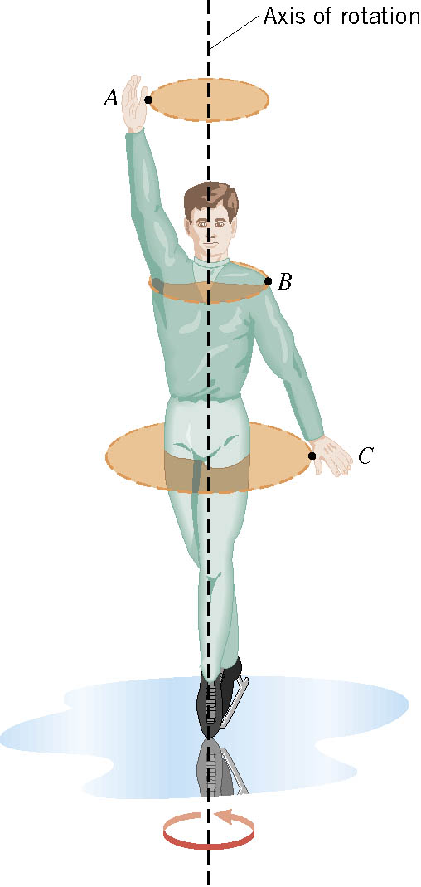
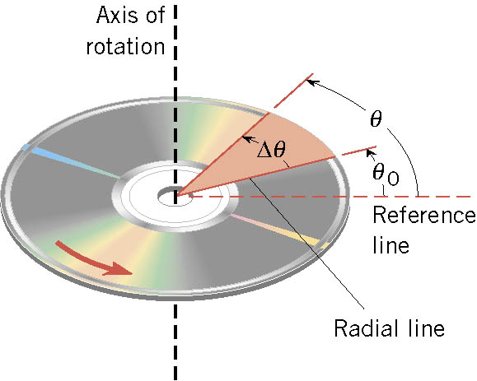
Rotational Motion and Angular Displacement
In the simplest kind of rotation, points on a rigid object move on circular paths around an axis of rotation.
The angle swept out by the line passing through any point on the body and intersecting the axis of rotation perpendicularly is called the angular displacement.
It’s a vector!! So there must be a direction…
How do we define directions?
+:if counter-clockwise
-:if clockwise
The direction vector points gets determined based on the right-hand rule.
These are just conventions!!

Slide 10
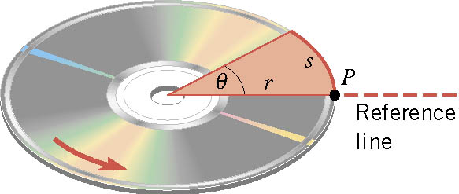
SI Unit of the Angular Displacement
Dimension?
None
For one full revolution:
Since the circumference of a circle is
2πr
One radian is an angle subtended by an arc of the same length as the radius!

Slide 11
Unit of the Angular Displacement
How many degrees are in one radian?
1 radian is
How radians is one degree?
And one degrees is
How many radians are in 10.5 revolutions?
Very important: In solving angular problems, all units, degrees or revolutions, must be converted to radians.

Slide 12
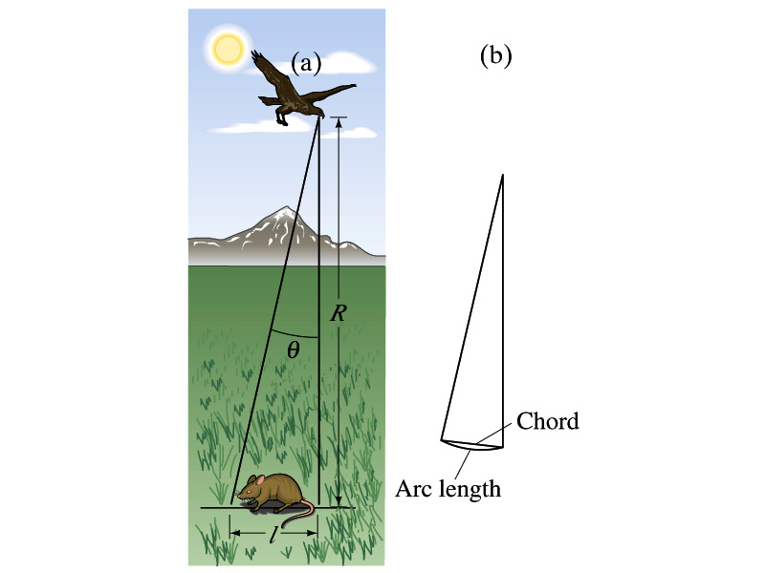
Example 8-2
A particular bird’s eyes can just distinguish objects that subtend an angle no smaller than about 3x10⁻⁴ rad. (a) How many degrees is this? (b) How small an object can the bird just distinguish when flying at a height of 100m?
(a) One radian is 360º/2π. Thus
(b) Since l=rθ and for small angle arc length is approximately the same as the chord length.

Slide 13
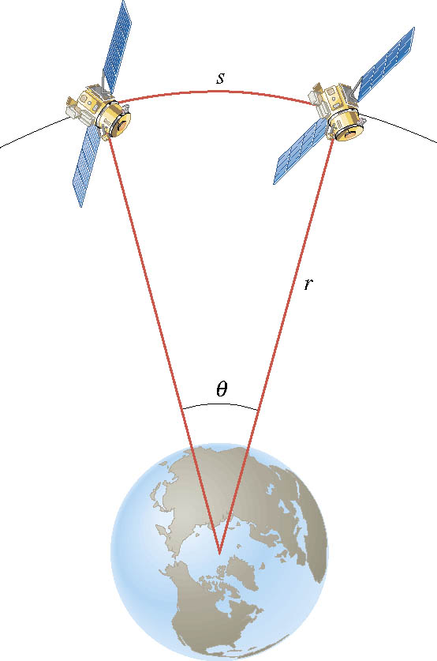
Ex. Adjacent Synchronous Satellites
Synchronous satellites are put into an orbit whose radius is 4.23×10⁷m. If the angular separation of the two satellites is 2.00 degrees, find the arc length that separates them.
What do we need to find out?
The Arc length!!!
Convert degrees to radians

Slide 14
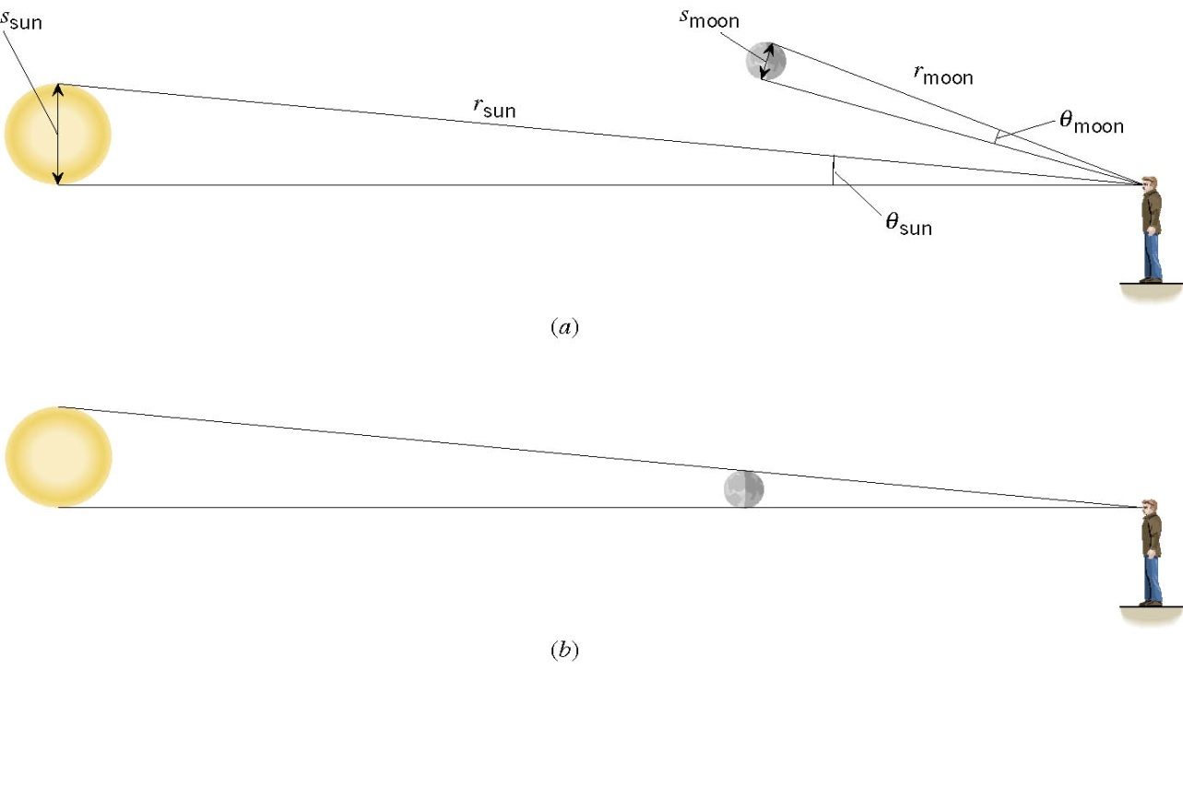
Ex. A Total Eclipse of the Sun
The diameter of the sun is about 400 times greater than that of the moon. By coincidence, the sun is also about 400 times farther from the earth than is the moon. For an observer on the earth, compare the angle subtended by the moon to the angle subtended by the sun and explain why this result leads to a total solar eclipse.
I can even cover the entire sun with my thumb!! Why?
Because the distance (r) from my eyes to my thumb is far shorter than that to the sun.

Slide 15
Angular Displacement, Velocity, and Acceleration
Angular displacement is defined as
θ_{f}
θ_{i}
How about the average angular velocity, the rate of change of angular displacement?
Unit?
rad/s
Dimension?
[T⁻¹]
By the same token, the average angular acceleration, rate of change of the angular velocity, is defined as…
Unit?
rad/s²
Dimension?
[T⁻²]
When rotating about a fixed axis, every particle on a rigid object rotates through the same angle and has the same angular speed and angular acceleration.

