Slide 1
PHYS 1441 – Section 001 Lecture #16
Wednesday, July 2, 2014
Dr. Jaehoon Yu
Rotational Kinematics
Equations of Rotational Kinematics
Relationship Between Angular and Linear Quantities
Torque
Rolling Motion of a Rigid Body
Moment of Inertia

Slide 2
Announcements
Final exam
10:30am – 12:30pm, Monday, July 7
Comprehensive exam, covers from CH1.1 – what we finish this Thursday, July 3, plus appendices A1 – A8
Bring your calculator but DO NOT input formula into it!
Your phones or portable computers are NOT allowed as a replacement!
You can prepare a one 8.5x11.5 sheet (front and back) of handwritten formulae and values of constants for the exam
None of the part of the solutions of any problems
no derived formulae, derivations of equations or word definitions!
No additional formulae or values of constants will be provided!

Slide 3
Reminder: Extra-Credit Special Project #5
Derive express the final velocities of the two objects which underwent an elastic collision as a function of known quantities m₁, m₂, v₀₁ and v₀₂ in a far greater detail than in the lecture note. (20 points)
Show mathematically what happens to the final velocities if m₁=m₂ and describe in words the resulting motion. (5 points)
Due: Monday, July 7, 2014

Slide 4
Angular Displacement, Velocity, and Acceleration
Angular displacement is defined as
θ_{f}
θ_{i}
How about the average angular velocity, the rate of change of angular displacement?
Unit?
rad/s
Dimension?
[T⁻¹]
By the same token, the average angular acceleration, rate of change of the angular velocity, is defined as…
Unit?
rad/s²
Dimension?
[T⁻²]
When rotating about a fixed axis, every particle on a rigid object rotates through the same angle and has the same angular speed and angular acceleration.

Slide 5
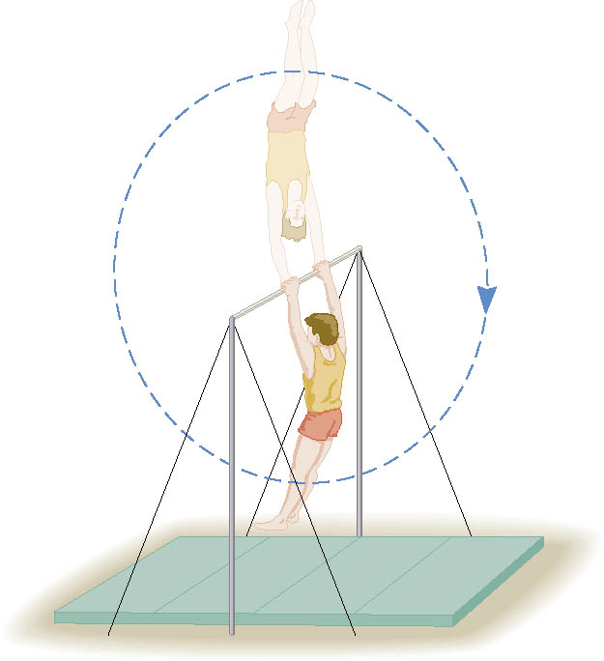
Ex. Gymnast on a High Bar
A gymnast on a high bar swings through two revolutions in a time of 1.90 s. Find the average angular velocity of the gymnast.
What is the angular displacement?
Why negative?
Because he is rotating clockwise!!

Slide 6
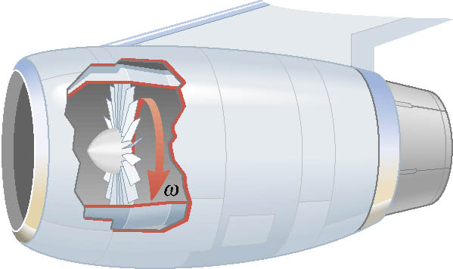
Ex. A Jet Revving Its Engines
As seen from the front of the engine, the fan blades are rotating with an angular velocity of -110 rad/s. As the
plane takes off, the angular velocity of the blades reaches -330 rad/s in a time of 14 s. Find the angular acceleration, assuming it to be constant.

Slide 7
Rotational Kinematics
The first type of motion we have learned in linear kinematics was under a constant acceleration. We will learn about the rotational motion under constant angular acceleration (α), because these are the simplest motions in both cases.
Just like the case in linear motion, one can obtain
Angular velocity under constant angular acceleration:
Linear kinematics
Angular displacement under constant angular acceleration:
Linear kinematics
One can also obtain
Linear kinematics

Slide 8
Rotational Kinematics Problem Solving Strategy
Visualize the problem by drawing a picture.
Write down the values that are given for any of the five kinematic variables and convert them to SI units.
Remember that the unit of the angle must be in radians!!
Verify that the information contains values for at least three of the five kinematic variables. Select the appropriate equation.
When the motion is divided into segments, remember that the final angular velocity of one segment is the initial velocity for the next.
Keep in mind that there may be two possible answers to a kinematics problem.

Slide 9
Example for Rotational Kinematics
A wheel rotates with a constant angular acceleration of +3.50 rad/s². If the angular velocity of the wheel is +2.00 rad/s at t_{i}=0, a) through what angle does the wheel rotate in 2.00s?
Using the angular displacement formula in the previous slide, one gets

Slide 10
Example for Rotational Kinematics cnt’d
What is the angular velocity at t=2.00s?
Using the angular speed and acceleration relationship
Find the angle through which the wheel rotates between t=2.00 s and t=3.00 s.
Using the angular kinematic formula
At t=2.00s
At t=3.00s
Angular displacement

Slide 11
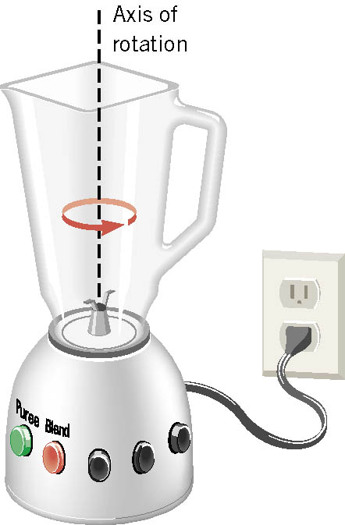
Ex. Blending with a Blender
The blade is whirling with an angular velocity of +375 rad/s when the “puree” button is pushed in. When the “blend” button is pushed, the blade accelerates and reaches a greater angular velocity after the blade has rotated through an angular displacement of +44.0 rad. The angular acceleration has a constant value of +1740 rad/s². Find the final angular velocity of the blade.
θ | α | ω | ω_{o} | t
+44.0rad
+1740rad/s²
?
+375rad/s
Which kinematic eq?
Which sign?
Why?
Because the blade is accelerating in counter-clockwise!

Slide 12
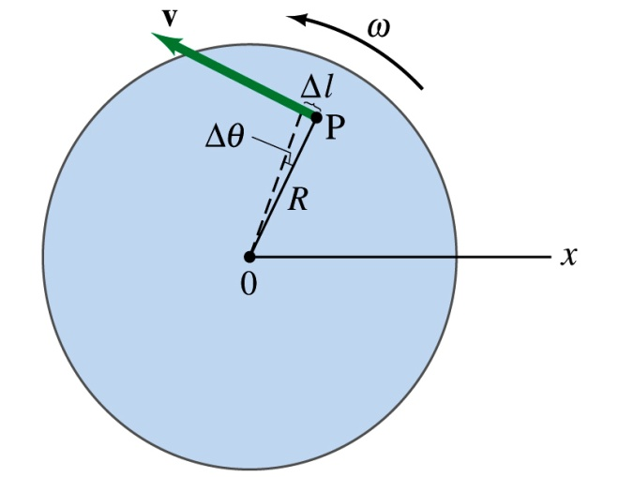
Relationship Between Angular and Linear Quantities
What do we know about a rigid object that rotates about a fixed axis of rotation?
Every particle (or masslet) in an object moves in a circle centered at the same axis of rotation with the same angular velocity.
When a point rotates, it has both the linear and angular components in its motion.
What is the linear component of the motion you see?
The direction of ω follows the right-hand rule.
Linear velocity along the tangential direction.
How do we related this linear component of the motion with angular component?
The arc-length is
So the tangential speed v is
What does this relationship tell you about the tangential speed of the points in the object and their angular speed?
Although every particle in the object has the same angular speed, its tangential speed differs and is proportional to its distance from the axis of rotation.
The farther away the particle is from the center of rotation, the higher the tangential speed.

Slide 13
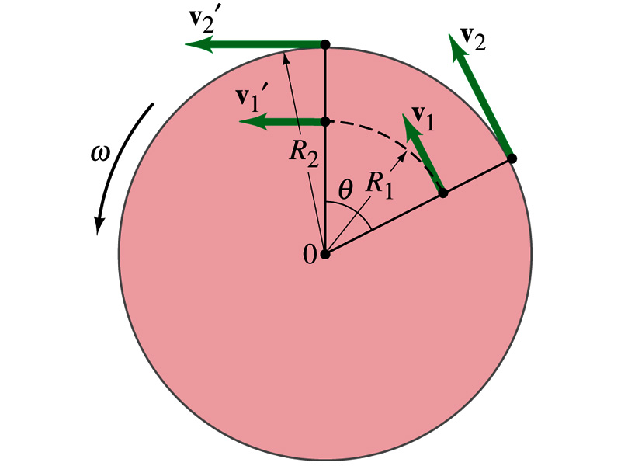
Is the lion faster than the horse?
A rotating carousel has one child sitting on the horse near the outer edge and another child on the lion halfway out from the center. (a) Which child has the greater linear speed? (b) Which child has the greater angular speed?
Linear speed is the distance traveled divided by the time interval. So the child sitting at the outer edge travels more distance within the given time than the child sitting closer to the center. Thus, the horse is faster than the lion.
(b) Angular speed is the angle traveled divided by the time interval. The angle both the children travel in the given time interval is the same. Thus, both the horse and the lion have the same angular speed.

Slide 14
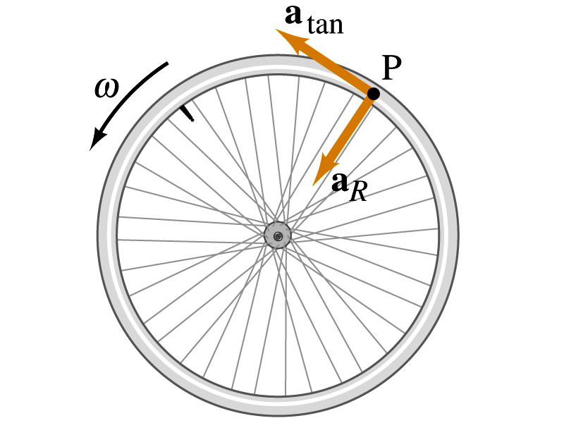
How about the acceleration?
How many different linear acceleration components do you see in a circular motion and what are they?
Two
Tangential, a_{t}, and the radial acceleration, a_{r}.
Since the tangential speed v is
The magnitude of tangential acceleration a_{t} is
What does this relationship tell you?
Although every particle in the object has the same angular acceleration, its tangential acceleration differs proportional to its distance from the axis of rotation.
The radial or centripetal acceleration a_{r} is
What does this tell you?
The father away the particle is from the rotation axis, the more radial acceleration it receives. In other words, it receives more centripetal force.
Total linear acceleration is

Slide 15
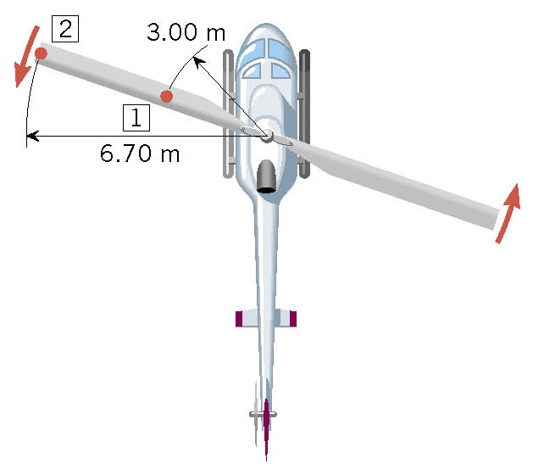
Ex. A Helicopter Blade
A helicopter blade has an angular velocity of +6.50 rev/s and an angular acceleration of +1.30 rev/s². For point 1 on the blade, find the magnitude of (a) the tangential speed and (b) the tangential acceleration.

