Slide 1
PHYS 1441 – Section 001
Lecture #1
Monday, June 8, 2015
Dr. Jaehoon Yu
Who am I?
How is this class organized?
What is Physics?
What do we want from this class?
Brief history of physics
Standards and units
Today’s homework is homework #1, due 11pm, this Wednesday, June 10!!

Slide 2
Announcements
Plea to you: Please turn off your cell-phones, pagers and computers in the class
Reading assignment #1: Read and follow through all sections of appendix A by Wednesday, June 10
  There will be a quiz next Wednesday, June 10, on this reading assignment

Slide 3
Who am I?
Name: Dr. Jaehoon Yu (You can call me Dr. Yu)
Office: Rm 342, Chemistry and Physics Building
Extension: x22814, E-mail: jaehoonyu@uta.edu
My profession: High Energy Particle Physics (HEP)
  Collide particles (protons on anti-protons or electrons on anti-electrons, positrons) at the energies equivalent to 10,000 Trillion degrees
  To understand
    Fundamental constituents of matter
    Forces between the constituents (gravitational, electro-magnetic, weak and strong forces)
    Origin of Mass
    Search for Dark Matter and Making of Dark Matter Beams
    Creation of Universe (Big Bang Theory)
  A pure scientific research activity
    Direct use of the fundamental laws we find may take longer than we want but
    Indirect product of research contribute to every day lives; eg. WWW
  Why do we do with this?
    Make our everyday lives better to help us live well as an integral part of the universe

Slide 4
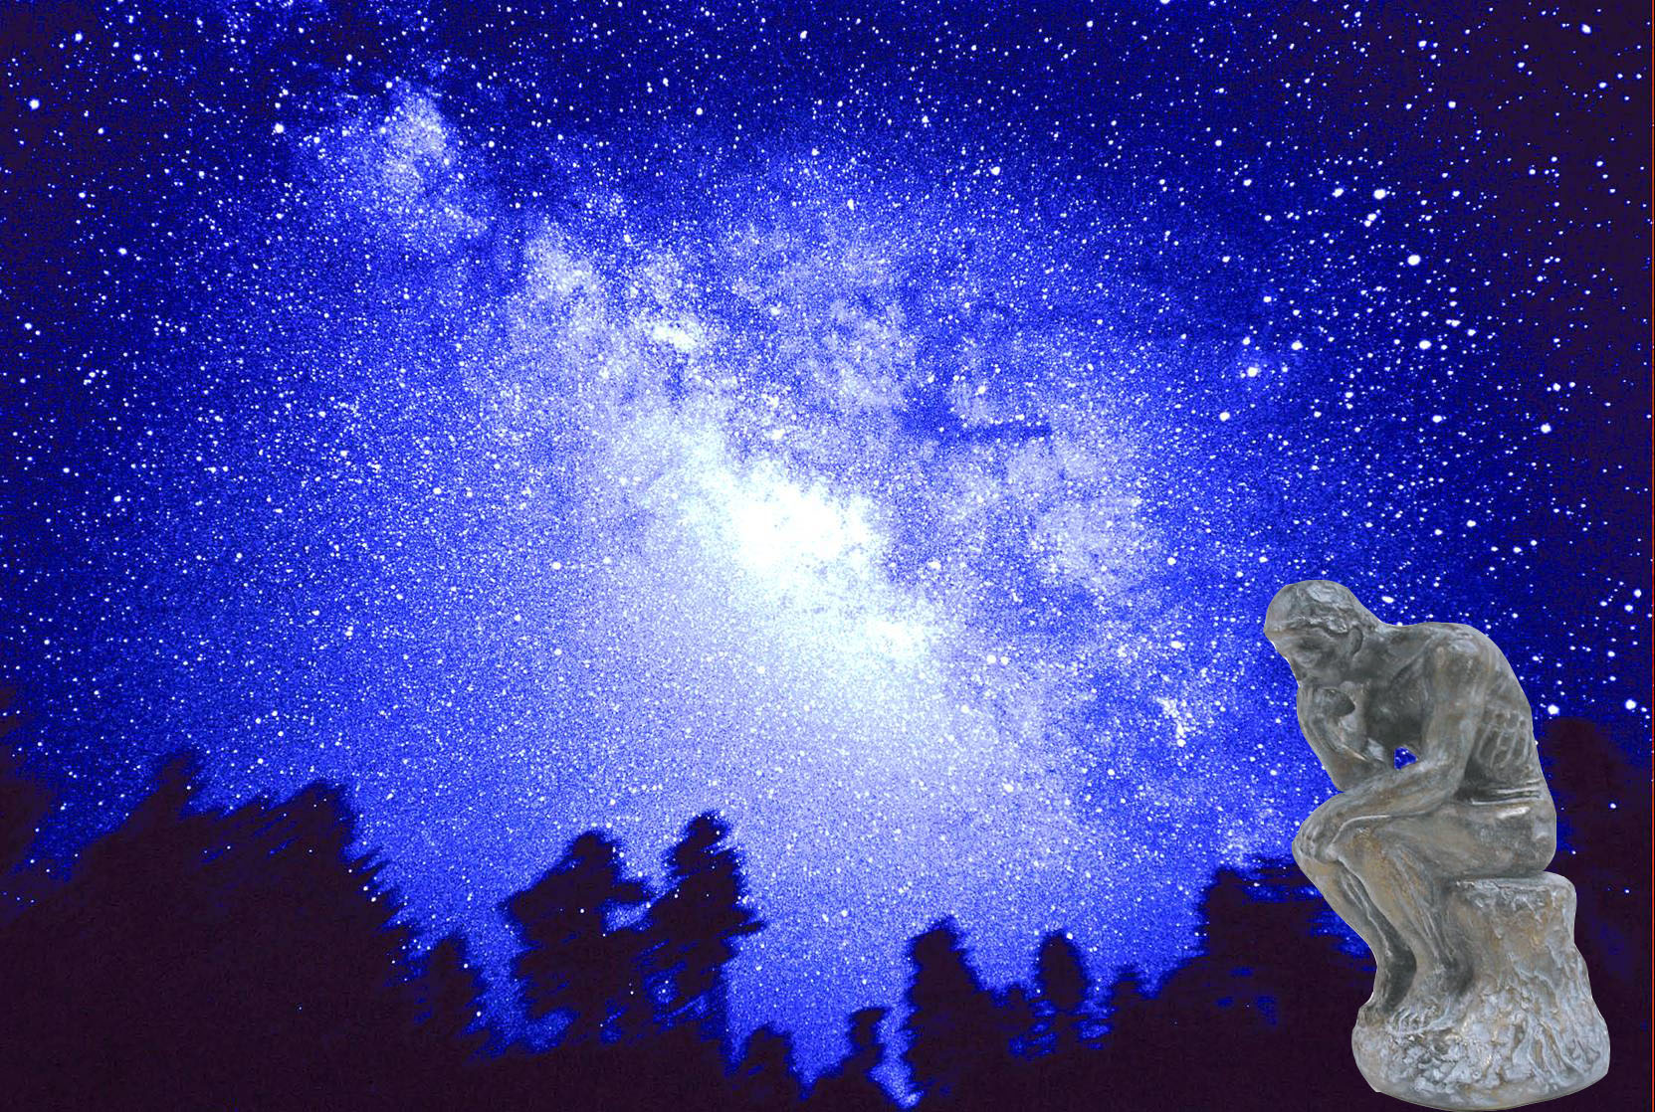

We always wonder…
What makes up the universe?
How does the universe work?
What holds the universe together?
How can we live in the universe well?
Where do we all come from?

Slide 5
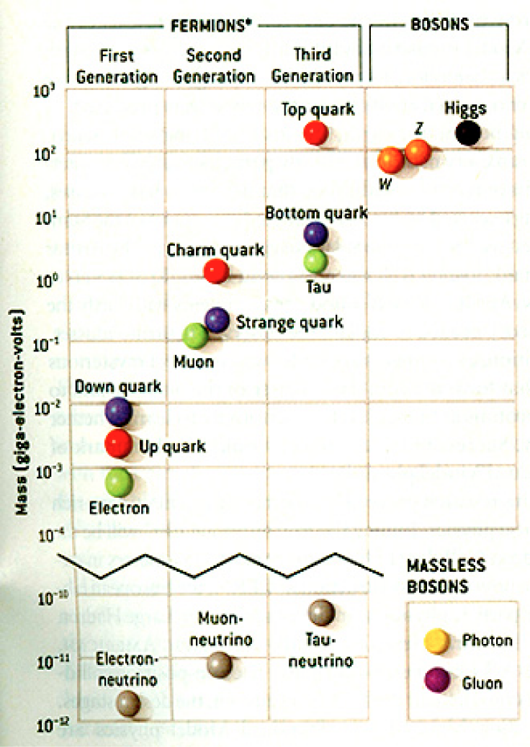
HEP and the Standard Model
HEP: A field of physics that studies the fundamental constituents of matter and basic principles of interactions between them.
Discovered in 1995, ~175m_{p}
Make up most ordinary matters ~0.1m_{p}
Total of 16 particles (12+4 force mediators) make up all the visible matter in the universe! ➔ Simple and elegant!!!
Tested to a precision of 1 part per million!

Slide 6
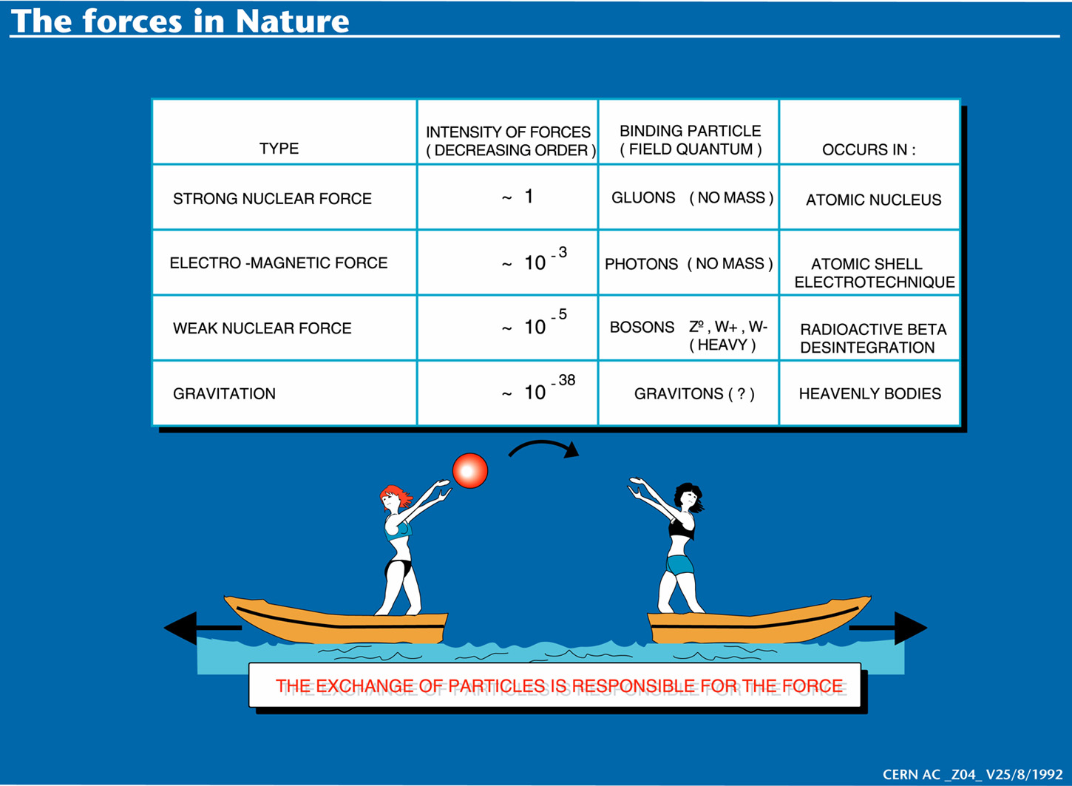

Slide 7
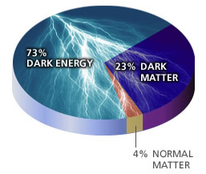
So what’s the problem?
Why is the mass range so large (0.1m_{p} – 175 m_{p})?
How do matters acquire mass?
  Higgs mechanism but where is the Higgs?
Why is the matter in the universe made only of particles?
Neutrinos have mass!! What are the mixing parameters, particle-anti particle asymmetry and mass ordering?
  The nature of neutrinos, Majorana, Dirac?
Why are there only four apparent forces?
Is the picture we present the real thing?
  What makes up the ~95% of the universe?
Are there any other theories that describe the universe better?
  Does the super-symmetry exist?
How is the universe created? The BIG BANG?
How can we live well in the universe as an integral partner?
  - Higgs mechanism, did we find the Higgs?
Notes:
----- Meeting Notes (2/12/14 10:16) -----

Slide 8
Accelerators are Powerful Microscopes.
They make high energy particle beams
that allow us to see small things.
seen by
low energy beam
(poorer resolution)
seen by
high energy beam
(better resolution)

Slide 9
Accelerators are also Time Machines.
They make particles last seen
in the earliest moments of the universe.
Energy
particle beam
energy
anti-particle beam
energy
Particle and anti-particle annihilate.
E = mc²

Slide 10
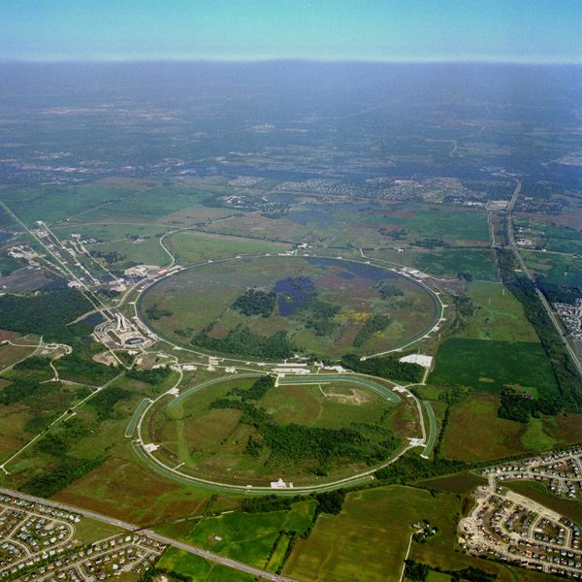
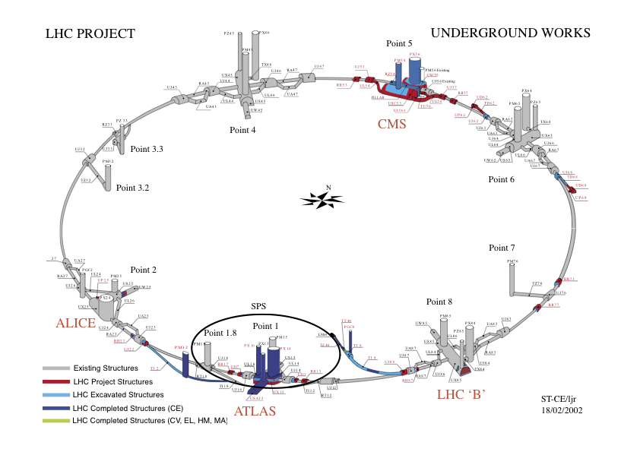
Fermilab Tevatron and LHC at CERN
World’s Highest Energy proton-anti-proton collider
  4km (2.5mi) circumference
  E_{cm}=1.96 TeV (=6.3x10⁻⁷J/p➔ 13M Joules on the area smaller than 10⁻⁴m²)
  Equivalent to the kinetic energy of a 20t truck at the speed 81mi/hr (130km/hr)
    ~100,000 times the energy density at the ground 0 of the Hiroshima atom bomb
  Tevatron was shut down in 2011
  Vibrant other programs running, including the search for dark matter with beams!!
World’s Highest Energy p-p collider
  27km (17mi) circumference, 100m (300ft) underground
  Design E_{cm}=14 TeV (=44x10⁻⁷J/p➔ 362M Joules on the area smaller than 10⁻⁴m²)
  Equivalent to the kinetic energy of a B727 (80tons) at the speed 193mi/hr (312km/hr)
    ~3M times the energy density at the ground 0 of the Hiroshima atom bomb
Large amount of data accumulated in 2010 – 2013
Beam returned after a 2 yr shutdown, data taking begun
Chicago
CDF
p
DØ
Tevatron
p

Slide 11
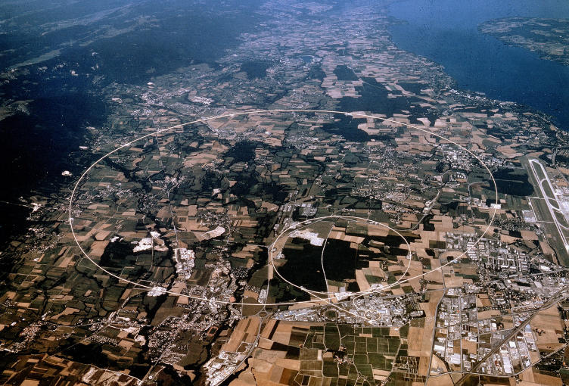


LHC @ CERN Aerial View
CMS
France
Geneva Airport
ATLAS
Swizerland

Slide 12
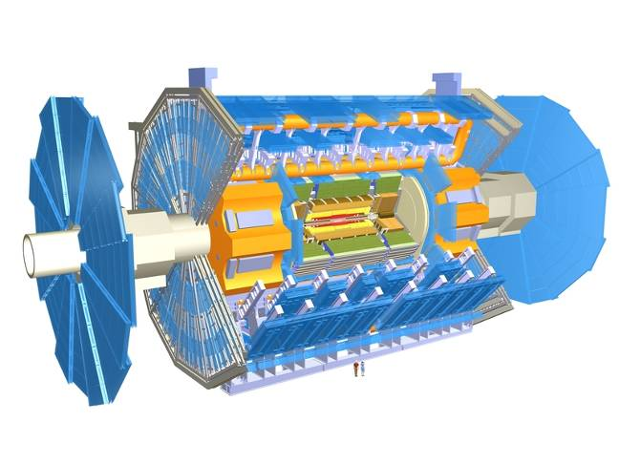
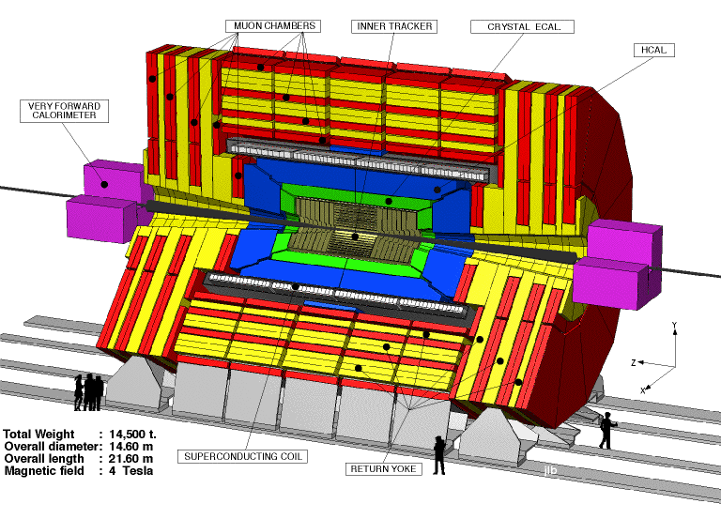
The ATLAS and CMS Detectors
Fully multi-purpose detectors with emphasis on lepton ID & precision E & P
Weighs 7000 tons and 10 story tall
Records 200 – 400 collisions/second
Records approximately 350 MB/second
Record ~2 PB per year ➔ 200*Printed material of the US Lib. of Congress

Slide 13
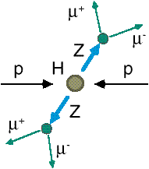
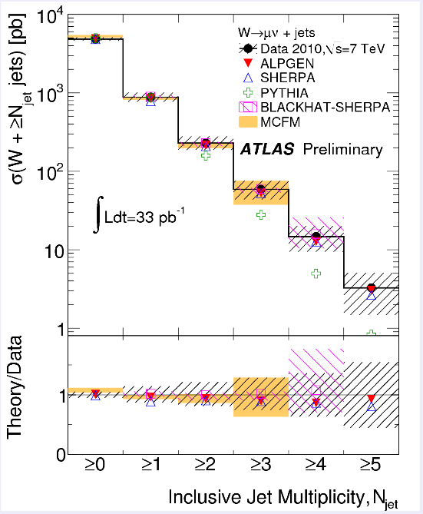
How do we look for the Higgs?
Identify Higgs candidate events
Understand fakes (backgrounds)
Look for a bump!!
  Large amount of data absolutely critical
e⁺ (μ⁺)
e⁻ (μ⁻)
e⁺
e⁻

Slide 14
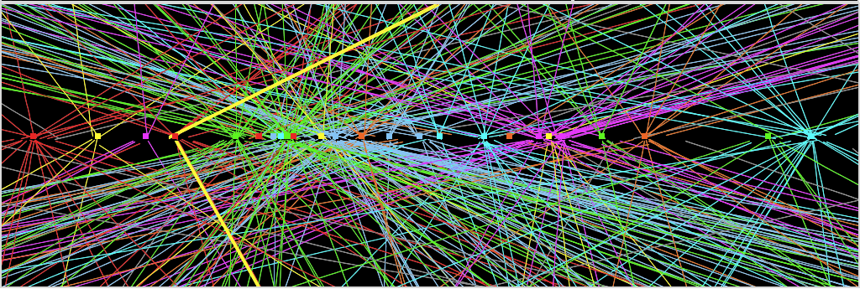
Challenges? No problem!
An interesting collision event with 25 collisions at once!!
Here it is!!

Slide 15
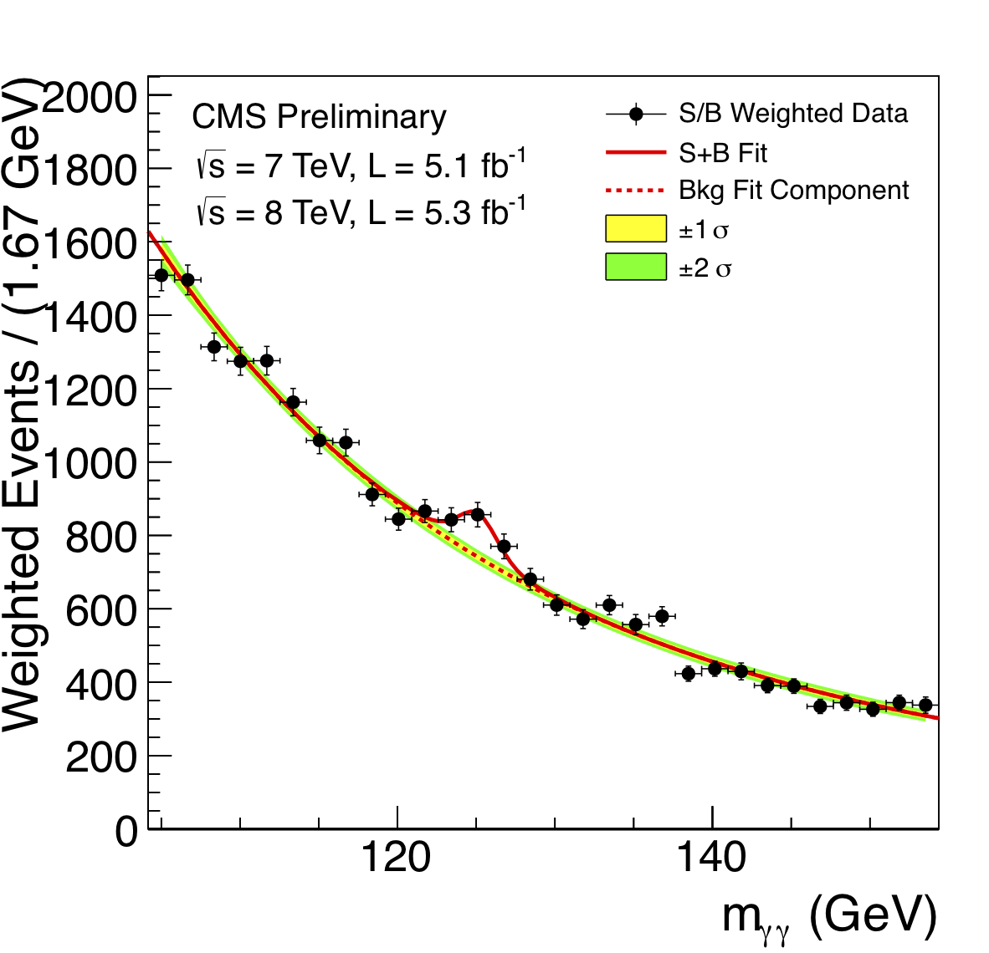
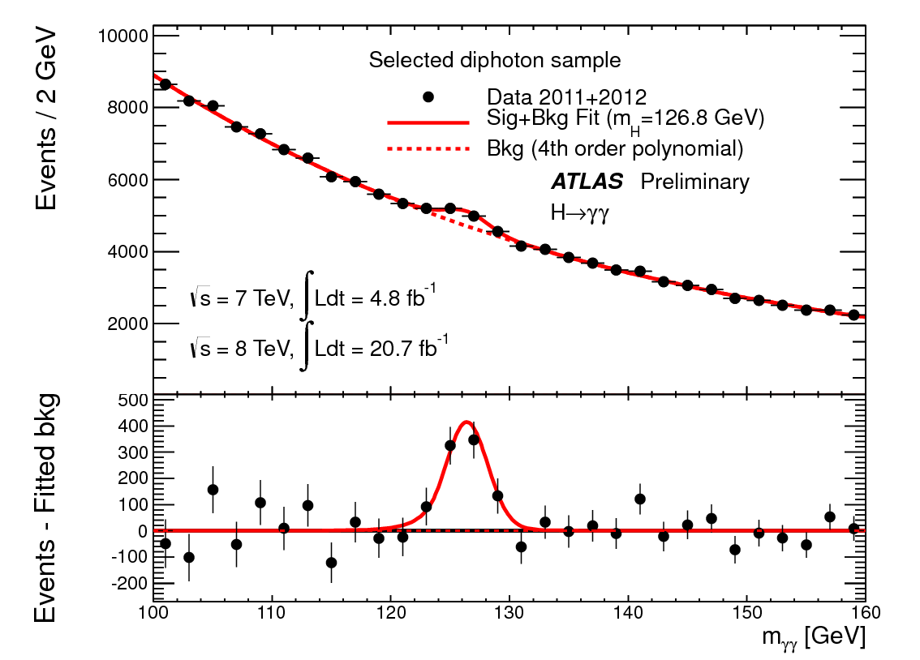
ATLAS and CMS Mass Bump Plots (H→γγ )
ATLAS
CMS
LOOK, Ma! Bumps!!

Slide 16

What did statistics do for Higgs?

Slide 17

How about this?

Slide 18
So have we seen the Higgs particle?
The statistical significance of the finding is way over 7 standard deviations

Slide 19
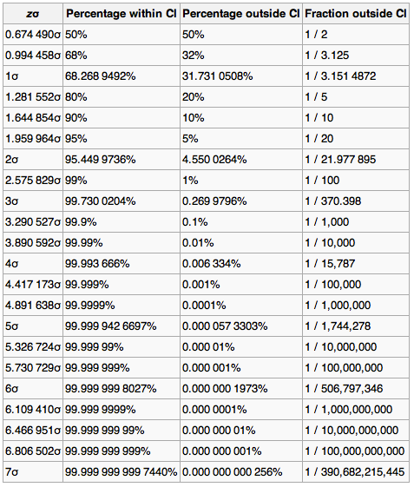
Statistical Significance Table

Slide 20
So have we seen the Higgs particle?
The statistical significance of the finding is much bigger than seven standard deviations
  Level of significance: much better than 99.999 999 999 7% (eleven 9s!!)
  We could be wrong once if we do the same experiment 391,000,000,000 times (will take ~13,000 years even if each experiment takes 1s!!)
So did we find the Higgs particle?
  We have discovered the heaviest new boson we’ve seen thus far
  It has many properties consistent with the Standard Model Higgs particle
    It quacks like a duck and walks like a duck but…
  We do not have enough data to precisely measure all the properties – mass, lifetime, the rate at which this particle decays to certain other particles, etc – to definitively determine its nature
Precision measurements and searches in new channels ongoing

Slide 21
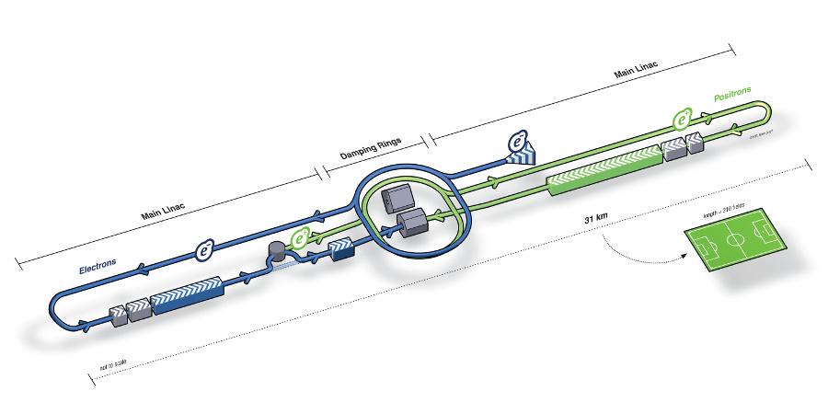
What’s next? Future Linear Collider
Now that we have found a new boson, precision measurement of the particle’s properties becomes important
An electron-positron collider on a straight line for precision measurements
10~15 years from now (In Dec. 2011, Japanese PM announced that they would bid for a LC in Japan and reaffirmed by the new PM in 2013)
  Japan working hard to garner broad world-wide support of the ILC
  Site has been selected and a design study on-going
Takes 10 years to build a detector
Circumference ~6.6km
~300 soccer fields
L~31km (~20 mi)

Slide 22
Dark Matter Searches at Fermilab
Fermi National Accelerator Laboratory is turning into a lab with very high intensity accelerator program
UTA group is part of three experiments
  Long Baseline Neutrino Experiment (LBNE), an $850M flagship experiment, with data expected in 2025
    High flux secondary beam and a near detector enables searches for DM
    In addition to precision measurements of key neutrino param..
    UTA playing very significant role in this experiment
A rich physics program for the next 20 – 30 years!!
If we see DM, we could use this to make DM Beam??

Slide 23
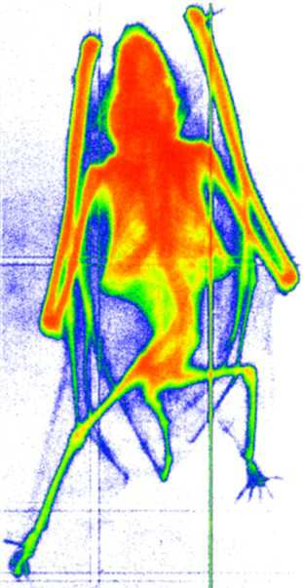
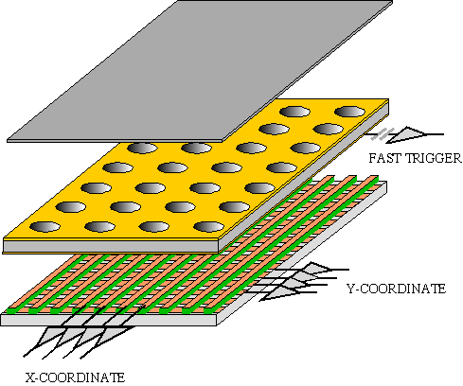
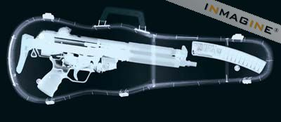
GEM Application Potential
FAST X-RAY IMAGING
Using the lower GEM signal, the readout can be self-triggered with energy discrimination:
9 keV absorption radiography of a small mammal (image size ~ 60 x 30 mm²)
A. Bressan et al,
Nucl. Instr. and Meth. A 425(1999)254
F. Sauli, Nucl. Instr. and Meth.A 461(2001)47

Slide 24
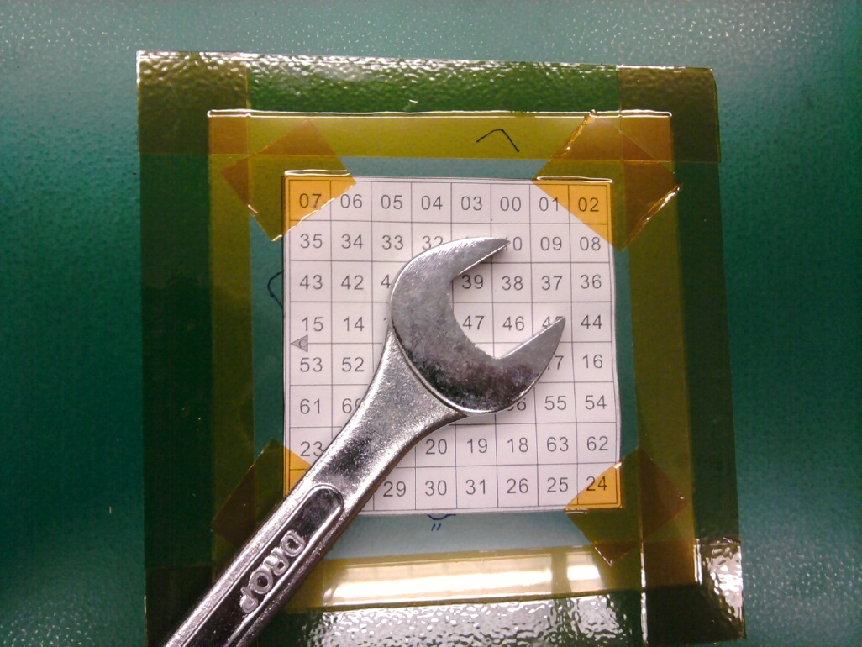
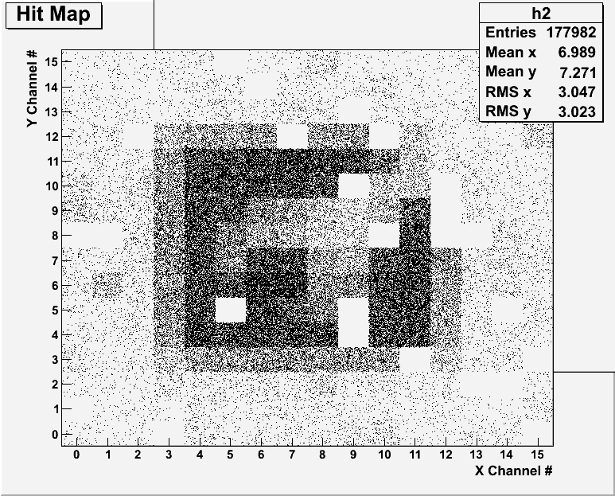
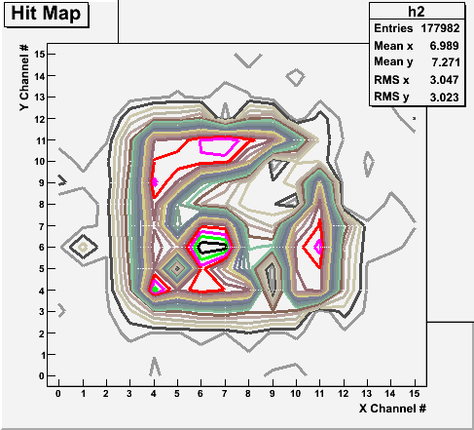
Bi-product of High Energy Physics Research
Can you see what the object is?
(GEM Detector X-ray Image)

Slide 25
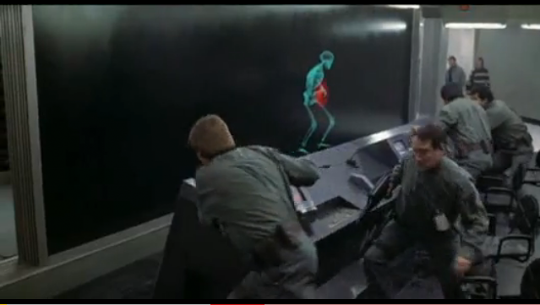
And in not too distant future, we could do …

Slide 26
Dark Matter Searches at Fermilab
Fermi National Accelerator Laboratory is turning into a lab with very high intensity accelerator program
My group is part of three experiments at Fermilab
  DUNE (data starts 2025), MiniBooNE (data now) and LArIAT (data now)
    High flux secondary beam and a near detector enables searches for DM
    In addition to precision measurements of key neutrino param
    UTA playing leading roles in DM (We are the DM people!!
A rich physics program for the next 20 – 30 years!!
If we see DM, we could use this to make DM Beam??

Slide 27

Discovery of the God Particle in 2012
2012 God particle discovery

Slide 28
Information & Communication Source
Course web page: http://www-hep.uta.edu/~yu/teaching/summer15-1441-001/summer15-1441-001.html
  Contact information & Class Schedule
  Syllabus
  Homework
  Holidays and Exam days
  Evaluation Policy
  Class Style & Communication
  Other information
Primary communication tool is e-mail: Make sure that your e-mail at the time of course registration is the one you most frequently read!!
Office Hours for Dr. Yu: 12:30 – 1:30pm, M-Th or by appointments

Slide 29
Evaluation Policy
Homework: 25%
Exams
  Final Comprehensive Exams (7/13): 23%
  Mid-term Comprehensive Exam (6/23): 20%
  One better of the two term Exams (6/15/15 and 7/1/15): 12%
    Total of two non-comprehensive term exams (6/15 and 7/1)
    One better of the two exams will be used for the final grade
  Missing an exam is not permissible unless pre-approved
    No makeup test
    You will get an F if you miss any of the exams without a prior approval no matter how well you’ve been doing in class!
Lab score: 10%
Pop-quizzes: 10%
Extra credits: 10% of the total
  Random attendances
  Strong participation in the class discussions
  Special projects (BIGGGGG!!!)
  Planetarium shows and Other many opportunities
Grading will be done on a sliding scale
100%

Slide 30
Homework
Solving homework problems is the only way to comprehend class material ➔ 2 homeworks per week
An electronic homework system has been setup for you
  Details are in the material distributed today and on the web
  https://quest.cns.utexas.edu/student/courses/list
  Choose the course PHYS1441-Summer15, unique number 41015
  Download homeworks, solve the problems and submit them online
  Multiple unsuccessful tries will deduct points
  Roster will close at 11pm Wednesday, June 10
  You need a UT e-ID: Go and apply at the URL https://idmanager.its.utexas.edu/eid_self_help/?createEID&qwicap-page-id=EA027EFF7E2DA39E if you don’t have one.
Each homework carries the same weight
Home work problems will be slightly ahead of the class
No homework will be dropped from the final grade!!
Home work will constitute 25% of the total ➔ A good way of keeping your grades high
Strongly encouraged to collaborate ➔ Does not mean you can copy

Slide 31
Attendances and Class Style
Attendances:
  Will be taken randomly
  Will be used for extra credits
Class style:
  Lectures will be on electronic media
    The lecture notes will be posted on the web AFTER each class
  Will be mixed with traditional methods
  Active participation through questions and discussions are STRONGLY encouraged ➔ Extra credit….
  Communication between you and me is extremely important
    If you have problems, please do not hesitate talking to me

Slide 32
Lab and Physics Clinic
Physics Labs: Starts today, Monday, June 8
  Important to understand physical principles through experiments
  10% of the grade
  Prelab questions can be obtained at www.uta.edu/physics/labs
  Lab syllabus is available in your assigned lab rooms.
Physics Clinic:
  Free service
  They provide general help on physics, including help solving homework problems
    Do not expect solutions of the problem from them!
    Do not expect them to tell you whether your answers are correct!
    It is your responsibility to make sure that you have done everything correctly!
  11am – 6pm, Mon – Thu in SH 007
  This service begins today!
  Please take full advantage of this service!!

Slide 33
Extra credit
10% addition to the total
  Could boost a B to A, C to B or D to C
What constitute for extra credit?
  Special projects (biggest!!)
  Random attendances
  Strong participation in the class discussions
  Watch the valid planetarium shows
  Many other opportunities

Slide 34
Valid Planetarium Shows
Regular running shows
  Texas Stargazing – Tuesdays at 2:00 pm; Dynamic Earth – Wed. at 2:00 pm;
  Stars of the Pharaohs – Fridays at 2:00pm and Saturdays at 5:30 pm
Shows that need special arrangements
  Astronaut; Bad Astronomy; Back to the Moon for Good, Black Holes (can watch up to 2 times)
  Experience the Aurora IBEX; Ice Worlds; Magnificent Sun; Mayan Prophecies
  Nano Cam; Stars of the Pharaohs; TimeSpace, Two Small Pieces of Glass
  Unseen Universe: The Vision of SOFIA; Violent Universe, We are Astronomers
How to submit for extra credit?
  Obtain the ticket stub that is signed and dated by the planetarium star lecturer of the day
  Collect the ticket stubs
  Tape one edge of all of the ticket stubs on a sheet of paper with your name and ID written on it
  Submit the sheet at the end of the semester at the final exam

Slide 35
What can you expect from this class?
All A’s?
  This would be really nice, wouldn’t it?
  But if it is too easy it is not fulfilling or meaningful….
This class is not going to be a stroll in the park!!
You will earn your grade in this class.
  You will need to put in sufficient time and sincere efforts
  Exams and quizzes will be tough!!
    Sometimes problems might not look exactly like what you learned in the class
    Just putting the right answer for free response problems does not work!
But you have a great control (up to 45%) of your grade in your hands
  Homework is 25% of the total grade!!
    Means you will have many homework problems
      Sometimes much more than any other classes
      Sometimes homework problems will be something that you have yet to learn in class
      Exam problems will be easier that homework problems but the same principles!!
  Lab 10%
  Extra credit 10%
I will work with you so that your efforts are properly rewarded

Slide 36
What do we want to learn in this class?
Physics is everywhere around you.
Skills to understand the fundamental principles that surrounds you in everyday lives…
Skills to identify what laws of physics applies to what phenomena and use them appropriately
Understand the impact of physical laws and apply them
Learn skills to think, research and analyze observations.
Learn skills to express observations and measurements in mathematical language
Learn skills to express your research in systematic manner in writing
But most importantly the confidence in your physics ability and to take on any challenges laid in front of you!!
Most importantly, let us have a lot of FUN!!

Slide 37
In this course, you will learn…
Fundamentals of mechanics
Kinematic equations and description of motions
Concepts of physical quantities that describe motions, such as velocity, speed, acceleration, etc
Vector and scalar quantities and their operations
Concepts of force, energy and momentum and the relationships between them and their conservation laws
Techniques to use conservation laws for motions
Rotational motions and Equilibrium conditions
Fluid and wave motions and thermodynamics

Slide 38
How to study for this course?
Keep up with the class for comprehensive understanding of materials
  Come to the class and participate in the discussions and problems solving sessions
  Follow through the lecture notes
  Work out example problems in the book yourself without looking at the solution
  Have many tons of fun in the class!!!!!
Keep up with the homework to put the last nail on the coffin
  One can always input the answers as you solve problems. Do not wait till you are done with all the problems.
  Form a study group and discuss how to solve problems with your friends, then work the problems out yourselves!
Prepare for upcoming classes
  Read the textbook for the material to be covered in the next class
The extra mile
  Work out additional problems in the back of the book starting the easiest problems to harder ones

Slide 39
Why do Physics?
Exp.{
To understand nature through experimental observations and measurements (Research)
Establish limited number of fundamental laws, usually with mathematical expressions
Predict the nature’s course
Theory and Experiment work hand-in-hand
Theory works generally under restricted conditions
Discrepancies between experimental measurements and theory are good for improvements
Improves our everyday lives, even though some laws can take a while till we see them amongst us
Theory {
39

Slide 40
Brief History of Physics
AD 18th century:
  Newton’s Classical Mechanics: A theory of mechanics based on observations and measurements
AD 19th Century:
  Electricity, Magnetism, and Thermodynamics
Late AD 19th and early 20th century (Modern Physics Era)
  Einstein’s theory of relativity: Generalized theory of space, time, and energy (mechanics)
  Quantum Mechanics: Theory of atomic phenomena
Physics has come very far, very fast, and is still progressing, yet we’ve got a long way to go
  What is matter made of?
  How do matters get mass?
  How and why do matters interact with each other?
  How is universe created?
40

Slide 41
Models, Theories and Laws
Models: An analogy or a mental image of a phenomena in terms of something we are familiar with
  Thinking light as waves, behaving just like water waves
  Often provide insights for new experiments and ideas
Theories: More systematically improved version of models
  Can provide quantitative predictions that are testable and more precise
Laws: Certain concise but general statements about how nature behaves
  Energy conservation
  The statement must be found experimentally valid to become a law
Principles: Less general statements of how nature behaves
  Has some level of arbitrariness
41

Slide 42
Uncertainties
Physical measurements have limited precision, however good they are, due to:
  Number of measurements
  Quality of instruments (meter stick vs micro-meter)
  Experience of the person doing measurements
  Etc
In many cases, uncertainties are more important and difficult to estimate than the central (or mean) values
Stat.{
{
Syst.
42

Slide 43
Significant Figures
Denote the precision of the measured values
  The number 80 implies precision of +/- 1, between 79 and 81
    If you are sure to +/-0.1, the number should be written 80.0
  Significant figures: non-zero numbers or zeros that are not place-holders
    34, 34.2, 0.001, 34.100
      34 has two significant digits
      34.2 has 3
      0.001 has one because the 0’s before 1 are place holders to position “.”
      34.100 has 5, because the 0’s after 1 indicates that the numbers in these digits are indeed 0’s.
    When there are many 0’s, use scientific notation for simplicity:
      31400000=3.14x10⁷
      0.00012=1.2x10⁻⁴
43

Slide 44
Significant Figures
Operational rules:
  Addition or subtraction: Keep the smallest number of decimal place in the result, independent of the number of significant digits: 12.001+ 3.1=
  Multiplication or Division: Keep the smallest number of significant digits in the result: 12.001 x 3.1 = , because the smallest significant figures is ?.
15.1
37
What does this mean?
The worst precision determines the precision the overall operation!!
In English?
Can’t get any better than the worst measurement!
44

