Slide 1
PHYS 1441 – Section 001
Lecture #2
Tuesday, June 9, 2015
Dr. Jaehoon Yu
Chapter 1
  Standards and units
  Dimensional Analysis
Chapter 2:
  One Dimensional Motion
    Instantaneous Velocity and Speed
    Acceleration
    Motion under constant acceleration

Slide 2
Announcements
Homework registration
  47/69 have registered as of early this morning
    Only 25 have submitted answers!!
    You must complete the process all the way to the submission to obtain the free full credit for homework #1!!
    You need to get approval for enrollment from me so please take an action quickly!
Reading assignment #1: Read and follow through all sections in appendix A by tomorrow, Wednesday, June 10
There will be a quiz tomorrow Wednesday, June 10, on this reading assignment and what we have learned up to today!
  Beginning of the class ➔ Do not be late
  Bring your calculator but DO NOT input formula into it!
    Cell phones or any types of computers cannot replace a calculator!
  BYOF: You may bring a one 8.5x11.5 sheet (front and back) of handwritten formulae and values of constants for the quiz
  No derivations, word definitions or solutions of any problems !
  No additional formulae or values of constants will be provided!

Slide 3
Special Project #1 for Extra Credit
Find the solutions for yx²-zx+v=0 ➔ 5 points
  You cannot just plug into the quadratic equations!
  You must show a complete algebraic process of obtaining the solutions!
Derive the kinematic equation from first principles and the known kinematic equations ➔ 10 points
You must show your OWN work in detail to obtain the full credit
    Must be in much more detail than in this lecture note!!!
    Please do not copy from the lecture note or from your friends. You will all get 0!
Due Thursday, June 11

Slide 4
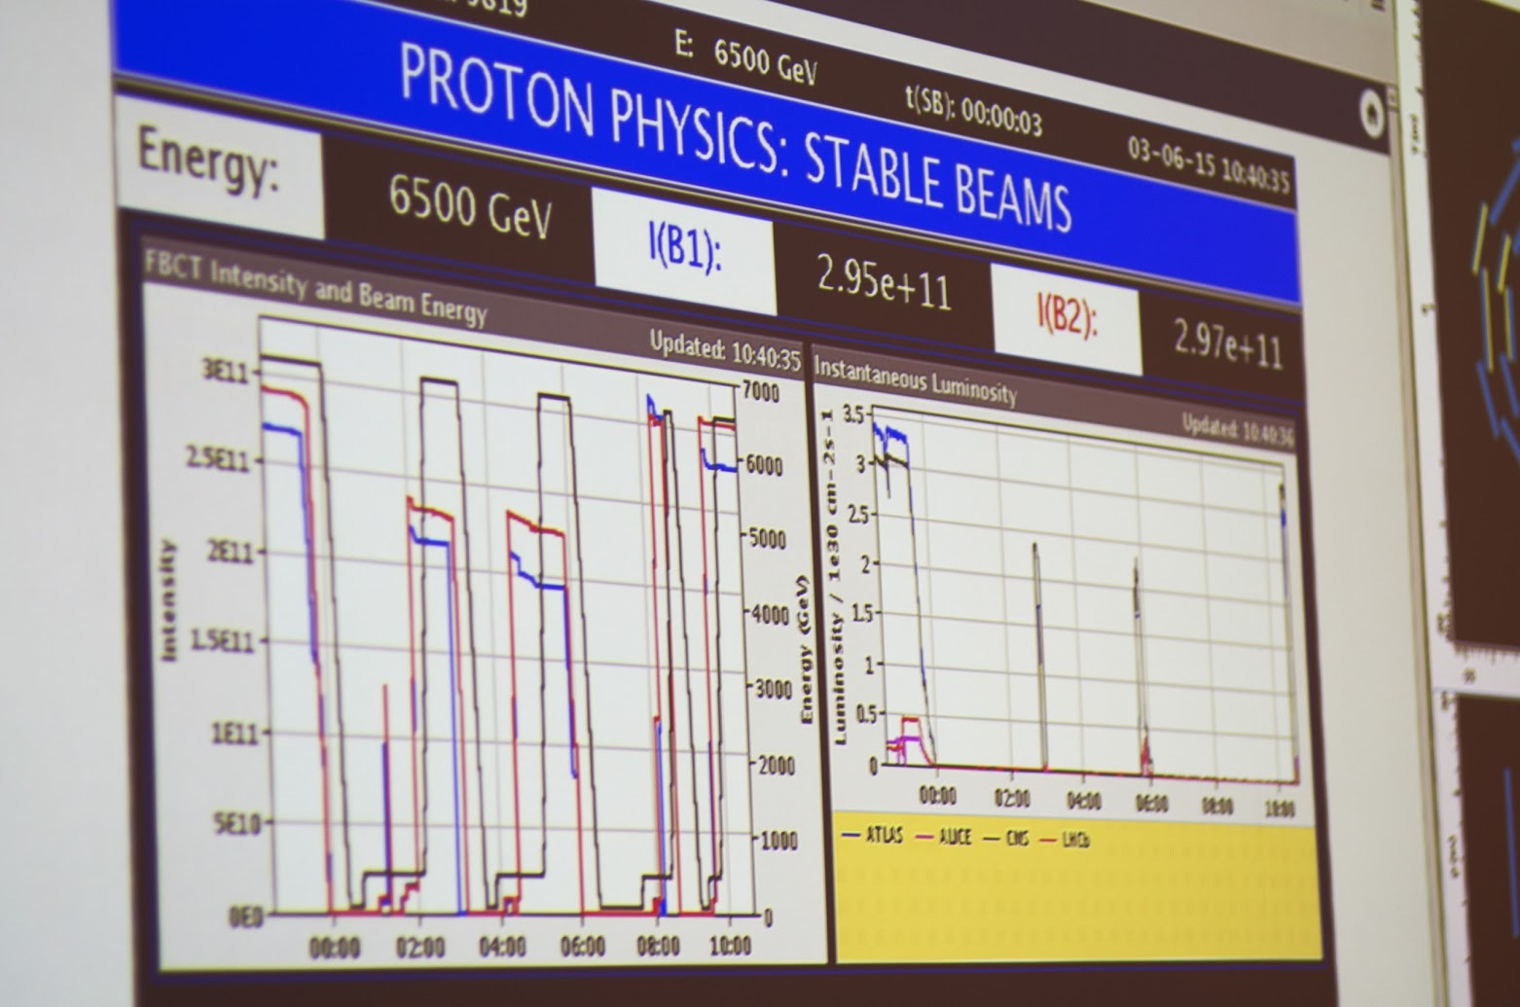
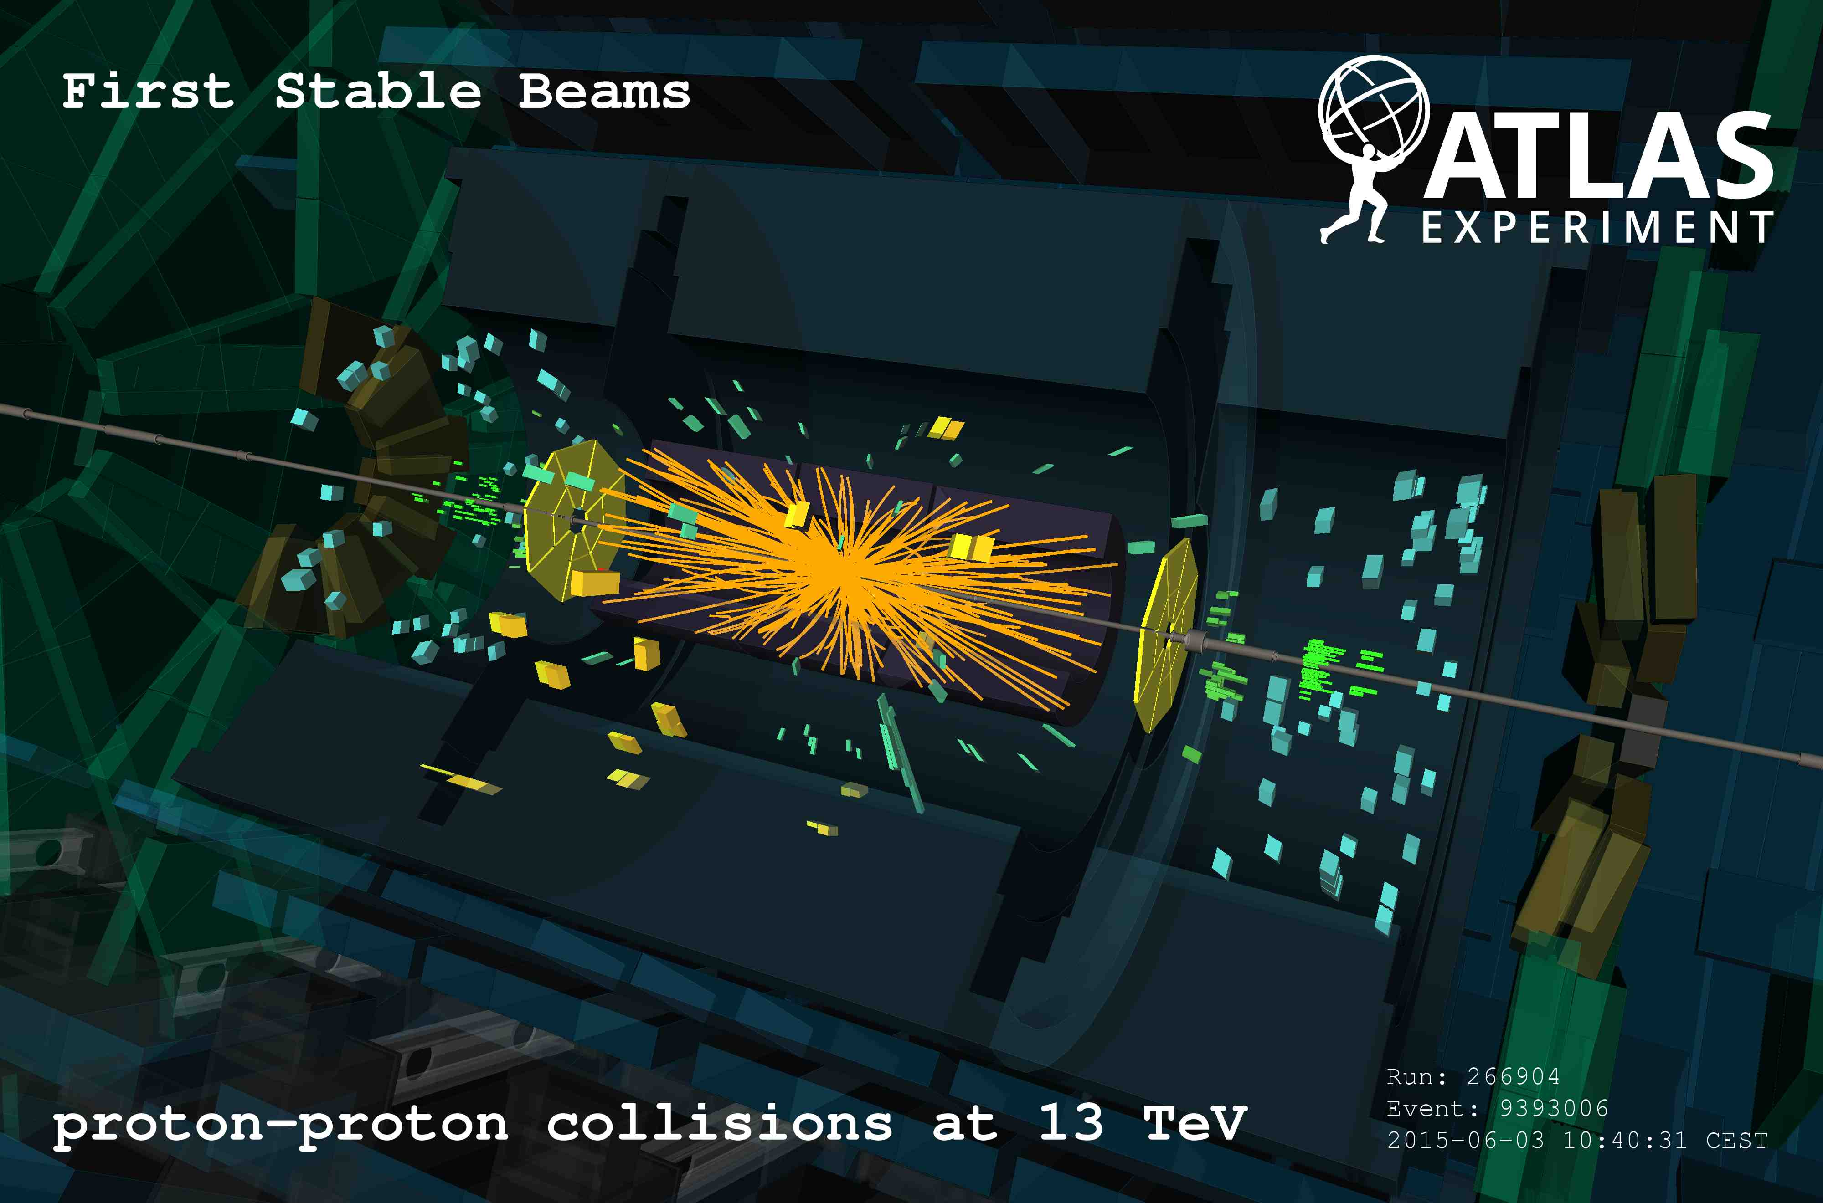
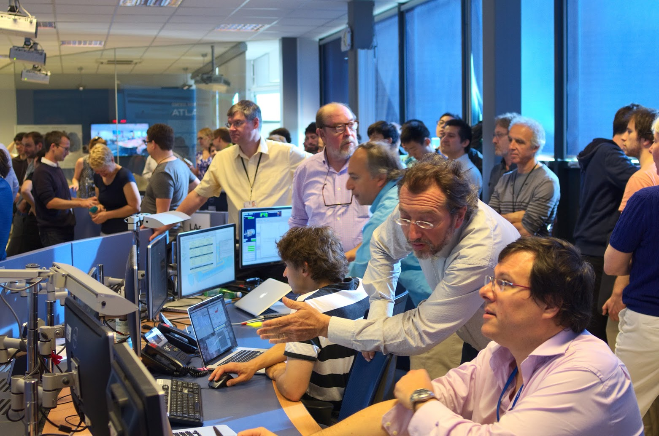
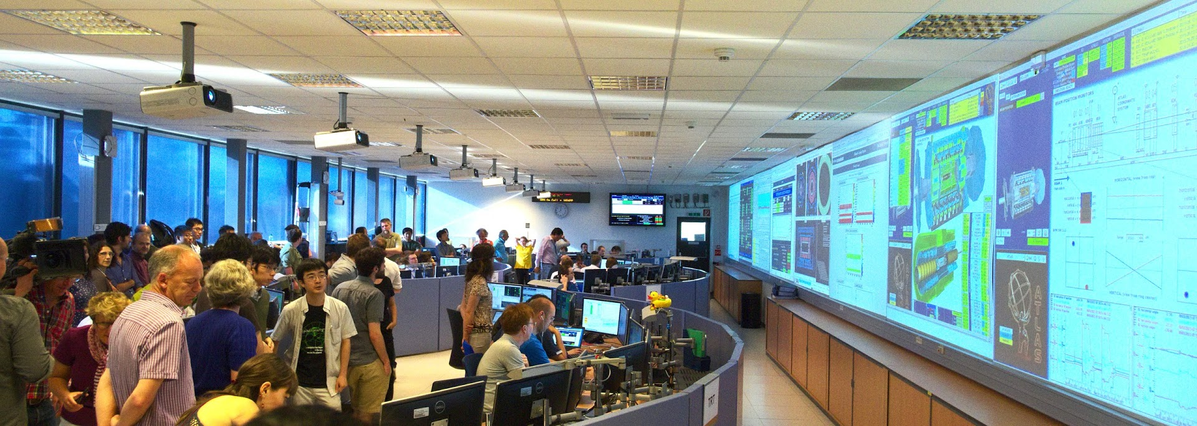
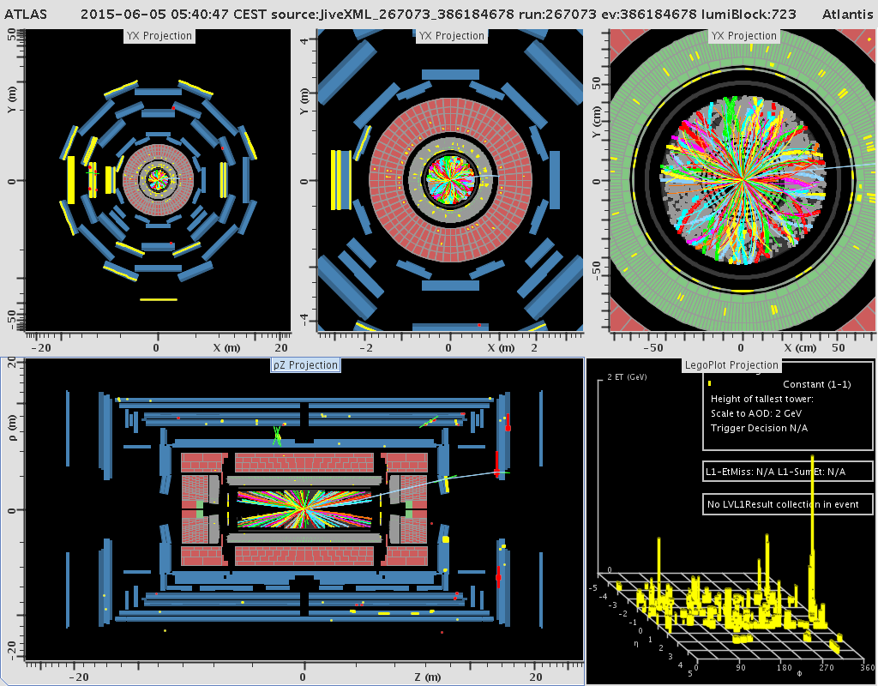
Highest Energy of 13 TeV Collisions

Slide 5
Needs for Standards and Units
Seven fundamental quantities for physical measurements
  Length, Mass, Time, Electric Current, Temperature, the Amount of substance and the Luminous intensity
Need a language that everyone can understand each other
  Consistency is crucial for physical measurements
  The same quantity measured by one must be comprehendible and reproducible by others
  Practical matters contribute
A system of unit called SI (System Internationale) was established in 1960 (it has been 55 yrs!)
  Length in meters (m)
  Mass in kilo-grams (kg)
  Time in seconds (s)
5

Slide 6
Definition of Three Relevant Base Units
SI Units
Definitions
1 m (Length) = 100 cm
One meter is the length of the path traveled by light in vacuum during the time interval of 1/299,792,458 of a second.
1 kg (Mass) =
1000 g
It is equal to the mass of the international prototype of the kilogram, made of platinum-iridium in International Bureau of Weights and Measure in France.
1 s (Time)
One second is the duration of 9,192,631,770 periods of the radiation corresponding to the transition between the two hyperfine levels of the ground state of the Cesium 133 (C¹³³) atom.
There are total of seven base quantities (see table 1-5 on page 10)
There are prefixes that scales the units larger or smaller for convenience (see T.1-4 pg. 10)
Units for other quantities, such as Newtons for force and Joule for energy, for ease of use
6

Slide 7
Prefixes, expressions and their meanings
Larger
Smaller
deca (da): 10¹
hecto (h): 10²
kilo (k): 10³
mega (M): 10⁶
giga (G): 10⁹
tera (T): 10¹²
peta (P): 10¹⁵
exa (E): 10¹⁸
zetta (Z): 10²¹
yotta (Y): 10²⁴
deci (d): 10⁻¹
centi (c): 10⁻²
milli (m): 10⁻³
micro (μ): 10⁻⁶
nano (n): 10⁻⁹
pico (p): 10⁻¹²
femto (f): 10⁻¹⁵
atto (a): 10⁻¹⁸
zepto (z): 10⁻²¹
yocto (y): 10⁻²⁴
7

Slide 8
International Standard Institutes
International Bureau of Weights and Measure http://www.bipm.fr/
  Base unit definitions: http://www.bipm.fr/enus/3_SI/base_units.html
  Unit Conversions: http://www.bipm.fr/enus/3_SI/
US National Institute of Standards and Technology (NIST) http://www.nist.gov/
8

Slide 9
How do we convert quantities from one unit to another?
Unit 1 =
Conversion factor X
Unit 2
1 inch | 2.54 | cm
1 inch | 0.0254 | m
1 inch | 2.54x10⁻⁵ | km
1 ft | 30.3 | cm
1 ft | 0.303 | m
1 ft | 3.03x10⁻⁴ | km
1 hr | 60 | minutes
1 hr | 3600 | seconds
And many | More | Here….
9

Slide 10
Examples 1.4 and 1.5 for Unit Conversions
Ex 1.4: An apartment has a floor area of 880 square feet (ft²). Express this in square meters (m²).
What do we need to know?
Ex 1.5: Where the posted speed limit is 55 miles per hour (mi/h or mph), what is this speed (a) in meters per second (m/s) and (b) kilometers per hour (km/h)?
(a)
(b)
10

Slide 11
Estimates & Order-of-Magnitude Calculations
Estimate = Approximation
  Useful for rough calculations to determine the necessity of higher precision
  Usually done under certain assumptions
  Might require modification of assumptions, if higher precision is necessary
Order of magnitude estimate: Estimates done to the precision of 10s or exponents of 10s;
  Three orders of magnitude: 10³=1,000
  Round up for Order of magnitude estimate; 8x10⁷ ~ 10⁸
  Similar terms: “Ball-park-figures”, “guesstimates”, etc
11

Slide 12
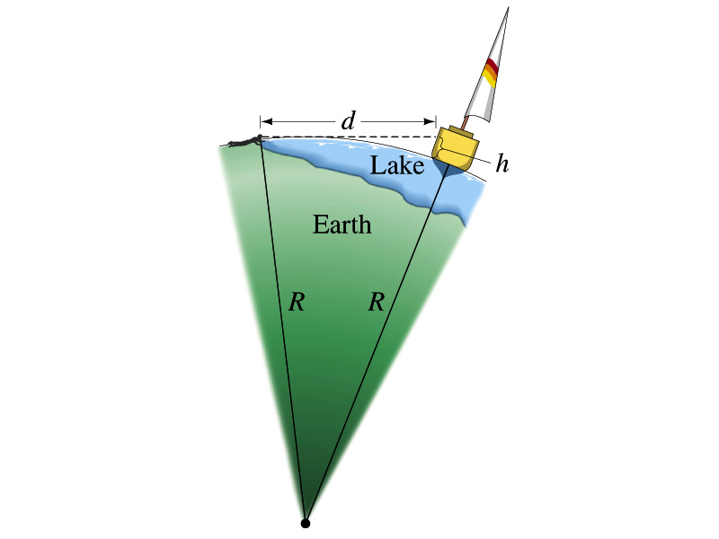
Back of the Chapter Problem # 34
Estimate the radius of the Earth using triangulation as shown in the picture when d=4.4km and h=1.5m.
Pythagorian theorem
D=4.4km
Solving for R
R
R+h
12
Real R=6380km

Slide 13
Dimension and Dimensional Analysis
An extremely useful concept in solving physical problems
Good to write physical laws in mathematical expressions
No matter what units are used the base quantities are the same
  Length (distance) is length whether meter or inch is used to express the size: Usually denoted as [L]
  The same is true for Mass ([M])and Time ([T])
  One can say “Dimension of Length, Mass or Time”
  Dimensions are treated as algebraic quantities: Can perform two algebraic operations; multiplication or division
13

Slide 14
Dimension and Dimensional Analysis cnt’d
One can use dimensions only to check the validity of one’s expression: Dimensional analysis
  Eg: Speed [v] = [L]/[T]=[L][T⁻¹]
    Distance (L) traveled by a car running at the speed V in time T
      L = V*T = [L/T]*[T]=[L]
More general expression of dimensional analysis is using exponents: eg. [v]=[L^{n}T^{m}] =[L][T⁻¹] where n = 1 and m = -1
14

Slide 15
Examples
Show that the expression [v] = [at] is dimensionally correct
    Speed: [v] =[L]/[T]
    Acceleration: [a] =[L]/[T]²
    Thus, [at] = (L/T²)xT=LT⁽⁻²⁺¹⁾ =LT⁻¹ =[L]/[T]= [v]
Suppose the acceleration a of a circularly moving particle with speed v and radius r is proportional to r^{n} and v^{m}. What are n andm?
a
r
v
Dimensionless
constant
Length
Speed
15

Slide 16
Some Fundamentals
Kinematics: Description of Motion without understanding the cause of the motion
Dynamics: Description of motion accompanied with understanding the cause of the motion
Vector and Scalar quantities:
  Scalar: Physical quantities that require magnitude but no direction
    Speed, length, mass, height, volume, area, magnitude of a vector quantity, etc
  Vector: Physical quantities that require both magnitude and direction
    Velocity, Acceleration, Force, Momentum
    It does not make sense to say “I ran with the velocity of 10miles/hour.”
Objects can be treated as point-like if their sizes are smaller than the scale in the problem
  Earth can be treated as a point like object (or a particle)in celestial problems
    Simplification of the problem (The first step in setting up to solve a problem…)
  Any other examples?
16

Slide 17
Some More Fundamentals
Motions: Can be described as long as the position is known at any given time (or position is expressed as a function of time)
  Translation: Linear motion along a line
  Rotation: Circular or elliptical motion
  Vibration: Oscillation
Dimensions
  0 dimension: A point
  1 dimension: Linear drag of a point, resulting in a line ➔ Motion in one-dimension is a motion on a line
  2 dimension: Linear drag of a line resulting in a surface
  3 dimension: Perpendicular Linear drag of a surface, resulting in a stereo object
17

Slide 18
Displacement, Velocity and Speed
One dimensional displacement is defined as:
A vector quantity
Displacement is the difference between initial and final potions of the motion and is a vector quantity. How is this different than distance?
Unit?
m
The average velocity is defined as:
Unit?
m/s
A vector quantity
Displacement per unit time in the period throughout the motion
The average speed is defined as:
Unit?
m/s
A scalar quantity

Slide 19
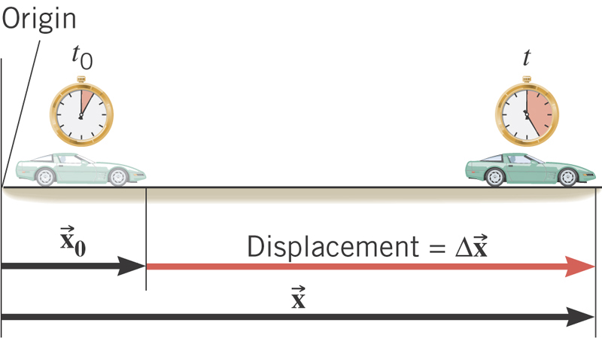
What is the displacement?
How much is the elapsed time?

Slide 20
Displacement, Velocity and Speed
One dimensional displacement is defined as:
Displacement is the difference between initial and final potions of the motion and is a vector quantity. How is this different than distance?
Unit?
m
The average velocity is defined as:
Unit?
m/s
Displacement per unit time in the period throughout the motion
The average speed is defined as:
Unit?
m/s
Can someone tell me what the difference between speed and velocity is?

Slide 21
Difference between Speed and Velocity
Let’s take a simple one dimensional translation that has many steps:
Let’s call this line as X-axis
Let’s have a couple of motions in a total time interval of 20 sec.
+10m
+15m
+5m
-5m
-10m
-15m
Total Displacement:
Average Velocity:
Total Distance Traveled:
Average Speed:
21

