Slide 1
PHYS 1441 – Section 001 Lecture #2
Tuesday, June 9, 2015
Dr. Jaehoon Yu
Chapter 2: One Dimensional Motion
Instantaneous Velocity and Speed
Acceleration
Motion under constant acceleration
One dimensional Kinematic Equations
How do we solve kinematic problems?
Falling motions
Today’s homework is homework #2, due 11pm, Sunday, June 14!!

Slide 2
Announcements
Homework registration
66/71 have registered as of early this morning
60 have submitted answers!!
Those of you who haven’t enrolled in must do so ASAP.
1st non-comprehensive term exam
In class Monday, June 15
Covers: CH1.1 through what we finish tomorrow, Thursday, June 11, plus appendix A
Bring your calculator but DO NOT input formula into it!
Cell phones or any types of computers cannot replace a calculator!
BYOF: You may bring a one 8.5x11.5 sheet (front and back) of handwritten formulae and values of constants for the quiz
No derivations, word definitions or solutions of any problems!
No additional formulae or values of constants will be provided!
The final exam is 10:30 – 12:30pm, Monday, July 13, in this room

Slide 3
Reminder: Special Project #1 for Extra Credit
Find the solutions for yx²-zx+v=0 ➔ 5 points
You cannot just plug into the quadratic equations!
You must show a complete algebraic process of obtaining the solutions!
Derive the kinematic equation from first principles and the known kinematic equations ➔ 10 points
You must show your OWN work in detail to obtain the full credit
Must be in much more detail than in this lecture note!!!
Please do not copy from the lecture note or from your friends. You will all get 0!
Due tomorrow Thursday, June 11

Slide 4
Displacement, Velocity and Speed
One dimensional displacement is defined as:
A vector quantity
Displacement is the difference between initial and final potions of the motion and is a vector quantity. How is this different than distance?
Unit?
m
The average velocity is defined as:
Unit?
m/s
A vector quantity
Displacement per unit time in the period throughout the motion
The average speed is defined as:
Unit?
m/s
A scalar quantity

Slide 5
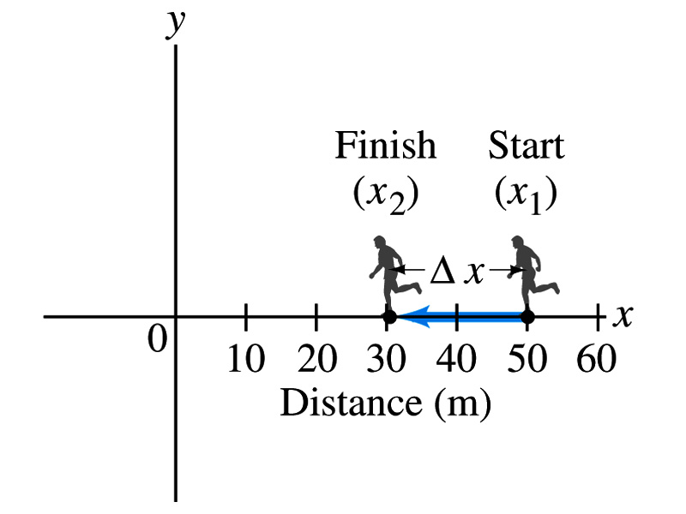
Example 2.1: Runner’s Average Velocity
The position of a runner as a function of time is plotted as moving along the x axis of a coordinate system. During a 3.00-s time interval, the runner’s position changes from x₁=50.0m to x₂=30.5 m, as shown in the figure. What is the runner’s average velocity? What is the average speed?
Displacement:
Average Velocity:
Average Speed:
5

Slide 6
Example Distance Run by a Jogger
How far does a jogger run in 1.5 hours if his average speed is 2.22 m/s?

Slide 7
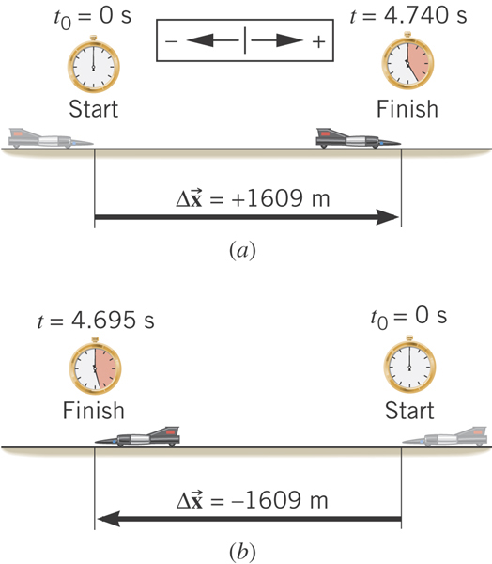
Example: The World’s Fastest Jet-Engine Car
Andy Green in the car ThrustSSC set a world record of 341.1 m/s in 1997. To establish such a record, the driver makes two runs through the course, one in each direction to nullify wind effects. From the data, determine the average speed for each run.
What is the speed?
Segment of a motion!!
What is the speed?
Segment of a motion!!

Slide 8
Instantaneous Velocity and Speed
Can average quantities tell you the detailed story of the whole motion?
NO!!
Instantaneous velocity is defined as:
What does this mean?
Displacement in an infinitesimal time interval
Average velocity over a very, very, very small amount of time
Instantaneous speed is the size (magnitude) of the velocity vector:
*Magnitude of Vectors are Expressed in absolute values

Slide 9
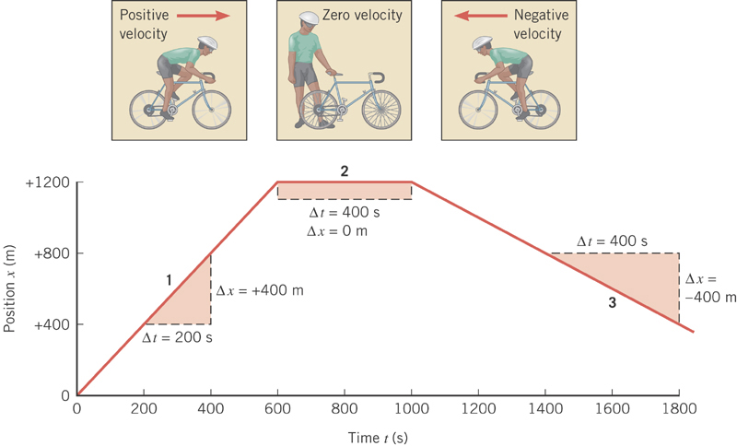
Position vs Time Plot
It is helpful to understand motions to draw them on position vs time plots.
Running at a constant velocity at a rate of +400m in 200s.
Velocity is 0 since stayed in the same location in 400s.
Running at a constant velocity but in the reverse direction as 1 at a rate of -400m in 400s.

Slide 10
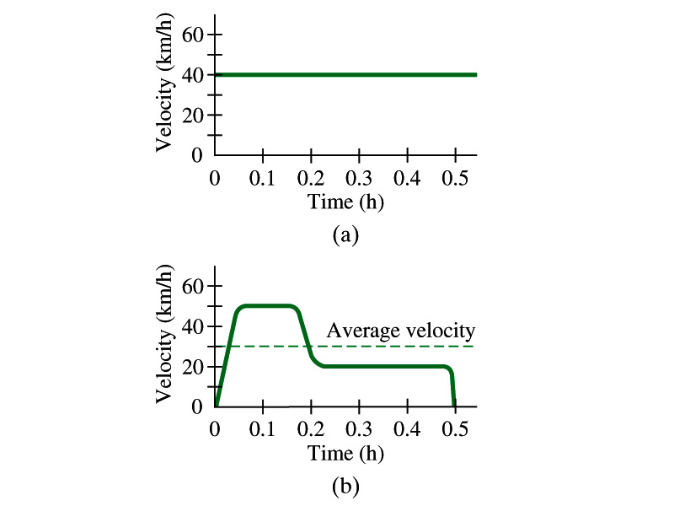
Velocity vs Time Plot

Slide 11
Displacement, Velocity and Speed
Displacement
Average velocity
Average speed
Instantaneous velocity
Instantaneous speed
11
11

Slide 12
Acceleration
Change of velocity in time (what kind of quantity is this?)
Vector!
Definition of Average acceleration:
analogs to
Dimension?
[LT⁻²]
Unit?
m/s²
Definition of Instantaneous acceleration: Average acceleration over a very short amount of time.
analogs to

Slide 13
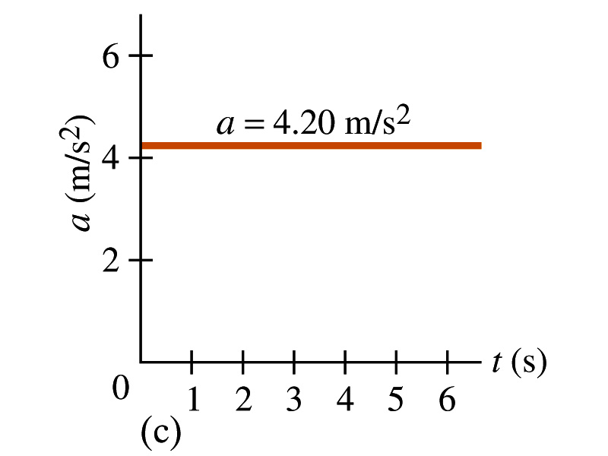
Acceleration vs Time Plot
What does this plot tell you?
Yes, you are right!!
The acceleration of this motion is a constant!!

Slide 14
Example 2.4
A car accelerates along a straight road from rest to 75km/h in 5.0s.
What is the magnitude of its average acceleration?

