Slide 1
PHYS 1441 – Section 001 Lecture #6
Wednesday, June 17, 2015
Dr. Jaehoon Yu
Understanding the 2 Dimensional Motion
2D Kinematic Equations of Motion
Projectile Motion
Maximum Range and Height

Slide 2
Announcements
Quiz #2
Beginning of the class tomorrow, Thursday, June 18
Covers CH3.1 to what we finish today, Wednesday, June 17
Bring your calculator but DO NOT input formula into it!
You can prepare a one 8.5x11.5 sheet (front and back) of handwritten formulae and values of constants for the exam ➔ no solutions of any kind, derivations or word definitions!
No additional formulae or values of constants will be provided!

Slide 3
Reminder: Special Project #2 for Extra Credit
Show that the trajectory of a projectile motion is a parabola and explain your answer.
20 points
Due: Monday, June 22
You MUST show full details of your OWN computations to obtain any credit
Beyond what was covered in this lecture note and in the book!

Slide 4
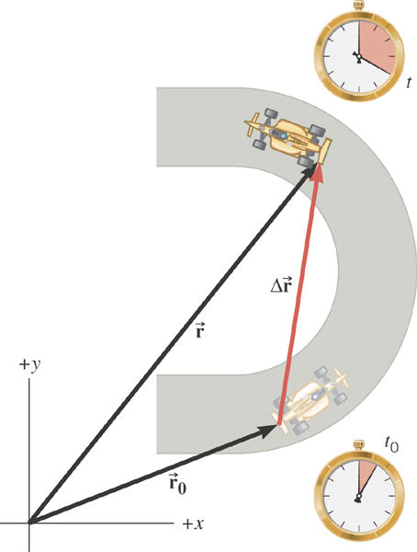
2D Displacement

Slide 5
2D Average Velocity
Average velocity is the
displacement divided by
the elapsed time.
What is the direction of the Average velocity?
Right! The same as the displacement!

Slide 6
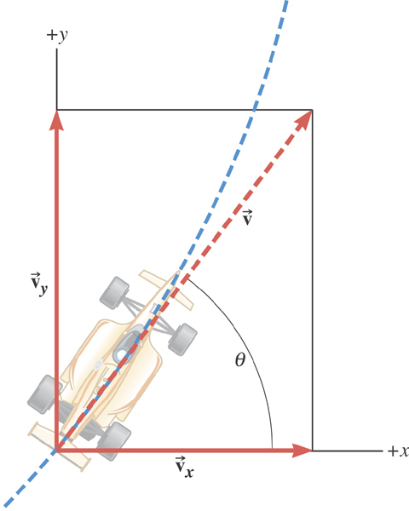
2D Instantaneous Velocity
The instantaneous velocity indicates how fast the car moves and the direction of motion at each instant of time.

Slide 7
2D Average Acceleration

Slide 8
Displacement, Velocity, and Acceleration in 2-dim
Displacement:
Average Velocity:
How is each of these quantities defined in 1-D?
Instantaneous Velocity:
Average Acceleration
Instantaneous Acceleration:

Slide 9
Kinematic Quantities in 1D and 2D
Quantities | 1 Dimension | 2 Dimension
Displacement
Average Velocity
Inst. Velocity
Average Acc.
Inst. Acc.
What is the difference between 1D and 2D quantities?

Slide 10
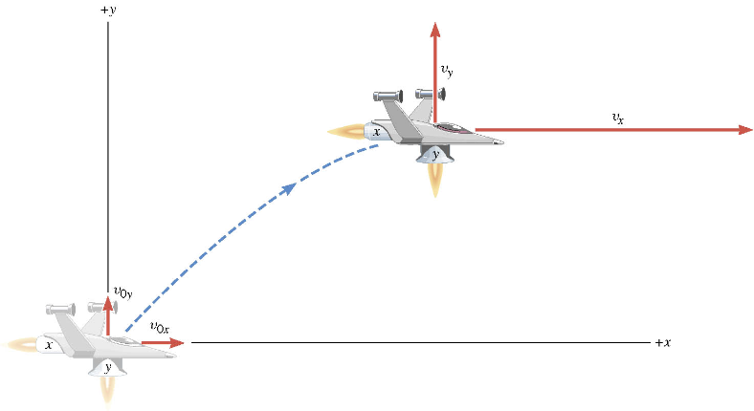
A Motion in 2 Dimension
This is a motion that could be viewed as two motions (x and y directions) combined into one. (superposition…)

Slide 11
Motion in horizontal direction (x)

Slide 12
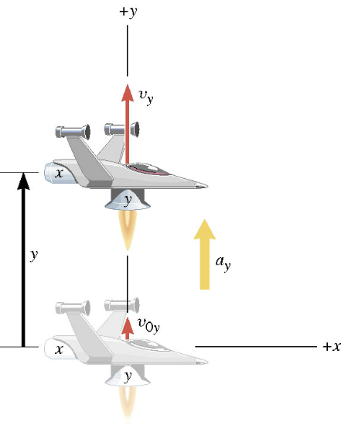
Motion in vertical direction (y)

Slide 13
A Motion in 2 Dimension
Imagine you add the two 1 dimensional motions on the left. It would make up a one 2 dimensional motion on the right.

Slide 14
Kinematic Equations in 2-Dim
x-component
y-component

Slide 15
Ex. A Moving Spacecraft
In the x direction, the spacecraft in zero-gravity zone has an initial velocity component of +22 m/s and an acceleration of +24 m/s². In the y direction, the analogous quantities are +14 m/s and an acceleration of +12 m/s². Find (a) x and v_{x}, (b) y and v_{y}, and (c) the final velocity of the spacecraft at time 7.0 s.

Slide 16
How do we solve this problem?
Visualize the problem ➔ Draw a picture!
Decide which directions are to be called positive (+) and negative (-). Normal convention is the right-hand rule.
Write down the values that are given for any of the five kinematic variables associated with each direction.
Verify that the information contains values for at least three of the kinematic variables. Do this for x and y separately. Select the appropriate equation.
When the motion is divided into segments, remember that the final velocity of one segment is the initial velocity for the next.
Keep in mind that there may be two possible answers to a kinematics problem.

Slide 17
Ex. continued
In the x direction, the spacecraft in a zero gravity zone has an initial velocity component of +22 m/s and an acceleration of +24 m/s². In the y direction, the analogous quantities are +14 m/s and an acceleration of +12 m/s². Find (a) x and v_{x}, (b) y and v_{y}, and (c) the final velocity of the spacecraft at time 7.0 s.
x | a_{x} | v_{x} | v_{ox} | t
? |  | ?
+24.0 m/s²
+22.0 m/s
7.0 s
y | a_{y} | v_{y} | v_{oy} | t
? |  | ?
+12.0 m/s²
+14.0 m/s
7.0 s

Slide 18
First, the motion in x-direciton…
x | a_{x} | v_{x} | v_{ox} | t
? | +24.0 m/s² | ? | +22 m/s | 7.0 s

Slide 19
Now, the motion in y-direction…
y | a_{y} | v_{y} | v_{oy} | t
? | +12.0 m/s² | ? | +14 m/s | 7.0 s

Slide 20
The final velocity…
A vector can be fully described when the magnitude and the direction are given. Any other way to describe it?
Yes, you are right! Using components and unit vectors!!

Slide 21
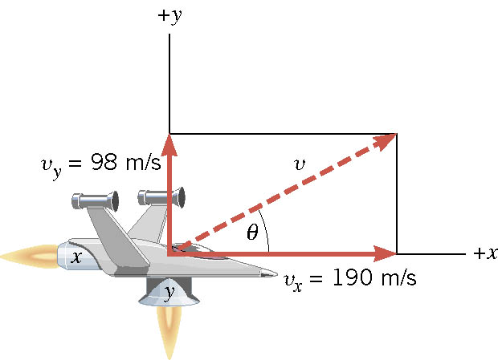
If we visualize the motion…

Slide 22
What is the Projectile Motion?
A 2-dim motion of an object under the gravitational acceleration with the following assumptions
Free fall acceleration, g, is constant over the range of the motion
and
Air resistance and other effects are negligible
A motion under constant acceleration!!!! ➔ Superposition of two motions
Horizontal motion with constant velocity ( no acceleration )
Vertical motion under constant acceleration ( g )

Slide 23
Projectile Motion
But the object is still moving!!
Why?
Because it still has constant velocity in horizontal direction!!
Why?
Because there is no acceleration in horizontal direction!!
Maximum height
The only acceleration in this motion. It is a constant!!

Slide 24
Kinematic Equations for a projectile motion
x-component
y-component

Slide 25
Example for a Projectile Motion
A ball is thrown with an initial velocity v=(20i+40j)m/s. Estimate the time of flight and the distance from the original position when the ball lands.
Which component determines the flight time and the distance?
Flight time is determined by the y component, because the ball stops moving when it is on the ground after the flight.
So the possible solutions are…
Distance is determined by the x component in 2-dim, because the ball is at y=0 position when it completed it’s flight.
Why isn’t 0 the solution?

Slide 26
Ex.3.6 The Height of a Kickoff
A placekicker kicks a football at an angle of 40.0 degrees and
the initial speed of the ball is 22 m/s. Ignoring air resistance,
determine the maximum height that the ball attains.

Slide 27
First, the initial velocity components

Slide 28
Motion in y-direction is of the interest..
y | a_{y} | v_{y} | v_{0y} | t
?
-9.8 m/s²
0 m/s
+14 m/s

Slide 29
Now the nitty, gritty calculations…
y | a_{y} | v_{y} | v_{0y} | t
? | -9.80 m/s² | 0 | 14 m/s
What happens at the maximum height?
The ball’s velocity in y-direction becomes 0!!
And the ball’s velocity in x-direction?
Stays the same!! Why?
Because there is no acceleration in x-direction!!
Which kinematic formula would you like to use?
Solve for y

Slide 30
Ex.3.6 extended: The Time of Flight of a Kickoff
What is the time of flight between kickoff and landing?

Slide 31
What is y when it reached the max range?
y | a_{y} | v_{y} | v_{oy} | t
 |  |  |  | ?
0 m
-9.80 m/s²
14 m/s

Slide 32
Now solve the kinematic equations in y direction!!
y | a_{y} | v_{y} | v_{oy} | t
0 | -9.80 m/s² |  | 14 m/s | ?
Since y=0
Two soultions
or
Solve for t

Slide 33
Ex.3.9 The Range of a Kickoff
Calculate the range R of the projectile.

Slide 34
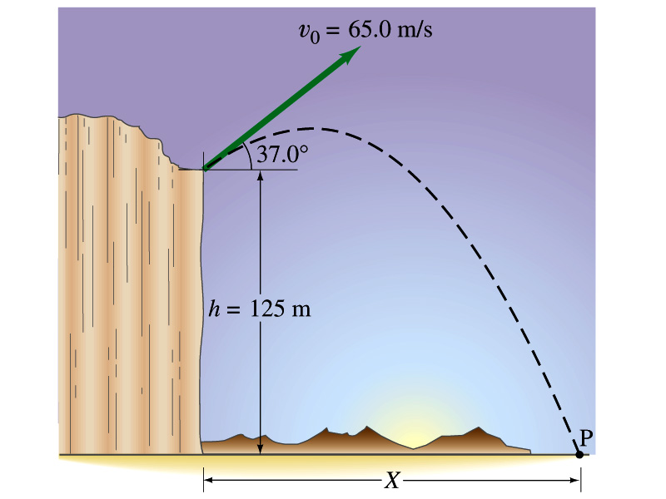
Example for a Projectile Motion
A stone was thrown upward from the top of a cliff at an angle of 37º to horizontal with initial speed of 65.0m/s. If the height of the cliff is 125.0m, how long is it before the stone hits the ground?
Becomes
Since negative time does not exist.
34

Slide 35
Example cont’d
What is the speed of the stone just before it hits the ground?
What are the maximum height and the maximum range of the stone?
Do these yourselves at home for fun!!!
35

