Slide 1
PHYS 1441 – Section 001 Lecture #7
Thursday, June 18, 2015
Dr. Jaehoon Yu
Projectile Motion
Maximum Range and Height
What is the Force?
Free Body Diagram
Newton’s Laws
Today’s homework is homework #4, due 11pm, Monday, June 22!!

Slide 2
Announcements
Reading Assignment
CH4.1 – 4.3
Mid-term exam
In the class coming Tuesday, June 23
Comprehensive exam
Covers CH1.1 to what we finish Monday, June 22+ Appendix A
Bring your calculator but DO NOT input formula into it!
Your phones or portable computers are NOT allowed as a replacement!
You can prepare a one 8.5x11.5 sheet (front and back) of handwritten formulae and values of constants for the exam ➔ no solutions of any kind, derivations or word definitions!
No additional formulae or values of constants will be provided!

Slide 3
Reminder: Special Project #2 for Extra Credit
Show that the trajectory of a projectile motion is a parabola and explain your answer.
20 points
Due: Monday, June 22
You MUST show full details of your OWN computations to obtain any credit
Beyond what was covered in this lecture note or in the book!

Slide 4
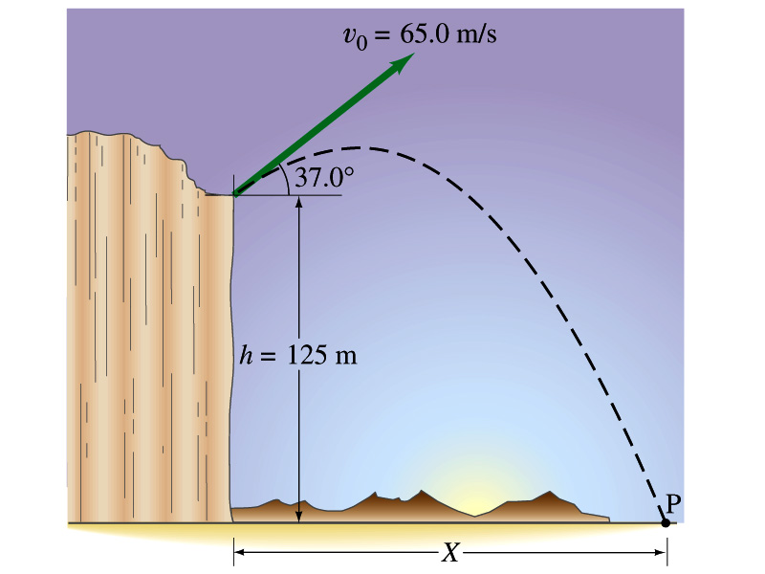
Another example for a Projectile Motion
A stone was thrown upward from the top of a cliff at an angle of 37º to horizontal with initial speed of 65.0m/s. If the height of the cliff is 125.0m, how long is it before the stone hits the ground?
Becomes
Since negative time does not exist.
4

Slide 5
Example cont’d
What is the speed of the stone just before it hits the ground?
What are the maximum height and the maximum range of the stone?
Do these yourselves at home for fun!!!
5

Slide 6
Horizontal Range and Max Height
Based on what we have learned previously, one can analyze the projectile motion in more detail
Maximum height an object can reach
Maximum range
For a projectile fired with an initial speed v₀ at angle θ₀, the time for it to reach maximum height can be obtained:
What happens at the maximum height?
At the maximum height the object’s vertical motion stops to turn around!!
g=9.8m/s²
Solve for t_{A}
Time to reach to the maximum height!!

Slide 7
Horizontal Range and Max Height
Since no acceleration is in x direction, it still flies even if v_{y}=0.
Range
Height

Slide 8
Maximum Range and Height
What are the conditions that give maximum height and range of a projectile motion?
This formula tells us that the maximum height can be achieved when θ₀=90º!!!
This formula tells us that the maximum range can be achieved when 2θ₀=90º, i.e., θ₀=45º!!!

Slide 9
Force
We’ve been learning kinematics; describing motion without understanding what the cause of the motion is. Now we are going to learn dynamics!!
FORCE is what causes an object to move.
Can someone tell me what FORCE is?
The above statement is not entirely correct. Why?
Because when an object is moving with a constant velocity no force is exerted on the object!!!
The FORCE is what cause changes to the velocity of an object!!
What does this statement mean?
When there is force, there is a change of velocity!!
What does the force cause?
An acceleration.!!
What happens if there are several forces being exerted on an object?
Forces are vector quantities, so vector sum of all forces, the NET FORCE, determines the direction of the acceleration of the object.
F₁
F₂
NET FORCE, F= F₁+F₂
When the net force on an object is 0, it has constant velocity and is at its equilibrium!!

Slide 10
More Forces
There are various types of forces
Contact Forces: Forces exerted by a physical contact of objects
Examples of Contact Forces: Baseball hit by a bat, Car collisions
Field Forces: Forces exerted without physical contact of objects
Examples of Field Forces: Gravitational Force, Electro-magnetic force
What are possible ways to measure strength of a force?
A calibrated spring whose length changes linearly with the force exerted .
Forces are vector quantities, so the addition of multiple forces must be done following the rules of vector additions.

Slide 11
Newton’s First Law and Inertial Frames
Aristotle (384-322BC): A natural state of a body is rest. Thus force is required to move an object. To move faster, ones needs larger forces.
Galileo’s statement on natural states of matter: Any velocity once imparted to a moving body will be rigidly maintained as long as the external causes of retardation are removed!!
Galileo’s statement is formulated by Newton into the 1st law of motion (Law of Inertia): In the absence of external forces, an object at rest remains at rest and an object in motion continues in motion with a constant velocity.
What does this statement tell us?
When no net force is exerted on an object, the acceleration of the object is 0.
Any isolated object, the object that do not interact with its surroundings, is either at rest or moving at a constant velocity.
Objects would like to keep its current state of motion, as long as there are no net force that interferes with the motion. This tendency is called the Inertia.
A frame of reference that is moving at a constant velocity is called the Inertial Frame
Is a frame of reference with an acceleration an Inertial Frame?
NO!

