Slide 1
PHYS 1441 – Section 001
Lecture #8
Monday, June 22, 2015
Dr. Jaehoon Yu
Newton’s Second Law
Free Body Diagram
Newton’s Third Law
Categories of forces
Application of Newton’s Laws
Today’s homework is homework #5, due 11pm, Friday, June 26!!

Slide 2
Announcements
Reading Assignment
  CH4.1 – 4.3
Mid-term exam
  In the class tomorrow, Tuesday, June 23
  Comprehensive exam
    Covers CH1.1 to what we finish today + Appendix A
  Bring your calculator but DO NOT input formula into it!
    Your phones or portable computers are NOT allowed as a replacement!
  You can prepare a one 8.5x11.5 sheet (front and back) of handwritten formulae and values of constants for the exam ➔ no solutions of any kind, derivations or word definitions!
    No additional formulae or values of constants will be provided!

Slide 3
Mass
Mass: A measure of the inertia of an object or the quantity of matter
Independent of the object’s surroundings: The same no matter where you go.
Independent of the method of measurement: The same no matter how you measure it.
The heavier the object, the bigger the inertia !!
It is harder to make changes of motion of a heavier object than a lighter one.
The same forces applied to two different masses result in different acceleration depending on the mass.
Note that the mass and the weight of an object are two different quantities!!
Weight of an object is the magnitude of the gravitational force exerted on the object.
Not an inherent property of an object!!!
Weight will change if you measure on the Earth or on the moon but the mass won’t!!
Unit of mass?

Slide 4
Newton’s Second Law of Motion
The acceleration of an object is directly proportional to the net force exerted on it and is inversely proportional to the object’s mass.
How do we write the above statement in a mathematical expression?
From this we obtain
Newton’s 2nd Law of Motion
Since this is a vector expression, each component must also satisfy:

Slide 5
Unit of the Force
From the vector expression in the previous page, what do you conclude the dimension and the unit of the force are?
The dimension of force is
The unit of force in SI is
For ease of use, we define a new derived unit called, Newton (N)

Slide 6
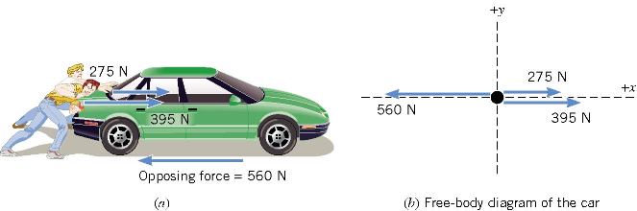
Free Body Diagram
A free-body-diagram is a diagram that represents the object and the forces that act on it.

Slide 7
Ex. Pushing a stalled car
What is the net force in this example?
F=
275 N
+ 395 N
– 560 N =
+110 N
Which direction?
The + x axis of the coordinate system.

Slide 8
What is the acceleration the car receives?
If the mass of the car is 1850 kg, then by Newton’s second law, the acceleration is
Since the motion is
in 1 dimension
Now we solve this
equation for a

Slide 9
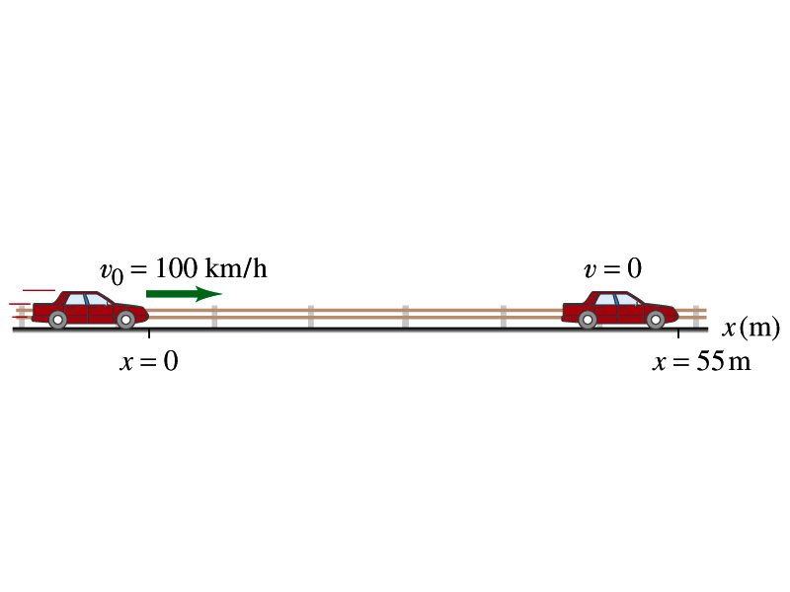
Example 4.3
What constant net force is required to bring a 1500kg car to rest from a speed of 100km/h within a distance of 55m?
What do we need to know to figure out the force?
Acceleration!!
What are given?
Initial speed:
Final speed:
Displacement:
This is a one dimensional motion. Which kinetic formula do we use to find acceleration?
Acceleration
Thus, the force needed to stop the car is
Linearly proportional to the mass of the car
Squarely proportional to the speed of the car
Inversely proportional to the force by the brake
Given the force how far does the car move till it stops?

Slide 10
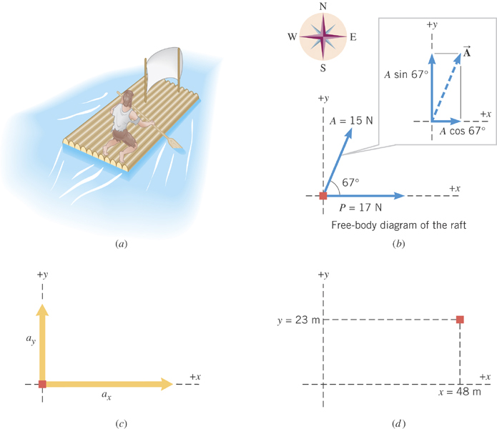
Ex. Stranded man on a raft
A man is stranded on a raft (mass of man and raft = 1300kg) as shown in the figure. By paddling, he causes an average force P of 17N to be applied to the raft in a direction due east (the +x direction). The wind also exerts a force A on the raft. This force has a magnitude of 15N and points 67º north of east. Ignoring any resistance from the water, find the x and y components of the rafts acceleration.

Slide 11
First, let’s compute the net force on the raft as follows:
Force | x component | y component
+17 N
0 N
+(15N)cos67º
+(15N)sin67º
+17+15cos67^{o=}
+15sin67º=
+23(N)
+14(N)

Slide 12
Now compute the acceleration components in x and y directions!!
And put them all together for the overall acceleration:

Slide 13
Example for Newton’s 2nd Law of Motion
Determine the magnitude and direction of the acceleration of the puck whose mass is 0.30kg and is being pulled by two forces, F1 and F2, as shown in the picture, whose magnitudes of the forces are 8.0 N and 5.0 N, respectively.
Components of F₁
F₁
θ₁=60^{ο}
Components of F₂
θ₂=−20^{ο}
F₂
Components of total force F
Magnitude and direction of acceleration a
Acceleration
Vector a
13

Slide 14
Newton’s Third Law (Law of Action and Reaction)
If two objects interact, the force F₂₁ that object 2 exerts on object 1 is equal in magnitude and opposite in direction to the force F₁₂ object 1 exerts on object 2.
F₁₂
F₂₁
2
1
The reaction force is equal in magnitude to the action force but in opposite direction. These two forces always act on different objects.
What is the reaction force to the force of a free falling object?
The gravitational force the object exerts on the Earth!
Stationary objects on top of a table has a reaction force (called the normal force) from table to balance the action force, the gravitational force.
14

Slide 15
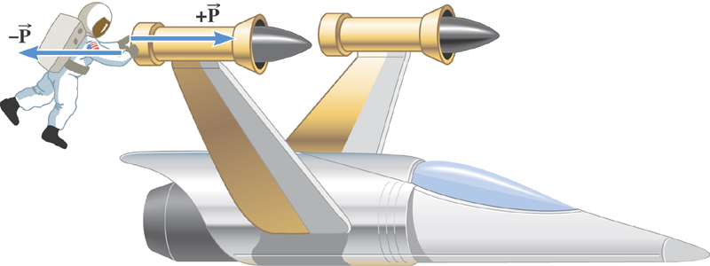
Ex. The Accelerations Produced by Action and Reaction Forces
Which one do you think will get a larger acceleration?
Suppose that the magnitude of the force P is 36 N. If the mass of the spacecraft is 11,000 kg and the mass of the astronaut is 92 kg, what are the accelerations?

Slide 16
Ex. continued
Force exerted on the space craft by the astronaut
Force exerted on the astronaut by the space craft
space craft’s acceleration
Astronaut’s acceleration

Slide 17
Example of Newton’s 3rd Law
A large man and a small boy stand facing each other on frictionless ice. They put their hands together and push against each other so that they move apart. a) Who moves away with the higher speed and by how much?
F₁₂
F₂₁= - F₁₂
m
M
Since
and
Establish the
equation
Divide by m
17

Slide 18
Example of Newton’s 3rd Law, cnt’d
Man’s velocity
Boy’s velocity
So boy’s velocity is higher than man’s, if M>m, by the ratio of the masses.
b) Who moves farther while their hands are in contact?
Boy’s displacement
Man’s displacement
Given in the same time interval, since the boy has higher acceleration and thereby higher speed, he moves farther than the man.
18

