Slide 1
PHYS 1441 – Section 001
Lecture #9
Wednesday, June 24, 2015
Dr. Jaehoon Yu
Newton’s Laws Recap
Application of Newton’s Laws
Force of Friction
Uniform Circular Motion
Today’s homework is homework #6, due 11pm, Tuesday, June 30!!

Slide 2
Announcements
Reading Assignments: CH5.4 and 5.9
Mid-term grade discussion
  Tomorrow in my office (CPB342) during the class time
  Organized by the last names
    A – G: 10:30 – 11:00am
    H – M: 11:00 – 11:30am
    N – R: 11:30 – 12:00pm
    S – Z: 12:00 – 12:30pm
In class next Thursday, July 2
  Non-comprehensive exam
  Covers CH 4.6 to what we finish next Wednesday, July 1
  Bring your calculator but DO NOT input formula into it!
    Your phones or portable computers are NOT allowed as a replacement!
  You can prepare a one 8.5x11.5 sheet (front and back) of handwritten formulae and values of constants for the exam ➔ no solutions, derivations, word definitions or key methods for solutions
    No additional formulae or values of constants will be provided!

Slide 3
Announcements II
Quiz 3
  Beginning of the class next Tuesday, June 30
  Covers CH4.6 through what we finish Monday, June 29
  BYOF
Quiz 2 results
  Class average: 24.5/49
    Equivalent to: 50/100
    Previous quiz: 75/100
  Class top score: 49/49
Mid-term exam results
  Class average: 59.4/109
    Equivalent to: 54.5/100
    Previous quiz: 65/100
  Class top score: 95/109

Slide 4
Special Project #3
Using the fact that g=9.80m/s² on the Earth’s surface, find the average density of the Earth.
  Use ONLY the following information but without computing the value of the volume explicitly
    The gravitational constant
    The radius of the Earth
20 point extra credit
Due: Tuesday, June 30
You must show your OWN, detailed work to obtain any credit!!

Slide 5
Newton’s Three Laws Motion
1st law of motion (Law of Inertia): In the absence of external forces, an object at rest remains at rest and an object in motion continues in motion with a constant velocity.
2nd law of motion: The acceleration of an object is directly proportional to the net force exerted on it and is inversely proportional to the object’s mass.
3rd law of motion: If two objects interact, the force F₂₁ that object 2 exerts on object 1 is equal in magnitude and opposite in direction to the force F₁₂ object 1 exerts on object 2.

Slide 6
Categories of Forces
Fundamental Forces: Truly unique forces that cannot be derived from any other forces
  Total of four fundamental forces
    Gravitational Force
    Electromagnetic Force
    Weak Nuclear Force
    Strong Nuclear Force
Non-fundamental forces: Forces that are derived from the fundamental forces
  Friction
  Tension in a rope
  Normal or support forces

Slide 7
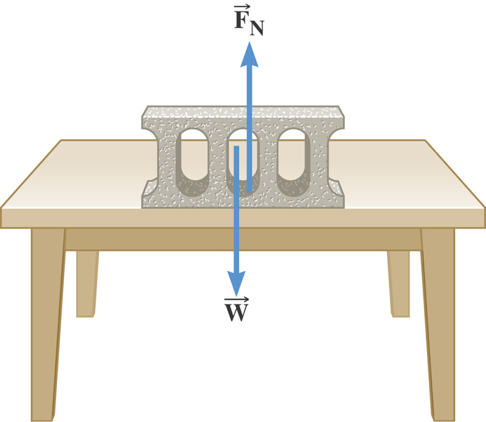
The Normal Force
The normal force is one component of the force that a surface exerts on an object with which it is in contact – namely, the force component that is perpendicular to the surface.

Slide 8
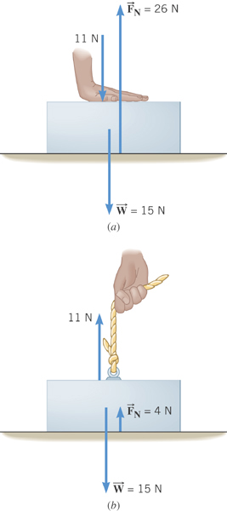
Some normal force exercises
Case 1: Hand pushing down on the book
Case 2: Hand pulling up the book

Slide 9
Some Basic Information
When Newton’s laws are applied, external forces are only of interest!!
Because, as described in Newton’s first law, an object will keep its current motion unless non-zero net external force is applied.
Why?
The force that reacts to action forces due to the surface structure of an object. Its direction is always perpendicular to the surface.
Normal Force, n:
Tension, T:
The reactionary force by a stringy object against an external force exerted on it.
A graphical tool which is a diagram of external forces on an object and is extremely useful analyzing forces and motion!! Drawn only on an object.
Free-body diagram

Slide 10
Solving a problem using Newton’s Laws
Identify all the forces acting on the object we are trying to figure out the motion!
Draw a free body diagram of all the forces with proper directions indicated
Write down the vector equation with all the forces
Establish force equations for each component of the forces
Solve for the quantities asked using force equations and the relevant kinematic equations

Slide 11
Applications of Newton’s Laws
Suppose you are pulling a box on frictionless ice, using a rope.
What are the forces being exerted on the box?
M
T
Gravitational force: F_{g}
n= -F_{g}
Normal force: n
Free-body diagram
T
Tension force: T
n= -F_{g}
Total vector force: F=F_{g}+n+T=T
F_{g}=-Mg
T
If T is a constant force, a_{x}, is constant
F_{g}= -Mg
What happened to the motion in y-direction?

Slide 12
Example w/o Friction
A crate of mass M is placed on a frictionless inclined plane of angle θ.
a) Determine the acceleration of the crate after it is released.
y
y
n
y
M
a
n
x
x
d
Free-body
Diagram
x
F_{g}
θ
θ
F= -Mg
Supposed the crate was released at the top of the incline, and the length of the incline is d. How long does it take for the crate to reach the bottom and what is its speed at the bottom?

Slide 13
Example for Using Newton’s Laws
A traffic light weighing 125 N hangs from a cable tied to two other cables fastened to a support. The upper cables make angles of 37.0º and 53.0º with the horizontal. Find the tension in the three cables.
y
37º
53º
Free-body
Diagram
T₁
T₂
37º
53º
x
T₃
Newton’s 2nd law
x-comp. of net force
y-comp. of net force

Slide 14
Force of Friction
Resistive force exerted on a moving object due to viscosity or other types frictional property of the medium in or surface on which the object moves.
These forces are either proportional to the velocity or the normal force.
Force of static friction, f_{s}:
The resistive force exerted on the object until just before the beginning of its movement
Empirical Formula
What does this formula tell you?
Static friction force increases till it reaches the limit!!
Beyond the limit, the object moves, and there is NO MORE static friction but the kinetic friction takes it over.
Force of kinetic friction, f_{k}
The resistive force exerted on the object during its movement
Which direction does kinetic friction apply?
Opposite to the motion!

Slide 15
Example w/ Friction
Suppose a block is placed on a rough surface inclined relative to the horizontal. The inclination angle is increased till the block starts to move. Show that by measuring this critical angle, θ_{c}, one can determine coefficient of static friction, μ_{s}.
y
n
y
M
Free-body
Diagram
a
n
x
f_{s}=μ_{s}n
x
F_{g}
θ
θ
F= -Mg
Net force
x comp.
y comp.

Slide 16
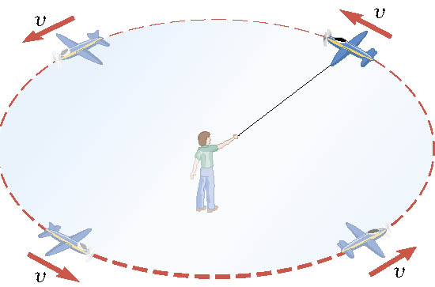
Definition of the Uniform Circular Motion
Uniform circular motion is the motion of an object traveling at a constant speed on a circular path.

Slide 17
Speed of a uniform circular motion?
Let T be the period of this motion, the time it takes for the object to travel once around the complete circle whose radius is r.

Slide 18
Ex. : A Tire-Balancing Machine
The wheel of a car has a radius of 0.29m and is being rotated at 830 revolutions per minute on a tire-balancing machine. Determine the speed at which the outer edge of the wheel is moving.

