Slide 1
PHYS 1441 – Section 001 Lecture #10
Monday, June 29, 2015
Dr. Jaehoon Yu
Centripetal Acceleration
Unbanked and Banked highways
Newton’s Law of Universal Gravitation
Work and Energy

Slide 2
Announcements
Reading Assignments: CH5.4 and 5.9
Quiz 3
Beginning of the class tomorrow, Tuesday, June 30
Covers CH4.6 through what we finish today
Bring your calculator but DO NOT input formula into it!
Your phones or portable computers are NOT allowed as a replacement!
You can prepare a one 8.5x11.5 sheet (front and back) of handwritten formulae and values of constants for the exam ➔ no solutions, derivations, word definitions or key methods for solutions
No additional formulae or values of constants will be provided!
Term exam #2
In class this Thursday, July 2
Non-comprehensive exam
Covers CH 4.6 to what we finish this Wednesday, July 1
BYOF

Slide 3
Reminder: Special Project #3
Using the fact that g=9.80m/s² on the Earth’s surface, find the average density of the Earth.
Use ONLY the following information but without computing the value of the volume explicitly
The gravitational constant
The radius of the Earth
20 point extra credit
Due: Tomorrow, Tuesday, June 30
You must show your OWN, detailed work to obtain any credit!!

Slide 4
Reminder: Special Project #4
Compute the gravitational force between two protons separates by 1m. (10 points)
Compute the electric force between the two protons separated by 1m. (10 points)
Express the electric force in #2 above in terms of the gravitational force in #1. (5 points)
You must look up the mass of the proton, the electrical charge of the proton in coulombs, electrical force constant, electric force formula, etc, and clearly write them on your project report
You MUST have your own, independent answers to the above three questions even if you worked together with others. All those who share the answers will get 0 credit if copied.
Due for the submission is Monday, July 6!

Slide 5
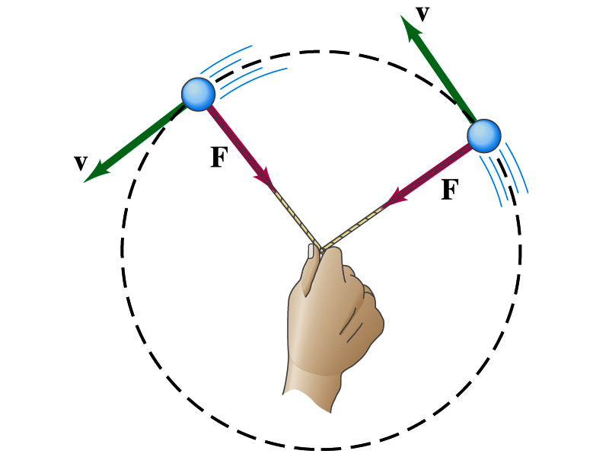
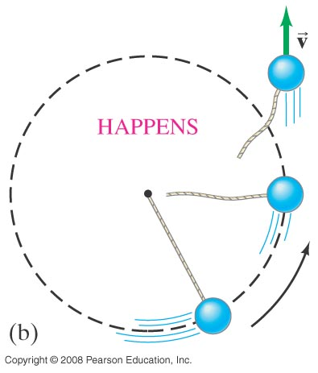
Newton’s Second Law & Centripetal Force
The centripetal * acceleration is always perpendicular to the velocity vector, v, and points to the center of the axis (radial direction) in a uniform circular motion.
Are there forces in this motion? If so, what do they do?
The force that causes the centripetal acceleration acts toward the center of the circular path and causes the change in the direction of the velocity vector. This force is called the centripetal force.
What do you think will happen to the ball if the string that holds the ball breaks?
The external force no longer exist. Therefore, based on Newton’s 1st law, the ball will continue its motion without changing its velocity and will fly away following the tangential direction to the circle.
*Mirriam Webster: Proceeding or acting in the direction toward the center or axis

Slide 6
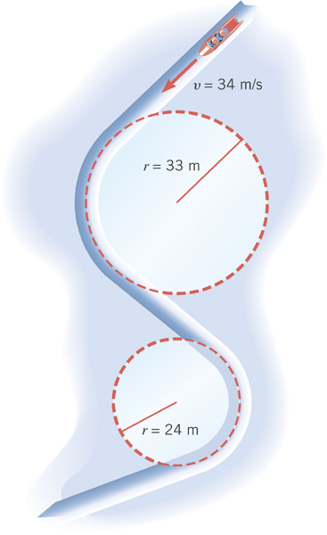
Ex. Effect of Radius on Centripetal Acceleration
The bobsled track at the 1994 Olympics in Lillehammer, Norway, contain turns with radii of 33m and 23m. Find the centripetal acceleration at each turn for a speed of 34m/s, a speed that was achieved in the two–man event. Express answers as multiples of g=9.8m/s².
Centripetal acceleration:
R=33m
R=24m

Slide 7
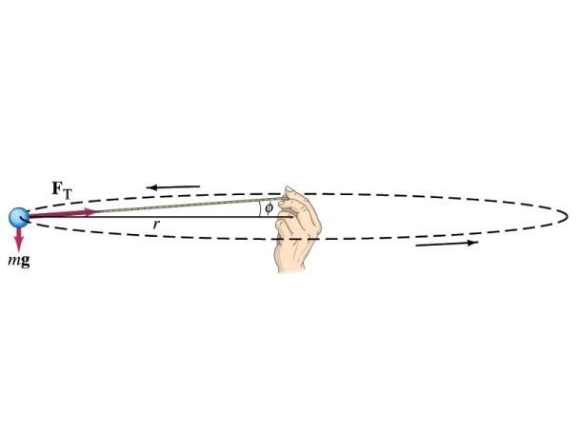
Example 5.3: Uniform Circular Motion
A ball of mass 0.500kg is attached to the end of a 1.50m long cord. The ball is moving in a horizontal circle. If the string can withstand maximum tension of 50.0 N, what is the maximum speed the ball can attain before the cord breaks?
Centripetal acceleration:
When does the string break?
when the required centripetal force is greater than the sustainable tension.
Calculate the tension of the cord when speed of the ball is 5.00m/s.

Slide 8
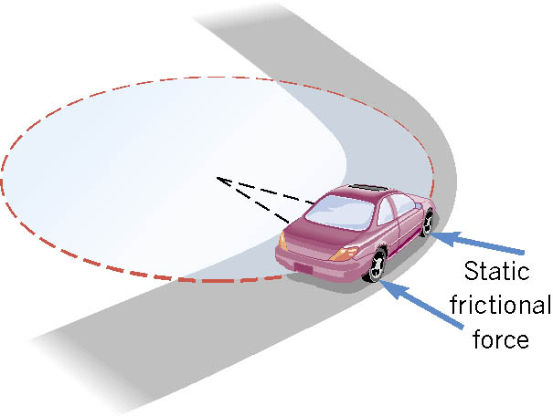
Unbanked Curve and Centripetal Force
On an unbanked curve, the static frictional force provides the centripetal force.

Slide 9
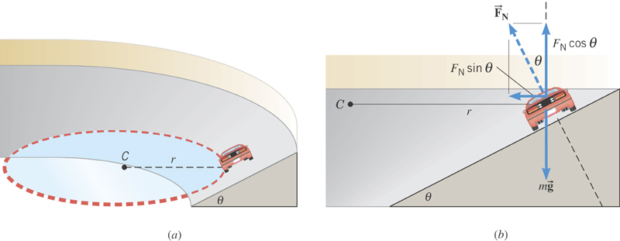
Banked Curves
On a frictionless banked curve, the centripetal force is the
horizontal component of the normal force. The vertical
component of the normal force balances the car’s weight.

Slide 10
Ex. The Daytona 500
The Daytona 500 is the major event of the NASCAR season. It is held at the Daytona International Speedway in Daytona, Florida. The turns in this oval track have a maximum radius (at the top) of r=316m and are banked steeply, with θ=31º. Suppose these maximum radius turns were frictionless. At what speed would the cars have to travel around them?
x comp.
y comp.
y
x

Slide 11
Newton’s Law of Universal Gravitation
People have been very curious about the stars in the sky, making observations for a long~ time. The data people collected, however, have not been explained until Newton has discovered the law of gravitation.
Every object in the Universe attracts every other object with a force that is directly proportional to the product of their masses and inversely proportional to the square of the distance between them.
How would you write this law mathematically?
With G
G is the universal gravitational constant, and its value is
Unit?
This constant is not given by the theory but must be measured by experiments.
This form of forces is known as the inverse-square law, because the magnitude of the force is inversely proportional to the square of the distance between the objects.

Slide 12
Ex. Gravitational Attraction
What is the magnitude of the gravitational force that acts on each particle in the figure, assuming m₁=12kg, m₂=25kg, and r=1.2m?

Slide 13
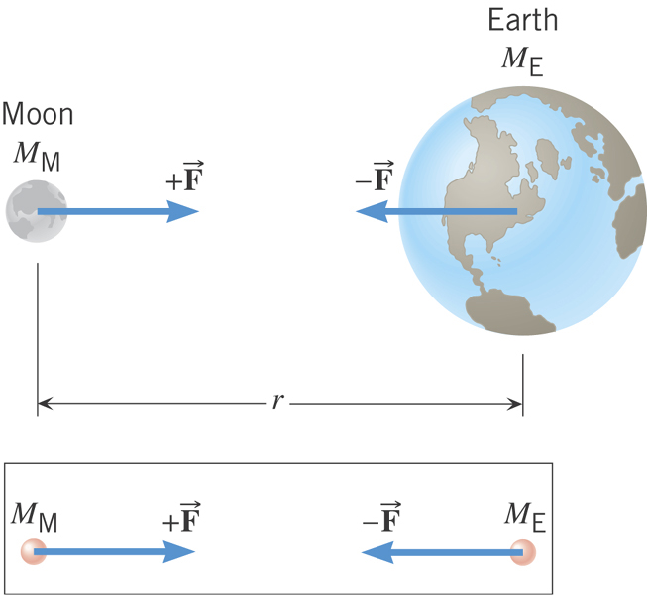
Why does the Moon orbit the Earth?

Slide 14
Gravitational Force and Weight
The attractive force exerted on an object by the Earth
Gravitational Force, F_{g}
Weight of an object with mass M is
What is the SI unit of weight?
N
Since weight depends on the magnitude of gravitational acceleration, g, it varies depending on geographical location.
By measuring the forces one can determine masses. This is why you can measure mass using the spring scale.

Slide 15
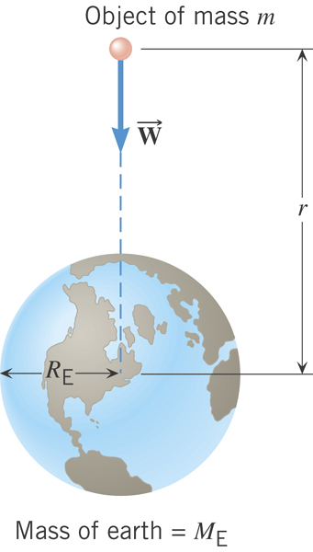
Gravitational Acceleration
Gravitational acceleration at distance r from the center of the earth!
What is the SI unit of g?
m/s²

Slide 16
Magnitude of the gravitational acceleration on the surface of the Earth
Gravitational force on the surface of the earth:

Slide 17
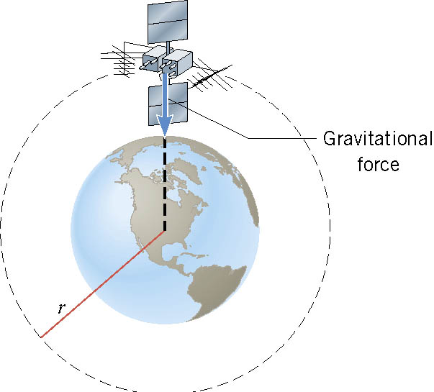
Satellite in Circular Orbits
There is only one speed that a satellite can have if the satellite is to remain in an orbit with a fixed radius.
What acts as the centripetal force?
The gravitational force of the earth pulling the satellite!

Slide 18
Ex. Orbital Speed of the Hubble Space Telescope
Determine the speed of the Hubble Space Telescope orbiting at a height of 598 km above the earth’s surface.

