Slide 1
PHYS 1441 – Section 001 Lecture #11
Tuesday, June 30, 2015
Dr. Jaehoon Yu
Newton’s Law of Universal Gravitation
Weightlessness
Work done by a constant force
Multiplication of Vectors
Work-Kinetic Energy Theorem
Today’s homework is homework #7, due 11pm, Friday, July 3!!

Slide 2
Announcements
Term exam #2
In class this Thursday, July 2
Non-comprehensive exam
Covers CH 4.6 to what we finish tomorrow Wednesday, July 1
Bring your calculator but DO NOT input formula into it!
Your phones or portable computers are NOT allowed as a replacement!
You can prepare a one 8.5x11.5 sheet (front and back) of handwritten formulae and values of constants for the exam ➔ no solutions, derivations, word definitions or key methods for solutions
No additional formulae or values of constants will be provided!
I am in physics chair’s office (SH108) through the remainder of this course

Slide 3
Reminder: Special Project #4
Compute the gravitational force between two protons separates by 1m. (10 points)
Compute the electric force between the two protons separated by 1m. (10 points)
Express the electric force in #2 above in terms of the gravitational force in #1. (5 points)
You must look up the mass of the proton, the electrical charge of the proton in coulombs, electrical force constant, electric force formula, etc, and clearly write them on your project report
You MUST have your own, independent answers to the above three questions even if you worked together with others. All those who share the answers will get 0 credit if copied.
Due for the submission is Monday, July 6!

Slide 4
Period of a Satellite in an Orbit
Speed of the satellite
Square either side and solve for T2
Period of a satellite
Kepler’s 3rd Law
This is applicable to any satellite or even for planets and moons.

Slide 5
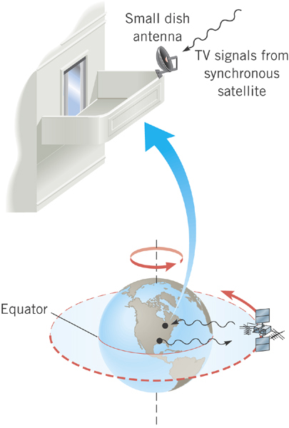
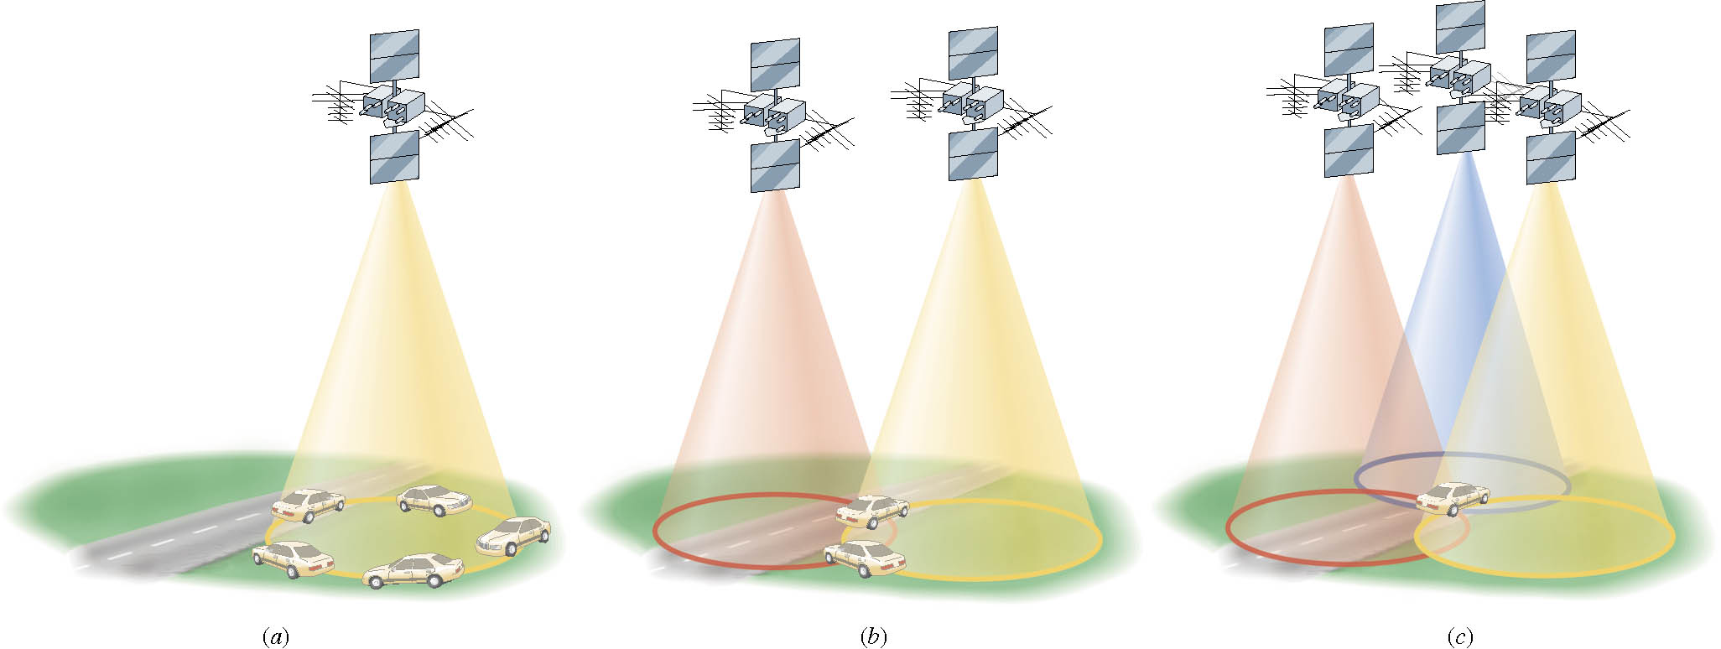
Geo-synchronous Satellites
Global Positioning System (GPS)
Satellite TV
What period should these satellites have?
The same as the earth!!
24 hours
What altitude must they be?

Slide 6
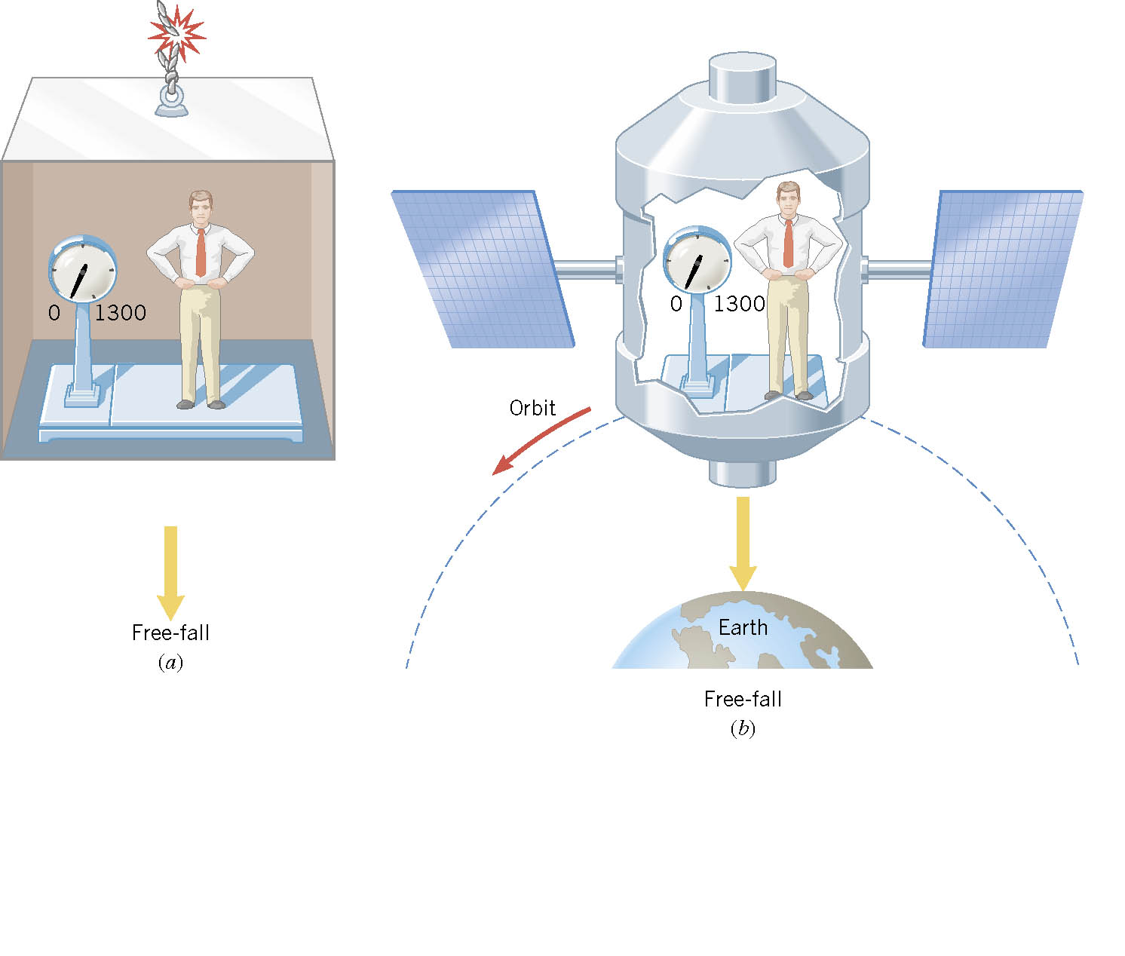
Ex. Apparent Weightlessness and Free Fall
0
0
In each case, what is the weight recorded by the scale?

Slide 7
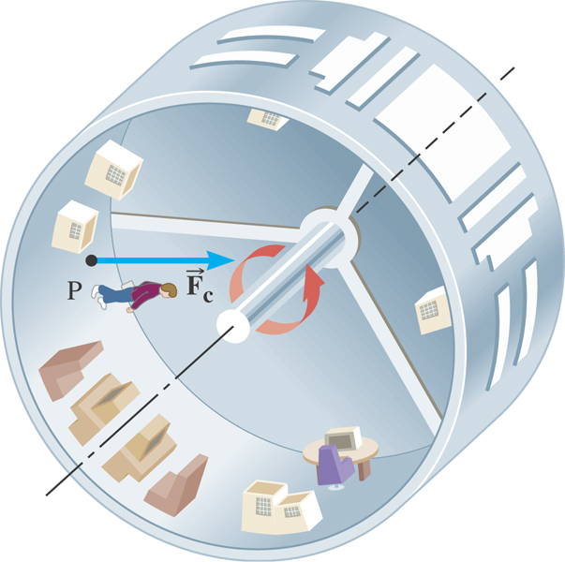
Ex. Artificial Gravity
At what speed must the surface of the space station move so that the astronaut experiences a push on his feet equal to his weight on earth? The radius is 1700 m.

Slide 8
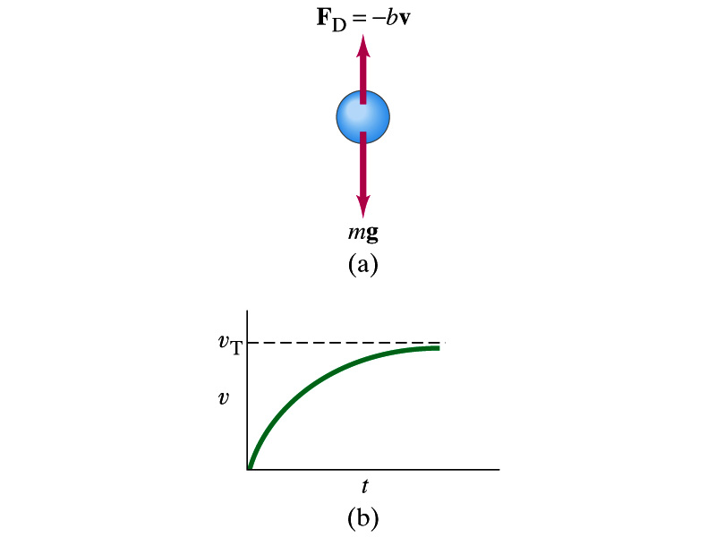
Motion in Resistive Forces
Medium can exert resistive forces on an object moving through it due to viscosity or other types frictional properties of the medium.
Some examples?
Air resistance, viscous force of liquid, etc
These forces are exerted on moving objects in opposite direction of the movement.
These forces are proportional to such factors as speed. They almost always increase with increasing speed.
Two different cases of proportionality:
Forces linearly proportional to speed: Slowly moving or very small objects
Forces proportional to square of speed: Large objects w/ reasonable speed
Terminal speed

Slide 9
Work Done by a Constant Force
A meaningful work in physics is done only when the net forces exerted on an object changes the energy of the object.
y
F
Free Body
Diagram
θ
M
M
θ
x
d
Which force did the work?
Force
Why?
What kind?
Scalar
Unit?
How much work did it do?
What does this mean?
Physically meaningful work is done only by the component of the force along the movement of the object.
Work is an energy transfer!!

Slide 10
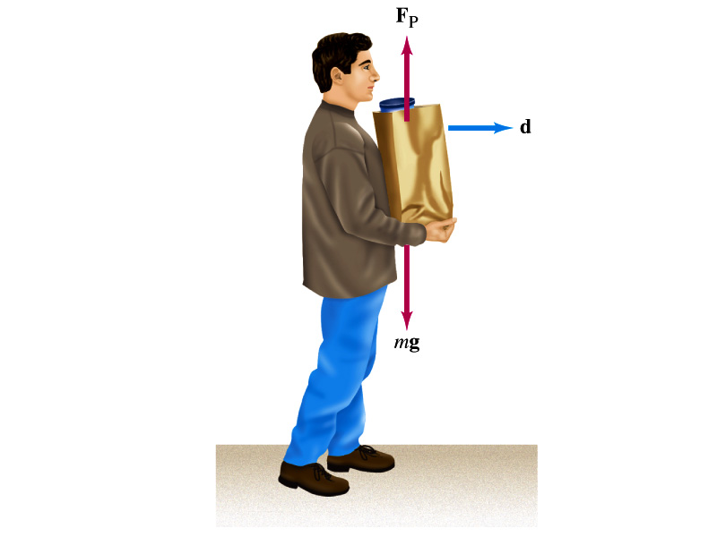
Let’s think about the meaning of work!
A person is holding a grocery bag and walking at a constant velocity.
Are his hands doing any work ON the bag?
No
Why not?
Because the force hands exert on the bag, F_{p}, is perpendicular to the displacement!!
This means that hands are not adding any energy to the bag.
So what does this mean?
In order for a force to perform any meaningful work, the energy of the object the force exerts on must change due to that force!!
What happened to the person?
He spends his energy just to keep the bag up but did not perform any work on the bag.

Slide 11
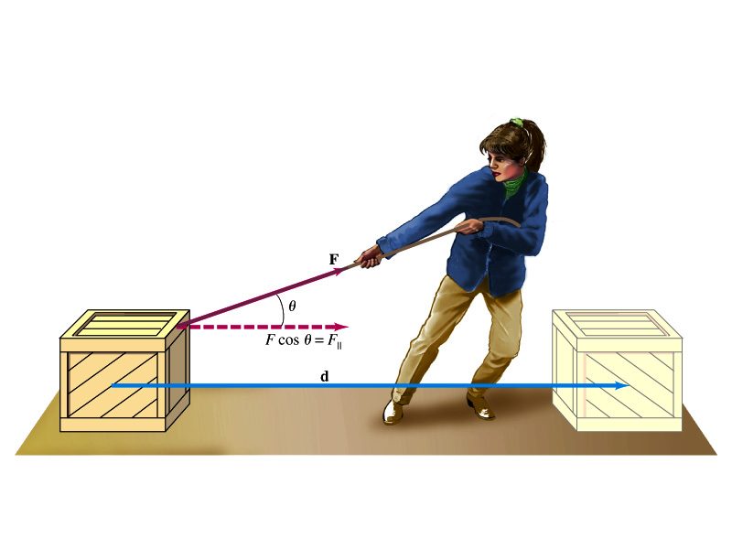
Work done by a constant force
s

Slide 12
Scalar Product of Two Vectors
Product of magnitude of the two vectors and the cosine of the angle between them
Operation is commutative
Operation follows the distribution law of multiplication
Scalar products of Unit Vectors
How does scalar product look in terms of components?
=0

Slide 13
Example of Work by the Scalar Product
A particle moving on the xy plane undergoes a displacement d=(2.0i+3.0j)m as a constant force F=(5.0i+2.0j) N acts on the particle.
Y
a) Calculate the magnitude of the displacement and that of the force.
F
d
X
b) Calculate the work done by the force F.
Can you do this using the magnitudes and the angle between d and F?

Slide 14
Ex. Pulling A Suitcase-on-Wheel
Find the work done by a 45.0N force in pulling the suitcase in the figure at an angle 50.0º for a distance s=75.0m.
Does work done by the same force depend on mass of the object being worked on?
NO
What does the mass do then?
Since the force is the same, the amount of the work done by the force on the object through the same displacement is the same. The only difference by the mass is the time needed to reach the same displacement.

Slide 15
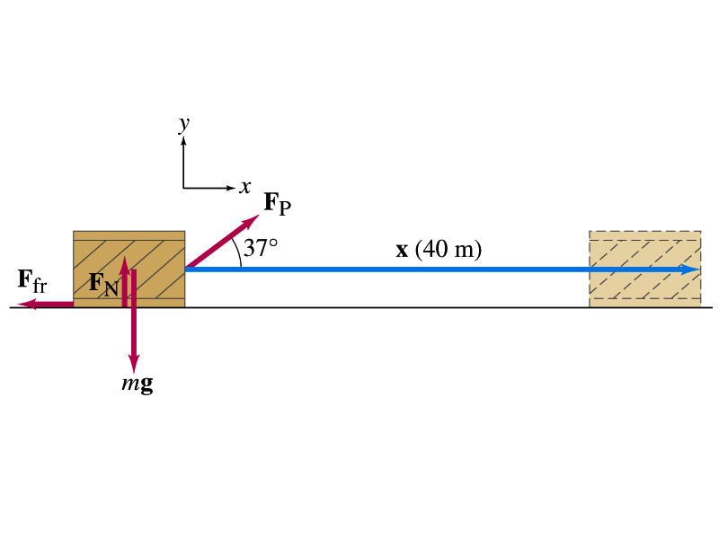
Ex. 6.1 Work done on a crate
A person pulls a 50kg crate 40m along a horizontal floor by a constant force F_{p}=100N, which acts at a 37º angle as shown in the figure. The floor is rough and exerts a friction force F_{fr}=50N. Determine (a) the work done by each force and (b) the net work done on the crate.
What are the forces exerting on the crate?
F_{p}
F_{fr}
F_{G}=-mg
F_{N}=+mg
Which force performs the work on the crate?
F_{p}
F_{fr}
Work done on the crate by F_{G}
Work done on the crate by F_{N}
Work done on the crate by F_{p}:
Work done on the crate by F_{fr}:
So the net work on the crate
This is the same as

