Slide 1
PHYS 1441 – Section 001
Lecture #12
Wednesday, July 1, 2015
Dr. Jaehoon Yu
Work-Kinetic Energy Theorem
  Work and Energy Involving Kinetic Friction
  Gravitational Potential Energy
  Elastic Potential Energy
  Mechanical Energy Conservation
  Power
Tomorrow’s homework is homework #8, due 11pm, Tuesday, July 7!!

Slide 2
Announcements
Term exam #2
  In class tomorrow Thursday, July 2
  Non-comprehensive exam
  Covers CH 4.6 to what we finish today
  Bring your calculator but DO NOT input formula into it!
    Your phones or portable computers are NOT allowed as a replacement!
  You can prepare a one 8.5x11.5 sheet (front and back) of handwritten formulae and values of constants for the exam ➔ no solutions, derivations, word definitions or key methods for solutions
    No additional formulae or values of constants will be provided!
Quiz 3 results
  Class average: 23/35
    Equivalent to 65.4/100
    Previous quizzes: 75/100 and 51/100
  Top score: 38/35

Slide 3
Reminder: Special Project #4
Compute the gravitational force between two protons separates by 1m. (10 points)
Compute the electric force between the two protons separated by 1m. (10 points)
Express the electric force in #2 above in terms of the gravitational force in #1. (5 points)
You must look up the mass of the proton, the electrical charge of the proton in coulombs, electrical force constant, electric force formula, etc, and clearly write them on your project report
You MUST have your own, independent answers to the above three questions even if you worked together with others. All those who share the answers will get 0 credit if copied.
Due for the submission is Monday, July 6!

Slide 4
Special Project #5
A ball of mass M at rest is dropped from the height h above the ground onto a spring on the ground, whose spring constant is k. Neglecting air resistance and assuming that the spring is in its equilibrium, express, in terms of the quantities given in this problem and the gravitational acceleration g, the distance x of which the spring is pressed down when the ball completely loses its energy. (10 points)
Find the x above if the ball’s initial speed is v_{i}. (10 points)
Due for the project is this Wednesday, July 8
You must show the detail of your OWN work in order to obtain any credit.

Slide 5
Work Done by a Constant Force
A meaningful work in physics is done only when the net forces acting on an object changes the energy of the object.
y
F
Free Body
Diagram
θ
M
M
θ
x
d
Work done by the force F is defined as
Unit?
What kind?
Scalar
Physically meaningful work is done only by the component of the force along the movement of the object and it changed the energy of the object it exerts on

Slide 6
How to compute the work?
Identify all forces (vector!!) involved in the motion
Draw a free-body diagram with the tails of all force vectors exerting on the object at one point with proper directions
  Optional: Compute the net force using x and y components of all forces (it usually works better if positive x direction aligns with the direction of the motion)
Identify the displacement vector
If components of all forces and displacements are given, use the component formula to compute the work by each force, keeping the proper signs
If magnitudes and the angle of all forces and displacements are given use the magnitude and angle formula (easier to use the net force in this case), keeping the signs properly
If more than one force act, add all work to obtain the overall amount of work performed on the object

Slide 7
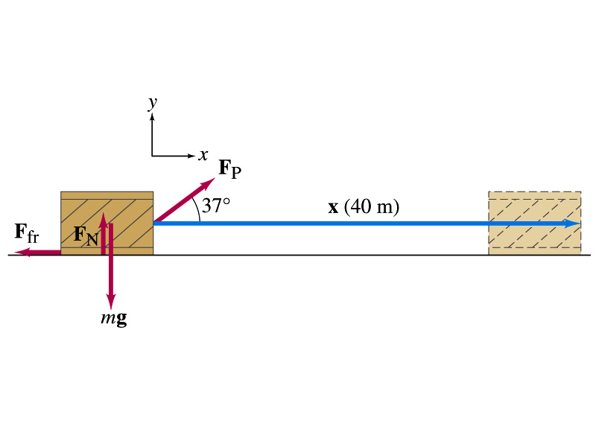
Ex. 6.1 Work done on a crate
A person pulls a 50kg crate 40m along a horizontal floor by a constant force F_{p}=100N, which acts at a 37º angle as shown in the figure. The floor is rough and exerts a friction force F_{fr}=50N. Determine (a) the work done by each force and (b) the net work done on the crate.
What are the forces exerting on the crate?
F_{p}
F_{fr}
F_{G}=-mg
F_{N}
Which force performs the work on the crate?
F_{p}
F_{fr}
Work done on the crate by F_{G}
Work done on the crate by F_{N}
Work done on the crate by F_{p}
Work done on the crate by F_{fr}
So the net work on the crate
This is the same as

Slide 8
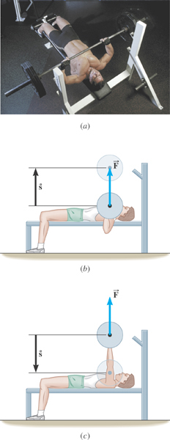
Ex. Bench Pressing and The Concept of Negative Work
A weight lifter is bench-pressing a barbell whose weight is 710N a distance of 0.65m above his chest. Then he lowers it the same distance. The weight is raised and lowered at a constant velocity. Determine the work done by the weight lifter in the two cases.
What is the angle between the force and the displacement?
What does the negative work mean?
The gravitational force does the work on the weight lifter!

Slide 9
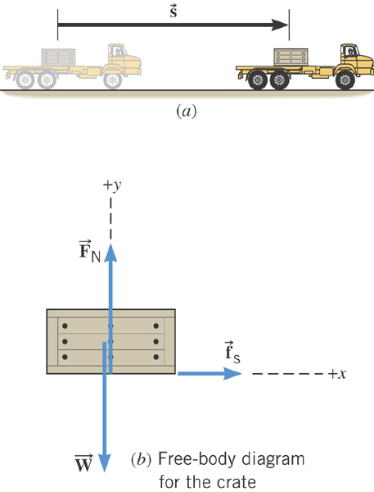
Ex. Accelerating a Crate
A truck is accelerating at the rate of +1.50 m/s². The mass of the crate is 120-kg and it does not slip. The magnitude of the displacement is 65 m. What is the total work done on the crate by all of the forces acting on it?
What are the forces acting on the crate in this motion?
Gravitational force on the crate, weight, W or F_{g}
Normal force force on the crate, F_{N}
Static frictional force on the crate, f_{s}

Slide 10
Ex. Continued…
Lets figure out what the work done by each of the forces in this motion is.
Work done by the gravitational force on the crate, W or F_{g}
Work done by Normal force force on the crate, F_{N}
Work done by the static frictional force on the crate, f_{s}
Which force did the work?
Static frictional force on the crate, f_{s}
How?
By holding on to the crate so that it moves with the truck!

Slide 11
Kinetic Energy and Work-Kinetic Energy Theorem
Some problems are hard to solve using Newton’s second law
  If forces acting on an object during the motion are complicated
  Relate the work done on the object by the net force to the change of the speed of the object
ΣF
Suppose net force ΣF acted on an object for the displacement d to increase its speed from v_{i} to v_{f}.
M
M
v_{i}
v_{f}
The work on the object by the net force ΣF is
s
Using the kinematic equation of motion
Kinetic Energy
Work
Work
Work done by the net force causes change in the object’s kinetic energy.
Work-Kinetic Energy Theorem

Slide 12
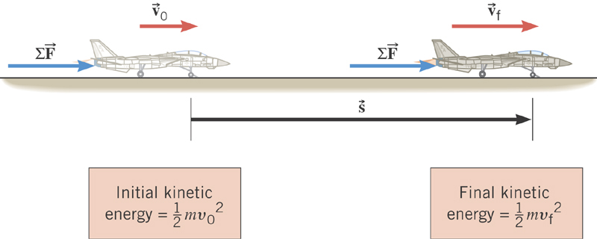
Work-Kinetic Energy Theorem
When a net external force by the jet engine does work on an object, the kinetic energy of the object changes according to

Slide 13
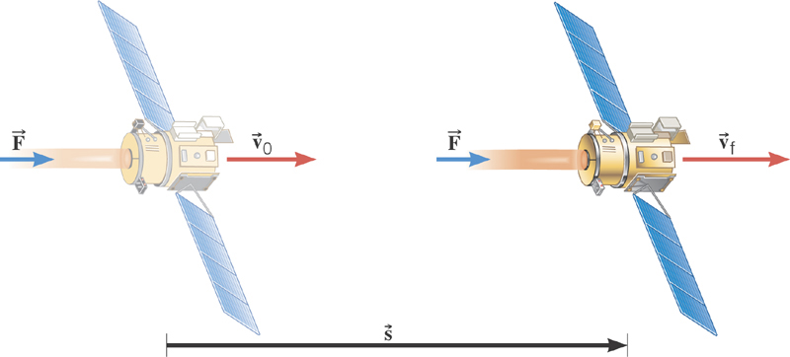
Ex. Deep Space 1
The mass of the space probe is 474-kg and its initial velocity is 275 m/s. If a 56.0-mN force acts on the probe parallel through a displacement of 2.42×10⁹m, what is its final speed?
Solve for v_{f}

Slide 14
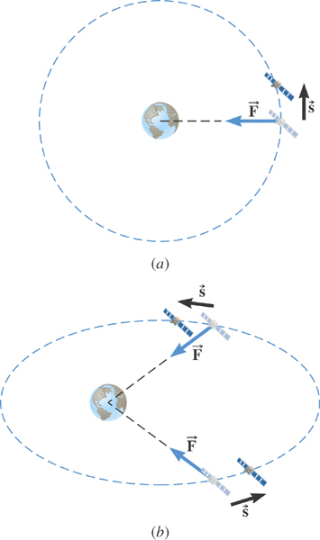
Ex. Satellite Motion and Work By the Gravity
A satellite is moving about the earth in a circular orbit and an elliptical orbit. For these two orbits, determine whether the kinetic energy of the satellite changes during the motion.
For a circular orbit
No change!
Why not?
Gravitational force is the only external force but it is perpendicular to the displacement. So no work.
For an elliptical orbit
Changes!
Why?
Gravitational force is the only external force but its angle with respect to the displacement varies. So it performs work.

Slide 15
Potential Energy
Energy associated with a system of objects ➔ Stored energy which has the potential or the possibility to work or to convert to kinetic energy
In order to describe potential energy, U, a system must be defined.
What does this mean?
The concept of potential energy can only be used under the special class of forces called the conservative force which results in the principle of conservation of mechanical energy.
What are the forms of energies in the universe?
Mechanical Energy
Chemical Energy
Biological Energy
Electromagnetic Energy
Nuclear Energy
Thermal Energy
These different types of energies are stored in the universe in many different forms!!!
If one takes into account ALL forms of energy, the total energy in the entire universe is conserved. It just transforms from one form to another.

Slide 16
Gravitational Potential Energy
This potential energy is given to an object by the gravitational field in the system of Earth by virtue of the object’s height from an arbitrary zero level
When an object is falling, the gravitational force, mg, performs the work on the object, increasing the object’s kinetic energy. So the potential energy of an object at a height y, the potential to do work, is expressed as
m
h_{i}
mg
m
The work done on the object by the gravitational force as the brick drops from y_{i} to y_{f} is:
h_{f}
(since )
What does this mean?
Work by the gravitational force as the brick drops from y_{i} to y_{f} is the negative change of the system’s potential energy
➔ Potential energy was spent in order for the gravitational force to increase the brick’s kinetic energy.

Slide 17
Example for Potential Energy
A bowler drops a bowling ball of mass 7kg on his toe. Choosing the floor level as y=0, estimate the total work done on the ball by the gravitational force as the ball falls on the toe.
Let’s assume that the top of the toe is 3cm from the floor and the hand was at 50cm above the floor.
M
The kinetic energy of a 60g bullet flying at 33m/s (100fts) or 119km/hr.
b) Perform the same calculation using the top of the bowler’s head as the origin.
What has to change?
First we must re-compute the positions of the ball in his hand and on his toe.
Assuming the bowler’s height is 1.8m, the ball’s original position is –1.3m, and the toe is at –1.77m.

