Slide 1
PHYS 1441 – Section 001
Lecture #13
Monday, July 6, 2015
Dr. Jaehoon Yu
Elastic Potential Energy
  Mechanical Energy Conservation
  Power
  Linear Momentum
  Linear Momentum, Impulse and Forces
  Linear Momentum Conservation

Slide 2
Announcements
Reading assignment: CH7.7
Quiz #4
  Beginning of the class Wednesday, July 8
  Covers CH 6.4 to what we finish tomorrow
  Bring your calculator but DO NOT input formula into it!
    Your phones or portable computers are NOT allowed as a replacement!
  You can prepare a one 8.5x11.5 sheet (front and back) of handwritten formulae and values of constants for the exam ➔ no solutions, derivations or definitions!
    No additional formulae or values of constants will be provided!
Bring your planetarium extra credit sheet by July 13
Student survey
Term 2 results
  Class average: 60.6/106
    Equivalent to: 57.2/100
    Previous results: 64.1/100 and 62.4/100
  Top score: 98/106

Slide 3
Reminder: Special Project #5
A ball of mass M at rest is dropped from the height h above the ground onto a spring on the ground, whose spring constant is k. Neglecting air resistance and assuming that the spring is in its equilibrium, express, in terms of the quantities given in this problem and the gravitational acceleration g, the distance x of which the spring is pressed down when the ball completely loses its energy. (10 points)
Find the x above if the ball’s initial speed is v_{i}. (10 points)
Due for the project is this Wednesday, July 8
You must show the detail of your OWN work in order to obtain any credit.

Slide 4
Special Project #6
Make a list of the rated power of all electric and electronic devices at your home and compiled them in a table. (2 points each for the first 10 items and 1 point for each additional item.)
  What is an item?
    Similar electric devices count as one item.
      All light bulbs make up one item, computers another, refrigerators, TVs, dryers (hair and clothes), electric cooktops, heaters, microwave ovens, electric ovens, dishwashers, etc.
      All you have to do is to count add all wattages of the light bulbs together as the power of the item
Estimate the cost of electricity for each of the items (taking into account the number of hours you use the device) on the table using the electricity cost per kWh of the power company that serves you and put them in a separate column in the above table for each of the items. (2 points each for the first 10 items and 1 point each additional items). Clearly write down what the unit cost of the power is per kWh above the table.
Estimate the the total amount of energy in Joules and the total electricity cost per month and per year for your home. (5 points)
Due: Beginning of the class Monday, July 13

Slide 5
Special Project Spread Sheet
Download this spread sheet from URL: http://www-hep.uta.edu/~yu/teaching/summer15-1441-001/
Just click the file with the name: sp6-spreadsheet.xlsx
Write down at the top your name and the charge per kwh by your electricity company

Slide 6
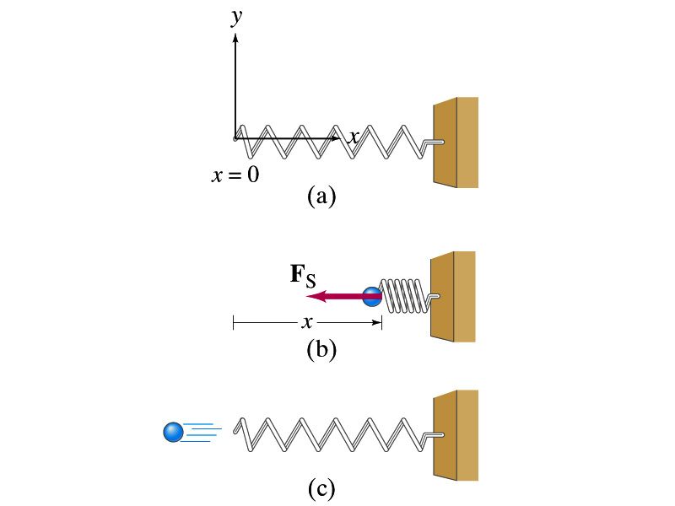
Elastic Potential Energy
Potential energy given to an object by a spring or an object with elasticity in the system that consists of an object and the spring.
The force spring exerts on an object when it is distorted from its equilibrium by a distance x is
Hooke’s Law
The work performed on the object by the spring is
The potential energy of this system is
What do you see from the above equations?
The work done on the object by the spring depends only on the initial and final position of the distorted spring.
Where else did you see this trend?
The gravitational potential energy, U_{g}
So what does this tell you about the elastic force?
A conservative force!!!

Slide 7
Conservative and Non-conservative Forces
The work done on an object by the gravitational force does not depend on the object’s path in the absence of a retardation force.
N
When directly falls, the work done on the object by the gravitation force is
m
l
h
When sliding down the hill of length l, the work is
mg
θ
How about if we lengthen the incline by a factor of 2, keeping the height the same??
Still the same amount of work☺
So the work done by the gravitational force on an object is independent of the path of the object’s motion. It only depends on the difference of the object’s initial and final position in the direction of the force.
Forces like gravitational and elastic forces are called the conservative force
If the work performed by the force does not depend on the path.
If the work performed on a closed path is 0.
Total mechanical energy is conserved!!

Slide 8
Conservation of Mechanical Energy
Total mechanical energy is the sum of kinetic and potential energies
Let’s consider a brick of mass m at the height h from the ground
What is the brick’s potential energy?
m
h
mg
What happens to the energy as the brick falls to the ground?
m
The brick gains speed
By how much?
h₁
So what?
The brick’s kinetic energy increased
And?
The lost potential energy is converted to kinetic energy!!
The total mechanical energy of a system remains constant in any isolated systems of objects that interacts only through conservative forces: Principle of mechanical energy conservation
What does this mean?

Slide 9
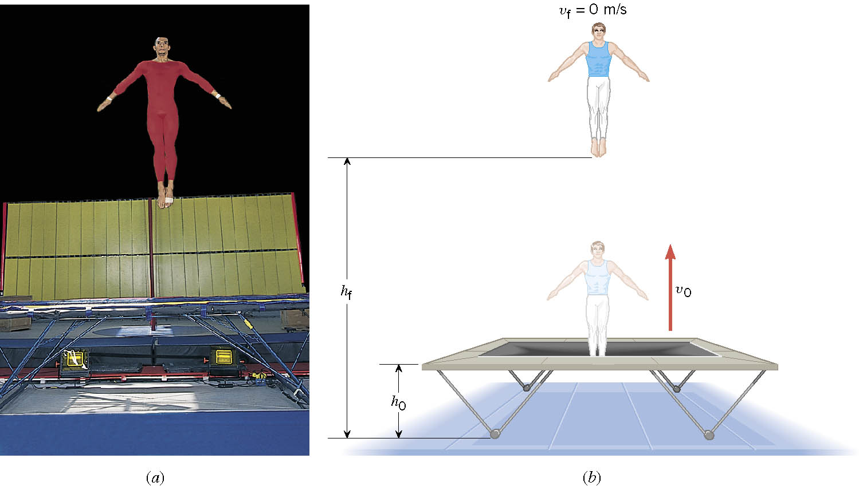
Ex. A Gymnast on a Trampoline
A gymnast leaves the trampoline at an initial height of 1.20 m and reaches a maximum height of 4.80 m before falling back down. What was the initial speed of the gymnast?

Slide 10
Ex. Continued
From the work-kinetic energy theorem
Work done by the gravitational force
Since at the maximum height, the final speed is 0. Using work-KE theorem, we obtain

Slide 11
Example
A ball of mass m at rest is dropped from the height h above the ground. a) Neglecting the air resistance, determine the speed of the ball when it is at the height y above the ground.
PE
KE
Using the principle of mechanical energy conservation
m
mgh
0
mv_{i}²/2
h
mg
m
mgy
mv²/2
mv_{f}²/2
b) Determine the speed of the ball at y if it had initial speed v_{i} at the time of the release at the original height h.
y
Again using the principle of mechanical energy conservation but with non-zero initial kinetic energy!!!
0
This result look very similar to a kinematic expression, doesn’t it? Which one is it?

Slide 12
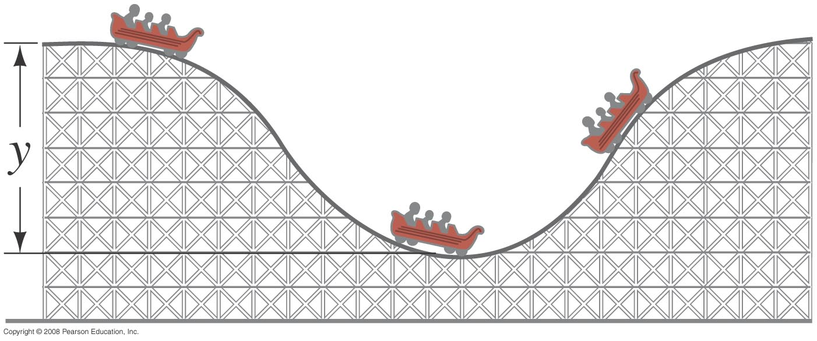
Ex. 6 – 8
Assuming the height of the hill in the figure is 40m, and the roller-coaster car starts from rest at the top, calculate (a) the speed if the roller coaster car at the bottom of the hill.
Using mechanical energy conservation
h
h₂
h₀
b) Determine at what height (h2) of the second hill it will have half the speed at the bottom?
Again using the principle of mechanical energy conservation but with non-zero initial kinetic energy!!!
Reorganize the terms
Solving for h₂-h₀

Slide 13
Power
Rate at which the work is done or the energy is transferred
  What is the difference for the same car with two different engines (4 cylinder and 8 cylinder) climbing the same hill?
  ➔ The time… 8 cylinder car climbs up the hill faster!
Is the total amount of work done by the engines different?
NO
Then what is different?
The rate at which the same amount of work performed is higher for 8 cylinders than 4.
Average power
Scalar quantity
Unit?
What do power companies sell?
Energy

Slide 14
Energy Loss in Automobile
Automobile uses only 13% of its fuel to propel the vehicle.
Why?
67% in the engine:
Incomplete burning
Heat
Sound
16% in friction with the road, air
4% in operating other crucial parts such as water pumps, alternator, etc
13% used for balancing energy loss related to moving the vehicle, like air resistance and road friction to tire, etc
Two frictional forces involved in moving vehicles
Coefficient of Rolling Friction; μ=0.016
Air Drag
Total Resistance
Total power to keep speed v=26.8m/s=60mi/h
Power to overcome each component of resistance

Slide 15
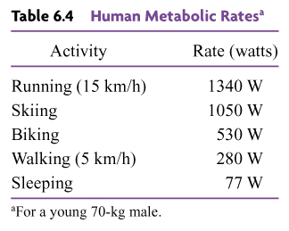
Human Metabolic Rates

Slide 16
Ex. The Power to Accelerate a Car
A 1.10x10³kg car, starting from rest, accelerates for 5.00s. The magnitude of the acceleration is a=4.60m/s². Determine the average power generated by the net force that accelerates the vehicle.
What is the force that accelerates the car?
Since the acceleration is constant, we obtain
From the kinematic formula
Thus, the average speed is
And, the average power is

