Slide 1
PHYS 1441 – Section 001
Lecture #15
Wednesday, July 8, 2015
Dr. Jaehoon Yu
Concept of the Center of Mass
  Center of Mass & Center of Gravity
  Fundamentals of the Rotational Motion
  Rotational Kinematics
  Equations of Rotational Kinematics
  Relationship Between Angular and Linear Quantities

Slide 2
Announcements
Reading Assignments: CH7.9 and 7.10
Final exam
  10:30am – 12:30pm, Monday, July 13, in this room
  Comprehensive exam, covers from CH1.1 – what we finish this Thursday, July 8, plus appendices A1 – A8
  Bring your calculator but DO NOT input formula into it!
    Your phones or portable computers are NOT allowed as a replacement!
  You can prepare a one 8.5x11.5 sheet (front and back) of handwritten formulae and values of constants for the exam ➔ no solutions, derivations or definitions!
    No additional formulae or values of constants will be provided!

Slide 3
Reminder: Special Project #6
Make a list of the rated power of all electric and electronic devices at your home and compiled them in a table. (2 points each for the first 10 items and 1 point for each additional item.)
  What is an item?
    Similar electric devices count as one item.
      All light bulbs make up one item, computers another, refrigerators, TVs, dryers (hair and clothes), electric cooktops, heaters, microwave ovens, electric ovens, dishwashers, etc.
      All you have to do is to count add all wattages of the light bulbs together as the power of the item
Estimate the cost of electricity for each of the items (taking into account the number of hours you use the device) on the table using the electricity cost per kWh of the power company that serves you and put them in a separate column in the above table for each of the items. (2 points each for the first 10 items and 1 point each additional items). Clearly write down what the unit cost of the power is per kWh above the table.
Estimate the the total amount of energy in Joules and the total electricity cost per month and per year for your home. (5 points)
Due: Beginning of the class Monday, July 13

Slide 4
Special Project Spread Sheet
Download this spread sheet from URL: http://www-hep.uta.edu/~yu/teaching/summer15-1441-001/
Just click the file with the name: sp6-spreadsheet.xlsx
Write down at the top your name and the charge per kwh by your electricity company

Slide 5
Center of Mass
We’ve been solving physical problems treating objects as sizeless points with masses, but in realistic situations objects have shapes with masses distributed throughout the body.
Center of mass of a system is the average position of the system’s mass and represents the motion of the system as if all the mass is on that point.
What does above statement tell you concerning the forces being exerted on the system?
The total external force exerted on the system of total mass M causes the center of mass to move at an acceleration given by as if the entire mass of the system is on the center of mass.
Consider a massless rod with two balls attached at either end.
m₁
m₂
x₁
x₂
The position of the center of mass of this system is the mass averaged position of the system
x_{CM}
CM is closer to the heavier object

Slide 6
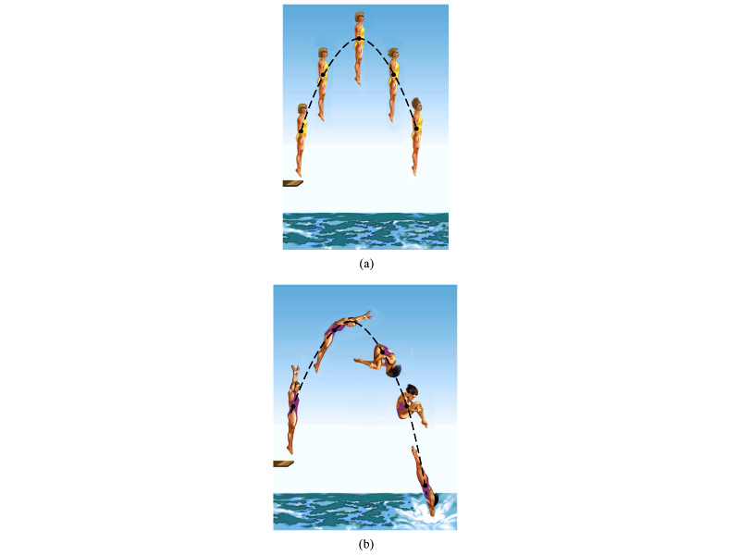
Motion of a Diver and the Center of Mass
Diver performs a simple dive.
The motion of the center of mass follows a parabola since it is a projectile motion.
Diver performs a complicated dive.
The motion of the center of mass still follows the same parabola since it still is a projectile motion.
The motion of the center of mass of the diver is always the same.

Slide 7
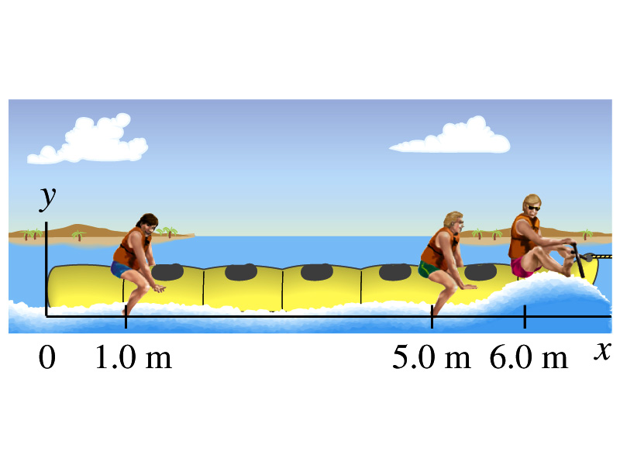
Ex. 7 – 12 Center of Mass
Thee people of roughly equivalent mass M on a lightweight (air-filled) banana boat sit along the x axis at positions x₁=1.0m, x₂=5.0m, and x₃=6.0m. Find the position of CM.
Using the formula for CM

Slide 8
Example for Center of Mass in 2-D
A system consists of three particles as shown in the figure. Find the position of the center of mass of this system.
Using the formula for CM for each position vector component
y=2
m₁
(0,2)
(x_{CM},y_{CM})
r_{CM}
(1,0)
(2,0)
m₂
m₃
x=1
x=2
One obtains
If

Slide 9
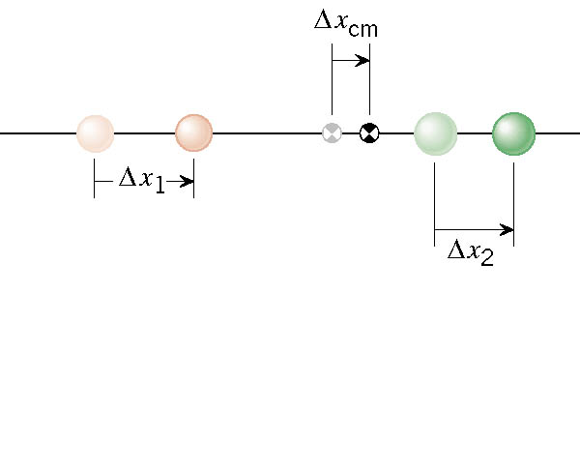
Velocity of the Center of Mass
In an isolated system, the total linear momentum does not change, therefore the velocity of the center of mass does not change.

Slide 10
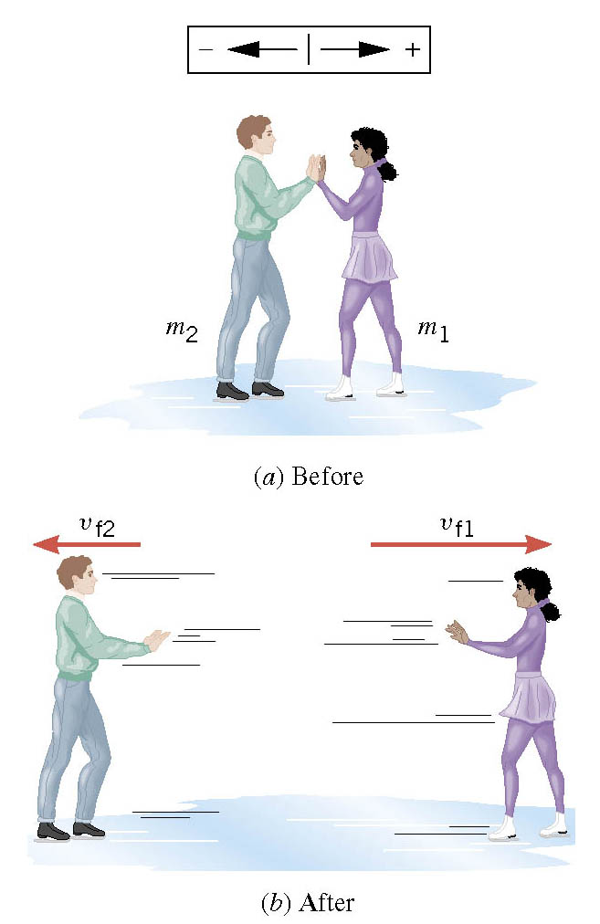
Another Look at the Ice Skater Problem
Starting from rest, two skaters push off against each other on ice where friction is negligible. One is a 54-kg woman and one is a 88-kg man. The woman moves away with a velocity of +2.5 m/s. What are the man’s velocity and that of the CM?

Slide 11
Center of Mass and Center of Gravity
CM
The center of mass of any symmetric object lies on the axis of symmetry and on any plane of symmetry, if the object’s mass is evenly distributed throughout the body.
Axis of symmetry
One can use gravity to locate CM.
Hang the object by one point and draw a vertical line following a plum-bob.
Hang the object by another point and do the same.
The point where the two lines meet is the CM.
How do you think you can determine the CM of the objects that are not symmetric?
Center of Gravity
Since a rigid object can be considered as a collection of small masses, one can see the total gravitational force exerted on the object as
Δm_{i}
What does this equation tell you?
The net effect of these small gravitational forces is equivalent to a single force acting on a point (Center of Gravity) with mass M.
Δm_{i}g
The CoG is the point in an object as if all the gravitational force is acting on!

Slide 12
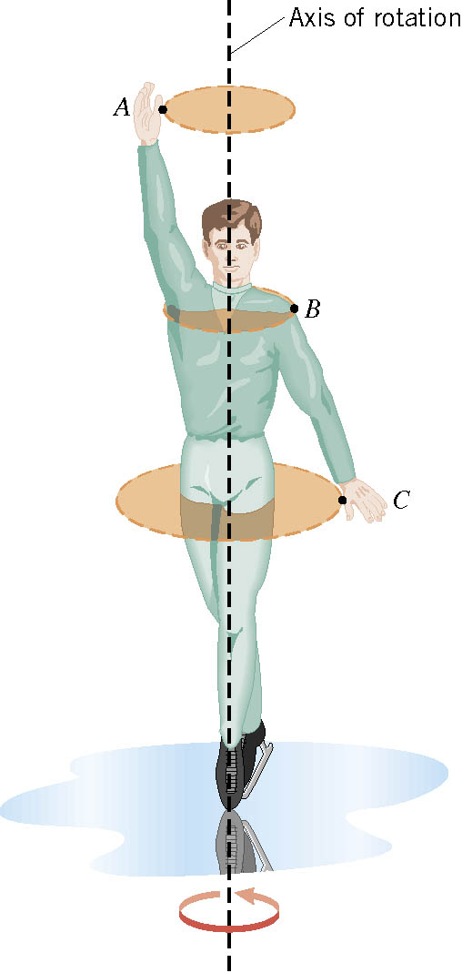
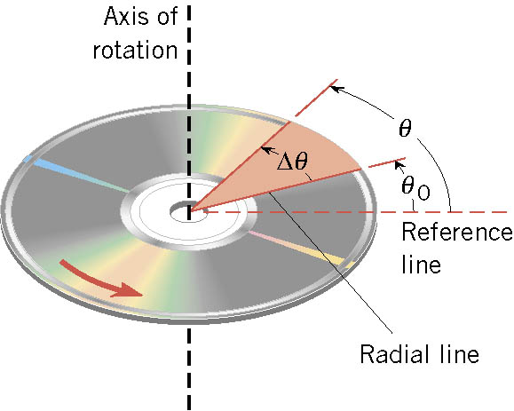
Rotational Motion and Angular Displacement
In the simplest kind of rotation, a point on a rigid object move on circular paths around an axis of rotation.
The angle swept out by the line passing through any point on the body and intersecting the axis of rotation perpendicularly is called the angular displacement.
It’s a vector!! So there must be a direction…
How do we define directions?
+:if counter-clockwise
-:if clockwise
The direction vector points gets determined based on the right-hand rule.
These are just conventions!!

Slide 13
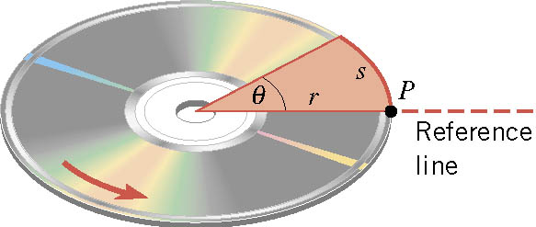

SI Unit of the Angular Displacement
Dimension?
None
For one full revolution:
Since the circumference of a circle is
2πr
One radian is an angle subtended by an arc of the same length as the radius!

Slide 14
Unit of the Angular Displacement
How many degrees are in one radian?
1 radian is
How radians is one degree?
And one degrees is
How many radians are in 10.5 revolutions?
Very important: In solving angular problems, all units, degrees or revolutions, must be converted to radians.

Slide 15
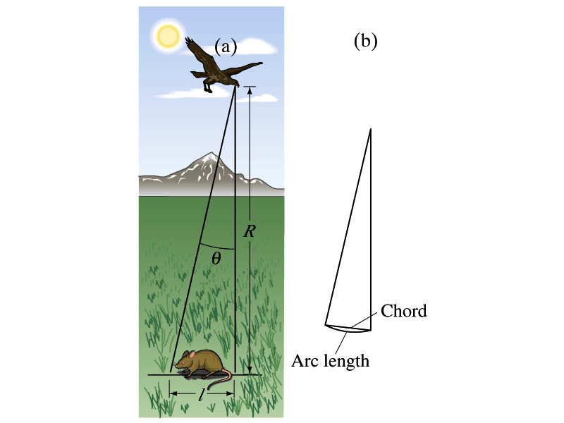
Example 8-2
A particular bird’s eyes can just distinguish objects that subtend an angle no smaller than about 3x10⁻⁴ rad. (a) How many degrees is this? (b) How small an object can the bird just distinguish when flying at a height of 100m?
(a) One radian is 360º/2π. Thus
(b) Since l=rθ and for small angle arc length is approximately the same as the chord length.

Slide 16
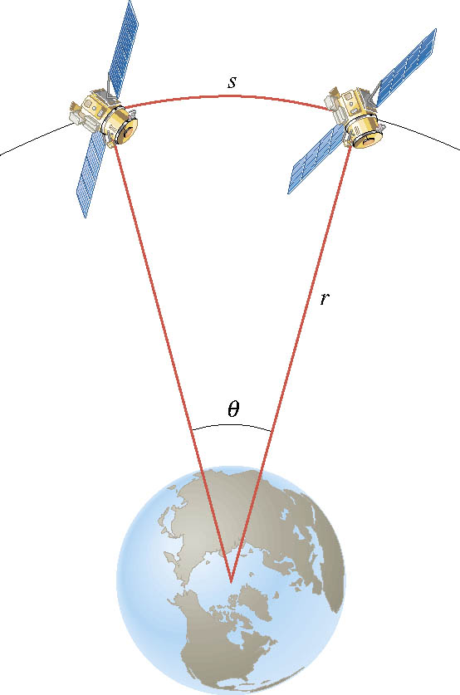
Ex. Adjacent Synchronous Satellites
Synchronous satellites are put into an orbit whose radius is 4.23×10⁷m. If the angular separation of the two satellites is 2.00 degrees, find the arc length that separates them.
What do we need to find out?
The arc length!!!
Convert degrees to radians

Slide 17
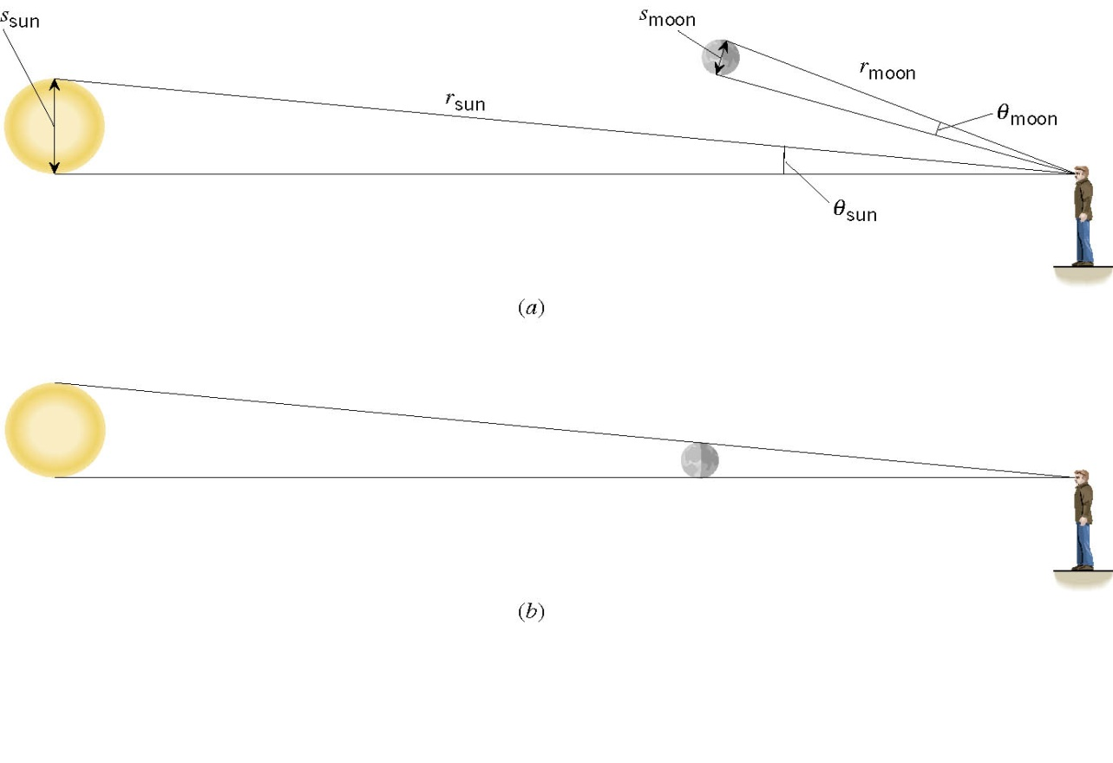
Ex. A Total Eclipse of the Sun
The diameter of the sun is about 400 times greater than that of the moon. By coincidence, the sun is also about 400 times farther from the earth than is the moon. For an observer on the earth, compare the angle subtended by the moon to the angle subtended by the sun and explain why this result leads to a total solar eclipse.
I can even cover the entire sun with my thumb!! Why?
Because the distance (r) from my eyes to my thumb is far shorter than that to the sun.

Slide 18
Angular Displacement, Velocity, and Acceleration
Angular displacement is defined as
θ_{f}
θ_{i}
How about the average angular velocity, the rate of change of angular displacement?
Unit?
rad/s
Dimension?
[T⁻¹]
By the same token, the average angular acceleration, rate of change of the angular velocity, is defined as…
Unit?
rad/s²
Dimension?
[T⁻²]
When rotating about a fixed axis, every particle on a rigid object rotates through the same angle and has the same angular speed and angular acceleration.

Slide 19
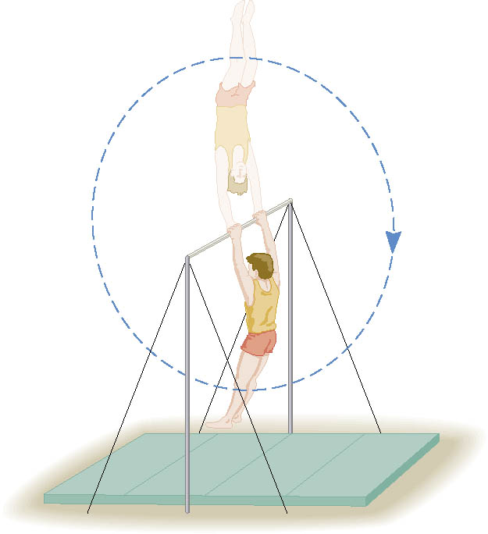
Ex. Gymnast on a High Bar
A gymnast on a high bar swings through two revolutions in a time of 1.90 s. Find the average angular velocity of the gymnast.
What is the angular displacement?
Why negative?
Because he is rotating clockwise!!

Slide 20
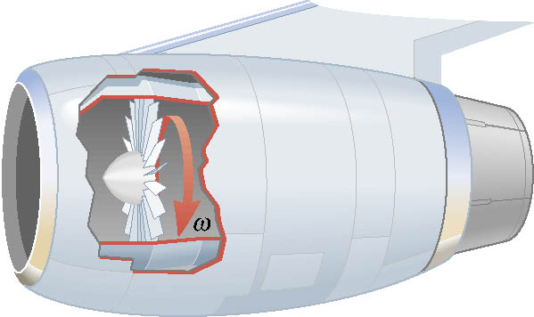
Ex. A Jet Revving Its Engines
As seen from the front of the engine, the fan blades are rotating with an angular velocity of -110 rad/s. As the
plane takes off, the angular velocity of the blades reaches -330 rad/s in a time of 14 s. Find the angular acceleration, assuming it to be constant.

Slide 21
Rotational Kinematics
The first type of motion we have learned in linear kinematics was under a constant acceleration. We will learn about the rotational motion under constant angular acceleration (α), because these are the simplest motions in both cases.
Just like the case in linear motion, one can obtain
Angular velocity under constant angular acceleration:
Translational kinematics
Angular displacement under constant angular acceleration:
Translational kinematics
One can also obtain
Translational kinematics

Slide 22
Rotational Kinematics Problem Solving Strategy
Visualize the problem by drawing a picture.
Write down the values that are given for any of the five kinematic variables and convert them to SI units.
  Remember that the unit of the angle must be in radians!!
Verify that the information contains values for at least three of the five kinematic variables. Select the appropriate equation.
When the motion is divided into segments, remember that the final angular velocity of one segment is the initial velocity for the next.
Keep in mind that there may be two possible answers to a kinematics problem.

Slide 23
Example for Rotational Kinematics
A wheel rotates with a constant angular acceleration of +3.50 rad/s². If the angular velocity of the wheel is +2.00 rad/s at t_{i}=0, a) through what angle does the wheel rotate in 2.00s?
Using the angular displacement formula in the previous slide, one gets

Slide 24
Example for Rotational Kinematics cnt’d
What is the angular velocity at t=2.00s?
Using the angular speed and acceleration relationship
Find the angle through which the wheel rotates between t=2.00 s and t=3.00 s.
Using the angular kinematic formula
At t=2.00s
At t=3.00s
Angular displacement

Slide 25
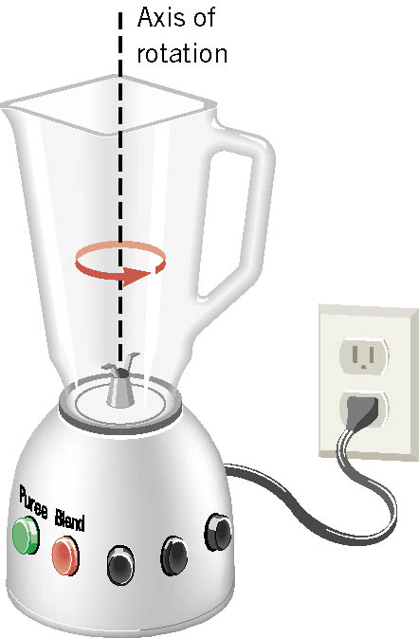
Ex. Blending with a Blender
The blade is whirling with an angular velocity of +375 rad/s when the “puree” button is pushed in. When the “blend” button is pushed, the blade accelerates and reaches a greater angular velocity after the blade has rotated through an angular displacement of +44.0 rad. The angular acceleration has a constant value of +1740 rad/s². Find the final angular velocity of the blade.
θ | α | ω | ω_{o} | t
+44.0rad
+1740rad/s²
?
+375rad/s
Which kinematic eq?
Which sign?
Why?
Because the blade is accelerating in counter-clockwise!

