Slide 1
PHYS 1441 – Section 001 Lecture #16
Thursday, July 9, 2015
Dr. Jaehoon Yu
Relationship Between Angular and Linear Quantities
Rolling Motion of a Rigid Body
Torque
Moment of Inertia
Angular Momentum & Its Conservation
Equilibrium

Slide 2
Announcements
Reading Assignments: CH8.9 and 9.3
Final exam
10:30am – 12:30pm, Monday, July 13, in this room
Comprehensive exam, covers from CH1.1 – CH9.3 plus appendices A1 – A8
Bring your calculator but DO NOT input formula into it!
Your phones or portable computers are NOT allowed as a replacement!
You can prepare a one 8.5x11.5 sheet (front and back) of handwritten formulae and values of constants for the exam ➔ no solutions, derivations or definitions!
No additional formulae or values of constants will be provided!
Quiz 4 results
Class average: 20.6/40
Equivalent to 51.5/100
Previous quizzes: 74.7/100, 50.8/100 and 65.4/100
Top score: 40/40

Slide 3
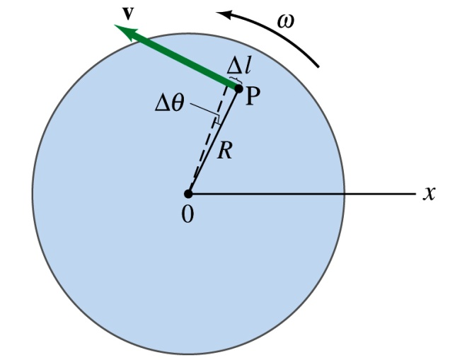
Relationship Between Angular and Linear Quantities
What do we know about a rigid object that rotates about a fixed axis of rotation?
Every particle (or masslet) in an object moves in a circle centered at the same axis of rotation with the same angular velocity.
When a point rotates, it has both the linear and angular components in its motion.
What is the linear component of the motion you see?
The direction of ω follows the right-hand rule.
Linear velocity along the tangential direction.
How do we related this linear component of the motion with angular component?
The arc-length is
So the tangential speed v is
What does this relationship tell you about the tangential speed of the points in the object and their angular speed?
Although every particle in the object has the same angular speed, its tangential speed differs and is proportional to its distance from the axis of rotation.
The farther away the particle is from the center of rotation, the higher the tangential speed.

Slide 4
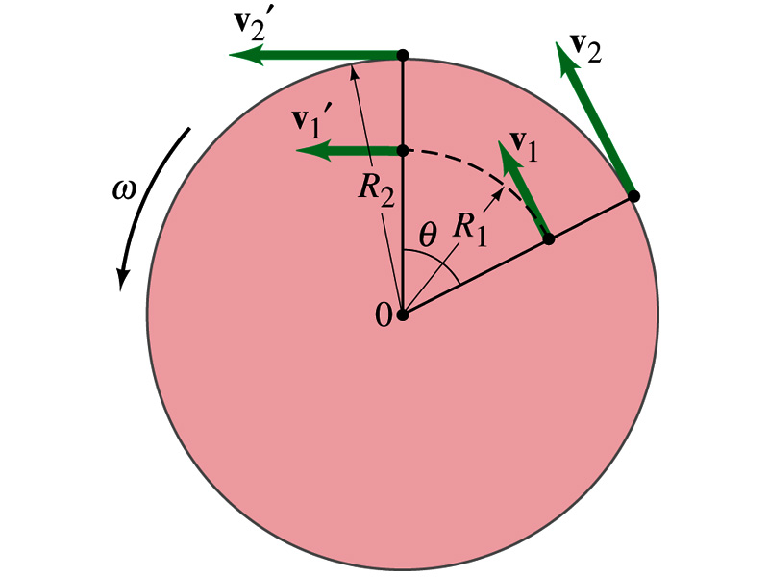
Is the lion faster than the horse?
A rotating carousel has one child sitting on the horse near the outer edge and another child on the lion halfway out from the center. (a) Which child has the greater linear speed? (b) Which child has the greater angular speed?
Linear speed is the distance traveled divided by the time interval. So the child sitting at the outer edge travels more distance within the given time than the child sitting closer to the center. Thus, the horse is faster than the lion.
(b) Angular speed is the angle traveled divided by the time interval. The angle both the children travel in the given time interval is the same. Thus, both the horse and the lion have the same angular speed.

Slide 5
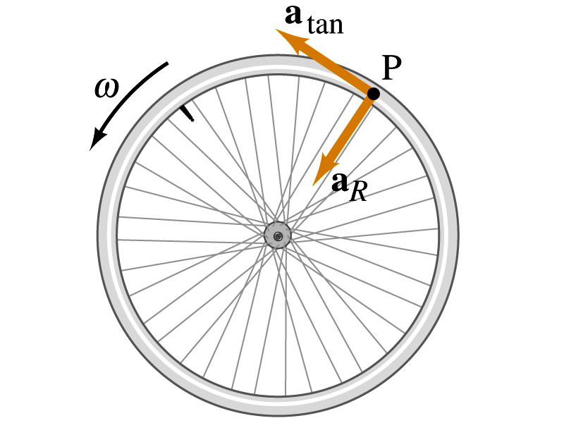
How about the acceleration?
How many different linear acceleration components do you see in a circular motion and what are they?
Two
Tangential, a_{t}, and the radial acceleration, a_{r}.
Since the tangential speed v is
The magnitude of tangential acceleration a_{t} is
What does this relationship tell you?
Although every particle in the object has the same angular acceleration, its tangential acceleration differs proportional to its distance from the axis of rotation.
The radial or centripetal acceleration a_{r} is
What does this tell you?
The father away the particle is from the rotation axis, the more radial acceleration it receives. In other words, it receives more centripetal force.
Total linear acceleration is

Slide 6
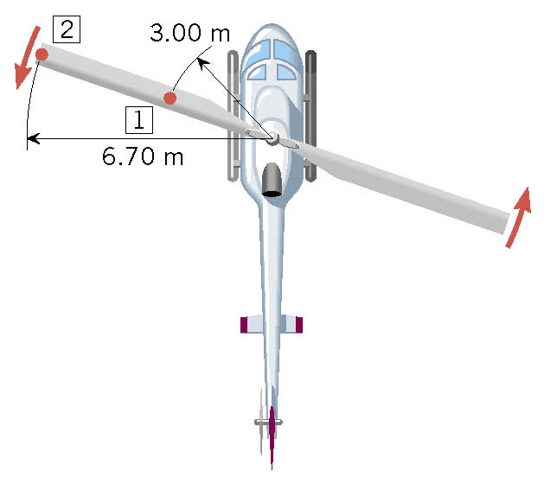
Ex. A Helicopter Blade
A helicopter blade has an angular velocity of +6.50 rev/s and an angular acceleration of +1.30 rev/s². For point 1 on the blade, find the magnitude of (a) the tangential speed and (b) the tangential acceleration.

Slide 7
Rolling Motion of a Rigid Body
What is a rolling motion?
A more generalized case of a motion where the rotational axis moves together with an object
A rotational motion about a moving axis
To simplify the discussion, let’s make a few assumptions
Limit our discussion on very symmetric objects, such as cylinders, spheres, etc
The object rolls on a flat surface
Let’s consider a cylinder rolling on a flat surface, without slipping.
Under what condition does this “Pure Rolling” happen?
The total linear distance the CM of the cylinder moved is
Thus the linear speed of the CM is
R
θ
s
s=Rθ
The condition for a “Pure Rolling motion”

Slide 8
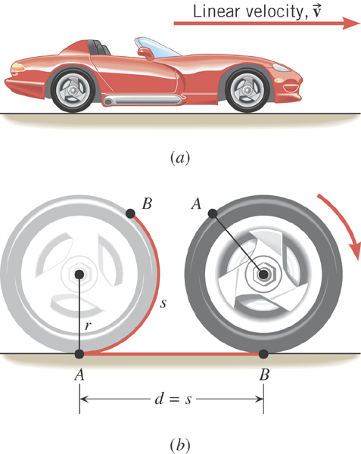
Ex. An Accelerating Car
Starting from rest, the car accelerates for 20.0 s with a constant linear acceleration of 0.800 m/s². The radius of the tires is 0.330 m. What is the angle through which each wheel has rotated?
θ | α | ω | ω_{o} | t
?
-2.42 rad/s²
0 rad/s
20.0 s

Slide 9
Torque
Torque is the tendency of a force to rotate an object about an axis. Torque, τ, is a vector quantity.
F
Consider an object pivoting about the point P by the force F being exerted at a distance r from P.
φ
r
The line of Action
The line that extends out of the tail of the force vector is called the line of action.
P
l₂
l₁
The perpendicular distance from the pivoting point P to the line of action is called the moment arm.
F₂
Moment arm
Magnitude of torque is defined as the product of the force exerted on the object to rotate it and the moment arm.
When there are more than one force being exerted on certain points of the object, one can sum up the torque generated by each force vectorially. The convention for sign of the torque is positive if rotation is in counter-clockwise and negative if clockwise.
Unit?

Slide 10
Example for Torque
A one piece cylinder is shaped as in the figure with core section protruding from the larger drum. The cylinder is free to rotate around the central axis shown in the picture. A rope wrapped around the drum whose radius is R₁ exerts force F₁ to the right on the cylinder, and another force exerts F₂ on the core whose radius is R₂ downward on the cylinder. A) What is the net torque acting on the cylinder about the rotation axis?
F₁
R₁
The torque due to F₁
and due to F₂
So the total torque acting on the system by the forces is
R₂
F₂
Suppose F₁=5.0 N, R₁=1.0 m, F₂= 15.0 N, and R₂=0.50 m. What is the net torque about the rotation axis and which way does the cylinder rotate from the rest?
Using the above result
The cylinder rotates in counter-clockwise.

Slide 11
Moment of Inertia
Rotational Inertia:
Measure of resistance of an object to changes in its rotational motion. Equivalent to mass in linear motion.
For a group of objects
For a rigid body
What are the dimension and unit of Moment of Inertia?
Determining Moment of Inertia is extremely important for computing equilibrium of a rigid body, such as a building.
Dependent on the axis of rotation!!!

Slide 12
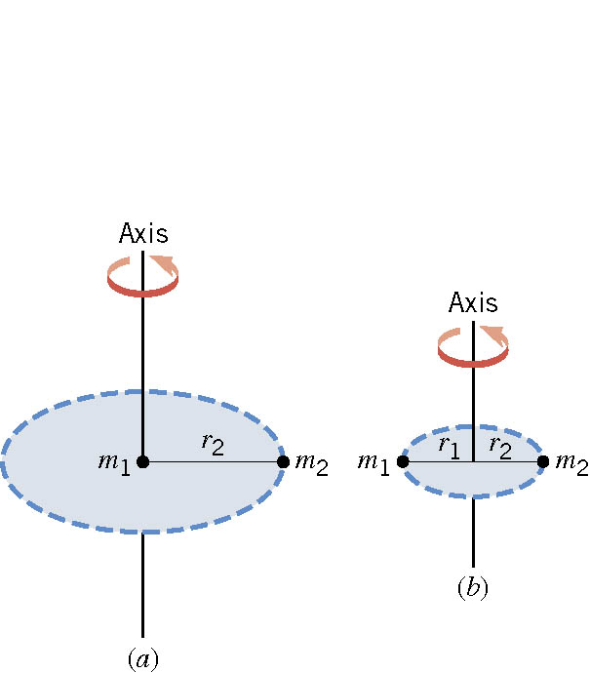
Ex. The Moment of Inertia Depends on Where the Axis Is.
Two particles each have mass m₁ and m₂ and are fixed at the ends of a thin rigid rod. The length of the rod is L. Find the moment of inertia when this object rotates relative to an axis that is perpendicular to the rod at (a) one end and (b) the center.
(a)
Which case is easier to spin?
(b)
Case (b)
Why?
Because the moment of inertia is smaller

Slide 13
Example for Moment of Inertia
In a system of four small spheres as shown in the figure, assuming the radii are negligible and the rods connecting the particles are massless, compute the moment of inertia and the rotational kinetic energy when the system rotates about the y-axis at angular speed ω.
y
m
b
Since the rotation is about y axis, the moment of inertia about y axis, I_{y}, is
l
l
M
O
M
x
b
m
Why are some 0s?
This is because the rotation is done about the y axis, and the radii of the spheres are negligible.

Slide 14
Check out Figure 8 – 20 for moment of inertia for various shaped objects

Slide 15
Rotational Kinetic Energy
y
v_{i}
What do you think the kinetic energy of a rigid object that is undergoing a circular motion is?
m_{i}
r_{i}
θ
Kinetic energy of a masslet, m_{i}, moving at a tangential speed, v_{i}, is
O
x
Since a rigid body is a collection of masslets, the total kinetic energy of the rigid object is
Since moment of Inertia, I, is defined as
The above expression is simplified as

Slide 16
Example for Moment of Inertia
In a system of four small spheres as shown in the figure, assuming the radii are negligible and the rods connecting the particles are massless, compute the moment of inertia and the rotational kinetic energy when the system rotates about the y-axis at angular speed ω.
y
m
Since the rotation is about y axis, the moment of inertia about y axis, I_{y}, is
b
l
l
M
O
M
x
b
This is because the rotation is done about y axis, and the radii of the spheres are negligible.
Why are some 0s?
m
Thus, the rotational kinetic energy is
Find the moment of inertia and rotational kinetic energy when the system rotates on the x-y plane about the z-axis that goes through the origin O.

Slide 17
Kinetic Energy of a Rolling Sphere
R
Let’s consider a sphere with radius R rolling down the hill without slipping.
h
x
ω
θ
v_{CM}
Since v_{CM}=Rω
What is the speed of the CM in terms of known quantities and how do you find this out?
Since the kinetic energy at the bottom of the hill must be equal to the potential energy at the top of the hill

Slide 18
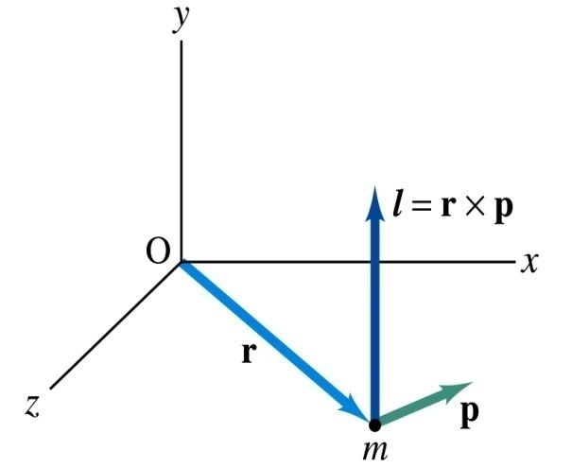
Angular Momentum of a Particle
If you grab onto a pole while running, your body will rotate about the pole, gaining angular momentum. We’ve used the linear momentum to solve physical problems with linear motions, the angular momentum will do the same for rotational motions.
z
Let’s consider a point-like object ( particle) with mass m located at the vector location r and moving with linear velocity v
The angular momentum L of this particle relative to the origin O is
y
What is the unit and dimension of angular momentum?
x
Note that L depends on origin O.
Why?
Because r changes
What else do you learn?
The direction of L is +z.
Since p is mv, the magnitude of L becomes
What do you learn from this?
If the direction of linear velocity points to the origin of rotation, the particle does not have any angular momentum.
If the linear velocity is perpendicular to position vector, the particle moves exactly the same way as a point on a rim.

Slide 19
Conservation of Angular Momentum
Remember under what condition the linear momentum is conserved?
Linear momentum is conserved when the net external force is 0.
By the same token, the angular momentum of a system is constant in both magnitude and direction, if the resultant external torque acting on the system is 0.
What does this mean?
Angular momentum of the system before and after a certain change is the same.
Three important conservation laws for isolated system that does not get affected by external forces
Mechanical Energy
Linear Momentum
Angular Momentum

Slide 20
Example for Angular Momentum Conservation
A star rotates with a period of 30 days about an axis through its center. After the star undergoes a supernova explosion, the stellar core, which had a radius of 1.0x10⁴km, collapses into a neutron star of radius 3.0km. Determine the period of rotation of the neutron star.
What is your guess about the answer?
The period will be significantly shorter, because its radius got smaller.
Let’s make some assumptions:
There is no external torque acting on it
The shape remains spherical
Its mass remains constant
Using angular momentum conservation
The angular speed of the star with the period T is
Thus

Slide 21
Similarity Between Linear and Rotational Motions
All physical quantities in linear and rotational motions show striking similarity.
Quantities | Linear | Rotational
Mass | Mass | Moment of Inertia
Length of motion | Distance | Angle (Radian)
Speed
Acceleration
Force | Force | Torque
Work | Work | Work
Power
Momentum
Kinetic Energy | Kinetic | Rotational

Slide 22
Conditions for Equilibrium
What do you think the term “An object is at its equilibrium” means?
The object is either at rest (Static Equilibrium) or its center of mass is moving at a constant velocity (Dynamic Equilibrium).
When do you think an object is at its equilibrium?
Translational Equilibrium: Equilibrium in linear motion
Is this it?
The above condition is sufficient for a point-like object to be at its translational equilibrium. However for an object with size this is not sufficient. One more condition is needed. What is it?
Let’s consider two forces equal in magnitude but in opposite direction acting on a rigid object as shown in the figure. What do you think will happen?
F
d
CM
The object will rotate about the CM. Since the net torque acting on the object about a rotational axis is not 0.
d
-F
For an object to be at its static equilibrium, the object should not have linear or angular speed.

Slide 23
More on Conditions for Equilibrium
To simplify the problem, we will only deal with forces acting on x-y plane, giving torque only along z-axis. What do you think the conditions for equilibrium be in this case?
The six possible equations from the two vector equations turns to three equations.
AND
What happens if there are many forces exerting on an object?
If an object is at its translational static equilibrium, and if the net torque acting on the object is 0 about one axis, the net torque must be 0 about any arbitrary axis.
F₁
F₂
O
r’
r₅
O’
F₃
F₅
Why is this true?
F₄
Because the object is not moving, no matter what the rotational axis is, there should not be any motion. It is simply a matter of mathematical manipulation.

Slide 24
How do we solve static equilibrium problems?
Select the object to which the equations for equilibrium are to be applied.
Identify all the forces and draw a free-body diagram with them indicated on it with their directions and locations properly indicated
Choose a convenient set of x and y axes and write down the force equation for each x and y component with correct signs.
Apply the equations that specify the balance of forces at equilibrium. Set the net force in the x and y directions equal to 0.
Select the most optimal rotational axis for torque calculations ➔ Selecting the axis such that the torque of one or more of the unknown forces become 0 makes the problem much easier to solve.
Write down the torque equation with proper signs.
Solve the force and torque equations for the desired unknown quantities.

Slide 25
Example for Mechanical Equilibrium
A uniform 40.0 N board supports the father and the daughter each weighing 800 N and 350 N, respectively, and is not moving. If the support (or fulcrum) is under the center of gravity of the board, and the father is 1.00 m from the center of gravity (CoG), what is the magnitude of the normal force n exerted on the board by the support?
1m
x
Since there is no linear motion, this system is in its translational equilibrium
n
F
D
M_{F}g
M_{D}g
M_{B}g
Therefore the magnitude of the normal force
Determine where the child should sit to balance the system.
The net torque about the fulcrum by the three forces are
Therefore to balance the system the daughter must sit

Slide 26
Example for Mech. Equilibrium Cont’d
Determine the position of the child to balance the system for different position of axis of rotation.
Rotational axis
1m
x
n
x/2
F
D
M_{F}g
M_{F}g
The net torque about the axis of rotation by all the forces are
M_{B}g
Since the normal force is
The net torque can be rewritten
What do we learn?
Therefore
No matter where the rotation axis is, net effect of the torque is identical.

Slide 27
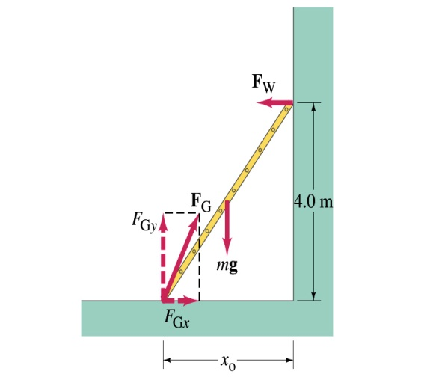
Example 9 – 7
A 5.0 m long ladder leans against a wall at a point 4.0m above the ground. The ladder is uniform and has mass 12.0kg. Assuming the wall is frictionless (but ground is not), determine the forces exerted on the ladder by the ground and the wall.
F_{W}
First the translational equilibrium, using components
FBD
F_{Gy}
mg
O
F_{Gx}
Thus, the y component of the force by the ground is
The length x₀ is, from Pythagorian theorem

Slide 28
Example 9 – 7 cont’d
From the rotational equilibrium
Thus the force exerted on the ladder by the wall is
The x component of the force by the ground is
Solve for F_{Gx}
Thus the force exerted on the ladder by the ground is
The angle between the ground force to the floor

Slide 29
Congratulations!!!!
You all are impressive and have done very well!!!
I certainly had a lot of fun with ya’ll and am truly proud of you!
Good luck with your exam!!!
Have a safe summer!!

