Slide 1
PHYS 1441 – Section 001
Lecture #1
Monday, June 6, 2016
Dr. Jaehoon Yu
Who am I?
How is this class organized?
What is Physics?
What do we want from this class?
Brief history of physics
Standards and units
Today’s homework is homework #1, due 11pm, this Wednesday, June 8!!

Slide 2
Announcements
Plea to you: Please turn off all your electronic gadgets, including cell-phones, computers
Reading assignment #1: Read and follow through all sections in appendix A by tomorrow, June 7
  A-1 through A-7
There will be a quiz on this and Ch. 21 on Wednesday, June 8.

Slide 3
Who am I?
Name: Dr. Jaehoon Yu (You can call me Dr. Yu)
Office: Rm 342, Chemistry and Physics Building
Extension: x22814, E-mail: jaehoonyu@uta.edu
My profession: High Energy Particle Physics (HEP)
  Collide particles (protons on anti-protons or electrons on anti-electrons, positrons) at the energies equivalent to 10,000 Trillion degrees
  To understand
    Fundamental constituents of matter
    Forces between the constituents (gravitational, electro-magnetic, weak and strong forces)
    Origin of Mass
    Search for Dark Matter and Making of Dark Matter Beams
    Creation of Universe (Big Bang Theory)
  A pure scientific research activity
    Direct use of the fundamental laws we find may take longer than we want but
    Indirect product of research contribute to every day lives; eg. WWW
  Why do we do with this?
    Make our everyday lives better to help us live well as an integral part of the universe

Slide 4
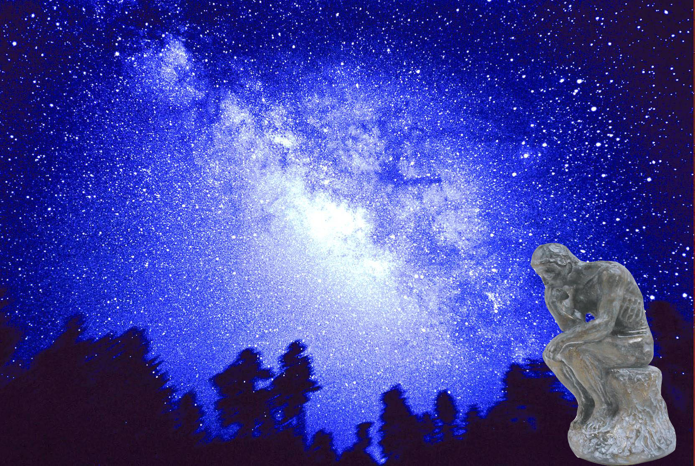

We always wonder…
What makes up the universe?
How does the universe work?
What holds the universe together?
How can we live in the universe well?
Where do we all come from?

Slide 5
High Energy Physics
Definition: A field of physics that pursues understanding the fundamental constituents of matter and basic principles of interactions between them.
Known interactions (forces):
  Gravitational Force
  Electromagnetic Force
  Weak Nuclear Force
  Strong Nuclear Force
Current theory: The Standard Model of Particle Physics

Slide 6
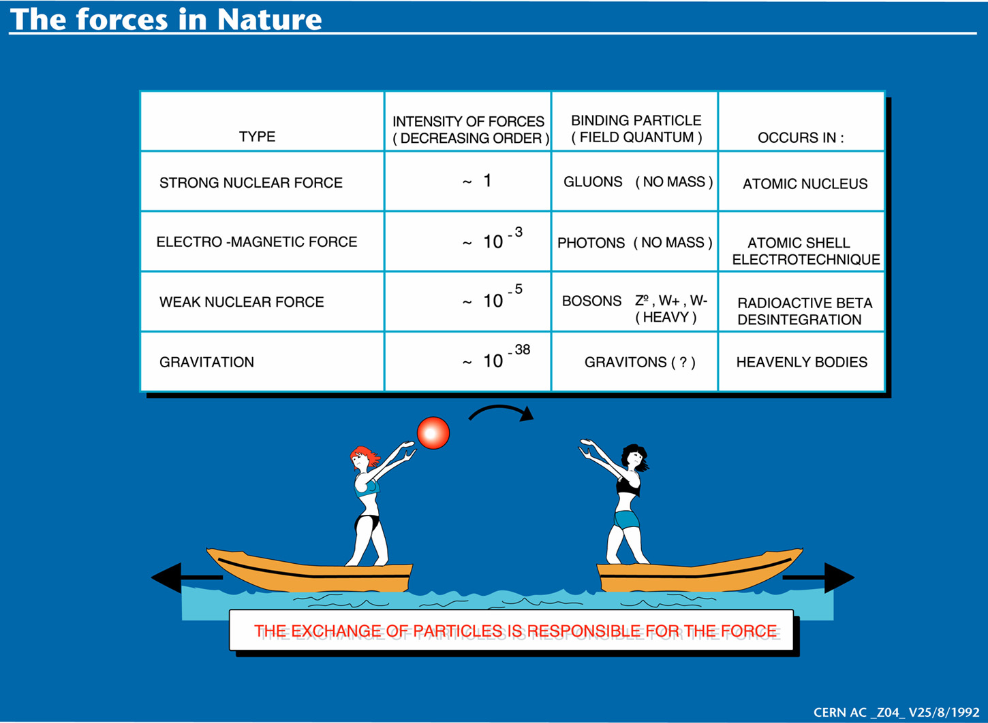

Slide 7
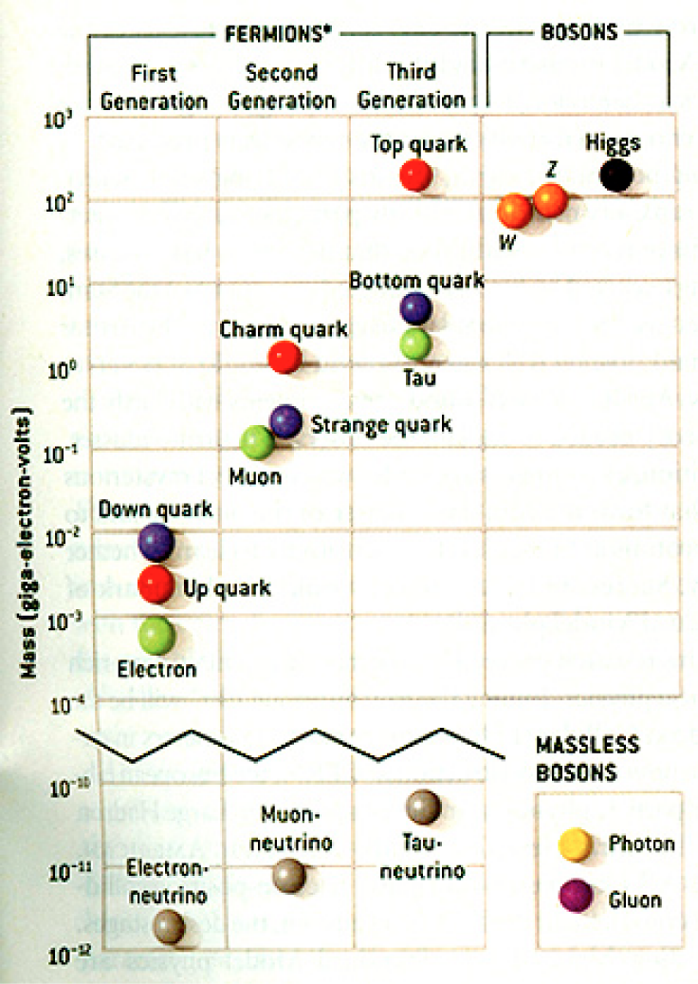
HEP and the Standard Model
Discovered in 1995, ~175m_{p}
Make up most ordinary matters ~0.1m_{p}
Total of 16 particles (12+4 force mediators) make up all the visible matter in the universe! ➔ Simple and elegant!!!
Tested to a precision of 1 part per million!

Slide 8

So what’s the problem?
Why is the mass range so large (0.1m_{p} – 175 m_{p})?
Is the new particle we’ve discovered really the Higgs particle?
Why is the matter in the universe made only of particles?
Neutrinos have mass!! What are the mixing parameters, particle-anti particle asymmetry and mass ordering?
Why are there only four apparent forces?
  Were they all unified at the Big Bang?
Notes:
----- Meeting Notes (2/12/14 10:16) -----

Slide 9
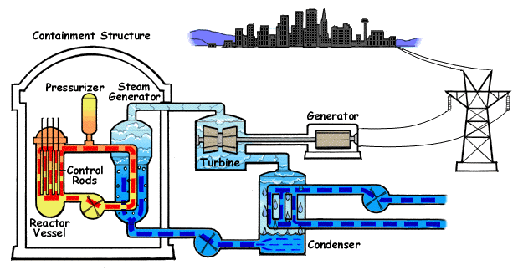
How does a nuclear power plant work?
Duke Energy
My 1000 year dream: Skip the whole thing!
Make electricity directly from nuclear force!

Slide 10
So what’s the problem?
Why is the mass range so large (0.1m_{p} – 175 m_{p})?
Is the particle we discovered really the Higgs particle?
Why is the matter in the universe made only of particles?
Neutrinos have mass!! What are the mixing parameters, particle-anti particle asymmetry and mass ordering?
Why are there only four apparent forces?
  Were they all unified at the Big Bang?
Is the picture we present the real thing?
Notes:
----- Meeting Notes (2/12/14 10:16) -----

Slide 11
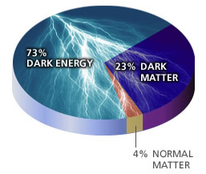
What makes up the universe?
~95% unknown!!
Notes:
----- Meeting Notes (2/12/14 10:16) -----

Slide 12
So what’s the problem?
Why is the mass range so large (0.1m_{p} – 175 m_{p})?
Is the particle we discovered really the Higgs particle?
Why is the matter in the universe made only of particles?
Neutrinos have mass!! What are the mixing parameters, particle-anti particle asymmetry and mass ordering?
Why are there only four apparent forces?
  Were they all unified at the Big Bang?
Is the picture we present the real thing?
  What makes up the remaining ~95% of the universe?
Are there any other particles we don’t know of?
  Big deal for the new LHC Run!
Where do we all come from?
How can we live well in the universe as an integral partner?
Notes:
----- Meeting Notes (2/12/14 10:16) -----

Slide 13
Accelerators are Powerful Microscopes.
They make high energy particle beams
that allow us to see small things.
seen by
low energy beam
(poorer resolution)
seen by
high energy beam
(better resolution)

Slide 14
Accelerators are also Time Machines.
They make particles last seen
in the earliest moments of the universe.
Energy
particle beam
energy
anti-particle beam
energy
Particle and anti-particle annihilate.
E = mc²

Slide 15
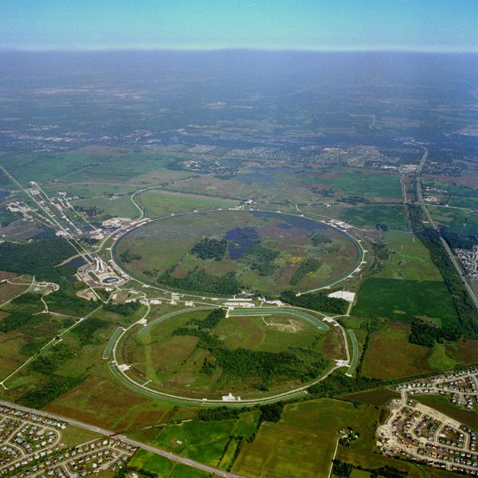
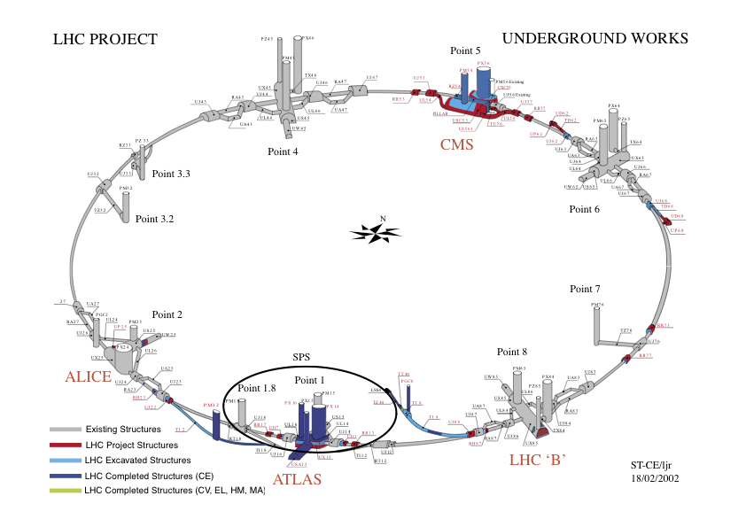
Fermilab Tevatron and LHC at CERN
World’s Highest Energy proton-anti-proton collider
  4km (2.5mi) circumference
  E_{cm}=1.96 TeV (=6.3x10⁻⁷J/p➔ 13M Joules on the area smaller than 10⁻⁴m²)
  Equivalent to the kinetic energy of a 20t truck at the speed 130km/hr
    ~100,000 times the energy density at the ground 0 of the Hiroshima atom bomb
  Tevatron was shut down in 2011
  Vibrant other programs running, including the search for dark matter with beams!!
World’s Highest Energy p-p collider
  27km (17mi) circumference, 100m (300ft) underground
  Design E_{cm}=14 TeV (=44x10⁻⁷J/p➔ 362M Joules on the area smaller than 10⁻⁴m²)
  Equivalent to the kinetic energy of a B727 (80tons) at the speed 310km/hr
    ~3M times the energy density at the ground 0 of the Hiroshima atom bomb
Large amount of data accumulated in 2010 – 2013
Beam returned 2015 after a 2 yr shutdown
2017 data taking ongoing
Chicago
CDF
p
DØ
Tevatron
p

Slide 16
What is the Higgs and What does it do?
When there is perfect symmetry, one cannot tell directions!

Slide 17

What? What’s the symmetry?
Where is the head of the table?
Without a broken symmetry, one cannot tell directional information!!

Slide 18
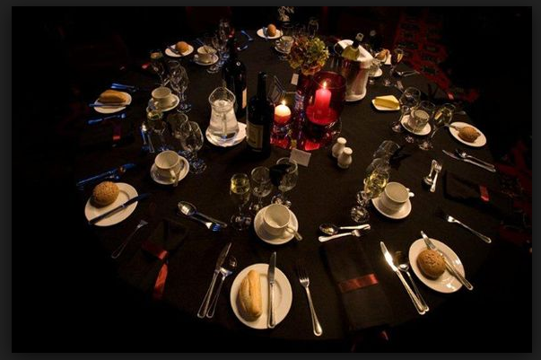
A broken symmetry

Slide 19
What is the Higgs and What does it do?
When there is perfect symmetry, one cannot tell directions!
Only when symmetry is broken, can one tell directions
Higgs field works to break the perfect symmetry and gives mass to all fundamental particles
Sometimes, this field spontaneously generates a particle, the Higgs particle
So the Higgs particle is the evidence of the existence of the Higgs field!

Slide 20



So how does Higgs Field work again?
Person in space ➔ no symmetry breaking
Person in air ➔ symmetry can be broken
Sometimes, you get
Just like the tornado is a piece of evidence of the existence of air, Higgs particle is a piece of evidence of Higgs mechanism

Slide 21
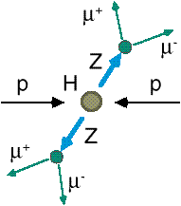
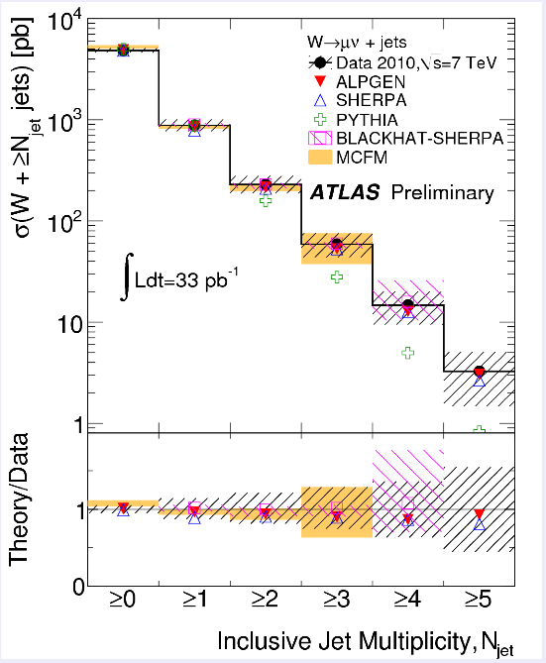
How do we look for the Higgs?
Identify Higgs candidate events
Understand fakes (backgrounds)
Look for a bump!!
  Large amount of data absolutely critical
e⁺ (μ⁺)
e⁻ (μ⁻)
e⁺
e⁻

Slide 22

What did statistics do for Higgs?

Slide 23

How about this?

Slide 24
So have we seen the Higgs particle?
The statistical significance of the finding is way over 7 standard deviations

Slide 25
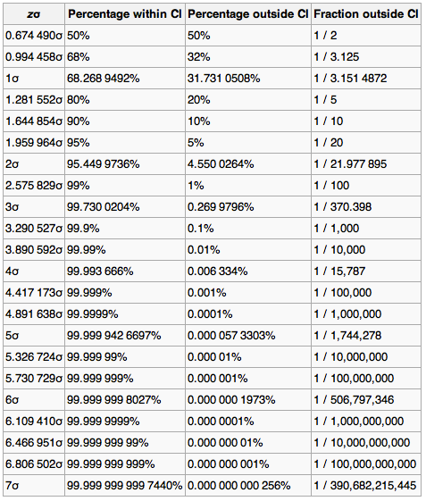
Statistical Significance Table

Slide 26
So have we seen the Higgs particle?
The statistical significance of the finding is much bigger than seven standard deviations
  Level of significance: much better than 99.999 999 999 7% (eleven 9s!!)
  We could be wrong once if we do the same experiment 391,000,000,000 times (will take ~13,000 years even if each experiment takes 1s!!)
So did we find the Higgs particle?
  We have discovered the heaviest new boson we’ve seen thus far
  It has many properties consistent with the Standard Model Higgs particle
    It quacks like a duck and walks like a duck but…
  We do not have enough data to precisely measure all the properties – mass, lifetime, the rate at which this particle decays to certain other particles, etc – to definitively determine its nature
Precision measurements and searches in new channels ongoing

Slide 27
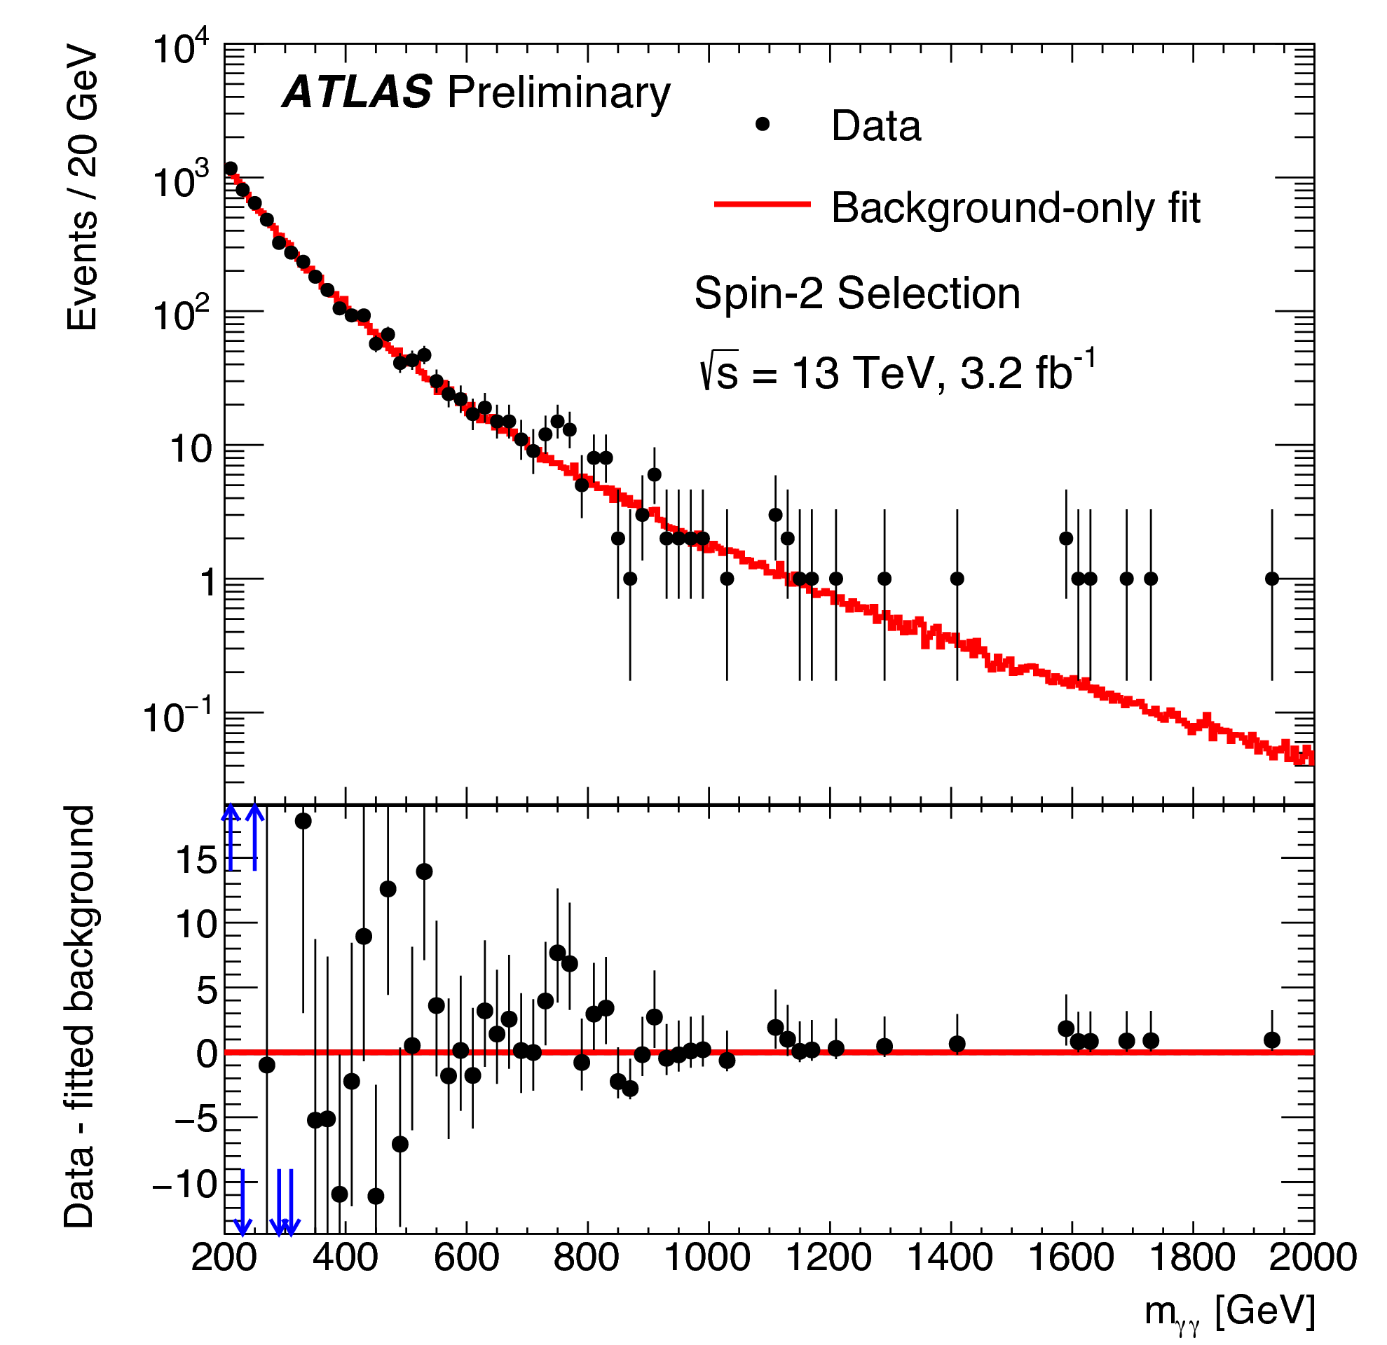
A hint of something new?
~760GeV
(2015 data)
Hmm!
~4.6σ Εξχεσσ!!

Slide 28
Statistical Significance Table
Not good enough yet!!

Slide 29

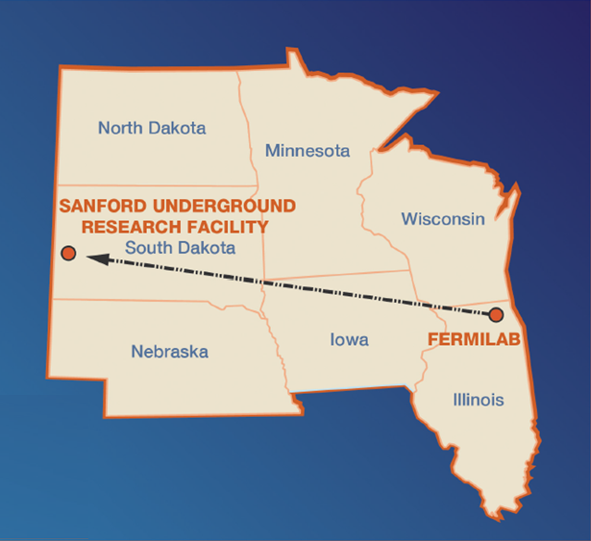
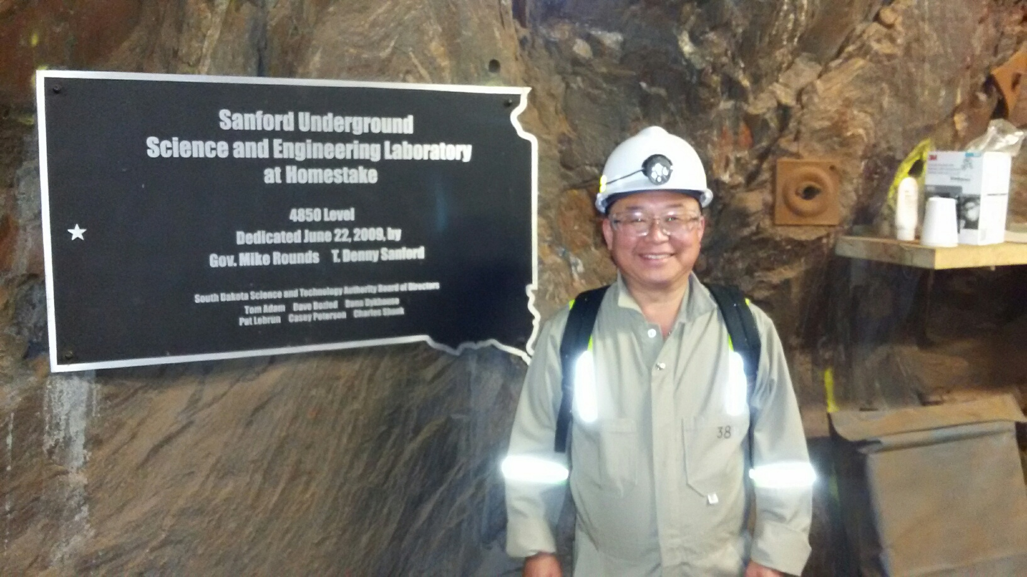
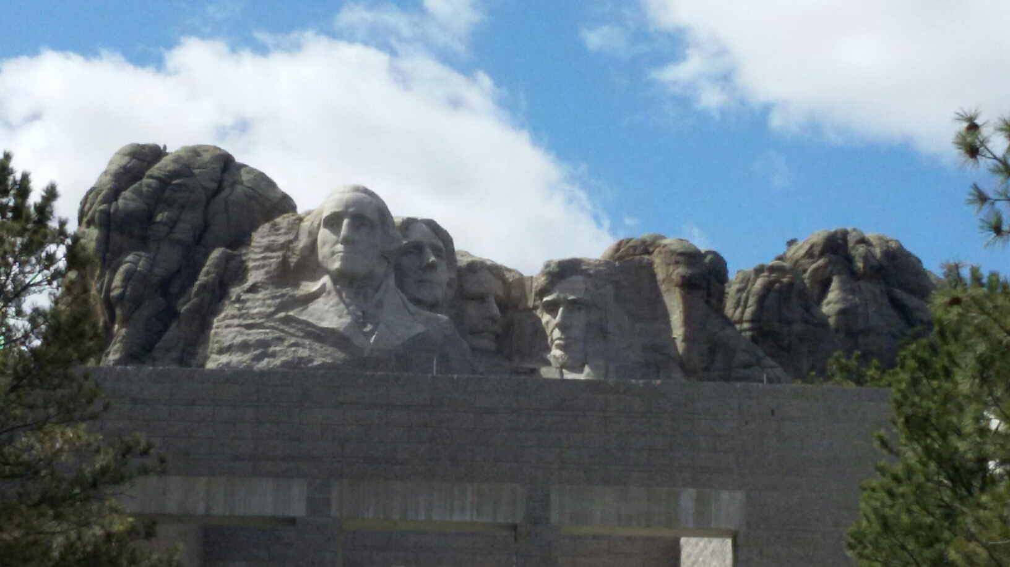
The Next Big Thing - DUNE Experiment
Stands for Deep Under Ground Neutrino Experiment
The flagship long baseline (1300km) ν experiment
  1500m underground in South Dakota
Yes, you are right! Mount Rushmore!!
Nobel Winning Neutrino Discovery by Ray Davis in 1960’s
Many Dark Matter experiments in progress
New DUNE area to be excavated shortly

Slide 30
Dark Matter Searches at Fermilab
Fermi National Accelerator Laboratory is turning into a lab with very high intensity accelerator program
UTA group is part of three experiments
  Long Baseline Neutrino Experiment (LBNE), an $850M flagship experiment, with data expected in 2025
    High flux secondary beam and a near detector enables searches for DM
    In addition to precision measurements of key neutrino param..
    UTA playing very significant role in this experiment
A rich physics program for the next 20 – 30 years!!
If we see DM, we could use this to make DM Beam??

Slide 31
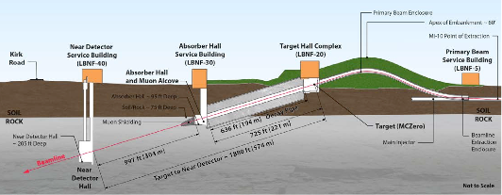
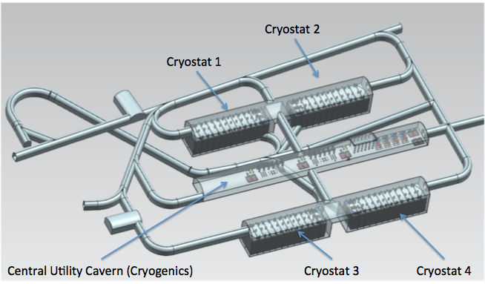
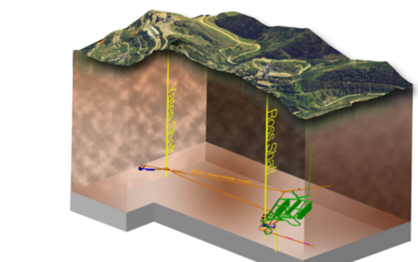
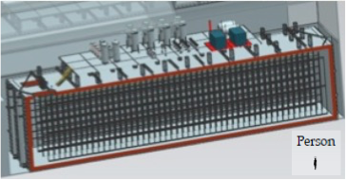
The Components of the DUNE Experiment
1300km
4 caverns with ~20kt total each
1500m underground
15m
62m
14m

Slide 32
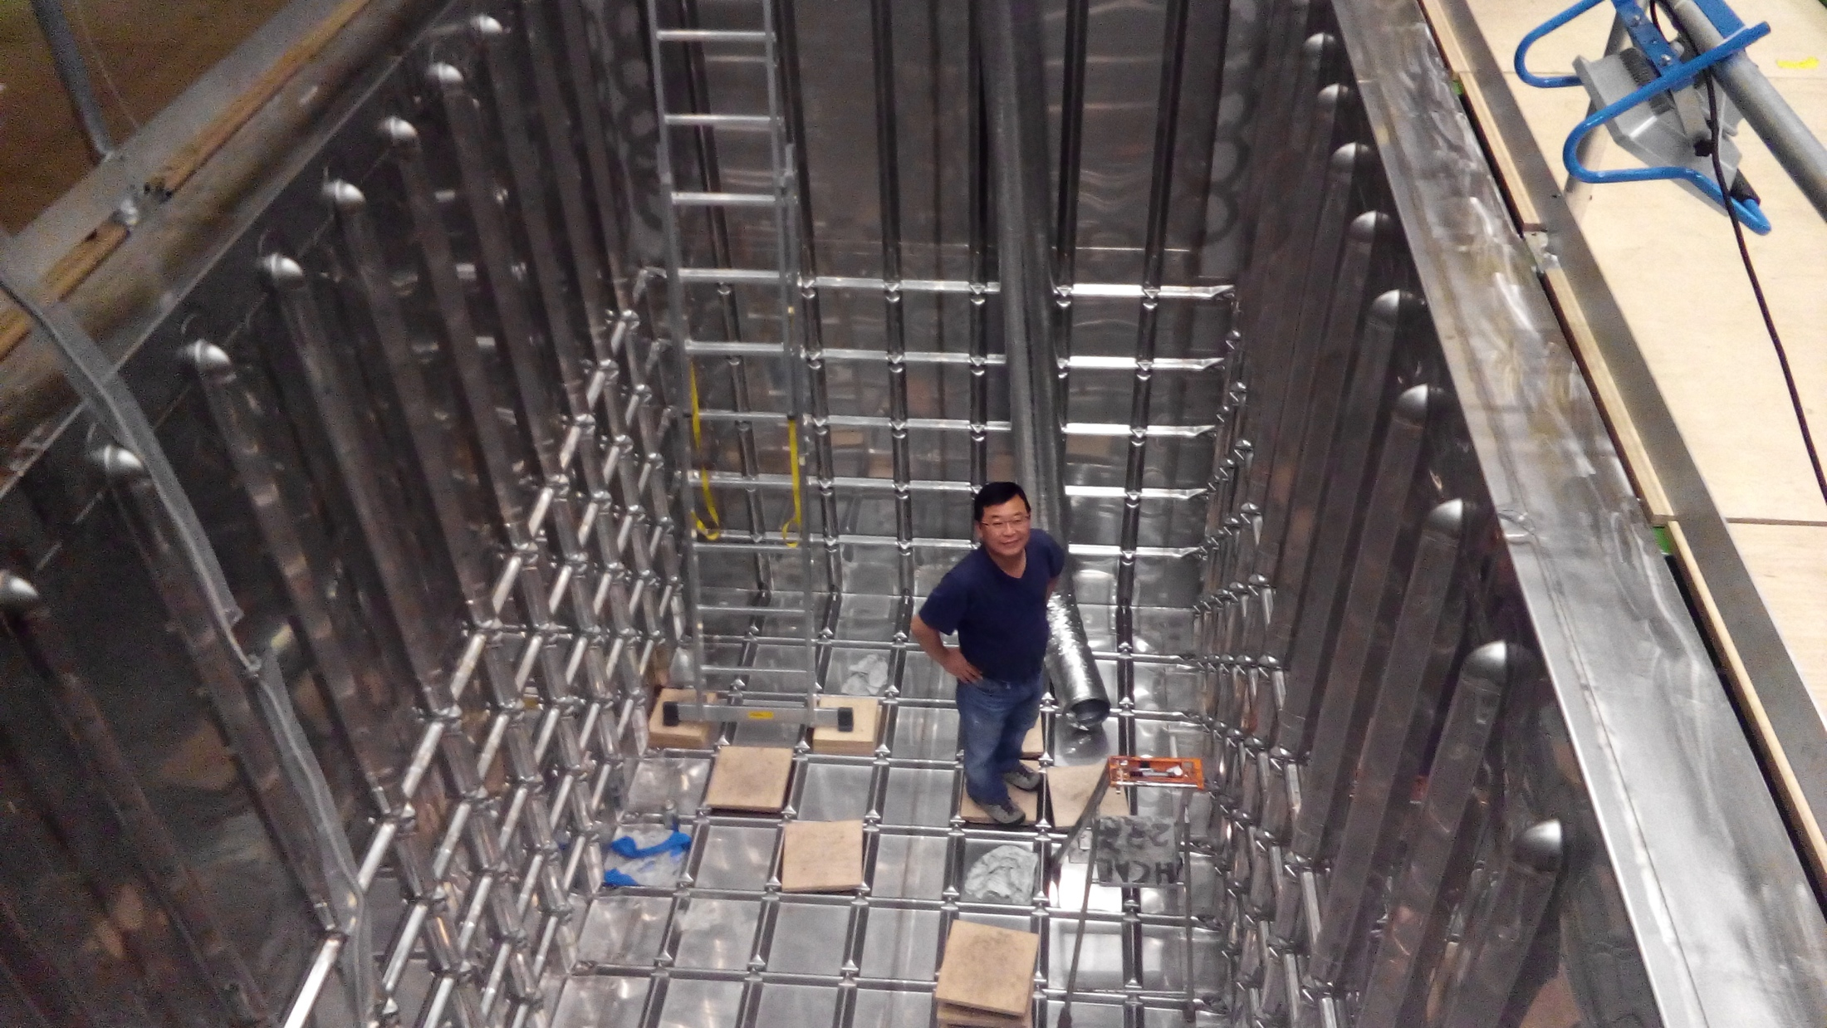
How BIG?
This is just for a 3mx1mx1m (42t) active volume baby prototype!!

Slide 33
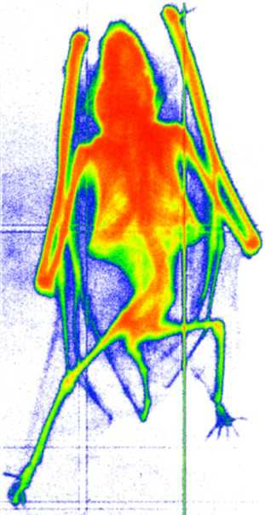
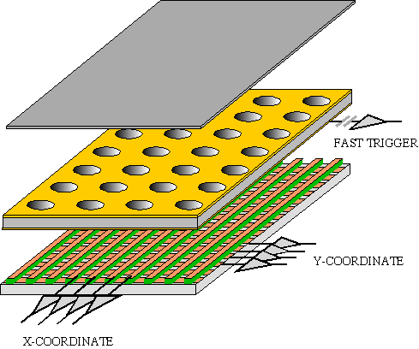

GEM Application Potential
FAST X-RAY IMAGING
Using the lower GEM signal, the readout can be self-triggered with energy discrimination:
9 keV absorption radiography of a small mammal (image size ~ 60 x 30 mm²)
A. Bressan et al,
Nucl. Instr. and Meth. A 425(1999)254
F. Sauli, Nucl. Instr. and Meth.A 461(2001)47

Slide 34
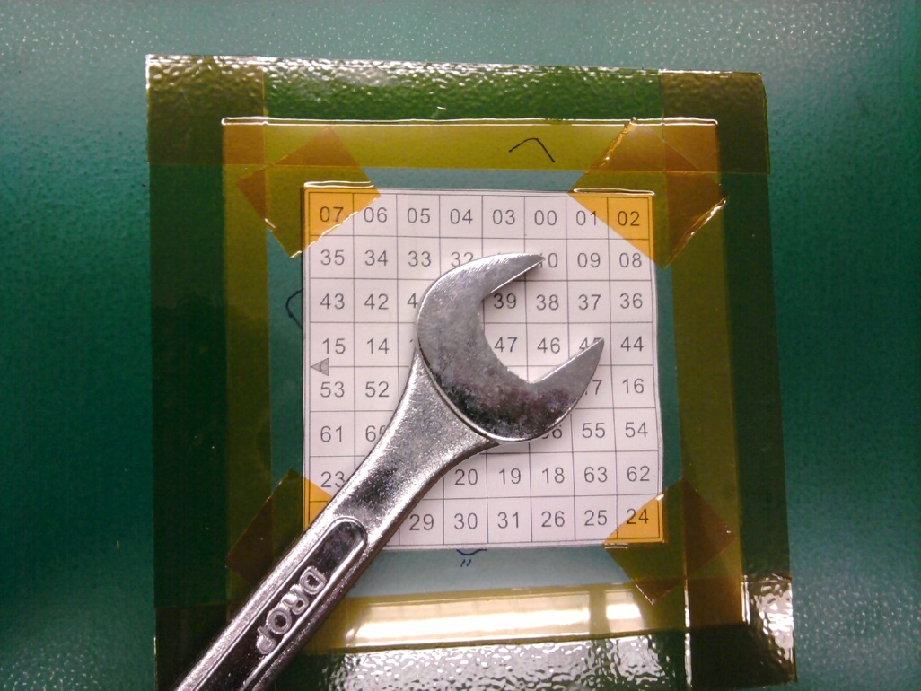
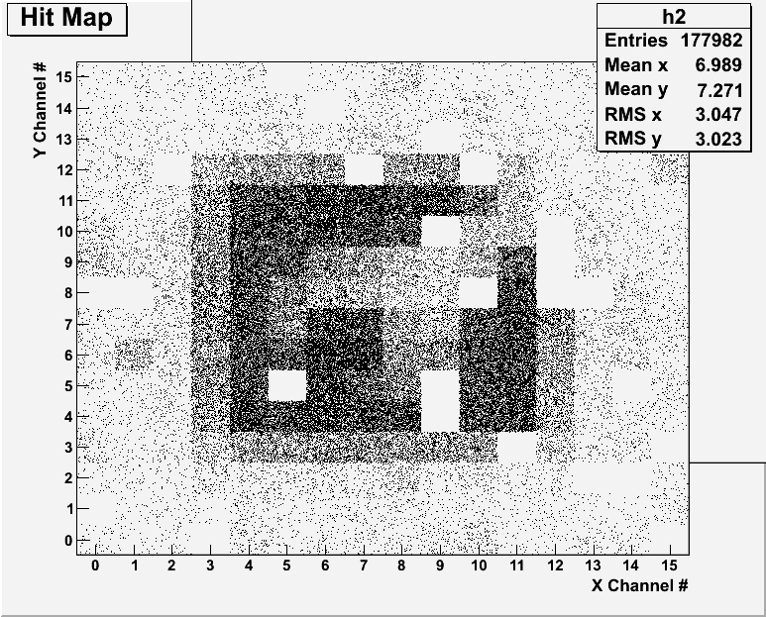
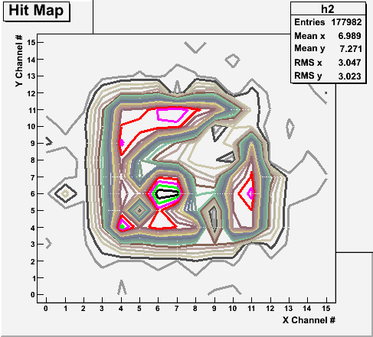
Bi-product of High Energy Physics Research
Can you see what the object is?
(GEM Detector X-ray Image)

Slide 35
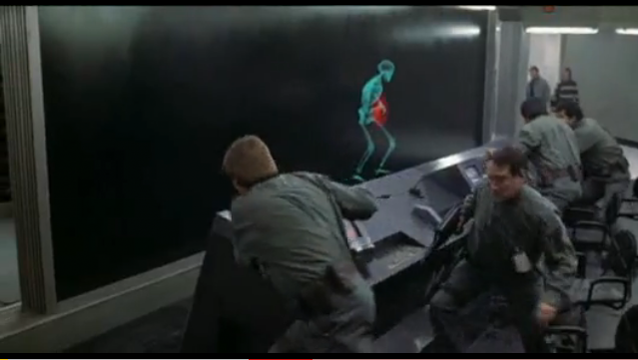
And in not too distant future, we could do …

Slide 36

Discovery of the God Particle in 2012
2012 God particle discovery

Slide 37
Information & Communication Source
Course web page: http://www-hep.uta.edu/~yu/teaching/summer16-1444-001/summer16-1444-001.html
  Contact information & Class Schedule
  Syllabus
  Homework
  Holidays and Exam days
  Evaluation Policy
  Class Style & Communication
  Other information
Primary communication tool is e-mail: Make sure that your e-mail at the time of course registration is the one you most frequently read!!
Office Hours for Dr. Yu: 12:30 – 1:30pm, M-Th or by appointments

Slide 38
Evaluation Policy
Homework: 25%
Exams
  Final Comprehensive Exams (7/11/16): 23%
  Mid-term Comprehensive Exam (6/22/16): 20%
  One better of the two term Exams (6/13/16 and 6/29/16): 12%
    Total of two non-comprehensive term exams (6/13 and 6/29)
    One better of the two exams will be used for the final grade
  Missing an exam is not permissible unless pre-approved
    No makeup test
    You will get an F if you miss any of the exams without a prior approval no matter how well you’ve been doing in class!
Lab score: 10%
Pop-quizzes: 10%
Extra credits: 10% of the total
  Random attendances
  Strong participation in the class discussions
  Special projects (BIGGGGG!!!)
  Planetarium shows and Other many opportunities
Grading will be done on a sliding scale
100%

Slide 39
Homework
Solving homework problems is the only way to comprehend class material ➔ 2 homeworks per week
An electronic homework system has been setup for you
  Details are in the material distributed today and on the web
  https://quest.cns.utexas.edu/student/courses/list
  Choose the course PHYS1444-Summer16, unique number 44016
  Download homeworks, solve the problems and submit them online
  Multiple unsuccessful tries will deduct points
  Roster will close at 11pm Wednesday, June 8
  You need a UT e-ID: Go and apply at the URL https://idmanager.its.utexas.edu/eid_self_help/?createEID&qwicap-page-id=EA027EFF7E2DA39E if you don’t have one.
Each homework carries the same weight
Home work problems will be slightly ahead of the class
No homework will be dropped from the final grade!!
Home work will constitute 25% of the total ➔ A good way of keeping your grades high
Strongly encouraged to collaborate ➔ Does not mean you can copy

Slide 40
Attendances and Class Style
Attendances:
  Will be taken randomly
  Will be used for extra credits
Class style:
  Lectures will be on electronic media
    The lecture notes will be posted on the web AFTER each class
  Will be mixed with traditional methods
  Active participation through questions and discussions are STRONGLY encouraged ➔ Extra credit….
  Communication between you and me is extremely important
    If you have problems, please do not hesitate talking to me

Slide 41
Lab and Physics Clinic
Physics Labs: Starts today, Monday, June 6
  Important to understand physical principles through experiments
  10% of the grade
  Prelab questions can be obtained at www.uta.edu/physics/labs
  Lab syllabus is available in your assigned lab rooms.
Physics Clinic:
  Free service
  They provide general help on physics, including help solving homework problems
    Do not expect solutions of the problem from them!
    Do not expect them to tell you whether your answers are correct!
    It is your responsibility to make sure that you have done everything correctly!
  11am – 6pm, Mon – Thu in SH 007
  This service begins today!
  Please take full advantage of this service!!

Slide 42
Extra credit
10% addition to the total
  Could boost a B to A, C to B or D to C
What constitute for extra credit?
  Special projects (biggest!!)
  Random attendances
  Strong participation in the class discussions
  Watch the valid planetarium shows
  Many other opportunities

Slide 43
Valid Planetarium Shows
Regular running shows
  Texas Stargazing – Tuesdays at 2:00 pm; Dynamic Earth – Wed. at 2:00 pm;
  We are astronomers– Fridays at 2:00pm and Saturdays at 5:30 pm
Shows that need special arrangements
  Black Holes (can watch up to 2 times)
  Astronaut; Bad Astronomy; Back to the Moon for Good; From Earth to the Universe; Experience the Aurora; IBEX; Ice Worlds; Magnificent Sun
  Mayan Prophecies; MicroCosm; Nano Cam; Stars of the Pharaohs; TimeSpace, Two Small Pieces of Glass; Unseen Universe; Violent Universe
How to submit for extra credit?
  Obtain the ticket stub that is signed and dated by the planetarium star lecturer of the day
  Collect the ticket stubs
  Tape one edge of all of the ticket stubs on a sheet of paper with your name and ID written on it
  Submit the sheet at the end of the semester at the final exam

Slide 44
What can you expect from this class?
All A’s?
  This would be really nice, wouldn’t it?
  But if it is too easy it is not fulfilling or meaningful….
This class is not going to be a stroll in the park!!
You will earn your grade in this class.
  You will need to put in sufficient time and sincere efforts
  Exams and quizzes will be tough!!
    Sometimes problems might not look exactly like what you learned in the class
    Just putting the right answer for free response problems does not work!
But you have a great control (up to 45%) of your grade in your hands
  Homework is 25% of the total grade!!
    Means you will have many homework problems
      Sometimes much more than any other classes
      Some homework problems will be something that you have yet to learn in class
      Exam problems will be easier than homework problems but the same principles!!
  Lab 10%
  Extra credit 10%
I will work with you so that your efforts are properly rewarded

Slide 45
What do we want to learn in this class?
Physics is everywhere around you.
Skills to understand the fundamental principles that surrounds you in everyday lives…
Skills to identify what laws of physics applies to what phenomena and use them appropriately
Understand the impact of physical laws and apply them
Learn skills to think, research and analyze observations.
Learn skills to express observations and measurements in mathematical language
Learn skills to express your research in systematic manner in writing
But most importantly the confidence in your physics ability and to take on any challenges laid in front of you!!
Most importantly, let us have a lot of FUN!!

Slide 46
Specifically, in this course, you will learn…
Concept of Electricity and Magnetism
Electric charge and magnetic poles
Electric and Magnetic Forces
Electric and magnetic potential and energies
Propagation of electric and magnetic fields
Relationship between electro-magnetic forces and light
Behaviors of light and optics
Special relativity and quantum theories

Slide 47
How to study for this course?
Keep up with the class for comprehensive understanding of materials
  Come to the class and participate in the discussions and problems solving sessions
  Follow through the lecture notes
  Work out example problems in the book yourself without looking at the solution
  Have many tons of fun in the class!!!!!
Keep up with the homework to put the last nail on the coffin
  One can always input the answers as you solve problems. Do NOT wait till you are done with all the problems.
  Form a study group and discuss how to solve problems with your friends, then work the problems out yourselves!
Prepare for upcoming classes
  Read the textbook for the material to be covered in the next class
The extra mile
  Work out additional problems in the back of the book starting the easiest problems to harder ones

