Slide 1
PHYS 1441 – Section 001 Lecture #3
Wednesday, June 8, 2016
Dr. Jaehoon Yu
Chapter 21
Coulomb’s Law
The Electric Field & Field Lines
Electric Fields and Conductors
Motion of a Charged Particle in an Electric Field
Electric Dipoles
Today’s homework is homework #2, due 11pm, Saturday, June 11!!

Slide 2
Announcements
34/35 of you have registered in the homework system.
27/35 submitted the homework!
1st non-comprehensive term exam
In class Monday, June 13
Covers: CH21.1 through what we finish tomorrow plus appendix A
Bring your calculator but DO NOT input formula into it!
Cell phones or any types of computers cannot replace a calculator!
BYOF: You may bring a one 8.5x11.5 sheet (front and back) of handwritten formulae and values of constants for the quiz
No derivations, word definitions or solutions of any problems!
No additional formulae or values of constants will be provided!

Slide 3
Extra Credit Special Project #1
Compare the Coulomb force to the Gravitational force in the following cases by expressing Coulomb force (F_{C}) in terms of the gravitational force (F_{G})
Between two protons separated by 1m
Between two protons separated by an arbitrary distance R
Between two electrons separated by 1m
Between two electrons separated by an arbitrary distance R
Five points each, totaling 20 points
BE SURE to show all the details of your work, including all formulae, and properly references to them
Please staple them before the submission
Due at the beginning of the class Monday, June 13

Slide 4
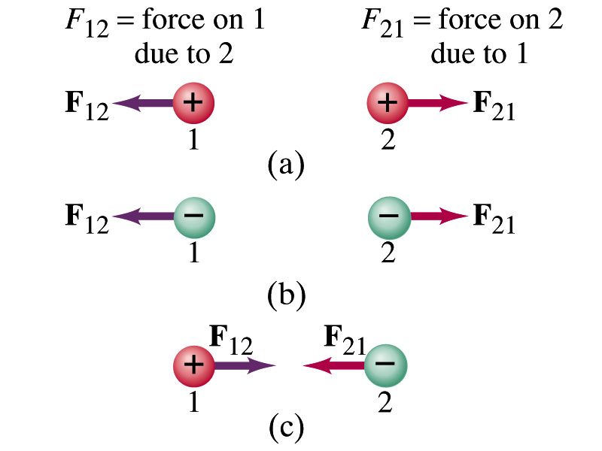
Coulomb’s Law – The Formula
Formula
Is Coulomb force a scalar quantity or a vector quantity? Unit?
A vector quantity. The unit is Newtons (N)!
The direction of electric (Coulomb) force is always along the line joining the two objects.
If the two charges are the same: forces are directed away from each other.
If the two charges are opposite: forces are directed toward each other.
Coulomb force is precise to 1 part in 10¹⁶.
Unit of charge is called Coulomb, C, in SI.
The value of the proportionality constant, k, in SI unit is
Thus, 1C is the charge that gives F~9x10⁹N of force when placed 1m apart from each other.

Slide 5
The Elementary Charge and Permittivity
Elementary charge, the smallest charge, is that of an electron:
Since electron is a negatively charged particle, its charge is –e.
Object cannot gain or lose fraction of an electron.
Electric charge is quantized.
It changes always in integer multiples of e.
The proportionality constant k is often written in terms of another constant, ε₀, the permittivity* of free space. They are related and .
Thus the electric force can be written:
Note that this force is for “point” charges at rest.
*Mirriam-Webster, Permittivity: The ability of a material to store electric potential energy under the influence of an electric field

Slide 6
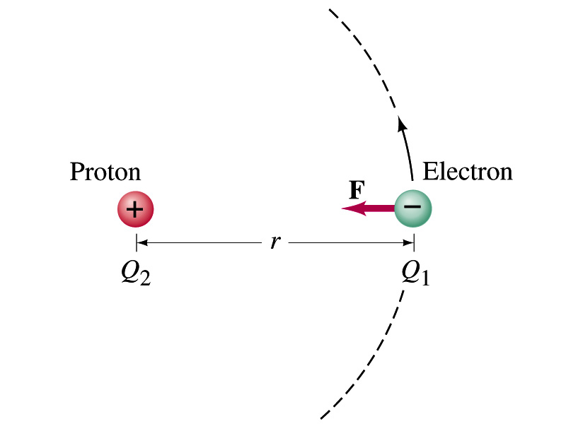
Example on Coulomb Force
Electric force on electron by proton. Determine the magnitude of the electric force on the electron of a hydrogen atom exerted by the single proton (Q₂=+e) that is its nucleus. Assume the electron “orbits” the proton at its average distance of r=0.53x10⁻¹⁰m.
Using Coulomb’s law
Each charge is
and
So the magnitude of the force is
Which direction?
Toward each other…

Slide 7
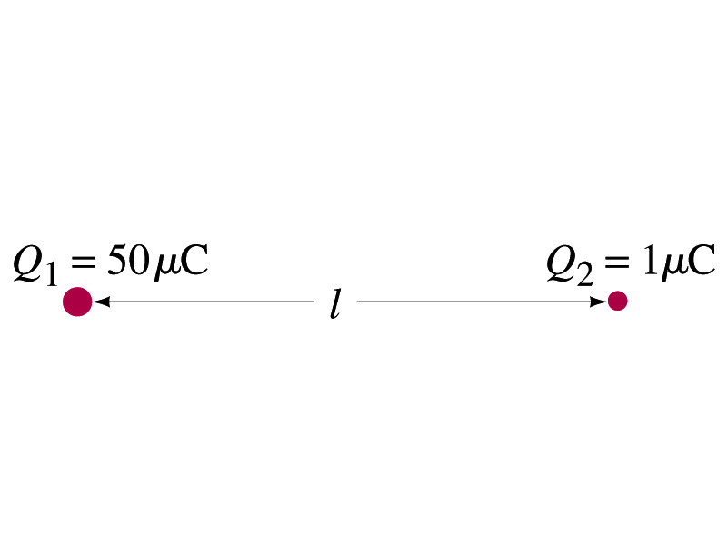
Example 21 – 1
Which charge exerts greater force? Two positive point charges, Q₁=50μC and Q₂=1μC, are separated by a distance L. Which is larger in magnitude, the force that Q₁ exerts on Q₂ or the force that Q₂ exerts on Q₁?
What is the force that Q₁ exerts on Q₂?
What is the force that Q₂ exerts on Q₁?
Therefore the magnitudes of the two forces are identical!!
Well then what is different?
The direction.
Which direction?
Opposite to each other!
What is this law?
Newton’s third law, the law of action and reaction!!

Slide 8
Vector Additions and Subtractions
Addition:
Triangular Method: One can add vectors by connecting the head of one vector to the tail of the other (head-to-tail)
Parallelogram method: Connect the tails of the two vectors and extend
Addition is commutative: Changing order of operation does not affect the results A+B=B+A, A+B+C+D+E=E+C+A+B+D
A+B
A
A+B
B
=
OR
B
A+B
B
A
A
Subtraction:
The same as adding a negative vector:A - B = A + (-B)
A
-B
Since subtraction is the equivalent to adding a negative vector, subtraction is also commutative!!!
A-B
Multiplication by a scalar is increasing the magnitude A, B=2A
A
B=2A

Slide 9
Example for Vector Addition
A force of 20.0N applies to north while another force of 35.0N applies in the direction 60.0º west of north. Find the magnitude and direction of resultant force.
F₂sin60^{ο}
N
F₂
60^{ο}
F₂cos60^{ο}
20
F
θ
F₁
E
Find other ways to solve this problem…

Slide 10
Components and Unit Vectors
Coordinate systems are useful in expressing vectors in their components
y
(+,+)
F_{y}
(F_{x},F_{y})
}Components
F
(-,+)
θ
x
} Magnitude
(-,-)
(+,-)
F_{x}

Slide 11
Unit Vectors
Unit vectors are the ones that tells us the directions of the components
Dimensionless
Magnitudes are exactly 1
Unit vectors are usually expressed in i, j, k or
So the vector F can be re-written as

Slide 12
Examples of Vector Operations
Find the resultant force which is the sum of F1=(2.0i+2.0j)N and F2 =(2.0i-4.0j)N.
Find the resultant force of the sum of three forces: F₁=(15i+30j +12k)N, F₂=(23i+14j -5.0k)N, and F₃=(-13i+15j)N.
Magnitude

Slide 13
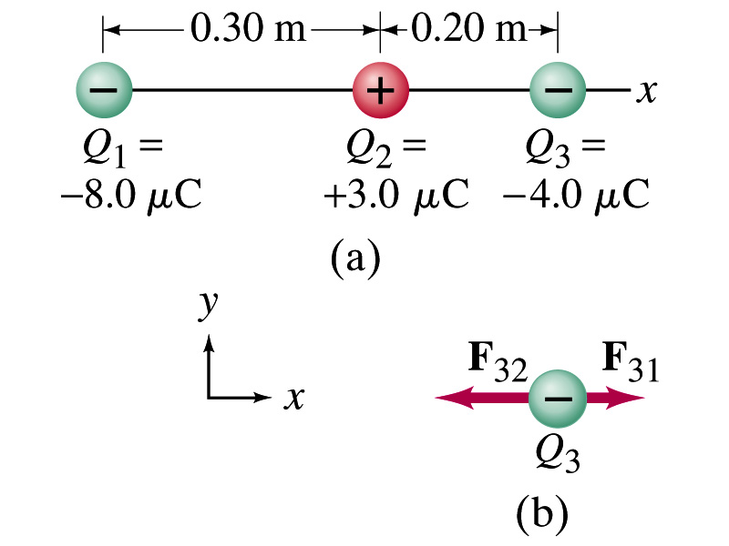
Example 21.2
Three charges in a line. Three charged particles are arranged in a line as shown in the figure. Calculate the net electrostatic force on particle 3 (the -4μC on the right) due to other two charges.
What is the force that Q₁ exerts on Q₃?
What is the force that Q₂ exerts on Q₃?
Using the vector sum of the two forces

