Slide 1
PHYS 1441 – Section 001 Lecture #5
Monday, June 13, 2016
Dr. Jaehoon Yu
Chapter 22
Electric Flux
Gauss’ Law with many charges
What is Gauss’ Law good for?
Chapter 23 Electric Potential
Electric Potential Energy
Today’s homework is homework #3, due 11pm, Wednesday, June 15!!

Slide 2
Announcements
Reading assignments
CH22.4

Slide 3
Reminder: Special Project #2 – Angels & Demons
Compute the total possible energy released from an annihilation of x-grams of anti-matter and the same quantity of matter, where x is the last two digits of your SS#. (20 points)
Use the famous Einstein’s formula for mass-energy equivalence
Compute the power output of this annihilation when the energy is released in x ns, where x is again the first two digits of your SS#. (10 points)
Compute how many cups of gasoline (8MJ) this energy corresponds to. (5 points)
Compute how many months of world electricity usage (3.6GJ/mo) this energy corresponds to. (5 points)
Due by the beginning of the class Thursday, June 16.

Slide 4
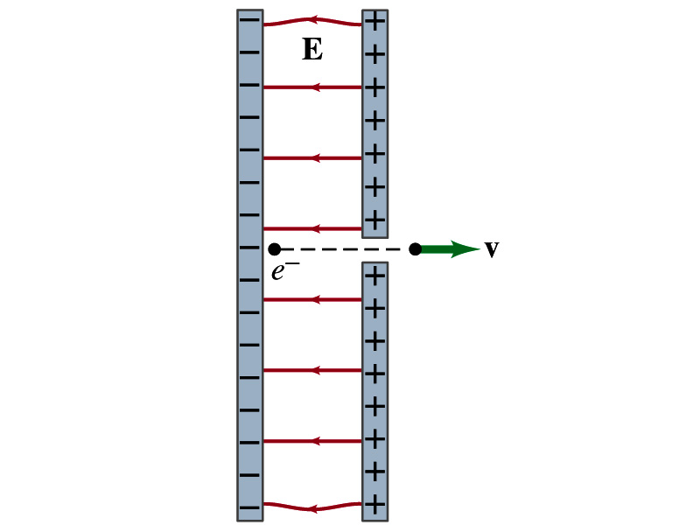
Special Project
Particle Accelerator. A charged particle of mass M with charge -Q is accelerated in the uniform field E between two parallel charged plates whose separation is D as shown in the figure on the right. The charged particle is accelerated from an initial speed v₀ near the negative plate and passes through a tiny hole in the positive plate.
Derive the formula for the electric field E to accelerate the charged particle to a fraction f of the speed of light c. Express E in terms of M, Q, D, f, c and v₀.
(a) Using the Coulomb force and kinematic equations. (8 points)
(b) Using the work-kinetic energy theorem. ( 8 points)
(c) Using the formula above, evaluate the strength of the electric field E to accelerate an electron from 0.1% of the speed of light to 90% of the speed of light. You need to look up the relevant constants, such as mass of the electron, charge of the electron and the speed of light. (5 points)
Due beginning of the class Monday, June 20

Slide 5
Gauss’ Law
Gauss’ law states the relationship between electric charge and the electric field.
More generalized and elegant form of Coulomb’s law.
The electric field by the distribution of charges can be obtained using Coulomb’s law by summing (or integrating) over the charge distributions.
Gauss’ law, however, gives an additional insight into the nature of electrostatic field and a more general relationship between the charge and the field

Slide 6
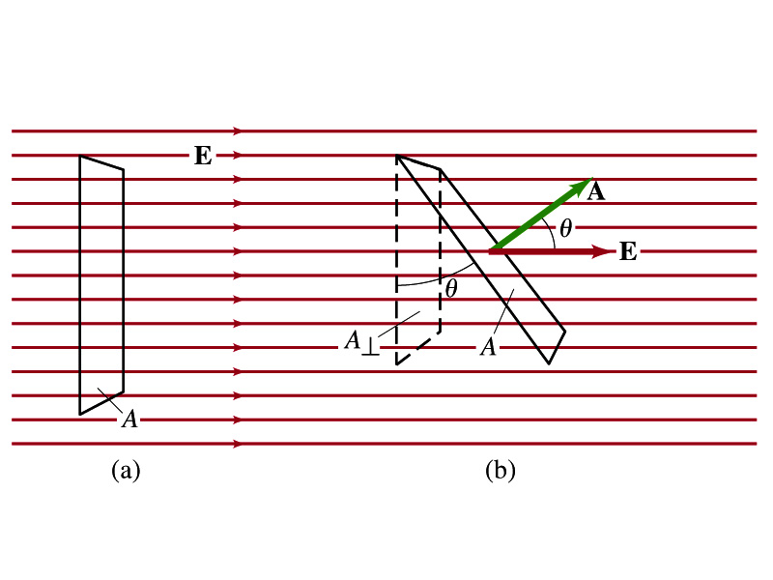
Electric Flux
Let’s imagine a surface of area A through which a uniform electric field E passes
The electric flux Φ_{E} is defined as
Φ_{E}=EA, if the field is perpendicular to the surface
Φ_{E}=EAcosθ, if the field makes an angle θ to the surface
So the electric flux is defined as .
How would you define the electric flux in words?
The total number of field lines passing through the unit area perpendicular to the field.

Slide 7
Example 22 – 1
Electric flux. (a) Calculate the electric flux through the rectangle in the figure (a). The rectangle is 10cm by 20cm and the electric field is uniform with magnitude 200N/C. (b) What is the flux in figure if the angle is 30 degrees?
The electric flux is defined as
So when (a) θ=0, we obtain
And when (b) θ=30 degrees, we obtain

