Slide 1
PHYS 1441 – Section 001
Lecture #6
Tuesday, June 14, 2016
Dr. Jaehoon Yu
Chapter 22
  Gauss’ Law and Coulomb’s Law
  Gauss’ Law with many charges
  What is Gauss’ Law good for?
  How to use Gauss’ Law to solve problems.
Chapter 23 Electric Potential
  Electric Potential Energy

Slide 2
Announcements
Quiz #2
  In class Thursday, June 16
  Covers CH22.1 through what we cover in class tomorrow, Wed. June 15
  Bring your calculator but DO NOT input formula into it!
    Cell phones or any types of computers cannot replace a calculator!
  BYOF: You may bring a one 8.5x11.5 sheet (front and back) of handwritten formulae and values of constants for the quiz
  No derivations, word definitions or solutions of any problems!
  No additional formulae or values of constants will be provided!
Reading assignments
  CH22.4

Slide 3
Reminder: Special Project #2 – Angels & Demons
Compute the total possible energy released from an annihilation of x-grams of anti-matter and the same quantity of matter, where x is the last two digits of your SS#. (20 points)
  Use the famous Einstein’s formula for mass-energy equivalence
Compute the power output of this annihilation when the energy is released in x ns, where x is again the first two digits of your SS#. (10 points)
Compute how many cups of gasoline (8MJ) this energy corresponds to. (5 points)
Compute how many months of world electricity usage (3.6GJ/mo) this energy corresponds to. (5 points)
Due by the beginning of the class Thursday, June 16.

Slide 4
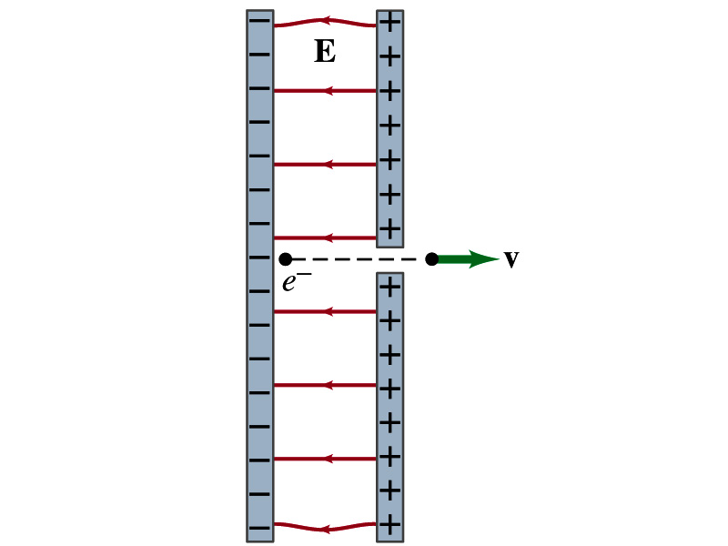
Special Project
Particle Accelerator. A charged particle of mass M with charge -Q is accelerated in the uniform field E between two parallel charged plates whose separation is D as shown in the figure on the right. The charged particle is accelerated from an initial speed v₀ near the negative plate and passes through a tiny hole in the positive plate.
  Derive the formula for the electric field E to accelerate the charged particle to a fraction f of the speed of light c. Express E in terms of M, Q, D, f, c and v₀.
  (a) Using the Coulomb force and kinematic equations. (8 points)
  (b) Using the work-kinetic energy theorem. ( 8 points)
  (c) Using the formula above, evaluate the strength of the electric field E to accelerate an electron from 0.1% of the speed of light to 90% of the speed of light. You need to look up the relevant constants, such as mass of the electron, charge of the electron and the speed of light. (5 points)
Due beginning of the class Monday, June 20

Slide 5
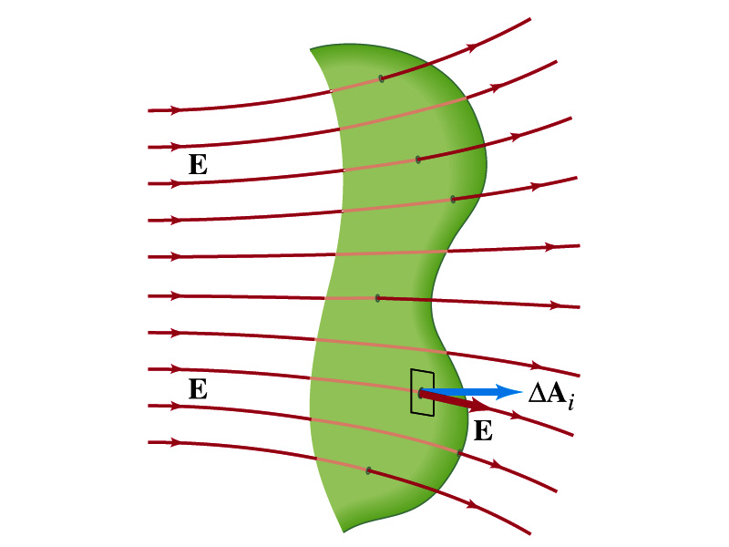
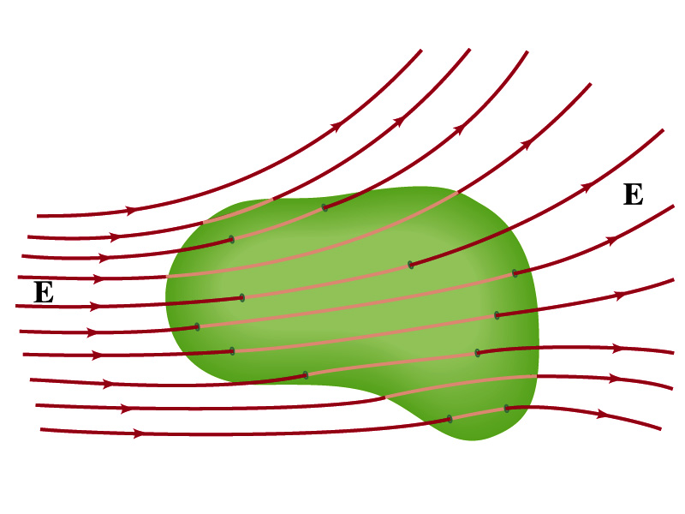
Generalization of the Electric Flux
Let’s consider a surface of area A that is not a square or flat but in some random shape, and that the field is not uniform.
The surface can be divided up into infinitesimally small areas of ΔA_{i} that can be considered flat.
And the electric field through this area can be considered uniform since the area is very small.
Then the electric flux through the entire surface is approximately
In the limit where ΔA_{i} → 0, the discrete summation becomes an integral.
open surface
enclosed surface

Slide 6
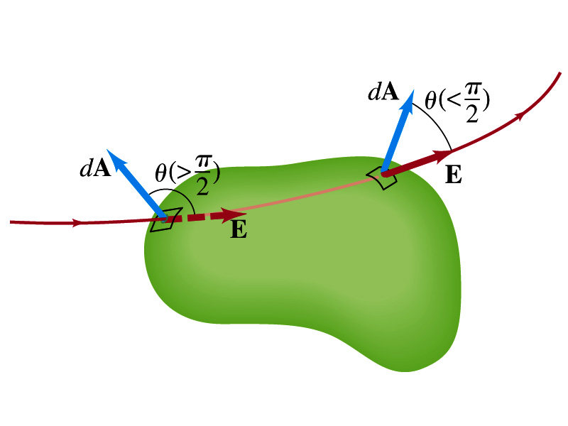
Generalization of the Electric Flux
We arbitrarily define that the area vector points outward from the enclosed volume.
  For the line leaving the volume, θ<π/2 and cosθ>0. The flux is positive.
  For the line coming into the volume, θ>π/2 and cosθ<0. The flux is negative.
  If Φ_{E}>0, there is net flux out of the volume.
  If Φ_{E}<0, there is flux into the volume.
In the above figures, each field that enters the volume also leaves the volume, so
The flux is non-zero only if one or more lines start or end inside the surface.

Slide 7
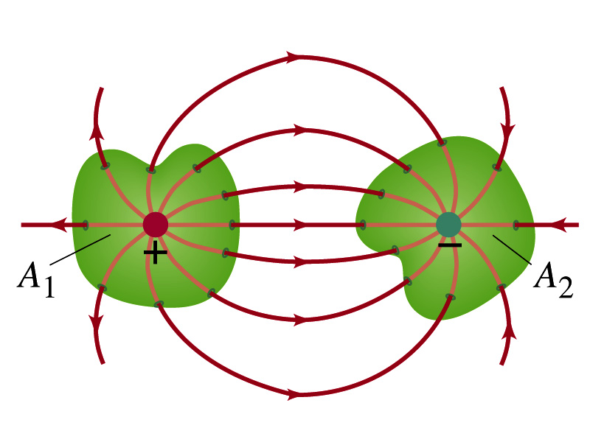
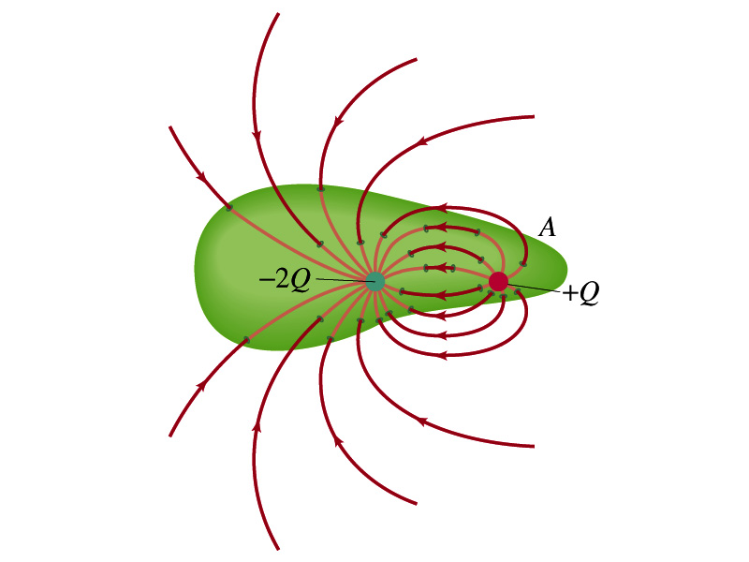
Generalization of the Electric Flux
The field line starts or ends only on a charge.
Sign of the net flux on the surface A₁?
  The net outward flux (positive flux)
How about A₂?
  Net inward flux (negative flux)
What is the flux in the bottom figure?
  There should be a net inward flux (negative flux) since the total charge inside the volume is negative.
The net flux that crosses an enclosed surface is proportional to the total charge inside the surface. ➔ This is the crux of Gauss’ law.

Slide 8
Gauss’ Law
q
q’
Let’s consider the case in the above figure.
What are the results of the closed integral of the Gaussian surfaces A₁ and A₂?
  For A₁
  For A₂

Slide 9
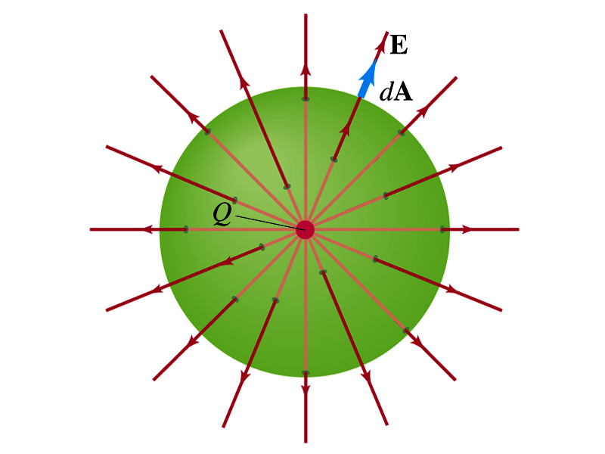
Coulomb’s Law from Gauss’ Law
Let’s consider a charge Q enclosed inside our imaginary Gaussian surface of sphere of radius r.
  Since we can choose any surface enclosing the charge, we choose the simplest possible one! ☺
The surface is symmetric about the charge.
  What does this tell us about the field E?
    Must have the same magnitude (uniform) at any point on the surface
    Points radially outward parallel to the surface vector dA.
The Gaussian integral can be written as
Solve
for E
Electric Field of
Coulomb’s Law

Slide 10
Gauss’ Law from Coulomb’s Law
Let’s consider a single static point charge Q surrounded by an imaginary spherical surface.
Coulomb’s law tells us that the electric field at a spherical surface of radius r is
Performing a closed integral over the surface, we obtain
Gauss’ Law

Slide 11
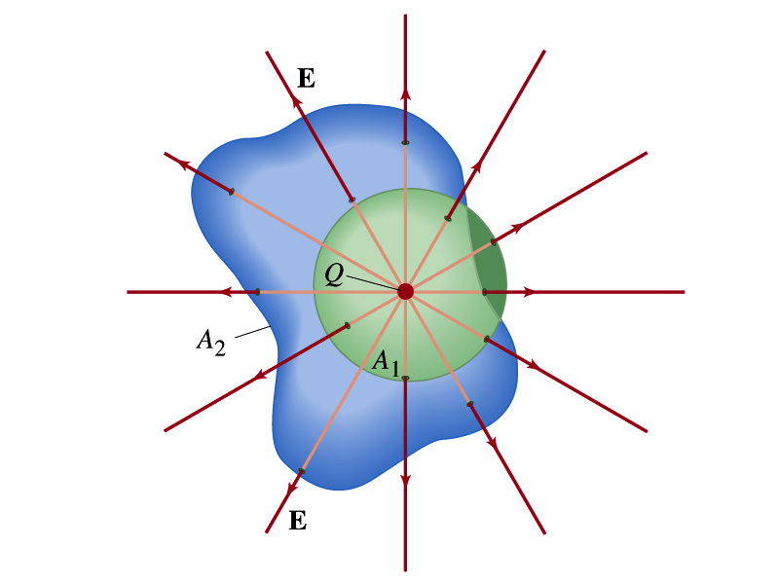
Gauss’ Law from Coulomb’s Law
Irregular Surface
Let’s consider the same single static point charge Q surrounded by a symmetric spherical surface A₁ and a randomly shaped surface A₂.
What is the difference in the number of field lines due to the charge Q, passing through the two surfaces?
  None. What does this mean?
    The total number of field lines passing through the surface is the same no matter what the shape of the enclosed surface is.
  So we can write:
  What does this mean?
    The flux due to the given enclosed charge is the same no matter what the shape of the surface enclosing it is. ➔ Gauss’ law, , is valid for any surface surrounding a single point charge Q.

Slide 12
Gauss’ Law w/ more than one charge
Let’s consider several charges inside a closed surface.
For each charge, Q_{i}, inside the chosen closed surface,
What is ?
The electric field produced by Q_{i} alone!
Since electric fields can be added vectorially, following the superposition principle, the total field E is equal to the sum of the fields due to each charge and any external fields. So
The value of the flux depends only on the charge enclosed in the surface!! ➔ Gauss’ law.
What is Q_{encl}?
The total enclosed charge!

Slide 13
So what is Gauss’ Law good for?
Derivation of Gauss’ law from Coulomb’s law is only valid for static electric charge.
Electric field can also be produced by changing magnetic fields.
  Coulomb’s law cannot describe this field while Gauss’ law is still valid
Gauss’ law is more general than Coulomb’s law.
  Can be used to obtain electric field, forces or obtain charges
Gauss’ Law: Any differences between the input and output flux of the electric field over any enclosed surface is due to the charge within that surface!!!

Slide 14
Solving problems with Gauss’ Law
Identify the symmetry of the charge distributions
Draw the appropriate Gaussian surface, making sure it passes through the point you want to know the electric field
Use the symmetry of charge distribution to determine the direction of E at the point of the Gaussian surface
Evaluate the flux
Calculate the enclosed charge by the Gaussian surface
  Ignore all the charges outside the Gaussian surface
Equate the flux to the enclosed charge and solve for E

Slide 15
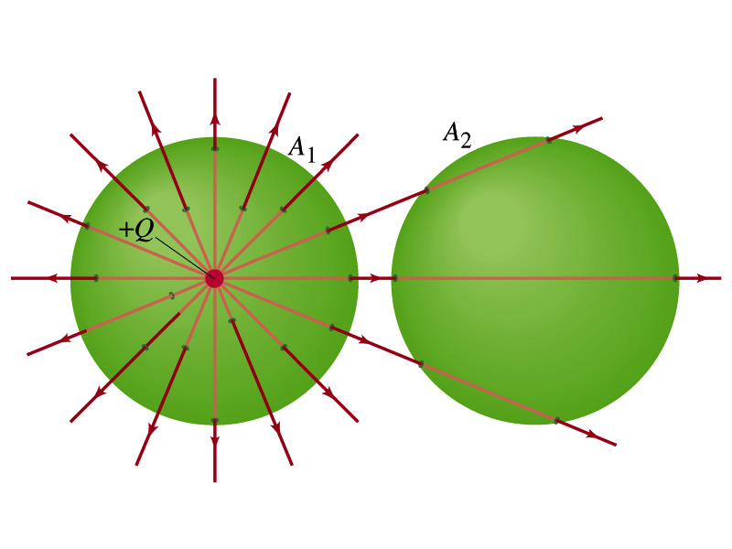
Example 22 – 2
Flux from Gauss’ Law: Consider two Gaussian surfaces, A₁ and A₂, shown in the figure. The only charge present is the charge +Q at the center of surface A₁. What is the net flux through each surface A₁ and A₂?
The surface A₁ encloses the charge +Q, so from Gauss’ law we obtain the total net flux
The surface A₂ the charge, +Q, is outside the surface, so the total net flux is 0.

Slide 16
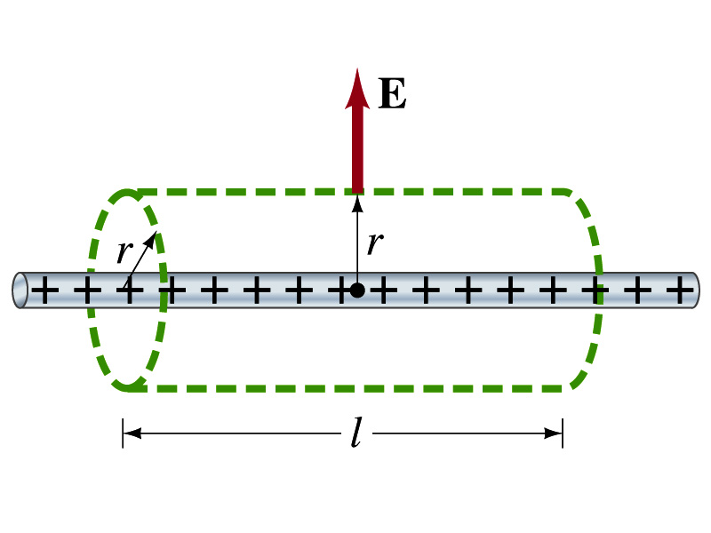
Example 22 – 6
Long uniform line of charge: A very long straight wire possesses a uniform positive charge per unit length, λ. Calculate the electric field at points near but outside the wire, far from the ends.
Which direction do you think the field due to the charge on the wire is?
  Radially outward from the wire, the direction of radial vector r.
Due to cylindrical symmetry, the field is the same on the Gaussian surface of a cylinder surrounding the wire.
  The end surfaces do not contribute to the flux at all. Why?
    Because the field vector E is perpendicular to the surface vector dA.
From Gauss’ law
Solving for E

Slide 17
A Brain Teaser of Electric Flux
What would change the electric flux through a circle lying in the xz plane where the electric field is (10N/C)j?
  Changing the magnitude of the electric field
  Changing the surface area of the circle
  Tipping the circle so that it is lying in the xy plane
  All of the above
  None of the above

Slide 18
Gauss’ Law Summary
The precise relation between flux and the enclosed charge is given by Gauss’ Law
    ε₀ is the permittivity of free space in the Coulomb’s law
A few important points on Gauss’ Law
  Freedom to choose!!
    The integral is performed over the value of E on a closed surface of our choice in any given situation.
  Test of existence of electrical charge!!
    The charge Q_{encl} is the net charge enclosed by the arbitrary closed surface of our choice.
  Universality of the law!
    It does NOT matter where or how much charge is distributed inside the surface.
  The charge outside the surface does not contribute to Q_{encl}. Why?
    The charge outside the surface might impact field lines but not the total number of lines entering or leaving the surface

Slide 19
Electric Potential Energy
Concept of energy is very useful solving mechanical problems
Conservation of energy makes solving complex problems easier.
When can the potential energy be defined?
  Only for a conservative force.
  The work done by a conservative force is independent of the path. What does it only depend on??
    The difference between the initial and final positions
  Can you give me an example of a conservative force?
    Gravitational force
Is the electrostatic force between two charges a conservative force?
  Yes. Why?
  The dependence of the force to the distance is identical to that of the gravitational force.
    The only thing matters is the direct linear distance between the objects not the path.

Slide 20
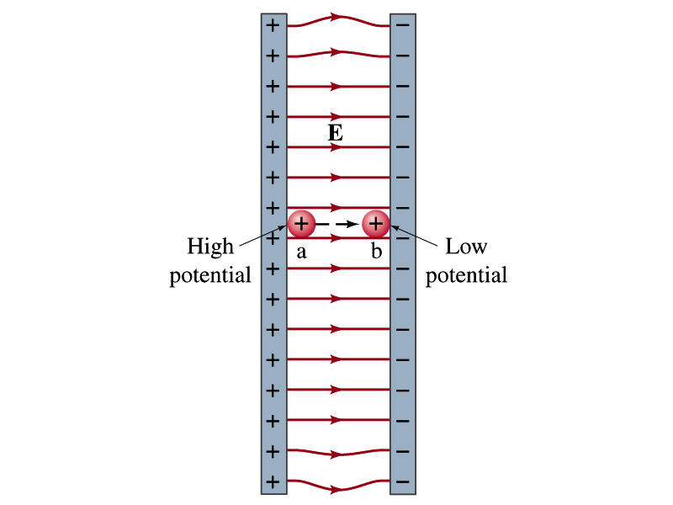
Electric Potential Energy
How would you define the change in electric potential energy U_{b} – U_{a}?
  The potential gained by the charge as it moves from point a to point b.
  The negative work done on the charge by the electric force to move it from a to b.
Let’s consider an electric field between two parallel plates w/ equal but opposite charges
  The field between the plates is uniform since the gap is small and the plates are infinitely long…
What happens when we place a small charge, +q, on a point at the positive plate and let go?
  The electric force will accelerate the charge toward negative plate.
  What kind of energy does the charged particle gain?
    Kinetic energy

Slide 21
Electric Potential Energy
What does this mean in terms of energies?
  The electric force is a conservative force.
  Thus, the mechanical energy (K+U) is conserved under this force.
  The charged object has only the electric potential energy at the positive plate.
  The electric potential energy decreases and
  Turns into kinetic energy as the electric force works on the charged object, and the charged object gains speed.
Point of greatest potential energy for
  Positively charged object
  Negatively charged object
PE=
U
0
KE=
0
K
ME=
U
K
U+K

Slide 22
Electric Potential
How is the electric field defined?
  Electric force per unit charge: F/q
We can define electric potential (potential) as
  The electric potential energy per unit charge
  This is like the voltage of a battery…
Electric potential is written with a symbol V
  If a positive test charge q has potential energy U_{a} at a point a, the electric potential of the charge at that point is

Slide 23
Electric Potential
Since only the difference in potential energy is meaningful, only the potential difference between two points is measurable
What happens when the electric force does “positive work”?
  The charge gains kinetic energy
  Electric potential energy of the charge decreases
Thus the difference in potential energy is the same as the negative of the work, W_{ba}, done on the charge by the electric field to move the charge from point a to b.
The potential difference V_{ba} is
  Electric potential is independent of the test charge!!

Slide 24
A Few Things about Electric Potential
What does the electric potential depend on?
  Other charges that creates the field
  What about the test charge?
    No, the electric potential is independent of the test charge
    Test charge gains potential energy by existing in the potential created by other charges
Which plate is at a higher potential?
  Positive plate. Why?
    Since positive charge has the greatest potential energy on it.
  What happens to the positive charge if it is let go?
    It moves from higher potential to lower potential
  How about a negative charge?
    Its potential energy is higher on the negative plate. Thus, it moves from negative plate to positive. Potential difference is the same.
The unit of the electric potential is Volt (V).
From the definition, 1V = 1J/C.
Zero point of electric potential can be chosen arbitrarily.
Often the ground, a conductor connected to Earth, is zero.

