Slide 1
PHYS 1441 – Section 001 Lecture #7
Wednesday, June 15, 2016
Dr. Jaehoon Yu
Chapter 23 Electric Potential
Electric Potential due to Point Charges
Shape of the Electric Potential
V due to Charge Distributions
Equi-potential Lines and Surfaces
Electric Potential Due to Electric Dipole
Chapter 24 Capacitance etc..
Capacitors
Today’s homework is homework #4, due 11pm, Sunday, June 19!!

Slide 2
Announcements
Quiz #2
Beginning of the class tomorrow, Thursday, June 16
Covers CH22.1 through what we cover in class today
Bring your calculator but DO NOT input formula into it!
Cell phones or any types of computers cannot replace a calculator!
BYOF: You may bring a one 8.5x11.5 sheet (front and back) of handwritten formulae and values of constants for the quiz
No derivations, word definitions or solutions of any problems!
No additional formulae or values of constants will be provided!
Reading assignments
CH23.9

Slide 3
Reminder: Special Project #2 – Angels & Demons
Compute the total possible energy released from an annihilation of x-grams of anti-matter and the same quantity of matter, where x is the last two digits of your SS#. (20 points)
Use the famous Einstein’s formula for mass-energy equivalence
Compute the power output of this annihilation when the energy is released in x ns, where x is again the first two digits of your SS#. (10 points)
Compute how many cups of gasoline (8MJ) this energy corresponds to. (5 points)
Compute how many months of world electricity usage (3.6GJ/mo) this energy corresponds to. (5 points)
Due by the beginning of the class tomorrow Thursday, June 16.

Slide 4
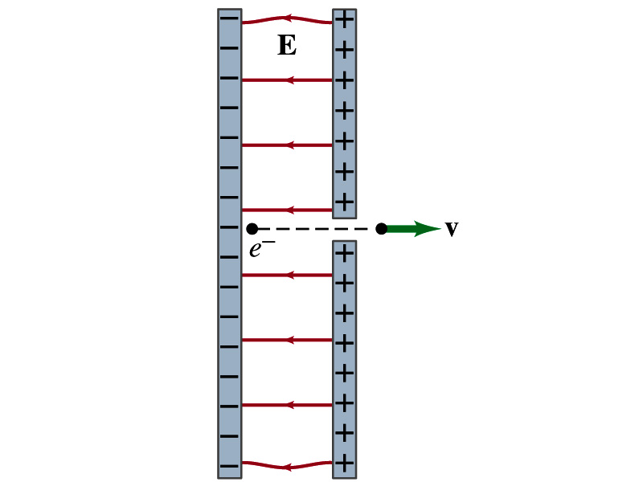
Special Project
Particle Accelerator. A charged particle of mass M with charge -Q is accelerated in the uniform field E between two parallel charged plates whose separation is D as shown in the figure on the right. The charged particle is accelerated from an initial speed v₀ near the negative plate and passes through a tiny hole in the positive plate.
Derive the formula for the electric field E to accelerate the charged particle to a fraction f of the speed of light c. Express E in terms of M, Q, D, f, c and v₀.
(a) Using the Coulomb force and kinematic equations. (8 points)
(b) Using the work-kinetic energy theorem. ( 8 points)
(c) Using the formula above, evaluate the strength of the electric field E to accelerate an electron from 0.1% of the speed of light to 90% of the speed of light. You need to look up the relevant constants, such as mass of the electron, charge of the electron and the speed of light. (5 points)
Due beginning of the class Monday, June 20

Slide 5
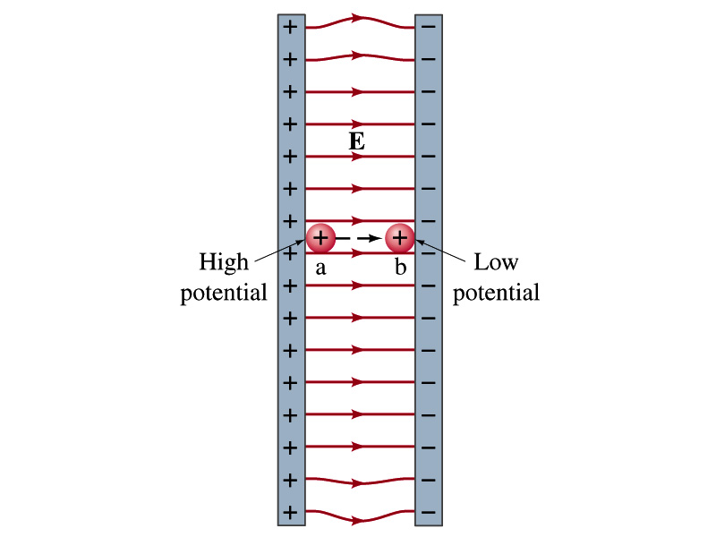
Example 23 – 1
A negative charge: Suppose a negative charge, such as an electron, is placed at point b in the figure. If the electron is free to move, will its electric potential energy increase or decrease? How will the electric potential change?
An electron placed at point b will move toward the positive plate since it was released at its highest potential energy point.
It will gain kinetic energy as it moves toward left, decreasing its potential energy.
The electron, however, moves from the point b at a lower potential to point a at a higher potential. ΔV=V_{a}-V_{b}>0.
This is because the potential is generated by the charges on the plates not by the electron.

Slide 6
Electric Potential and Potential Energy
What is the definition of the electric potential?
The potential energy difference per unit charge
OK, then, how would you express the potential energy that a charge q would obtain when it is moved between point a and b with the potential difference V_{ba}?
In other words, if an object with charge q moves through a potential difference V_{ba}, its potential energy changes by qV_{ba}.
So based on this, how differently would you describe the electric potential in words?
A measure of how much energy an electric charge can acquire in a given situation
A measure of how much work a given charge can do.

Slide 7
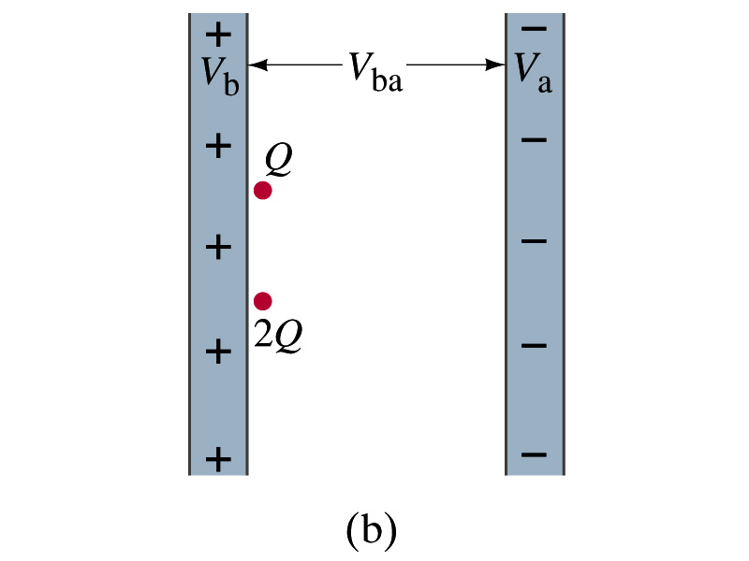
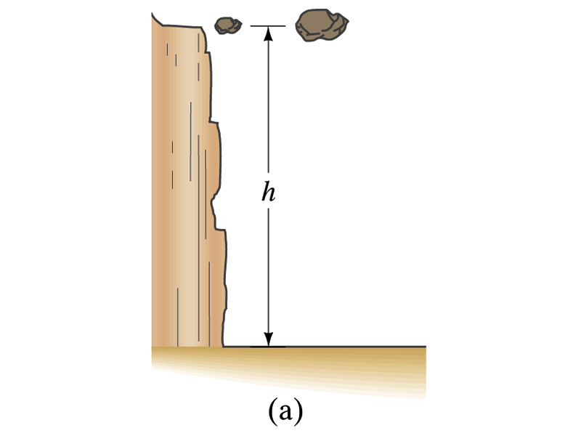
Comparisons of Potential Energies
Let’s compare gravitational and electric potential energies
m
2m
What are the potential energies of the rocks?
mgh and 2mgh
Which rock has a bigger potential energy?
The rock with a larger mass
Why?
It’s got a bigger mass.
What are the potential energies of the charges?
QV_{ba} and 2QV_{ba}
Which object has a bigger potential energy?
The object with a larger charge.
Why?
It’s got a bigger charge.
The potential is the same but the heavier rock or larger charge can do a greater work.

Slide 8
Electric Potential and Potential Energy
The electric potential difference gives potential energy or the possibility to perform work based on the charge of the object.
So what is happening in batteries or generators?
They maintain a potential difference.
The actual amount of energy used or transformed depends on how much charge flows.
How much is the potential difference maintained by a car’s battery?
12Volts
If for a given period, 5C charge flows through the headlight lamp, what is the total energy transformed?
E_{tot}=5C*12V=60 Umm… What is the unit?
If it is left on twice as long? E_{tot}=10C*12V=120J.
Joules

Slide 9
Some Typical Voltages
Sources | Approximate Voltage
Thundercloud to ground | 10⁸ V
High-Voltage Power Lines | 10⁶ V
Power supply for TV tube | 10⁴ V
Automobile ignition | 10⁴ V
Household outlet | 10² V
Automobile battery | 12 V
Flashlight battery | 1.5 V
Resting potential across nerve membrane | 10⁻¹ V
Potential changes on skin (EKG and EEG) | 10⁻⁴ V
In a typical lightening strike, 15C of electrons are released in 500μs. What is the total kinetic energy of these electrons when they strike ground? What is the power released during this strike? What do you think will happen to a tree hit by this lightening?

Slide 10
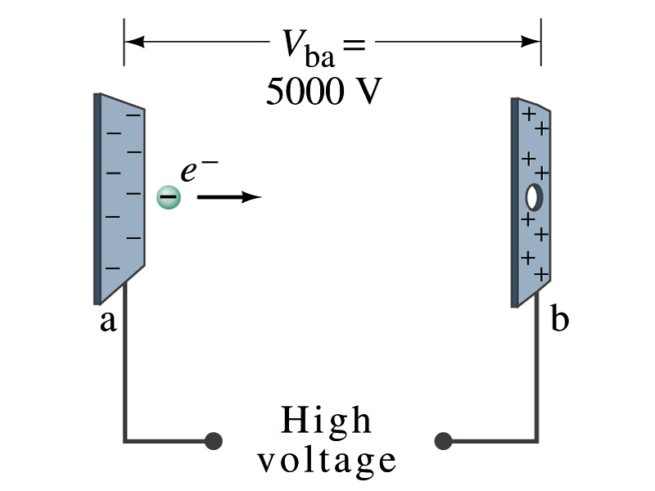
Example 23 – 2
Electrons in TV tube: Suppose an electron in the picture tube of a television set is accelerated from rest through a potential difference V_{ba}=+5000V. (a) What is the change in potential energy of the electron? (b) What is the speed of the electron (m=9.1x10⁻³¹kg) as a result of this acceleration? (c) Repeat for a proton (m=1.67x10⁻²⁷kg) that accelerates through a potential difference of V_{ba}=-5000V.
(a) What is the charge of an electron?
So what is the change of its potential energy?

Slide 11
Example 23 – 2
(b) Speed of the electron?
The entire potential energy of the electron turns to its kinetic energy. Thus the equation is
(C) Speed of a proton?

Slide 12
Electric Potential and Electric Field
The effect of a charge distribution can be described in terms of electric field or electric potential.
What kind of quantities are the electric field and the electric potential?
Electric Field:
Electric Potential:
Since electric potential is a scalar quantity, it is often easier to handle.
Well other than the above, what are the connections between these two quantities?
Vector
Scalar

Slide 13
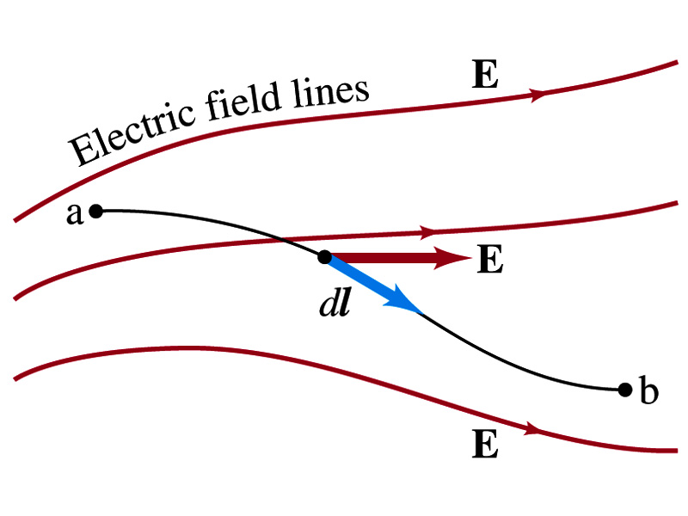
Electric Potential and Electric Field
Potential energy change is expressed in terms of a conservative force (point a at a higher potential)
For the electrical case, we are more interested in the potential difference:
This formula can be used to determine V_{ba} when the electric field is given.
When the field is uniform
so
What does “-”sign mean?
The direction of E is along that of decreasing potential.
Unit of the electric field in terms of potential?
V/m
Can you derive this from N/C?

Slide 14
Example
Uniform electric field obtained from voltage: Two parallel plates are charged to a voltage of 50V. If the separation between the plates is 5.0cm, calculate the magnitude of the electric field between them, ignoring any fringe effect.
5cm
50V
What is the relationship between electric field and the potential for a uniform field?
Solving for E
Which direction is the field?
Direction of decreasing potential!

Slide 15
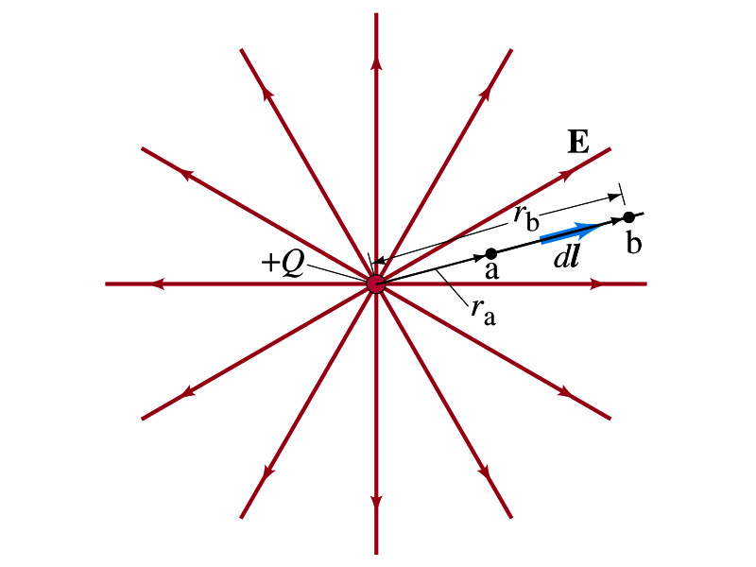
Electric Potential due to Point Charges
What is the electric field by a single point charge Q at a distance r?
Electric potential due to the field E for moving from point r_{a} to r_{b} in radial direction away from the charge Q is

Slide 16
Electric Potential due to Point Charges
Since only the differences in potential have physical meaning, we can choose at .
The electrical potential V at a distance r from a single point charge Q is
So the absolute potential by a single point charge can be thought of the potential difference by a single point charge between r and infinity

Slide 17
Properties of the Electric Potential
What are the differences between the electric potential and the electric field?
Electric potential
Electric potential energy per unit charge
Inversely proportional to the distance
Simply add the potential by each of the source charges to obtain the total potential from multiple charges, since potential is a scalar quantity
Electric field
Electric force per unit charge
Inversely proportional to the square of the distance
Need vector sums to obtain the total field from multiple source charges
Potential due to a positive charge is a large positive near the charge and decreases towards 0 at the large distance.
Potential due to a negative charge is a large negative near the charge and increases towards 0 at a large distance.

Slide 18
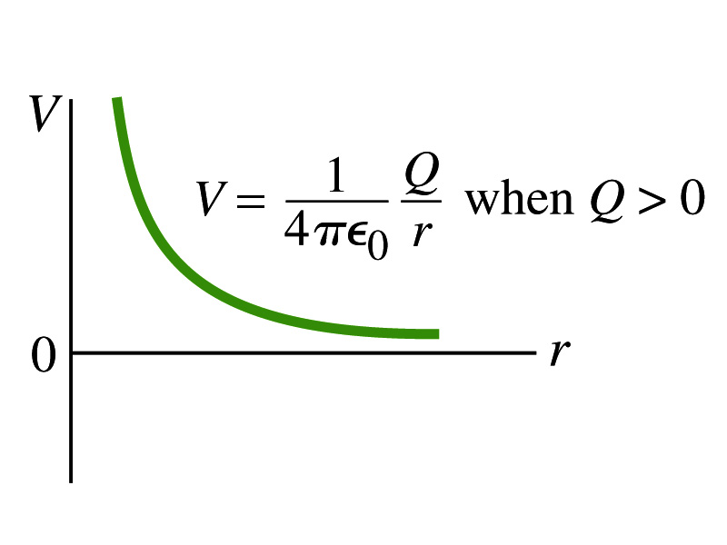
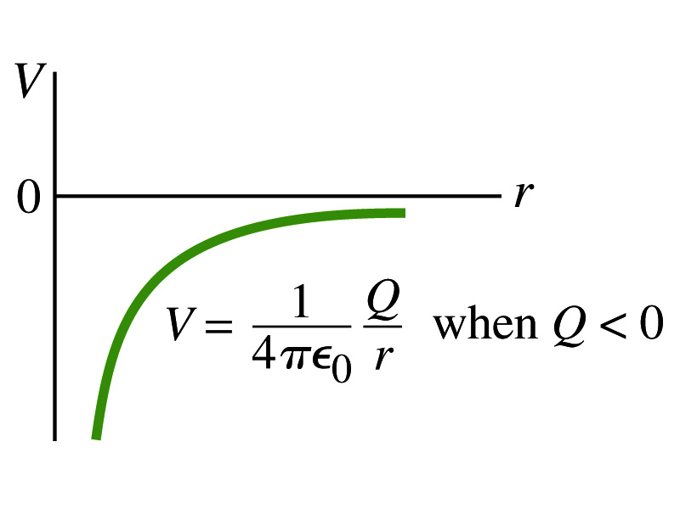
Shape of the Electric Potential
So, how does the electric potential look like as a function of distance?
What is the formula for the potential by a single charge?
Positive Charge
Negative Charge
Uniformly charged sphere would have the potential the same as a single point charge.
What does this mean?
Uniformly charged sphere behaves like all the charge is on the single point in the center.

Slide 19
Example 23 – 6
Work to bring two positive charges close together: What minimum work is required by an external force to bring the charge q=3.00μC from a great distance away (r=∞) to a point 0.500m from a charge Q=20.0 μC?
What is the work done by the electric field in terms of potential energy and potential?
Since we obtain
Electric force does negative work. In other words, the external force must work +1.08J to bring the charge 3.00μC from infinity to 0.500m to the charge 20.0μC.

Slide 20
Electric Potential by Charge Distributions
Let’s consider a case of n individual point charges in a given space and V=0 at r=∞.
Then the potential V_{ia} due to the charge Q_{i} at point a, distance r_{ia} from Q_{i} is
Thus the total potential V_{a} by all n point charges is
For a continuous charge distribution, we obtain

Slide 21
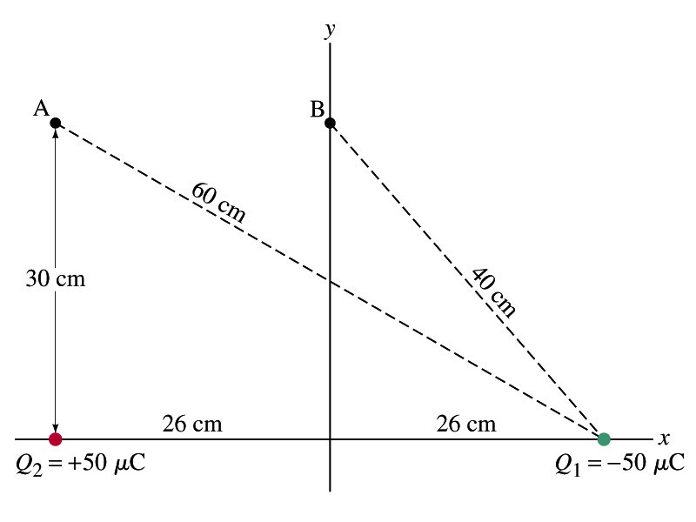
Example
Potential due to two charges: Calculate the electric potential (a) at point A in the figure due to the two charges shown, and (b) at point B.
Potential is a scalar quantity, so one adds the potential by each of the source charge, as if they are numbers.
(a) potential at A is
(b) How about potential at B?

Slide 22
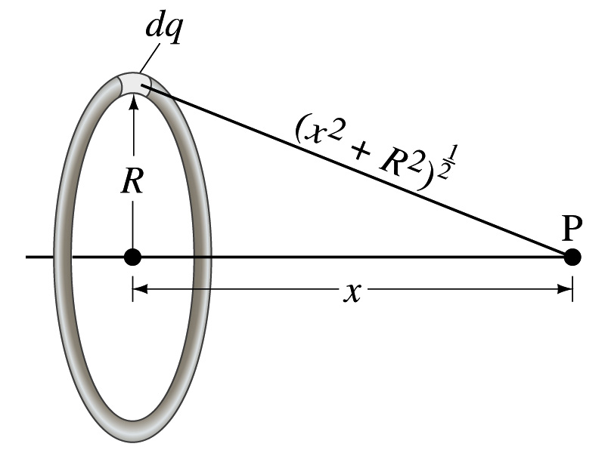
Example 23 – 8
Potential due to a ring of charge: A thin circular ring of radius R carries a uniformly distributed charge Q. Determine the electric potential at a point P on the axis of the ring a distance x from its center.
Each point on the ring is at the same distance from the point P. What is the distance?
So the potential at P is
What’s this?

