Slide 1
PHYS 1441 – Section 001 Lecture #8
Friday, June 16, 2016
Dr. Jaehoon Yu
Chapter 23 Electric Potential
Equi-potential Lines and Surfaces
Electric Potential Due to Electric Dipole
Chapter 24 Capacitance etc..
Capacitors

Slide 2
Announcements
Mid Term Exam
In class Wednesday, June 22
Covers CH21.1 through what we cover in class coming Tuesday + appendix
Bring your calculator but DO NOT input formula into it!
Cell phones or any types of computers cannot replace a calculator!
BYOF: You may bring a one 8.5x11.5 sheet (front and back) of handwritten formulae and values of constants for the quiz
No derivations, word definitions or solutions of any problems!
No additional formulae or values of constants will be provided!
Reading assignments
CH23.9

Slide 3
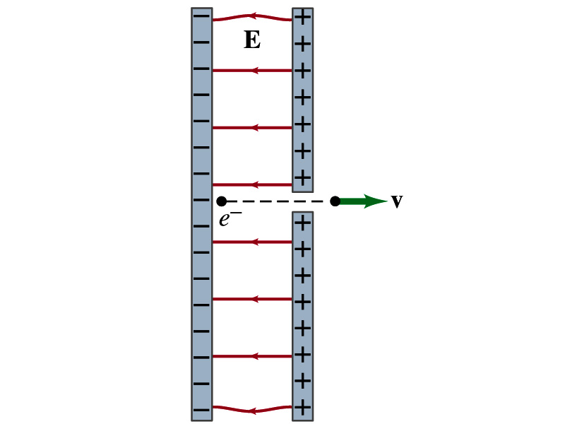
Reminder for Special Project #3
Particle Accelerator. A charged particle of mass M with charge -Q is accelerated in the uniform field E between two parallel charged plates whose separation is D as shown in the figure on the right. The charged particle is accelerated from an initial speed v₀ near the negative plate and passes through a tiny hole in the positive plate.
Derive the formula for the electric field E to accelerate the charged particle to a fraction f of the speed of light c. Express E in terms of M, Q, D, f, c and v₀.
(a) Using the Coulomb force and kinematic equations. (8 points)
(b) Using the work-kinetic energy theorem. ( 8 points)
(c) Using the formula above, evaluate the strength of the electric field E to accelerate an electron from 0.1% of the speed of light to 90% of the speed of light. You need to look up the relevant constants, such as mass of the electron, charge of the electron and the speed of light. (5 points)
Due beginning of the class Monday, June 20

Slide 4
Equi-potential Surfaces
Electric potential can be graphically shown using the equipotential lines in 2-D or the equipotential surfaces in 3-D
Any two points on the equipotential surfaces (lines) are at the same potential
What does this mean in terms of the potential difference?
The potential difference between the two points on an equipotential surface is 0.
How about the potential energy difference?
Also 0.
What does this mean in terms of the work to move a charge along the surface between these two points?
No work is necessary to move a charge between these two points.

Slide 5
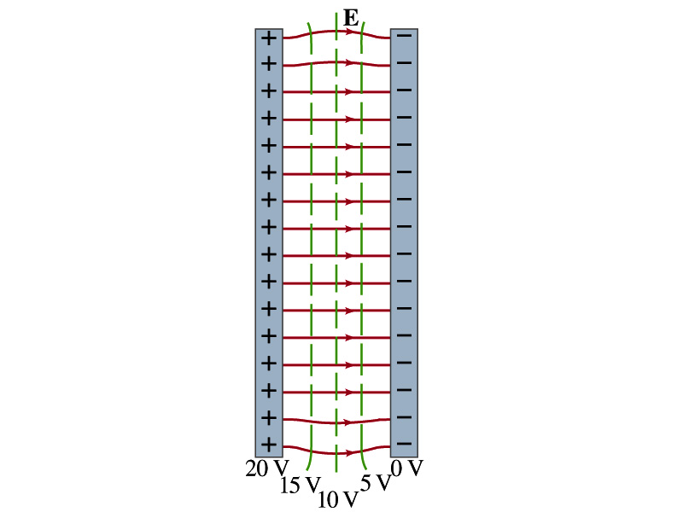
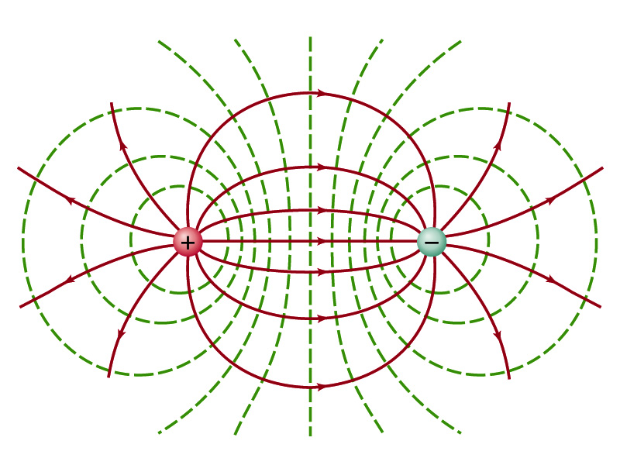
Equi-potential Surfaces
An equipotential surface (line) must be perpendicular to the electric field. Why?
If there are any parallel components to the electric field, it would require work to move a charge along the surface.
Since the equipotential surface (line) is perpendicular to the electric field, we can draw these surfaces or lines easily.
Since there can be no electric field within a conductor in a static case, the entire volume of a conductor must be at the same potential.
So the electric field must be perpendicular to the conductor surface.
Parallel Plate
Point charges
Just like a topological map

Slide 6
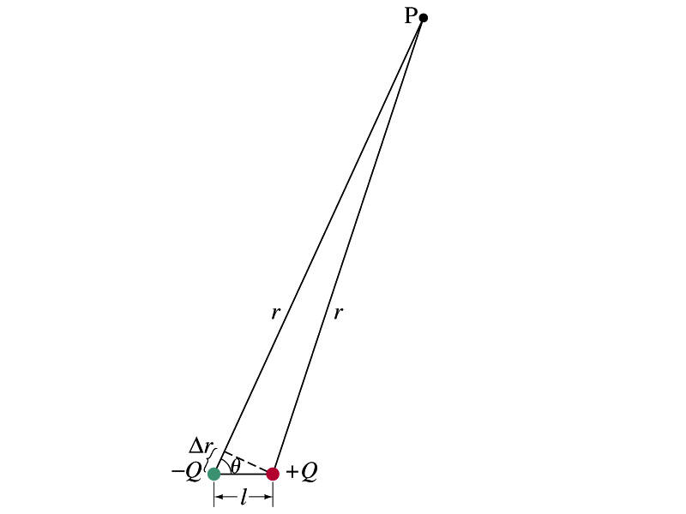
Electric Potential due to Electric Dipoles
What is an electric dipole?
Two equal point charge Q of opposite signs separated by a distance l and behaves like one entity: P=Ql
For the electric potential due to a dipole at a point p
We take V=0 at r=∞
The simple sum of the potential at p by the two charges is
Since Δr=lcosθ and if r>>l, r>>Δr, thus r~r+Δr and
V by a dipole at a
distance r from
the dipole

Slide 7
E Determined from V
Potential difference between two points under the electric field is
So in a differential form, we can write
What are dV and E_{l}?
dV is the infinitesimal potential difference between the two points separated by a distance dl
E_{l} is the field component along the direction of dl.
Thus we can write the field component E_{l} as
The component of the electric field in any direction is equal to the negative rate of change of the electric potential as a function of distance in that direction.!!
Physical Meaning?

Slide 8
E Determined from V
The quantity dV/dl is called the gradient of V in a particular direction
If no direction is specified, the term gradient refers to the direction on which V changes most rapidly and this would be the direction of the field vector E at that point.
So if E and dl are parallel to each other,
If E is written as a function x, y and z, the l refers to x, y and z
is the “partial derivative” of V with respect to x, while y and z held constant
In vector form,
is called del or the gradient operator and is a vector operator.

Slide 9
Electrostatic Potential Energy
Consider a case in which a point charge q is moved between points a and b where the electrostatic potential due to other charges in the system is V_{a} and V_{b}
The change in electrostatic potential energy of q in the field by other charges is
Now what is the electrostatic potential energy of a system of charges?
Let’s choose V=0 at r=∞
If there are no other charges around, single point charge Q₁ in isolation has no potential energy and is under no electric force

Slide 10
Electrostatic Potential Energy; Two charges
If a second point charge Q₂ is brought close to Q₁ at a distance r₁₂, the potential due to Q₁ at the position of Q₂ is
The potential energy of the two charges relative to V=0 at r= ∞ is
This is the work that needs to be done by an external force to bring Q₂ from infinity to a distance r₁₂ from Q₁.
It is also a negative of the work needed to separate them to infinity.

Slide 11
Electrostatic Potential Energy; Three Charges
So what do we do for three charges?
Work is needed to bring all three charges together
Work needed to bring Q₁ to a certain location without the presence of any charge is 0.
Work needed to bring Q₂ to a distance to Q₁ is
Work need to bring Q₃ to certain distances to Q₁ and Q₂ is
So the total electrostatic potential energy of the three charge system is
What about a four charge system or N charge system?

Slide 12
Electrostatic Potential Energy: electron Volt
What is the unit of electrostatic potential energy?
Joules
Joules is a very large unit in dealing with electrons, atoms or molecules atomic scale problems
For convenience a new unit, electron volt (eV), is defined
1 eV is defined as the energy acquired by a particle carrying the charge equal to that of an electron (q=e) when it moves across a potential difference of 1V.
How many Joules is 1 eV then?
eV however is NOT a standard SI unit. You must convert the energy to Joules for computations.
What is the speed of an electron with kinetic energy 5000eV?

Slide 13
Capacitors (or Condensers)
What is a capacitor?
A device that can store electric charge
But does not let them flow through
What does it consist of?
Usually consists of two conducting objects (plates or sheets) placed near each other without touching
Why can’t they touch each other?
The charge will neutralize…
Can you give some examples?
Camera flash, UPS, Surge protectors, binary circuits, memory, etc…
How is a capacitor different than a battery?
Battery provides potential difference by storing energy (usually chemical energy) while the capacitor stores charges but very little energy.

Slide 14
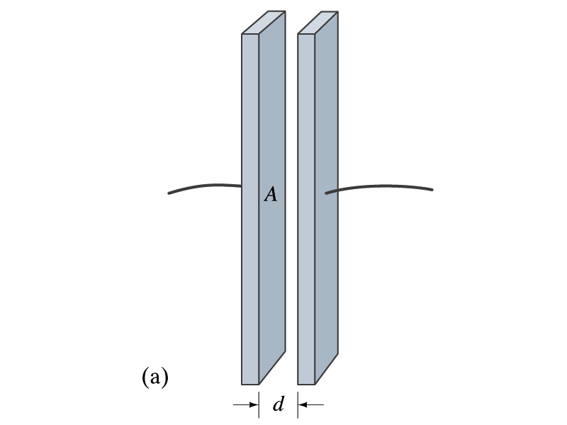
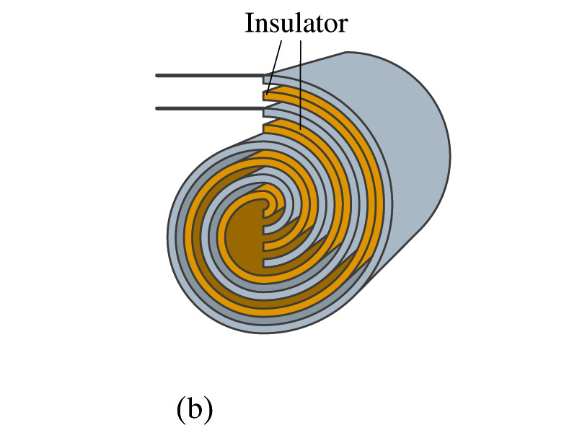
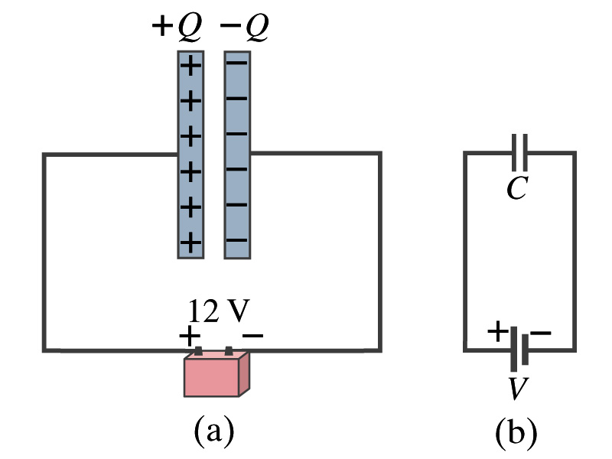
Capacitors
A simple capacitor consists of a pair of parallel plates of area A separated by a distance d.
A cylindrical capacitors are essentially parallel plates wrapped around as a cylinder.
How would you draw symbols for a capacitor and a battery?
Capacitor -||-
Battery (+) -|i- (-)
Circuit
Diagram

