Slide 1
PHYS 1441 – Section 001 Lecture #10
Tuesday, June 21, 2016
Dr. Jaehoon Yu
Chapter 25
Electric Current and Resistance
The Battery
Ohm’s Law: Resisters, Resistivity
Electric Power
Alternating Current
Microscopic View of Electric Current
Ohm’s Law in Microscopic View
EMF and Terminal Voltage

Slide 2
Announcements
Mid Term Exam
In class tomorrow, Wednesday, June 22
Covers CH21.1 through what we cover in class today + appendix
Bring your calculator but DO NOT input formula into it!
Cell phones or any types of computers cannot replace a calculator!
BYOF: You may bring a one 8.5x11.5 sheet (front and back) of handwritten formulae and values of constants for the quiz
No derivations, word definitions or solutions of any problems!
No additional formulae or values of constants will be provided!
Reading assignments
CH25. 8 – 25.10
Quiz 2 results
Class average: 31.5/70
Equivalent to 45/100
Previous results: 48/100
Top score: 59/70

Slide 3
Electric Current and Resistance
So far we have been studying static electricity
What is the static electricity?
The charges so far has not been moving but staying put at the location they are placed.
Now we will learn dynamics of electricity
What is the electric current?
A flow of electric charge
A few examples of the things that use electric current in everyday lives?
In an electrostatic situation, there is no electric field inside a conductor but when there is current, there is field inside a conductor. Why?
Electric field is needed to keep charges moving

Slide 4
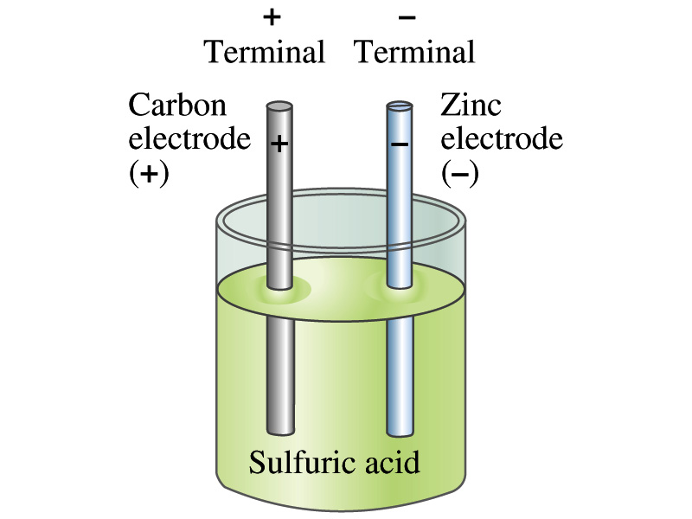
The Electric Battery
What is a battery?
A device that produces electrical energy from the stored chemical energy and produces electricity ➔ Maintains potential difference!
Electric battery was invented by Volta in 1790s in Italy
It was made of disks of zinc and silver based on his research that certain combinations of materials produce a greater electromotive force (emf), or potential, than others
Simplest batteries contain two plates made of dissimilar metals called electrodes
Electrodes are immersed in a solution, the electrolyte
This unit is called a cell and many of these form a battery
Zinc and Iron in the figure are called terminals

Slide 5
How does a battery work?
One of the electrodes in the figure is zinc and the other carbon
The acid electrolyte reacts with the zinc electrode and dissolves it.
Each zinc atom leaves two electrons in the electrode and enters into the solution as a positive ion ➔ zinc electrode acquires negative charge and the electrolyte becomes positively charged
The carbon electrode picks up the positive charge
Since the two terminals are oppositely charged, there is a potential difference between them

Slide 6
How does a battery work?
When the terminals are not connected, only the necessary amount of zinc is dissolved into the solution.
How is a particular potential maintained?
As too many of zinc ion gets produced, if the terminals are not connected,
zinc electrode gets increasingly charged up negative
zinc ions get recombined with the electrons in zinc electrode
Why does battery go dead?
When the terminals are connected, the negative charges will flow away from the zinc electrode
More zinc atoms dissolve into the electrolyte to produce more charge
One or more electrode get used up not producing any more charge.

Slide 7
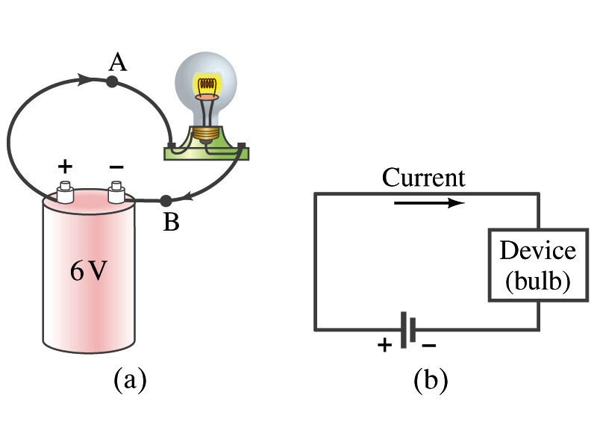
Electric Current
When a circuit is powered by a battery (or a source of emf) the charge can flow through the circuit.
Electric Current: Any flow of charge
Current can flow whenever there is a potential difference between the ends of a conductor (or when the two ends have opposite charges)
The current can flow even through the empty space under certain conditions
Electric current in a wire can be defined as the net amount of charge that passes through the wire’s full cross section at any point per unit time (just like the flow of water through a conduit.)
Average current is defined as:
The instantaneous current is:
What kind of a quantity is the current?
Unit of the current?
C/s
1A=1C/s
Scalar
In a single circuit, conservation of electric charge guarantees that the current at one point of the circuit is the same as any other points on the circuit.

Slide 8
Example 25 – 1
Current is a flow of charge: A steady current of 2.5A flows in a wire for 4.0min. (a) How much charge passed by any point in the circuit? (b) How many electrons would this be?
Current is total amount charge flow through a circuit in a given time. So from we obtain
The total number of electrons passed through the circuit is

Slide 9
Direction of the Electric Current
What do conductors have in abundance?
Free electrons
What happens if a continuous loop of conducting wire is connected to the terminals of a battery?
Electrons start flowing through the wire continuously as soon as both the terminals are connected to the wire. How?
The potential difference between the battery terminals sets up an electric field inside the wire and in the direction parallel to it
Free electrons in the conducting wire get attracted to the positive terminal
The electrons leaving negative terminal flow through the wire and arrive at the positive terminal
Electrons flow from negative to positive terminal
Due to historical convention, the direction of the current is opposite to the direction of flow of electrons ➔ Conventional Current

Slide 10
Ohm’s Law: Resistance and Resistors
What do we need to produce electric current?
Potential difference
Georg S. Ohm experimentally established that the current is proportional to the potential difference ( )
If we connect a wire to a 12V battery, the current flowing through the wire is twice that of 6V, three times that of 4V and four times that of 3V battery.
What happens if we reverse the sign of the voltage?
It changes the direction of the current flow
Does not change the magnitude of the current
Just as in water flow case, if the height difference is large the flow rate is large ➔ If the potential difference is large, the current is large.

Slide 11
Ohm’s Law: Resistance
The exact amount of current flow in a wire depends on
The voltage
The resistance of the wire to the flow of electrons
Just like the gunk in water pipe slows down water flow
Electrons are slowed down due to interactions with the atoms of the wire
The higher the resistance the less the current for the given potential difference V
So how would you define resistance?
So that current is inversely proportional to the resistance
Often it is rewritten as
What does this mean?
The metal conductor’s resistance R is a constant independent of V.
This linear relationship is not valid for some materials like diodes, vacuum tubes, transistors etc. ➔ These are called non-ohmic
Unit?
Ohm’s Law
ohms

Slide 12
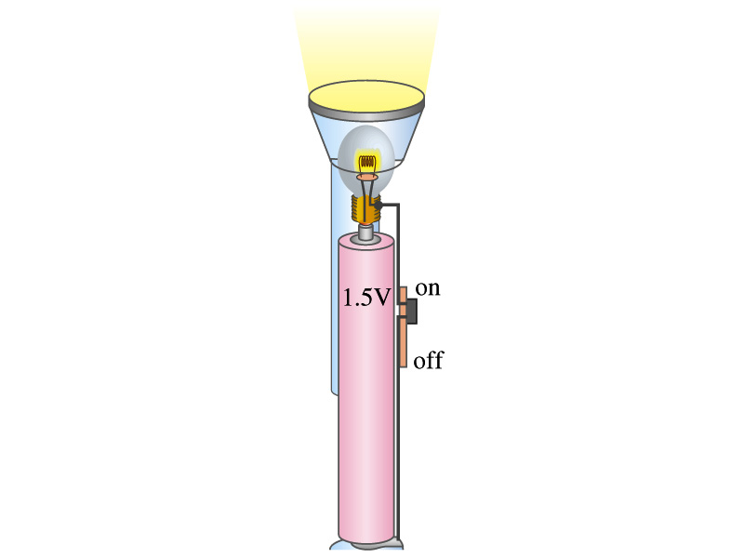
Example 25 – 4
Flashlight bulb resistance: A small flashlight bulb draws 300mA from its 1.5V battery. (a) What is the resistance of the bulb? (b) If the voltage drops to 1.2V, how would the current change?
From Ohm’s law, we obtain
Would the current increase or decrease, if the voltage reduces to 1.2V?
If the resistance did not change, the current is

Slide 13
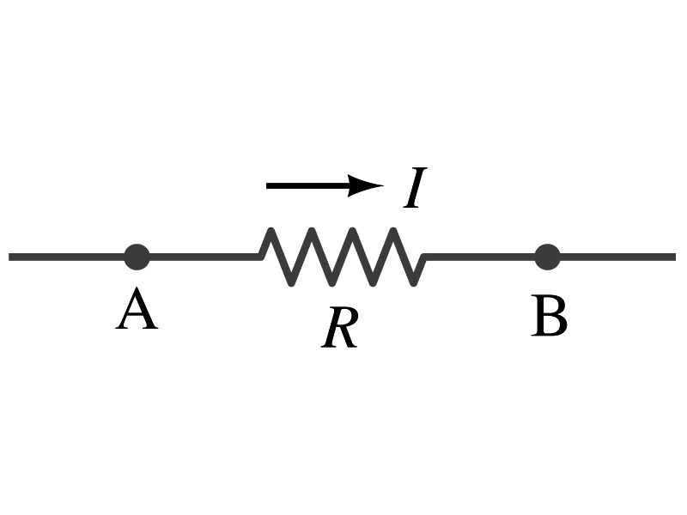
Ohm’s Law: Resistors
All electric devices offer resistance to the flow of current.
Filaments of light bulbs or heaters are wires with high resistance to cause electrons to lose their energy in the wire
In general connecting wires have low resistance compared to other devices on the circuit
In circuits, resistors are used to control the amount of current
Resistors offer resistance of less than one ohm to millions of ohms
Main types are
“wire-wound” resistors which consists of a coil of fine wire
“composition” resistors which are usually made of semiconductor carbon
thin metal films
When drawn in the circuit, the symbol for a resistor is:
Wires are drawn simply as straight lines

Slide 14
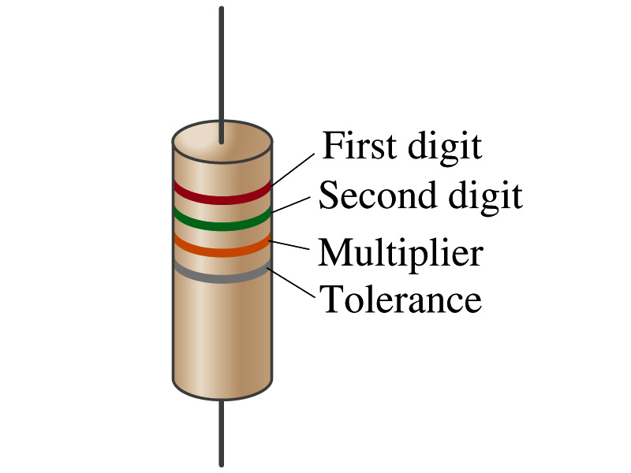
Ohm’s Law: Resistor Values
Resistors have its resistance color-coded on its body
The color-coding follows the convention below:
Color | Number | Multiplier | Tolerance
Black | 0 | 1=10⁰
Brown | 1 | 10¹
Red | 2 | 10²
Orange | 3 | 10³
Yellow | 4 | 10⁴
Green | 5 | 10⁵
Blue | 6 | 10⁶
Violet | 7 | 10⁷
Gray | 8 | 10⁸
White | 9 | 10⁹
Gold |  | 10-¹ | 5%
Silver |  | 10⁻² | 10%
None |  |  | 20%
What is the resistance of the resistor in this figure?

Slide 15
Resistivity
It is experimentally found that the resistance R of a metal wire is directly proportional to its length l and inversely proportional to its cross-sectional area A
How would you formularize this?
The proportionality constant ρ is called the resistivity and depends on the material used. What is the unit of this constant?
ohm-m or Ω−m
The values depends on purity, heat treatment, temperature, etc
How would you interpret the resistivity?
The higher the resistivity the higher the resistance
The lower the resistivity the lower the resistance and the higher the conductivity ➔ Silver has the lowest resistivity.
So the silver is the best conductor
The reciprocal of the resistivity is called the conductivity, σ,
A
l

Slide 16
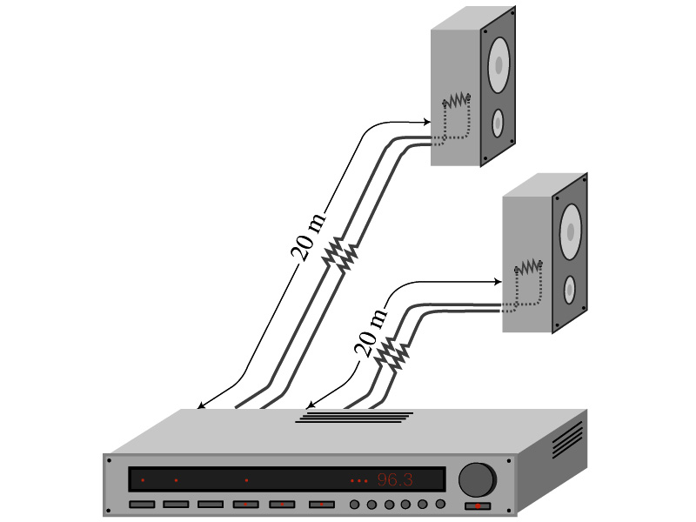
Example 25 – 5
Speaker wires: Suppose you want to connect your stereo to remote speakers. (a) If each wire must be 20m long, what diameter copper wire should you use to keep the resistance less than 0.1-Ω per wire? (b) If the current on each speaker is 4.0A, what is the voltage drop across each wire?
The resistivity of a copper is
Table 25.1
From the formula for resistance, we can obtain the formula for area
Solve for A
Solve for d
From Ohm’s law, V=IR, we obtain

Slide 17
Example 25 – 6
Stretching changes resistance: A wire of resistance R is stretched uniformly until it is twice its original length. What happens to its resistance?
What is the constant quantity in this problem?
The volume!
What is the volume of a cylinder of length L and radius r?
What happens to A if L increases factor two, L’=2L?
The cross-sectional area, A, halves. A’=A/2
The original resistance is
The new resistance is
The resistance of the wire increases by a factor of four if the length increases twice.

Slide 18
Temperature Dependence of Resistivity
Do you think the resistivity depends on temperature?
Yes
Would it increase or decrease with the temperature?
Increase
Why?
Because the atoms are vibrating more rapidly as temperature increases and are arranged in a less orderly fashion. So?
They might interfere more with the flow of electrons.
If the temperature change is not too large, the resistivity of metals usually increase nearly linearly w/ temperature
α is the temperature coefficient of resistivity
α of some semiconductors can be negative due to increased number of freed electrons.

Slide 19
Electric Power
Why is the electric energy useful?
It can transform into different forms of energy easily.
Motors, pumps, etc, transform electric energy to mechanical energy
Heaters, dryers, cook-tops, etc, transforms electricity to thermal energy
Light bulb filament transforms electric energy to light energy
Only about 10% of the energy turns to light and the 90% lost via heat
Typical household light bulb and heating elements have resistance of order a few ohms to a few hundred ohms
How does electric energy transforms to thermal energy?
Flowing electrons collide with the vibrating atoms of the wire.
In each collision, part of electron’s kinetic energy is transferred to the atom it collides with.
The kinetic energy of wire’s atoms increases, and thus the temperature of the wire increases.
The increased thermal energy can be transferred as heat through conduction and convection to the air in a heater or to food on a pan, through radiation to bread in a toaster or radiated as light.

Slide 20
Electric Power
How do we find out the power transformed by an electric device?
What is definition of the power?
The rate at which work is done or the energy is transformed
What is the energy transformed when an infinitesimal charge dq moves through a potential difference V?
dU=Vdq
If dt is the time required for an amount of charge dq to move through the potential difference V, the power P is
Thus, we obtain .
What is the unit?
What kind of quantity is the electrical power?
Scalar
P=IV can apply to any devices while the formula with resistance can only apply to devices that has resistance.
What is this?
In terms of resistance
Watts = J/s

Slide 21
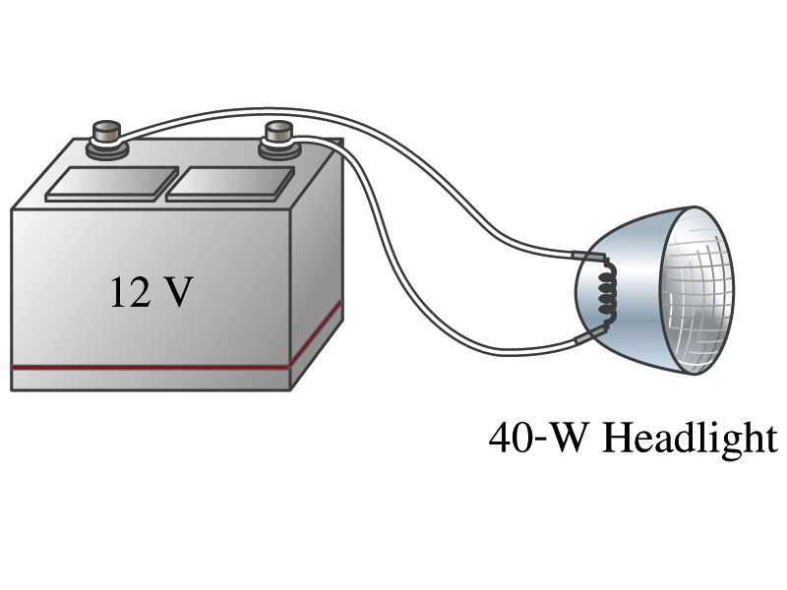
Example 25 – 8
Headlights: Calculate the resistance of a 40-W automobile headlight designed for 12V.
Since the power is 40W and the voltage is 12V, we use the formula with V and R.
Solve for R

Slide 22
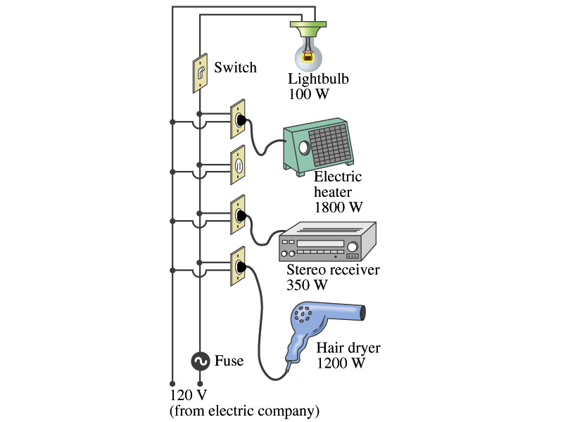
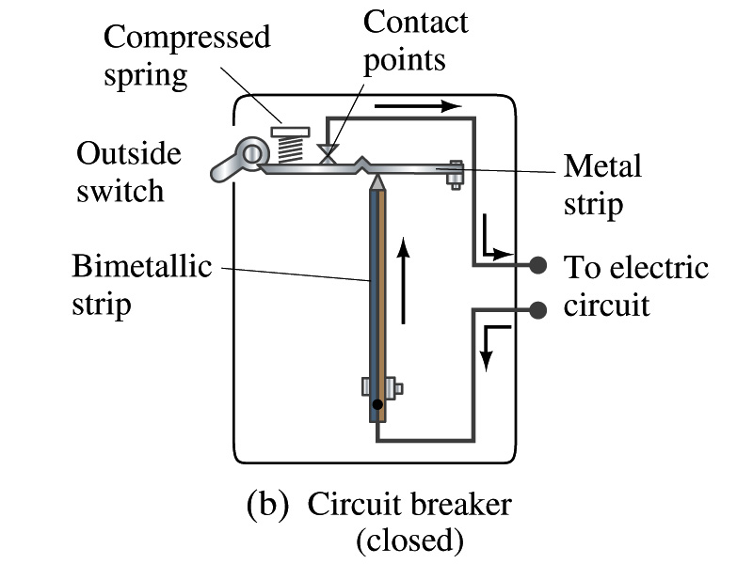
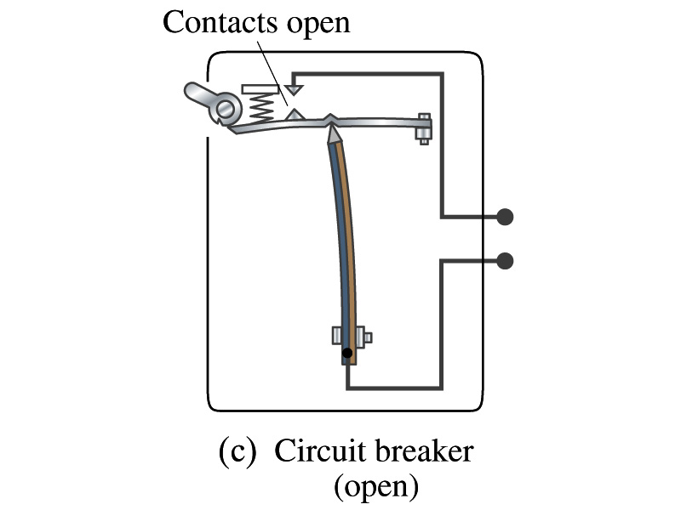
Power in Household Circuits
Household devices usually have small resistance
But since they draw current, if they become large enough, wires can heat up (overloaded)
Why is using thicker wires safer?
Thicker wires has less resistance, lower heat
Overloaded wire can set off a fire at home
How do we prevent this?
Put in a switch that would disconnect the circuit when overloaded
Fuse or circuit breakers
They open up the circuit when the current is over certain value
Overload

Slide 23
Example 25 – 11
Will a fuse blow?: Determine the total current drawn by all the devices in the circuit in the figure.
The total current is the sum of current drawn by individual device.
Solve for I
Bulb
Heater
Stereo
Dryer
Total current
What is the total power?

Slide 24
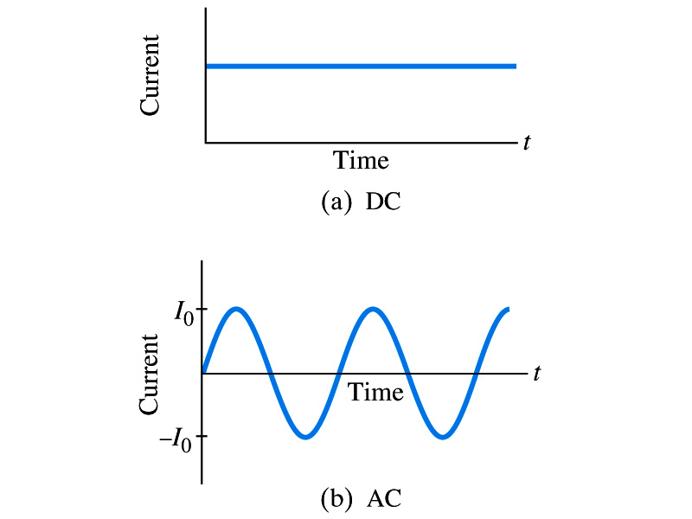
Alternating Current
Does the direction of the flow of current change while a battery is connected to a circuit?
No. Why?
Because its source of potential difference stays put.
This kind of current is called the Direct Current (DC), and it does not change its direction of flow while the battery is connected.
How would DC look as a function of time?
A straight line
Electric generators at electric power plant produce alternating current (AC)
AC reverses direction many times a second
AC is sinusoidal as a function of time
Most the currents supplied to homes and business are AC.

Slide 25
The Alternating Current
The voltage produced by an AC electric generator is sinusoidal
This is why the current is sinusoidal
Voltage produced can be written as
What are the maximum and minimum voltages?
V₀ (–V₀) and 0
The potential oscillates between +V₀ and –V₀, the peak voltages or amplitude
What is f?
The frequency, the number of complete oscillations made per second. What is the unit of f? What is the normal size of f in the US?
f=60Hz in the US and Canada.
Many European countries have f=50Hz.
ω=2πf

Slide 26
Alternating Current
Since V=IR, if a voltage V exists across a resistance R, the current I is
What are the maximum and minimum currents?
I₀ (–I₀) and 0.
The current oscillates between +I₀ and –I₀, the peak currents or amplitude. The current is positive when electron flows to one direction and negative when they flow opposite.
AC is as many times positive as negative. What’s the average current?
Zero. So there is no power and no heat is produced in a heater?
Yes there is! The electrons actually flow back and forth, so power is delivered.
What is this?

Slide 27
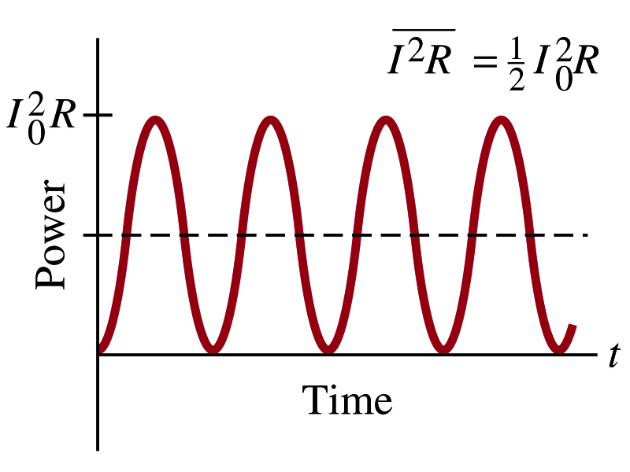
Power Delivered by Alternating Current
AC power delivered to a resistance is:
Since the current is squared, the power is always positive
The average power delivered is
Since the power is also P=V²/R, we can obtain
The average of the square of current and voltage are important in calculating power:
Average power

Slide 28
Power Delivered by Alternating Current
The square root of each of these are called root-mean-square, or rms:
rms values are sometimes called effective values
These are useful quantities since they can substitute current and voltage directly in power, as if they are in DC
In other words, an AC of peak voltage V₀ or peak current I₀ produces as much power as DC voltage of V_{rms} or DC current I_{rms}.
So normally, rms values in AC are specified or measured.
US uses 115V rms voltage. What is the peak voltage?
Europe uses 240V

Slide 29
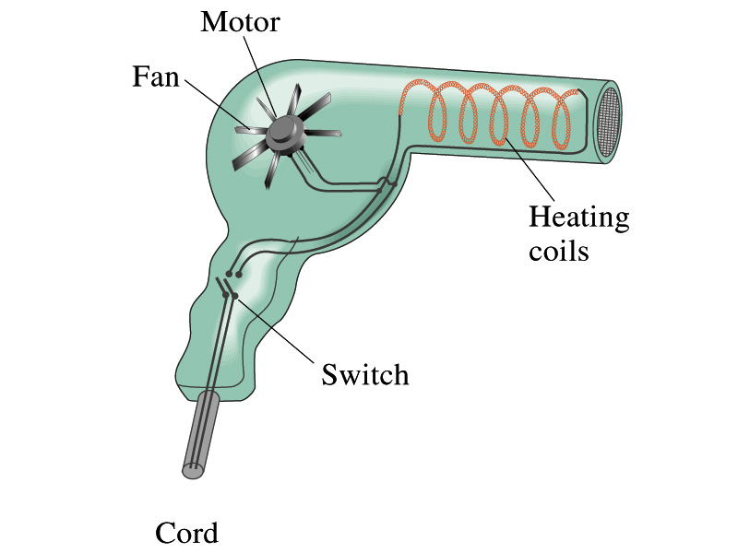
Example 25 – 13
Hair Dryer. (a) Calculate the resistance and the peak current in a 1000-W hair dryer connected to a 120-V AC line. (b) What happens if it is connected to a 240-V line in Britain?
The rms current is:
The peak current is:
Thus the resistance is:
(b) If connected to 240V in Britain …
The average power provide by the AC in UK is
So?
The heating coils in the dryer will melt!

Slide 30
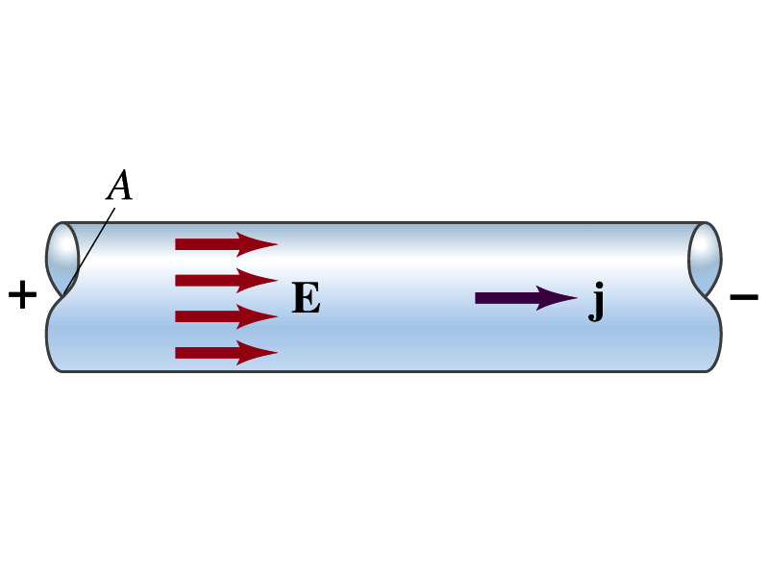
Microscopic View of Electric Current
When a potential difference is applied to the two ends of a wire w/ uniform cross-section, the direction of electric field is parallel to the walls of the wire, this is possible since the charges are moving
Let’s define a microscopic vector quantity, the current density, j, the electric current per unit cross-sectional area
j=I/A or I = jA if the current density is uniform
If not uniform
The direction of j is the direction the positive charge would move when placed at that position, generally the same as E
The current density exists on any point in space while the current I refers to a conductor as a whole so a macroscopic

Slide 31
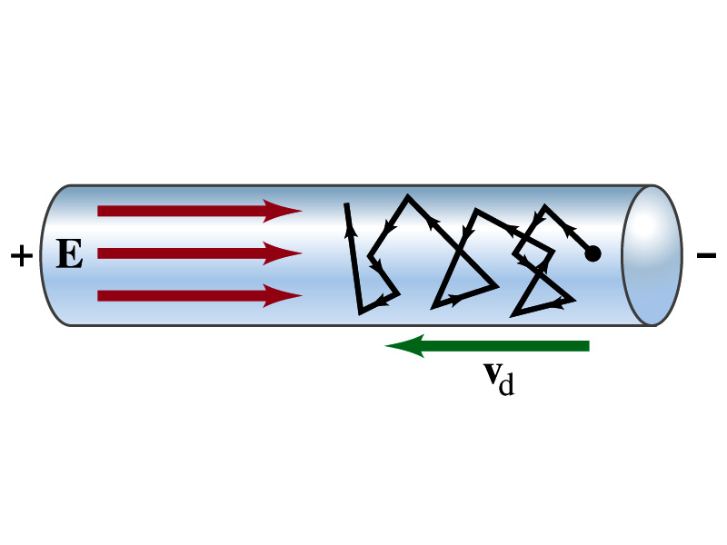
Microscopic View of Electric Current
The direction of j is the direction of a positive charge. So in a conductor, since negatively charged electrons move, the direction is –j.
Let’s think about the current in a microscopic view again:
When voltage is applied to the end of a wire
Electric field is generated by the potential difference
Electrons feel force and get accelerated
Electrons soon reach to a steady average speed due to collisions with atoms in the wire, called drift velocity, v_{d}
The drift velocity is normally much smaller than electrons’ average random speed.

Slide 32
Microscopic View of Electric Current
How do we relate v_{d} with the macroscopic current I?
In time interval Δt, the electrons travel l =v_{d}Δt on average
If wire’s x-sectional area is A, in time Δt electrons in a volume V=l A=Av_{d}Δt will pass through the area A
If there are n free electrons ( of charge –e) per unit volume, the total charge ΔQ that pass through A in time Δt is
The current I in the wire is
The density in vector form is
For any types of charge:

Slide 33
Microscopic View of Electric Current
The drift velocity of electrons in a wire is only about 0.05mm/s. How could we get light turned on immediately then?
While the electrons in a wire travels slow, the electric field travels essentially at the speed of light. Then what is all the talk about electrons flowing through?
It is just like water. When you turn on the facet, water flows right off the facet despite the fact that the water travels slow.
Electricity is the same. Electrons fill the conductor wire and when the switch is flipped on or a potential difference is applied, the electrons closed to the positive terminal flows into the bulb.
Interesting, isn’t it? Why is the field travel at the speed of light then?

Slide 34
Ohm’s Law in Microscopic View
Ohm’s law can be written in microscopic quantities.
Resistance in terms of resistivity is
We can rewrite the potential V and current I as: I=jA, V=El.
If electric field is uniform, from V=IR, we obtain
So
In a metal conductor, ρ or σ does not depend on V, thus, the current density j is proportional to the electric field E ➔ Microscopic statement of Ohm’s Law
In vector form, the density can be written as

Slide 35
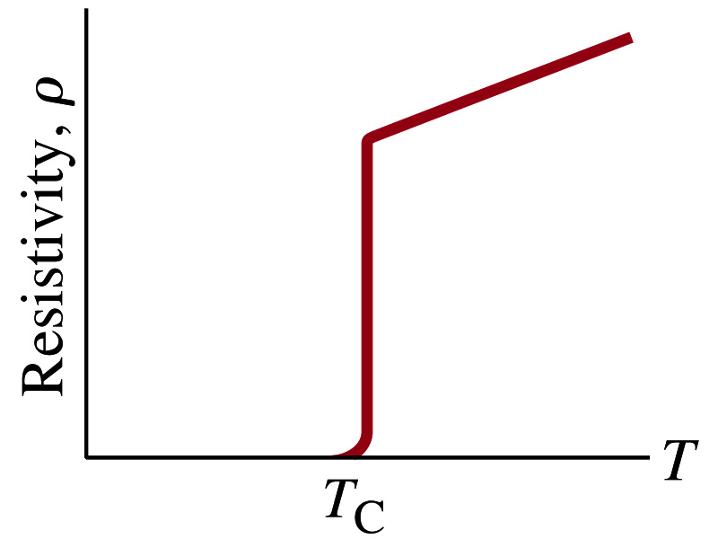
Superconductivity
At the temperature near absolute 0K, resistivity of certain material becomes 0.
This state is called the “superconducting” state.
Observed in 1911 by H. K. Onnes when he cooled mercury to 4.2K (-269ºC).
Resistance of mercury suddenly dropped to 0.
In general superconducting materials become superconducting below a transition temperature.
The highest temperature superconductivity seen is 160K
First observation above the boiling temperature of liquid nitrogen is in 1987 at 90k observed from a compound of yttrium, barium, copper and oxygen.
Since much smaller amount of material can carry just as much current more efficiently, superconductivity can make electric cars more practical, computers faster, and capacitors store higher energy

Slide 36
Electric Hazards: Leakage Currents
How does one feel shock by electricity?
Electric current stimulates nerves and muscles, and we feel a shock
The severity of the shock depends on the amount of current, how long it acts and through what part of the body it passes
Electric current heats tissues and can cause burns
Currents above 70mA on a torso for a second or more is fatal, causing heart to function irregularly, “ventricular fibrillation”
A dry human body between two points on opposite side of the body is about 10⁴ to 10⁶ Ω.
When wet, it could be 10³Ω.
A person in good contact with the ground who touches 120V DC line with wet hands can get the current:
Could be lethal

