Slide 1
PHYS 1441 – Section 001 Lecture #16
Tuesday, July 5, 2016
Dr. Jaehoon Yu
Chapter 29:EM Induction & Faraday’s Law
Faraday’s Law of Induction
Lenz’s Law
Generation of Electricity
Transformer
Mutual and Self Inductance
Energy Stored in Magnetic Field
Alternating Current and AC Circuits
Chapter 30: Inductance
Today’s homework is #9, due 11pm, Thursday, July 7!!

Slide 2
Announcements
Quiz #4 Thursday, July 7
Beginning of the class
Covers 29.1 through what we finish tomorrow, Wednesday, July 6
BYOF
Final exam
In class (10:30am – 12:30pm) Monday, July 11
Comprehensive exam
Covers CH21.1 through what we finish Thursday, July 7
BYOF
Reading Assignments
CH30.9 – CH30.11

Slide 3
Faraday’s Law of Induction
In terms of magnetic flux, we can formulate Faraday’s findings
The emf induced in a circuit is equal to the rate of change of magnetic flux through the circuit
If the circuit contains N closely wrapped loops, the total induced emf is the sum of emf induced in each loop
Why negative?
Has got a lot to do with the direction of induced emf…
Faraday’s Law of Induction

Slide 4
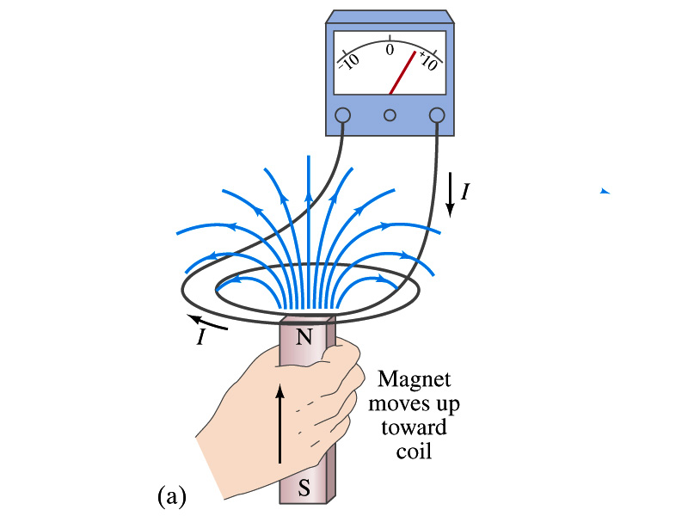
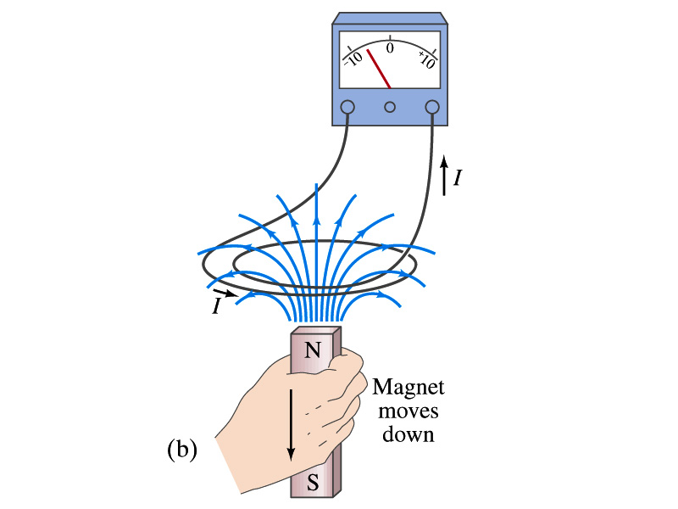
Lenz’s Law
It is experimentally found that
An induced emf gives rise to a current whose magnetic field opposes the original change in flux ➔ This is known as Lenz’s Law
In other words, an induced emf is always in a direction that opposes the original change in flux that caused it.
We can use Lenz’s law to explain the following cases in the figures
When the magnet is moving into the coil
Since the external flux increases, the field inside the coil takes the opposite direction to minimize the change and causes the current to flow clockwise
When the magnet is moving out
Since the external flux decreases, the field inside the coil takes the opposite direction to compensate the loss, causing the current to flow counter-clockwise
Which law is Lenz’s law result of?
Energy conservation. Why?

Slide 5
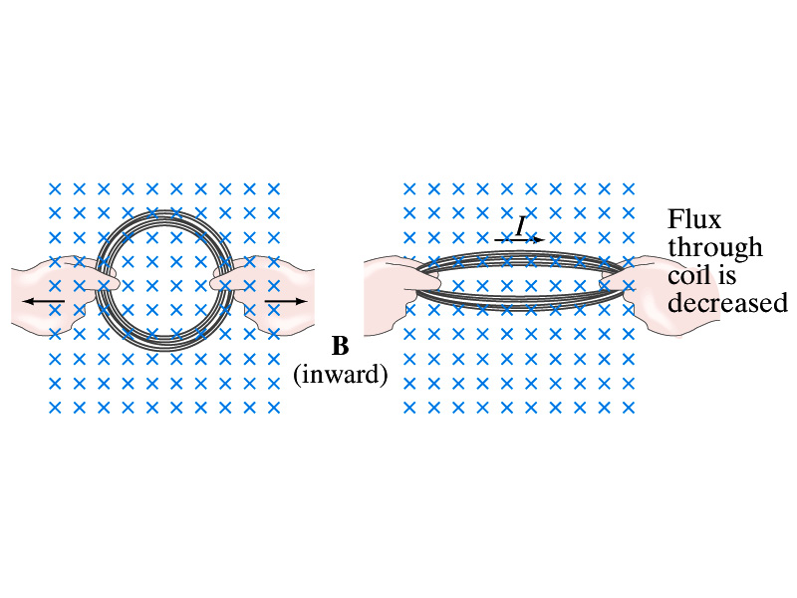
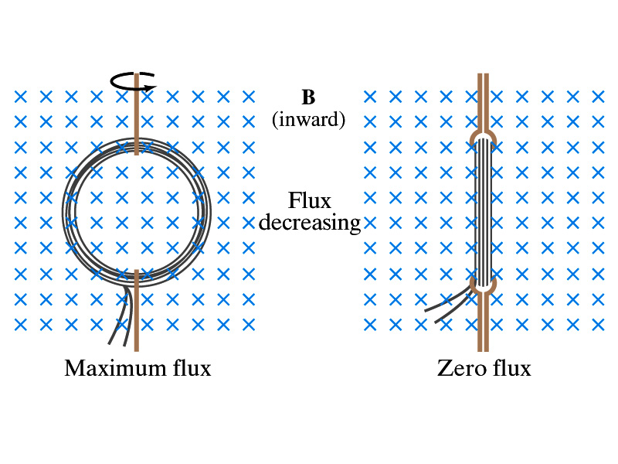
Induction of EMF
How can we induce emf?
Let’s look at the formula for the magnetic flux
What do you see? What are the things that can change with time to result in a change of magnetic flux?
Magnetic field
The area of the loop
The angle θ between the field and the area vector

Slide 6
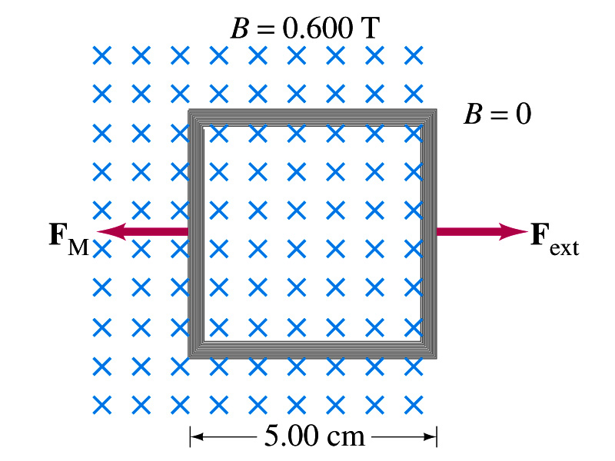
Example 29 – 5
Pulling a coil from a magnetic field. A square coil of wire with side 5.00cm contains 100 loops and is positioned perpendicular to a uniform 0.600-T magnetic field. It is quickly and uniformly pulled from the field (moving perpendicular to B) to a region where B drops abruptly to zero. At t=0, the right edge of the coil is at the edge of the field. It takes 0.100s for the whole coil to reach the field-free
region. Find (a) the rate of change in flux through the coil, (b) the emf and current induced, and (c) how much energy is dissipated in the coil if its resistance is 100Ω. (d) what was the average force required?
What should be computed first?
The initial flux at t=0.
The flux at t=0 is
The change of flux is
Thus the rate of change of the flux is

Slide 7
Example 29 – 5, cnt’d
Thus the total emf induced in this period is
The induced current in this period is
Which direction would the induced current flow?
Clockwise
The total energy dissipated is
Force for each coil is
Force for N coil is

Slide 8
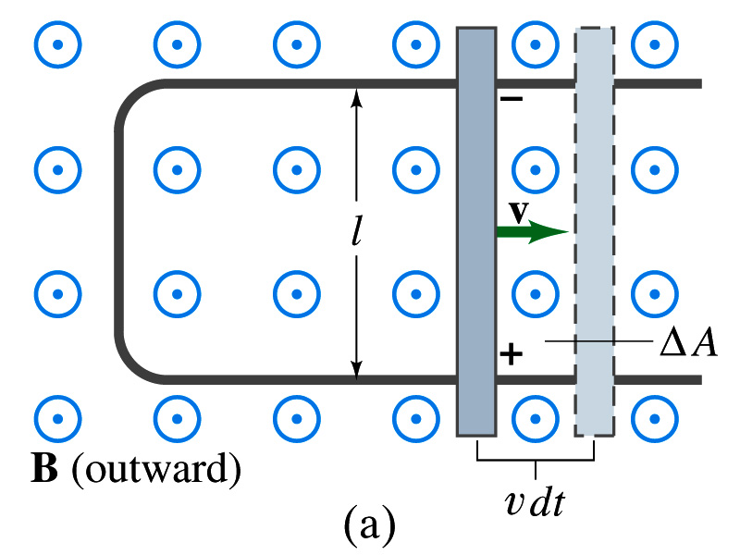
EMF Induced on a Moving Conductor
Another way of inducing emf is using a U shaped conductor with a movable rod resting on it.
As the rod moves at a speed v, it travels vdt in time dt, changing the area of the loop by dA=lvdt.
Using Faraday’s law, the induced emf for this loop is
This equation is valid as long as B, l and v are perpendicular to each other. What do we do if not?
Use the scalar product of vector quantities
An emf induced on a conductor moving in a magnetic field is called a motional emf

Slide 9
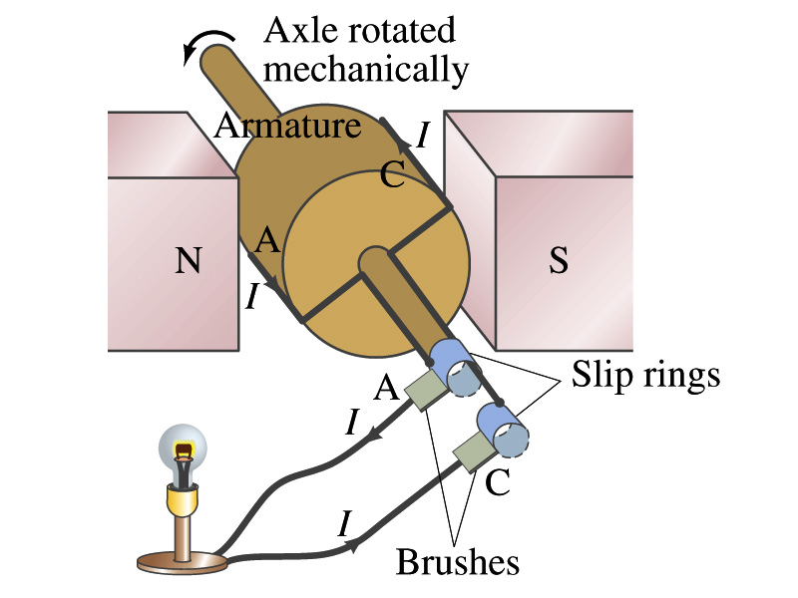
Electric Generators
What does a generator do?
Transforms mechanical energy into the electrical energy
What does this look like?
An inverse of an electric motor which transforms electrical energy to mechanical energy
An electric generator is also called a dynamo
Whose law does the generator based on?
Faraday’s law of induction

Slide 10
How does an Electric Generator work?
An electric generator consists of
Many coils of wires wound on an armature that can rotate by mechanical means in a magnetic field
An emf is induced in the rotating coil
Electric current is the output of a generator
Which direction does the output current flow when the armature rotates counterclockwise?
The conventional current flows outward on wire A toward the brush
After half the revolution the wire A will be where the wire C is and the current flow on A is reversed
Thus the current produced is alternating its direction

Slide 11
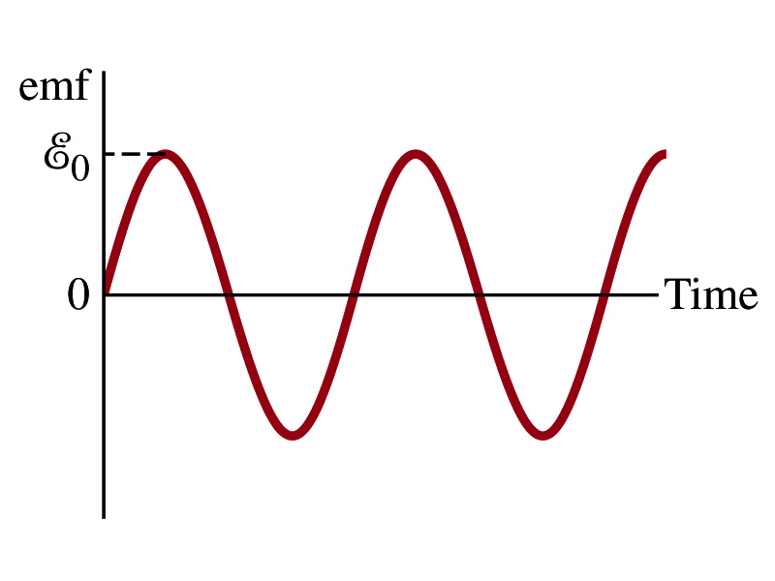
How does an Electric Generator work?
Let’s assume the loop is rotating in a uniform B field w/ a constant angular velocity ω. The induced emf is
What is the variable that changes above?
The angle θ. What is dθ/dt?
The angular speed ω.
So θ=θ₀+ωt
If we choose θ₀=0, we obtain
If the coil contains N loops:
What is the shape of the output?
Sinusoidal w/ amplitude ε₀=NBAω
USA frequency is 60Hz. Europe is at 50Hz
Most the U.S. power is generated at steam plants

Slide 12
Example 29 – 9
An AC generator. The armature of a 60-Hz AC generator rotates in a 0.15-T magnetic field. If the area of the coil is 2.0x10⁻²m², how many loops must the coil contain if the peak output is to be ε₀=170V?
The maximum emf of a generator is
Solving for N
Since
We obtain

Slide 13
US Electricity Sources

Slide 14
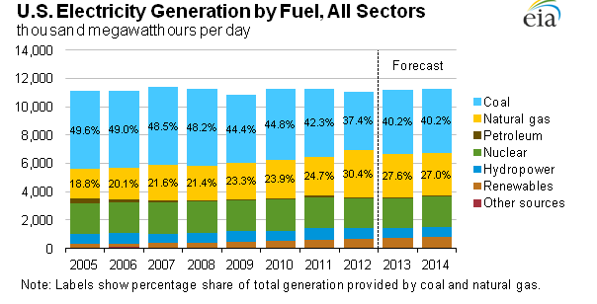
US Electricity Consumption by Source
US Energy Information Administration http://www.eia.gov/electricity/

Slide 15
The World Energy Consumption
In 2008, total worldwide energy consumption was 474 EJ (474×10¹⁸ J=132 PWh).
Equivalent to an average energy consumption rate of 15 terawatts (1.504×10¹³ W)
US uses 26.6 PWh (as of 2008)
The potential for renewable energy
solar energy 1600 EJ (444,000 TWh)
wind power 600 EJ (167,000 TWh)
geothermal energy 500 EJ (139,000 TWh),
biomass 250 EJ (70,000 TWh)
hydropower 50 EJ (14,000 TWh) an
ocean energy 1 EJ (280 TWh)

Slide 16
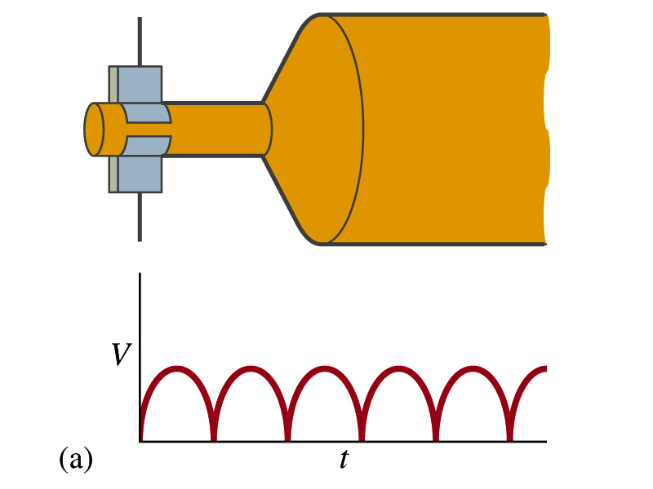
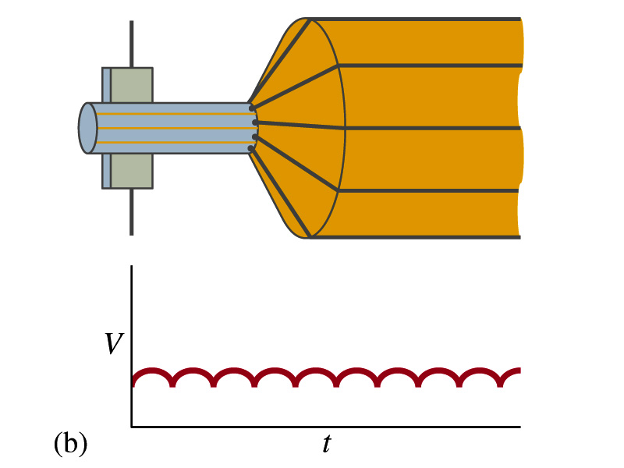
A DC Generator
A DC generator is almost the same as an AC generator except the slip rings are replaced by split-ring commutators
Output can be smoothed out by placing a capacitor on the output
More commonly done using many armature windings
Smooth output using many windings

Slide 17
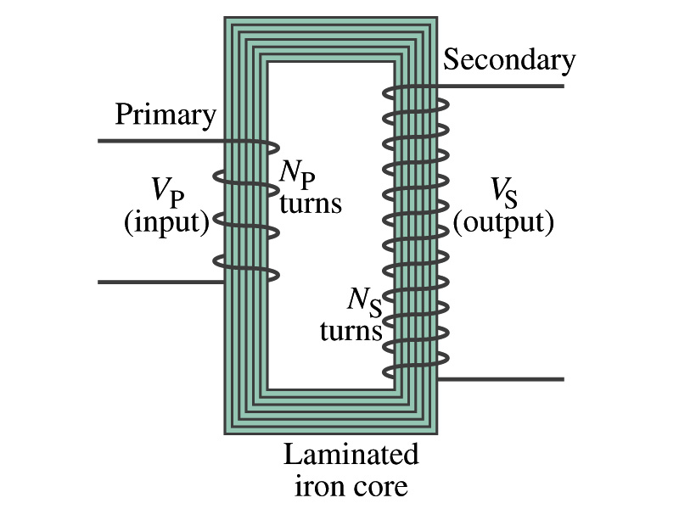
Transformer
What is a transformer?
A device for increasing or decreasing an AC voltage
A few examples?
TV sets to provide High Voltage to picture tubes, portable electronic device converters, transformers on the pole, etc
A transformer consists of two coils of wires known as the primary and the secondary
The two coils can be interwoven or linked by a laminated soft iron core to reduce losses due to Eddy current
Transformers are designed so that all magnetic flux produced by the primary coil pass through the secondary

Slide 18
How does a transformer work?
When an AC voltage is applied to the primary, the changing B it produces will induce voltage of the same frequency in the secondary wire
So how would we make the voltage different?
By varying the number of loops in each coil
From Faraday’s law, the induced emf in the secondary is
The input primary voltage is
Since dΦ_{B}/dt is the same, we obtain
Transformer Equation

Slide 19
Transformer Equation
The transformer equation does not work for DC current
Since there is no change of magnetic flux!!
If N_{S}>N_{P}, the output voltage is greater than the input so it is called a step-up transformer while N_{S}<N_{P} is called step-down transformer
Now, it looks like energy conservation is violated since we can get more emf from smaller ones, right?
Wrong! Wrong! Wrong! Energy is always conserved!
A well designed transformer can be more than 99% efficient
The power output is the same as the input:
The output current for step-up transformer will be lower than the input, while it is larger for step-down x-former than the input.

Slide 20
Example for A Transformer
Portable radio transformer. A transformer for home use of a portable radio reduces 120-V AC to 9.0V AC. The secondary contains 30 turns, and the radio draws 400mA. Calculate (a) the number of turns in the primary (b) the current in the primary and (c) the power transformed.
(a) What kind of a transformer is this?
A step-down x-former
Since
We obtain
We obtain
(b) Also from the transformer equation
(c) Thus the power transformed is
How about the input power?
The same assuming 100% efficiency.

Slide 21
Example 29 – 13: Power Transmission
Transmission lines. An average of 120kW of electric power is sent to a small town from a power plant 10km away. The transmission lines have a total resistance of 0.4Ω. Calculate the power loss if the power is transmitted at (a) 240V and (b) 24,000V.
We cannot use P=V²/R since we do not know the voltage along the transmission line. We, however, can use P=I²R.
(a) If 120kW is sent at 240V, the total current is
Thus the power loss due to transmission line is
(b) If 120kW is sent at 24,000V, the total current is
Thus the power loss due to transmission line is
The higher the transmission voltage, the smaller the current, causing less loss of energy. This is why power is transmitted w/ HV, as high as 170kV.

Slide 22
Electric Field due to Magnetic Flux Change
When the electric current flows through a wire, there is an electric field in the wire that moves electrons
We saw, however, that changing magnetic flux induces a current in the wire. What does this mean?
There must be an electric field induced by the changing magnetic flux.
In other words, a changing magnetic flux produces an electric field
This results apply not just to wires but to any conductor or any region in space

Slide 23
Generalized Form of Faraday’s Law
Recall the relationship between the electric field and the potential difference
Induced emf in a circuit is equal to the work done per unit charge by the electric field
So we obtain
The integral is taken around a path enclosing the area through which the magnetic flux Φ_{Β} is changing.

Slide 24
Inductance
Changing magnetic flux through a circuit induce an emf in that circuit
An electric current produces a magnetic field
From these, we can deduce
A changing current in one circuit must induce an emf in a nearby circuit ➔ Mutual inductance
Or induce an emf in itself ➔ Self inductance

Slide 25
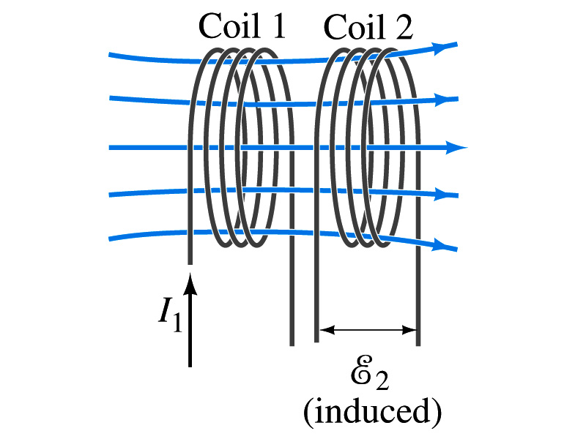
Mutual Inductance
If two coils of wire are placed near each other, a changing current in one will induce an emf in the other.
What is the induced emf, ε₂, in coil2 proportional to?
Rate of the change of the magnetic flux passing through it
This flux is due to current I₁ in coil 1
If Φ₂₁ is the magnetic flux in each loop of coil2 created by coil1 and N₂ is the number of closely packed loops in coil2, then N₂Φ₂₁ is the total flux passing through coil2.
If the two coils are fixed in space, N₂Φ₂₁ is proportional to the current I₁ in coil 1, .
The proportionality constant for this is called the Mutual Inductance and defined as .
The emf induced in coil2 due to the changing current in coil1 is

Slide 26
Mutual Inductance
The mutual induction of coil2 with respect to coil1, M₂₁,
is a constant and does not depend on I₁.
depends only on “geometric” factors such as the size, shape, number of turns and relative position of the two coils, and whether a ferromagnetic material is present
The farther apart the two coils are the less flux can pass through coil, 2, so M₂₁ will be less.
In most cases the mutual inductance is determined experimentally
Conversely, the changing current in coil2 will induce an emf in coil1
M₁₂ is the mutual inductance of coil1 with respect to coil2 and M₁₂ = M₂₁
We can put M=M₁₂=M₂₁ and obtain
SI unit for mutual inductance is henry (H)
What? Does this make sense?

Slide 27
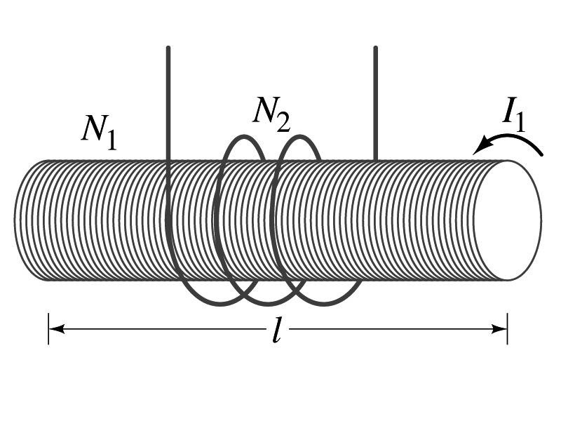
Example 30 – 1
Solenoid and coil. A long thin solenoid of length l and cross-sectional area A contains N₁ closely packed turns of wire. Wrapped around it is an insulated coil of N₂ turns. Assuming all the flux from coil 1 (the solenoid) passes through coil 2, calculate the mutual inductance.
First we need to determine the flux produced by the solenoid.
What is the magnetic field inside the solenoid?
Since the solenoid is closely packed, we can assume that the field lines are perpendicular to the surface area of the coils. Thus the flux through coil 2 is
Thus the mutual inductance of coil 2 is
Note that M₂₁ only depends on geometric factors!

Slide 28
Self Inductance
The concept of inductance applies to a single isolated coil of N turns. How does this happen?
When a changing current passes through a coil
A changing magnetic flux is produced inside the coil
The changing magnetic flux in turn induces an emf in the same coil
This emf opposes the change in flux. Whose law is this?
Lenz’s law
What would this do?
When the current through the coil is increasing?
The increasing magnetic flux induces an emf that opposes the original current
This tends to impedes its increase, trying to maintain the original current
When the current through the coil is decreasing?
The decreasing flux induces an emf in the same direction as the current
This tends to increase the flux, trying to maintain the original current

Slide 29
Self Inductance
Since the magnetic flux Φ_{B} passing through N turn coil is proportional to current I in the coil,
We define self-inductance, L:
The induced emf in a coil of self-inductance L is
What is the unit for self-inductance?
What does magnitude of L depend on?
Geometry and the presence of a ferromagnetic material
Self inductance can be defined for any circuit or part of a circuit
Self Inductance

Slide 30
So what in the world is the Inductance?
It is an impediment onto the electrical current due to the existence of changing flux
So what?
In other words, it behaves like a resistance to the varying current, such as AC, that causes the constant change of flux
But it also provides means to store energy, just like the capacitance

Slide 31
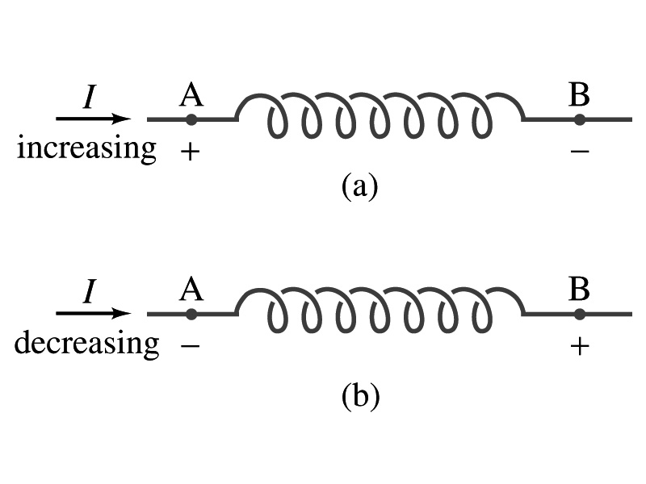
Inductor
An electrical circuit always contains some inductance but is normally negligibly small
If a circuit contains a coil of many turns, it could have large inductance
A coil that has significant inductance, L, is called an inductor and is express with the symbol
Precision resisters are normally wire wound
Would have both resistance and inductance
The inductance can be minimized by winding the wire back on itself in opposite direction to cancel magnetic flux
This is called a “non-inductive winding”
If an inductor has negligible resistance, inductance controls the changing current
For an AC current, the greater the inductance the less the AC current
An inductor thus acts like a resistor to impede the flow of alternating current (not to DC, though. Why?)
The quality of an inductor is indicated by the term reactance or impedance

Slide 32
Example 30 – 3
Solenoid inductance. (a) Determine the formula for the self inductance L of a tightly wrapped solenoid ( a long coil) containing N turns of wire in its length l and whose cross-sectional area is A. (b) Calculate the value of L if N=100, l=5.0cm, A=0.30cm² and the solenoid is air filled. (c) calculate L if the solenoid has an iron core with μ=4000μ₀.
What is the magnetic field inside a solenoid?
The flux is, therefore,
Using the formula for self inductance:
(b) Using the formula above
(c) The magnetic field with an iron core solenoid is

Slide 33
Energy Stored in the Magnetic Field
When an inductor of inductance L is carrying current I which is changing at a rate dI/dt, energy is supplied to the inductor at a rate
What is the work needed to increase the current in an inductor from 0 to I?
The work, dW, done in time dt is
Thus the total work needed to bring the current from 0 to I in an inductor is

Slide 34
Energy Stored in the Magnetic Field
The work done to the system is the same as the energy stored in the inductor when it is carrying current I
This is compared to the energy stored in a capacitor, C, when the potential difference across it is V:
Just like the energy stored in a capacitor is considered to reside in the electric field between its plates
The energy in an inductor can be considered to be stored in its magnetic field
Energy Stored in a magnetic field inside an inductor

Slide 35
Stored Energy in terms of B
So how is the stored energy written in terms of magnetic field B?
Inductance of an ideal solenoid without a fringe effect
The magnetic field in a solenoid is
Thus the energy stored in an inductor is
Thus the energy density is
This formula is valid in any region of space
If a ferromagnetic material is present, μ₀ becomes μ.
E
What is this?
E density
Volume V
What volume does Al represent?
The volume inside a solenoid!!

Slide 36
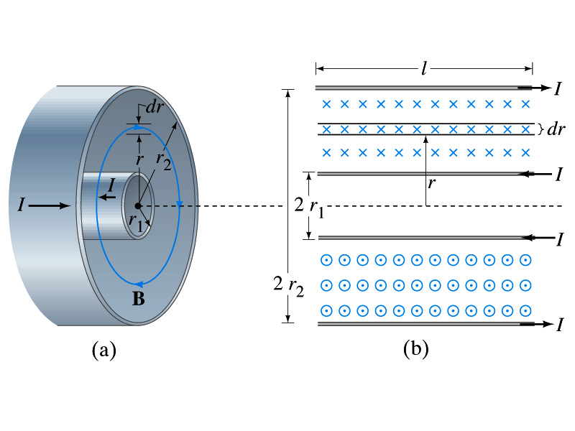
Example 30 – 5
Energy stored in a coaxial cable. (a) How much energy is being stored per unit length in a coaxial cable whose conductors have radii r₁ and r₂ and which carry a current I? (b) Where is the energy density highest?
(a) The total flux through l of the cable is
Thus inductance per unit length for a coaxial cable is
Thus the energy stored per unit length is
(b) Since the magnetic field is
The energy density is highest where B is highest. Since B is highest close to r=r₁, near the surface of the inner conductor.
And the energy density is

Slide 37
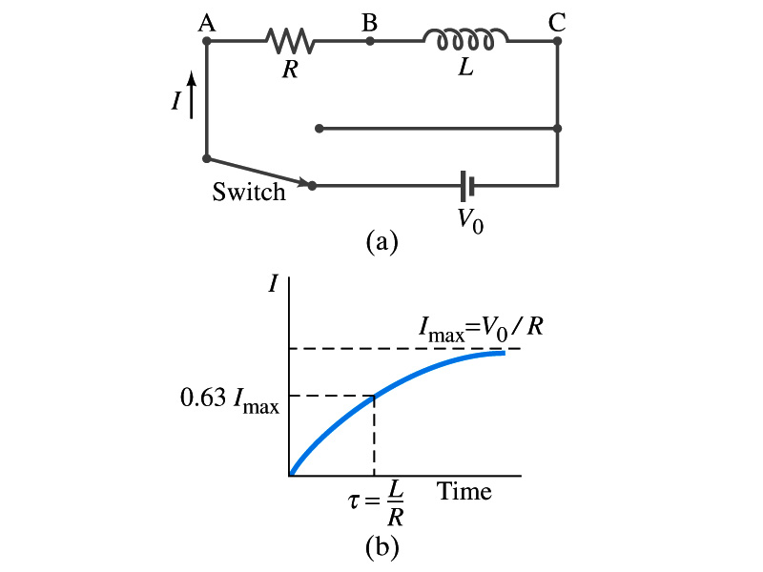
LR Circuits
What happens when an emf is applied to an inductor?
An inductor has some resistance, however negligible
So an inductor can be drawn as a circuit of separate resistance and coil. What is the name this kind of circuit?
What happens at the instance the switch is thrown to apply emf to the circuit?
The current starts to flow, gradually increasing from 0
This change is opposed by the induced emf in the inductor ➔ the emf at point B is higher than point C
However there is a voltage drop at the resistance which reduces the voltage across inductance
Thus the current increases less rapidly
The overall behavior of the current is a gradual increase, reaching to the maximum current I_{max}=V₀/R.
LR Circuit

Slide 38
LR Circuits
This can be shown w/ Kirchhoff loop rules
The emfs in the circuit are the battery voltage V₀ and the emf ε=-L(dI/dt) in the inductor opposing the current increase
The sum of the potential changes through the circuit is
Where I is the current at any instance
By rearranging the terms, we obtain a differential eq.
We can integrate just as in RC circuit
So the solution is
Where τ=L/R
This is the time constant τ of the LR circuit and is the time required for the current I to reach 0.63 of the maximum

Slide 39
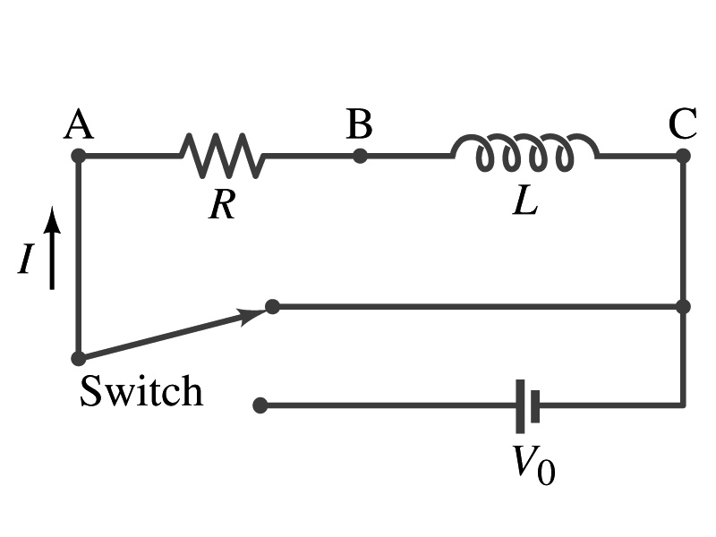
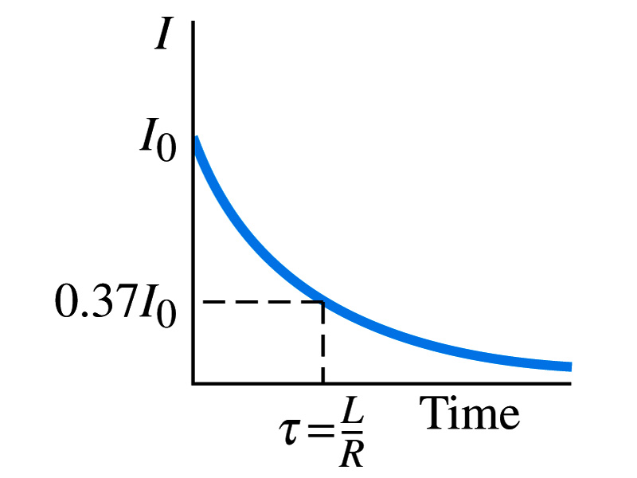
Discharge of LR Circuits
If the switch is flipped away from the battery
The differential equation becomes
So the integration is
Which results in the solution
The current decays exponentially to zero with the time constant τ=L/R
So there always is a reaction time when a system with a coil, such as an electromagnet, is turned on or off.
The current in LR circuit behaves almost the same as that in RC circuit but the time constant is inversely proportional to R in LR circuit unlike the RC circuit

Slide 40
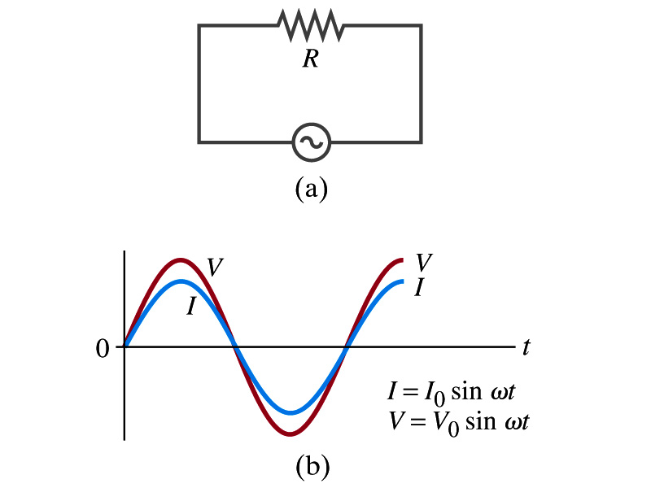
AC Circuit w/ Resistance only
What do you think will happen when an AC source is connected to a resistor?
From Kirchhoff’s loop rule, we obtain
Thus
where
What does this mean?
Current is 0 when voltage is 0 and current is in its peak when voltage is in its peak.
Current and voltage are “in phase”
Energy is lost via the transformation into heat at an average rate

Slide 41
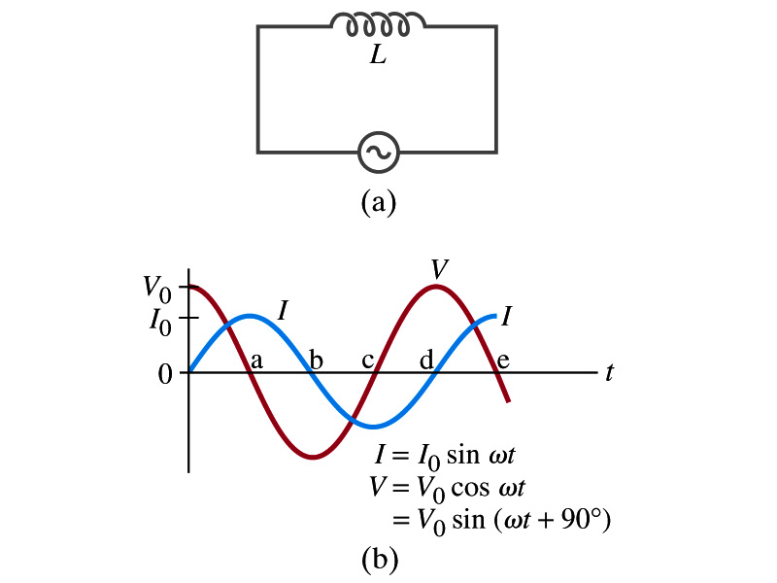
AC Circuit w/ Inductance only
From Kirchhoff’s loop rule, we obtain
Thus
Using the identity
where
What does this mean?
Current and voltage are “out of phase by π/2 or 90º”. In other words the current reaches its peak ¼ cycle after the voltage
What happens to the energy?
No energy is dissipated
The average power is 0 at all times
The energy is stored temporarily in the magnetic field
Then released back to the source

Slide 42
AC Circuit w/ Inductance only
How are the resistor and inductor different in terms of energy?
Inductor
Resistor
How are they the same?
They both impede the flow of charge
For a resistance R, the peak voltage and current are related to
Similarly, for an inductor we may write
Where X_{L} is the inductive reactance of the inductor
What do you think is the unit of the reactance?
The relationship is not valid at a particular instance. Why not?
Since V₀ and Ι₀ do not occur at the same time
Stores the energy temporarily in the magnetic field and then releases it back to the emf source
Does not store energy but transforms it to thermal energy, losing it to the environment
0 when ω=0.
Ω
is valid!

Slide 43
Example 30 – 9
Reactance of a coil. A coil has a resistance R=1.00Ω and an inductance of 0.300H. Determine the current in the coil if (a) 120 V DC is applied to it; (b) 120 V AC (rms) at 60.0Hz is applied.
Is there a reactance for DC?
Nope. Why not?
Since ω=0,
So for DC power, the current is from Kirchhoff’s rule
For an AC power with f =60Hz, the reactance is
Since the resistance can be ignored compared to the reactance, the rms current is

Slide 44
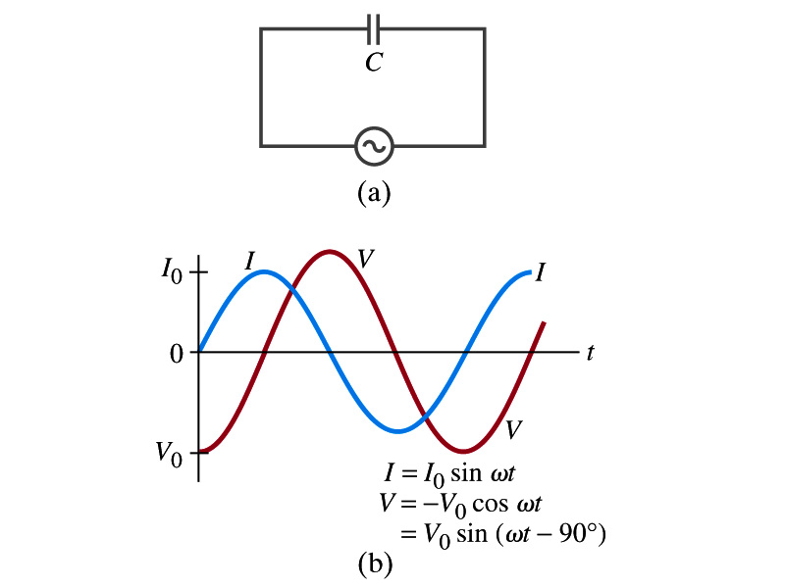
AC Circuit w/ Capacitance only
What happens when a capacitor is connected to a DC power source?
The capacitor quickly charges up.
There is no steady current flow in the circuit
Since the capacitor prevents the flow of the DC current
What do you think will happen if it is connected to an AC power source?
The current flows continuously. Why?
When the AC power turns on, charge begins to flow one direction, charging up the plates
When the direction of the power reverses, the charge flows in the opposite direction

Slide 45
AC Circuit w/ Capacitance only
From Kirchhoff’s loop rule, we obtain
The current at any instance is
The charge Q on the plate at any instance is
Thus the voltage across the capacitor is
Using the identity
Where

Slide 46
AC Circuit w/ Capacitance only
So the voltage is
What does this mean?
Current and voltage are “out of phase by π/2 or 90º” but in this case, the voltage reaches its peak ¼ cycle after the current
What happens to the energy?
No energy is dissipated
The average power is 0 at all times
The energy is stored temporarily in the electric field
Then released back to the source
Applied voltage and the current in the capacitor can be written as
Where the capacitive reactance X_{C} is defined as
Again, this relationship is only valid for rms quantities
Infinite when ω=0.

Slide 47
Example 30 – 10
Capacitor reactance. What are the peak and rms current in the circuit in the figure if C=1.0μF and V_{rms}=120V? Calculate for (a) f=60Hz, and then for (b) f=6.0x10⁵Hz.
The peak voltage is
The capacitance reactance is
Thus the peak current is
The rms current is

Slide 48
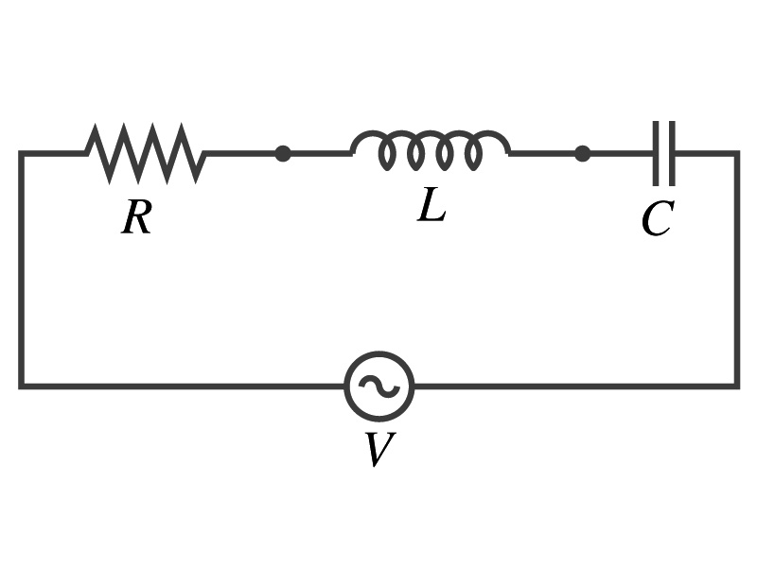
AC Circuit w/ LRC
The voltage across each element is
V_{R} is in phase with the current
V_{L} leads the current by 90º
V_{C} lags the current by 90º
From Kirchhoff’s loop rule
V=V_{R}+V_{L}+V_{C}
However since they do not reach the peak voltage at the same time, the peak voltage of the source V₀ will not equal V_{R0}+V_{L0}+V_{C0}
The rms voltage also will not be the simple sum of the three
Let’s try to find the total impedance, peak current Ι₀ and the phase difference between Ι₀ and V₀.

Slide 49
AC Circuit w/ LRC
The current at any instance is the same at all point in the circuit
The currents in each elements are in phase
Why?
Since the elements are in series
How about the voltage?
They are not in phase.
The current at any given time is
The analysis of LRC circuit is done using the “phasor” diagram in which arrows are drawn in an xy plane to represent the amplitude of each voltage, just like vectors
The lengths of the arrows represent the magnitudes of the peak voltages across each element; V_{R0}=I₀R, V_{L0}=I₀X_{L} and V_{C0}=I₀X_{C}
The angle of each arrow represents the phase of each voltage relative to the current, and the arrows rotate at the angular frequency ω to take into account the time dependence.
The projection of each arrow on y axis represents voltage across each element at any given time

Slide 50
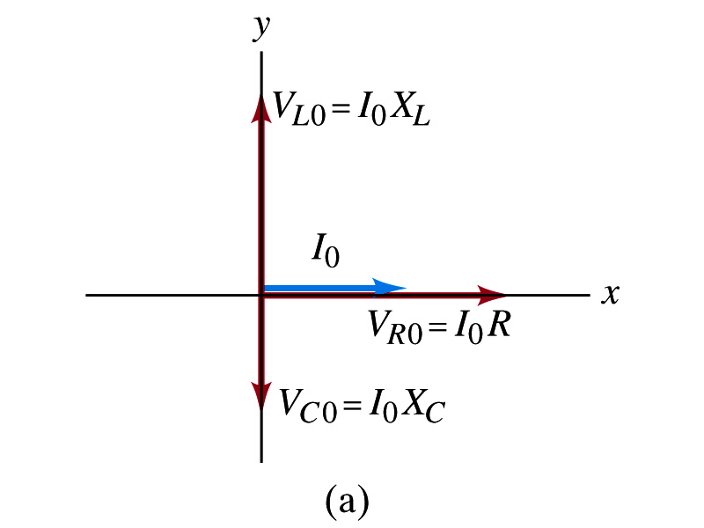
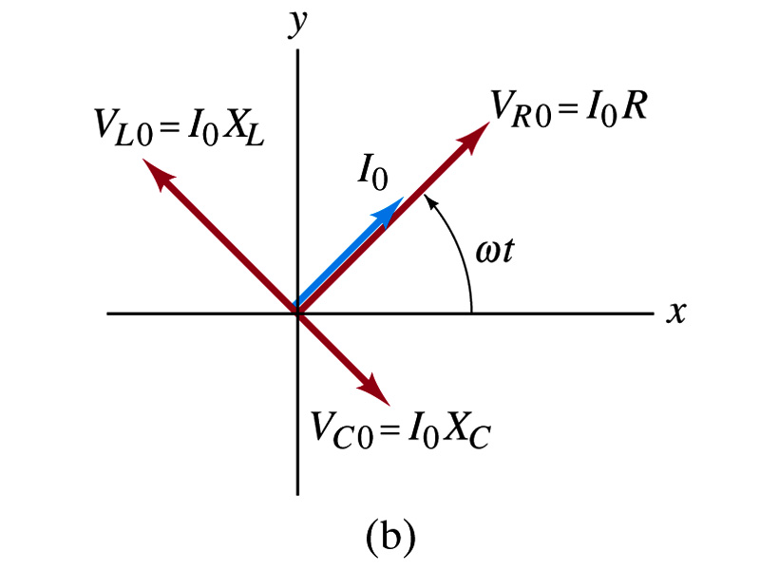
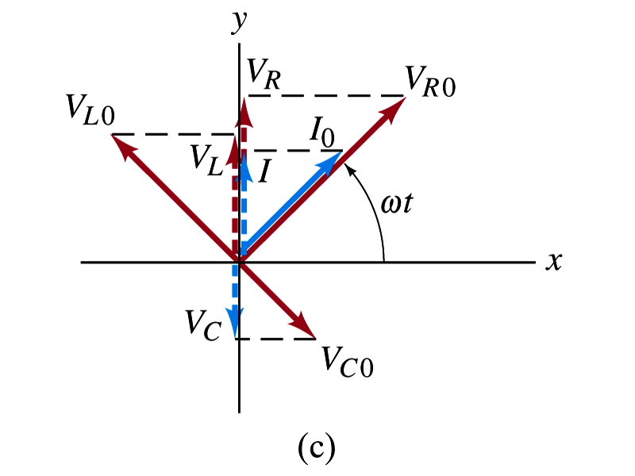
Phasor Diagrams
At t=0, Ι=0.
Thus V_{R0}=0, V_{L0}=Ι₀X_{L}, V_{C0}=Ι₀X_{C}
At t=t,
Thus, the voltages (y-projections) are
+90º
-90º

Slide 51
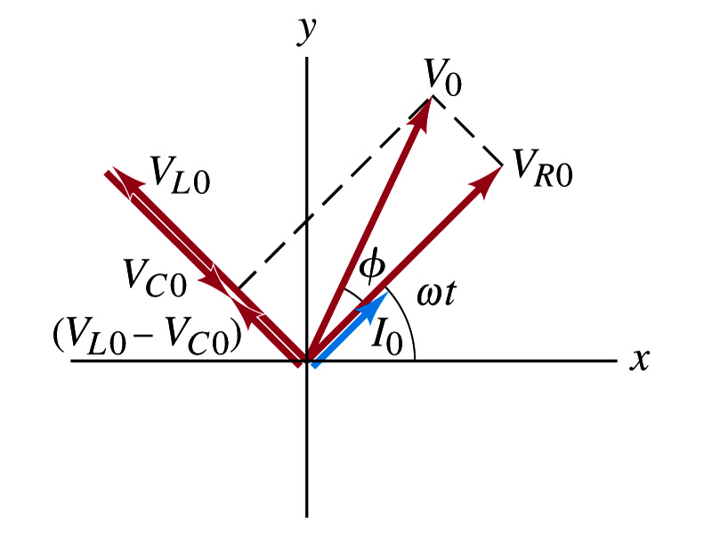
AC Circuit w/ LRC
Since the sum of the projections of the three vectors on the y axis is equal to the projection of their sum.
The sum of the projections represents the instantaneous voltage across the whole circuit which is the source voltage
So we can use the sum of all vectors as the representation of the peak source voltage V₀.
V₀ forms an angle φ to V_{R0} and rotates together with the other vectors as a function of time,
We determine the total impedance Z of the circuit defined by the relationship or
From Pythagorean theorem, we obtain
Thus the total impedance is

Slide 52
AC Circuit w/ LRC
The phase angle φ is
or
What is the power dissipated in the circuit?
Which element dissipates the power?
Only the resistor
The average power is
Since R=Zcosφ
We obtain
The factor cosφ is referred as the power factor of the circuit
For a pure resistor, cosφ=1 and
For a capacitor or inductor alone φ=-90º or +90º, so cosφ=0 and

Slide 53
Maxwell’s Equations
The development of EM theory by Oersted, Ampere and others was not done in terms of EM fields
The idea of fields was introduced somewhat by Faraday
Scottish physicist James C. Maxwell unified all the phenomena of electricity and magnetism in one theory with only four equations (Maxwell’s Equations) using the concept of fields
This theory provided the prediction of EM waves
As important as Newton’s law since it provides dynamics of electromagnetism
This theory is also in agreement with Einstein’s special relativity
The biggest achievement of 19th century electromagnetic theory is the prediction and experimental verifications that the electromagnetic waves can travel through the empty space
What do you think this accomplishment did?
Open a new world of communication
It also yielded the prediction that the light is an EM wave
Since all of Electromagnetism is contained in the four Maxwell’s equations, this is considered as one of the greatest achievements of human intellect

Slide 54
Ampere’s Law
Do you remember the mathematical expression of Oersted discovery of a magnetic field produced by an electric current, given by Ampere?
We’ve learned that a varying magnetic field produces an electric field
Then can the reverse phenomena, that a changing electric field producing a magnetic field, possible?
If this is the case, it would demonstrate a beautiful symmetry in nature between electricity and magnetism

Slide 55
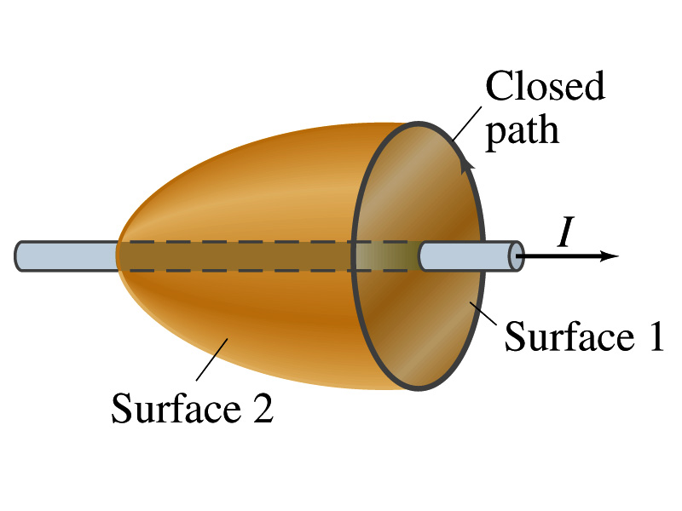
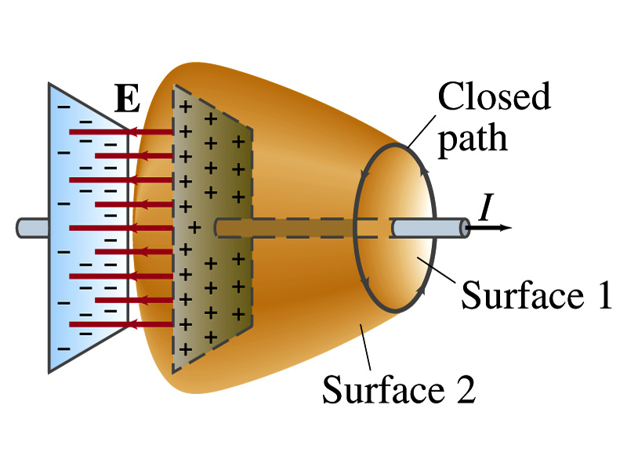
Expanding Ampere’s Law
Let’s consider a wire carrying current Ι
The current that is enclosed in the loop passes through the surface # 1 in the figure
We could imagine a different surface # 2 that shares the same enclosed path but cuts through the wire in a different location. What is the current that passes through the surface?
Still Ι.
So the Ampere’s law still works
We could then consider a capacitor being charged up or being discharged.
The current Ι enclosed in the loop passes through the surface #1
However the surface #2 that shares the same closed loop do not have any current passing through it.
There is magnetic field present since there is current ➔ In other words there is a changing electric field in between the plates
Maxwell resolved this by adding an additional term to Ampere’s law involving the changing electric field

Slide 56
Modifying Ampere’s Law
To determine what the extra term should be, we first have to figure out what the electric field between the two plates is
The charge Q on the capacitor with capacitance C is Q=CV
Where V is the potential difference between the plates
Since V=Ed
Where E is the uniform field between the plates, and d is the separation of the plates
And for parallel plate capacitor C=ε₀A/d
We obtain

Slide 57
Modifying Ampere’s Law
If the charge on the plate changes with time, we can write
Using the relationship between the current and charge we obtain
Where Φ_{Ε}=EA is the electric flux through the surface between the plates
So in order to make Ampere’s law work for the surface 2 in the figure, we must write it in the following form
This equation represents the general form of Ampere’s law
This means that a magnetic field can be caused not only by an ordinary electric current but also by a changing electric flux
Extra term by Maxwell

Slide 58
Example 31 – 1
Charging capacitor. A 30-pF air-gap capacitor has circular plates of area A=100cm². It is charged by a 70-V battery through a 2.0-Ω resistor. At the instance the battery is connected, the electric field between the plates is changing most rapidly. At this instance, calculate (a) the current into the plates, and (b) the rate of change of electric field between the plates. (c) Determine the magnetic field induced between the plates. Assume E is uniform between the plates at any instant and is zero at all points beyond the edges of the plates.
Since this is an RC circuit, the charge on the plates is:
For the initial current (t=0), we differentiate the charge with respect to time.
The electric field is
Change of the electric field is

Slide 59
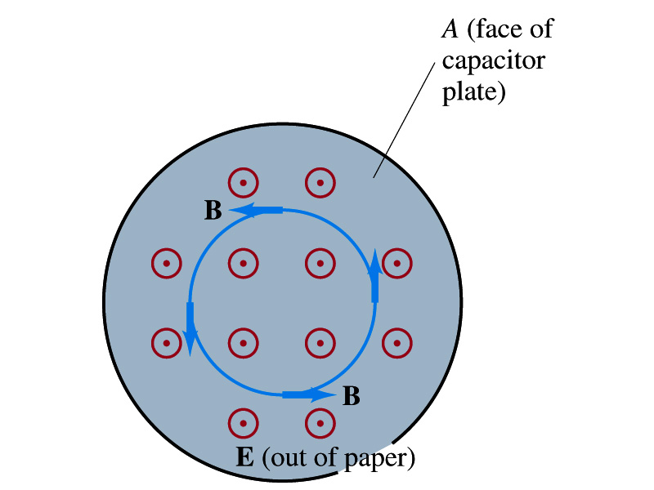
Example 31 – 1
(c) Determine the magnetic field induced between the plates. Assume E is uniform between the plates at any instant and is zero at all points beyond the edges of the plates.
The magnetic field lines generated by changing electric field is perpendicular to E and is circular due to symmetry
Whose law can we use to determine B?
Extended Ampere’s Law w/ Ι_{encl}=0!
We choose a circular path of radius r, centered at the center of the plane, following the B.
For r<r_{plate}, the electric flux is
since E is uniform throughout the plate
So from Ampere’s law, we obtain
Solving for B
For r<r_{plate}
Since we assume E=0 for r>r_{plate}, the electric flux beyond the plate is fully contained inside the surface.
So from Ampere’s law, we obtain
Solving for B
For r>r_{plate}

Slide 60
Displacement Current
Maxwell interpreted the second term in the generalized Ampere’s law equivalent to an electric current
He called this term as the displacement current, Ι_{D}
While the other term is called as the conduction current, Ι
Ampere’s law then can be written as
Where
While it is in effect equivalent to an electric current, a flow of electric charge, this actually does not have anything to do with the flow itself

Slide 61
Gauss’ Law for Magnetism
If there is a symmetry between electricity and magnetism, there must be an equivalent law in magnetism as the Gauss’ Law in electricity
For a magnetic field B, the magnetic flux Φ_{B} through the surface is defined as
Where the integration is over the area of either an open or a closed surface
The magnetic flux through a closed surface which completely encloses a volume is
What was the Gauss’ law in the electric case?
The electric flux through a closed surface is equal to the total net charge Q enclosed by the surface divided by ε₀.
Similarly, we can write Gauss’ law for magnetism as
Why is result of the integral zero?
There is no isolated magnetic poles, the magnetic equivalent of single electric charges
Gauss’ Law for electricity
Gauss’ Law for magnetism

Slide 62
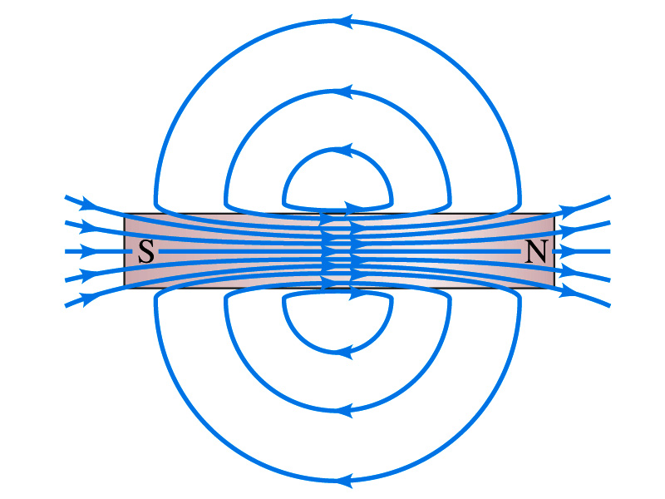
Gauss’ Law for Magnetism
What does the Gauss’ law in magnetism mean physically?
There are as many magnetic flux lines that enter the enclosed volume as leave it
If magnetic monopole does not exist, there is no starting or stopping point of the flux lines
Electricity do have the source and the sink
Magnetic field lines must be continuous
Even for bar magnets, the field lines exist both insides and outside of the magnet

Slide 63
Maxwell’s Equations
In the absence of dielectric or magnetic materials, the four equations developed by Maxwell are:
Gauss’ Law for electricity
A generalized form of Coulomb’s law relating electric field to its sources, the electric charge
Gauss’ Law for magnetism
A magnetic equivalent of Coulomb’s law relating magnetic field to its sources. This says there are no magnetic monopoles.
Faraday’s Law
An electric field is produced by a changing magnetic field
Ampére’s Law
A magnetic field is produced by an electric current or by a changing electric field

Slide 64
Maxwell’s Amazing Leap of Faith
According to Maxwell, a magnetic field will be produced even in an empty space if there is a changing electric field
He then took this concept one step further and concluded that
If a changing magnetic field produces an electric field, the electric field is also changing in time.
This changing electric field in turn produces the magnetic field that also changes.
This changing magnetic field then in turn produces the electric field that changes.
This process continues.
With the manipulation of the equations, Maxwell found that the net result of this interacting changing fields is a wave of electric and magnetic fields that can actually propagate (travel) through the space

Slide 65
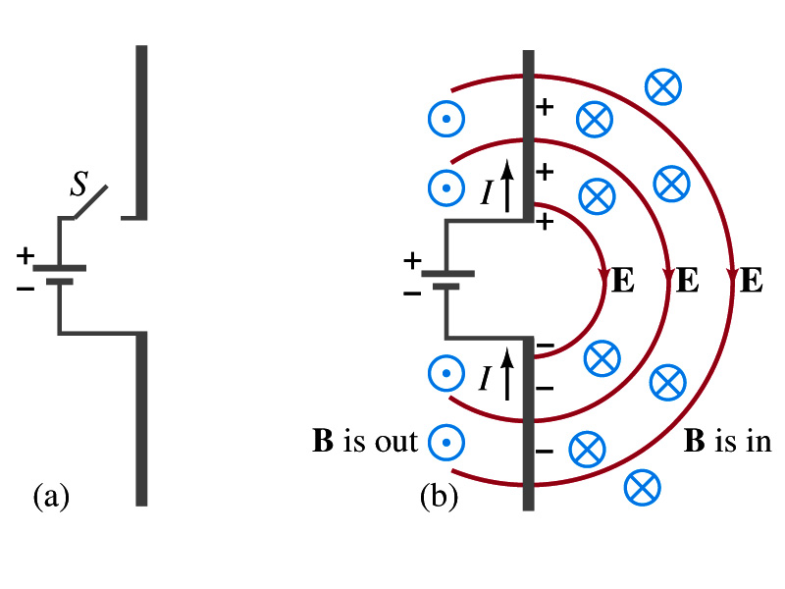
Production of EM Waves
Consider two conducting rods that will serve as an antenna are connected to a DC power source
What do you think will happen when the switch is closed?
The rod connected to the positive terminal is charged positive and the other negatively
Then the electric field will be generated between the two rods
Since there is current that flows through, the rods generates a magnetic field around them
How far would the electric and magnetic fields extend?
In static case, the field extends indefinitely
When the switch is closed, the fields are formed nearby the rods quickly but
The stored energy in the fields won’t propagate w/ infinite speed

Slide 66
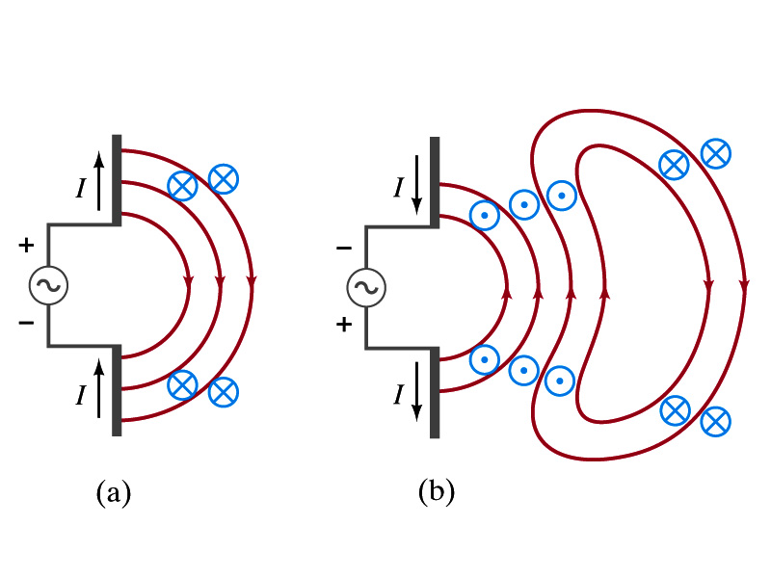
Production of EM Waves
What happens if the antenna is connected to an ac power source?
When the connection was initially made, the rods are charging up quickly w/ the current flowing in one direction as shown in the figure
The field lines form as in the dc case
The field lines propagate away from the antenna
Then the direction of the voltage reverses
The new field lines with the opposite direction forms
While the original field lines still propagates away from the rod reaching out far
Since the original field propagates through an empty space, the field lines must form a closed loop (no charge exist)
Since changing electric and magnetic fields produce changing magnetic and electric fields, the fields moving outward is self supporting and do not need antenna with flowing charge
The fields far from the antenna is called the radiation field
Both electric and magnetic fields form closed loops perpendicular to each other

Slide 67
Properties of Radiation Fields
The fields travel on the other side of the antenna as well
The field strength are the greatest in the direction perpendicular to the oscillating charge while along the direction is 0
The magnitude of E and B in the radiation field decrease with distance as 1/r
The energy carried by the EM wave is proportional to the square of the amplitude, E² or B²
So the intensity of wave decreases as 1/r²

Slide 68
Properties of Radiation Fields
The electric and magnetic fields at any point are perpendicular to each other and to the direction of motion
The fields alternate in direction
The field strengths vary from maximum in one direction, to 0 and to max in the opposite direction
The electric and magnetic fields are in phase
Very far from the antenna, the field lines are pretty flat over a reasonably large area
Called plane waves

Slide 69
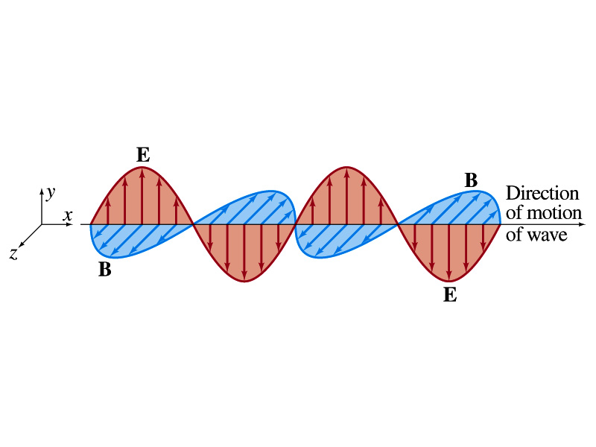
EM Waves
If the voltage of the source varies sinusoidally, the field strengths of the radiation field vary sinusoidally
We call these waves EM waves
They are transverse waves
EM waves are always waves of fields
Since these are fields, they can propagate through an empty space
In general accelerating electric charges give rise to electromagnetic waves
This prediction from Maxwell’s equations was experimentally by Heinrich Hertz through the discovery of radio waves

Slide 70
EM Waves and Their Speeds
Let’s consider a region of free space. What’s a free space?
An area of space where there is no charges or conduction currents
In other words, far from emf sources so that the wave fronts are essentially flat or not distorted over a reasonable area
What are these flat waves called?
Plane waves
At any instance E and B are uniform over a large plane perpendicular to the direction of propagation
So we can also assume that the wave is traveling in the x-direction w/ velocity, v=vi, and that E is parallel to y axis and B is parallel to z axis

Slide 71
Maxwell’s Equations w/ Q=Ι=0
In this region of free space, Q=0 and Ι=0, thus the four Maxwell’s equations become
Q_{encl}=0
No Changes
No Changes
I_{encl}=0
One can observe the symmetry between electricity and magnetism.
The last equation is the most important one for EM waves and their propagation!!

Slide 72
EM Waves from Maxwell’s Equations
If the wave is sinusoidal w/ wavelength λ and frequency f, such traveling wave can be written as
Where
What is v?
It is the speed of the traveling wave
What are E₀ and B₀?
The amplitudes of the EM wave. Maximum values of E and B field strengths.
Thus

Slide 73
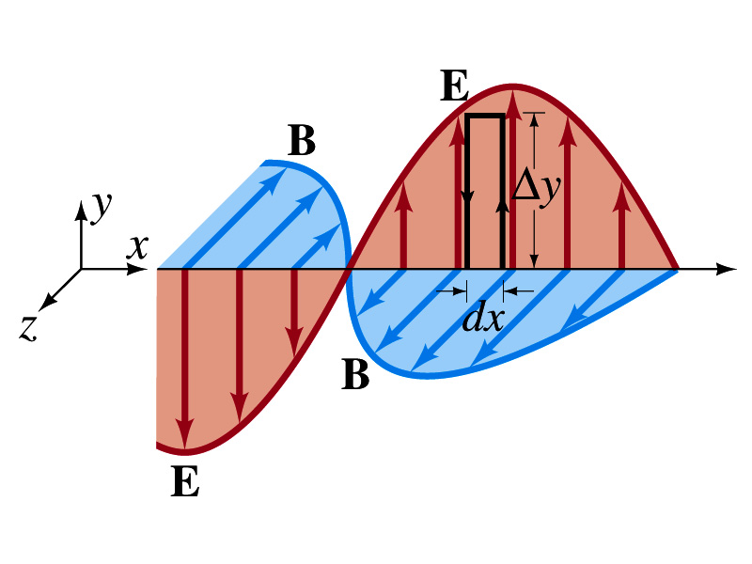
From Faraday’s Law
Let’s apply Faraday’s law
to the rectangular loop of height Δy and width dx
along the top and bottom of the loop is 0. Why?
Since E is perpendicular to dl.
So the result of the integral through the loop counterclockwise becomes
For the right-hand side of Faraday’s law, the magnetic flux through the loop changes as
Thus
Since E and B
depend on x and t

Slide 74
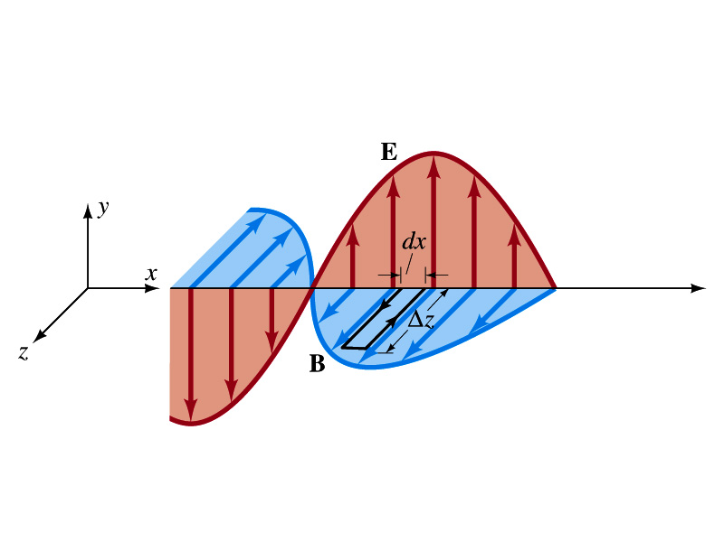
From Modified Ampére’s Law
Let’s apply Maxwell’s 4th equation
to the rectangular loop of length Δz and width dx
along the x-axis of the loop is 0
Since B is perpendicular to dl.
So the result of the integral through the loop counterclockwise becomes
For the right-hand side of the equation is
Thus
Since E and B
depend on x and t

Slide 75
Relationship between E, B and v
Let’s now use the relationship from Faraday’s law
Taking the derivatives of E and B as given their traveling wave form, we obtain
Since E and B are in phase, we can write
This is valid at any point and time in space. What is v?
The velocity of the wave
We obtain
Since
Thus

Slide 76
Speed of EM Waves
Let’s now use the relationship from Apmere’s law
Taking the derivatives of E and B as given their traveling wave form, we obtain
However, from the previous page we obtain
Thus
Since
We obtain
Thus
The speed of EM waves is the same as the speed of light. EM waves behaves like the light.

Slide 77
Speed of Light w/o Sinusoidal Wave Forms
Taking the time derivative on the relationship from Ampere’s laws, we obtain
By the same token, we take position derivative on the relationship from Faraday’s law
From these, we obtain
Since the equation for traveling wave is
By correspondence, we obtain
A natural outcome of Maxwell’s equations is that E and B obey the wave equation for waves traveling w/ speed
Maxwell predicted the existence of EM waves based on this
and

Slide 78
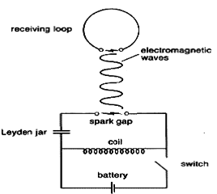
Light as EM Wave
People knew some 60 years before Maxwell that light behaves like a wave, but …
They did not know what kind of waves they are.
Most importantly what is it that oscillates in light?
Heinrich Hertz first generated and detected EM waves experimentally in 1887 using a spark gap apparatus
Charge was rushed back and forth in a short period of time, generating waves with frequency about 10⁹Hz (these are called radio waves)
He detected using a loop of wire in which an emf was produced when a changing magnetic field passed through
These waves were later shown to travel at the speed of light and behave exactly like the light just not visible

Slide 79
Light as EM Wave
The wavelengths of visible light were measured in the first decade of the 19th century
The visible light wave length were found to be between 4.0x10⁻⁷m (400nm) and 7.5x10⁻⁷m (750nm)
The frequency of visible light is fλ=c
Where f and λ are the frequency and the wavelength of the wave
What is the range of visible light frequency?
4.0x10¹⁴Hz to 7.5x10¹⁴Hz
c is 3x10⁸m/s, the speed of light
EM Waves, or EM radiation, are categorized using EM spectrum

Slide 80
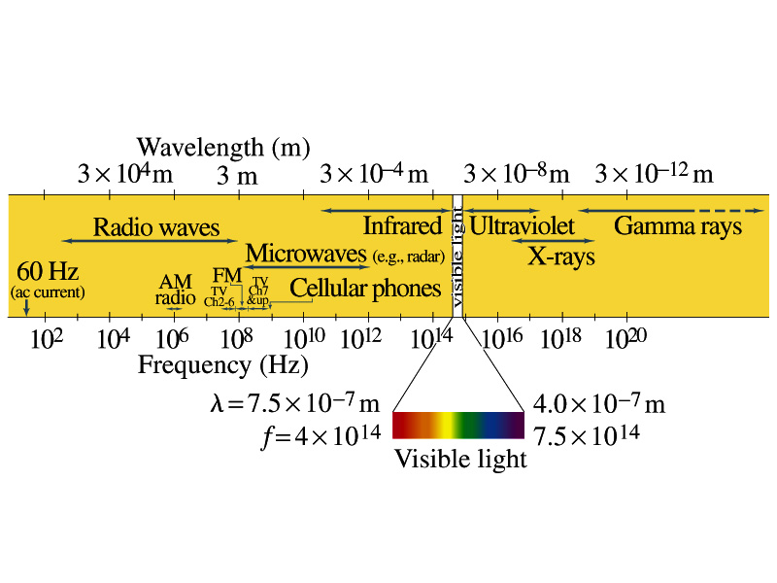
Electromagnetic Spectrum
Low frequency waves, such as radio waves or microwaves can be easily produced using electronic devices
Higher frequency waves are produced natural processes, such as emission from atoms, molecules or nuclei
Or they can be produced from acceleration of charged particles
Infrared radiation (IR) is mainly responsible for the heating effect of the Sun
The Sun emits visible lights, IR and UV
The molecules of our skin resonate at infrared frequencies so IR is preferentially absorbed and thus warm up

Slide 81
Example 31 – 3
Wavelength of EM waves. Calculate the wavelength (a) of a 60-Hz EM wave, (b) of a 93.3-MHz FM radio wave and (c) of a beam of visible red light from a laser at frequency 4.74x10¹⁴Hz.
What is the relationship between speed of light, frequency and the wavelength?
Thus, we obtain
For f=60Hz
For f=93.3MHz
For f=4.74x10¹⁴Hz

Slide 82
EM Wave in the Transmission Lines
Can EM waves travel through a wire?
Can it not just travel through the empty space?
Nope. It sure can travel through a wire.
When a source of emf is connected to a transmission line, the electric field within the wire does not set up immediately at all points along the line
When two wires are separated via air, the EM wave travel through the air at the speed of light, c.
However, through medium w/ permittivity ε and permeability μ, the speed of the EM wave is given
Is this faster than c?
Nope! It is slower.

Slide 83
Example 31 – 5
Phone call time lag. You make a telephone call from New York to London. Estimate the time the electrical signal to travel to reach London (a) carried on a 5000km telephone cable under the Atlantic Ocean and (b) sent via satellite 36,000km above the ocean. Would this cause a noticeable delay in either case?
Time delay via the cable:
Delay via satellite
So in case of satellite, the delay is likely noticeable!!

Slide 84
Energy in EM Waves
Since B=E/c and , we can rewrite the energy density
Note that the energy density associate with B field is the same as that associate with E
So each field contribute half to the total energy
By rewriting in B field only, we obtain
We can also rewrite to contain both E and B

Slide 85
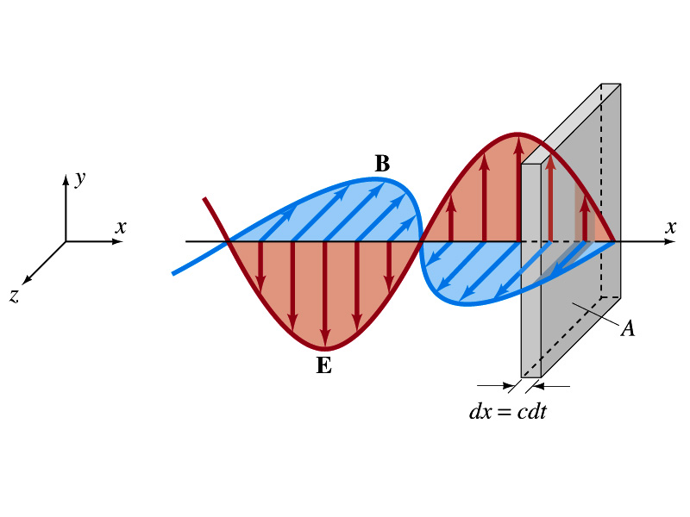
Energy Transport
What is the energy the wave transport per unit time per unit area?
This is given by the vector S, the Poynting vector
The unit of S is W/m².
The direction of S is the direction in which the energy is transported. Which direction is this?
The direction the wave is moving
Let’s consider a wave passing through an area A perpendicular to the x-axis, the axis of propagation
How much does the wave move in time dt?
dx=cdt
The energy that passes through A in time dt is the energy that occupies the volume dV,
Since the energy density is u=ε₀E², the total energy, dU, contained in the volume V is

Slide 86
Energy Transport
Thus, the energy crossing the area A per time dt is
Since E=cB and , we can also rewrite
Since the direction of S is along v, perpendicular to E and B, the Poynting vector S can be written
This gives the energy transported per unit area per unit time at any instant
What is the unit?
W/m²

Slide 87
Average Energy Transport
The average energy transport in an extended period of time is useful since sometimes we do not detect the rapid variation with respect to time because the frequency is so high.
If E and B are sinusoidal,
Thus we can write the magnitude of the average Poynting vector as
This time averaged value of S is the intensity, defined as the average power transferred across unit area. E₀ and B₀ are maximum values.
We can also write
Where E_{rms} and B_{rms} are the rms values ( )

Slide 88
Example 31 – 6
E and B from the Sun. Radiation from the Sun reaches the Earth (above the atmosphere) at a rate of about 1350W/m². Assume that this is a single EM wave and calculate the maximum values of E and B.
What is given in the problem?
The average S!!
For E₀,
For B₀

