Slide 1
PHYS 1441 – Section 001 Lecture #2
Tuesday, June 5, 2018
Dr. Jaehoon Yu
Brief history of physics
Some basics …
Chapter 21
Static Electricity and Charge Conservation
Charges in Atom, Insulators and Conductors & Induced Charge
Coulomb’s Law
The Electric Field & Field Lines
Electric Fields and Conductors
Today’s homework is homework #2, due 11pm, this Saturday, June 9!!

Slide 2
Announcements
39/45 of you have registered in the homework system.
23/39 submitted the homework!
Fantastic job!!
You need my enrollment approval… So move quickly…
Remember, the deadline for the first homework is 11pm tomorrow, Wednesday, June 6
You MUST submit the homework to obtain 100% credit!
Also please be sure to make the payment in time otherwise your access as well as my access to the site for grading is cut.
Reading assignments: CH21 – 7
Quiz at the beginning of the class tomorrow, Wed. June 6
Appendix A1 – A8 and what we’ve learned today!

Slide 3
Extra Credit Special Project #1
Compare the Coulomb force to the Gravitational force in the following cases by expressing Coulomb force (F_{C}) in terms of the gravitational force (F_{G})
Between two protons separated by 1m
Between two protons separated by an arbitrary distance R
Between two electrons separated by 1m
Between two electrons separated by an arbitrary distance R
Five points each, totaling 20 points
BE SURE to show all the details of your work, including all formulae, proper references to them and explanations
Please staple them before the submission
Due at the beginning of the class Monday, June 11

Slide 4
Valid Planetarium Shows
Regular running shows
Out There; Time Space; Phantom of the Universe; Astronomy 101; Rosetta; Hot and Energetic Universe
For show times: http://www.uta.edu/planetarium/
Shows that need special arrangements
Black Holes (can watch up to 2 times)
Astronaut; Bad Astronomy; From Earth to the Universe; Experience the Aurora; IBEX; Ice Worlds; Magnificent Sun; Mayan Prophecies;
Mayan Prophecies; Nano Cam; Stars of the Pharaohs; Two Small Pieces of Glass; Unseen Universe; Violent Universe
How to submit for extra credit?
Obtain the ticket stub that is signed and dated by the planetarium star lecturer at the show
Collect the ticket stubs
Tape one edge of all of the ticket stubs on a sheet of paper with your name and ID written on it
Submit the sheet at the end of the semester at the final exam

Slide 5
Why do Physics?
Exp.{
To understand nature through experimental observations and measurements (Research)
Establish limited number of fundamental laws, usually with mathematical expressions
Predict the nature’s course
Theory and Experiment work hand-in-hand
Discrepancies between experimental measurements and theory are good for improvements
The general principles formulated through theory is used to improve our everyday lives, even though some laws can take a while till we see them amongst us
Theory {
5

Slide 6
Brief History of Physics
AD 18th century:
Newton’s Classical Mechanics: A theory of mechanics based on observations and measurements
AD 19th Century:
Electricity, Magnetism, and Thermodynamics
Late AD 19th and early 20th century (Modern Physics Era)
Einstein’s theory of relativity: Generalized theory of space, time, and energy (mechanics)
Quantum Mechanics: Theory of atomic phenomena
Physics has come very far, very fast, and is still progressing, yet we’ve got a long way to go
What is matter made of?
How do matters get mass?
How and why do matters interact with each other?
How is universe created?
6

Slide 7
Models, Theories and Laws
Models: An analogy or a mental image of a phenomena in terms of something we are familiar with
Thinking light as waves, behaving just like water waves
Often provide insights for new experiments and ideas
Theories: More systematically improved version of models
Can provide quantitative predictions that are testable and more precise
Laws: Certain concise but general statements about how nature behaves
Energy conservation
The statement must be found experimentally valid to become a law
Principles: Less general statements of how nature behaves
Has some level of arbitrariness
7

Slide 8
Uncertainties
Physical measurements have limited precision, however good they are, due to:
Number of measurements
Quality of instruments (meter stick vs micro-meter)
Experience of the person doing measurements
Etc
In many cases, uncertainties are more important and difficult to estimate than the central (or mean) values
Stat.{
{
Syst.
8

Slide 9
Significant Figures
Denote the precision of the measured values
The number 80 implies precision of +/- 1, between 79 and 81
If you are sure to +/-0.1, the number should be written 80.0
Significant figures: non-zero numbers or zeros that are not place-holders
34, 34.2, 0.001, 34.100
34 has two significant digits
34.2 has 3
0.001 has one because the 0’s before 1 are place holders to position “.”
34.100 has 5, because the 0’s after 1 indicate that the numbers in these digits are indeed 0’s.
When there are many 0’s, use scientific notation for simplicity:
31400000=3.14x10⁷
0.00012=1.2x10⁻⁴
9

Slide 10
Significant Figures
Operational rules:
Addition or subtraction: Keep the smallest number of decimal place in the result, independent of the number of significant digits: 12.001+ 3333.1=
Multiplication or Division: Keep the smallest number of significant digits in the result: 12.001 x 3.1 = , because the smallest significant figures is ?.
3345.1
37
What does this mean?
The worst precision determines the precision the overall operation!!
In English?
Can’t get any better than the worst of the measurements!
10

Slide 11
SI Base Quantities and Units
Quantity | Unit | Unit Abbrevation
Length | Meter | m
Time | Second | s
Mass | Kilogram | kg
Electric current | Ampere | A
Temperature | Kelvin | k
Amount of substance | Mole | mol
Luminous Intensity | Candela | cd
There are prefixes that scales the units larger or smaller for convenience (see pg. 7)

Slide 12
Prefixes, expressions and their meanings
Larger
Smaller
deca (da): 10¹
hecto (h): 10²
kilo (k): 10³
mega (M): 10⁶
giga (G): 10⁹
tera (T): 10¹²
peta (P): 10¹⁵
exa (E): 10¹⁸
zetta (Z): 10²¹
yotta (Y): 10²⁴
deci (d): 10⁻¹
centi (c): 10⁻²
milli (m): 10⁻³
micro (μ): 10⁻⁶
nano (n): 10⁻⁹
pico (p): 10⁻¹²
femto (f): 10⁻¹⁵
atto (a): 10⁻¹⁸
zepto (z): 10⁻²¹
yocto (y): 10⁻²⁴
12

Slide 13
How do we convert quantities from one unit to another?
Unit 1 =
Conversion factor X
Unit 2
1 inch | 2.54 | cm
1 inch | 0.0254 | m
1 inch | 2.54x10⁻⁵ | km
1 ft | 30.3 | cm
1 ft | 0.303 | m
1 ft | 3.03x10⁻⁴ | km
1 hr | 60 | minutes
1 hr | 3600 | seconds
And many | More | Here….
13

Slide 14
What does the Electric Force do?
Electric force is the bases of modern technology
Virtually everything we use every day uses electric force
Can you give a few examples?
But this force also affects many others
Making up materials with atoms and molecules
Biological metabolic processes
Nerve signals, heart pumping, etc
Virtually all the forces we have learned in Physics I:
Friction, normal force, elastic force and other contact forces are the results of electric forces acting at the atomic level

Slide 15
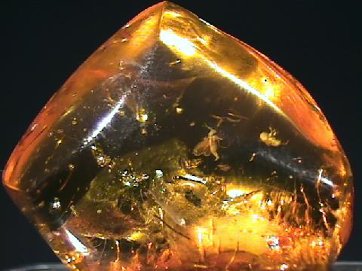
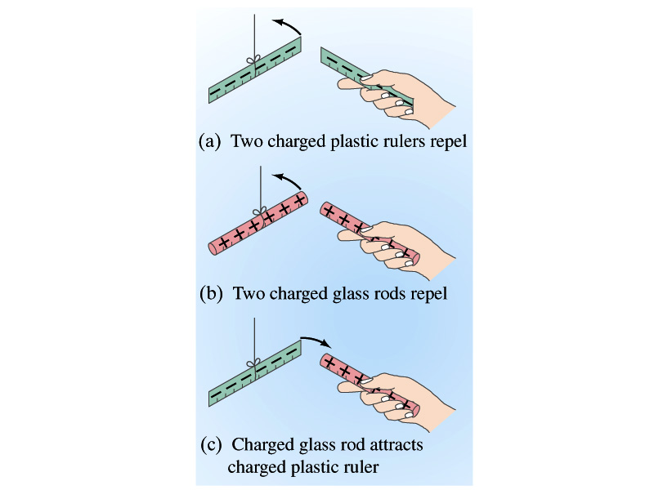
Static Electricity; Electric Charge and Its Conservation
Electricity is from Greek word elecktron=amber, a petrified tree resin that attracts matter if rubbed
Static Electricity: an amber effect
An object becomes charged or “posses a net electric charge” due to rubbing
Can you give some examples?
Two types of electric charge
Like charges repel while unlike charges attract
Benjamin Franklin referred the charge on glass rod as the positive, arbitrarily. Thus the charge that attracts glass rod is negative. ➔ This convention is still used.

Slide 16
Static Electricity; Electric Charge and Its Conservation
Franklin argued that when a certain amount of charge is produced on one body in a process, an equal amount of opposite type of charge is produced on another body.
The positive and negative are treated algebraically so that during any process the net change in the amount of produced charge is 0.
When you comb your hair with a plastic comb, the comb acquires negative charge and the hair an equal amount of positive charge.
This is the law of conservation of electric charge.
The net amount of electric charge produced in any process is ZERO!!
If an object or one region of space acquires a positive charge, then an equal amount of negative charge will be found in neighboring areas or objects.
No violations have ever been observed.
This conservation law is as firmly established as that of energy or momentum.

Slide 17
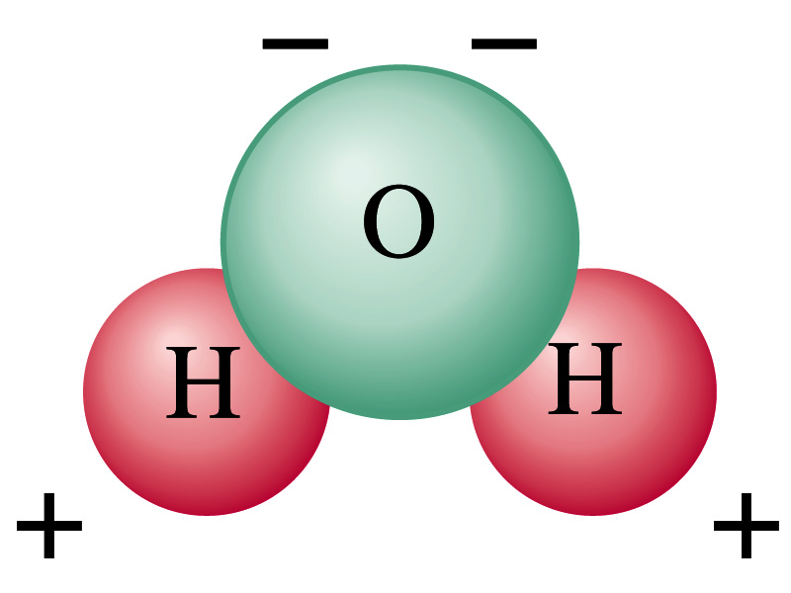
Electric Charge in an Atom
It has been understood through the past century that an atom consists of
A positively charged heavy core ⬅ What is the name?
This core is the nucleus and consists of neutrons and protons.
Many negatively charged light particles surround the core ⬅ What is the name of these light particles?
These are called electrons
How many of these in an atom?
So what is the net electrical charge of an atom?
Zero!!! Electrically neutral!!!
Can you explain what happens when a comb is rubbed on a towel?
Electrons from the towel get transferred to the comb, making the comb negatively charged while leaving positive ions on the towel.
These charges eventually get neutralized primarily by water molecules in the air.
As many as the number of protons in the nucleus!!

Slide 18
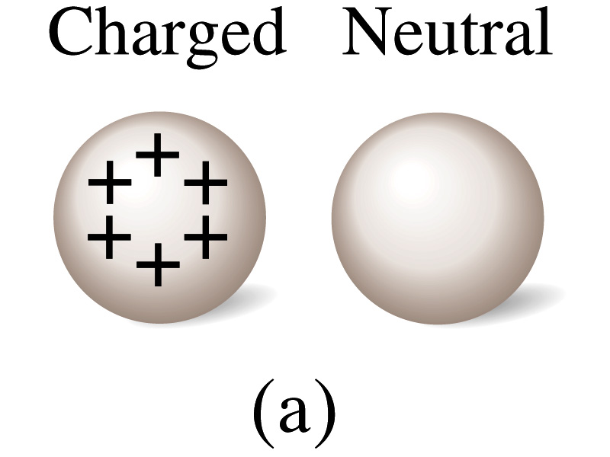
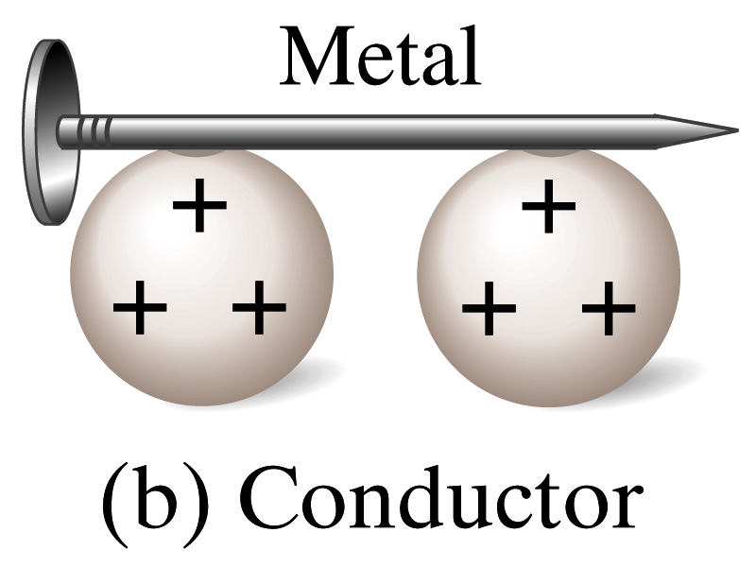
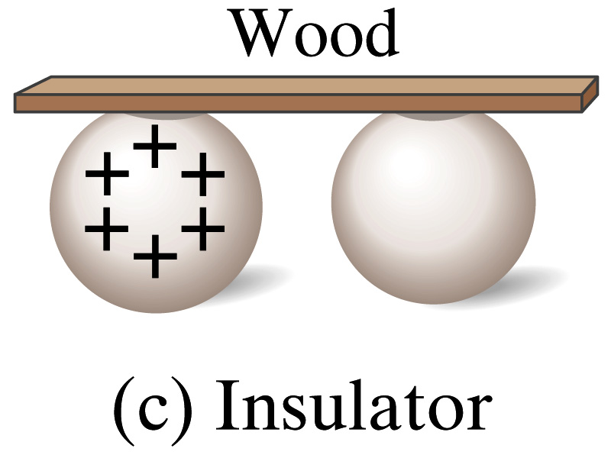
Insulators and Conductors
Let’s imagine two metal balls of which one is charged
What will happen if they are connected by
A metallic object?
Some charge is transferred through this object.
These objects are called conductors of electricity.
An wooden object?
No charge is transferred
These objects are called nonconductors or insulators.
Metals are generally good conductors whereas most other materials are insulators.
There are third kind of materials called, semi-conductors, like silicon or germanium ➔ conduct only in certain conditions
Atomically, conductors have loosely bound electrons while insulators have them tightly bound!

Slide 19
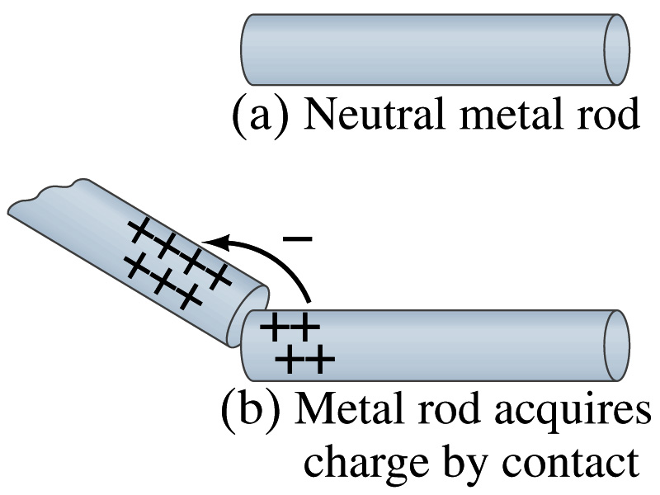
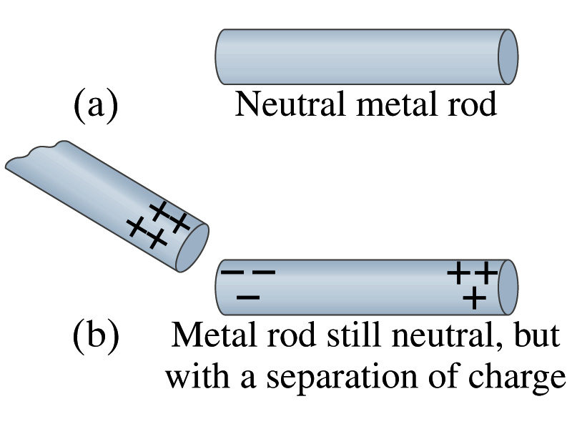
Induced Charge
When a positively charged metallic object is brought close to an uncharged metal object
If two objects touch each other, the free electrons in the neutral one are attracted to the positively charged object and some will pass over to it, leaving the neutral object positively charged ➔ Charging by conduction
If the objects get close, the free electrons in the neutral one still move within the metal toward the charged object leaving the opposite side of the object positively charged.
The charges have been “induced” in the opposite ends of the object.

Slide 20
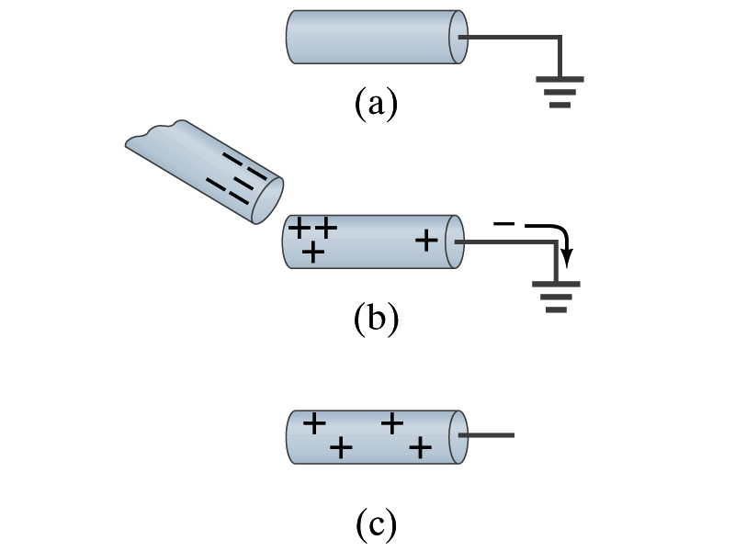
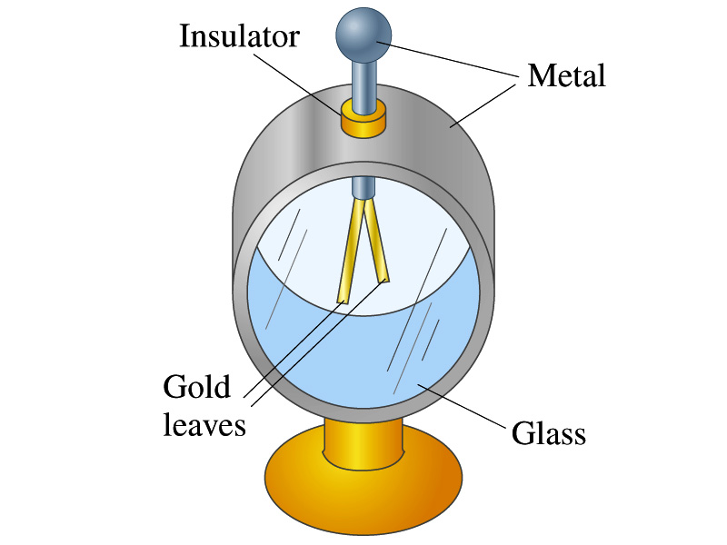
Induced Charge
ground
We can induce a net charge on a metal object by connecting a wire to the ground.
The object is “grounded” or “earthed”.
Since the Earth is so large and conducts, it can give or accept charge.
The Earth acts as a reservoir of electric charge.
If negative charge is brought close to a neutral metal
Positive charge will be induced toward the negatively charged metal.
The negative charges in the neutral metal will be gathered on the opposite side, transferring through the wire to the Earth.
If the wire is cut, the metal bar has net positive charge.
An electroscope is a device that can be used for detecting charge and signs.
How does this work?

Slide 21
Coulomb’s Law
Charges exert force to each other. What factors affect the magnitude of this force?
Any guesses?
Charles Coulomb figured this out in 1780’s.
Coulomb found that the electric force is
Proportional to the multiplication of the two charges
If one of the charges doubles, the force doubles.
If both the charges double, the force quadruples.
Inversely proportional to the square of the distances between them.
Electric charge is the fundamental property of matter, just like mass.
How would you put the above into a formula?

Slide 22
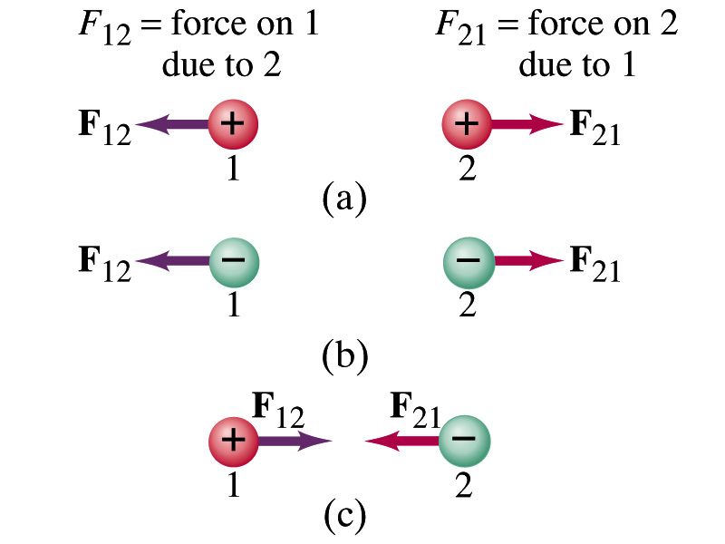
Coulomb’s Law – The Formula
Formula
Is Coulomb force a scalar quantity or a vector quantity? Unit?
A vector quantity. The unit is Newtons (N)!
The direction of electric (Coulomb) force is always along the line joining the two objects.
If the two charges are the same: forces are directed away from each other.
If the two charges are opposite: forces are directed toward each other.
Coulomb force is precise to 1 part in 10¹⁶.
Unit of charge is called Coulomb, C, in SI.
The value of the proportionality constant, k, in SI unit is
Thus, 1C is the charge that gives F~9x10⁹N of force when placed 1m apart from each other.

Slide 23
Electric Force
and Gravitational Force
Extremely
Similar
Does the electric force look similar to another force? What is it?
Gravitational Force
What are the sources of the forces?
Electric Force: Electric charges, fundamental properties of matter
Gravitational Force: Masses, fundamental properties of matter
What else is similar?
Inversely proportional to the square of the distance between the sources of the force ➔ What is this kind law called?
Inverse Square Law
What is the difference?
Gravitational force is always attractive.
Electric force depends on the type of the two charges. (must pay good attention to the signs due to the sign of the charge and the vector force directions!!)

