Slide 1
PHYS 1441 – Section 001 Lecture #4
Thursday, June 7, 2018
Dr. Jaehoon Yu
Chapter 21
The Electric Field & Field Lines
Electric Fields and Conductors
Motion of a Charged Particle in an Electric Field
Electric Dipoles
Chapter 22
Electric Flux

Slide 2
Announcements
1st Term exam
In class, coming Monday, June 11: DO NOT MISS THE EXAM!
CH21.1 to what we learn on today, Thursday, June 7 + Appendices A1 – A8
You can bring your calculator but it must not have any relevant formula pre-input
Cell phones or any types of computers cannot replaced a calculator!
BYOF: You may bring one 8.5x11.5 sheet (front and back) of handwritten formulae and values of constants for the exam
No derivations, word definitions, or solutions of any problems !
No additional formulae or values of constants will be provided!
Quiz results
Class average: 16.6/35
Equivalent to : 47.5/100
Top score: 35/35

Slide 3
Special Project #2 – Angels & Demons
Compute the total possible energy released from an annihilation of x-grams of anti-matter and the same quantity of matter, where x is the last two digits of your SS#. (20 points)
Use the famous Einstein’s formula for mass-energy equivalence
Compute the power output of this annihilation when the energy is released in x ns, where x is again the first two digits of your SS#. (10 points)
Compute how many cups of gasoline (8MJ) this energy corresponds to. (5 points)
Compute how many months of world electricity usage (3.6GJ/mo) this energy corresponds to. (5 points)
Due by the beginning of the class Wednesday, June. 13

Slide 4
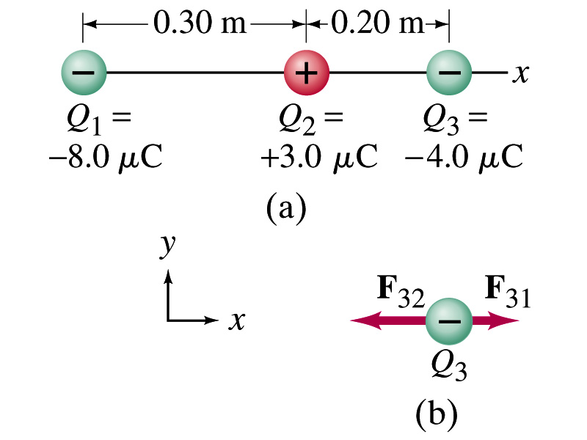
Example 21.2
Three charges on a line. Three charged particles are arranged in a line as shown in the figure. Calculate the net electrostatic force on particle 3 (the -4μC on the right) due to other two charges.
What is the force that Q₁ exerts on Q₃?
What is the force that Q₂ exerts on Q₃?
Using the vector sum of the two forces

Slide 5
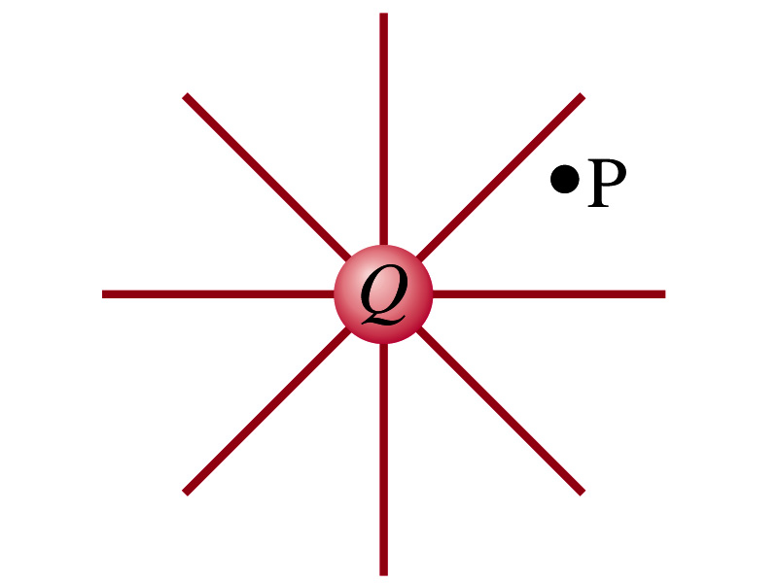
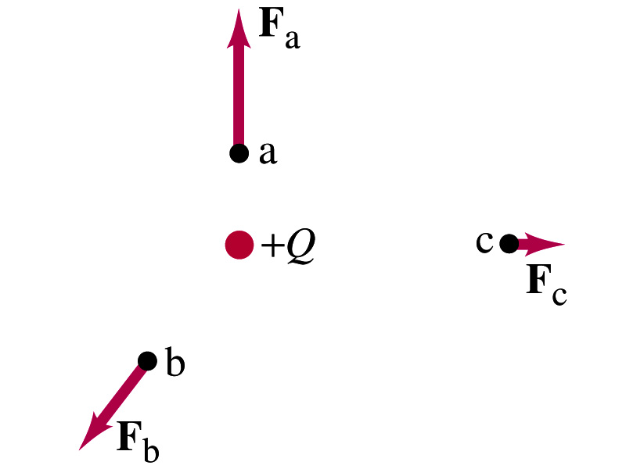
The Electric Field
Both gravitational and electric forces act over a distance without contacting objects ➔ What kind of forces are these?
Field forces
Michael Faraday developed an idea of field.
Faraday (1791 – 1867) argued that the electric field extends outward/inward from every charge and permeates through all of space.
Field by a charge or a group of charges can be inspected by placing a small positive test charge in the vicinity and measuring the force on it.

Slide 6
The Electric Field
The electric field at any point in space is defined as the force exerted on a tiny positive test charge divide by magnitude of the test charge
Electric force per unit charge
What kind of quantity is the electric field?
Vector quantity. Why?
What is the unit of the electric field?
N/C
What is the magnitude of the electric field at a distance r from a single point charge Q?

Slide 7
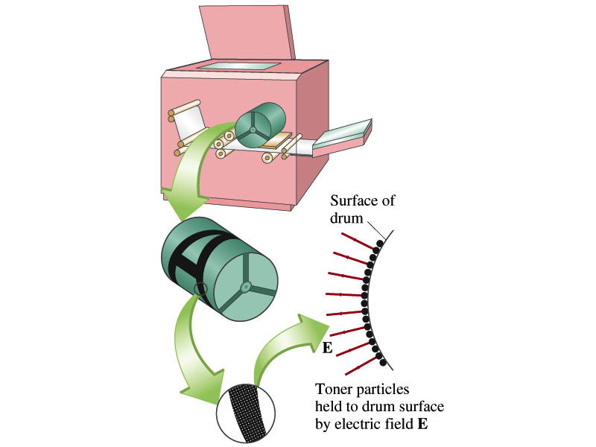
Example 21 – 5
Electrostatic copier. An electrostatic copier works by selectively arranging positive charges (in a pattern to be copied) on the surface of a non-conducting drum, then gently sprinkling negatively charged dry toner (ink) onto the drum. The toner particles temporarily stick to the pattern on the drum and are later transferred to paper and “melted” to produce the copy. Suppose each toner particle has a mass of 9.0x10⁻¹⁶kg and carries the average of 20 extra electrons to provide an electric charge. Assuming that the electric force on a toner particle must exceed twice its weight in order to ensure sufficient attraction, compute the required electric field strength near the surface of the drum.
The electric force must be the same as twice the gravitational force on the toner particle.
So we can write
Thus, the magnitude of the electric field is

Slide 8
Direction of the Electric Field
If there are more than one charge present, the individual fields due to each charge are added vectorially to obtain the total field at any point.
This superposition principle of electric field has been verified by experiments.
For a given electric field E at a given point in space, we can calculate the force F on any charge q, F=qE.
What happens to the direction of the force and the field depending on the sign of the charge q?
The F and E are in the same directions if q > 0
The F and E are in the opposite directions if q < 0

Slide 9
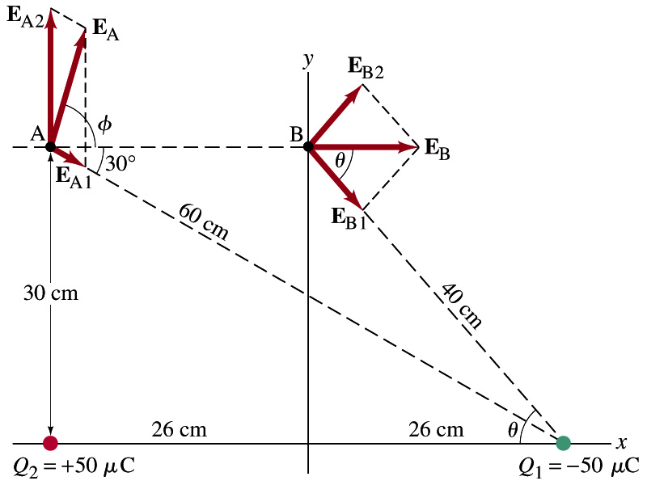
Example 21 – 8
E above two point charges: Calculate the total electric field (a) at point A and (b) at point B in the figure on the right due to both the charges Q₁ and Q₂.
How do we solve this problem?
First, compute the magnitude of fields at each point due to each of the two charges.
Then add them at each point vectorially!
First, the electric field at point A by Q₁ and then Q₂.

Slide 10
Example 21 – 8, cnt’d
Now the components of the electric field vectors by the two charges at point A.
So the electric field at point A is
The magnitude of the electric field at point A is
Now onto the electric field at point B

Slide 11
Example 21 – 8, cnt’d
Electric field at point B is easier due to symmetry!
Since the magnitude of the charges are the same and the distance to point B from the two charges are the same, the magnitude of the electric field by the two charges at point B are the same!!
Now the components!
First, the y-component!
Now, the x-component!
So the electric field at point B is
The magnitude of the electric field at point B

Slide 12
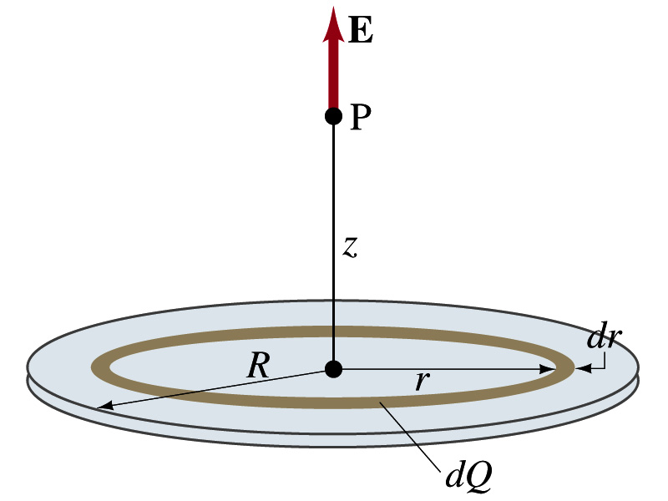
Example 21 – 12
Uniformly charged disk: Charge is distributed uniformly over a thin circular disk of radius R. The charge per unit area (C/m²) is σ. Calculate he electric field at a point P on the axis of the disk, a distance z above its center.
How do we solve this problem?
First, compute the magnitude of the field (dE) at point P due to the charge (dQ) on the ring of infinitesimal width dr.
From the result of example 21 – 11 (please do this problem yourself)
Since the surface charge density is constant, σ, and the ring has an area of 2πrdr, the infinitesimal charge of dQ is
So the infinitesimal field dE can be written

Slide 13
Example 21 – 12 cnt’d
Now integrating dE over 0 through R, we get
What happens if the disk has infinitely large area?
So the electric field due to an evenly distributed surface charge with density, σ, is

Slide 14
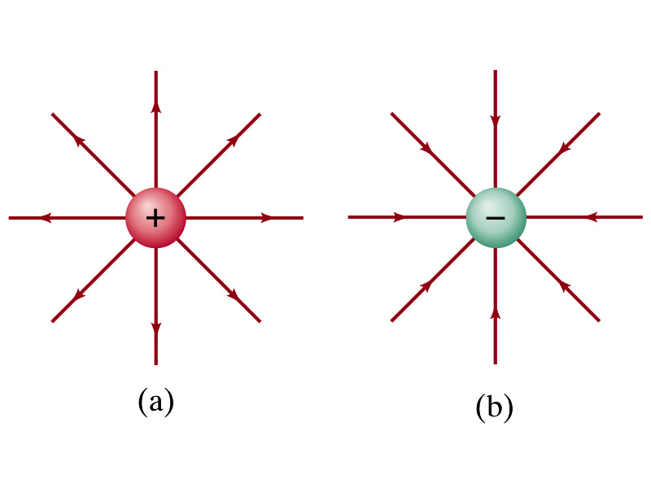
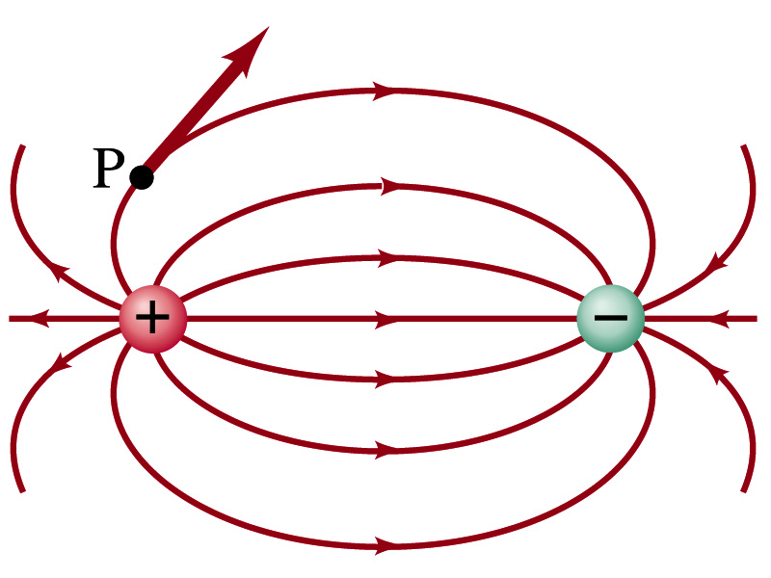
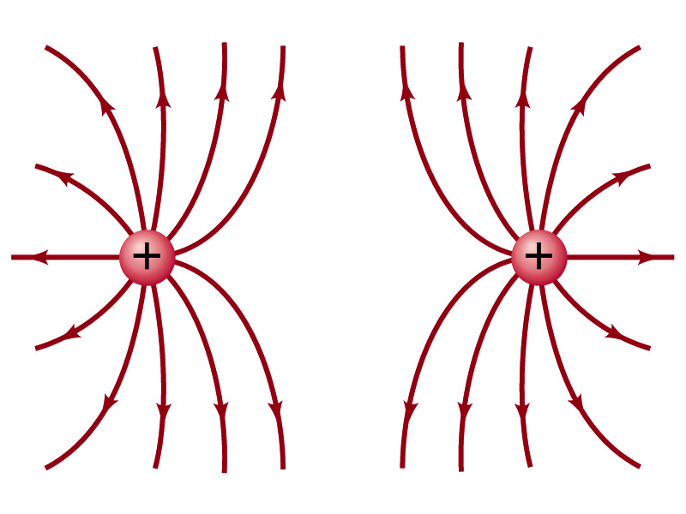
Field Lines
The electric field is a vector quantity. Thus, its magnitude can be expressed by the length of the vector and the direction by the direction the arrowhead points.
Since the field permeates through the entire space, drawing vector arrows is not a good way of expressing the field.
Electric field lines are drawn to indicate the direction of the force due to the given field on a positive test charge.
Number of lines crossing unit area perpendicular to E is proportional to the magnitude of the electric field.
The closer the lines are together, the stronger the electric field in that region.
Start on positive charges and end on negative charges.
Earth’s G-field lines

Slide 15
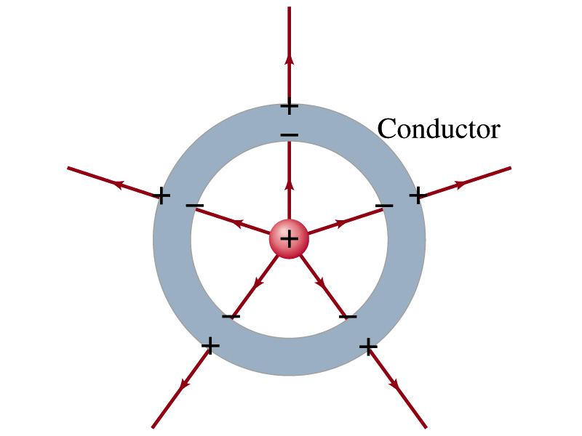
Electric Field and Conductors
The electric field inside a conductor is ZERO in static situation. (If the charge is at rest.) Why?
If there were an electric field within a conductor, there would be force on its free electrons.
The electrons will move until they reached the position where the electric field becomes zero.
Electric field can exist inside a non-conductor.
Consequences of the above
Any net charge on a conductor distributes itself on the surface.
Although no field exists inside a conductor, the fields can exist outside the conductor due to induced charges on the surface
The electric field is always perpendicular to the surface outside of a conductor.

Slide 16
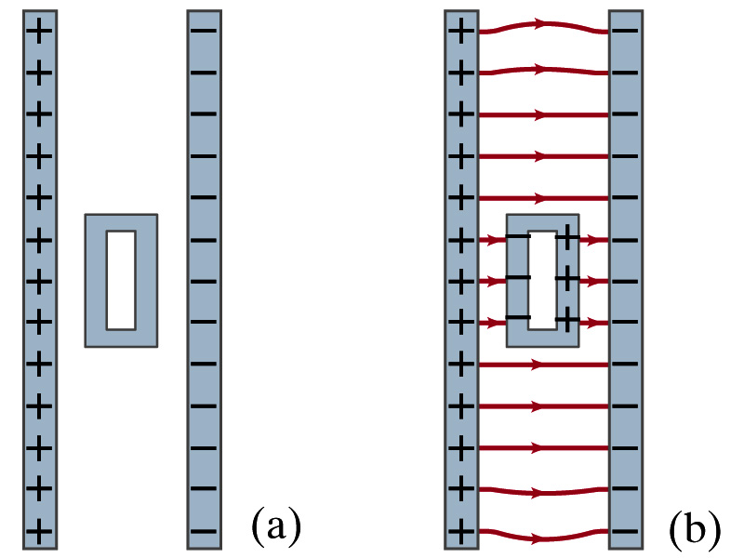
Example 21-13
Shielding, and safety in a storm. A hollow metal box is placed between two parallel charged plates. What is the field like in the box?
If the metal box were solid
The free electrons in the box would redistribute themselves along the surface so that the field lines would not penetrate into the metal.
The free electrons do the same in hollow metal boxes just as well as it did in a solid metal box.
Thus a conducting box is an effective device for shielding. ➔ Faraday cage
So what do you think will happen if you were inside a car when the car was struck by a lightening?

Slide 17
Motion of a Charged Particle in an Electric Field
If an object with an electric charge q is at a point in space where the electric field is E, the force exerting on the object is .
What do you think will happen to the charge?
Let’s think about the cases like these on the right.
The object will move along the field line…Which way?
Depends on the sign of the charge
The charge gets accelerated under an electric field.

Slide 18
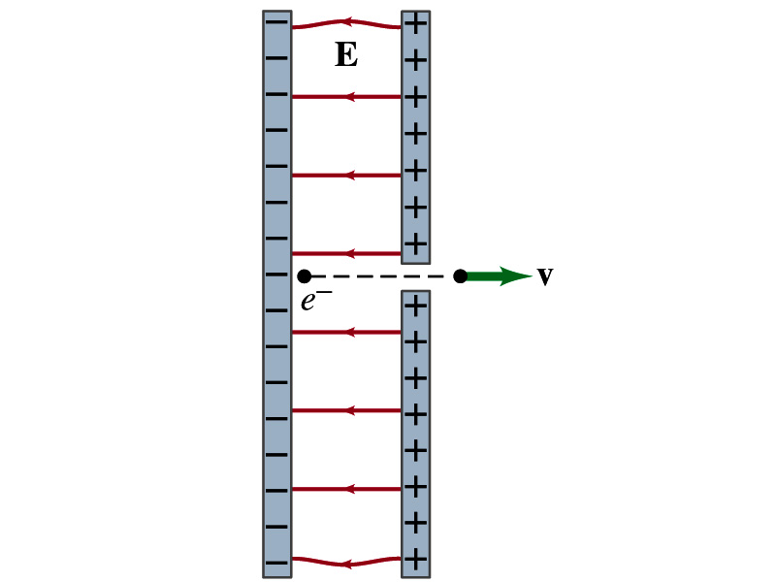
Example 21 – 14
Electron accelerated by electric field. An electron (mass m = 9.1x10⁻³¹kg) is accelerated in a uniform field E (E=2.0x10⁴N/C) between two parallel charged plates. The separation of the plates is 1.5cm. The electron is accelerated from rest near the negative plate and passes through a tiny hole in the positive plate. (a) With what speed does it leave the hole? (b) Show that the gravitational force can be ignored. Assume the hole is so small that it does not affect the uniform field between the plates.
The magnitude of the force on the electron is F=qE and is directed to the right. The equation to solve this problem is
The magnitude of the electron’s acceleration is
Between the plates the field E is uniform, thus the electron undergoes a uniform acceleration

Slide 19
Example 21 – 14
Since the travel distance is 1.5x10⁻²m, using one of the kinetic eq. of motions,
Since there is no electric field outside the conductor, the electron continues moving with this speed after passing through the hole.
(b) Show that the gravitational force can be ignored. Assume the hole is so small that it does not affect the uniform field between the plates.
The magnitude of the electric force on the electron is
The magnitude of the gravitational force on the electron is
Thus the gravitational force on the electron is negligible compared to the electromagnetic force.

