Slide 1
PHYS 1441 – Section 001 Lecture #5
Monday, June 11, 2018
Dr. Jaehoon Yu
Chapter 21
Electric Dipole and Its Electric Field
Chapter 22
Gauss’ Law
Electric Flux
Gauss’ Law with Multiple Charges
What is Gauss’ Law Good For?
Today’s homework is homework #3, due 11pm, Wednesday, June 13!!

Slide 2
Announcements
Bring out special project #1
Reading assignments: CH21.11 and 22.4

Slide 3
Reminder: SP#2 – Angels & Demons
Compute the total possible energy released from an annihilation of x-grams of anti-matter and the same quantity of matter, where x is the last two digits of your SS#. (20 points)
Use the famous Einstein’s formula for mass-energy equivalence
Compute the power output of this annihilation when the energy is released in x ns, where x is again the first two digits of your SS#. (10 points)
Compute how many cups of gasoline (8MJ) this energy corresponds to. (5 points)
Compute how many months of world electricity usage (3.6GJ/mo) this energy corresponds to. (5 points)
Due by the beginning of the class Wednesday, June. 13

Slide 4
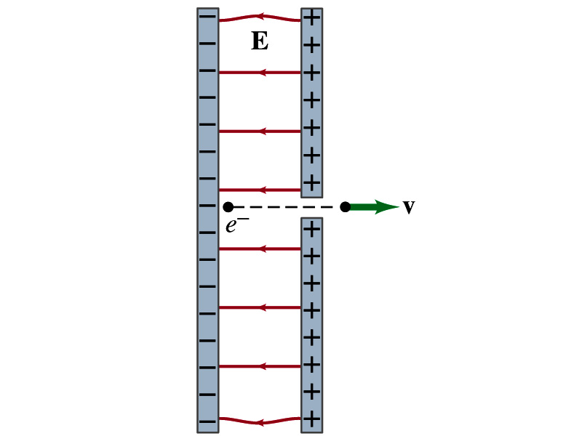
Special Project #3
Particle Accelerator. A charged particle of mass M with charge -Q is accelerated in the uniform field E between two parallel charged plates whose separation is D as shown in the figure on the right. The charged particle is accelerated from an initial speed v₀ near the negative plate and passes through a tiny hole in the positive plate.
Derive the formula for the electric field E to accelerate the charged particle to a fraction f of the speed of light c. Express E in terms of M, Q, D, f, c and v₀.
(a) Using the Coulomb force and kinematic equations. (8 points)
(b) Using the work-kinetic energy theorem. ( 8 points)
(c) Using the formula above, evaluate the strength of the electric field E to accelerate an electron from 0.1% of the speed of light to 90% of the speed of light. You need to look up the relevant constants, such as mass of the electron, charge of the electron and the speed of light. (5 points)
Due beginning of the class Monday, June 18

Slide 5
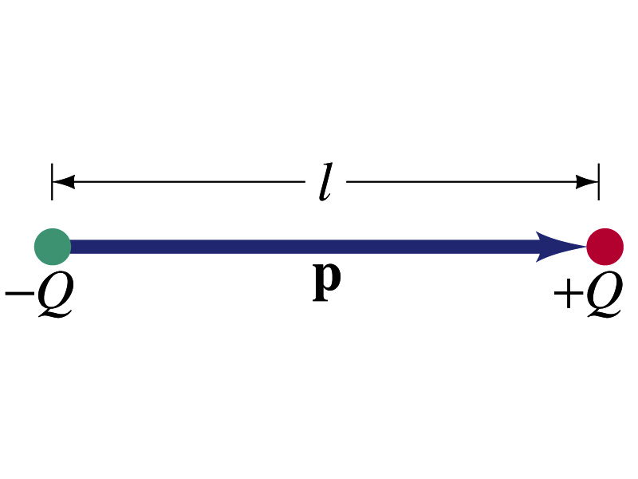
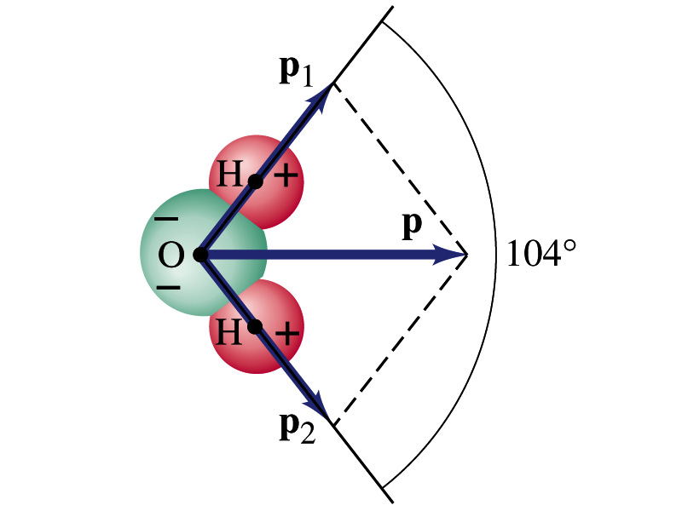
Electric Dipoles
An electric dipole is the combination of two equal charges of opposite signs, +Q and –Q, separated by a distance l, which behaves as one entity.
The quantity Ql is called the electric dipole moment and is represented by the symbol p.
The dipole moment is a vector quantity, p
The magnitude of the dipole moment is Ql. Unit?
Its direction is from the negative chage to the positive charge.
Many of diatomic molecules like CO have a dipole moment. ➔ These are referred as polar molecules.
Even if the molecule is electrically neutral, their sharing of electrons causes separation of charges
Symmetric diatomic molecules, such as O₂, do not have dipole moment.
C-m
The water molecule also has a dipole moment which is the vector sum of two dipole moments between Oxygen and each of Hydrogen atoms.

Slide 6
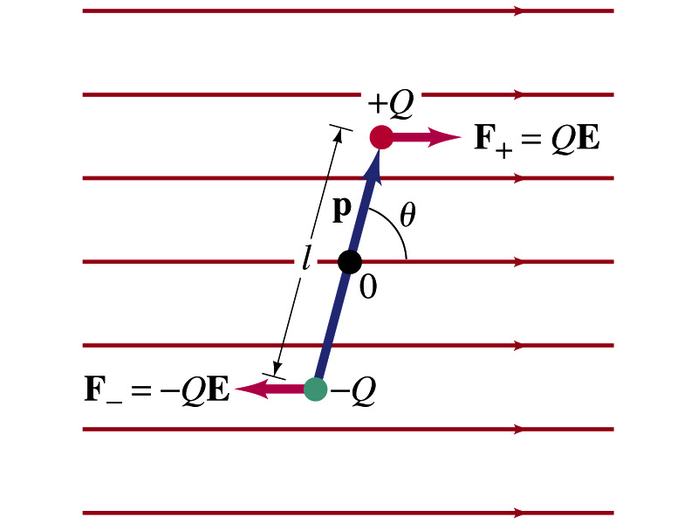
Dipoles in an External Field
Let’s consider a dipole placed in a uniform electric field E.
What do you think will happen to the dipole in the figure?
Forces will be exerted on the charges.
The positive charge will get pushed toward right while the negative charge will get pulled toward left.
What is the net force acting on the dipole?
Zero
So will the dipole not move?
Yes, it will.
Why?
There is a torque applied on the dipole.

Slide 7
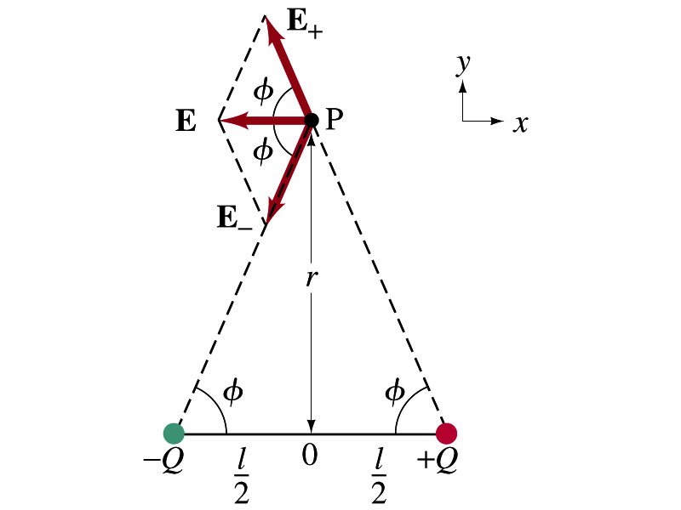
Electric Field by a Dipole
Let’s consider the case in the picture.
There are fields by both the charges. So the total electric field by the dipole is
The magnitudes of the two fields are equal
Now we must work out the x and y components of the total field.
Sum of the two y components is
Zero since they are the same but in opposite direction
So the magnitude of the total field is the same as the sum of the two x-components:

Slide 8
Dipole Electric Field from Afar
What happens when r>>l?.
Why does this make sense?
Since from a long distance, the two charges are very close so that the overall charge gets close to 0!!
This dependence works for the point not on the bisecting line as well

