Slide 1
PHYS 1441 – Section 001 Lecture #6
Tuesday, June 12, 2018
Dr. Jaehoon Yu
Chapter 22
Gauss’ Law
Electric Flux
Gauss’ Law with Multiple Charges
What is Gauss’ Law Good For?
Chapter 23
Electric Potential due to Point Charge
Shape of the Electric Potential

Slide 2
Announcements
Quiz #2
You can bring your calculator but it must not have any relevant formula pre-input
Cell phones or any types of computers cannot replaced a calculator!
BYOF: You may bring one 8.5x11.5 sheet (front and back) of handwritten formulae and values of constants for the exam
No derivations, word definitions, or solutions of any problems !
No additional formulae or values of constants will be provided!
Reading assignments
CH22.4

Slide 3
Reminder: SP#2 – Angels & Demons
Compute the total possible energy released from an annihilation of x-grams of anti-matter and the same quantity of matter, where x is the last two digits of your SS#. (20 points)
Use the famous Einstein’s formula for mass-energy equivalence
Compute the power output of this annihilation when the energy is released in x ns, where x is again the first two digits of your SS#. (10 points)
Compute how many cups of gasoline (8MJ) this energy corresponds to. (5 points)
Compute how many months of world electricity usage (3.6GJ/mo) this energy corresponds to. (5 points)
Due by the beginning of the class tomorrow Wed. June. 13

Slide 4
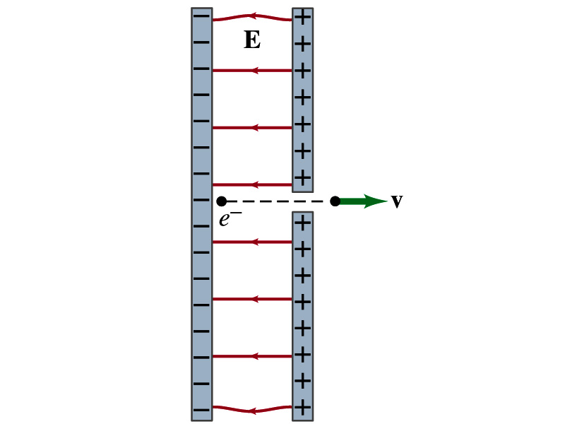
Reminder: Special Project #3
Particle Accelerator. A charged particle of mass M with charge -Q is accelerated in the uniform field E between two parallel charged plates whose separation is D as shown in the figure on the right. The charged particle is accelerated from an initial speed v₀ near the negative plate and passes through a tiny hole in the positive plate.
Derive the formula for the electric field E to accelerate the charged particle to a fraction f of the speed of light c. Express E in terms of M, Q, D, f, c and v₀.
(a) Using the Coulomb force and kinematic equations. (8 points)
(b) Using the work-kinetic energy theorem. ( 8 points)
(c) Using the formula above, evaluate the strength of the electric field E to accelerate an electron from 0.1% of the speed of light to 90% of the speed of light. You need to look up the relevant constants, such as mass of the electron, charge of the electron and the speed of light. (5 points)
Due beginning of the class Monday, June 18

Slide 5
Gauss’ Law
Gauss’ law states the relationship between the electric charge and the electric field.
More generalized and elegant form of Coulomb’s law.
The electric field by the distribution of charges can be obtained using Coulomb’s law by summing (or integrating) over the charge distributions.
Gauss’ law, however, gives an additional insight into the nature of electrostatic field and a more general relationship between the charge and the field

Slide 6
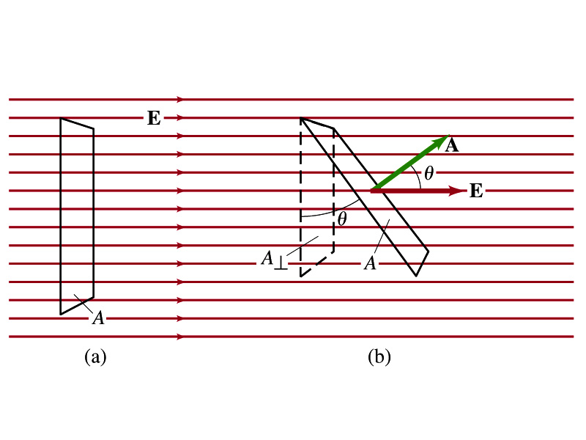
Electric Flux
Let’s imagine a surface of area A through which a uniform electric field E passes
The electric flux Φ_{E} is defined as
Φ_{E}=EA, if the field is perpendicular to the surface
Φ_{E}=EAcosθ, if the field makes an angle θ to the surface
So the electric flux is defined as .
How would you define the electric flux in words?
The total number of field lines passing through the unit area perpendicular to the field.

Slide 7
Example 22 – 1
Electric flux. (a) Calculate the electric flux through the rectangle in the figure (a). The rectangle is 10cm by 20cm and the electric field is uniform with magnitude 200N/C. (b) What is the flux if the angle is 30 degrees?
The electric flux is defined as
So when (a) θ=0, we obtain
And when (b) θ=30 degrees, we obtain

Slide 8
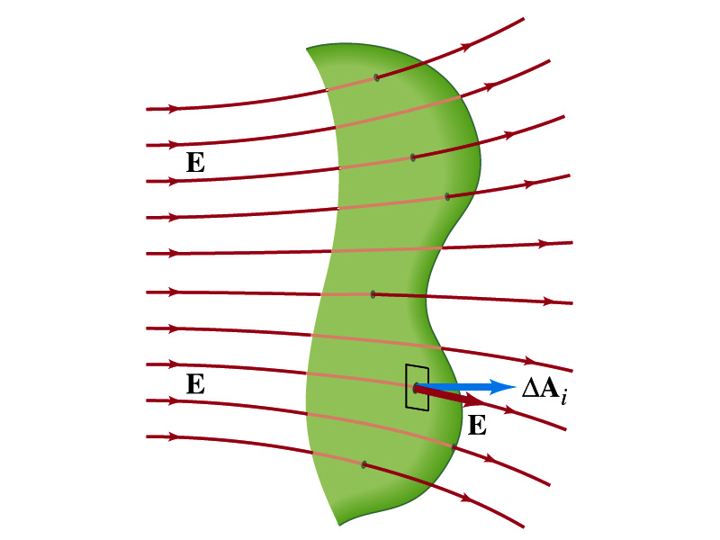
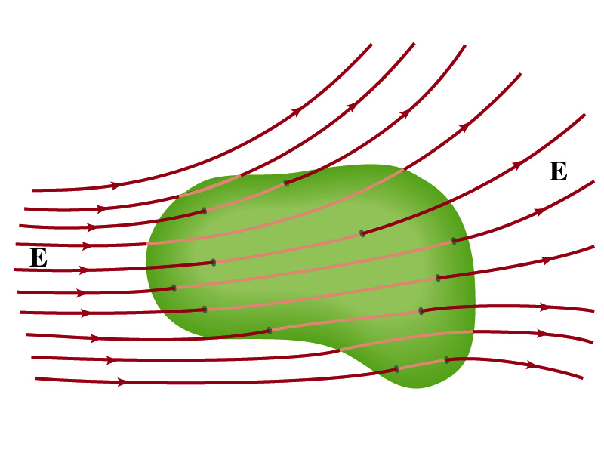
Generalization of the Electric Flux
Let’s consider a surface of area A that is not a square or flat but in some random shape, and that the field is not uniform.
The surface can be divided up into infinitesimally small areas of ΔA_{i} that can be considered flat.
And the electric field through this area can be considered uniform since the area is very small.
Then the electric flux through the entire surface is approximately
In the limit where ΔA_{i} → 0, the discrete summation becomes an integral.
open surface
enclosed surface

Slide 9
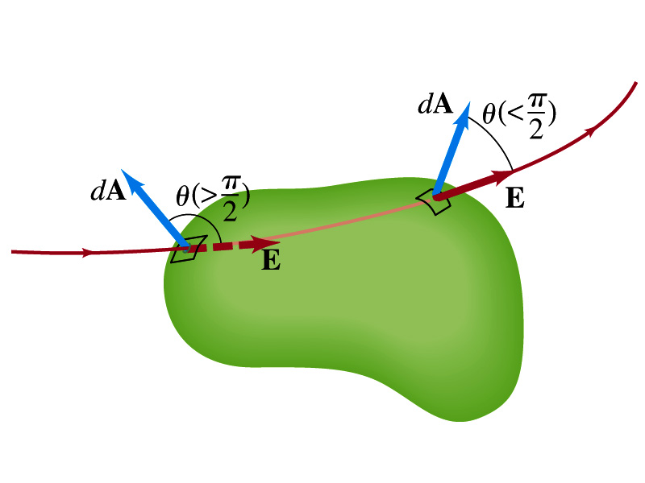
Generalization of the Electric Flux
We arbitrarily define that the area vector points outward from the enclosed volume.
For the line leaving the volume, |θ|<π/2 and cosθ>0. The flux is positive.
For the line coming into the volume, |θ|>π/2 and cosθ<0. The flux is negative.
If Φ_{E}>0, there is net flux out of the volume.
If Φ_{E}<0, there is flux into the volume.
In the above figures, each field that enters the volume also leaves the volume, so
The flux is non-zero only if one or more lines start or end inside the surface.

Slide 10
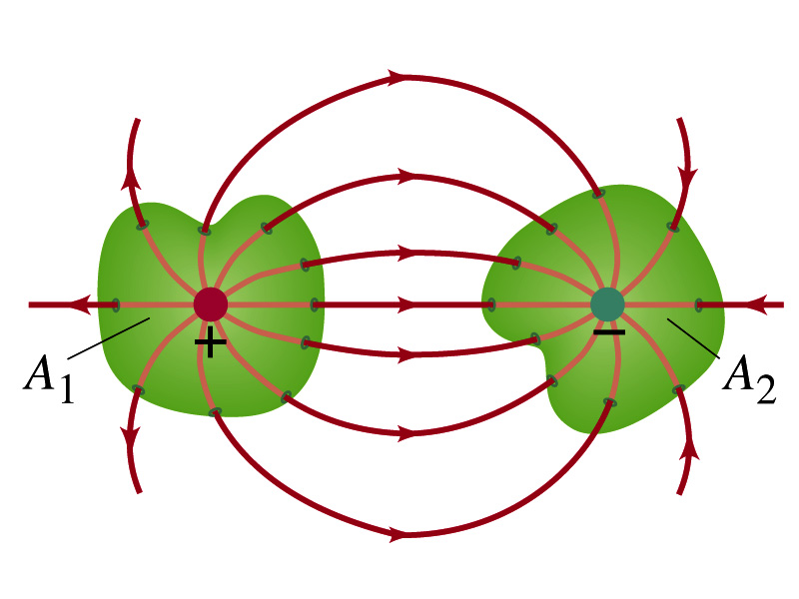
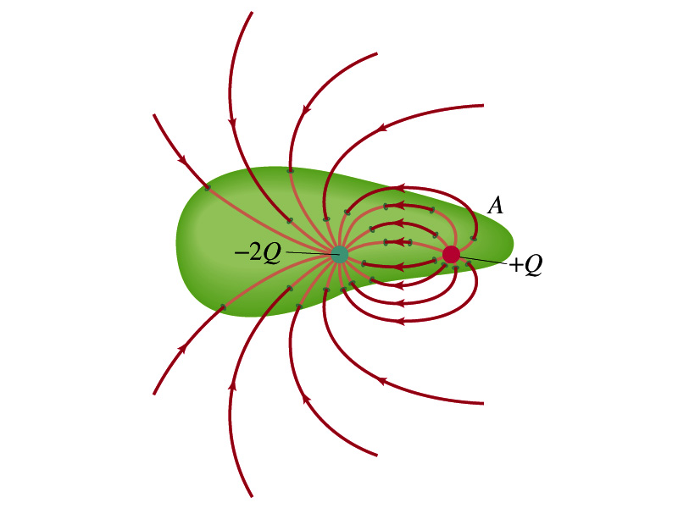
Generalization of the Electric Flux
The field line starts or ends only on a charge.
Sign of the net flux on the surface A₁?
Net outward flux (positive flux)
How about A₂?
Net inward flux (negative flux)
What is the flux in the bottom figure?
There should be a net inward flux (negative flux) since the total charge inside the volume is negative.
The net flux that crosses an enclosed surface is proportional to the total charge inside the surface. ➔ This is the crux of Gauss’ law.

Slide 11
Gauss’ Law
q
q’
Let’s consider the case in the above figure.
What are the results of the closed integral of the Gaussian surfaces A₁ and A₂?
For A₁
For A₂

Slide 12
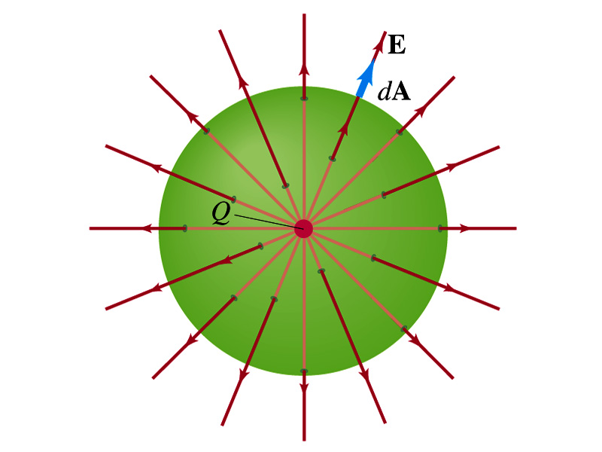
Coulomb’s Law from Gauss’ Law
Let’s consider a charge Q enclosed inside our imaginary Gaussian surface of sphere of radius r.
Since we can choose any surface enclosing the charge, we choose the simplest possible one! ☺
The surface is symmetric about the charge.
What does this tell us about the field E?
Have the same magnitude (uniform) at any point on the surface
Points radially outward parallel to the surface vector dA.
The Gaussian integral can be written as
Solve
for E
Electric Field of
Coulomb’s Law

Slide 13
Gauss’ Law from Coulomb’s Law
Let’s consider a single static point charge Q surrounded by an imaginary spherical surface.
Coulomb’s law tells us that the electric field at a spherical surface of radius r is
Performing a closed integral over the surface, we obtain
Gauss’ Law

Slide 14
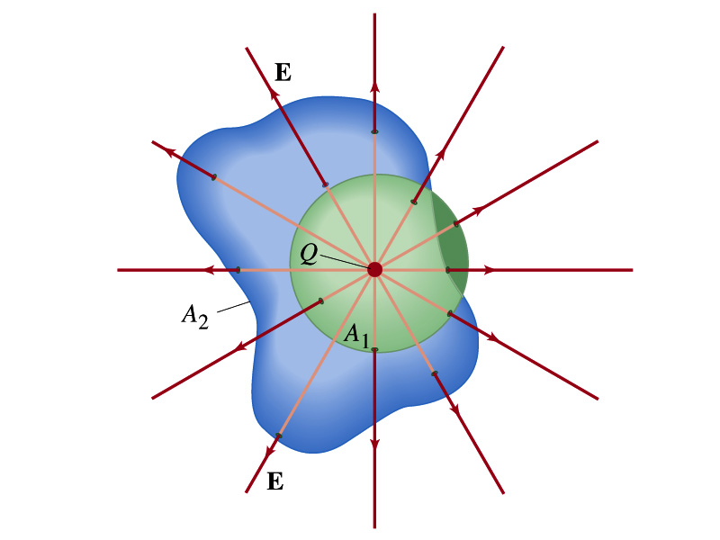
Gauss’ Law from Coulomb’s Law Irregular Surface
Let’s consider the same single static point charge Q surrounded by a symmetric spherical surface A₁ and a randomly shaped surface A₂.
What is the difference in the total number of field lines due to the charge Q, passing through the two surfaces?
None. What does this mean?
The total number of field lines passing through the surface is the same no matter what the shape of the enclosed surface is.
So we can write:
What does this mean?
The flux due to the given enclosed charge is the same independent of the shape of the surface enclosing it is. ➔ Gauss’ law, , is valid for any surface surrounding a single point charge Q.

Slide 15
Gauss’ Law w/ more than one charge
Let’s consider several charges inside a closed surface.
For each charge, Q_{i} inside the chosen closed surface,
What is ?
The electric field produced by Q_{i} alone!
Since electric fields can be added vectorially, following the superposition principle, the total field E is equal to the sum of the fields due to each charge and any external fields. So
The value of the flux depends only on the charge enclosed in the surface!! ➔ Gauss’ law.
What is Q_{encl}?
The total enclosed charge!

Slide 16
So what is Gauss’ Law good for?
Derivation of Gauss’ law from Coulomb’s law is only valid for static electric charge.
Electric field can also be produced by changing magnetic fields.
Coulomb’s law cannot describe this field while Gauss’ law is still valid
Gauss’ law is more general than Coulomb’s law.
Can be used to obtain electric field, forces or obtain charges
Gauss’ Law: Any differences between the input and output flux of the electric field over any enclosed surface is due to the charge inside that surface!!!

Slide 17
Solving problems with Gauss’ Law
Identify the symmetry of the charge distributions
Draw an appropriate Gaussian surface, making sure it passes through the point you want to know the electric field
Use the symmetry of charge distribution to determine the direction of E at the point of the Gaussian surface
Evaluate the flux
Calculate the enclosed charge by the Gaussian surface
Ignore all the charges outside the Gaussian surface
Equate the flux to the enclosed charge and solve for E

Slide 18
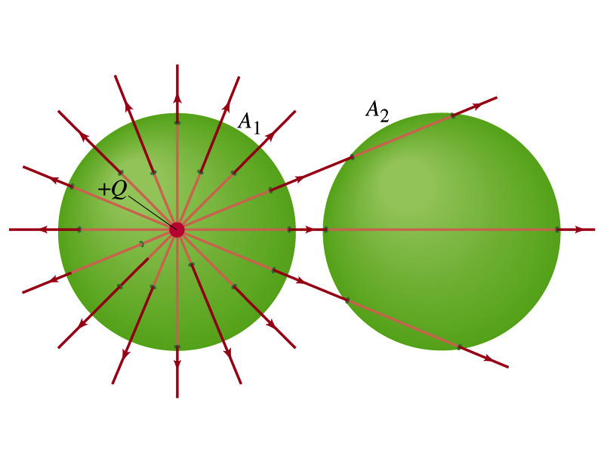
Example 22 – 2
Flux from Gauss’ Law: Consider two Gaussian surfaces, A₁ and A₂, shown in the figure. The only charge present is the charge +Q at the center of surface A₁. What is the net flux through each surface A₁ and A₂?
The surface A₁ encloses the charge +Q, so from Gauss’ law we obtain the total net flux
The surface A₂ the charge, +Q, is outside the surface, so the total net flux is 0.

Slide 19
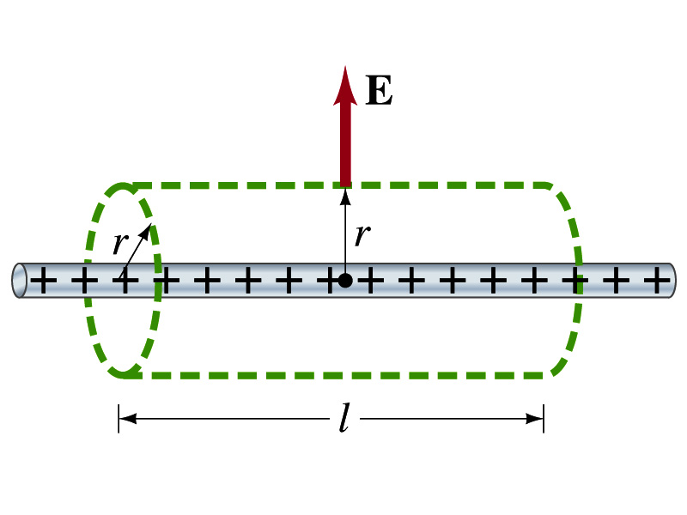
Example 22 – 6
Long uniform line of charge: A very long straight wire possesses a uniform positive charge per unit length, λ. Calculate the electric field a point near but outside the wire, far from the ends.
Which direction do you think the field due to the charge on the wire is?
Radially outward from the wire, the direction of radial vector r.
Due to cylindrical symmetry, the field is the same on the Gaussian surface of a cylinder surrounding the wire.
The end surfaces do not contribute to the flux at all. Why?
Because the field vector E is perpendicular to the surface vector dA.
From Gauss’ law
Solving for E

Slide 20
A Brain Teaser of Electric Flux
What would change the electric flux through a circle lying in the xz plane where the electric field is (10N/C)j?
Changing the magnitude of the electric field
Changing the surface area of the circle
Tipping the circle so that it is lying in the xy plane
All of the above
None of the above

Slide 21
Gauss’ Law Summary
The precise relationship between flux and the enclosed charge is given by Gauss’ Law
ε₀ is the permittivity of free space in the Coulomb’s law
A few important points on Gauss’ Law
Freedom to choose!!
The surface integral is performed over the value of E on a closed surface of our choice in any given situation.
Test of existence of electrical charge!!
The charge Q_{encl} is the net charge enclosed by the arbitrary closed surface of our choice.
Universality of the law!
It does NOT matter where or how much charge is distributed inside the surface. Gauss’ law still applies!
The charge outside the surface does not contribute to Q_{encl}. Why?
The charge outside the surface might impact field lines but not the total number of lines entering or leaving the surface.

