Slide 1
PHYS 1441 – Section 001 Lecture #8
Thursday, June 14, 2018
Dr. Jaehoon Yu
Chapter 23
V due to Charge Distributions
Equi-potential Lines and Surfaces
Electric Potential Due to Electric Dipole
Chapter 24 Capacitance etc..
Capacitors
Capacitors in Series or Parallel
Electric Energy Storage

Slide 2
Announcements
Reading Assignment
CH 23.9
Mid-term exam
In class Wednesday, June 20
Comprehensive exam which covers CH21.1 through what we learn Tuesday, June 19 plus appendices A and B the math refresher
BYOF
Term 1 results
Class Average: 57.7/96
Equivalent to 60.1/100
Top score: 91/96

Slide 3
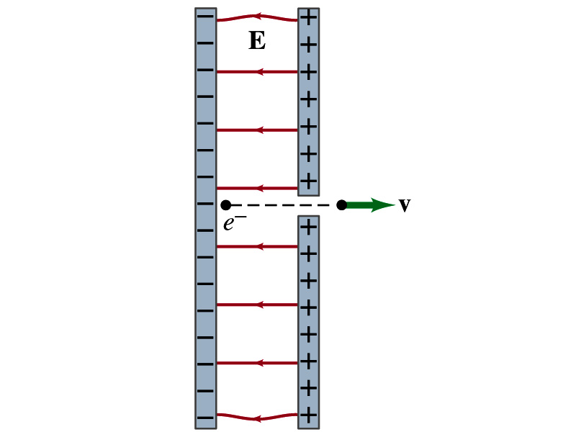
Reminder: Special Project #3
Particle Accelerator. A charged particle of mass M with charge -Q is accelerated in the uniform field E between two parallel charged plates whose separation is D as shown in the figure on the right. The charged particle is accelerated from an initial speed v₀ near the negative plate and passes through a tiny hole in the positive plate.
Derive the formula for the electric field E to accelerate the charged particle to a fraction f of the speed of light c. Express E in terms of M, Q, D, f, c and v₀.
(a) Using the Coulomb force and kinematic equations. (8 points)
(b) Using the work-kinetic energy theorem. ( 8 points)
(c) Using the formula above, evaluate the strength of the electric field E to accelerate an electron from 0.1% of the speed of light to 90% of the speed of light. You need to look up the relevant constants, such as mass of the electron, charge of the electron and the speed of light. (5 points)
Due beginning of the class Monday, June 18

Slide 4
Electric Potential by Charge Distributions
Let’s consider a case of n individual point charges in a given space and V=0 at r=∞.
Then the potential V_{ia} due to the charge Q_{i} at point a, at a distance r_{ia} from Q_{i} is
Thus the total potential V_{a} by all n point charges is
For a continuous charge distribution, we obtain

Slide 5
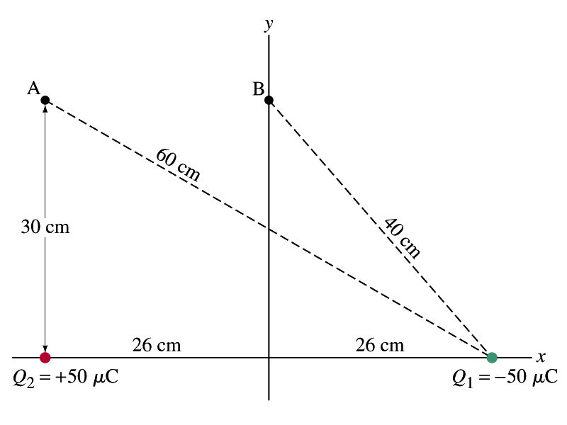
Example
Potential due to two charges: Calculate the electric potential (a) at point A in the figure due to the two charges shown, and (b) at point B.
Potential is a scalar quantity, so one adds the potential by each of the source charge, as if they are numbers.
(a) potential at A is
(b) How about potential at B?

Slide 6
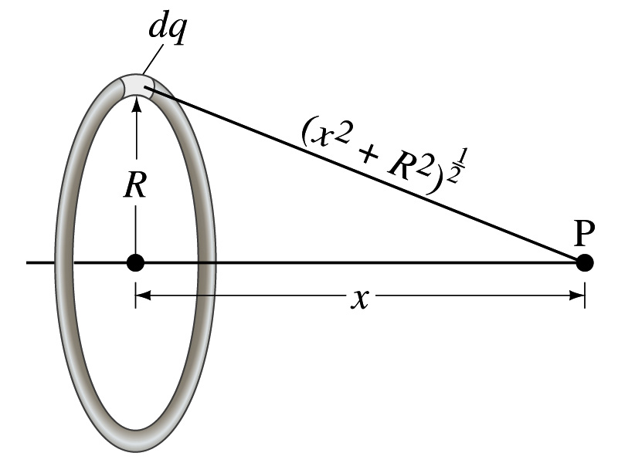
Example 23 – 8
Potential due to a ring of charge: A thin circular ring of radius R carries a uniformly distributed charge Q. Determine the electric potential at a point P on the axis of the ring a distance x from its center.
Each point on the ring is at the same distance from the point P. What is the distance?
So the potential at P is
What’s this?

Slide 7
Equi-potential Surfaces
Electric potential can be graphically shown using the equipotential lines in 2-D or the equipotential surfaces in 3-D
Any two points on the equipotential surfaces (lines) are at the same potential
What does this mean in terms of the potential difference?
The potential difference between any two points on an equipotential surface is 0.
How about the potential energy difference?
Also 0.
What does this mean in terms of the work to move a charge along the surface between these two points?
No work is necessary to move a charge between these two points.

Slide 8
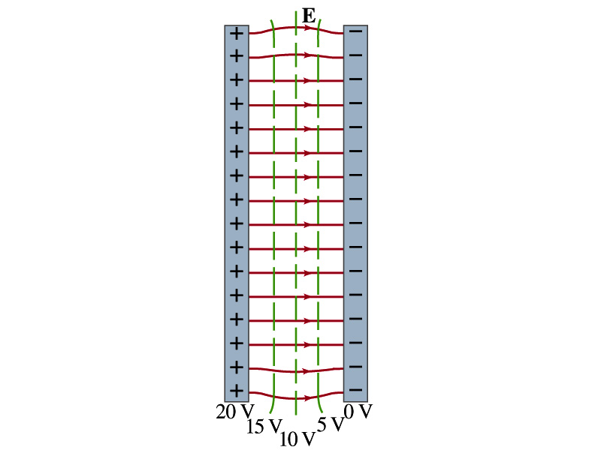
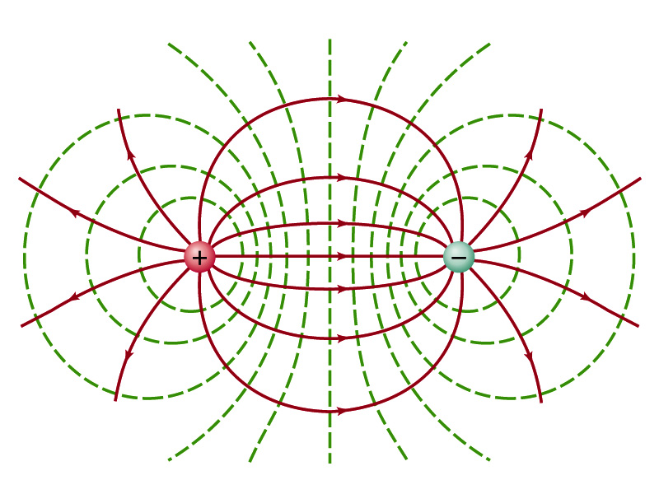
Equi-potential Surfaces
An equipotential surface (line) must be perpendicular to the electric field. Why?
If there are any parallel components to the electric field, it would require work to move a charge along the surface.
Since the equipotential surface (line) is perpendicular to the electric field, we can draw these surfaces or lines easily.
Since there can be no electric field within a conductor in a static case, the entire volume of a conductor must be at the same potential.
So the electric field must be perpendicular to the conductor surface.
Parallel Plate
Point charges
Just like a topological map

Slide 9
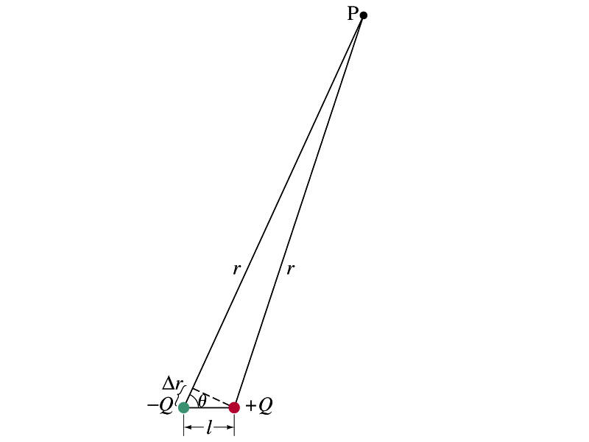
Electric Potential due to Electric Dipoles
What is an electric dipole?
Two equal point charge Q of opposite signs separated by a distance l and behaves like one entity: P=Ql
For the electric potential due to a dipole at a point p
We take V=0 at r=∞
The simple sum of the potential at p by the two charges is
Since Δr=lcosθ and if r>>l, r>>Δr, thus r~r+Δr and
V by a dipole at a
distance r from
the dipole

Slide 10
E Determined from V
Potential difference between two points under the electric field is
So in a differential form, we can write
What are dV and E_{l}?
dV is the infinitesimal potential difference between the two points separated by a distance dl
E_{l} is the field component along the direction of dl.
Thus we can write the field component E_{l} as
The component of the electric field in any direction is equal to the negative rate of change of the electric potential as a function of distance in that direction.!!
Physical Meaning?

Slide 11
E Determined from V
The quantity dV/dl is called the gradient of V in a particular direction
If no direction is specified, the term gradient refers to the direction on which V changes most rapidly and this would be the direction of the field vector E at that point.
So if E and dl are parallel to each other,
If E is written as a function x, y and z, the l refers to x, y and z
is the “partial derivative” of V with respect to x, while y and z are held constant
In vector form,
is called del or the gradient operator and is a vector operator.

Slide 12
Electrostatic Potential Energy
Consider a case in which a point charge q is moved between points a and b where the electrostatic potential due to other charges in the system is V_{a} and V_{b}
The change in electrostatic potential energy of q in the field by other charges is
Now what is the electrostatic potential energy of a system of charges?
Let’s choose V=0 at r=∞
If there are no other charges around, single point charge Q₁ in isolation has no potential energy and is under no electric force

Slide 13
Electrostatic Potential Energy; Two charges
If a second point charge Q₂ is brought close to Q₁ at a distance r₁₂, the potential due to Q₁ at the position of Q₂ is
The potential energy of the two charges relative to V=0 at r= ∞ is
This is the work that needs to be done by an external force to bring Q₂ from infinity to the distance r₁₂ from Q₁.
It is also a negative of the work needed to separate them to infinity.

Slide 14
Electrostatic Potential Energy; Three Charges
So what do we do for three charges?
Work is needed to bring all three charges together
Work needed to bring Q₁ to a certain location without the presence of any charge is 0.
Work needed to bring Q₂ to a distance to Q₁ is
Work need to bring Q₃ to certain distances to Q₁ and Q₂ is
So the total electrostatic potential energy of the three charge system is
What about a four charge system or N charge system?

Slide 15
Electrostatic Potential Energy: electron Volt
What is the unit of electrostatic potential energy?
Joules
Joules is a very large unit in dealing with electrons, atoms or molecules atomic scale problems
For convenience a new unit, electron volt (eV), is defined
1 eV is defined as the energy acquired by a particle carrying the charge equal to that of an electron (q=e) when it moves across a potential difference of 1V.
How many Joules is 1 eV then?
eV however is NOT a standard SI unit. You must convert the energy to Joules for computations.
What is the speed of an electron with kinetic energy 5000eV?

Slide 16
Capacitors (or Condensers)
What is a capacitor?
A device that can store electric charge
But does not let them flow through
What does it consist of?
Usually consists of two conducting objects (plates or sheets) placed near each other without touching
Why can’t they touch each other?
The charge will neutralize…
Can you give some examples?
Camera flash, UPS, Surge protectors, binary circuits, memory, etc…
How is the capacitor different than the battery?
Battery provides potential difference by storing energy (usually chemical energy) while the capacitor stores charges but very little energy.

Slide 17
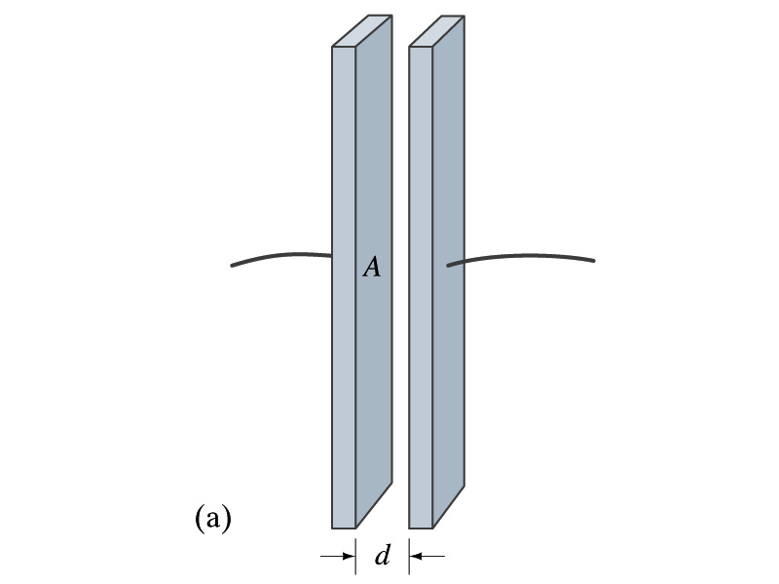
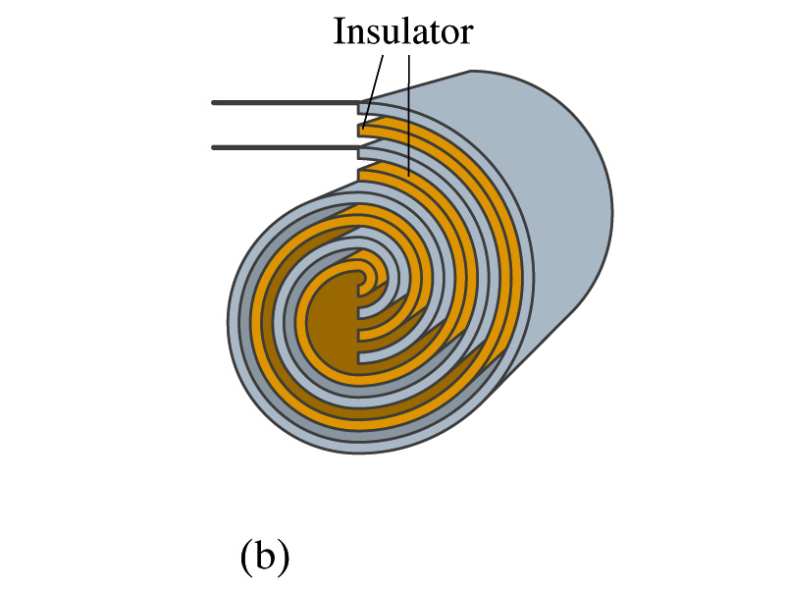
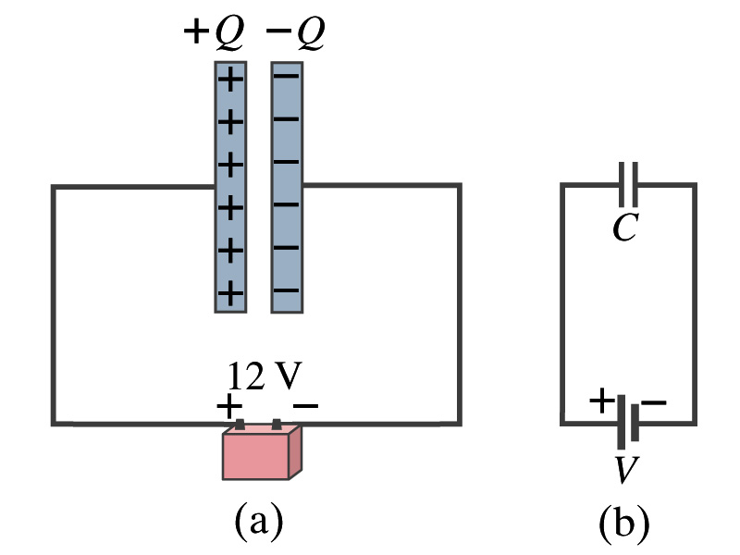
Capacitors
A simple capacitor consists of a pair of parallel plates of area A separated by a distance d.
A cylindrical capacitors are essentially parallel plates wrapped around as a cylinder.
How would you draw symbols for a capacitor and a battery in a circuit diagram?
Capacitor -||-
Battery (+) -|i- (-)
Circuit
Diagram

Slide 18
Capacitors
What do you think will happen if a battery is connected ( or the voltage is applied) to a capacitor?
The capacitor gets charged quickly, one plate positive and the other negative in equal amount.
Each battery terminal, the wires and the plates are conductors. What does this mean?
All conductors are at the same potential. And?
So the full battery voltage is applied across the capacitor plates.
So for a given capacitor, the amount of charge stored on each capacitor plate is proportional to the potential difference V_{ba} between the plates. How would you write this formula?
C is a proportionality constant, called the capacitance of the device.
What is the unit?
C is a property of a capacitor so does not depend on Q or V.
C/V
or
Farad (F)
Normally use μF or pF.

