Slide 1
PHYS 1441 – Section 001 Lecture #11
Wednesday, June 20, 2018
Dr. Jaehoon Yu
Chapter 25
Alternating Current
Microscopic View of Electric Current
Ohm’s Law in Microscopic View
EMF and Terminal Voltage

Slide 2
Announcements
Reading Assignments: CH25.8 - 25.10
We will have a mid-term grade discussion Tuesday coming week, June 24. We will have a class for the first 30min followed by the discussion in my office.
To allow the mid-term grade discussion, the date for term exam #2 will have to change to Thursday, June 28, from Wednesday, June 27.

Slide 3
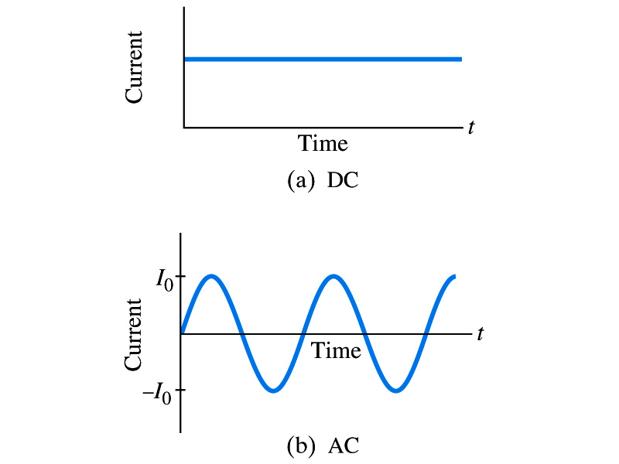
Alternating Current
Does the direction of the flow of current change while a battery is connected to a circuit?
No. Why?
Because its source of potential difference stays put.
This kind of current is called the Direct Current (DC), and it does not change its direction of flow while the battery is connected.
How would DC look as a function of time?
A straight line
Electric generators at electric power plant produce alternating current (AC)
AC reverses direction many times a second
AC is sinusoidal as a function of time
Most the currents supplied to homes and business are AC.

Slide 4
The Alternating Current
The voltage produced by an AC electric generator is sinusoidal
This is why the current is sinusoidal
Voltage produced can be written as
What are the maximum and minimum voltages?
V₀ (–V₀) and 0
The potential oscillates between +V₀ and –V₀, the peak voltages or amplitude
What is f?
The frequency, the number of complete oscillations made per second. What is the unit of f? What is the normal size of f in the US?
f=60Hz in the US and Canada.
Many European countries have f=50Hz.
ω=2πf

Slide 5
Alternating Current
Since V=IR, if a voltage V exists across a resistance R, the current I is
What are the maximum and minimum currents?
I₀ (–I₀) and 0.
The current oscillates between +I₀ and –I₀, the peak currents or amplitude. The current is positive when electron flows to one direction and negative when they flow opposite.
AC is as many times positive as negative. What’s the average current?
Zero. So there is no power and no heat is produced in a heater?
Yes there is! The electrons actually flow back and forth, so power is delivered.
What is this?

Slide 6
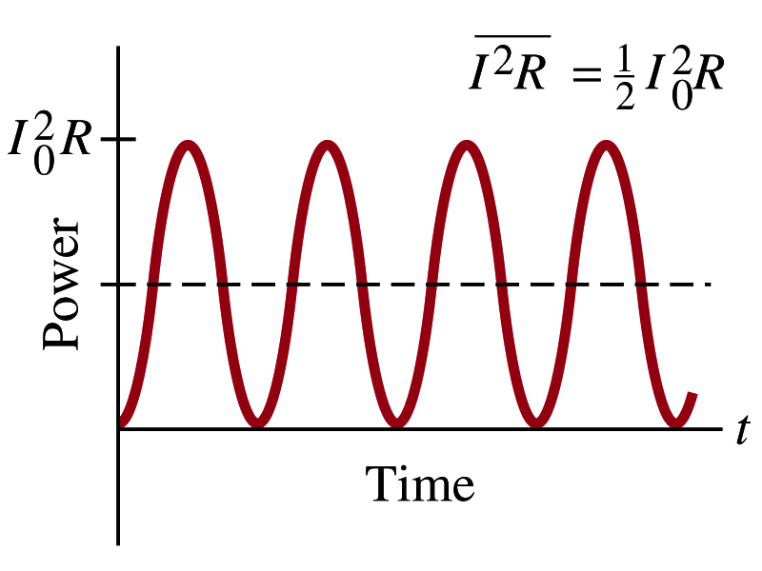
Power Delivered by Alternating Current
AC power delivered to a resistance is:
Since the current is squared, the power is always positive
The average power delivered is
Since the power is also P=V²/R, we can obtain
The average of the square of current and voltage are important in calculating power:
Average power

Slide 7
Power Delivered by Alternating Current
The square root of each of these are called root-mean-square, or rms:
rms values are sometimes called effective values
These are useful quantities since they can substitute current and voltage directly in power, as if they are in DC
In other words, an AC of peak voltage V₀ or peak current I₀ produces as much power as DC voltage of V_{rms} or DC current I_{rms}.
So normally, rms values in AC are specified or measured.
US uses 115V rms voltage. What is the peak voltage?
Europe uses 240V

Slide 8
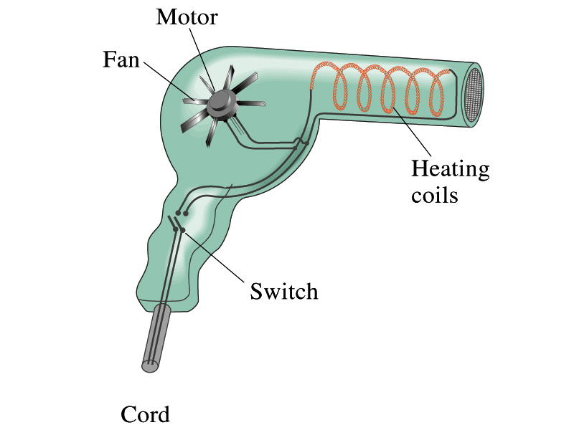
Example 25 – 13
Hair Dryer. (a) Calculate the resistance and the peak current in a 1000-W hair dryer connected to a 120-V AC line. (b) What happens if it is connected to a 240-V line in Britain?
The rms current is:
The peak current is:
Thus the resistance is:
(b) If connected to 240V in Britain …
The average power provide by the AC in UK is
So?
The heating coils in the dryer will melt!

Slide 9
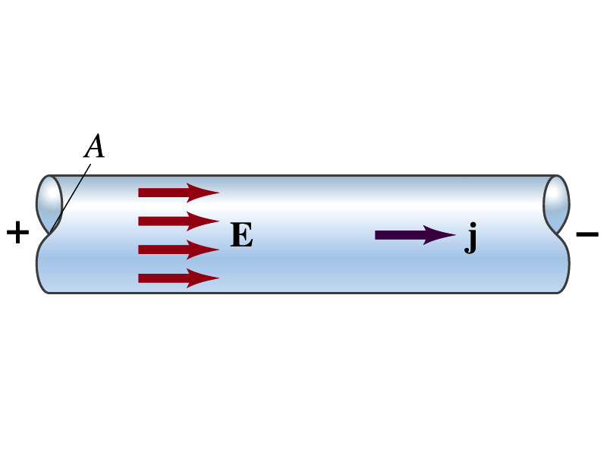
Microscopic View of Electric Current
When a potential difference is applied to the two ends of a wire w/ uniform cross-section, the direction of electric field is parallel to the walls of the wire, this is possible since the charges are moving
Let’s define a microscopic vector quantity, the current density, j, the electric current per unit cross-sectional area
j=I/A or I = jA if the current density is uniform
If not uniform
The direction of j is the direction the positive charge would move when placed at that position, generally the same as E
The current density exists on any point in space while the current I refers to a conductor as a whole so a macroscopic

Slide 10
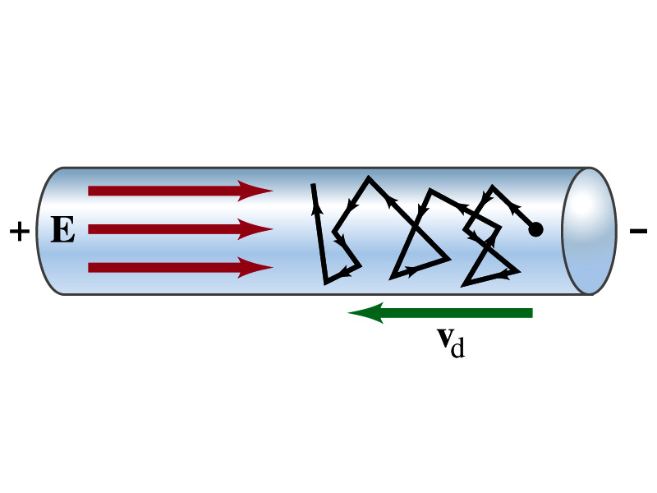
Microscopic View of Electric Current
The direction of j is the direction of a positive charge. So in a conductor, since negatively charged electrons move, the direction is –j.
Let’s think about the current in a microscopic view again:
When voltage is applied to the end of a wire
Electric field is generated by the potential difference
Electrons feel force and get accelerated
Electrons soon reach to a steady average speed due to collisions with atoms in the wire, called drift velocity, v_{d}
The drift velocity is normally much smaller than electrons’ average random speed.

Slide 11
Microscopic View of Electric Current
The drift velocity of electrons in a wire is only about 0.05mm/s. How could we get light turned on immediately then?
While the electrons in a wire travels slow, the electric field travels essentially at the speed of light. Then what is all the talk about electrons flowing through?
It is just like water. When you turn on the facet, water flows right off the facet despite the fact that the water travels slow.
Electricity is the same. Electrons fill the conductor wire and when the switch is flipped on or a potential difference is applied, the electrons close to the positive terminal flows into the bulb.
Interesting, isn’t it? Why is the field travel at the speed of light then?

Slide 12
Ohm’s Law in Microscopic View
Ohm’s law can be written in microscopic quantities.
Resistance in terms of resistivity is
We can rewrite the potential V and current I as: I=jA, V=El.
If electric field is uniform, from V=IR, we obtain
So
In a metal conductor, ρ or σ does not depend on V, thus, the current density j is proportional to the electric field E ➔ Microscopic statement of Ohm’s Law
In vector form, the density can be written as

Slide 13
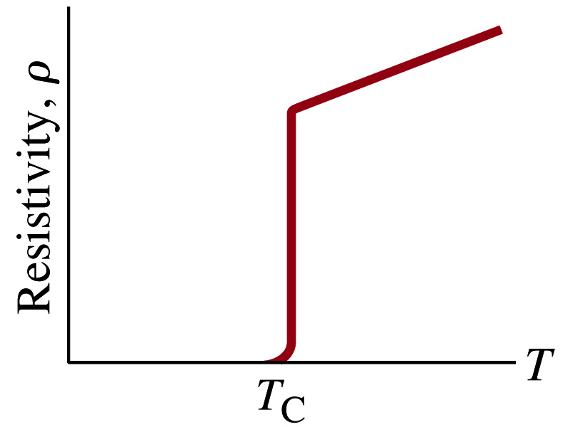
Superconductivity
At the temperature near absolute 0K, resistivity of certain material becomes 0.
This state is called the “superconducting” state.
Observed in 1911 by H. K. Onnes when he cooled mercury to 4.2K (-269ºC).
Resistance of mercury suddenly dropped to 0.
In general superconducting materials become superconducting below a transition temperature (T_{c}).
The highest temperature superconductivity seen is 160K
First observation above the boiling temperature of liquid nitrogen is in 1987 at 90k observed from a compound of yttrium, barium, copper and oxygen.
Since much smaller amount of material can carry just as much current more efficiently, superconductivity can make electric cars more practical, computers faster, and capacitors store higher energy

Slide 14
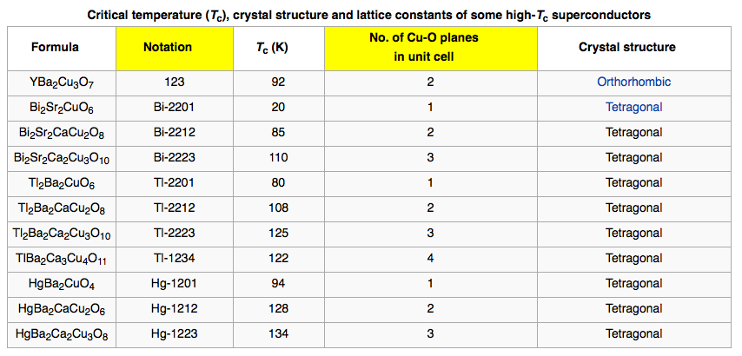
Critical Temperature of Superconductors

Slide 15
Electric Hazards: Leakage Currents
How does one feel shock by electricity?
Electric current stimulates nerves and muscles, and we feel a shock
The severity of the shock depends on the amount of current, how long it acts and through what part of the body it passes
Electric current heats the tissue and can cause burns
Currents above 70mA on a torso for a second or more is fatal, causing heart to function irregularly, “ventricular fibrillation”.
A dry human body between two points on opposite side of the body is about 10⁴ to 10⁶ Ω.
When wet, it could be 10³Ω.
A person in good contact with the ground who touches 120V DC line with wet hands can get the current:
Could be lethal

