Slide 1
PHYS 1441 – Section 001 Lecture #12
Thursday, June 21, 2018
Dr. Jaehoon Yu
Chapter 25
Super-Conductivity
EMF and Terminal Voltage
Chapter 26
Resistors in Series and Parallel
Kirchhoff’s Rules
EMFs in Series and Parallel
RC Circuits
Today’s homework is homework #6, due 11pm, Monday, June 25!!

Slide 2
Announcements
One-on-one mid-term grade discussion Tuesday, June 24.
Class for the first 30min
In my office – CPB342.
Last names begin with
A – G: 11:05 – 11:35
H – M: 11:35 – 12:00
N – Z: 12 – 12:30
If you have schedule issue, please be sure to come in early for the discussion
The date for term exam #2 has been change to Thursday, June 28
Grade scheme reminder
Homework: 25%
Final exam: 23%
Midterm exam: 20%
Better of the two term exams: 12%
Lab: 10%
Quizzes: 10%
Extra Credit: 10%
Reading assignments: CH26.4 – CH26.7

Slide 3
Special Project #4
Make a list of the power consumption and the resistance of all electric and electronic devices at your home and compile them in a table. (10 points total for the first 10 items and 0.5 points each additional item.)
Estimate the cost of electricity for each of the items on the table using your own electric cost per kWh (if you don’t find your own, use $0.12/kWh) and put them in the relevant column. (5 points total for the first 10 items and 0.2 points each additional items)
Estimate the the total amount of energy in Joules and the total electricity cost per day, per month and per year for your home. (8 points)
Due: Beginning of the class Tuesday, June 24

Slide 4
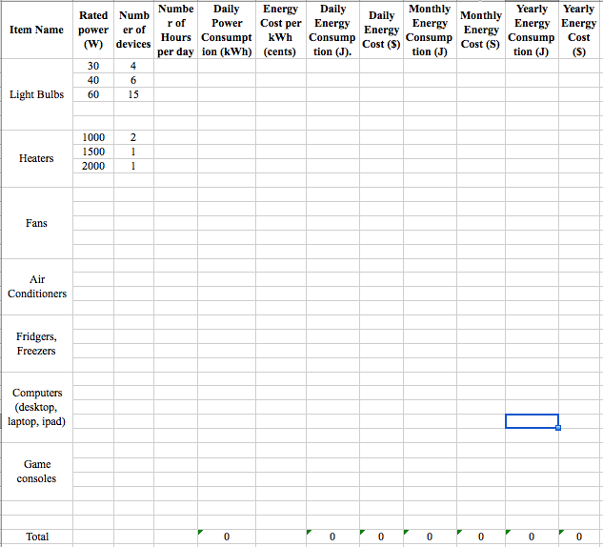

Slide 5
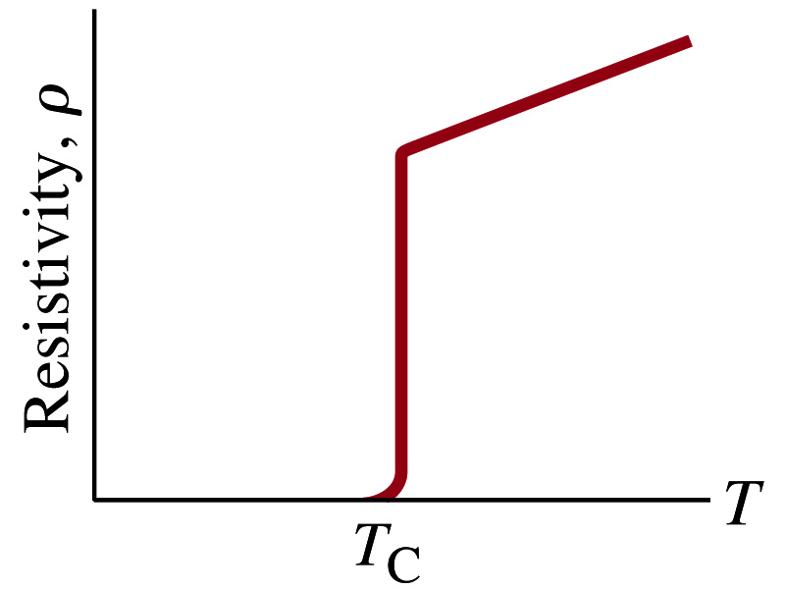
Superconductivity
At the temperature near absolute 0K, resistivity of certain material becomes 0.
This state is called the “superconducting” state.
Observed in 1911 by H. K. Onnes when he cooled mercury to 4.2K (-269ºC).
Resistance of mercury suddenly dropped to 0.
In general superconducting materials become superconducting below a transition temperature (T_{c}).
The highest temperature superconductivity seen is 160K
First observation above the boiling temperature of liquid nitrogen is in 1987 at 90k observed from a compound of yttrium, barium, copper and oxygen.
Since much smaller amount of material can carry just as much current more efficiently, superconductivity can make electric cars more practical, computers faster, and capacitors store higher energy

Slide 6
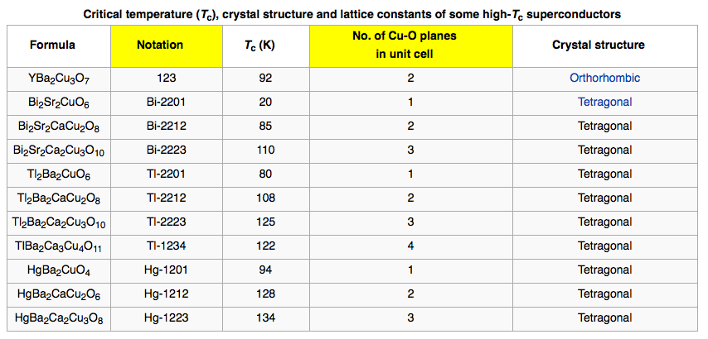
Critical Temperature of Superconductors

Slide 7
Electric Hazards: Leakage Currents
How does one feel shock by electricity?
Electric current stimulates nerves and muscles, and we feel a shock
The severity of the shock depends on the amount of current, how long it acts and through what part of the body it passes
Electric current heats the tissue and can cause burns
Currents above 70mA on a torso for a second or more is fatal, causing heart to function irregularly, “ventricular fibrillation”.
A dry human body between two points on opposite side of the body is about 10⁴ to 10⁶ Ω.
When wet, it could be 10³Ω.
A person in good contact with the ground who touches 120V DC line with wet hands can get the current:
Could be lethal

Slide 8
EMF and Terminal Voltage
What do we need to have current in an electric circuit?
A device that provides a potential difference, such as a battery or a generator
They normally convert some types of energy into the electric energy
These devices are called source of electromotive force (emf)
This is does NOT refer to a real “force”.
Potential difference between terminals of an emf source, when no current flows to an external circuit, is called the emf (E) of the source.
The battery itself has some internal resistance (r) due to the flow of charges in the electrolyte
Why does the headlight dim when you start the car?
The starter needs a large amount of current but the battery cannot provide charge fast enough to supply current to both the starter and the headlight

Slide 9
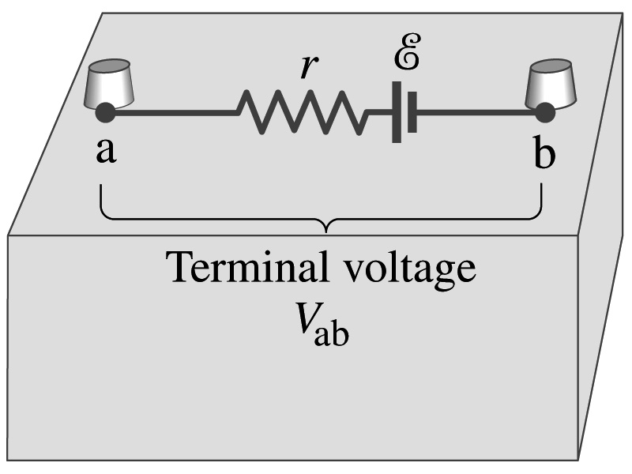
EMF and Terminal Voltage
Since the internal resistance is inside the battery, we can never separate them out.
So the terminal voltage difference is V_{ab}=V_{a}-V_{b}.
When no current is drawn from the battery, the terminal voltage equals the emf which is determined by the chemical reaction; V_{ab}= E.
However when the current I flows naturally from the battery, there is an internal drop in voltage which is equal to Ir. Thus the actual delivered terminal voltage is

Slide 10
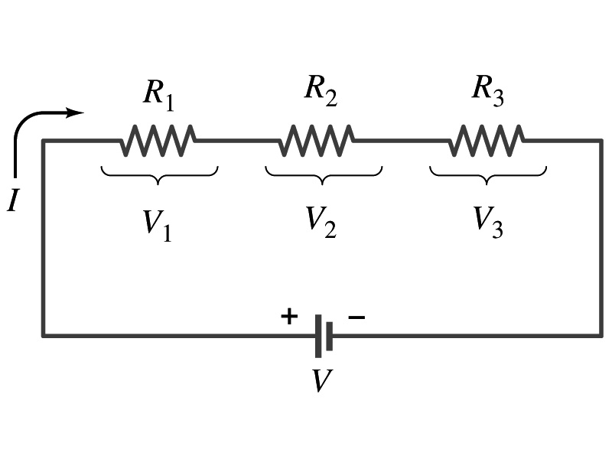
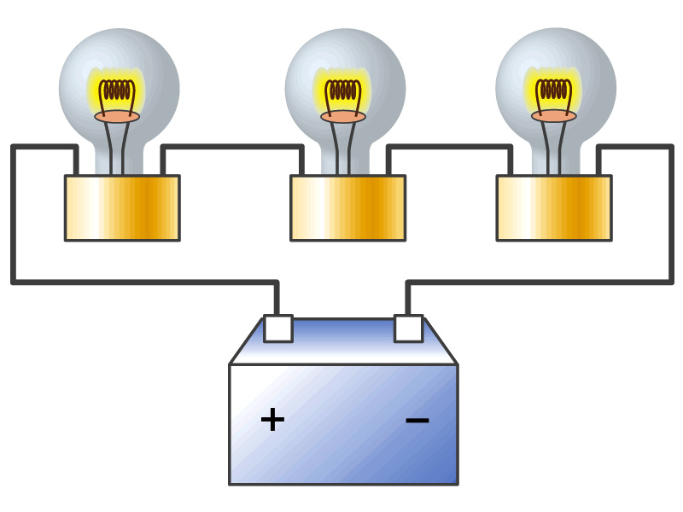
Resisters in Series
Resisters are in series when two or more resisters are connected end to end
These resisters represent simple resisters in circuit or electrical devices, such as light bulbs, heaters, dryers, etc
What is common for devices in a series circuit?
Current is the same through all the elements in series
Potential difference across every element in the circuit is
V₁=IR₁, V₂=IR₂ and V₃=IR₃
Since the total potential difference is V, we obtain
V=IR_{eq}=V₁+V₂+V₃=I(R₁+R₂+R₃)
Thus, R_{eq}=R₁+R₂+R₃
Resisters in series
When resisters are connected in series, the total resistance increases and the current decreases.

Slide 11
Energy Losses in Resisters
Why is it true that V=V₁+V₂+V₃?
What is the potential energy loss when charge q passes through resisters R₁, R₂ and R₃
ΔU₁=qV₁, ΔU₂=qV₂, ΔU₃=qV₃
Since the total energy loss should be the same as the total energy provided to the system, we obtain
ΔU=qV=ΔU₁+ΔU₂+ΔU₃=q(V₁+V₂+V₃)
Thus, V=V₁+V₂+V₃

Slide 12
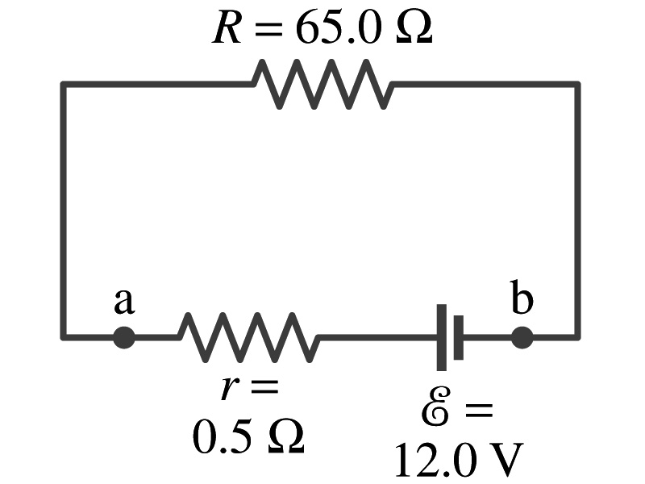
Example 26 – 1
Battery with internal resistance. A 65.0-Ω resistor is connected to the terminals of a battery whose emf is 12.0V and whose internal resistance is 0.5-Ω. Calculate (a) the current in the circuit, (b) the terminal voltage of the battery, V_{ab}, and (c) the power dissipated in the resistor R and in the battery’s internal resistor.
(a) Since
We obtain
What is this?
Solve for I
A battery or a source of emf.
(b) The terminal voltage V_{ab} is
(c) The power dissipated in R and r are

Slide 13
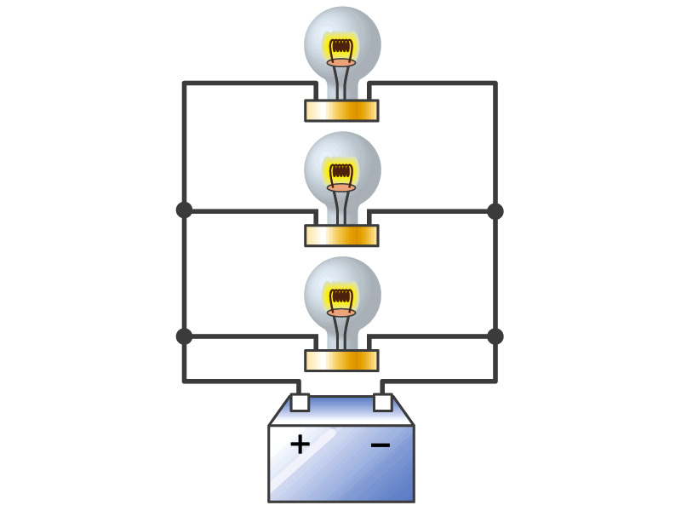
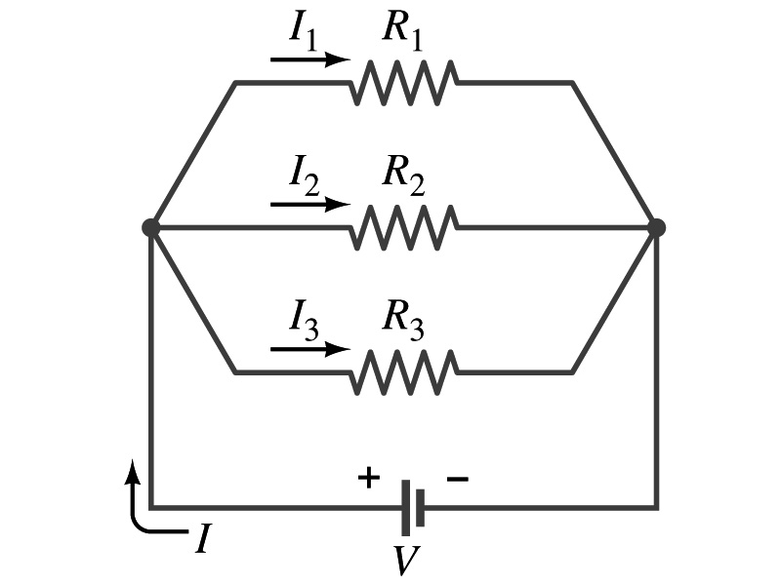
Resisters in Parallel
Resisters are in parallel when two or more resisters are connected in separate branches
Most the house and building wirings are arranged this way.
What is common for the devices in a parallel circuit?
The voltage is the same across all the resisters.
The total current that leaves the battery is, however, split.
The current that passes through every element is
I₁=V/R₁, I₂=V/R₂, I₃=V/R₃
Since the total current is I, we obtain
I=V/R_{eq}=I₁+I₂+I₃=V(1/R₁+1/R₂+1/R₃)
Thus, 1/R_{eq}=1/R₁+1/R₂+1/R₃
Resisters in parallel
When resisters are connected in parallel, the total resistance decreases and the current increases.

Slide 14
Resister and Capacitor Arrangements
Parallel Capacitor arrangements
Parallel Resister arrangements
Series Capacitor arrangements
Series Resister arrangements

Slide 15
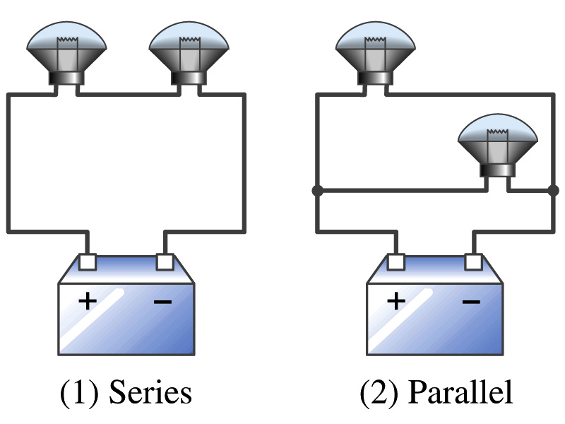
Example 26 – 2
Series or parallel? (a) The light bulbs in the figure are identical and have identical resistance R. Which configuration produces more light? (b) Which way do you think the headlights of a car are wired?
(a) What are the equivalent resistances for the two cases?
Series
Parallel
So
The bulbs get brighter when the total power transformed is larger.
series
parallel
So parallel circuit provides brighter lighting.
(b) Car’s headlights are in parallel to provide brighter lighting and also to prevent both lights going out at the same time when one burns out.
So what is bad about parallel circuits?
Uses more energy in a given time.

Slide 16
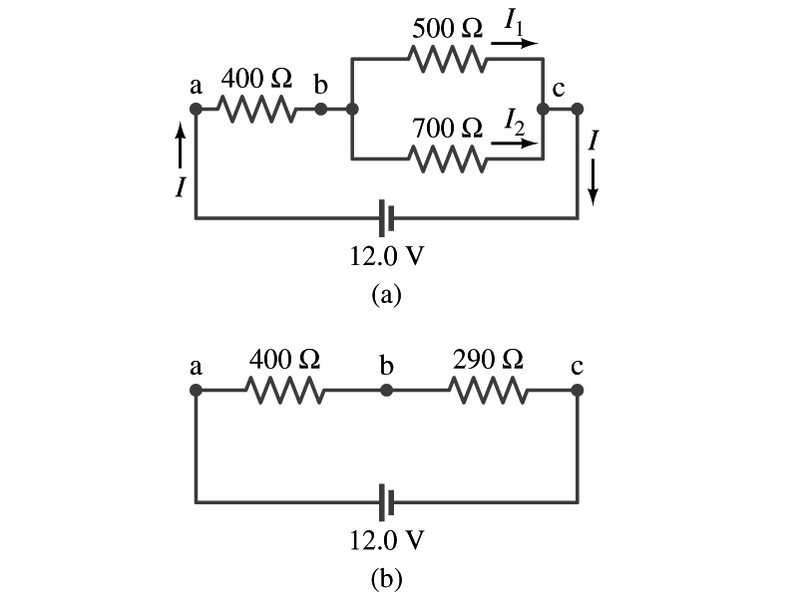
Example 26 – 5
Current in one branch. What is the current flowing through the 500-Ω resister in the figure?
We need to find the total current.
What do we need to find first?
To do that we need to compute the equivalent resistance.
R_{eq} of the small parallel branch is:
R_{eq} of the circuit is:
Thus the total current in the circuit is
The voltage drop across the parallel branch is
The current flowing across 500-Ω resister is therefore
What is the current flowing 700-Ω resister?

Slide 17
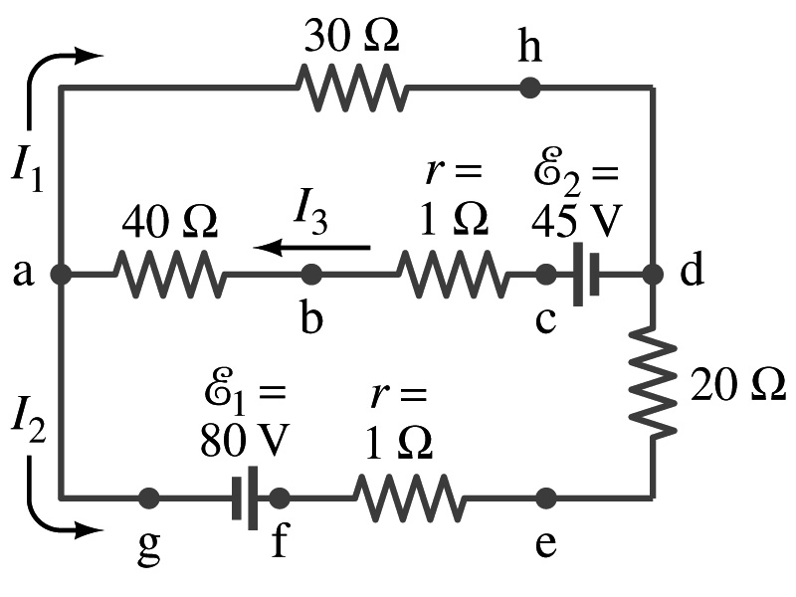
Kirchhoff’s Rules – 1st Rule
Some circuits are very complicated to do the analysis using the simple combinations of resisters
G. R. Kirchhoff devised two rules to deal with complicated circuits.
Kirchhoff’s rules are based on conservation of charge and energy
Kirchhoff’s 1st rule: The junction rule, charge conservation.
At any junction point, the sum of all currents entering the junction must be equal to the sum of all currents leaving the junction.
In other words, what goes in must come out.
At junction a in the figure, I₃ comes into the junction while I₁ and I₂ leaves: I₃ = I₁+ I₂

Slide 18
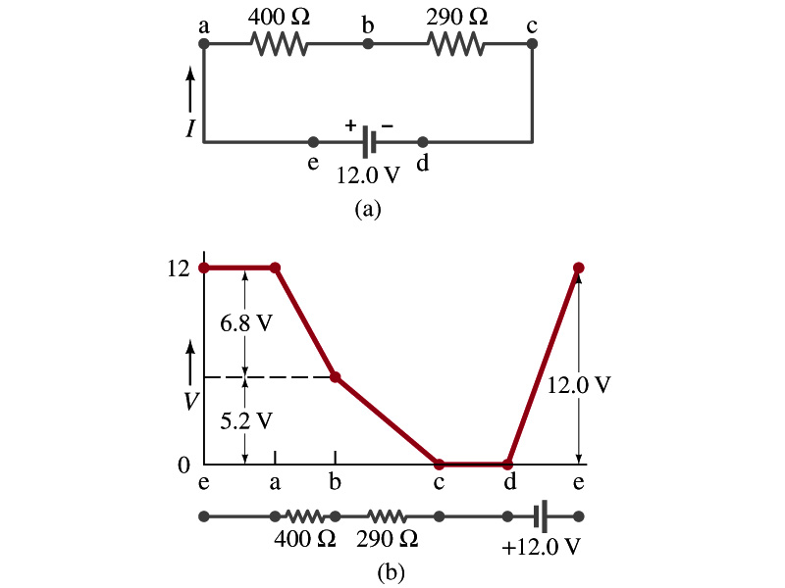
Kirchhoff’s Rules – 2nd Rule
Kirchoff’s 2nd rule: The loop rule, uses conservation of energy.
The sum of the changes in potential in any closed path of a circuit must be zero.
I=12/690=0.017A.
The current in the circuit in the figure is
Point e is the high potential point while point d is the lowest potential.
When the test charge starts at e and returns to e, the total potential change is 0.
Between point e and a, no potential change since there is no source of potential nor any resistance.
Between a and b, there is a 400Ω resistance, causing IR=0.017*400 =6.8V drop.
Between b and c, there is a 290Ω resistance, causing IR=0.017*290 =5.2V drop.
Since these are voltage drops, we use negative sign for these, -6.8V and -5.2V.
No change between c and d while from d to e there is +12V change.
Thus the total change of the voltage through the loop is: -6.8V-5.2V+12V=0V.

Slide 19
How to use Kirchhoff’s Rules??
Determine the flow of currents at the junctions and label each and everyone of the currents.
It does not matter which direction, you decide but keep it!
You cannot have all current coming in or going out of a junction, though!
If the value of the current after completing the calculations are negative, you just need to flip the direction of the current flow.
Write down the current equation based on Kirchhoff’s 1st rule at various junctions.
Be sure to see if any of them are the same.
Choose closed loops in the circuit
Write down the potential in each interval of the junctions, keeping the proper signs as you decided in step 1 above.
Write down the potential equations for each loop.
Solve the equations for unknowns.

Slide 20
Example 26 – 9
Use Kirchhoff’s rules. Calculate the currents I₁, I₂ and I₃ in each of the branches of the circuit in the figure.
The directions of the current through the circuit is not known a priori but since the current tends to move away from the positive terminal of a battery, we arbitrarily choose the direction of the currents as shown.
We have three unknowns so we need three equations.
Using Kirchhoff’s junction rule at point a, we obtain
This is the same for junction d as well, so no additional information.
Now the second rule on the loop ahdcba.
The total voltage change in the loop ahdcba is.

Slide 21
Example 26 – 9, cnt’d
Now the second rule on the other loop agfedcba.
The total voltage change in loop agfedcba is.
So the three equations become
We can obtain the three current by solving these equations for I₁, I₂ and I₃.
Do this yourselves!!

