Slide 1
PHYS 1441 – Section 001 Lecture #13
Monday, June 25, 2018
Dr. Jaehoon Yu
Chapter26
EMFs in Series and Parallel
RC Circuits
Chapter 27: Magnetism and Magnetic Field
Electric Current and Magnetism
Magnetic Forces on Electric Current
About Magnetic Field
Today’s homework is homework #7, due 11pm, Friday, June 29!!

Slide 2
Announcements
One-on-one mid-term grade discussion tomorrow Tuesday, June 24.
Class for the first 30min ➔ Quiz 3
In my office – CPB342.
Last names begin with
A – G: 11:05 – 11:35
H – M: 11:35 – 12:00
N – Z: 12 – 12:30
If you have schedule issue, please be sure to come in early for the discussion
Quiz 3 tomorrow, Tuesday, June 26 in class
Covers CH25.6 – what we finish today
Bring your calculator but DO NOT input formula into it!
Cell phones or any types of computers cannot replace a calculator!
BYOF: You may bring a one 8.5x11.5 sheet (front and back) of handwritten formulae and values of constants
No derivations, word definitions or solutions of any kind!
No additional formulae or values of constants will be provided!
Reading assignments: CH27.6 – CH27.9

Slide 3
Reminder: Special Project #4
Make a list of the power consumption and the resistance of all electric and electronic devices at your home and compile them in a table. (10 points total for the first 10 items and 0.5 points each additional item.)
Estimate the cost of electricity for each of the items on the table using your own electric cost per kWh (if you don’t find your own, use $0.12/kWh) and put them in the relevant column. (5 points total for the first 10 items and 0.2 points each additional items)
Estimate the the total amount of energy in Joules and the total electricity cost per day, per month and per year for your home. (8 points)
Due: Beginning of the class tomorrow Tuesday, June 24

Slide 4
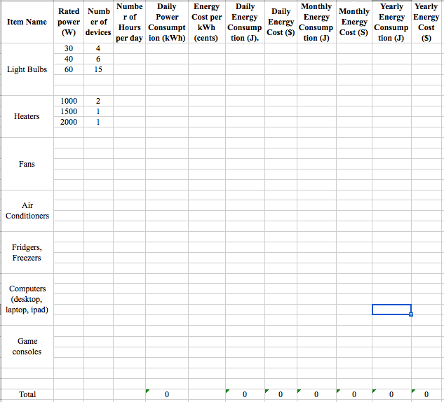

Slide 5
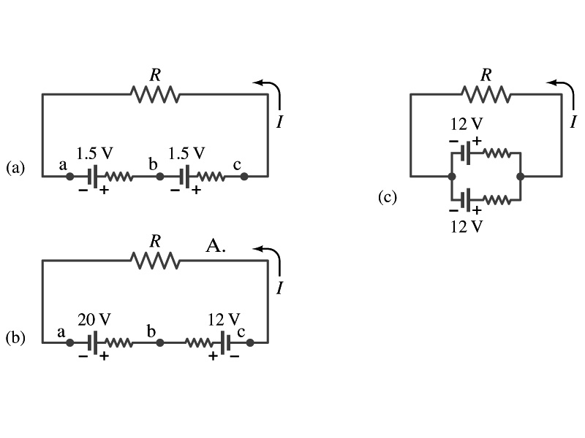
EMFs in Series and Parallel: Charging a Battery
When two or more sources of emfs, such as batteries, are connected in series
The total voltage is the algebraic sum of their voltages, if their direction is the same
V_{ab}=1.5 + 1.5=3.0V in figure (a).
If the batteries are arranged in an opposite direction, the total voltage is the difference between them
Parallel arrangements (c) are used only to increase currents. An example?
V_{ac}=20 – 12=8.0V in figure (b)
Connecting batteries in opposite direction is wasteful.
This, however, is the way a battery charger works.
Since the 20V battery is at a higher voltage, it forces charges into 12V battery
Some battery are rechargeable since their chemical reactions are reversible but most the batteries do not reverse their chemical reactions

Slide 6
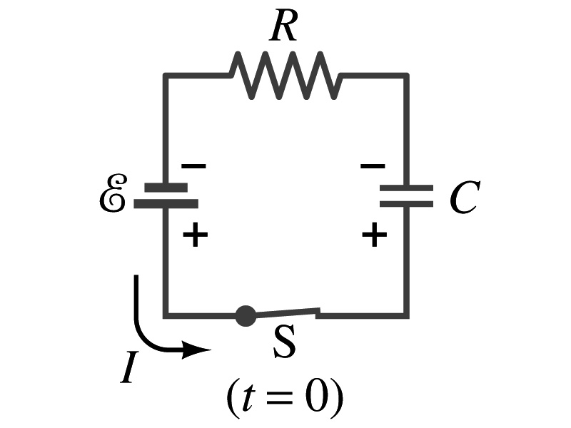
RC Circuits
Circuits containing both resisters and capacitors
RC circuits are used commonly in everyday life
Control windshield wiper
Timing of traffic light from red to green
Camera flashes and heart pacemakers
How does an RC circuit look?
There should be a source of emf, capacitors and resisters
What happens when the switch S is closed?
Current immediately starts flowing through the circuit.
Electrons flow out of negative terminal of the emf source, through the resister R and accumulates on the upper plate of the capacitor.
The electrons from the bottom plate of the capacitor will flow into the positive terminal of the battery, leaving only the positive charge on the bottom plate.
As the charge accumulates on the capacitor, the potential difference across it increases
The current reduces gradually to 0 till the voltage across the capacitor is the same as the emf.
The charge on the capacitor increases till it reaches to its maximum CE.

Slide 7
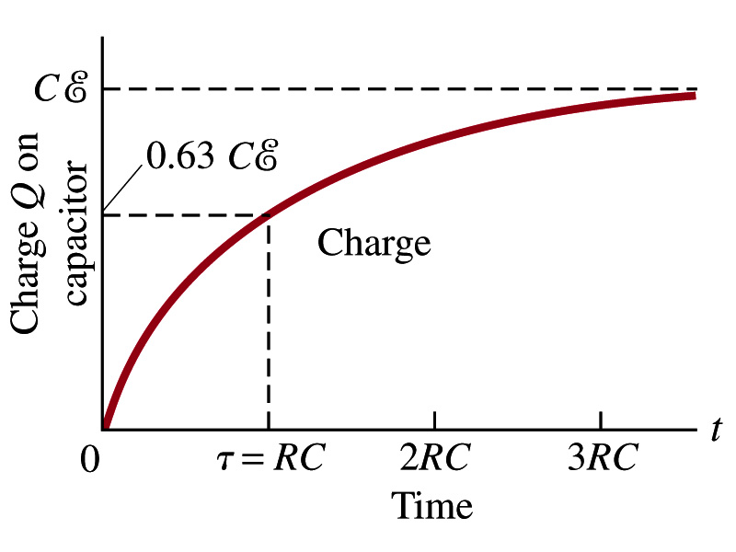
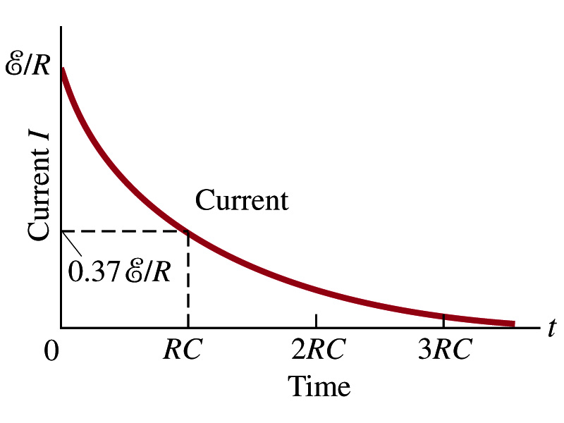
RC Circuits
How does all this look like in graphs?
The charge and the current on the capacitor as a function of time
From energy conservation (Kirchhoff’s 2nd rule), the emf E must be equal to the sum of voltage drop across the capacitor and the resister
E=IR+Q/C
R includes all resistance in the circuit, including the internal resistance of the battery, I is the current in the circuit at any instance, and Q is the charge of the capacitor at that same instance.

Slide 8
Analysis of RC Circuits
In an RC circuit and
What can we see from the above equations?
Q and V_{C} increase from 0 at t=0 to maximum value Q_{max}=CE and V_{C}= E.
In how much time?
The quantity RC is called the time constant of the circuit, τ
τ=RC, What is the unit?
What is the physical meaning?
The time required for the capacitor to reach (1 - e⁻¹)=0.63 or 63% of the full charge
The current is
Sec.

Slide 9
Example 26 – 12
RC circuit, with emf. The capacitance in the circuit of the figure is C=0.30μF, the total resistance is 20kΩ, and the battery emf is 12V. Determine (a) the time constant, (b) the maximum charge the capacitor could acquire, (c) the time it takes for the charge to reach 99% of this value, (d) the current I when the charge Q is half its maximum value, (e) the maximum current, and (f) the charge Q when, the current I is 0.20 its maximum value.
(a) Since
We obtain
(b) Maximum charge is
(c) Since
For 99% we obtain
(d) Since
We obtain
The current when Q is 0.5Q_{max}
(e) When is I maximum?
when Q=0:
(f) What is Q when I=120mA?

Slide 10
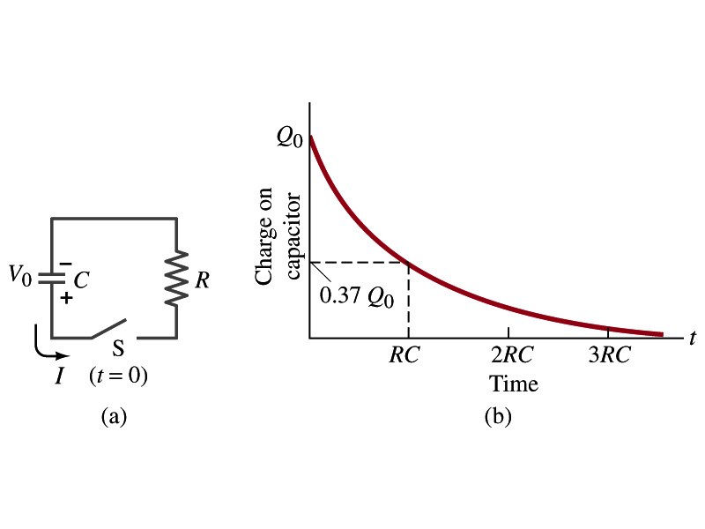
Discharging RC Circuits
When a capacitor is already charged, it is allowed to discharge through a resistance R.
When the switch S is closed, the voltage across the resistor at any instant equals that across the capacitor. Thus IR=Q/C.
The rate at which the charge leaves the capacitor equals the negative the current flows through the resistor
I= - dQ/dt
Since the current is leaving the capacitor
Thus the voltage equation becomes a differential equation
Rearrange terms

Slide 11
Discharging RC Circuits
Now, let’s integrate from t=0 when the charge is Q₀ to t when the charge is Q
The result is
Thus, we obtain
What does this tell you about the charge on the capacitor?
It decreases exponentially w/ time at the time constant RC
Just like the case of charging
The current is:
The current also decreases exponentially w/ time w/ the time constant RC
What is this?

Slide 12
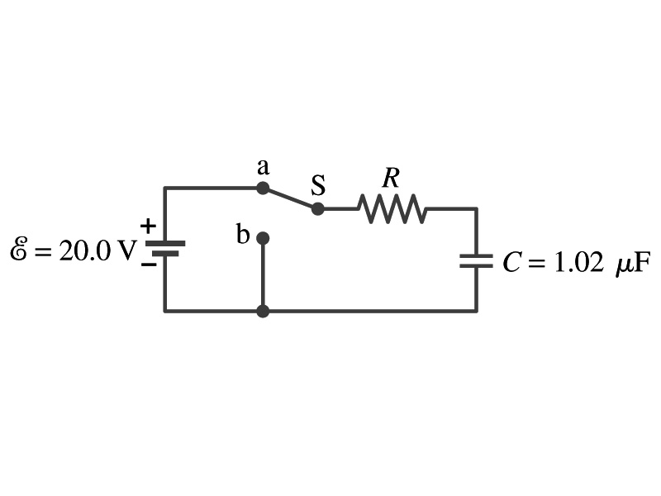
Example 26 – 13
Discharging RC circuit. In the RC circuit shown in the figure the battery has fully charged the capacitor, so Q₀=CE. Then at t=0, the switch is thrown from position a to b. The battery emf is 20.0V, and the capacitance C=1.02μF. The current I is observed to decrease to
0.50 of its initial value in 40μs. (a) what is the value of R? (b) What is the value of Q, the charge on the capacitor, at t=0? (c) What is Q at t=60μs?
(a) Since the current reaches to 0.5 of its initial value in 40μs, we can obtain
For 0.5I₀
Rearrange terms
Solve for R
(b) The value of Q at t=0 is
(c) What do we need to know first for the value of Q at t=60μs?
The RC time
Thus

Slide 13
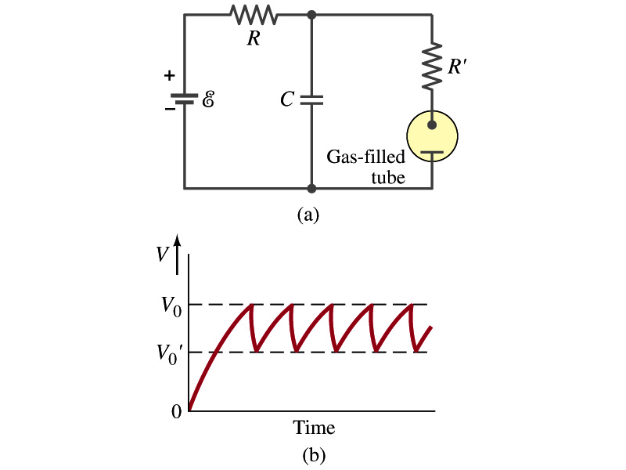
Application of RC Circuits
What do you think the charging and discharging characteristics of RC circuits can be used for?
To produce voltage pulses at a regular frequency
How?
The capacitor charges up to a particular voltage and discharges
A simple way of doing this is to use breakdown of voltage in a gas filled tube
The discharge occurs when the voltage breaks down at V₀
After the completion of discharge, the tube no longer conducts
Then the voltage is at V₀’ and it starts charging up
How do you think the voltage as a function of time look?
A sawtooth shape
Pace maker, intermittent windshield wiper, etc

Slide 14
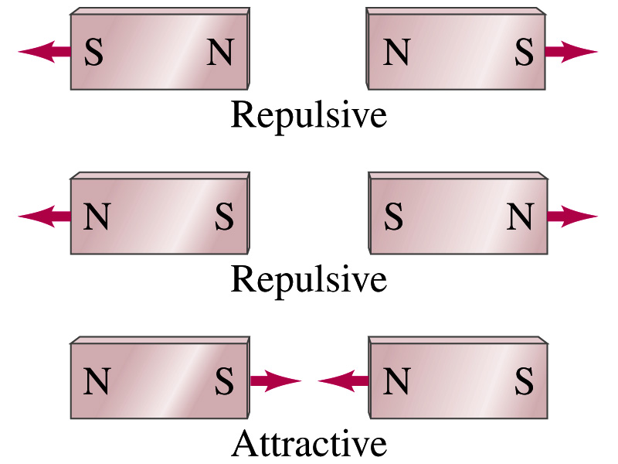
Magnetism
What are magnets?
Objects with two poles, North and South poles
The pole that points to the geographical North is the North pole and the other is the South pole
Principle of compass
These are called the magnet due to the name of the region, Magnesia, where the rocks that attract each other were found
What happens when two magnets are brought to each other?
They exert force onto each other
What kind?
Both repulsive and attractive forces depending on the configurations
Like poles repel each other while the unlike poles attract

Slide 15
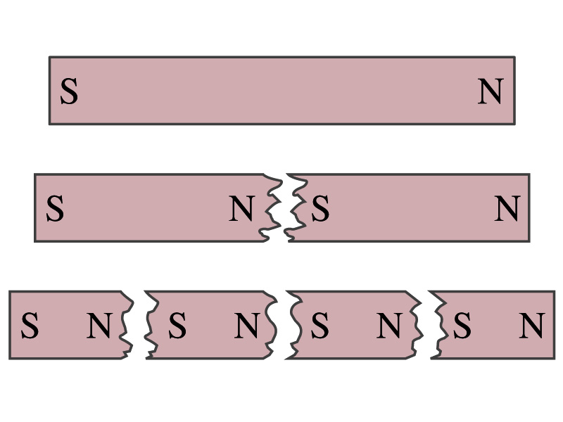
Magnetism
So the magnetic poles are the same as the electric charge?
No. Why not?
While the electric charges (positive and negative) can be isolated, the magnetic poles cannot be isolated.
So what happens when a magnet is cut?
If a magnet is cut, two magnets are made.
The more they get cut, the more magnets are made
Single pole magnets are called the monopole but it has not been seen yet
Ferromagnetic materials: Materials that show strong magnetic effects
Iron, cobalt, nickel, gadolinium and certain alloys
Other materials show very weak magnetic effects

Slide 16
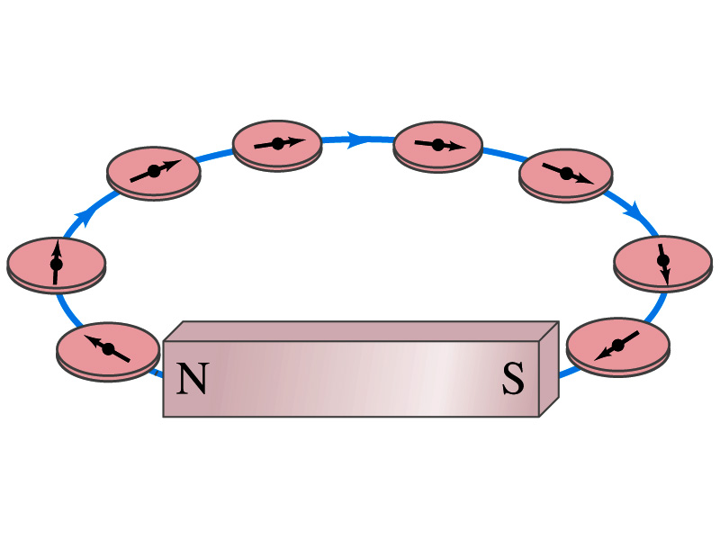
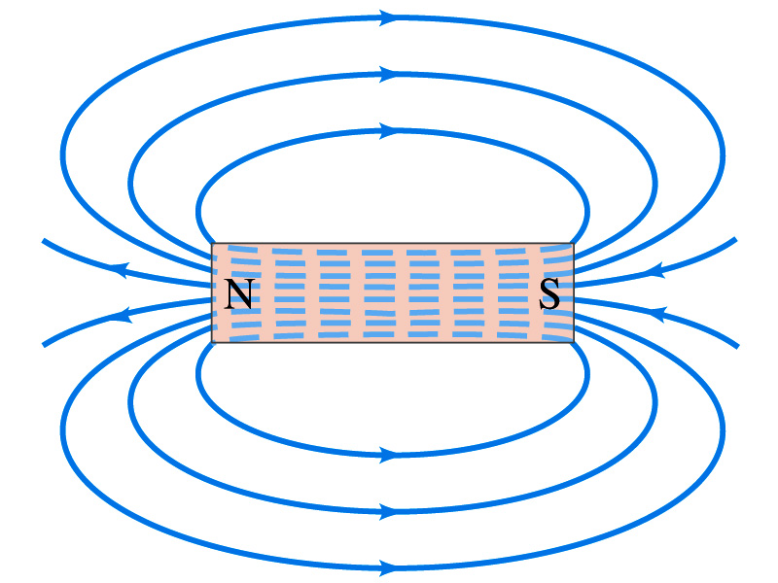
Magnetic Field
Just like the electric field that surrounds electric charge, a magnetic field surrounds a magnet
What does this mean?
Magnetic force is also a field force
The force one magnet exerts onto another can be viewed as the interaction between the magnet and the magnetic field produced by the other magnet
What kind of quantity is the magnetic field? Vector or Scalar?
So one can draw magnetic field lines, too.
Vector
The direction of the magnetic field is tangential to the field line at any point
The direction of the field is the direction the north pole of a compass would point to
The number of lines per unit area is proportional to the strength of the magnetic field
Magnetic field lines continue inside the magnet
Since magnets always have both the poles, magnetic field lines form closed loops unlike electric field lines

Slide 17
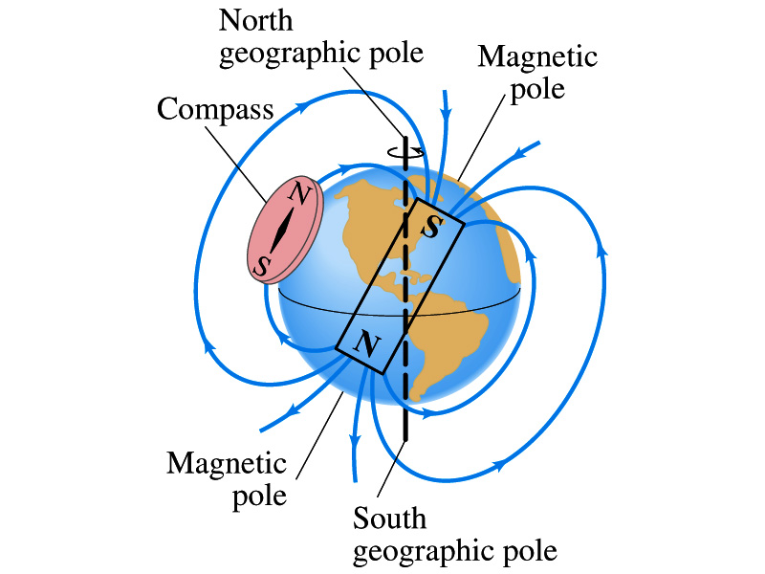
Earth’s Magnetic Field
What magnetic pole does the geographic North pole has to have?
Magnetic South pole. What? How do you know that?
Since the magnetic North pole points to the geographic North, the geographic north must have magnetic south pole
The pole in the North is still called geomagnetic North pole just because it is in the North
Similarly, South pole has magnetic North pole
The Earth’s magnetic poles do not coincide with the geographic poles ➔ magnetic declination
Geomagnetic North pole is in Northern Canada, some 900km off the true North pole
Earth’s magnetic field line is not tangent to the earth’s surface at all points
The angle the Earth’s field makes to the horizontal line is called the angle dip

Slide 18
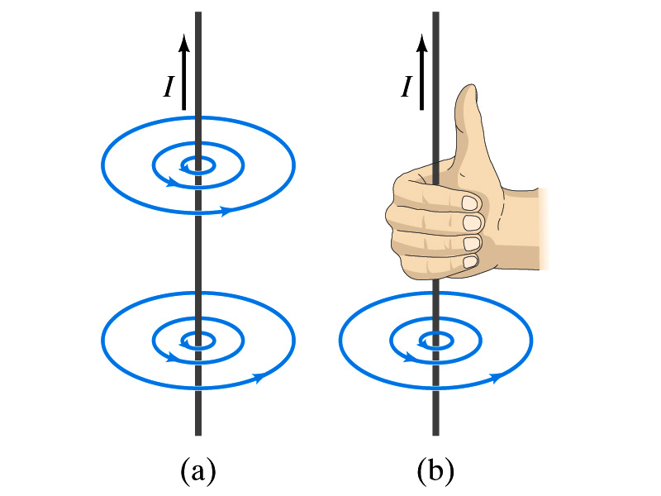
Electric Current and Magnetism
In 1820, Oersted found that when a compass needle is placed near an electric wire, the needle deflects as soon as the wire is connected to a battery and the current flows
Electric current produces a magnetic field
The first indication that electricity and magnetism are of the same origin
What about a stationary electric charge and magnet?
They don’t affect each other.
The magnetic field lines produced by a current in a straight wire is in the form of circles following the “right-hand” rule
The field lines follow right-hand fingers wrapped around the wire when the thumb points to the direction of the electric current

Slide 19
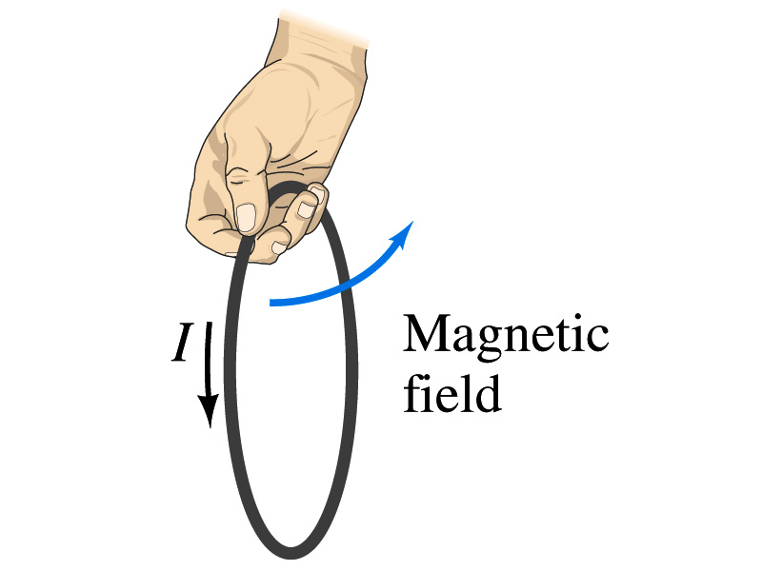
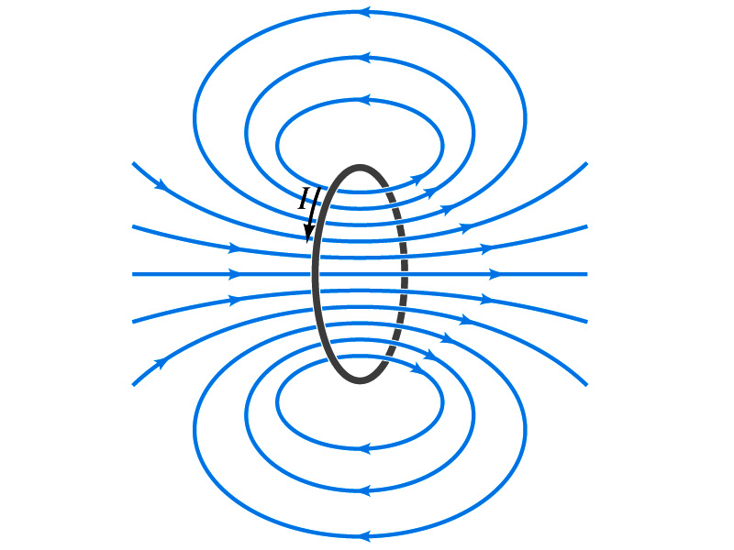
Directions in a Circular Wire?
OK, then what is the direction of the magnetic field generated by the current flowing through a circular loop?

Slide 20
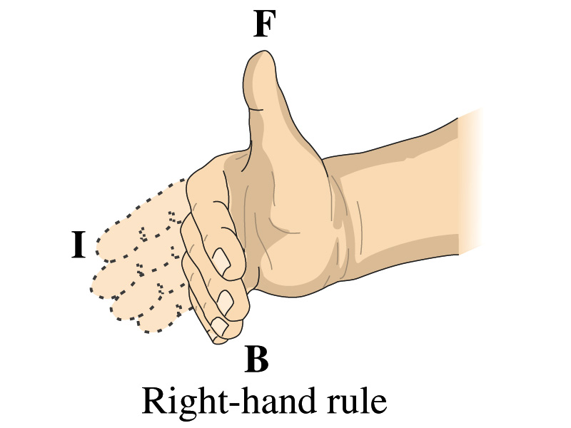
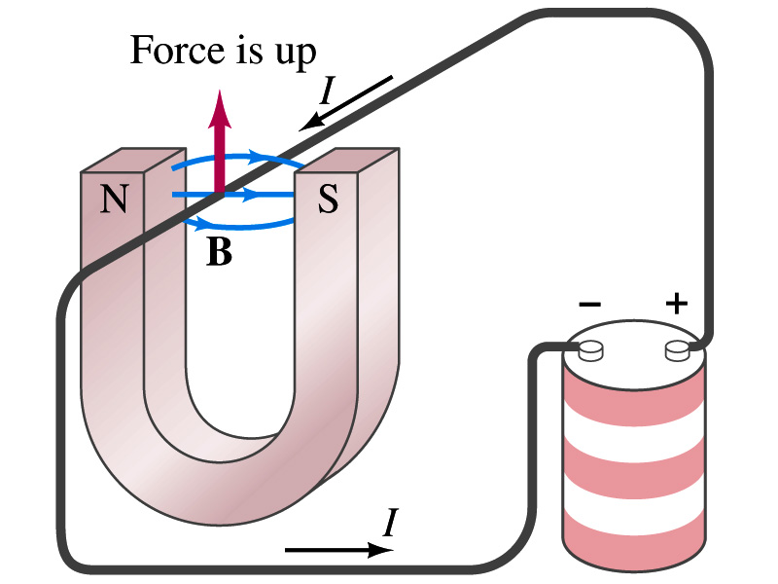
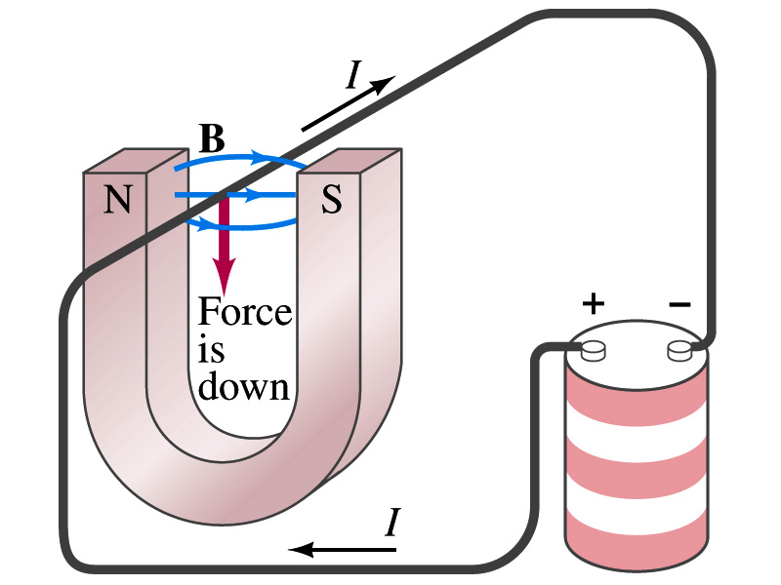
Magnetic Forces on Electric Current
Since the electric current exerts force on a magnet, the magnet should also exert force on the electric current
Which law justifies this?
Newton’s 3rd law
This was also discovered by Oersted
Direction of the force is always
perpendicular to the direction of the current
perpendicular to the direction of the magnetic field, B
Experimentally the direction of the force is given by another right-hand rule ➔ When the fingers of the right-hand points to the direction of the current and the finger tips bent to the direction of magnetic field B, the direction of thumb points to the direction of the force

Slide 21
Magnetic Forces on Electric Current
OK, we are set for the direction but what about the magnitude?
It is found that the magnitude of the force is directly proportional
To the current in the wire
To the length of the wire in the magnetic field (if the field is uniform)
To the strength of the magnetic field
The force also depends on the angle θ between the directions of the current and the magnetic field
When the wire is perpendicular to the field, the force is the strongest
When the wire is parallel to the field, there is no force at all
Thus the force on current I in the wire w/ length l in a uniform field B is

Slide 22
Magnetic Forces on Electric Current
Magnetic field strength B can be defined using the previous proportionality relationship w/ the constant 1:
if θ=90º, and if θ=0º
So the magnitude of the magnetic field B can be defined as
where F_{max} is the magnitude of the force on a straight length l of the wire carrying the current I when the wire is perpendicular to B
The relationship between F, B and I can be written in a vector formula:
l is the vector whose magnitude is the length of the wire and its direction is along the wire in the direction of the conventional current
This formula works if B is uniform.
If B is not uniform or l does not form the same angle with B everywhere, the infinitesimal force acting on a differential length dl is

Slide 23
Fundamentals on the Magnetic Field, B
The magnetic field is a vector quantity
The SI unit for B is tesla (T)
What is the definition of 1 Tesla in terms of other known units?
1T=1N/Am
In older names, tesla is the same as weber per meter-squared
1Wb/m²=1T
The cgs unit for B is gauss (G)
How many T is one G?
1G=10⁻⁴ T
For computation, one MUST convert G to T at all times
Magnetic field on the Earth’s surface is about 0.5G=0.5x10⁻⁴T
On a diagram, for field coming out and for going in.

Slide 24
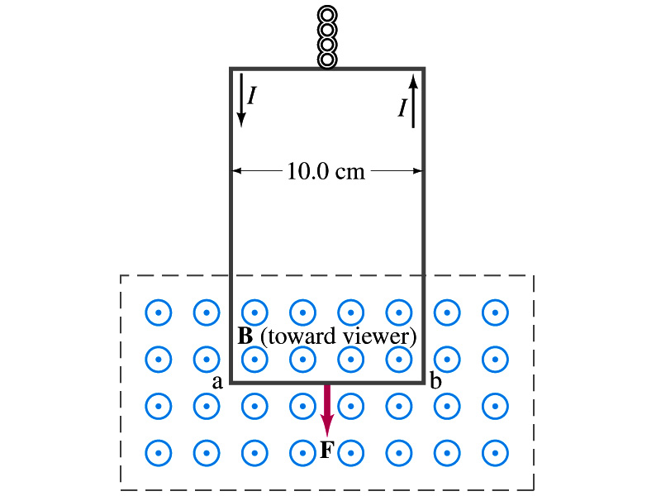
Example 27 – 2
Measuring a magnetic field. A rectangular loop of wire hangs vertically as shown in the figure. A magnetic field B is directed horizontally perpendicular to the wire, and points out of the page. The magnetic field B is very nearly uniform along the horizontal portion of wire ab (length l=10.0cm) which is near the center of a large magnet producing the field. The top portion of the wire loop is free of the field. The loop hangs from a balance which measures a downward force ( in addition to the gravitational force) of F=3.48x10⁻²N when the wire carries a current I=0.245A. What is the magnitude of the magnetic field B at the center of the magnet?
Magnetic force exerted on the wire due to the uniform field is
Since
Magnitude of the force is
Solving for B
Something is not right! What happened to the forces on the loop on the side?
The two forces cancel out since they are in opposite direction with the same magnitude.

Slide 25
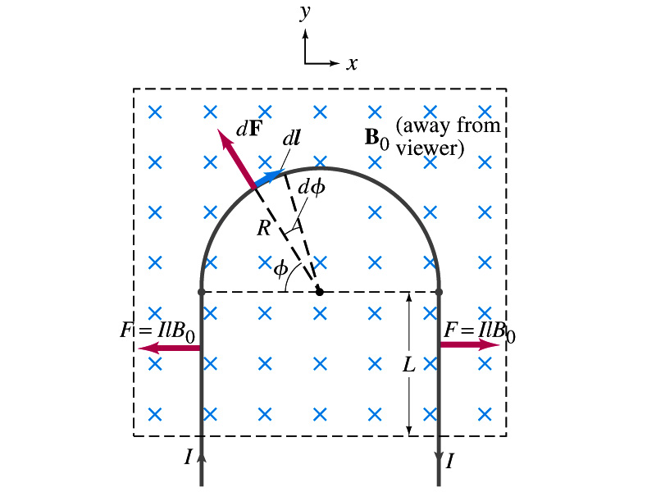
Example 27 – 3
Magnetic force on a semi-circular wire. A rigid wire, carrying the current I, consists of a semicircle of radius R and two straight portions as shown in the figure. The wire lies in a plane perpendicular to the uniform magnetic field B₀. The straight portions each have length l within the field. Determine the net force on the wire due to the magnetic field B₀.
As in the previous example, the forces on the straight sections of the wire is equal and in opposite direction. Thus they cancel.
What do we use to figure out the net force on the semicircle?
We divide the semicircle into infinitesimal straight sections.
What is the net x component of the force exerting on the circular section?
0
Why?
Because the forces on left and the right-hand sides of the semicircle balance.
Since
Y-component of the force dF is
Integrating over ϕ=0 - π
Which direction?
Vertically upward direction. The wire will be pulled deeper into the field.

