Slide 1
PHYS 1441 – Section 001 Lecture #15
Thursday, June 28, 2018
Dr. Jaehoon Yu
Chapter 28:Sources of Magnetic Field
Sources of Magnetic Field
Magnetic Field Due to Straight Wire
Magnetic Materials
Hysteresis
Chapter 29:EM Induction & Faraday’s Law
Induced EMF and EM Induction
Faraday’s Law of Induction
Lenz’s Law

Slide 2
Announcements
Class feedback survey at http://uta.mce.cc/
Bring out your and fill in the survey now
Planetarium extra credit
Be sure to tape one end onto a sheet of paper with your name on it
Submit it at the beginning of the final exam at 10:30 – 12:30pm Monday, July 9
DO NOT miss the exam! You will get an F!
Quiz #4
Beginning of the class Thursday, July 5
Covers CH 28.1 – what we finish Tuesday, July 3

Slide 3
Sources of Magnetic Field
We have learned so far about the effects of magnetic field on the electric current and the moving charge
We will now learn about the dynamics of magnetism
How do we determine magnetic field strengths in certain situations?
How do two wires with electric current interact?
What is the general approach to finding the connection between current and magnetic field?

Slide 4
Magnetic Field due to a Straight Wire
The magnetic field due to the current flowing through a straight wire forms a circular pattern around the wire
What do you imagine the strength of the field is as a function of the distance from the wire?
It must be weaker as the distance increases
How about as a function of current?
Directly proportional to the current
Indeed, the above are experimentally verified
This is valid as long as r << the length of the wire
The proportionality constant is μ₀/2π, thus the field strength becomes
μ₀ is the permeability of free space

Slide 5
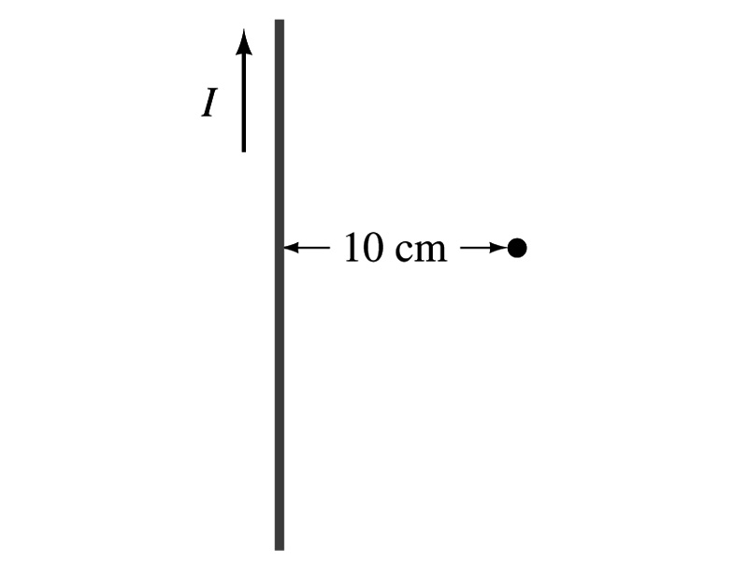
Example 28 – 1
Calculation of B near wire. A vertical electric wire in the wall of a building carries a DC current of 25A upward. What is the magnetic field at a point 10cm due East of this wire?
Using the formula for the magnetic field near a straight wire
So we can obtain the magnetic field at 10cm away as

