Slide 1
PHYS 1441 – Section 001
Lecture #16
Monday, July 2, 2018
Dr. Animesh Chatterjee
Chapter 28:Sources of Magnetic Field
  Magnetic Field Due to Straight Wire
  Magnetic Materials
  Hysteresis
Chapter 29:EM Induction & Faraday’s Law
  Induced EMF and EM Induction
  Faraday’s Law of Induction
  Lenz’s Law
  Generation of Electricity
Today’s homework is #9, due 11pm, Thursday, July 5!!

Slide 2
PHYS 1441 – Section 001
Lecture #17
Tuesday, July 3, 2018
Dr. Animesh Chatterjee
Chapter 29:EM Induction & Faraday’s Law
  Transformer
  Mutual and Self Inductance
  Energy Stored in Magnetic Field
  Alternating Current and AC Circuits
Chapter 30: Inductance
  Mutual and Self Inductance
  Energy Stored in Magnetic Field
Today’s homework is #10, due 11pm, Saturday, July 7!!

Slide 3
PHYS 1441 – Section 001
Lecture #18
Thursday, July 5, 2018
Dr. Animesh Chatterjee
Chapter 30: Inductance
  Energy Stored in Magnetic Field
  Alternating Current and AC Circuits
  AC Circuit W/ LRC
Chapter 31: Maxwell’s Equations
  Expansion of Ampere’s Law
  Gauss’ Law for Magnetism
  Production of EM Waves
  Light as EM Waves

Slide 4
Announcement
Quiz #4
  Beginning of the class Thursday, July 5
  Covers CH 28.1 – what we finish Tuesday, July 3
  BYOF
Final Exam
  In class 10:30 – 12:30, Monday, July 9
  Comprehensive Exam: Covers CH21.1 – what we finish Thursday, July 5 + Math refresher Appendices
  BYOF
Reading Assignments:
  Ch29.5, CH29.8, CH30.10 and CH30.11
Be sure to bring your planetarium extra credit sheet Monday, July 9

Slide 5
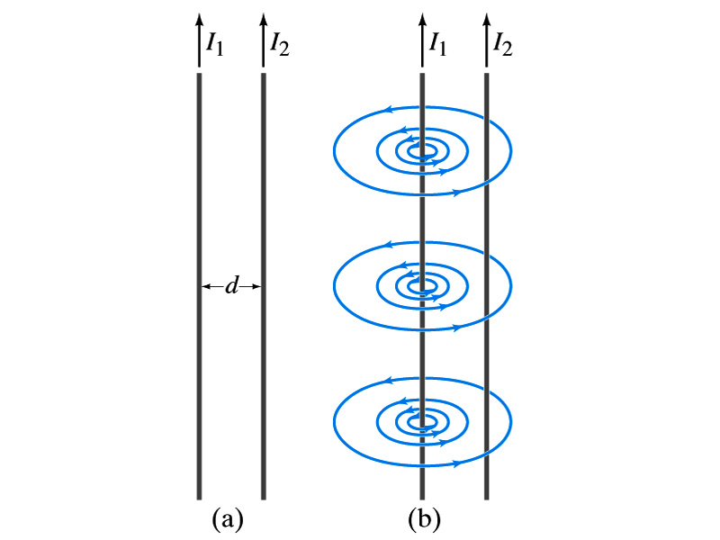
Force Between Two Parallel Wires
We have learned that a wire carrying the electric current produces magnetic field
Now what do you think will happen if we place two current carrying wires next to each other?
  They will exert force onto each other. Repel or attract?
  Depending on the direction of the currents
This was first pointed out by Ampére.
Let’s consider two long parallel conductors separated by a distance d, carrying currents I₁ and I₂.
At the location of the second conductor, the magnitude of the magnetic field produced by I₁ is

Slide 6
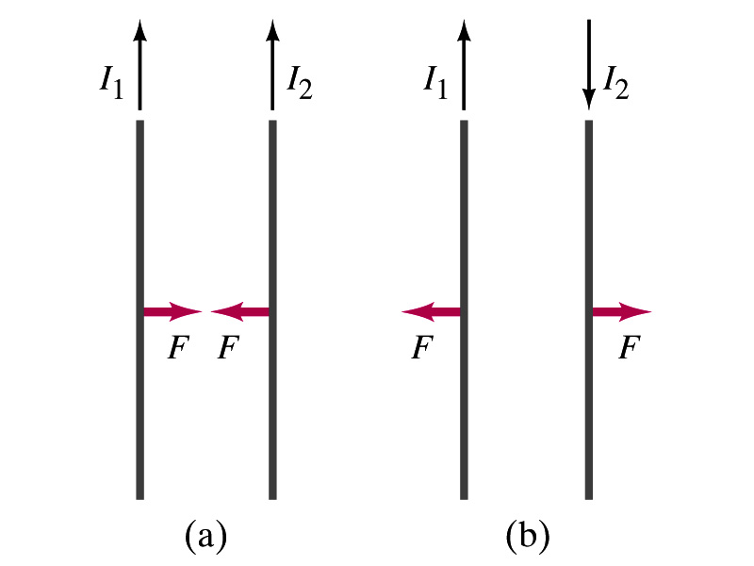
Force Between Two Parallel Wires
The force F by a magnetic field B₁ on a wire of length l, carrying the current I₂ when the field and the current are perpendicular to each other is:
  So the force per unit length is
  This force is only due to the magnetic field generated by the wire carrying the current I₁
    There is the force exerted on the wire carrying the current I₁ by the wire carrying current I₂ of the same magnitude but in opposite direction
So the force per unit length is
How about the direction of the force?
If the currents are in the same direction, the attractive force. If opposite, repulsive.

Slide 7
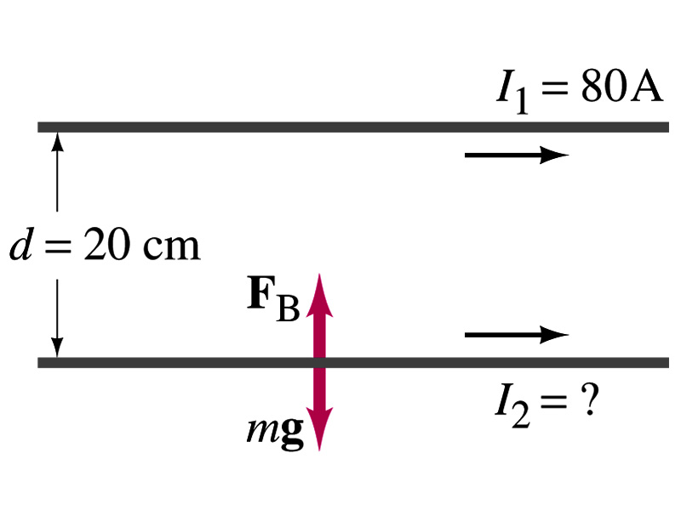
Example 28 – 5
Suspending a wire with current. A horizontal wire carries a current I₁=80A DC. A second parallel wire 20cm below it must carry how much current I₂ so that it doesn’t fall due to the gravity? The lower has a mass of 0.12g per meter of length.
Which direction is the gravitational force?
Down to the center of the Earth
This force must be balanced by the magnetic force exerted on the wire by the first wire.
Solving for I₂

Slide 8
Operational Definition of Ampere and Coulomb
The permeability of free space is defined to be exactly
The unit of current, ampere, is defined using the definition of the force between two wires each carrying 1A of current and separated by 1m
  So 1A is defined as: the current flowing each of two long parallel conductors 1m apart, which results in a force of exactly 2x10⁻⁷N/m.
Coulomb is then defined as exactly 1C=1A s.
We do it this way since the electric current is measured more accurately and controlled more easily than the charge.

Slide 9
Ampére’s Law
What is the relationship between the magnetic field strength and the current?
  Does this work in all cases?
    Nope!
    OK, then when?
    Only valid for a long straight wire
Then what would be the more generalized relationship between the current and the magnetic field for any shapes of the wire?
  French scientist André Marie Ampére proposed such a relationship soon after Oersted’s discovery

Slide 10
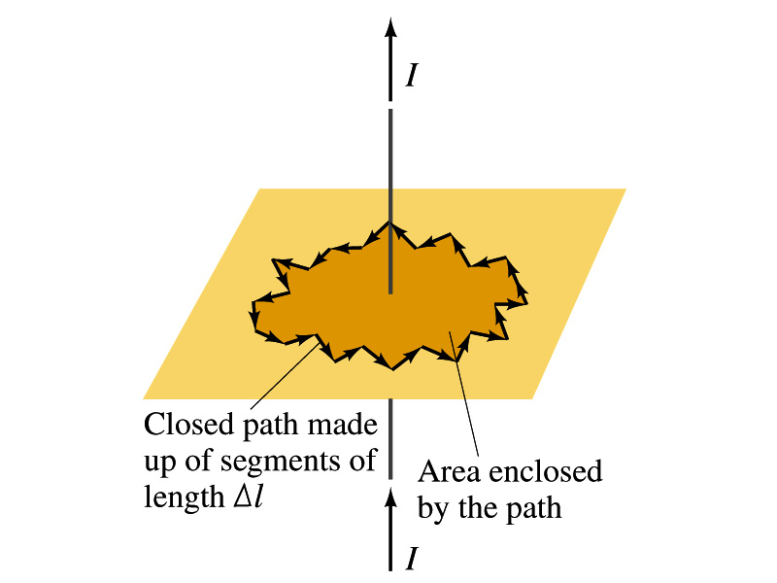
Ampére’s Law
Let’s consider an arbitrary closed path around the current as shown in the figure.
  Let’s split this path in small segments each of Δl long.
  The sum of all the products of the length of each segment and the component of B parallel to that segment is equal to μ₀ times the net current I_{encl} that passes through the surface enclosed by the path
  In the limit Δl →0, this relation becomes
Ampére’s Law
Looks very similar to a law in the electricity. Which law is it?
Gauss’ Law

Slide 11
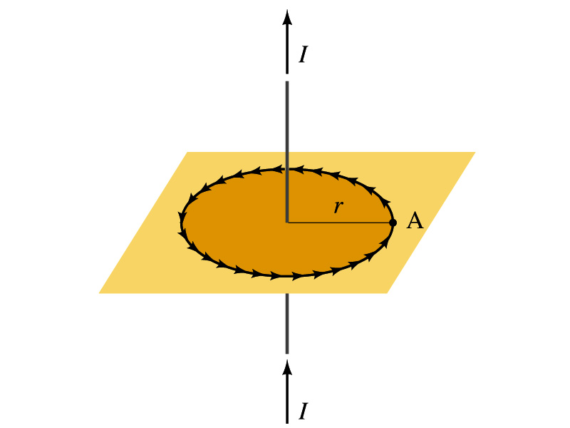
Verification of Ampére’s Law
Let’s find the magnitude of B at a distance r away from a long straight wire w/ current I
  This is a verification of Ampere’s Law
  We can apply Ampere’s law to a circular path of radius r.
Solving for B
  We just verified that Ampere’s law works in a simple case
  Experiments verified that it works for other cases too
  The importance of this formula, however, is that it provides means to relate magnetic field to current

Slide 12
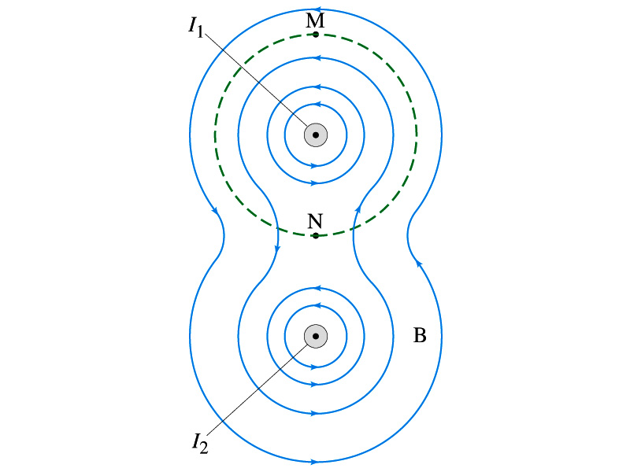
Verification of Ampére’s Law
Since Ampere’s law is valid in general, B in Ampere’s law is not just due to the current I_{encl}.
B is the field at each point in space along the chosen path due to all sources
  Including the current I enclosed by the path but also due to any other sources
  How do you obtain B in the figure at any point?
    Vector sum of the field by the two currents
  The result of the closed path integral in Ampere’s law for green dashed path is still μ₀I₁. Why?
  While B in each point along the path varies, the integral over the closed path still comes out the same whether there is the second wire or not.

Slide 13
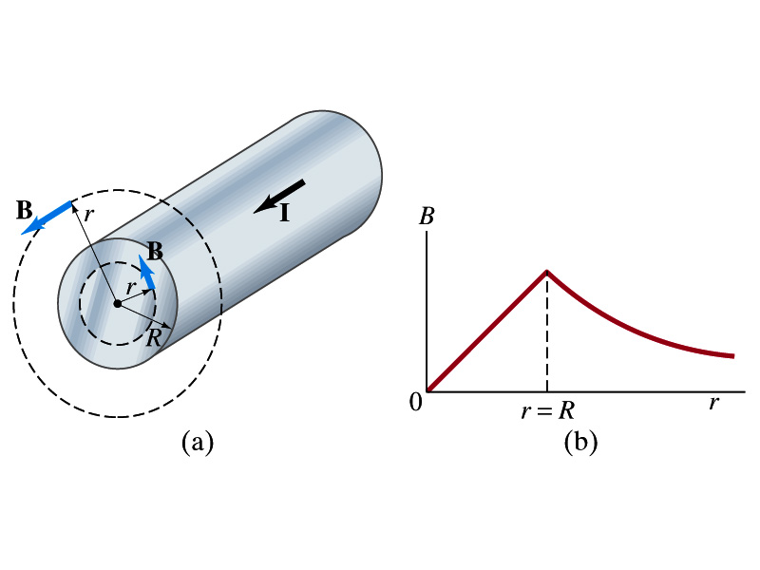
Example 28 – 6
Field inside and outside a wire. A long straight cylindrical wire conductor of radius R carries current I of uniform density in the conductor. Determine the magnetic field at (a) points outside the conductor (r>R) and (b) points inside the conductor (r<R). Assume that r, the radial distance from the axis, is much less than the length of the wire. (c) If R=2.0mm and I=60A, what is B at r=1.0mm, r=2.0mm and r=3.0mm?
Since the wire is long, straight and symmetric, the field should be the same at any point the same distance from the center of the wire.
Since B must be tangential to circles around the wire, let’s choose a circular path of the closed-path integral outside the wire (r>R). What is I_{encl}?
So using Ampere’s law
Solving for B

Slide 14
Example 28 – 6 cont’d
For r<R, the current inside the closed path is less than I. How much is it?
So using Ampere’s law
Solving for B
What does this mean?
The field is 0 at r=0 and increases linearly as a function of the distance from the center of the wire up to r=R then decreases as 1/r beyond the radius of the conductor.

Slide 15
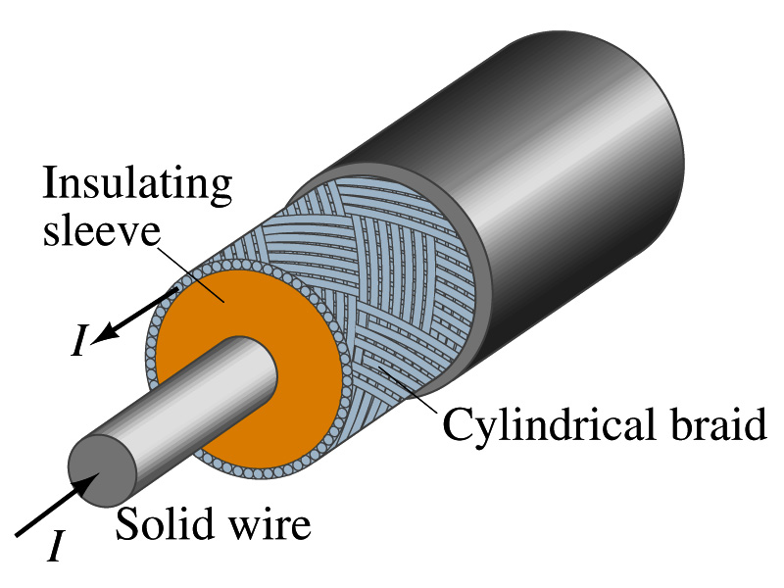
Example 28 – 7
Coaxial cable. A coaxial cable is a single wire surrounded by a cylindrical metallic braid, as shown in the figure. The two conductors are separated by an insulator. The central wire carries current to the other end of the cable, and the outer braid carries the return current and is usually considered ground. Describe the magnetic field (a) in the space between the conductors and (b) outside the cable.
(a) The magnetic field between the conductors is the same as the long, straight wire case since the current in the outer conductor does not impact the enclosed current.
(b) Outside the cable, we can draw a similar circular path, since we expect the field to have a circular symmetry. What is the sum of the total current inside the closed path?
So there is no magnetic field outside a coaxial cable. In other words, the coaxial cable self-shields. The outer conductor also shields against an external electric field. Cleaner signal and less noise.

Slide 16
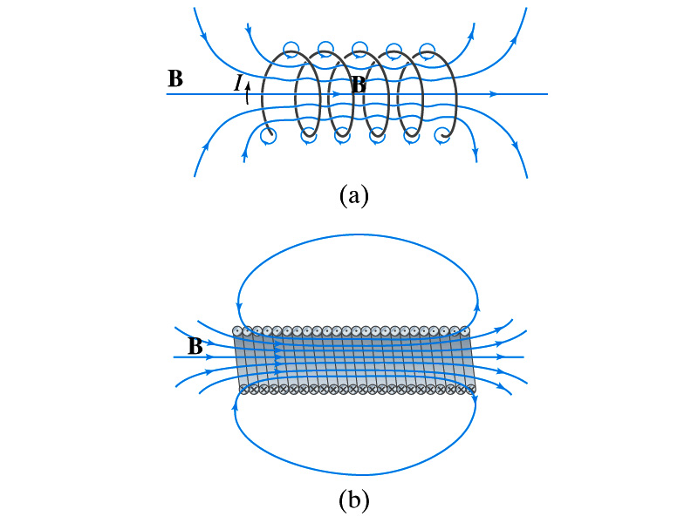
Solenoid and Its Magnetic Field
What is a solenoid?
  A long coil of wire consisting of many loops
  If the space between loops are wide
    The field near the wires are nearly circular
    Between any two wires, the fields due to each loop cancel
    Toward the center of the solenoid, the fields add up to give a field that can be fairly large and uniform
  For a long, densely packed loops
    The field is nearly uniform and parallel to the solenoid axes within the entire cross section
    The field outside the solenoid is very small compared to the field inside, except the ends
      The same number of field lines spread out to an open space
Solenoid Axis

Slide 17
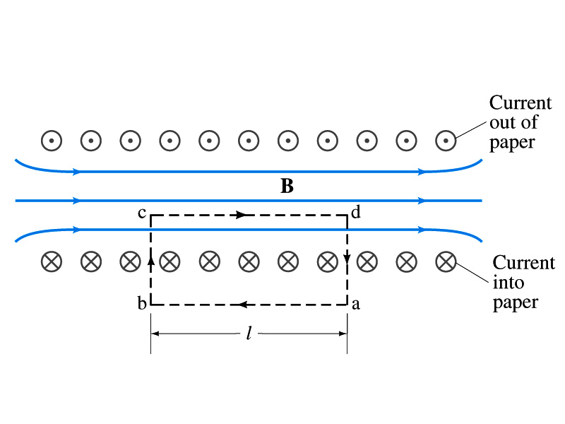
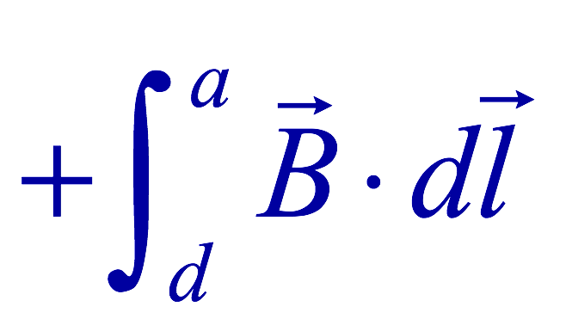
Solenoid Magnetic Field
Now let’s use Ampere’s law to determine the magnetic field inside a very long, densely packed solenoid
Let’s choose the path abcd, far away from the ends
  We can consider four segments of the loop for integral
  The field outside the solenoid is negligible. So the integral on a→b is 0.
  Now the field B is perpendicular to the bc and da segments. So these integrals become 0, also.

Slide 18
Solenoid Magnetic Field
  So the sum becomes:
  If the current I flows in the wire of the solenoid, the total current enclosed by the closed path is NI
    Where N is the number of loops (or turns of the coil) enclosed
  Thus Ampere’s law gives us
  If we let n=N/l be the number of loops per unit length, the magnitude of the magnetic field within the solenoid becomes
    B depends on the number of loops per unit length, n, and the current I
      Does not depend on the position within the solenoid but uniform inside it, like a bar magnet

Slide 19
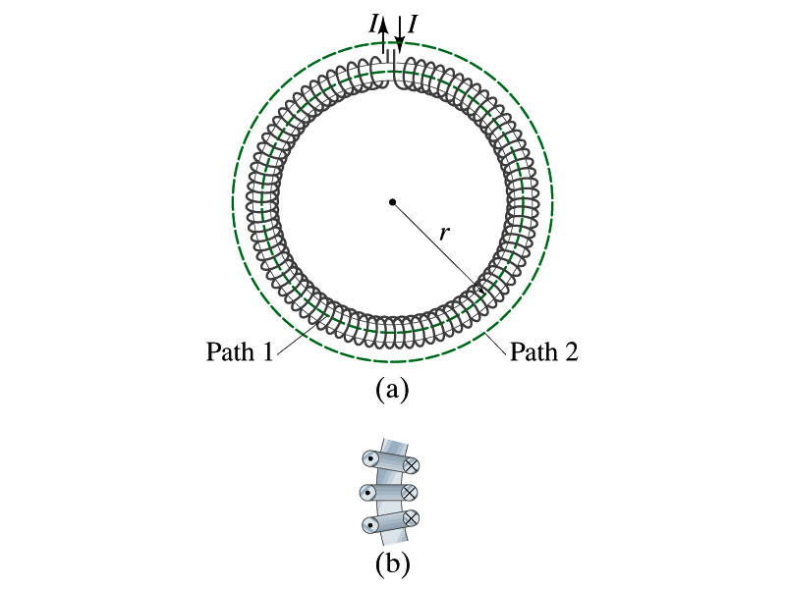
Example 28 – 10
Toroid. Use Ampere’s law to determine the magnetic field (a) inside and (b) outside a toroid, which is like a solenoid bent into the shape of a circle.
(a) How do you think the magnetic field lines inside the toroid look?
Since it is a bent solenoid, it should be a circle concentric with the toroid.
If we choose path of integration one of these field lines of radius r inside the toroid, path 1, to use the symmetry of the situation, making B the same at all points on the path, we obtain from Ampere’s law
Solving for B
So the magnetic field inside a toroid is not uniform. It is larger on the inner edge. However, the field will be uniform if the radius is large and the toroid is thin. The filed in this case is B = μ₀nI.
(b) Outside the solenoid, the field is 0 since the net enclosed current is 0.

Slide 20
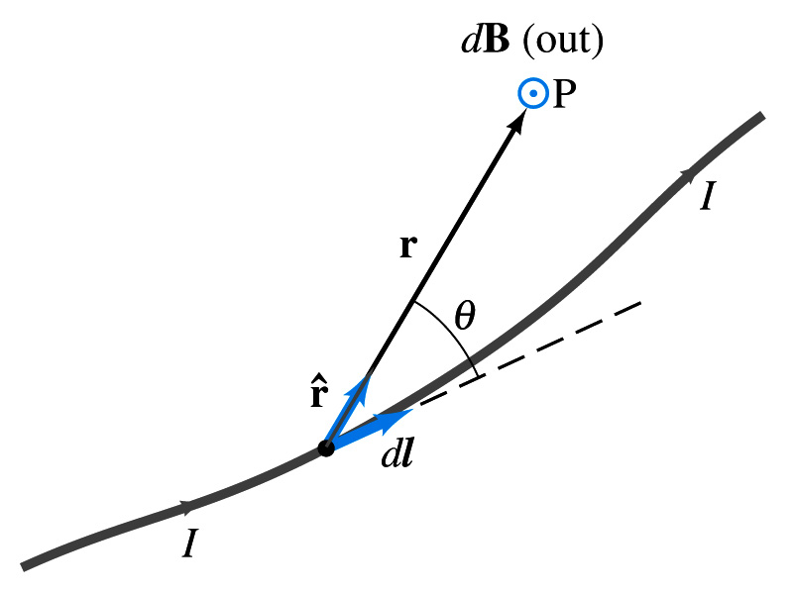
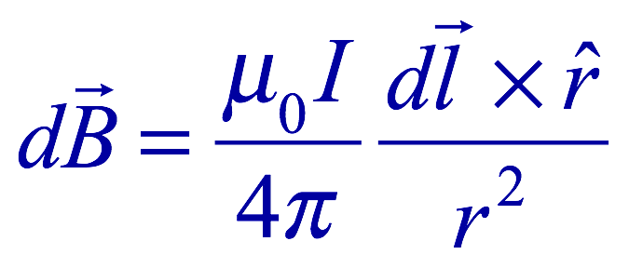
Biot-Savart Law
Ampere’s law is useful in determining magnetic field utilizing symmetry
But sometimes it is useful to have another method of using infinitesimal current segments for B field
  Jean Baptiste Biot and Feilx Savart developed a law that a current I flowing in any path can be considered as many infinitesimal current elements
  The infinitesimal magnetic field dB caused by the infinitesimal length dl that carries current I is
    r is the displacement vector from the element dl to the point P
    Biot-Savart law is the magnetic equivalent to Coulomb’s law
Biot-Savart Law
B field in Biot-Savart law is only that by the current, nothing else.

Slide 21
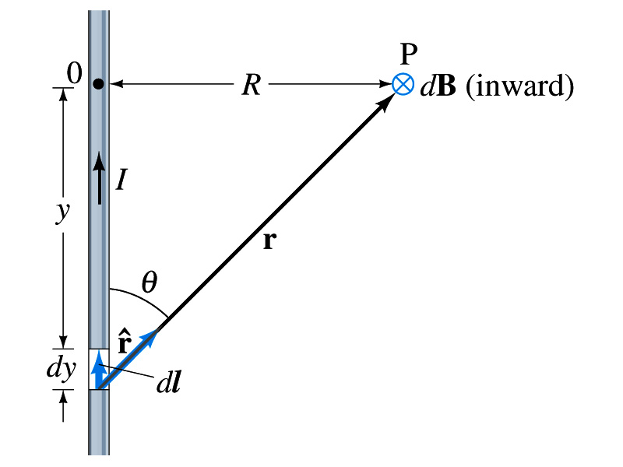
Example 28 – 11
B due to current I in a straight wire. For the field near a long straight wire carrying a current I, show that the Biot-Savarat law gives the same result as the simple long straight wire, B=μ₀I/2πR.
What is the direction of the field B at point P?
Going into the page.
All dB at point P has the same direction based on right-hand rule.
The magnitude of B using Biot-Savart law is
Where dy=dl and r²=R²+y² and since we obtain
Integral becomes
The same as the simple, long straight wire!! It works!!

Slide 22
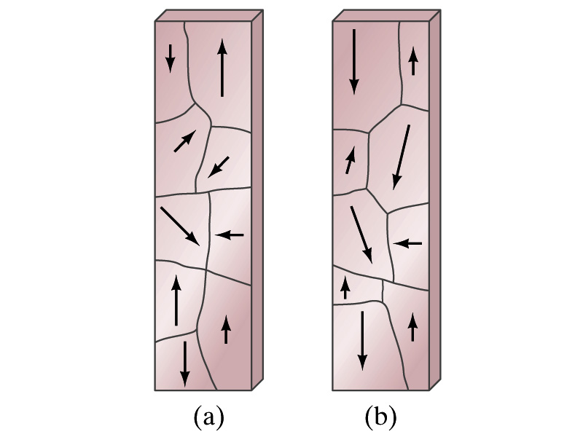
Magnetic Materials - Ferromagnetism
Iron is a material that can turn into a strong magnet
  This kind of material is called ferromagnetic material
In microscopic sense, ferromagnetic materials consist of many tiny regions called domains
  Domains are like little magnets usually smaller than 1mm in length or width
What do you think the alignment of domains are like when they are not magnetized?
  Randomly arranged
What if they are magnetized?
  The size of the domains aligned with the external magnetic field direction grows while those of the domains not aligned reduce
  This gives magnetization to the material
How do we demagnetize a bar magnet?
  Hit the magnet hard or heat it over the Curie temperature

Slide 23
B in Magnetic Materials
What is the magnetic field inside a solenoid?
  Magnetic field in a long solenoid is directly proportional to the current.
  This is valid only if air is inside the coil
What do you think will happen to B if we have something other than the air inside the solenoid?
  It will be increased dramatically, when the current flows
    Especially if a ferromagnetic material such as an iron is put inside, the field could increase by several orders of magnitude
Why?
  Since the domains in the iron aligns permanently by the external field.
  The resulting magnetic field is the sum of that due to current and due to the iron

Slide 24
B in Magnetic Materials
It is sometimes convenient to write the total field as the sum of two terms
  B₀ is the field due only to the current in the wire, namely the external field
    The field that would be present without a ferromagnetic material
  B_{M} is the additional field due to the ferromagnetic material itself; often B_{M}>>B₀
The total field in this case can be written by replacing μ₀ with another proportionality constant μ, the magnetic permeability of the material
  μ is a property of a magnetic material
  μ is not a constant but varies with the external field

Slide 25
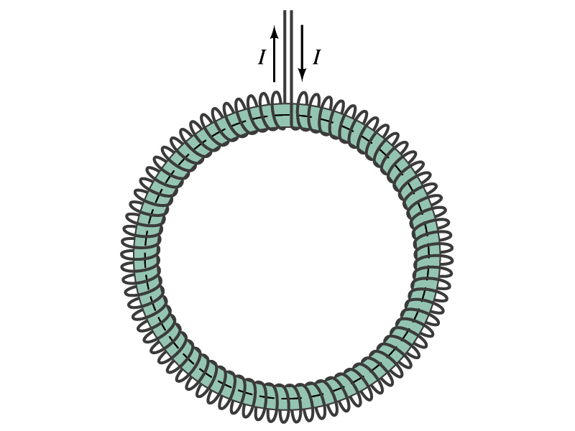
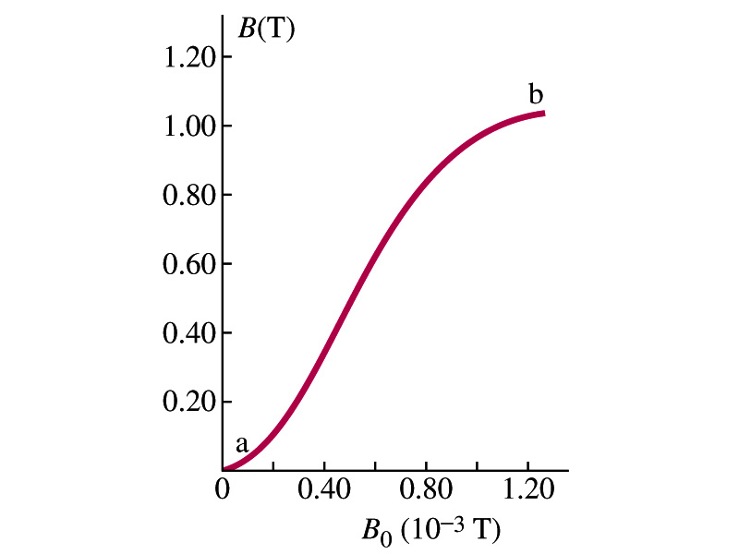
Hysteresis
Iron Core Toroid
What is a toroid?
  A solenoid bent into a shape
Toroid can be used for magnetic field measurement
  Why?
  Since it does not leak magnetic field outside of itself, it fully contains all the magnetic field created within it.
Consider an un-magnetized iron core toroid, without any current flowing in the wire
  What do you think will happen if the current slowly increases?
  B₀ increases linearly with the current.
  And B increases also but follows the curved line shown in the graph
  As B₀ increases, the domains become more aligned until nearly all are aligned (point b on the graph)
    The iron is said to be approaching saturation
    Point b is typically at 70% of the max

Slide 26
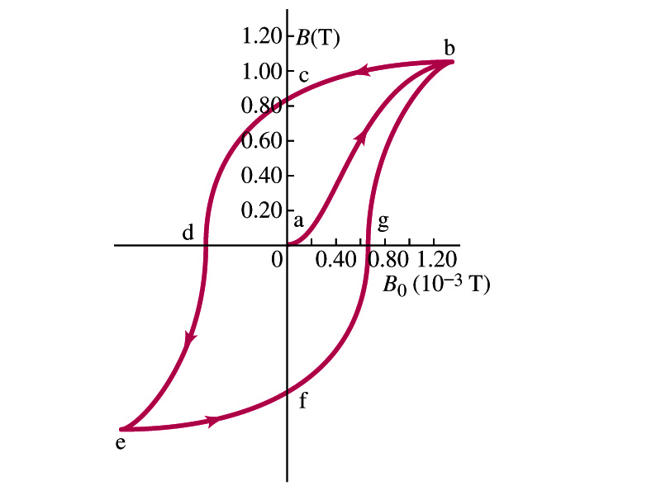
Hysteresis
What do you think will happen to B if the external field B₀ is reduced to 0 by decreasing the current in the coil?
  Of course it goes to 0!!
  Wrong! Wrong! Wrong! They do not go to 0. Why not?
  The domains do not completely return to random alignment state
Now if the current direction is reversed, the external magnetic field direction is reversed, causing the total field B pass 0, and the direction reverses to the opposite side
  If the current is reversed again, the total field B will increase but never goes through the origin
This kind of curve whose path does not retrace themselves and does not go through the origin is called the Hysteresis.

Slide 27
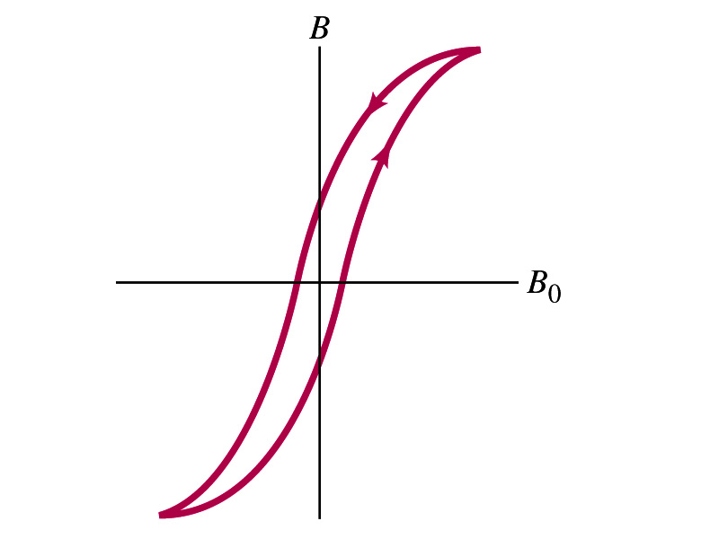
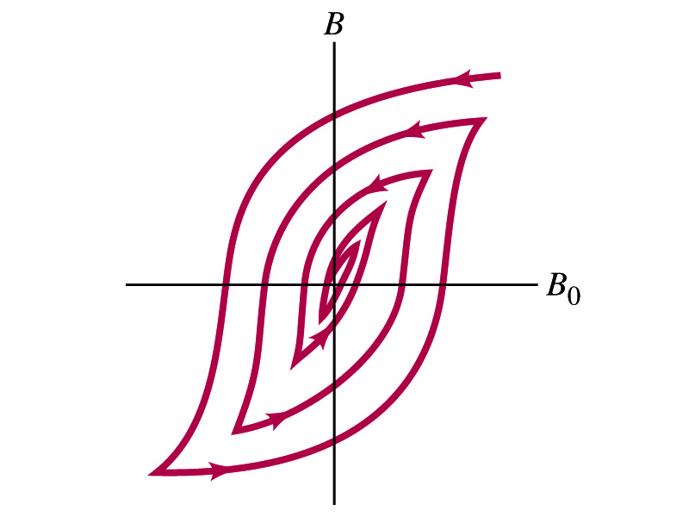
Magnetically Soft Material
In a hysteresis cycle, much energy is transformed to thermal energy. Why?
  Due to the microscopic friction between domains as they change directions to align with the external field
The energy dissipated in the hysteresis cycle is proportional to the area of the hysteresis loop
Ferromagnetic material with large hysteresis area is called magnetically hard while the small ones are called soft
  Which one do you think are preferred in electromagnets or transformers?
    Soft. Why?
    Since the energy loss is small and much easier to switch off the field
Then how do we demagnetize a ferromagnetic material?
  Keep repeating the Hysteresis loop, reducing the range of B₀.

Slide 28
Induced EMF
It has been discovered by Oersted and company in early 19th century that
  Magnetic field can be produced by the electric current
  Magnetic field can exert force on the electric charge
So if you were scientists at that time, what would you wonder?
  Yes, you are absolutely right! You would wonder if the magnetic field can create the electric current.
  An American scientist Joseph Henry and an English scientist Michael Faraday independently found that it was possible
    Though, Faraday was given the credit since he published his work before Henry did
      He also did a lot of detailed studies on magnetic induction

Slide 29
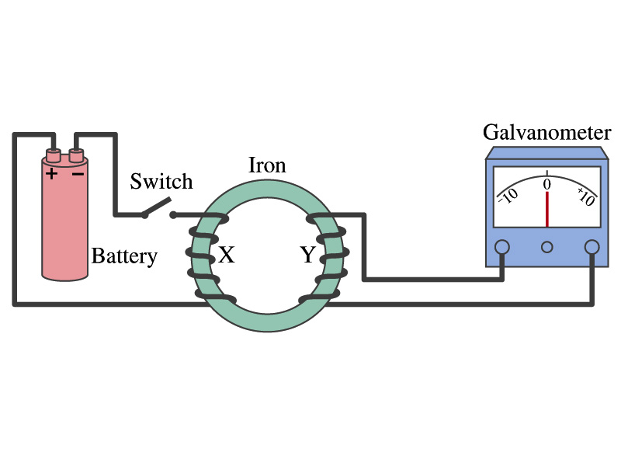
Electromagnetic Induction
Faraday used an apparatus below to show that magnetic field can induce current
Despite his hope he did not see steady current induced on the other side when the switch is thrown
But he did see that the needle on the Galvanometer turns strongly when the switch is initially thrown and is opened
  When the magnetic field through coil Y changes, a current flows as if there were a source of emf
Thus he concluded that an induced emf is produced by a changing magnetic field ➔ Electromagnetic Induction

Slide 30
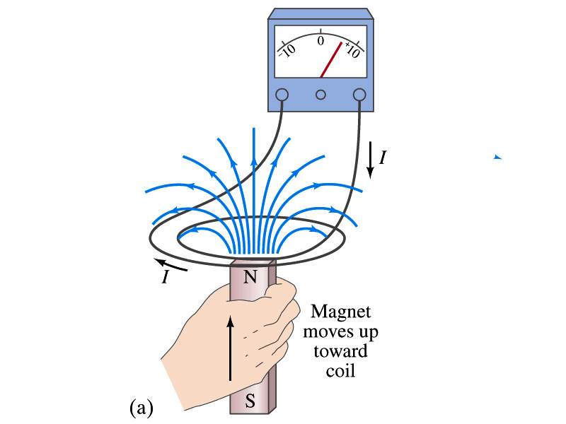
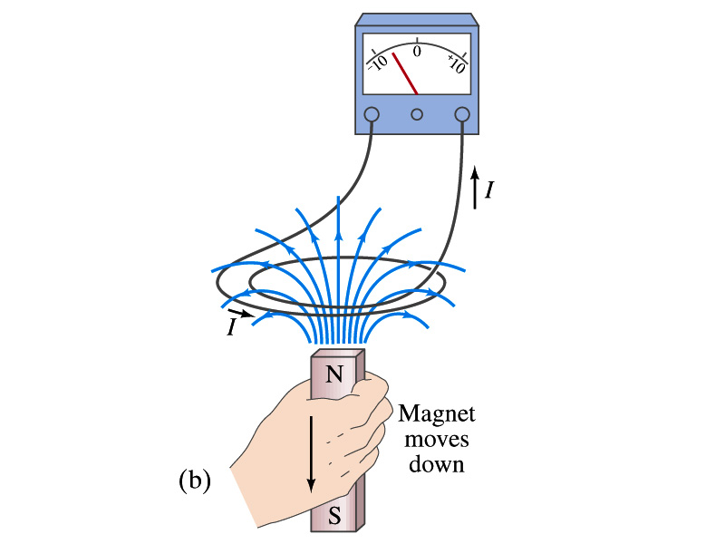
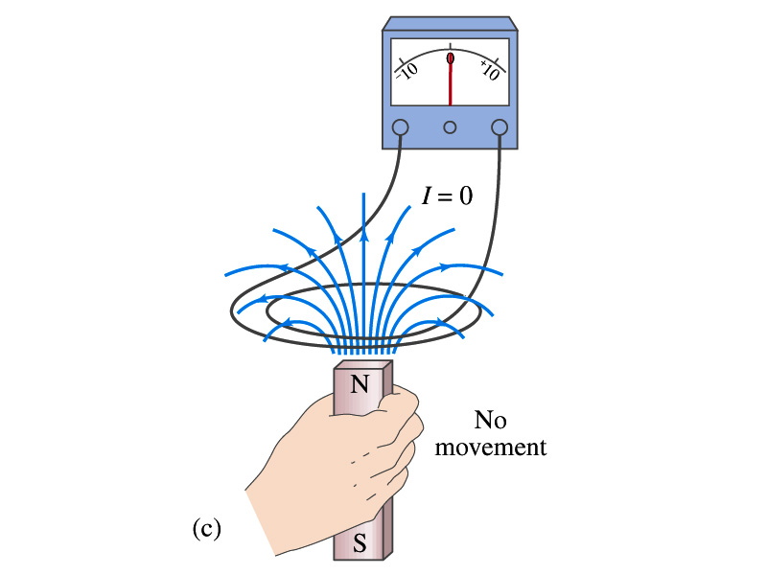
Electromagnetic Induction
Further studies on electromagnetic induction taught
  If a magnet is moved quickly into a coil of wire, a current is induced in the wire.
  If a magnet is removed from the coil, a current is induced in the wire in the opposite direction
  By the same token, the current can also be induced if the magnet stays put but the coil moves toward or away from the magnet
  Current is also induced if the coil rotates.
In other words, it does not matter whether the magnet or the coil moves. It is the relative motion that counts.

Slide 31
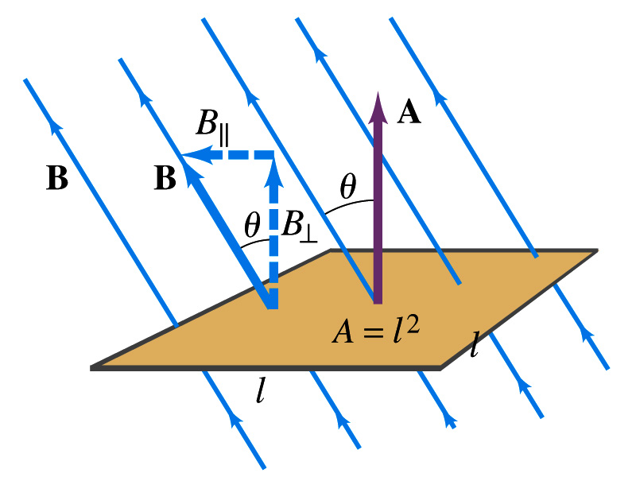
Magnetic Flux
So what do you think is the induced emf proportional to?
  The rate of changes of the magnetic field?
    the higher the changes the higher the induction
  Not really, it rather depends on the rate of change of the magnetic flux, Φ_{B}.
  Magnetic flux is defined as (just like the electric flux)
    θ is the angle between B and the area vector A whose direction is perpendicular to the face of the loop based on the right-hand rule
  What kind of quantity is the magnetic flux?
    Scalar. Unit?
    or weber
If the area of the loop is not simple or B is not uniform, the magnetic flux can be written as

Slide 32
Faraday’s Law of Induction
In terms of magnetic flux, we can formulate Faraday’s findings
  The emf induced in a circuit is equal to the rate of change of magnetic flux through the circuit
If the circuit contains N closely wrapped loops, the total induced emf is the sum of emf induced in each loop
  Why negative?
    Has got a lot to do with the direction of induced emf…
Faraday’s Law of Induction

Slide 33
Lenz’s Law
It is experimentally found that
  An induced emf gives rise to a current whose magnetic field opposes the original change in flux ➔ This is known as Lenz’s Law
  In other words, an induced emf is always in a direction that opposes the original change in flux that caused it.
  We can use Lenz’s law to explain the following cases in the figures
    When the magnet is moving into the coil
      Since the external flux increases, the field inside the coil takes the opposite direction to minimize the change and causes the current to flow clockwise
    When the magnet is moving out
      Since the external flux decreases, the field inside the coil takes the opposite direction to compensate the loss, causing the current to flow counter-clockwise
Which law is Lenz’s law result of?
  Energy conservation. Why?

Slide 34
Induced EMF
It has been discovered by Oersted and company in early 19th century that
  Magnetic field can be produced by the electric current
  Magnetic field can exert force on the electric charge
So if you were scientists at that time, what would you wonder?
  Yes, you are absolutely right! You would wonder if the magnetic field can create the electric current.
  An American scientist Joseph Henry and an English scientist Michael Faraday independently found that it was possible
    Though, Faraday was given the credit since he published his work before Henry did
      He also did a lot of detailed studies on magnetic induction

Slide 35
Electromagnetic Induction
Faraday used an apparatus below to show that magnetic field can induce current
Despite his hope he did not see steady current induced on the other side when the switch is thrown
But he did see that the needle on the Galvanometer turns strongly when the switch is initially thrown and is opened
  When the magnetic field through coil Y changes, a current flows as if there were a source of emf
Thus he concluded that an induced emf is produced by a changing magnetic field ➔ Electromagnetic Induction

Slide 36
Electromagnetic Induction
Further studies on electromagnetic induction taught
  If a magnet is moved quickly into a coil of wire, a current is induced in the wire.
  If a magnet is removed from the coil, a current is induced in the wire in the opposite direction
  By the same token, the current can also be induced if the magnet stays put but the coil moves toward or away from the magnet
  Current is also induced if the coil rotates.
In other words, it does not matter whether the magnet or the coil moves. It is the relative motion that counts.

Slide 37
Magnetic Flux
So what do you think is the induced emf proportional to?
  The rate of changes of the magnetic field?
    the higher the changes the higher the induction
  Not really, it rather depends on the rate of change of the magnetic flux, Φ_{B}.
  Magnetic flux is defined as (just like the electric flux)
    θ is the angle between B and the area vector A whose direction is perpendicular to the face of the loop based on the right-hand rule
  What kind of quantity is the magnetic flux?
    Scalar. Unit?
    or weber
If the area of the loop is not simple or B is not uniform, the magnetic flux can be written as

Slide 38
Faraday’s Law of Induction
In terms of magnetic flux, we can formulate Faraday’s findings
  The emf induced in a circuit is equal to the rate of change of magnetic flux through the circuit
If the circuit contains N closely wrapped loops, the total induced emf is the sum of emf induced in each loop
  Why negative?
    Has got a lot to do with the direction of induced emf…
Faraday’s Law of Induction

Slide 39
Lenz’s Law
It is experimentally found that
  An induced emf gives rise to the current whose magnetic field opposes the original change in flux ➔ This is known as Lenz’s Law
  In other words, an induced emf is always in the direction that opposes the original change in flux that caused it.
  We can use Lenz’s law to explain the following cases in the figures
    When the magnet is moving into the coil
      Since the external flux increases, the field inside the coil takes the opposite direction to minimize the change and causes the current to flow clockwise
    When the magnet is moving out
      Since the external flux decreases, the field inside the coil takes the opposite direction to compensate the loss, causing the current to flow counter-clockwise
Which law is Lenz’s law result of?
  Energy conservation. Why?

Slide 40
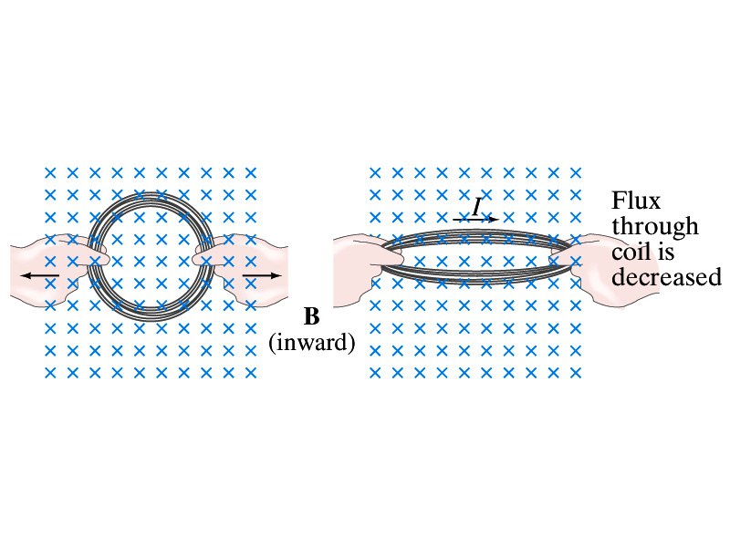
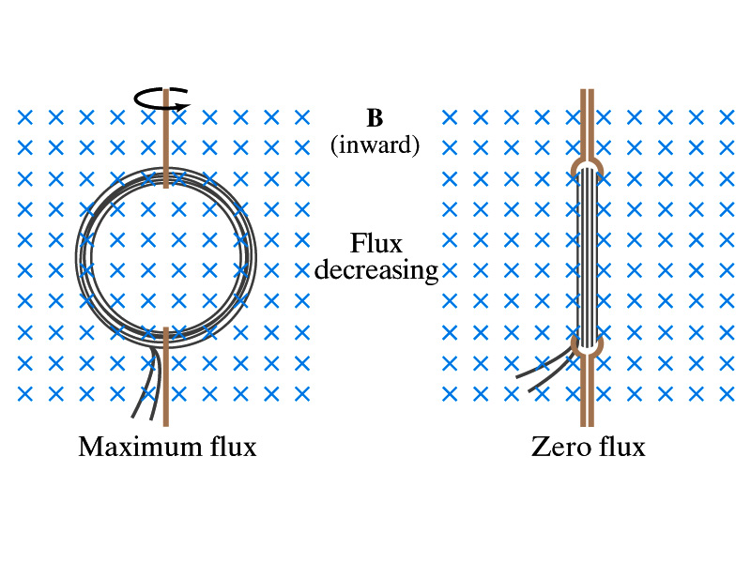
Induction of EMF
How can we induce emf?
Let’s look at the formula for the magnetic flux
What do you see? What are the things that can change with time to result in change of magnetic flux?
  Magnetic field
  The area of the loop
  The angle θ between the field and the area vector

Slide 41
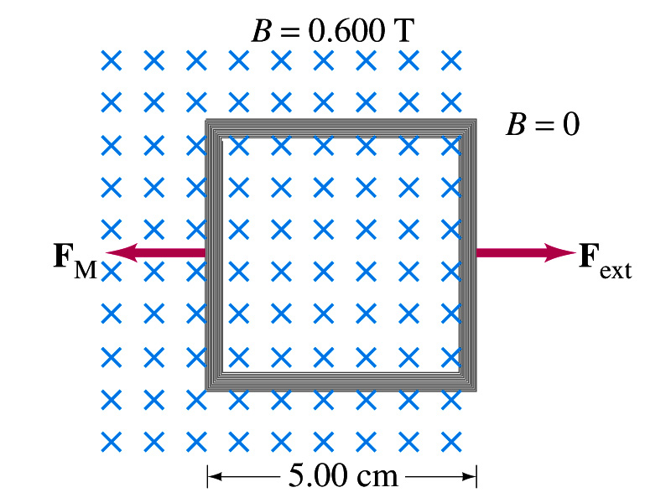
Example 29 – 5
Pulling a coil from a magnetic field. A square coil of wire with side 5.00cm contains 100 loops and is positioned perpendicular to a uniform 0.600-T magnetic field. It is quickly and uniformly pulled from the field (moving perpendicular to B) to a region where B drops abruptly to zero. At t=0, the right edge of the coil is at the edge of the field. It takes 0.100s for the whole coil to reach the field-free
region. Find (a) the rate of change in flux through the coil, (b) the emf and the current induced, and (c) how much energy is dissipated in the coil if its resistance is 100Ω. (d) what was the average force required?
What should be computed first?
The initial flux at t=0.
The flux at t=0 is
The change of flux is
Thus the rate of change of the flux is

Slide 42
Example 29 – 5, cnt’d
Thus the total emf induced in this period is
The induced current in this period is
Which direction would the induced current flow?
Clockwise
The total energy dissipated is
Force for each coil is
Force for N coil is

Slide 43
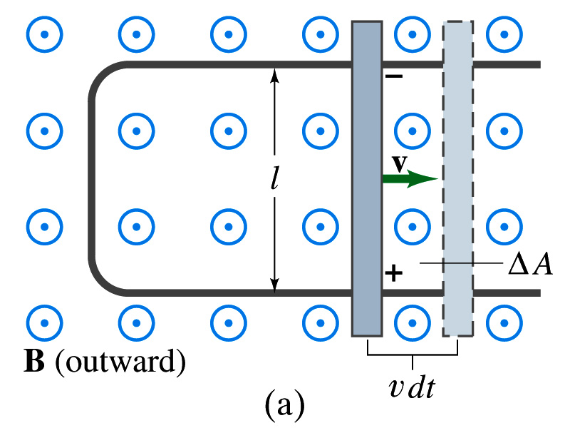
EMF Induced on a Moving Conductor
Another way of inducing emf is using a U shaped conductor with a movable rod resting on it.
As the rod moves at a speed v, it travels vdt in time dt, changing the area of the loop by dA=lvdt.
Using Faraday’s law, the induced emf for this loop is
  This equation is valid as long as B, l and v are perpendicular to each other. What do we do if not?
    Use the scalar product of vector quantities
An emf induced on a conductor moving in a magnetic field is called a motional emf

Slide 44
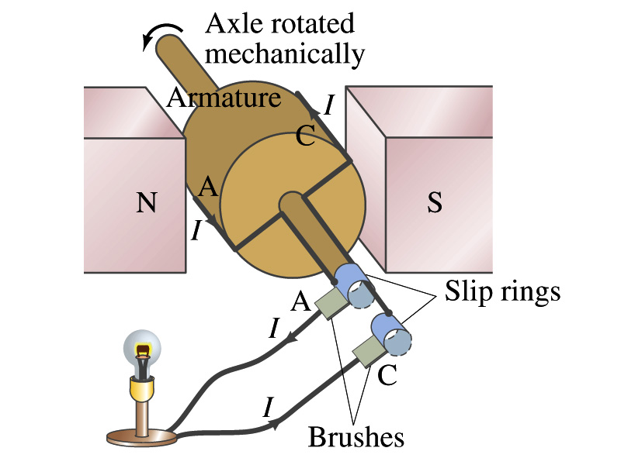
Electric Generators
What does a generator do?
  Transforms mechanical energy into the electrical energy
  What does this look like?
    An inverse of an electric motor which transforms electrical energy to mechanical energy
  An electric generator is also called a dynamo
Whose law does the generator based on?
  Faraday’s law of induction

Slide 45
How does an Electric Generator work?
An electric generator consists of
  Many coils of wires wound on an armature that can rotate by mechanical means in a magnetic field
An emf is induced in the rotating coil
Electric current is the output of a generator
Which direction does the output current flow when the armature rotates counterclockwise?
  The conventional current flows outward on wire A toward the brush
  After half the revolution the wire A will be where the wire C is and the current flow on A is reversed
Thus the current produced is alternating its direction

Slide 46
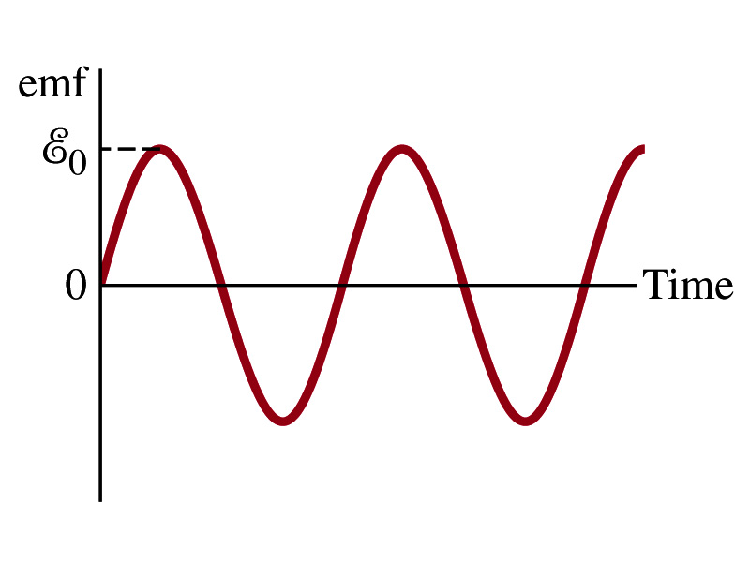
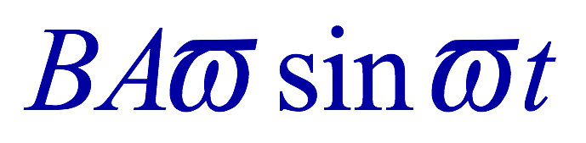
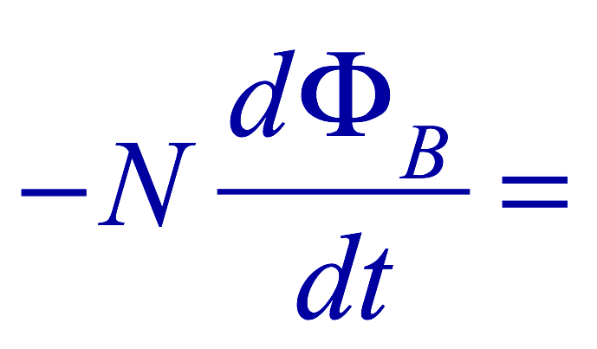

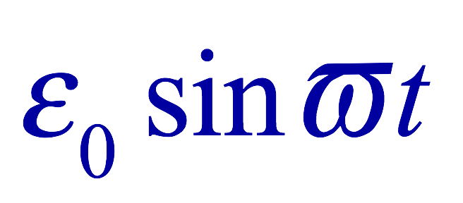
How does an Electric Generator work?
Let’s assume the loop is rotating in a uniform B field w/ a constant angular velocity ω. The induced emf is
What is the variable that changes above?
  The angle θ. What is dθ/dt?
    The angular speed ω.
  So θ=θ₀+ωt
  If we choose θ₀=0, we obtain
  If the coil contains N loops:
  What is the shape of the output?
    Sinusoidal w/ the amplitude ε₀=NBAω
USA frequency is 60Hz. Europe is at 50Hz
  Most the U.S. power is generated at steam plants

Slide 47
Example 29 – 9
An AC generator. The armature of a 60-Hz AC generator rotates in a 0.15-T magnetic field. If the area of the coil is 2.0x10⁻²m², how many loops must the coil contain if the peak output is to be ε₀=170V?
The maximum emf of a generator is
Solving for N
Since
We obtain

Slide 48
US Electricity Sources

Slide 49
US Electric E Consumption by Users
US Energy Information Administration http://www.eia.gov/electricity/

Slide 50
The World Energy Consumption
In 2013, total worldwide energy consumption was 567 EJ (567×10¹⁸ J=157 PWh)➔ expected >1000EJ by 2050
  Equivalent to an average energy consumption rate of 18 terawatts (1.8×10¹³ W)
  US uses 39.1 PWh (1.38kWh/person, as of 2014)
The potential for renewable energy
  solar energy 1600 EJ (444,000 TWh)
  wind power 600 EJ (167,000 TWh)
  geothermal energy 500 EJ (139,000 TWh),
  biomass 250 EJ (70,000 TWh)
  hydropower 50 EJ (14,000 TWh) an
  ocean energy 1 EJ (280 TWh)
  Read this paper if you want to learn more

Slide 51
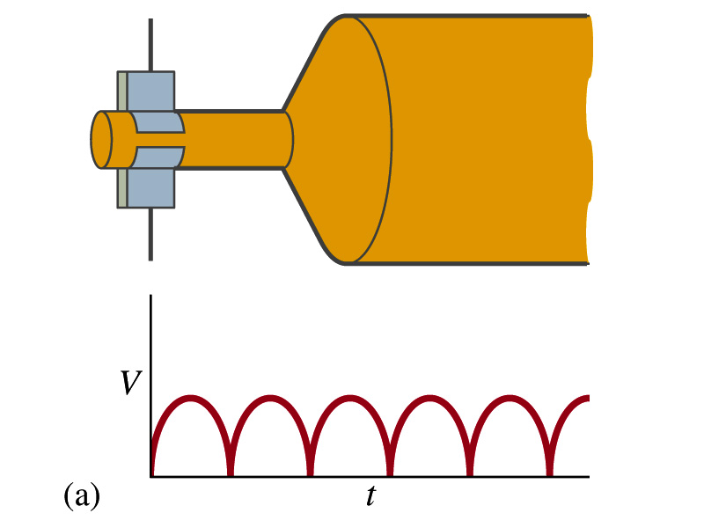
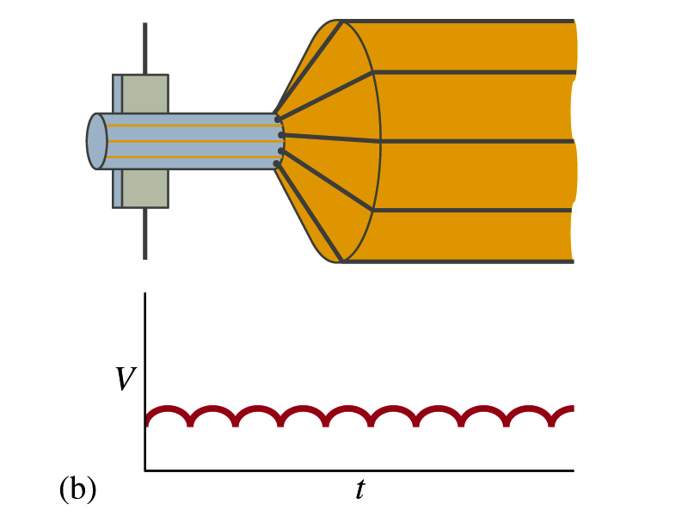
A DC Generator
A DC generator is almost the same as an AC generator except the slip rings are replaced by split-ring commutators
Output can be smoothed out by placing a capacitor in parallel to the output
  More commonly done using many armature windings
Smooth output using many windings

Slide 52
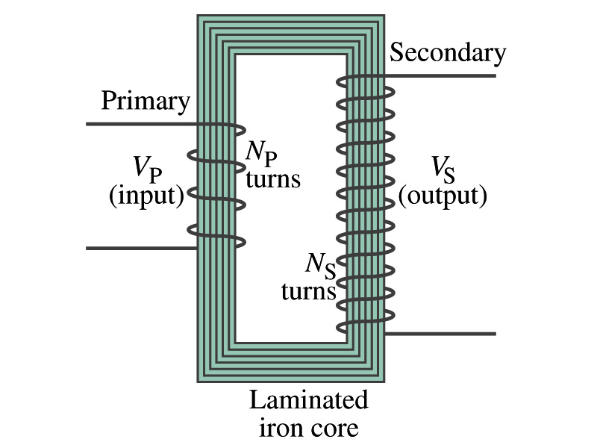
Transformer
What is a transformer?
  A device for increasing or decreasing an AC voltage
  A few examples?
    TV sets to provide the high voltage to picture tubes, portable electronic device converters, transformers on the pole, etc
A transformer consists of two coils of wires known as the primary and the secondary
  The two coils can be interwoven or linked by a laminated soft iron core to reduce losses due to Eddy current
Transformers are designed so that all magnetic flux produced by the primary coil pass through the secondary

Slide 53
How does a transformer work?
When an AC voltage is applied to the primary, the changing B it produces will induce voltage of the same frequency in the secondary wire
So how would we make the voltage different?
  By varying the number of loops in each coil
  From Faraday’s law, the induced emf in the secondary is
  The input primary voltage is
  Since dΦ_{B}/dt is the same, we obtain
Transformer Equation

Slide 54
Transformer Equation
The transformer equation does not work for DC current
  Since there is no change of magnetic flux!!
If N_{S}>N_{P}, the output voltage is greater than the input so it is called a step-up transformer while N_{S}<N_{P} is called step-down transformer
Now, it looks like energy conservation is violated since we can get more emf from smaller ones, right?
  Wrong! Wrong! Wrong! Energy is always conserved!
  A well designed transformer can be more than 99% efficient
  The power output is the same as the input:
The output current for a step-up transformer will be lower than the input, while it is larger for a step-down x-former than the input.

Slide 55
Example for A Transformer
Portable radio transformer. A transformer for home use of a portable radio reduces 120-V AC to 9.0V AC. The secondary contains 30 turns, and the radio draws 400mA. Calculate (a) the number of turns in the primary (b) the current in the primary and (c) the power transformed.
(a) What kind of a transformer is this?
A step-down x-former
Since
We obtain
We obtain
(b) Also from the transformer equation
(c) Thus the power transformed is
How about the input power?
The same assuming 100% efficiency.

Slide 56
Example 29 – 13: Power Transmission
Transmission lines. An average of 120kW of electric power is sent to a small town from a power plant 10km away. The transmission lines have a total resistance of 0.4Ω. Calculate the power loss if the power is transmitted at (a) 240V and (b) 24,000V.
We cannot use P=V²/R since we do not know the voltage along the transmission line. We, however, can use P=I²R.
(a) If 120kW is sent at 240V, the total current is
Thus the power loss due to transmission line is
(b) If 120kW is sent at 24,000V, the total current is
Thus the power loss due to transmission line is
The higher the transmission voltage, the smaller the current, causing less loss of energy. This is why power is transmitted w/ HV, as high as 170kV.

Slide 57
Electric Field due to Magnetic Flux Change
When the electric current flows through a wire, there is an electric field in the wire that moves electrons
We saw, however, that changing magnetic flux induces a current in the wire. What does this mean?
  There must be an electric field induced by the changing magnetic flux.
In other words, a changing magnetic flux produces an electric field
This results apply not just to wires but to any conductor or any region in space

Slide 58
Generalized Form of Faraday’s Law
Recall the relationship between the electric field and the potential difference
Induced emf in a circuit is equal to the work done per unit charge by the electric field
So we obtain
The integral is taken around a path enclosing the area through which the magnetic flux Φ_{Β} is changing.

Slide 59
Inductance
Changing magnetic flux through a circuit induce an emf in that circuit
An electric current produces a magnetic field
From these, we can deduce
  A changing current in one circuit must induce an emf in a nearby circuit ➔ Mutual inductance
  Or induce an emf in itself ➔ Self inductance

Slide 60
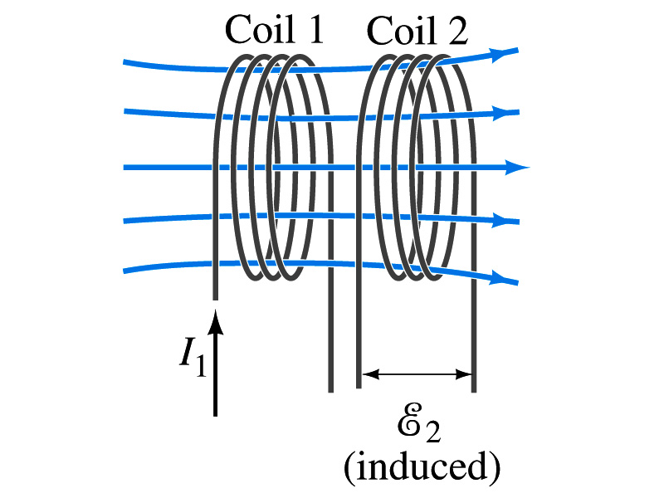
Mutual Inductance
If two coils of wire are placed near each other, a changing current in one will induce an emf in the other.
What is the induced emf, ε₂, in coil2 proportional to?
  Rate of the change of the magnetic flux passing through it
This flux is due to current I₁ in coil 1
If Φ₂₁ is the magnetic flux in each loop of coil2 created by coil1 and N₂ is the number of closely packed loops in coil2, then N₂Φ₂₁ is the total flux passing through coil2.
If the two coils are fixed in space, N₂Φ₂₁ is proportional to the current I₁ in coil 1, .
The proportionality constant for this is called the Mutual Inductance and defined as .
The emf induced in coil2 due to the changing current in coil1 is

Slide 61
Mutual Inductance
The mutual induction of coil2 with respect to coil1, M₂₁,
  is a constant and does not depend on I₁.
  depends only on “geometric” factors such as the size, shape, number of turns and relative position of the two coils, and whether a ferromagnetic material is present
    The farther apart the two coils are the less flux can pass through coil, 2, so M₂₁ will be less.
  In most cases the mutual inductance is determined experimentally
Conversely, the changing current in coil2 will induce an emf in coil1
  M₁₂ is the mutual inductance of coil1 with respect to coil2 and M₁₂ = M₂₁
  We can put M=M₁₂=M₂₁ and obtain
  SI unit for mutual inductance is henry (H)
What? Does this make sense?

Slide 62
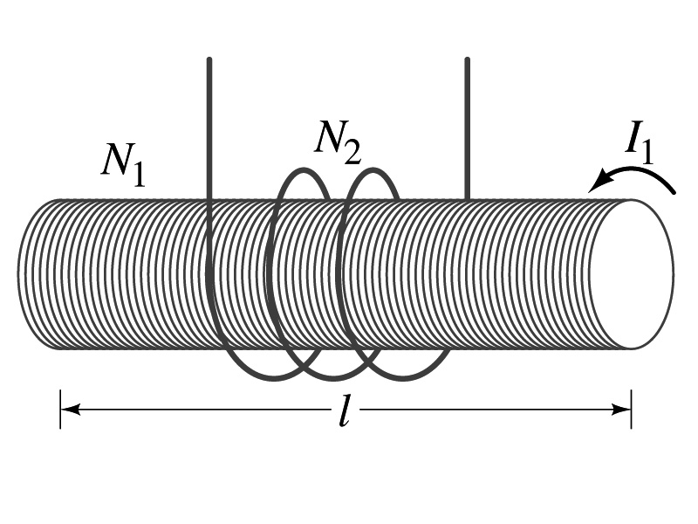
Example 30 – 1
Solenoid and coil. A long thin solenoid of length l and cross-sectional area A contains N₁ closely packed turns of wire. Wrapped around it is an insulated coil of N₂ turns. Assuming all the flux from coil 1 (the solenoid) passes through coil 2, calculate the mutual inductance.
First we need to determine the flux produced by the solenoid.
What is the magnetic field inside the solenoid?
Since the solenoid is closely packed, we can assume that the field lines are perpendicular to the surface area of the coils. Thus the flux through coil 2 is
Thus the mutual inductance of coil 2 is
Note that M₂₁ only depends on geometric factors!

Slide 63
Self Inductance
The concept of inductance applies to a single isolated coil of N turns. How does this happen?
  When a changing current passes through a coil
  A changing magnetic flux is produced inside the coil
  The changing magnetic flux in turn induces an emf in the same coil
  This emf opposes the change in flux. Whose law is this?
    Lenz’s law
What would this do?
  When the current through the coil is increasing?
    The increasing magnetic flux induces an emf that opposes the original current
    This tends to impedes its increase, trying to maintain the original current
  When the current through the coil is decreasing?
    The decreasing flux induces an emf in the same direction as the current
    This tends to increase the flux, trying to maintain the original current

Slide 64
Self Inductance
Since the magnetic flux Φ_{B} passing through N turn coil is proportional to current I in the coil,
We define self-inductance, L:
The induced emf in a coil of self-inductance L is
  What is the unit for self-inductance?
What does magnitude of L depend on?
  Geometry and the presence of a ferromagnetic material
Self inductance can be defined for any circuit or part of a circuit
Self Inductance

Slide 65
So what in the world is the Inductance?
It is an impediment onto the electrical current due to the existence of changing flux
So what?
In other words, it behaves like a resistance to the varying current, such as AC, that causes the constant change of flux
But it also provides means to store energy, just like the capacitance

Slide 66
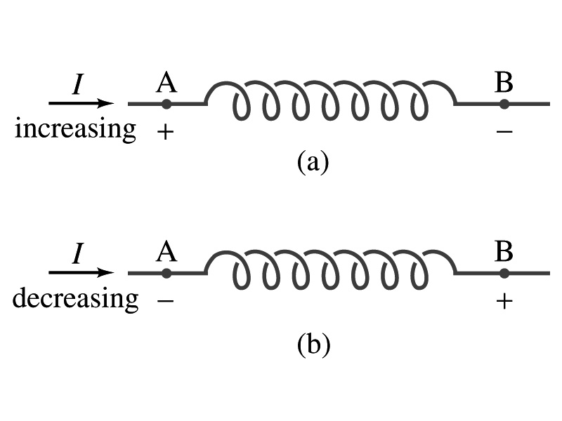
Inductor
An electrical circuit always contains some inductance but is normally negligibly small
  If a circuit contains a coil of many turns, it could have large inductance
A coil that has significant inductance, L, is called an inductor and is express with the symbol
  Precision resisters are normally wire wound
    Would have both resistance and inductance
    The inductance can be minimized by winding the wire back on itself in opposite direction to cancel magnetic flux
    This is called a “non-inductive winding”
If an inductor has negligible resistance, inductance controls the changing current
For an AC current, the greater the inductance the less the AC current
  An inductor thus acts like a resistor to impede the flow of alternating current (not to DC, though. Why?)
  The quality of an inductor is indicated by the term reactance or impedance

Slide 67
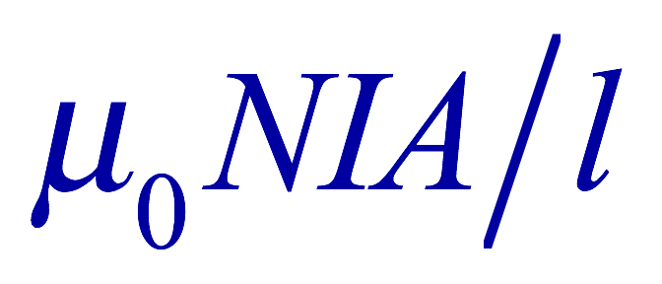
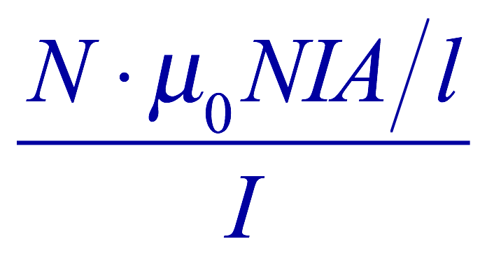
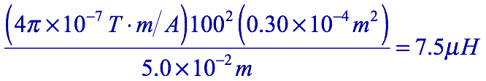
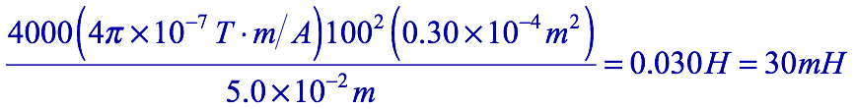
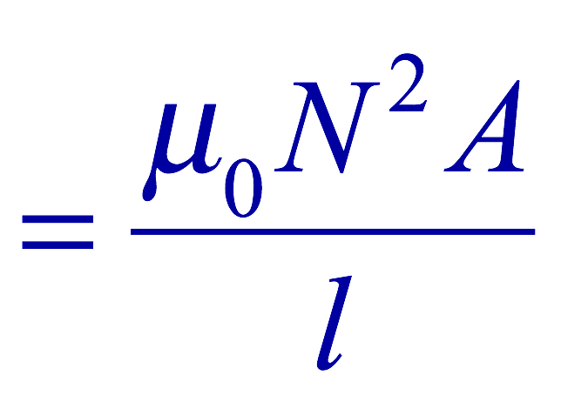
Example 30 – 3
Solenoid inductance. (a) Determine the formula for the self inductance L of a tightly wrapped solenoid ( a long coil) containing N turns of wire in its length l and whose cross-sectional area is A. (b) Calculate the value of L if N=100, l=5.0cm, A=0.30cm² and the solenoid is air filled. (c) calculate L if the solenoid has an iron core with μ=4000μ₀.
What is the magnetic field inside a solenoid?
The flux is, therefore,
Using the formula for self inductance:
(b) Using the formula above
(c) The magnetic field with an iron core solenoid is

Slide 68
Electric Field due to Magnetic Flux Change
When the electric current flows through a wire, there is an electric field in the wire that moves electrons
We saw, however, that changing magnetic flux induces a current in the wire. What does this mean?
  There must be an electric field induced by the changing magnetic flux.
In other words, a changing magnetic flux produces an electric field
This results apply not just to wires but to any conductor or any region in space

Slide 69
Generalized Form of Faraday’s Law
Recall the relationship between the electric field and the potential difference
Induced emf in a circuit is equal to the work done per unit charge by the electric field
So we obtain
The integral is taken around a path enclosing the area through which the magnetic flux Φ_{Β} is changing.

Slide 70
Inductance
Changing magnetic flux through a circuit induce an emf in that circuit
An electric current produces a magnetic field
From these, we can deduce
  A changing current in one circuit must induce an emf in a nearby circuit ➔ Mutual inductance
  Or induce an emf in itself ➔ Self inductance

Slide 71
Mutual Inductance
If two coils of wire are placed near each other, a changing current in one will induce an emf in the other.
What is the induced emf, ε₂, in coil2 proportional to?
  Rate of the change of the magnetic flux passing through it
This flux is due to current I₁ in coil 1
If Φ₂₁ is the magnetic flux in each loop of coil2 created by coil1 and N₂ is the number of closely packed loops in coil2, then N₂Φ₂₁ is the total flux passing through coil2.
If the two coils are fixed in space, N₂Φ₂₁ is proportional to the current I₁ in coil 1, .
The proportionality constant for this is called the Mutual Inductance and defined as .
The emf induced in coil2 due to the changing current in coil1 is

Slide 72
Mutual Inductance
The mutual induction of coil2 with respect to coil1, M₂₁,
  is a constant and does not depend on I₁.
  depends only on “geometric” factors such as the size, shape, number of turns and relative position of the two coils, and whether a ferromagnetic material is present
    The farther apart the two coils are the less flux can pass through coil, 2, so M₂₁ will be less.
  In most cases the mutual inductance is determined experimentally
Conversely, the changing current in coil2 will induce an emf in coil1
  M₁₂ is the mutual inductance of coil1 with respect to coil2 and M₁₂ = M₂₁
  We can put M=M₁₂=M₂₁ and obtain
  SI unit for mutual inductance is henry (H)
What? Does this make sense?

Slide 73
Example 30 – 1
Solenoid and coil. A long thin solenoid of length l and cross-sectional area A contains N₁ closely packed turns of wire. Wrapped around it is an insulated coil of N₂ turns. Assuming all the flux from coil 1 (the solenoid) passes through coil 2, calculate the mutual inductance.
First we need to determine the flux produced by the solenoid.
What is the magnetic field inside the solenoid?
Since the solenoid is closely packed, we can assume that the field lines are perpendicular to the surface area of the coils. Thus the flux through coil 2 is
Thus the mutual inductance of coil 2 is
Note that M₂₁ only depends on geometric factors!

Slide 74
Self Inductance
The concept of inductance applies to a single isolated coil of N turns. How does this happen?
  When a changing current passes through a coil
  A changing magnetic flux is produced inside the coil
  The changing magnetic flux in turn induces an emf in the same coil
  This emf opposes the change in flux. Whose law is this?
    Lenz’s law
What would this do?
  When the current through the coil is increasing?
    The increasing magnetic flux induces an emf that opposes the original current
    This tends to impedes its increase, trying to maintain the original current
  When the current through the coil is decreasing?
    The decreasing flux induces an emf in the same direction as the current
    This tends to increase the flux, trying to maintain the original current

Slide 75
Self Inductance
Since the magnetic flux Φ_{B} passing through N turn coil is proportional to current I in the coil,
We define self-inductance, L:
The induced emf in a coil of self-inductance L is
  What is the unit for self-inductance?
What does magnitude of L depend on?
  Geometry and the presence of a ferromagnetic material
Self inductance can be defined for any circuit or part of a circuit
Self Inductance

Slide 76
So what in the world is the Inductance?
It is an impediment onto the electrical current due to the existence of changing flux
So what?
In other words, it behaves like a resistance to the varying current, such as AC, that causes the constant change of flux
But it also provides means to store energy, just like the capacitance

Slide 77
Self Inductance
The concept of inductance applies to a single isolated coil of N turns. How does this happen?
  When a changing current passes through a coil
  A changing magnetic flux is produced inside the coil
  The changing magnetic flux in turn induces an emf in the same coil
  This emf opposes the change in flux. Whose law is this?
    Lenz’s law
What would this do?
  When the current through the coil is increasing?
    The increasing magnetic flux induces an emf that opposes the original current
    This tends to impedes its increase, trying to maintain the original current
  When the current through the coil is decreasing?
    The decreasing flux induces an emf in the same direction as the current
    This tends to increase the flux, trying to maintain the original current

Slide 78
Self Inductance
Since the magnetic flux Φ_{B} passing through N turn coil is proportional to current I in the coil,
We define self-inductance, L:
The induced emf in a coil of self-inductance L is
  What is the unit for self-inductance?
What does magnitude of L depend on?
  Geometry and the presence of a ferromagnetic material
Self inductance can be defined for any circuit or part of a circuit
Self Inductance

Slide 79
So what in the world is the Inductance?
It is an impediment onto the electrical current due to the existence of changing flux
So what?
In other words, it behaves like a resistance to the varying current, such as AC, that causes the constant change of flux
But it also provides means to store energy, just like the capacitance

Slide 80
Inductor
An electrical circuit always contains some inductance but is normally negligibly small
  If a circuit contains a coil of many turns, it could have large inductance
A coil that has significant inductance, L, is called an inductor and is express with the symbol
  Precision resisters are normally wire wound
    Would have both resistance and inductance
    The inductance can be minimized by winding the wire back on itself in opposite direction to cancel magnetic flux
    This is called a “non-inductive winding”
If an inductor has negligible resistance, inductance controls the changing current
For an AC current, the greater the inductance the less the AC current
  An inductor thus acts like a resistor to impede the flow of alternating current (not to DC, though. Why?)
  The quality of an inductor is indicated by the term reactance or impedance

Slide 81
Example 30 – 3
Solenoid inductance. (a) Determine the formula for the self inductance L of a tightly wrapped solenoid ( a long coil) containing N turns of wire in its length l and whose cross-sectional area is A. (b) Calculate the value of L if N=100, l=5.0cm, A=0.30cm² and the solenoid is air filled. (c) calculate L if the solenoid has an iron core with μ=4000μ₀.
What is the magnetic field inside a solenoid?
The flux is, therefore,
Using the formula for self inductance:
(b) Using the formula above
(c) The magnetic field with an iron core solenoid is

Slide 82
Energy Stored in the Magnetic Field
When an inductor of inductance L is carrying current I which is changing at a rate dI/dt, energy is supplied to the inductor at a rate
What is the work needed to increase the current in an inductor from 0 to I?
  The work, dW, done in time dt is
  Thus the total work needed to bring the current from 0 to I in an inductor is

Slide 83
Energy Stored in the Magnetic Field
The work done to the system is the same as the energy stored in the inductor when it is carrying current I
  This is compared to the energy stored in a capacitor, C, when the potential difference across it is V:
  Just like the energy stored in a capacitor is considered to reside in the electric field between its plates
  The energy in an inductor can be considered to be stored in its magnetic field
Energy Stored in a magnetic field inside an inductor

Slide 84
Stored Energy in terms of B
So how is the stored energy written in terms of magnetic field B?
  Inductance of an ideal solenoid without a fringe effect
  The magnetic field in a solenoid is
  Thus the energy stored in an inductor is
  Thus the energy density is
  This formula is valid in any region of space
  If a ferromagnetic material is present, μ₀ becomes μ.
E
What is this?
E density
Volume V
What volume does Al represent?
The volume inside a solenoid!!

Slide 85
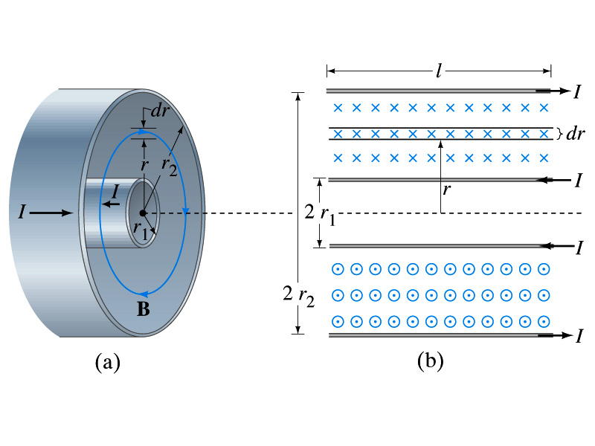

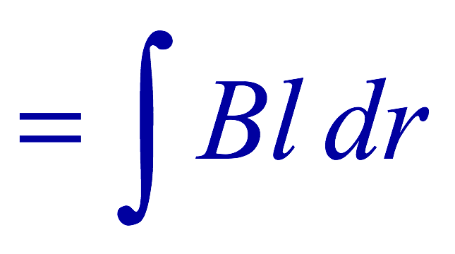
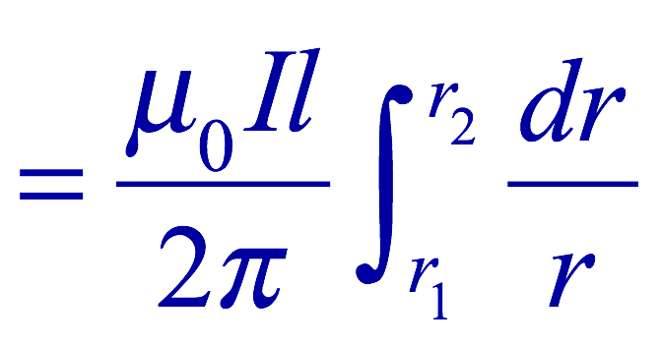
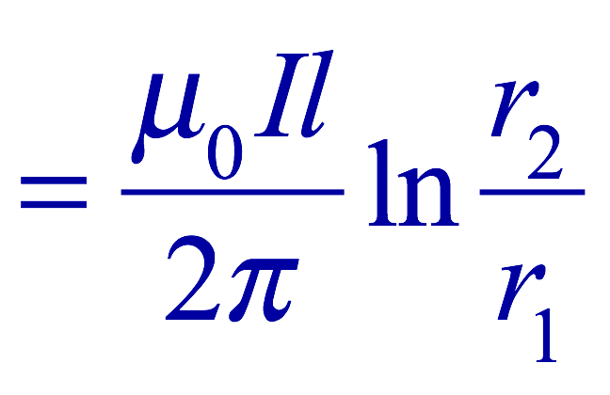
Example 30 – 5
Energy stored in a coaxial cable. (a) How much energy is being stored per unit length in a coaxial cable whose conductors have radii r₁ and r₂ and which carry a current I? (b) Where is the energy density highest?
(a) The total flux through l of the cable is
Thus inductance per unit length for a coaxial cable is
Thus the energy stored per unit length is
(b) Since the magnetic field is
The energy density is highest where B is highest. Since B is highest close to r=r₁, near the surface of the inner conductor.
And the energy density is

Slide 86

LR Circuits
What happens when an emf is applied to an inductor?
  An inductor has some resistance, however negligible
    So an inductor can be drawn as a circuit of separate resistance and coil. What is the name this kind of circuit?
  What happens at the instance the switch is thrown to apply emf to the circuit?
    The current starts to flow, gradually increasing from 0
    This change is opposed by the induced emf in the inductor ➔ the emf at point B is higher than point C
    However there is a voltage drop at the resistance which reduces the voltage across inductance
    Thus the current increases less rapidly
    The overall behavior of the current is a gradual increase, reaching to the maximum current I_{max}=V₀/R.
LR Circuit

Slide 87
LR Circuits
This can be shown w/ Kirchhoff loop rules
  The emfs in the circuit are the battery voltage V₀ and the emf ε=-L(dI/dt) in the inductor opposing the current increase
  The sum of the potential changes through the circuit is
  Where I is the current at any instance
  By rearranging the terms, we obtain a differential eq.
  We can integrate just as in RC circuit
  So the solution is
  Where τ=L/R
    This is the time constant τ of the LR circuit and is the time required for the current I to reach 0.63 of the maximum

Slide 88



Discharge of LR Circuits
If the switch is flipped away from the battery
  The differential equation becomes
  So the integration is
  Which results in the solution
  The current decays exponentially to zero with the time constant τ=L/R
  So there always is a reaction time when a system with a coil, such as an electromagnet, is turned on or off.
  The current in LR circuit behaves almost the same as that in RC circuit but the time constant is inversely proportional to R in LR circuit unlike the RC circuit

Slide 89


AC Circuit w/ Resistance only
What do you think will happen when an AC source is connected to a resistor?
From Kirchhoff’s loop rule, we obtain
Thus
  where
What does this mean?
  Current is 0 when voltage is 0 and current is in its peak when voltage is in its peak.
  Current and voltage are “in phase”
Energy is lost via the transformation into heat at an average rate

Slide 90

AC Circuit w/ Inductance only
From Kirchhoff’s loop rule, we obtain
Thus
  Using the identity
  where
What does this mean?
  Current and voltage are “out of phase by π/2 or 90º”. In other words the current reaches its peak ¼ cycle after the voltage
What happens to the energy?
  No energy is dissipated
  The average power is 0 at all times
  The energy is stored temporarily in the magnetic field
  Then released back to the source

Slide 91
AC Circuit w/ Inductance only
How are the resistor and inductor different in terms of energy?
  Inductor
  Resistor
How are they the same?
  They both impede the flow of charge
  For a resistance R, the peak voltage and current are related to
  Similarly, for an inductor we may write
    Where X_{L} is the inductive reactance of the inductor
    What do you think is the unit of the reactance?
    The relationship is not valid at a particular instance. Why not?
      Since V₀ and Ι₀ do not occur at the same time
Stores the energy temporarily in the magnetic field and then releases it back to the emf source
Does not store energy but transforms it to thermal energy, losing it to the environment
0 when ω=0.
Ω
is valid!

Slide 92
Example 30 – 9
Reactance of a coil. A coil has a resistance R=1.00Ω and an inductance of 0.300H. Determine the current in the coil if (a) 120 V DC is applied to it; (b) 120 V AC (rms) at 60.0Hz is applied.
Is there a reactance for DC?
Nope. Why not?
Since ω=0,
So for DC power, the current is from Kirchhoff’s rule
For an AC power with f =60Hz, the reactance is
Since the resistance can be ignored compared to the reactance, the rms current is

Slide 93

AC Circuit w/ Capacitance only
What happens when a capacitor is connected to a DC power source?
  The capacitor quickly charges up.
  There is no steady current flow in the circuit
    Since the capacitor prevents the flow of the DC current
What do you think will happen if it is connected to an AC power source?
  The current flows continuously. Why?
  When the AC power turns on, charge begins to flow one direction, charging up the plates
  When the direction of the power reverses, the charge flows in the opposite direction

Slide 94
AC Circuit w/ Capacitance only
From Kirchhoff’s loop rule, we obtain
The current at any instance is
The charge Q on the plate at any instance is
Thus the voltage across the capacitor is
  Using the identity
  Where

Slide 95
AC Circuit w/ Capacitance only
So the voltage is
What does this mean?
  Current and voltage are “out of phase by π/2 or 90º” but in this case, the voltage reaches its peak ¼ cycle after the current
What happens to the energy?
  No energy is dissipated
  The average power is 0 at all times
  The energy is stored temporarily in the electric field
  Then released back to the source
Applied voltage and the current in the capacitor can be written as
  Where the capacitive reactance X_{C} is defined as
  Again, this relationship is only valid for rms quantities
Infinite when ω=0.

Slide 96
Example 30 – 10
Capacitor reactance. What are the peak and rms current in the circuit in the figure if C=1.0μF and V_{rms}=120V? Calculate for (a) f=60Hz, and then for (b) f=6.0x10⁵Hz.
The peak voltage is
The capacitance reactance is
Thus the peak current is
The rms current is

Slide 97

AC Circuit w/ LRC
The voltage across each element is
  V_{R} is in phase with the current
  V_{L} leads the current by 90º
  V_{C} lags the current by 90º
From Kirchhoff’s loop rule
V=V_{R}+V_{L}+V_{C}
  However since they do not reach the peak voltage at the same time, the peak voltage of the source V₀ will not equal V_{R0}+V_{L0}+V_{C0}
  The rms voltage also will not be the simple sum of the three
Let’s try to find the total impedance, peak current Ι₀ and the phase difference between Ι₀ and V₀.

Slide 98
AC Circuit w/ LRC
The current at any instance is the same at all point in the circuit
  The currents in each elements are in phase
  Why?
    Since the elements are in series
  How about the voltage?
    They are not in phase.
The current at any given time is
The analysis of LRC circuit is done using the “phasor” diagram in which arrows are drawn in an xy plane to represent the amplitude of each voltage, just like vectors
  The lengths of the arrows represent the magnitudes of the peak voltages across each element; V_{R0}=I₀R, V_{L0}=I₀X_{L} and V_{C0}=I₀X_{C}
  The angle of each arrow represents the phase of each voltage relative to the current, and the arrows rotate at the angular frequency ω to take into account the time dependence.
    The projection of each arrow on y axis represents voltage across each element at any given time

Slide 99



Phasor Diagrams
At t=0, Ι=0.
  Thus V_{R0}=0, V_{L0}=Ι₀X_{L}, V_{C0}=Ι₀X_{C}
At t=t,
Thus, the voltages (y-projections) are
+90º
-90º

Slide 100

AC Circuit w/ LRC
Since the sum of the projections of the three vectors on the y axis is equal to the projection of their sum.
  The sum of the projections represents the instantaneous voltage across the whole circuit which is the source voltage
  So we can use the sum of all vectors as the representation of the peak source voltage V₀.
V₀ forms an angle φ to V_{R0} and rotates together with the other vectors as a function of time,
We determine the total impedance Z of the circuit defined by the relationship or
From Pythagorean theorem, we obtain
Thus the total impedance is

Slide 101
AC Circuit w/ LRC
The phase angle φ is
or
What is the power dissipated in the circuit?
  Which element dissipates the power?
  Only the resistor
The average power is
  Since R=Zcosφ
  We obtain
  The factor cosφ is referred as the power factor of the circuit
  For a pure resistor, cosφ=1 and
  For a capacitor or inductor alone φ=-90º or +90º, so cosφ=0 and

Slide 102
AC Circuit w/ LRC
Since the sum of the projections of the three vectors on the y axis is equal to the projection of their sum.
  The sum of the projections represents the instantaneous voltage across the whole circuit which is the source voltage
  So we can use the sum of all vectors as the representation of the peak source voltage V₀.
V₀ forms an angle φ to V_{R0} and rotates together with the other vectors as a function of time,
We determine the total impedance Z of the circuit defined by the relationship or
From Pythagorean theorem, we obtain
Thus the total impedance is

Slide 103
AC Circuit w/ LRC
The phase angle φ is
or
What is the power dissipated in the circuit?
  Which element dissipates the power?
  Only the resistor
The average power is
  Since R=Zcosφ
  We obtain
  The factor cosφ is referred as the power factor of the circuit
  For a pure resistor, cosφ=1 and
  For a capacitor or inductor alone φ=-90º or +90º, so cosφ=0 and

Slide 104
Maxwell’s Equations
The development of EM theory by Oersted, Ampere and others was not done in terms of EM fields
  The idea of fields was introduced somewhat by Faraday
Scottish physicist James C. Maxwell unified all the phenomena of electricity and magnetism in one theory with only four equations (Maxwell’s Equations) using the concept of fields
  This theory provided the prediction of EM waves
  As important as Newton’s law since it provides dynamics of electromagnetism
  This theory is also in agreement with Einstein’s special relativity
The biggest achievement of 19th century electromagnetic theory is the prediction and experimental verifications that the electromagnetic waves can travel through the empty space
  What do you think this accomplishment did?
    Open a new world of communication
    It also yielded the prediction that the light is an EM wave
Since all of Electromagnetism is contained in the four Maxwell’s equations, this is considered as one of the greatest achievements of human intellect

Slide 105
Ampere’s Law
Do you remember the mathematical expression of Oersted discovery of a magnetic field produced by an electric current, given by Ampere?
We’ve learned that a varying magnetic field produces an electric field
Then can the reverse phenomena, that a changing electric field producing a magnetic field, possible?
  If this is the case, it would demonstrate a beautiful symmetry in nature between electricity and magnetism

Slide 106


Expanding Ampere’s Law
Let’s consider a wire carrying current Ι
  The current that is enclosed in the loop passes through the surface # 1 in the figure
  We could imagine a different surface # 2 that shares the same enclosed path but cuts through the wire in a different location. What is the current that passes through the surface?
    Still Ι.
  So the Ampere’s law still works
We could then consider a capacitor being charged up or being discharged.
  The current Ι enclosed in the loop passes through the surface #1
  However the surface #2 that shares the same closed loop do not have any current passing through it.
    There is magnetic field present since there is current ➔ In other words there is a changing electric field in between the plates
    Maxwell resolved this by adding an additional term to Ampere’s law involving the changing electric field

Slide 107
Modifying Ampere’s Law
To determine what the extra term should be, we first have to figure out what the electric field between the two plates is
  The charge Q on the capacitor with capacitance C is Q=CV
    Where V is the potential difference between the plates
  Since V=Ed
    Where E is the uniform field between the plates, and d is the separation of the plates
  And for parallel plate capacitor C=ε₀A/d
  We obtain

Slide 108
Modifying Ampere’s Law
  If the charge on the plate changes with time, we can write
  Using the relationship between the current and charge we obtain
    Where Φ_{Ε}=EA is the electric flux through the surface between the plates
  So in order to make Ampere’s law work for the surface 2 in the figure, we must write it in the following form
  This equation represents the general form of Ampere’s law
    This means that a magnetic field can be caused not only by an ordinary electric current but also by a changing electric flux
Extra term by Maxwell

Slide 109
Example 31 – 1
Charging capacitor. A 30-pF air-gap capacitor has circular plates of area A=100cm². It is charged by a 70-V battery through a 2.0-Ω resistor. At the instance the battery is connected, the electric field between the plates is changing most rapidly. At this instance, calculate (a) the current into the plates, and (b) the rate of change of electric field between the plates. (c) Determine the magnetic field induced between the plates. Assume E is uniform between the plates at any instant and is zero at all points beyond the edges of the plates.
Since this is an RC circuit, the charge on the plates is:
For the initial current (t=0), we differentiate the charge with respect to time.
The electric field is
Change of the electric field is

Slide 110

Example 31 – 1
(c) Determine the magnetic field induced between the plates. Assume E is uniform between the plates at any instant and is zero at all points beyond the edges of the plates.
The magnetic field lines generated by changing electric field is perpendicular to E and is circular due to symmetry
Whose law can we use to determine B?
Extended Ampere’s Law w/ Ι_{encl}=0!
We choose a circular path of radius r, centered at the center of the plane, following the B.
For r<r_{plate}, the electric flux is
since E is uniform throughout the plate
So from Ampere’s law, we obtain
Solving for B
For r<r_{plate}
Since we assume E=0 for r>r_{plate}, the electric flux beyond the plate is fully contained inside the surface.
So from Ampere’s law, we obtain
Solving for B
For r>r_{plate}

Slide 111
Displacement Current
Maxwell interpreted the second term in the generalized Ampere’s law equivalent to an electric current
  He called this term as the displacement current, Ι_{D}
  While the other term is called as the conduction current, Ι
Ampere’s law then can be written as
  Where
  While it is in effect equivalent to an electric current, a flow of electric charge, this actually does not have anything to do with the flow itself

Slide 112
Gauss’ Law for Magnetism
If there is a symmetry between electricity and magnetism, there must be an equivalent law in magnetism as the Gauss’ Law in electricity
For a magnetic field B, the magnetic flux Φ_{B} through the surface is defined as
  Where the integration is over the area of either an open or a closed surface
The magnetic flux through a closed surface which completely encloses a volume is
What was the Gauss’ law in the electric case?
  The electric flux through a closed surface is equal to the total net charge Q enclosed by the surface divided by ε₀.
Similarly, we can write Gauss’ law for magnetism as
Why is result of the integral zero?
  There is no isolated magnetic poles, the magnetic equivalent of single electric charges
Gauss’ Law for electricity
Gauss’ Law for magnetism

Slide 113

Gauss’ Law for Magnetism
What does the Gauss’ law in magnetism mean physically?
  There are as many magnetic flux lines that enter the enclosed volume as leave it
  If magnetic monopole does not exist, there is no starting or stopping point of the flux lines
    Electricity do have the source and the sink
  Magnetic field lines must be continuous
  Even for bar magnets, the field lines exist both insides and outside of the magnet

Slide 114
Maxwell’s Equations
In the absence of dielectric or magnetic materials, the four equations developed by Maxwell are:
Gauss’ Law for electricity
A generalized form of Coulomb’s law relating electric field to its sources, the electric charge
Gauss’ Law for magnetism
A magnetic equivalent of Coulomb’s law relating magnetic field to its sources. This says there are no magnetic monopoles.
Faraday’s Law
An electric field is produced by a changing magnetic field
Ampére’s Law
A magnetic field is produced by an electric current or by a changing electric field

Slide 115
Maxwell’s Amazing Leap of Faith
According to Maxwell, a magnetic field will be produced even in an empty space if there is a changing electric field
  He then took this concept one step further and concluded that
    If a changing magnetic field produces an electric field, the electric field is also changing in time.
    This changing electric field in turn produces the magnetic field that also changes.
    This changing magnetic field then in turn produces the electric field that changes.
    This process continues.
  With the manipulation of the equations, Maxwell found that the net result of this interacting changing fields is a wave of electric and magnetic fields that can actually propagate (travel) through the space

Slide 116

Production of EM Waves
Consider two conducting rods that will serve as an antenna are connected to a DC power source
  What do you think will happen when the switch is closed?
    The rod connected to the positive terminal is charged positive and the other negatively
    Then the electric field will be generated between the two rods
    Since there is current that flows through, the rods generates a magnetic field around them
How far would the electric and magnetic fields extend?
  In static case, the field extends indefinitely
  When the switch is closed, the fields are formed nearby the rods quickly but
  The stored energy in the fields won’t propagate w/ infinite speed

Slide 117

Production of EM Waves
What happens if the antenna is connected to an ac power source?
  When the connection was initially made, the rods are charging up quickly w/ the current flowing in one direction as shown in the figure
    The field lines form as in the dc case
    The field lines propagate away from the antenna
  Then the direction of the voltage reverses
    The new field lines with the opposite direction forms
    While the original field lines still propagates away from the rod reaching out far
      Since the original field propagates through an empty space, the field lines must form a closed loop (no charge exist)
    Since changing electric and magnetic fields produce changing magnetic and electric fields, the fields moving outward is self supporting and do not need antenna with flowing charge
  The fields far from the antenna is called the radiation field
  Both electric and magnetic fields form closed loops perpendicular to each other

Slide 118
Properties of Radiation Fields
The fields travel on the other side of the antenna as well
The field strength are the greatest in the direction perpendicular to the oscillating charge while along the direction is 0
The magnitude of E and B in the radiation field decrease with distance as 1/r
The energy carried by the EM wave is proportional to the square of the amplitude, E² or B²
  So the intensity of wave decreases as 1/r²

Slide 119
Properties of Radiation Fields
The electric and magnetic fields at any point are perpendicular to each other and to the direction of motion
The fields alternate in direction
  The field strengths vary from maximum in one direction, to 0 and to max in the opposite direction
The electric and magnetic fields are in phase
Very far from the antenna, the field lines are pretty flat over a reasonably large area
  Called plane waves

Slide 120

EM Waves
If the voltage of the source varies sinusoidally, the field strengths of the radiation field vary sinusoidally
We call these waves EM waves
They are transverse waves
EM waves are always waves of fields
  Since these are fields, they can propagate through an empty space
In general accelerating electric charges give rise to electromagnetic waves
This prediction from Maxwell’s equations was experimentally by Heinrich Hertz through the discovery of radio waves

Slide 121
EM Waves and Their Speeds
Let’s consider a region of free space. What’s a free space?
  An area of space where there is no charges or conduction currents
  In other words, far from emf sources so that the wave fronts are essentially flat or not distorted over a reasonable area
  What are these flat waves called?
    Plane waves
    At any instance E and B are uniform over a large plane perpendicular to the direction of propagation
  So we can also assume that the wave is traveling in the x-direction w/ velocity, v=vi, and that E is parallel to y axis and B is parallel to z axis

Slide 122
Maxwell’s Equations w/ Q=Ι=0
In this region of free space, Q=0 and Ι=0, thus the four Maxwell’s equations become
Q_{encl}=0
No Changes
No Changes
I_{encl}=0
One can observe the symmetry between electricity and magnetism.
The last equation is the most important one for EM waves and their propagation!!

Slide 123
EM Waves from Maxwell’s Equations
If the wave is sinusoidal w/ wavelength λ and frequency f, such traveling wave can be written as
  Where
  What is v?
    It is the speed of the traveling wave
  What are E₀ and B₀?
    The amplitudes of the EM wave. Maximum values of E and B field strengths.
Thus

Slide 124

From Faraday’s Law
Let’s apply Faraday’s law
  to the rectangular loop of height Δy and width dx
along the top and bottom of the loop is 0. Why?
  Since E is perpendicular to dl.
  So the result of the integral through the loop counterclockwise becomes
  For the right-hand side of Faraday’s law, the magnetic flux through the loop changes as
Thus
Since E and B
depend on x and t

Slide 125




From Modified Ampére’s Law
Let’s apply Maxwell’s 4th equation
  to the rectangular loop of length Δz and width dx
along the x-axis of the loop is 0
  Since B is perpendicular to dl.
  So the result of the integral through the loop counterclockwise becomes
  For the right-hand side of the equation is
Thus
Since E and B
depend on x and t

Slide 126


Relationship between E, B and v
Let’s now use the relationship from Faraday’s law
Taking the derivatives of E and B as given their traveling wave form, we obtain
  Since E and B are in phase, we can write
    This is valid at any point and time in space. What is v?
      The velocity of the wave
We obtain
Since
Thus

Slide 127




Speed of EM Waves
Let’s now use the relationship from Apmere’s law
Taking the derivatives of E and B as given their traveling wave form, we obtain
  However, from the previous page we obtain
  Thus
Since
We obtain
Thus
The speed of EM waves is the same as the speed of light. EM waves behaves like the light.

Slide 128


Speed of Light w/o Sinusoidal Wave Forms
Taking the time derivative on the relationship from Ampere’s laws, we obtain
By the same token, we take position derivative on the relationship from Faraday’s law
From these, we obtain
Since the equation for traveling wave is
By correspondence, we obtain
A natural outcome of Maxwell’s equations is that E and B obey the wave equation for waves traveling w/ speed
  Maxwell predicted the existence of EM waves based on this
and

Slide 129

Light as EM Wave
People knew some 60 years before Maxwell that light behaves like a wave, but …
  They did not know what kind of waves they are.
    Most importantly what is it that oscillates in light?
Heinrich Hertz first generated and detected EM waves experimentally in 1887 using a spark gap apparatus
  Charge was rushed back and forth in a short period of time, generating waves with frequency about 10⁹Hz (these are called radio waves)
  He detected using a loop of wire in which an emf was produced when a changing magnetic field passed through
  These waves were later shown to travel at the speed of light and behave exactly like the light just not visible

Slide 130
Light as EM Wave
The wavelengths of visible light were measured in the first decade of the 19th century
  The visible light wave length were found to be between 4.0x10⁻⁷m (400nm) and 7.5x10⁻⁷m (750nm)
  The frequency of visible light is fλ=c
    Where f and λ are the frequency and the wavelength of the wave
      What is the range of visible light frequency?
      4.0x10¹⁴Hz to 7.5x10¹⁴Hz
    c is 3x10⁸m/s, the speed of light
EM Waves, or EM radiation, are categorized using EM spectrum

Slide 131

Electromagnetic Spectrum
Low frequency waves, such as radio waves or microwaves can be easily produced using electronic devices
Higher frequency waves are produced natural processes, such as emission from atoms, molecules or nuclei
Or they can be produced from acceleration of charged particles
Infrared radiation (IR) is mainly responsible for the heating effect of the Sun
  The Sun emits visible lights, IR and UV
    The molecules of our skin resonate at infrared frequencies so IR is preferentially absorbed and thus warm up

Slide 132
Example 31 – 3
Wavelength of EM waves. Calculate the wavelength (a) of a 60-Hz EM wave, (b) of a 93.3-MHz FM radio wave and (c) of a beam of visible red light from a laser at frequency 4.74x10¹⁴Hz.
What is the relationship between speed of light, frequency and the wavelength?
Thus, we obtain
For f=60Hz
For f=93.3MHz
For f=4.74x10¹⁴Hz

Slide 133
EM Wave in the Transmission Lines
Can EM waves travel through a wire?
  Can it not just travel through the empty space?
  Nope. It sure can travel through a wire.
When a source of emf is connected to a transmission line, the electric field within the wire does not set up immediately at all points along the line
  When two wires are separated via air, the EM wave travel through the air at the speed of light, c.
  However, through medium w/ permittivity ε and permeability μ, the speed of the EM wave is given
    Is this faster than c?
Nope! It is slower.

Slide 134




Example 31 – 5
Phone call time lag. You make a telephone call from New York to London. Estimate the time the electrical signal to travel to reach London (a) carried on a 5000km telephone cable under the Atlantic Ocean and (b) sent via satellite 36,000km above the ocean. Would this cause a noticeable delay in either case?
Time delay via the cable:
Delay via satellite
So in case of satellite, the delay is likely noticeable!!

Slide 135


Energy in EM Waves
Since B=E/c and , we can rewrite the energy density
  Note that the energy density associate with B field is the same as that associate with E
  So each field contribute half to the total energy
By rewriting in B field only, we obtain
We can also rewrite to contain both E and B

Slide 136

Energy Transport
What is the energy the wave transport per unit time per unit area?
  This is given by the vector S, the Poynting vector
    The unit of S is W/m².
    The direction of S is the direction in which the energy is transported. Which direction is this?
      The direction the wave is moving
Let’s consider a wave passing through an area A perpendicular to the x-axis, the axis of propagation
  How much does the wave move in time dt?
    dx=cdt
  The energy that passes through A in time dt is the energy that occupies the volume dV,
  Since the energy density is u=ε₀E², the total energy, dU, contained in the volume V is

Slide 137
Energy Transport
Thus, the energy crossing the area A per time dt is
Since E=cB and , we can also rewrite
Since the direction of S is along v, perpendicular to E and B, the Poynting vector S can be written
  This gives the energy transported per unit area per unit time at any instant
What is the unit?
W/m²

Slide 138
Average Energy Transport
The average energy transport in an extended period of time is useful since sometimes we do not detect the rapid variation with respect to time because the frequency is so high.
If E and B are sinusoidal,
Thus we can write the magnitude of the average Poynting vector as
  This time averaged value of S is the intensity, defined as the average power transferred across unit area. E₀ and B₀ are maximum values.
We can also write
  Where E_{rms} and B_{rms} are the rms values ( )

Slide 139
Example 31 – 6
E and B from the Sun. Radiation from the Sun reaches the Earth (above the atmosphere) at a rate of about 1350W/m². Assume that this is a single EM wave and calculate the maximum values of E and B.
What is given in the problem?
The average S!!
For E₀,
For B₀

