Slide 1
PHYS 1441 – Section 001
Lecture #3
Wednesday, June 5, 2019
Dr. Jaehoon Yu
Chapter 21
  The Electric Field & Field Lines
  Electric Fields and Conductors
  Motion of a Charged Particle in an Electric Field
  Electric Dipoles
Chapter 22
  Electric Flux

Slide 2
Announcements
27/30 of you are registered to the homework system!
  27/27 submitted the homework! Excellent!
  There are still couple of you who haven’t registered yet!
    Please register and submit the homework ASAP! The roster closes tonight!
1st Term exam
  In class, coming Monday, June 10: DO NOT MISS THE EXAM!
  CH21.1 to what we learn on tomorrow, Thursday, June 6 + Appendices A1 – A8
  You can bring your calculator but it must not have any relevant formula pre-input
    Cell phones or any types of computers cannot replaced a calculator!
    Do NOT miss the exam!
  BYOF: You may bring one 8.5x11.5 sheet (front and back) of handwritten formulae and values of constants for the exam
  No derivations, word definitions, no setups or solutions of any problems!
  No additional formulae or values of constants will be provided!

Slide 3
Reminder: Extra Credit Special Project #1
Compare the Coulomb force to the Gravitational force in the following cases by expressing Coulomb force (F_{C}) in terms of the gravitational force (F_{G})
  Between the two protons separated by 1m
  Between the two protons separated by an arbitrary distance R
  Between the two electrons separated by 1m
  Between the two electrons separated by an arbitrary distance R
Five points each, totaling 20 points
BE SURE to show all the details of your own work, including all formulae, proper references to them and explanations
Please be sure to staple them before the submission
Due at the beginning of the class Monday, June 10

Slide 4
Vector Additions and Subtractions
Addition:
  Triangular Method: One can add vectors by connecting the head of one vector to the tail of the other (head-to-tail)
  Parallelogram method: Connect the tails of the two vectors and extend
  Addition is commutative: Changing order of operation does not affect the results A+B=B+A, A+B+C+D+E=E+C+A+B+D
A+B
A
A+B
B
=
OR
B
A+B
B
A
A
Subtraction:
  The same as adding a negative vector:A - B = A + (-B)
A
-B
Since subtraction is equivalent to adding a negative vector, subtraction is also commutative!!!
A-B
Multiplication by a scalar is increasing the magnitude A, B=2A
A
B=2A

Slide 5
Example for Vector Addition
A force of 20.0N applies to north while another force of 35.0N applies in the direction 60.0º west of north. Find the magnitude and direction of resultant force.
F₂sin60^{ο}
N
F₂
60^{ο}
F₂cos60^{ο}
20
F
θ
F₁
E
Find other ways to solve this problem…

Slide 6
Components and Unit Vectors
Coordinate systems are useful in expressing vectors in their components
y
(+,+)
F_{y}
(F_{x},F_{y})
}Components
F
(-,+)
θ
x
} Magnitude
(-,-)
(+,-)
F_{x}

Slide 7
Unit Vectors
A unit vector is the vector that indicates only the directions of the components
Dimensionless
Magnitudes are exactly 1
Unit vectors are usually expressed in i, j, k or (⬅preferred method in this class!)
So the vector F can be re-written as

Slide 8
Examples of Vector Operations
Find the resultant force which is the sum of F1=(2.0i+2.0j)N and F2 =(2.0i-4.0j)N.
Find the resultant force of the sum of three forces: F₁=(15i+30j +12k)N, F₂=(23i+14j -5.0k)N, and F₃=(-13i+15j)N.
Magnitude

Slide 9
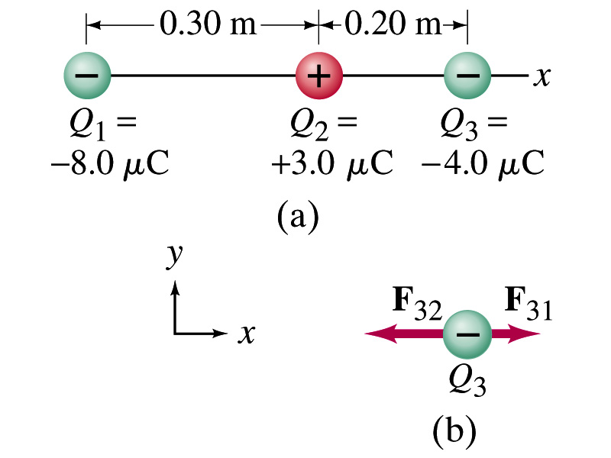
Example 21.2
Three charges on a line. Three charged particles are arranged in a line as shown in the figure. Calculate the net electrostatic force on particle 3 (the -4μC on the right) due to other two charges.
What is the force that Q₁ exerts on Q₃?
What is the force that Q₂ exerts on Q₃?
Using the vector sum of the two forces

Slide 10
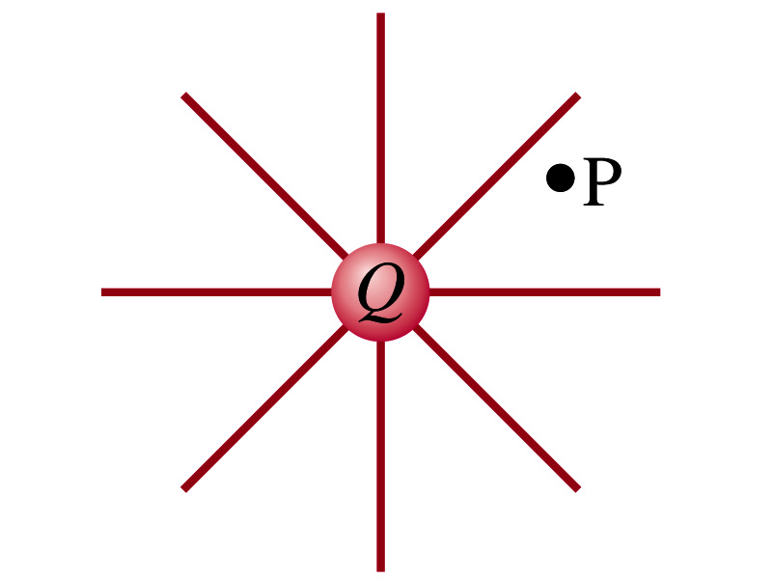
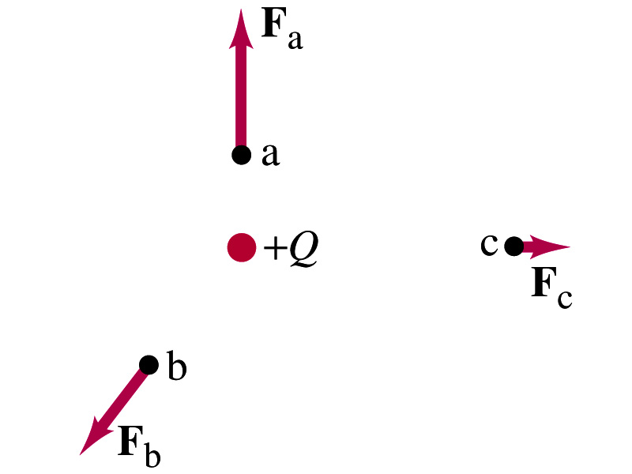
The Electric Field
Both gravitational and electric forces act over a distance without contacting objects ➔ What kind of forces are these?
  Field forces
Michael Faraday developed the idea of the field.
  Faraday (1791 – 1867) argued that the electric field extends outward/inward from every charge and permeates through all of space.
Field by a charge or a group of charges can be inspected by placing a small positive test charge in the vicinity and measuring the force on it.
  You imagine what would happen to the test charge!
  E due to a charge is independent of the other charge

Slide 11
The Electric Field
The electric field at any point in space is defined as the force exerted on a tiny positive test charge divide by magnitude of the test charge
  Electric force per unit charge
What kind of quantity is the electric field?
  Vector quantity. Why?
What is the unit of the electric field?
  N/C
What is the magnitude of the electric field at a distance r from a single point charge Q?

Slide 12
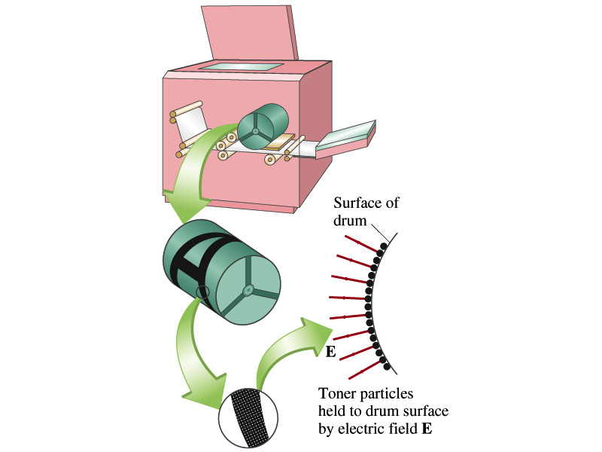
Example 21 – 5
Electrostatic copier. An electrostatic copier works by selectively arranging positive charges (in a pattern to be copied) on the surface of a non-conducting drum, then gently sprinkling negatively charged dry toner (ink) onto the drum. The toner particles temporarily stick to the pattern on the drum and are later transferred to paper and “melted” to produce the copy. Suppose each toner particle has a mass of 9.0x10⁻¹⁶kg and carries the average of 20 extra electrons to provide an electric charge. Assuming that the electric force on a toner particle must exceed twice its weight in order to ensure sufficient attraction, compute the required electric field strength near the surface of the drum.
The electric force must be the same as twice the gravitational force on the toner particle.
So we can write
Thus, the magnitude of the electric field is

Slide 13
Direction of the Electric Field
If there are more than one charge present, the individual fields due to each charge are added vectorially to obtain the total field at any point.
This superposition principle of electric field has been verified by experiments.
For a given electric field E at a given point in space, we can calculate the force F on any charge q, F=qE.
  What happens to the direction of the force and the field depending on the sign of the charge q?
  The F and E are in the same directions if q > 0
  The F and E are in the opposite directions if q < 0

Slide 14
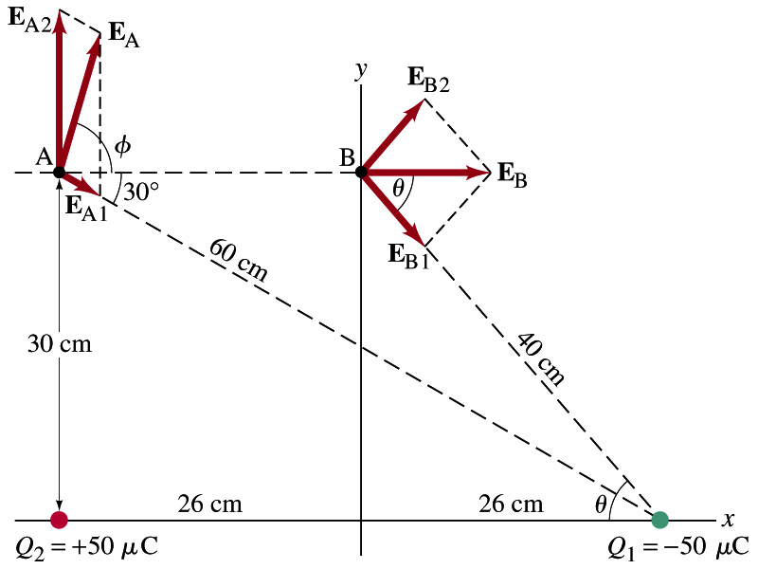
Example 21 – 8
E above two point charges: Calculate the total electric field (a) at point A and (b) at point B in the figure on the right due to both the charges Q₁ and Q₂.
How do we solve this problem?
First, compute the magnitude of fields at each point due to each of the two charges.
Then add them at each point vectorially!
First, the electric field at point A by Q₁ and then Q₂.

Slide 15
Example 21 – 8, cnt’d
Now the components of the electric field vectors by the two charges at point A.
So the electric field at point A is
The magnitude of the electric field at point A is
Now onto the electric field at point B

Slide 16
Example 21 – 8, cnt’d
Electric field at point B is easier due to symmetry!
Since the magnitude of the charges are the same and the distance to point B from the two charges are the same, the magnitude of the electric field by the two charges at point B are the same!!
Now the components!
First, the y-component!
Now, the x-component!
So the electric field at point B is
The magnitude of the electric field at point B

Slide 17
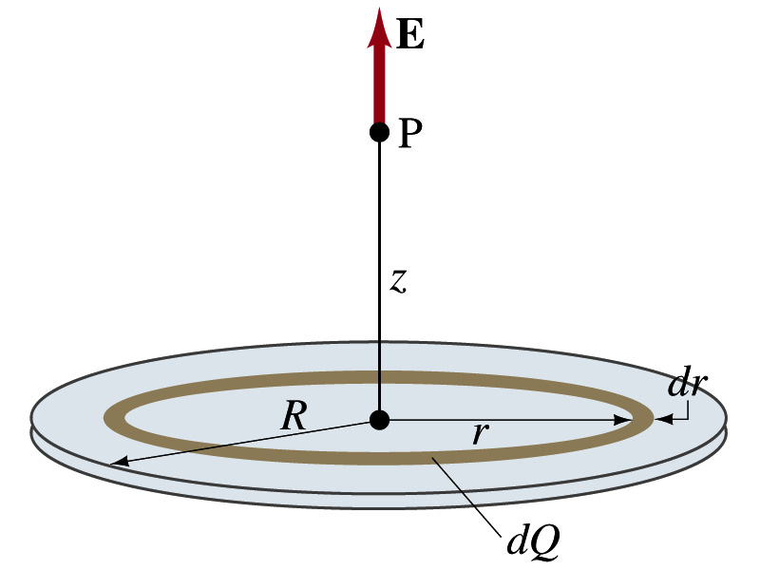
Example 21 – 12
Uniformly charged disk: Charge is distributed uniformly over a thin circular disk of radius R. The charge per unit area (C/m²) is σ. Calculate he electric field at a point P on the axis of the disk, a distance z above its center.
How do we solve this problem?
First, compute the magnitude of the field (dE) at point P due to the charge (dQ) on the ring of infinitesimal width dr.
From the result of example 21 – 11 (please do this problem yourself)
Since the surface charge density is constant, σ, and the ring has an area of 2πrdr, the infinitesimal charge of dQ is
So the infinitesimal field dE can be written

Slide 18
Example 21 – 12 cnt’d
Now integrating dE over 0 through R, we get
What happens if the disk has infinitely large area?
So the electric field due to an evenly distributed surface charge with density, σ, is

