Slide 1
PHYS 1441 – Section 001
Lecture #4
Thursday, June 6, 2019
Dr. Jaehoon Yu
Chapter 21
  The Field Lines
  Electric Fields and Conductors
  Motion of a Charged Particle in an Electric Field
  Electric Dipole and Its Electric Field
Chapter 22
  Gauss’ Law
  Electric Flux
  Gauss’ Law with Multiple Charges
Today’s homework is #3, due 11pm, next Wednesday, June 12!!

Slide 2
Announcements
1st Term exam
  In class, coming Monday, June 10: DO NOT MISS THE EXAM!
  CH21.1 to what we learn on today (CH22.2?) + Appendices A1 – A8
  You can bring your calculator but it must not have any relevant formula pre-input
    Cell phones or any types of computers cannot replaced a calculator!
  BYOF: You may bring one 8.5x11.5 sheet (front and back) of handwritten formulae and values of constants for the exam
  No derivations, word definitions, no setups or solutions of any problems!
  No additional formulae or values of constants will be provided!
Quiz 1 results
  Class average: 15.5/35
    Equivalent to 44.3/100
  Top score: 26/35

Slide 3
Reminder: Extra Credit Special Project #1
Compare the Coulomb force to the Gravitational force in the following cases by expressing Coulomb force (F_{C}) in terms of the gravitational force (F_{G})
  Between the two protons separated by 1m
  Between the two protons separated by an arbitrary distance R
  Between the two electrons separated by 1m
  Between the two electrons separated by an arbitrary distance R
Five points each, totaling 20 points
BE SURE to show all the details of your own work, including all formulae, proper references to them and explanations
Please be sure to staple them before the submission
Due at the beginning of the class Monday, June 10

Slide 4
SP#2 – Angels & Demons
Compute the total possible energy released from an annihilation of x-grams of anti-matter and the same quantity of matter, where x is the last two digits of your SS#. (20 points)
  Use the famous Einstein’s formula for mass-energy equivalence
Compute the power output of this annihilation when the energy is released in x ns, where x is again the first two digits of your SS#. (10 points)
Compute how many cups of gasoline (8MJ) this energy corresponds to. (5 points)
Compute how many months of world electricity usage (3.6GJ/mo) this energy corresponds to. (5 points)
Due by the beginning of the class Wednesday, June. 12

Slide 5
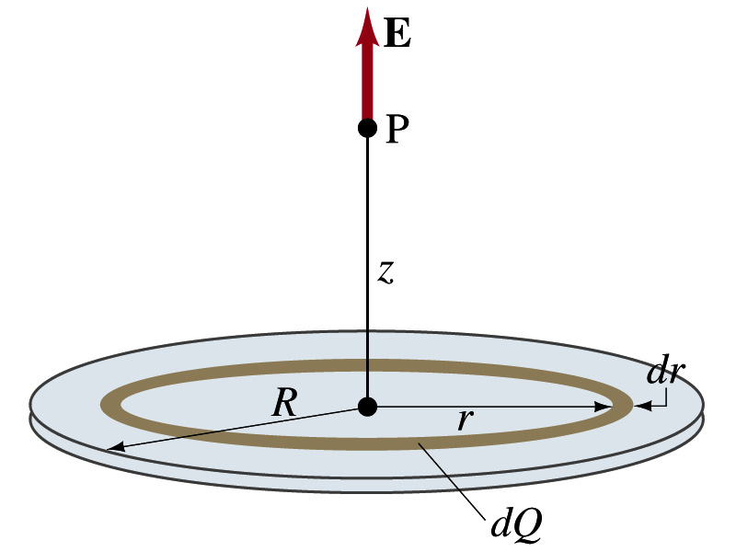
Example 21 – 12
Uniformly charged disk: Charge is distributed uniformly over a thin circular disk of radius R. The charge per unit area (C/m²) is σ. Calculate he electric field at a point P on the axis of the disk, a distance z above its center.
How do we solve this problem?
First, compute the magnitude of the field (dE) at point P due to the charge (dQ) on the ring of infinitesimal width dr.
From the result of example 21 – 11 (please do this problem yourself)
Since the surface charge density is constant, σ, and the ring has an area of 2πrdr, the infinitesimal charge of dQ is
So the infinitesimal field dE can be written

Slide 6
Example 21 – 12 cnt’d
Now integrating dE over 0 through R, we get
What happens if the disk has infinitely large area?
So the electric field due to an evenly distributed surface charge with density, σ, is

Slide 7
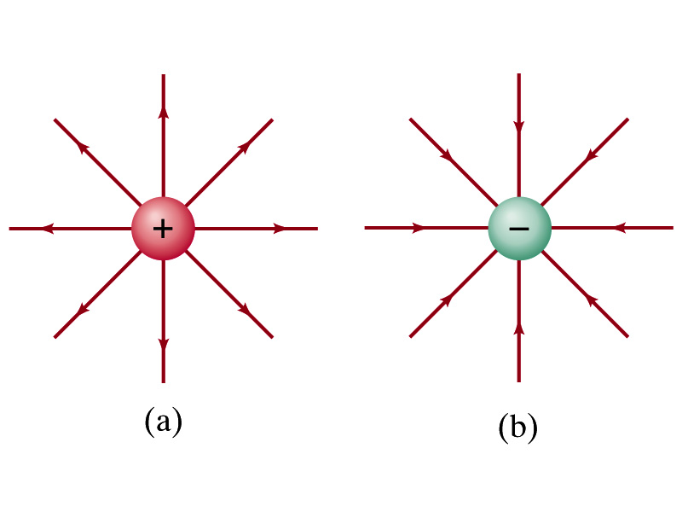
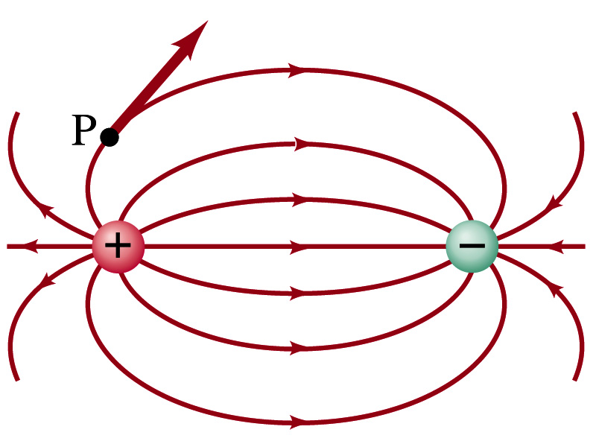
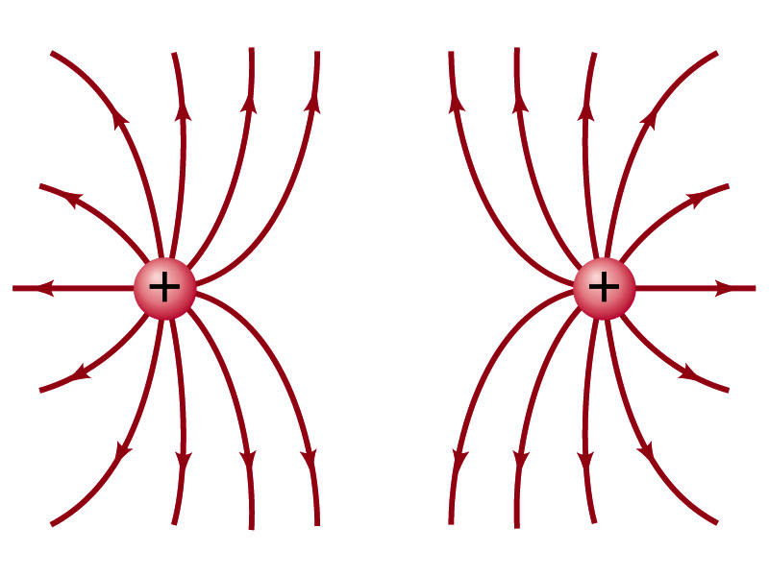

Field Lines
The electric field is a vector quantity. Thus, its magnitude can be expressed by the length of an arrow and the direction by the direction the arrowhead points.
Since the field permeates through the entire space, drawing vector arrows is not a good way of expressing the field.
Electric field lines are drawn to indicate the direction of the force due to the given field on a positive test charge.
  Number of lines crossing unit area perpendicular to E is proportional to the magnitude of the electric field.
  The closer the lines are together, the stronger the electric field in that region.
  Start on positive charges and end on negative charges.
Earth’s G-field lines

Slide 8
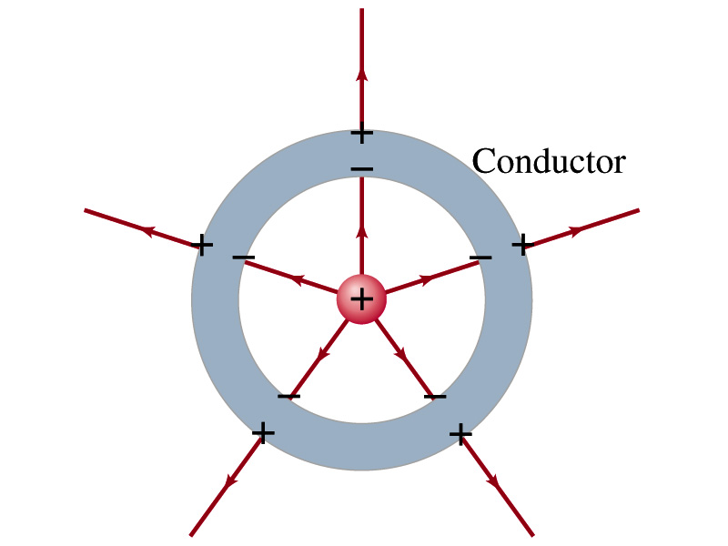
Electric Field and Conductors
The electric field inside a conductor is ZERO in static situation. (If the charge is at rest.) Why?
  If there were an electric field within a conductor, there would be a force on its free electrons.
  The electrons will move until they reached the position where the electric field becomes zero.
  Electric field inside a non-conductor, however, CAN exist.
Consequences of the above
  Any net charge on a conductor distributes itself on the surface.
  Although no E field exists inside a conductor, the field can exist outside the conductor due to induced charges on the surface
  The electric field is always perpendicular to the surface outside of a conductor.

Slide 9
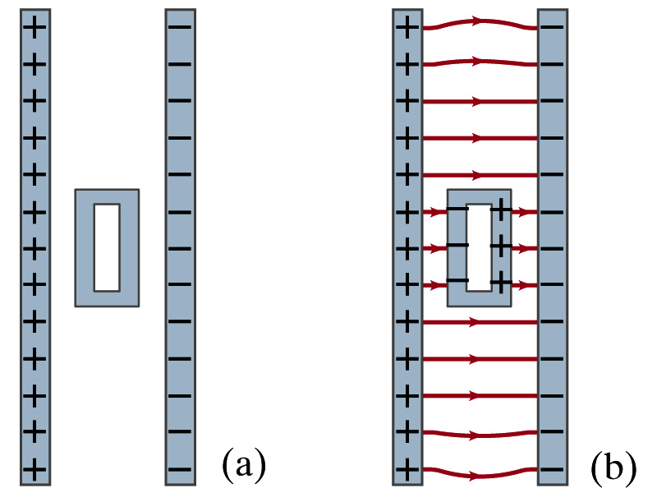
Example 21-13
Shielding, and safety in a storm. A hollow metal box is placed between two parallel charged plates. What is the field like in the box?
If the metal box were solid
  The free electrons in the box would redistribute themselves along the surface so that the field lines would not penetrate into the metal.
The free electrons do the same in hollow metal boxes just as well as it did in a solid metal box.
Thus a conducting box is an effective device for shielding. ➔ Faraday cage
So what do you think will happen if you were inside a car when the car was struck by a lightening?

Slide 10
Motion of a Charged Particle in an Electric Field
If an object with an electric charge q is at a point in space where the electric field is E, the force exerting on the object is .
What do you think will happen to the charge?
  Let’s think about the cases like these on the right.
  The object will move along the field line…Which way?
    Depends on the sign of the charge
  The charge gets accelerated under an electric field.

Slide 11
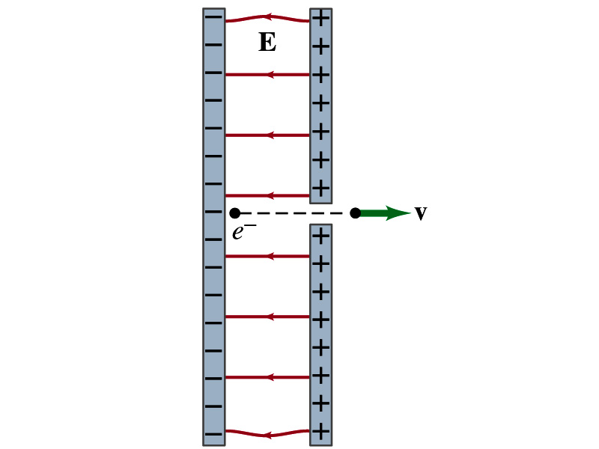
Example 21 – 14
Electron accelerated by electric field. An electron (mass m = 9.1x10⁻³¹kg) is accelerated in a uniform field E (E=2.0x10⁴N/C) between two parallel charged plates. The separation of the plates is 1.5cm. The electron is accelerated from rest near the negative plate and passes through a tiny hole in the positive plate. (a) With what speed does it leave the hole? (b) Show that the gravitational force can be ignored. Assume the hole is so small that it does not affect the uniform field between the plates.
The magnitude of the force on the electron is F=qE and is directed to the right. The equation to solve this problem is
The magnitude of the electron’s acceleration is
Between the plates the field E is uniform, thus the electron undergoes a uniform acceleration

Slide 12
Example 21 – 14
Since the travel distance is 1.5x10⁻²m, using one of the kinetic eq. of motions,
Since there is no electric field outside the conductor, the electron continues moving with this speed after passing through the hole.
(b) Show that the gravitational force can be ignored. Assume the hole is so small that it does not affect the uniform field between the plates.
The magnitude of the electric force on the electron is
The magnitude of the gravitational force on the electron is
Thus the gravitational force on the electron is negligible compared to the electromagnetic force.

Slide 13
Gauss’ Law
Gauss’ law states the relationship between the electric charge and the electric field.
  More generalized and elegant form of Coulomb’s law.
The electric field by the distribution of charges can be obtained using Coulomb’s law by summing (or integrating) over the charge distributions.
Gauss’ law, however, gives an additional insight into the nature of electrostatic field and a more general relationship between the charge and the field

Slide 14
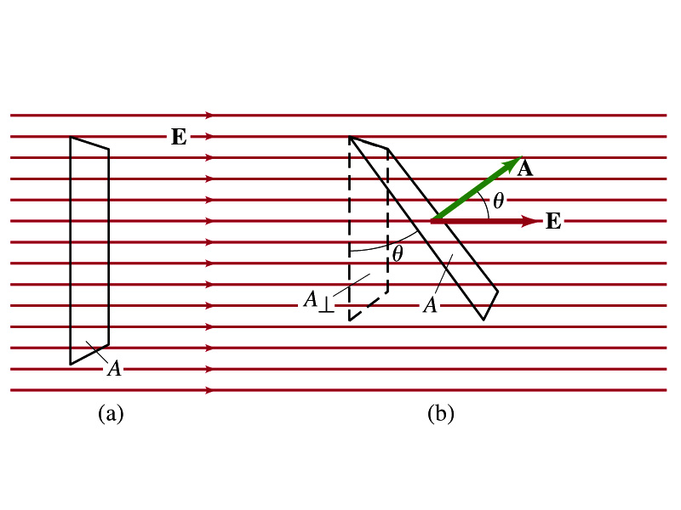
Electric Flux
Let’s imagine a surface of area A through which a uniform electric field E passes
The electric flux Φ_{E} is defined as
  Φ_{E}=EA, if the field is perpendicular to the surface
  Φ_{E}=EAcosθ, if the field makes an angle θ to the surface
So the electric flux is defined as .
How would you define the electric flux in words?
  The total number of field lines passing through the unit area perpendicular to the field.

Slide 15
Example 22 – 1
Electric flux. (a) Calculate the electric flux through the rectangle in the figure (a). The rectangle is 10cm by 20cm and the electric field is uniform with magnitude 200N/C. (b) What is the flux if the angle is 30 degrees?
The electric flux is defined as
So when (a) θ=0, we obtain
And when (b) θ=30 degrees, we obtain

Slide 16
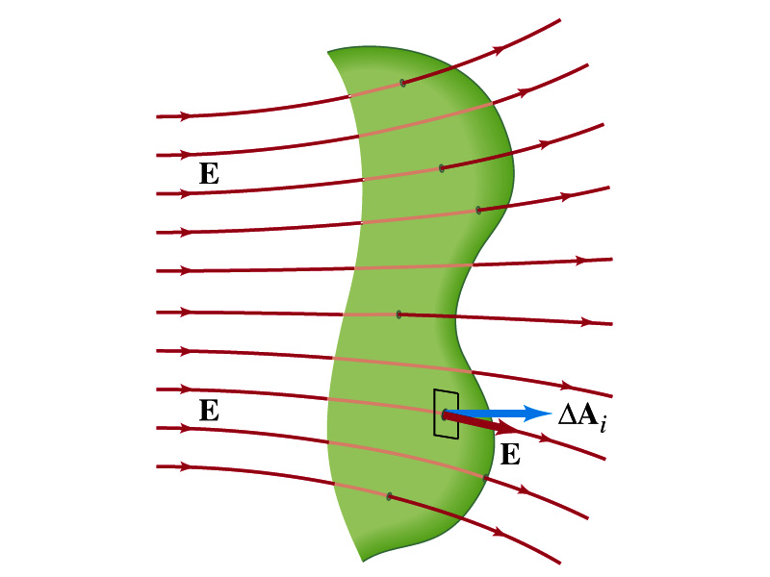
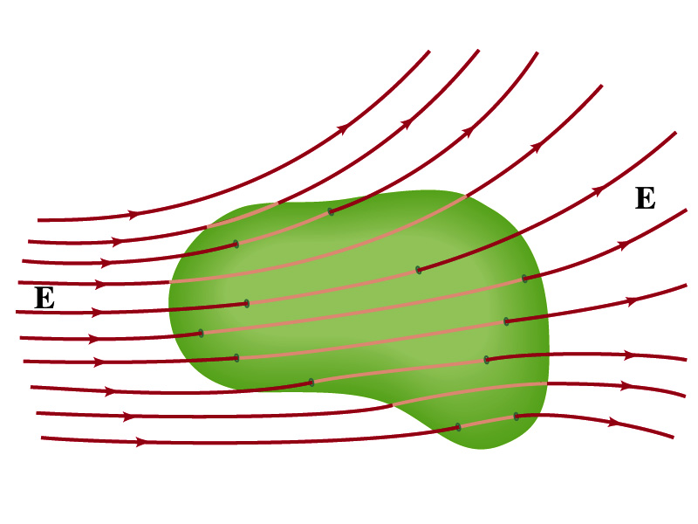
Generalization of the Electric Flux
Let’s consider a surface of area A that is not a square or flat but in some random shape, and that the field is not uniform.
The surface can be divided up into infinitesimally small areas of ΔA_{i} that can be considered flat.
And the electric field through this area can be considered uniform since the area is very small.
Then the electric flux through the entire surface is approximately
In the limit where ΔA_{i} → 0, the discrete summation becomes an integral.
open surface
enclosed surface

Slide 17
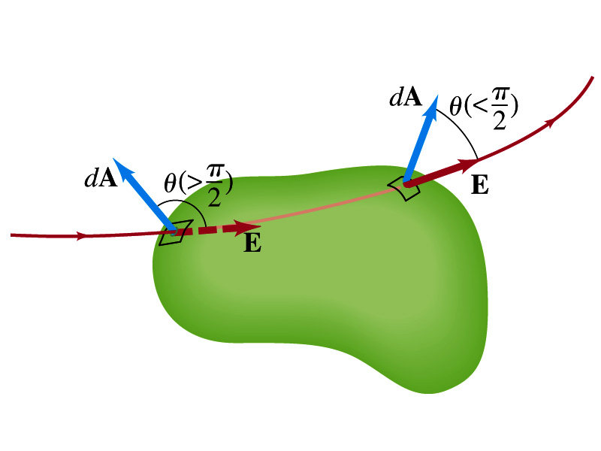
Generalization of the Electric Flux
We arbitrarily define that the area vector points outward from the enclosed volume.
  For the line leaving the volume, |θ|<π/2 and cosθ>0. The flux is positive.
  For the line coming into the volume, |θ|>π/2 and cosθ<0. The flux is negative.
  If Φ_{E}>0, there is net flux out of the volume.
  If Φ_{E}<0, there is flux into the volume.
In the above figures, each field line that enters the volume also leaves the volume, so
The flux is non-zero only if one or more lines start or end inside the surface.

Slide 18
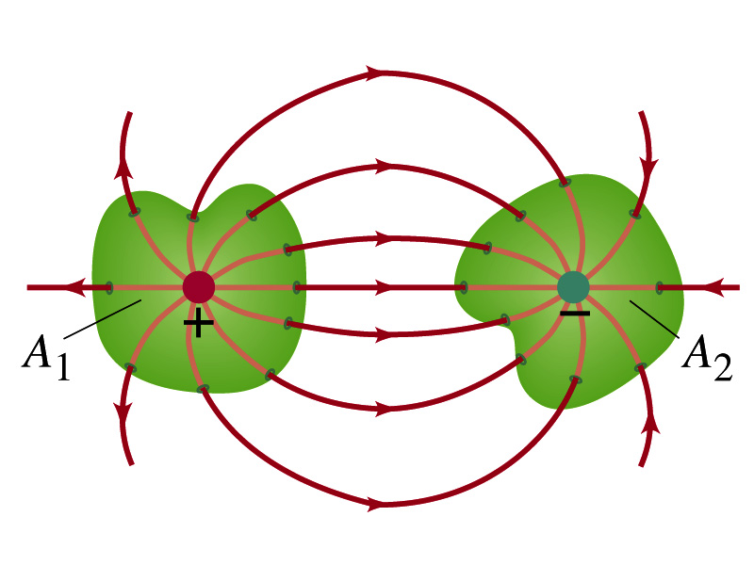
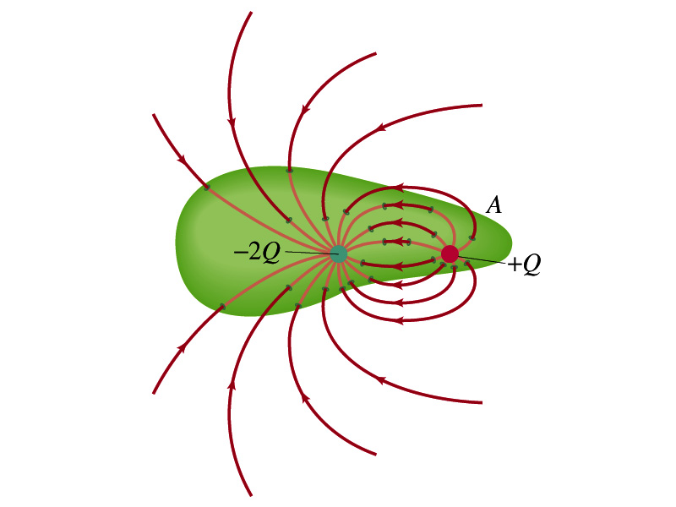
Generalization of the Electric Flux
The field line starts or ends only on a charge.
Sign of the net flux on the surface A₁?
  Net outward flux (positive flux)
How about A₂?
  Net inward flux (negative flux)
What is the flux in the figure bottom right?
  There should be a net inward flux (negative flux) since the total charge inside the volume is negative.
The net flux that crosses an enclosed surface is proportional to the total charge inside the surface. ➔ This is the crux of Gauss’ law.

Slide 19
Gauss’ Law
q
q’
Let’s consider the case in the above figure.
What are the results of the closed integral of the Gaussian surfaces A₁ and A₂?
  For A₁
  For A₂

Slide 20
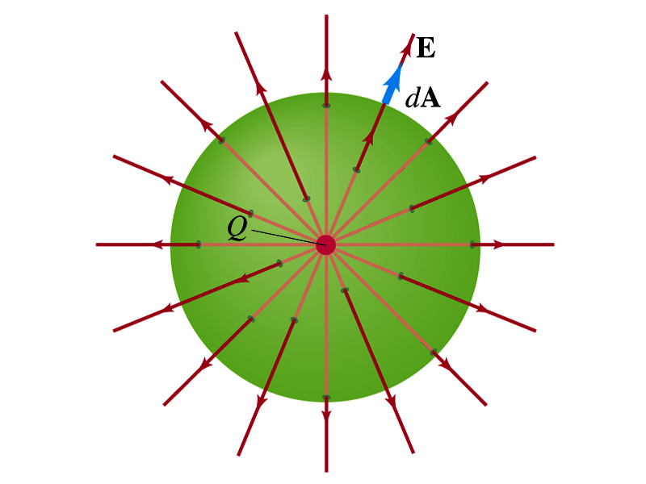
Coulomb’s Law from Gauss’ Law
Let’s consider a charge Q enclosed inside our imaginary Gaussian surface of sphere of radius r.
  Since we can choose any surface enclosing the charge, we choose the simplest possible one! ☺
The surface is symmetric about the charge.
  What does this tell us about the field E?
    Have the same magnitude (uniform) at any point on the surface
    Points radially outward parallel to the surface vector dA.
The Gaussian integral can be written as
Solve
for E
Electric Field of
Coulomb’s Law

Slide 21
Gauss’ Law from Coulomb’s Law
Let’s consider a single static point charge Q surrounded by an imaginary spherical surface.
Coulomb’s law tells us that the electric field at a spherical surface of radius r is
Performing a closed integral over the surface, we obtain
Gauss’ Law

Slide 22
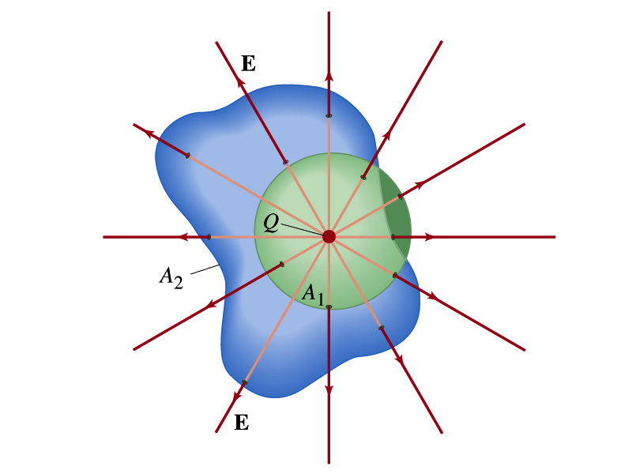
Gauss’ Law from Coulomb’s Law
Irregular Surface
Let’s consider the same single static point charge Q surrounded by a symmetric spherical surface A₁ and a randomly shaped surface A₂.
What is the difference in the total number of field lines due to the charge Q, passing through the two surfaces?
  None. What does this mean?
    The total number of field lines passing through the surface is the same no matter what the shape of the enclosed surface is.
  So we can write:
  What does this mean?
    The flux due to the given enclosed charge is the same independent of the shape of the surface enclosing it is. ➔ Gauss’ law, , is valid for any surface surrounding a single point charge Q.

Slide 23
Gauss’ Law w/ more than one charge
Let’s consider several charges inside a closed surface.
For each charge, Q_{i} inside the chosen closed surface,
What is ?
The electric field produced by Q_{i} alone!
Since electric fields can be added vectorially, following the superposition principle, the total field E is equal to the sum of the fields due to each charge and any external fields. So
The value of the flux depends only on the charge enclosed in the surface!! ➔ Gauss’ law.
What is Q_{encl}?
The total enclosed charge!

Slide 24
So what is Gauss’ Law good for?
Derivation of Gauss’ law from Coulomb’s law is only valid for static electric charge.
Electric field can also be produced by changing magnetic fields.
  Coulomb’s law cannot describe this field while Gauss’ law is still valid
Gauss’ law is more general than Coulomb’s law.
  Can be used to obtain electric field, forces or obtain charges
Gauss’ Law: Any differences between the input and output flux of the electric field over any enclosed surface is due to the charge inside that surface!!!

Slide 25
Solving problems with Gauss’ Law
Identify the symmetry of the charge distributions
Draw an appropriate Gaussian surface, making sure it passes through the point you want to know the electric field
Use the symmetry of charge distribution to determine the direction of E at the point of the Gaussian surface
Evaluate the flux
Calculate the enclosed charge by the Gaussian surface
  Ignore all the charges outside the Gaussian surface
Equate the flux to the enclosed charge and solve for E

Slide 26
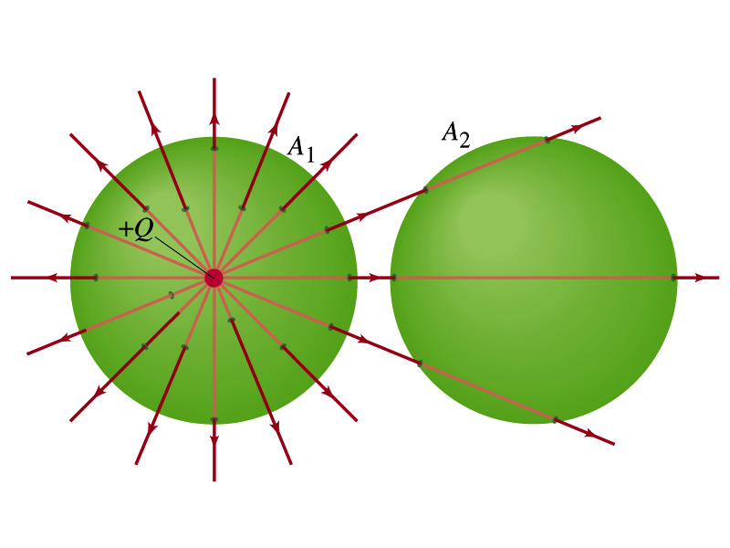
Example 22 – 2
Flux from Gauss’ Law: Consider two Gaussian surfaces, A₁ and A₂, shown in the figure. The only charge present is the charge +Q at the center of surface A₁. What is the net flux through each surface A₁ and A₂?
The surface A₁ encloses the charge +Q, so from Gauss’ law we obtain the total net flux
The surface A₂ the charge, +Q, is outside the surface, so the total net flux is 0.

Slide 27
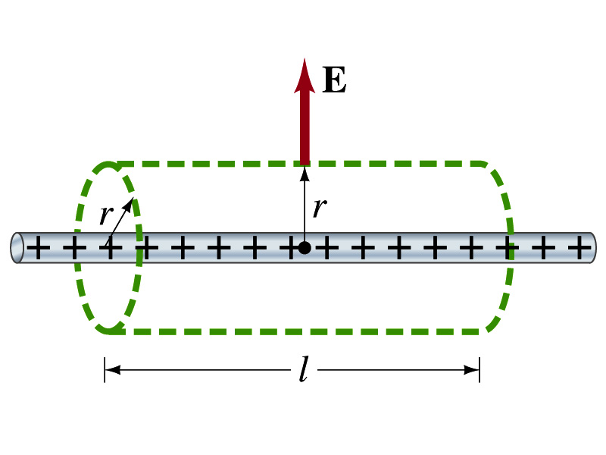
Example 22 – 6
Long uniform line of charge: A very long straight wire possesses a uniform positive charge per unit length, λ. Calculate the electric field a point near but outside the wire, far from the ends.
Which direction do you think the field due to the charge on the wire is?
  Radially outward from the wire, the direction of radial vector r.
Due to cylindrical symmetry, the field is the same on the Gaussian surface of a cylinder surrounding the wire.
  The end surfaces do not contribute to the flux at all. Why?
    Because the field vector E is perpendicular to the surface vector dA.
From Gauss’ law
Solving for E

Slide 28
A Brain Teaser of Electric Flux
What would change the electric flux through a circle lying in the xz plane where the electric field is (10N/C)j?
  Changing the magnitude of the electric field
  Changing the surface area of the circle
  Tipping the circle so that it is lying in the xy plane
  All of the above
  None of the above

Slide 29
Gauss’ Law Summary
The precise relationship between flux and the enclosed charge is given by Gauss’ Law
    ε₀ is the permittivity of free space in the Coulomb’s law
A few important points on Gauss’ Law
  Freedom to choose!!
    The surface integral is performed over the value of E on a closed surface of our choice in any given situation.
  Test of existence of electrical charge!!
    The charge Q_{encl} is the net charge enclosed by the arbitrary closed surface of our choice.
  Universality of the law!
    It does NOT matter where or how much charge is distributed inside the surface. Gauss’ law still applies!
  The charge outside the surface does not contribute to Q_{encl}. Why?
    The charge outside the surface might impact field lines but not the total number of lines entering or leaving the surface.

