Slide 1
PHYS 1441 – Section 001
Lecture #5
Monday, June 10, 2019
Dr. Jaehoon Yu
Chapter 22
  Electric Dipole
Chapter 23
  Electric Potential Energy
  Electric Potential due to Point Charges
  Shape of the Electric Potential
  V due to Charge Distributions
Today’s homework is #4, due 11pm, Friday, June 14!!

Slide 2
Announcements
Reading Assignment
  CH 23.9

Slide 3
Reminder: SP#2 – Angels & Demons
Compute the total possible energy released from an annihilation of x-grams of anti-matter and the same quantity of matter, where x is the last two digits of your SS#. (20 points)
  Use the famous Einstein’s formula for mass-energy equivalence
Compute the power output of this annihilation when the energy is released in x ns, where x is again the first two digits of your SS#. (10 points)
Compute how many cups of gasoline (8MJ) this energy corresponds to. (5 points)
Compute how many months of world electricity usage (3.6GJ/mo) this energy corresponds to. (5 points)
Due by the beginning of the class Wednesday, June. 12

Slide 4
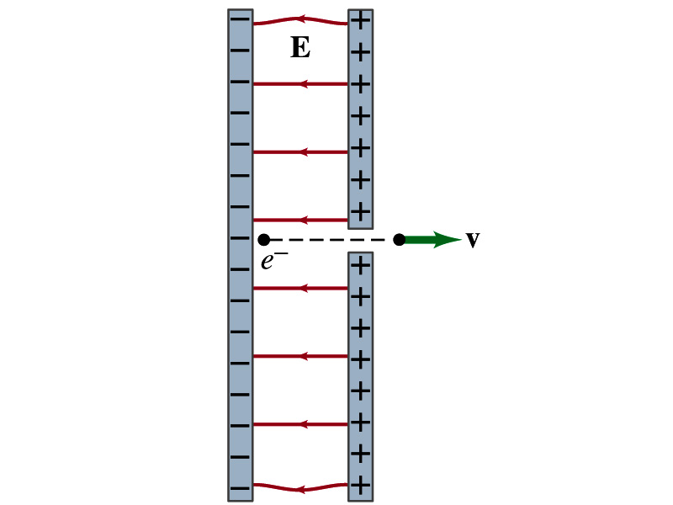
Special Project #3
Particle Accelerator. A charged particle of mass M with charge -Q is accelerated in the uniform field E between two parallel charged plates whose separation is D as shown in the figure on the right. The charged particle is accelerated from an initial speed v₀ near the negative plate and passes through a tiny hole in the positive plate as shown in the figure right.
  Derive the formula for the electric field E to accelerate the charged particle to a fraction f of the speed of light c. Express E in terms of M, Q, D, f, c and v₀.
  (a) Using the Coulomb force and kinematic equations. (8 points)
  (b) Using the work-kinetic energy theorem. ( 8 points)
  (c) Using the formula above, evaluate the strength of the electric field E to accelerate an electron from 0.1% of the speed of light to 90% of the speed of light. You need to look up the relevant constants, such as mass of the electron, charge of the electron and the speed of light. (5 points)
Please do NOT copy but have your own handwritten answer!
Due beginning of the class Monday, June 17

Slide 5
Gauss’ Law Summary
The precise relationship between flux and the enclosed charge is given by Gauss’ Law
    ε₀ is the permittivity of free space in the Coulomb’s law
A few important points on Gauss’ Law
  Freedom to choose!!
    The surface integral is performed over the value of E on a closed surface of your choice in any given situation.
  Test of existence of electrical charge!!
    The charge Q_{encl} is the net charge enclosed by the arbitrary closed surface of your choice.
  Universality of the law!
    It does NOT matter where or how much charge is distributed inside the surface. Gauss’ law still applies!
  The charge outside the surface does not contribute to Q_{encl}. Why?
    The charge outside the surface might impact the field lines but not the total number of lines entering or leaving the surface.

Slide 6
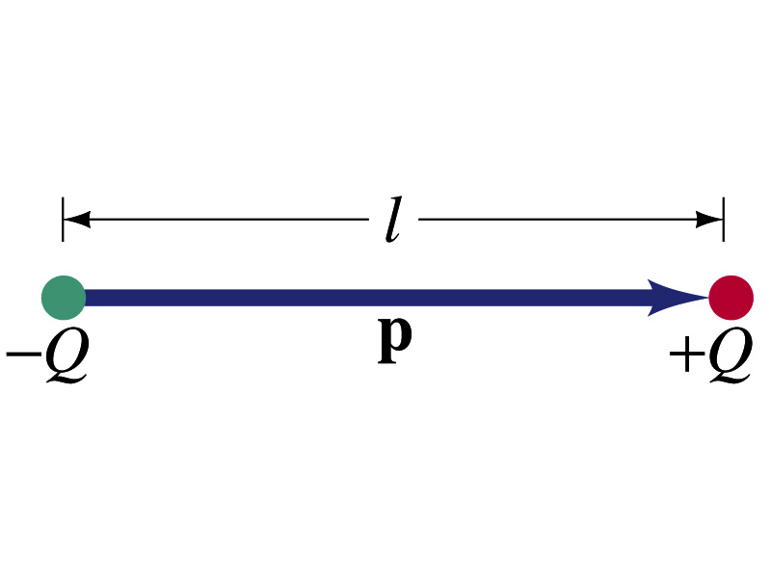
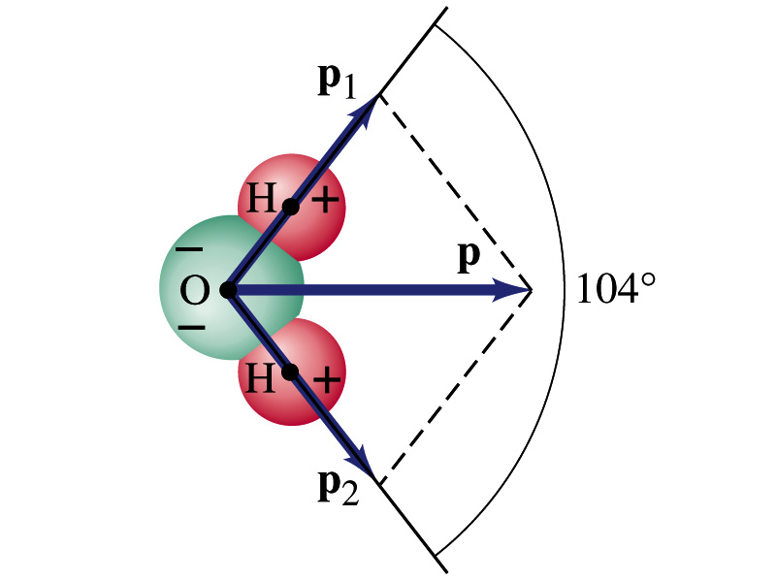
Electric Dipoles
An electric dipole is the combination of two equal charges of opposite signs, +Q and –Q, separated by a distance l, which behaves as one entity.
The quantity Ql is called the electric dipole moment and is represented by the symbol p.
  The dipole moment is a vector quantity, p
  The magnitude of the dipole moment is Ql. Unit?
  Its direction is from the negative charge to the positive charge.
  Many of diatomic molecules like CO have a dipole moment. ➔ These are referred as polar molecules.
    Even if the molecule is electrically neutral, their sharing of electrons causes separation of charges
    Symmetric diatomic molecules, such as O₂, do not have dipole moment.
C-m
  The water molecule also has a dipole moment which is the vector sum of two dipole moments between Oxygen and each of Hydrogen atoms.

Slide 7
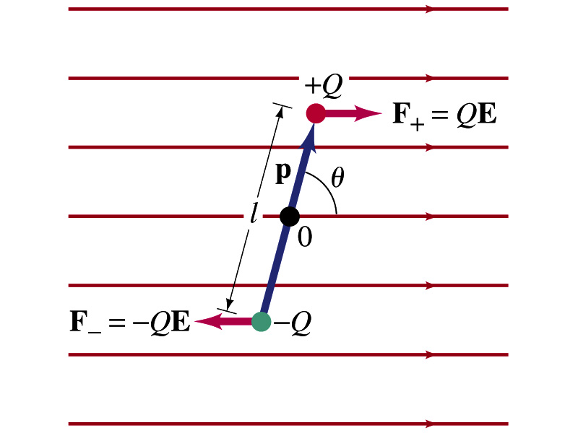
Dipoles in an External Field
Let’s consider a dipole placed in a uniform electric field E.
What do you think will happen to the dipole in the figure?
  Force will be exerted on the charges.
    The positive charge will get pushed toward right while the negative charge will get pulled toward left.
  What is the net force acting on the dipole?
    Zero
  So will the dipole not move?
    Yes, it will.
  Why?
    There is a torque applied on the dipole.

Slide 8
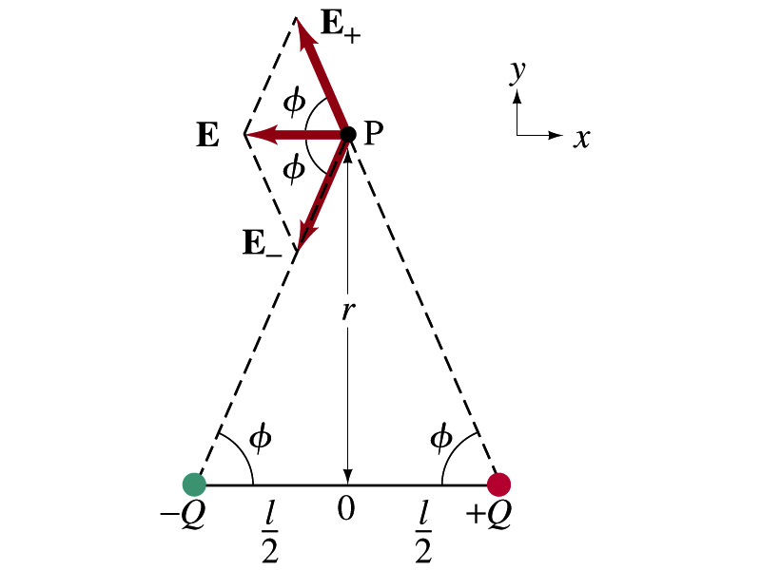
Electric Field by a Dipole
Let’s consider the case in the picture.
There are fields by both the charges. So the total electric field by the dipole is
The magnitudes of the two fields are equal
Now we must work out the x and y components of the total field.
  Sum of the two y components is
    Zero since they are the same but in opposite direction
  So the magnitude of the total field is the same as the sum of the two x-components:

Slide 9
Dipole Electric Field from Afar
What happens when r>>l?.
Why does this make sense?
  Since from a long distance, the two charges are very close so that the overall charge gets close to 0!!
  This dependence works for the point not on the bisecting line as well

Slide 10
Electric Potential Energy
Concept of energy is very useful solving mechanical problems
Conservation of energy makes solving complex problems easier.
When can the potential energy be defined?
  Only for a conservative force.
  The work done by a conservative force is independent of the path. What does it only depend on??
    The difference between the initial and final positions
  Can you give me an example of a conservative force?
    Gravitational force
Is the electrostatic force between two charges a conservative force?
  Yes. Why?
  The dependence of the force to the distance is identical to that of the gravitational force.
    The only thing matters is the direct linear distance between the objects not the path.

