Slide 1
PHYS 1441 – Section 001 Lecture #7
Wednesday, June 12, 2019
Dr. Jaehoon Yu
Chapter 23
V due to Charge Distributions
Equi-potential Lines and Surfaces
Electric Potential Due to Electric Dipole
Chapter 24 Capacitance etc..
Capacitors
Capacitors in Series or Parallel
Electric Energy Storage
Today’s homework is #5, due 11pm, Sunday, June 16!!

Slide 2
Announcements
Quiz #2
At the beginning of the class tomorrow, Thursday, June 13
Covers up to what we’ve learned today
You can bring your calculator but it must not have any relevant formula pre-input
Cell phones or any types of computers cannot replaced a calculator!
BYOF: You may bring one 8.5x11.5 sheet (front and back) of handwritten formulae and values of constants for the exam
No derivations, word definitions, setups or solutions of any problems!
No additional formulae or values of constants will be provided!
Term 1 result
Class average: 56.4/100
Top score: 97.5
Reminder: Evaluation criteria
Homework: 25%
Final exam: 23%
Mid-term: 20%
One better of the two term exams:12%
Lab and quizzes: 10% each + 10% extra credit!!

Slide 3
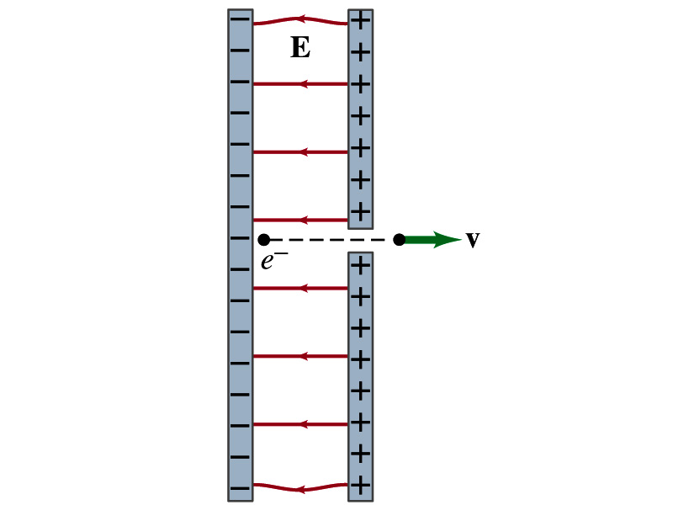
Reminder: Special Project #3
Particle Accelerator. A charged particle of mass M with charge -Q is accelerated in the uniform field E between two parallel charged plates whose separation is D as shown in the figure on the right. The charged particle is accelerated from an initial speed v₀ near the negative plate and passes through a tiny hole in the positive plate as shown in the figure right.
Derive the formula for the electric field E to accelerate the charged particle to a fraction f of the speed of light c. Express E in terms of M, Q, D, f, c and v₀.
(a) Using the Coulomb force and kinematic equations. (8 points)
(b) Using the work-kinetic energy theorem. ( 8 points)
(c) Using the formula above, evaluate the strength of the electric field E to accelerate an electron from 0.1% of the speed of light to 90% of the speed of light. You need to look up the relevant constants, such as mass of the electron, charge of the electron and the speed of light. (5 points)
Please do NOT copy but have your own handwritten answer!
Due beginning of the class Monday, June 17

Slide 4
Properties of the Electric Potential
What are the differences between the electric potential and the electric field?
Electric potential
Electric potential energy per unit charge
Inversely proportional to the distance
Simply add the potential by each of the source charges to obtain the total potential from multiple charges, since potential is a scalar quantity
Electric field
Electric force per unit charge
Inversely proportional to the square of the distance
Need vector sums to obtain the total field from multiple source charges
Potential due to a positive charge is a large positive near the charge and decreases towards 0 at the large distance.
Potential due to a negative charge is a large negative near the charge and increases towards 0 at a large distance.

Slide 5
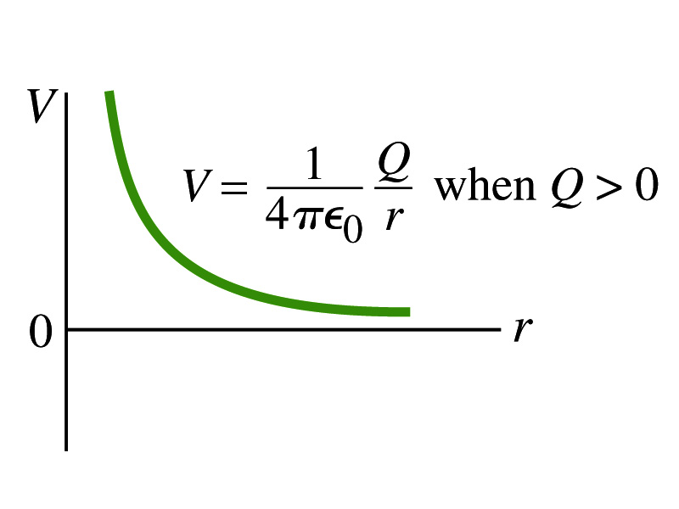
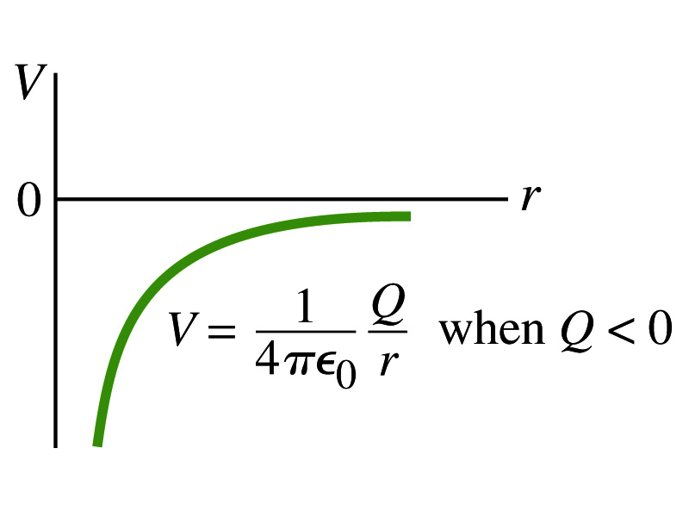
Shape of the Electric Potential
So, how does the electric potential look like as a function of distance?
What is the formula for the potential by a single charge?
If Q is Positive
If Q is Negative
Uniformly charged sphere would have the potential the same as a single point charge.
What does this mean?
Uniformly charged sphere behaves like all the charge is on the single point in the center.

Slide 6
Example 23 – 6
Work to bring two positive charges close together: What is minimum work required by an external force to bring the charge q=+3.00μC from a great distance away (r=∞) to a point 0.500m from a charge Q=+20.0 μC?
What is the work done by the electric field in terms of potential energy and potential?
Since we obtain
Electric force does negative work. In other words, the external force must work +1.08J to bring the charge 3.00μC from infinity to 0.500m to the charge 20.0μC.

Slide 7
Electric Potential by Charge Distributions
Let’s consider the case of n individual point charges in a given space and V=0 at r=∞.
Then the potential V_{ia} due to the charge Q_{i} at point a, at a distance r_{ia} from Q_{i} is
Thus the total potential V_{a} by all n point charges is
For a continuous charge distribution, we obtain

Slide 8
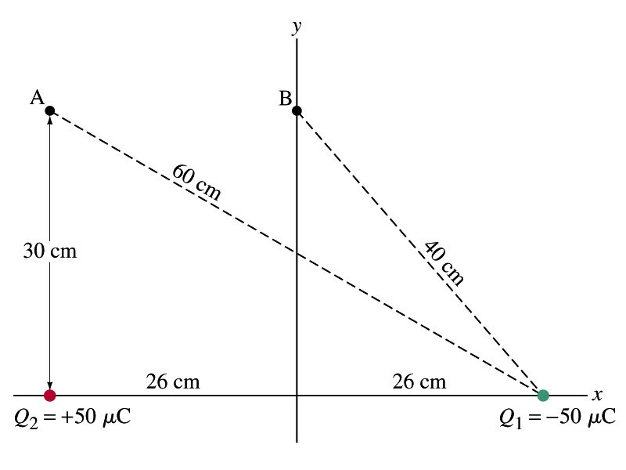
Example
Potential due to two charges: Calculate the electric potential (a) at point A in the figure due to the two charges shown, and (b) at point B.
Potential is a scalar quantity, so one adds the potential by each of the source charge, as if they are numbers.
(a) potential at A is
(b) How about potential at B?

Slide 9
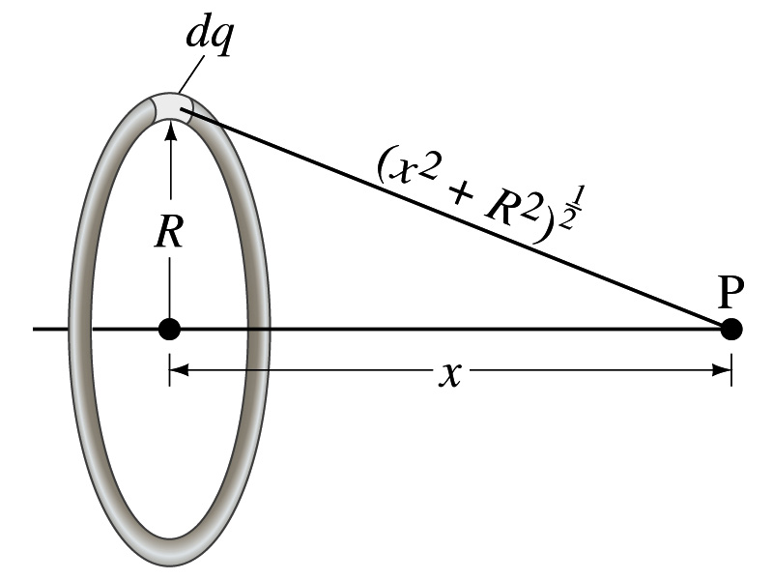
Example 23 – 8
Potential due to a ring of charge: A thin circular ring of radius R carries a uniformly distributed charge Q. Determine the electric potential at a point P on the axis of the ring a distance x from its center.
Each point on the ring is at the same distance from the point P. What is the distance?
So the potential at P is
What’s this?

Slide 10
Equi-potential Surfaces
Electric potential can be graphically shown using the equipotential lines in 2-D or the equipotential surfaces in 3-D
Any two points on the equipotential surfaces (lines) are at the same potential
What does this mean in terms of the potential difference?
The potential difference between any two points on an equipotential surface is 0.
How about the potential energy difference?
Also 0.
What does this mean in terms of the work to move a charge along the surface between these two points?
No work is necessary to move a charge between these two points.

Slide 11
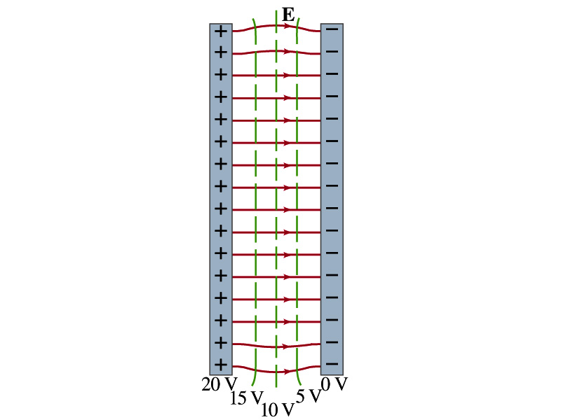
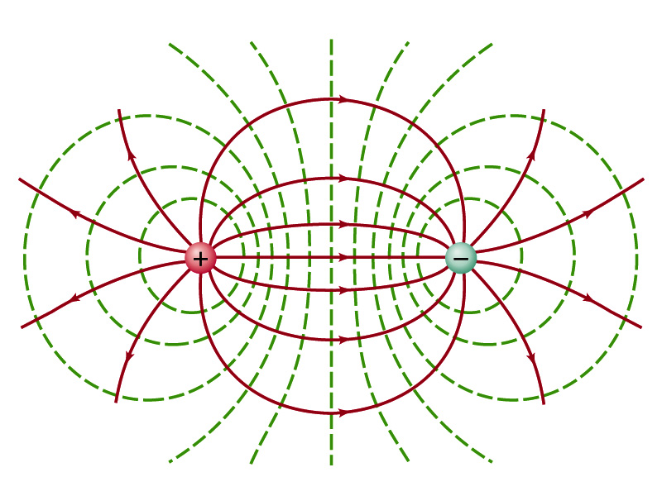
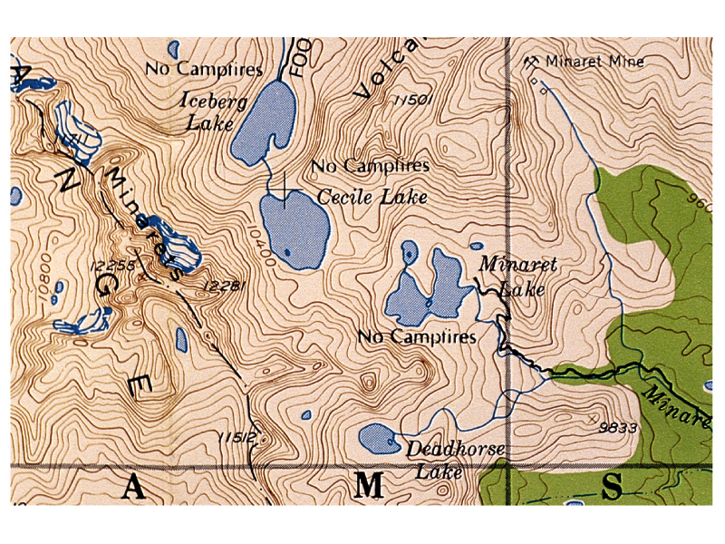
Equi-potential Surfaces
An equipotential surface (line) must be perpendicular to the electric field. Why?
If there are any parallel components to the electric field, it would require work to move a charge along the surface.
Since the equipotential surface (line) is perpendicular to the electric field, we can draw these surfaces or lines easily.
Since there can be no electric field within a conductor in a static case, the entire volume of a conductor must be at the same potential.
So the electric field must be perpendicular to the conductor surface.
Parallel Plate
Point charges
Just like a topological map

Slide 12
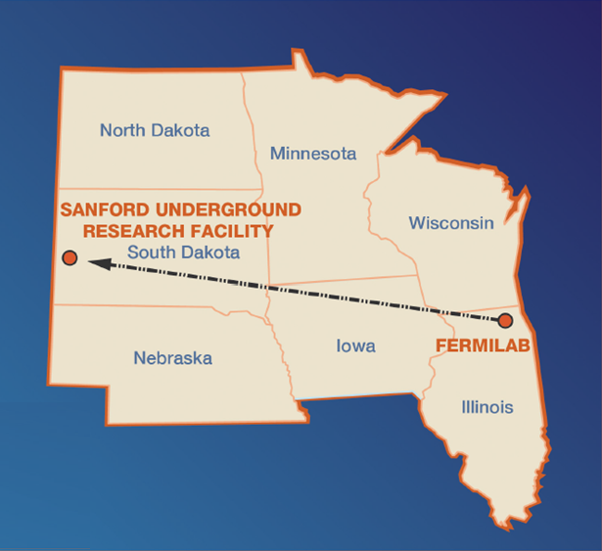
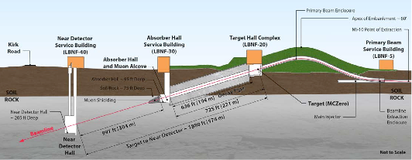
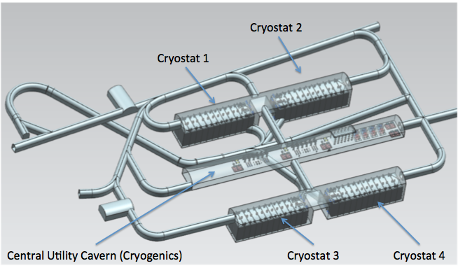
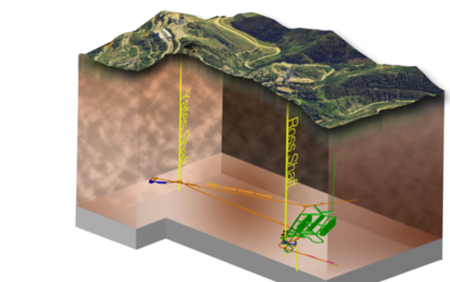
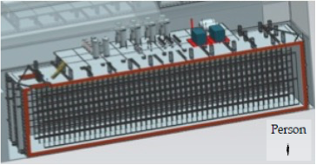
DUNE Experiment
Broadband ν beam from Fermilab
LBNF ν Beam
P_{Beam} :1.2MW →2.4MW
1300km (800 miles)
Long Baseline
4 caverns w/ active V~10kt LAr each
~30xICARUS
LBNF Far Detector Site, SURF
1500m underground
15m
15m
66m

Slide 13
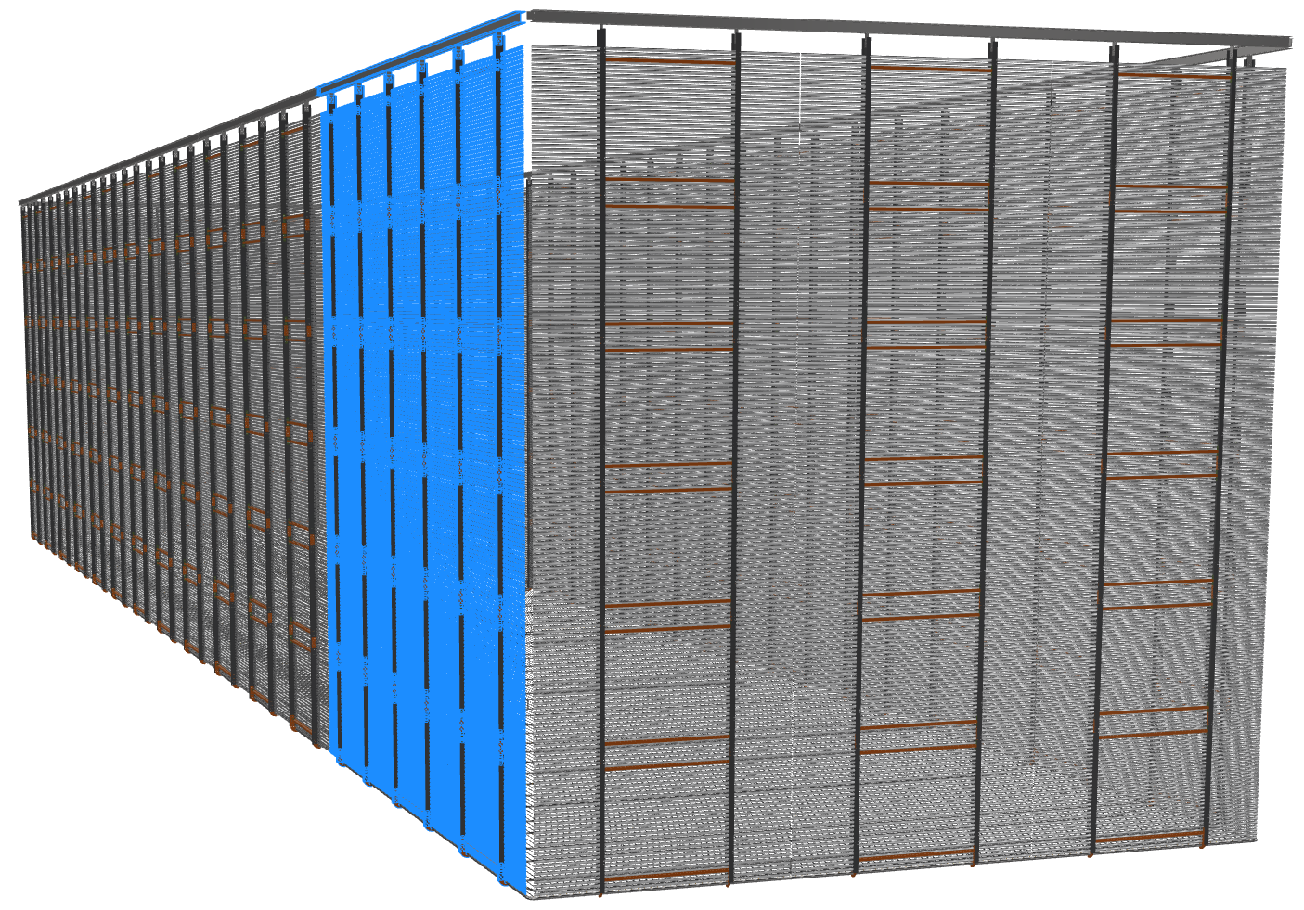
DUNE Field Cage Outside View
End walls will be angled
12m
-600kV
50cm

Slide 14
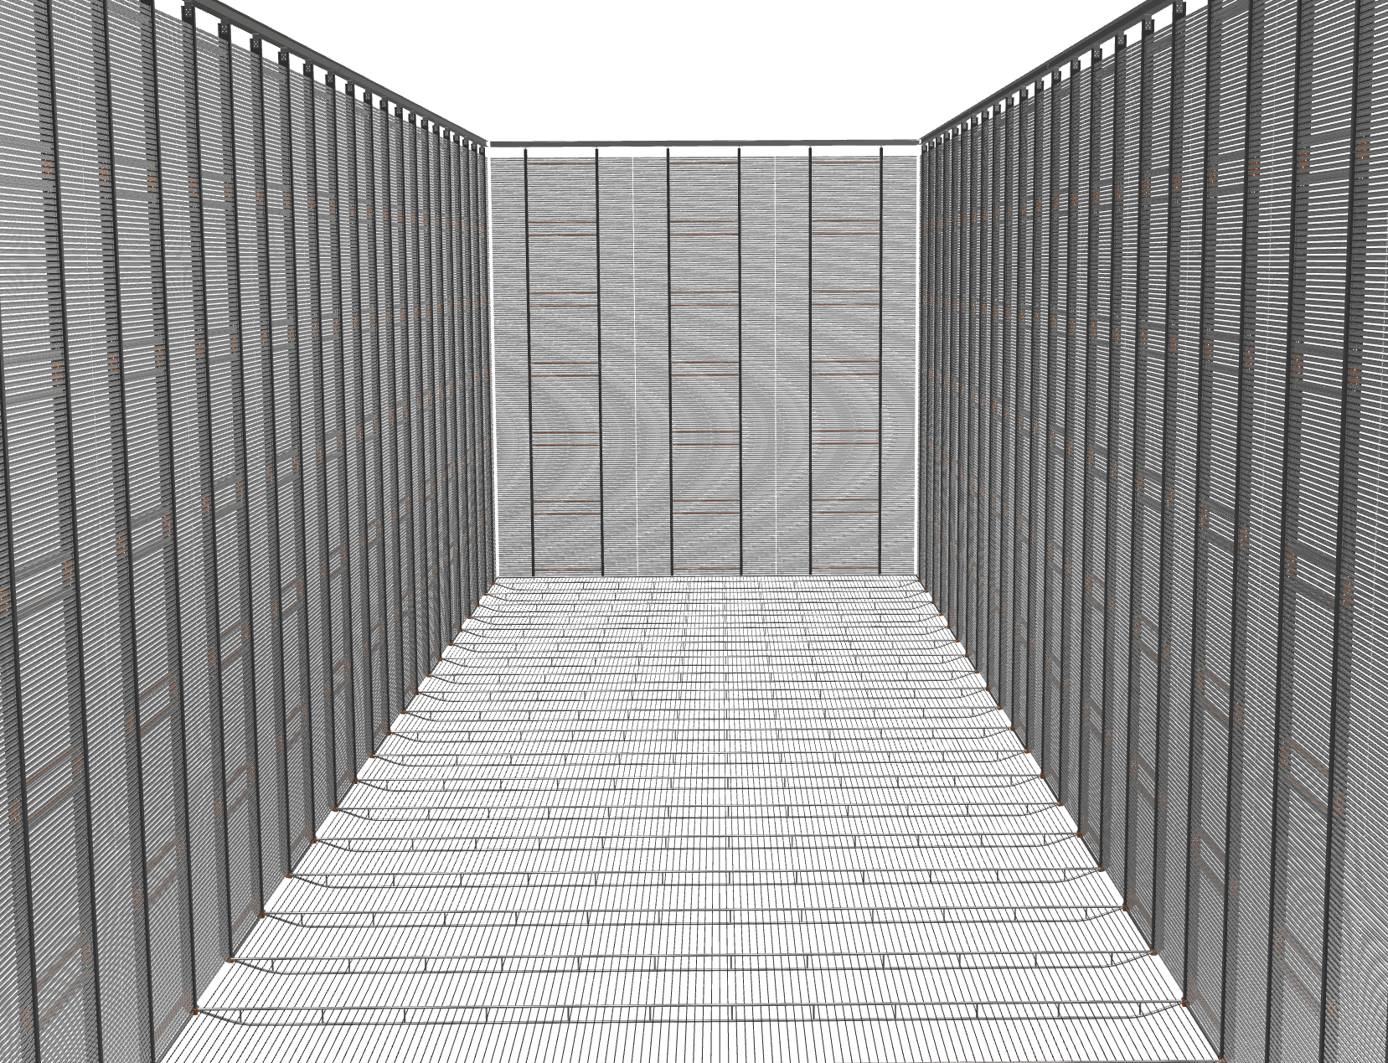
DUNE Field Cage Inside View

Slide 15
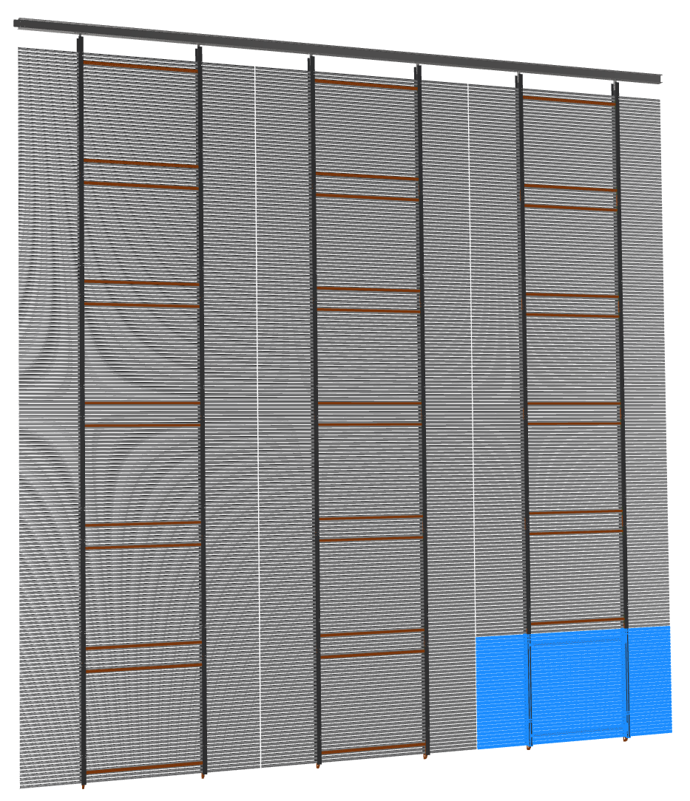
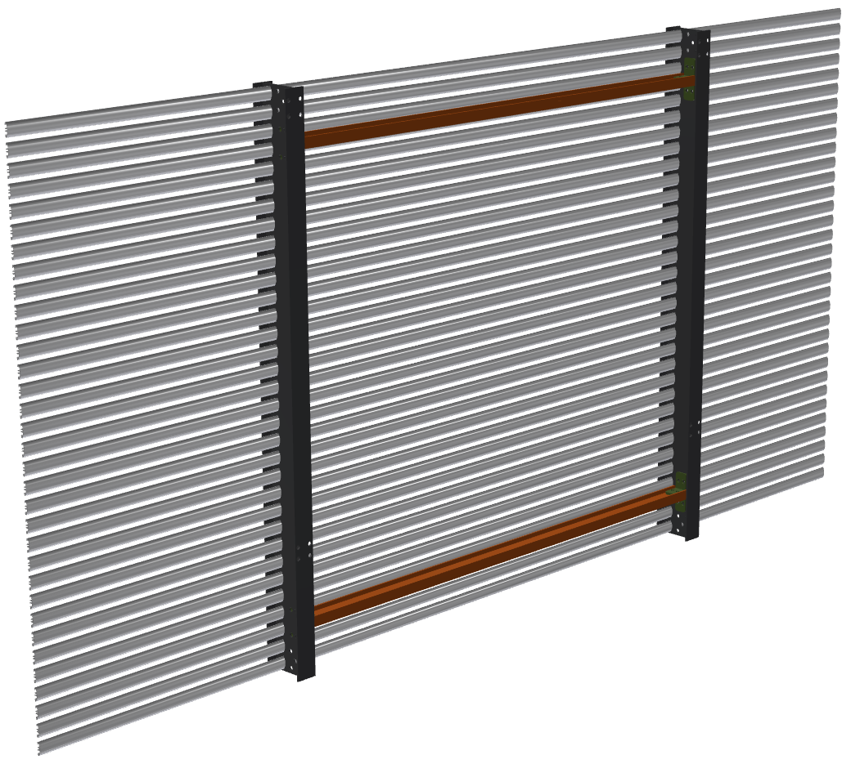
DUNE Field Cage Construction
FC Module (FCM): 4m wide x 2m tall
FC Super Module (FCSM): 12m x 12m (3x6 FCM)
Each FCSM is supported by one 12m long SS beam.
The I-beam is hang from 2 cables to the roof
Entire FC: 12 FC Super Modules
The sub-modules will have profiles face out
Use 4” I-beams

Slide 16
FC Module
FC Module (FCM): 4m wide x 2m tall
FC Super Module (FCSM): 12m x 12m (3x6 FCM)
Each FCSM is supported by one 12m long SS beam.
The I-beam is hang from 2 cables to the roof
Entire FC: 12 FC Super Modules
The sub-modules will have profiles face out
Use 4” I-beams

Slide 17
Cathode and Field Cage Connection at the Corner

Slide 18
Field Simulations
2D simulation
Equipotential lines

