Slide 1
PHYS 1444 – Section 001 Lecture #10
Wednesday, June 19, 2019
Dr. Jaehoon Yu
Chapter 25
Electric Current and Resistance
The Battery
Ohm’s Law: Resistors
Resistivity
Electric Power
Alternating Current
Today’s homework is #8, due 11pm, Monday, June 24!!

Slide 2
Announcements
Reading Assignments: CH25.9 and 25.10
Today, we will have the class through 11:55am to allow us to move over to CPB303 for the lunch and the professor Carlo Rubbia Meeting
Please be sure to sign in your name for the quadruple Extra Credit on the sign-in sheet
We will have a mid-term grade discussion tomorrow, Thursday, June 20. We will have a class till 11:30am, followed by the discussion in my office (CPB342).
Last name A – K:11:30 – 12:00
Last name L – Y: 12:00 – 12:30
Mid-term results
Class Average: 65.8/100
Previous result: 56.4/100
Top score: 86.5

Slide 3
Electric Current and Resistance
So far we have been studying static electricity
What is the static electricity?
The charges so far has not been moving but staying put at the location they are placed.
Now we will learn dynamics of the electricity
What is the electric current?
A flow of electric charge
A few examples of the things that use electric current in everyday lives?
In an electrostatic situation, there is no electric field inside a conductor but when there is current, there is field inside a conductor. Why?
Electric field is needed to keep charges moving

Slide 4
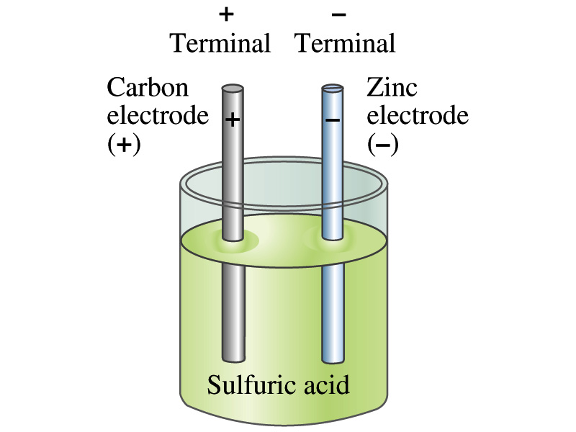
The Electric Battery
What is a battery?
A device that produces electrical energy from the stored chemical energy and produces electricity ➔ Maintains a potential difference!
Electric battery was invented by Volta in 1790s in Italy
It was made of disks of zinc and silver based on his research that certain combinations of materials produce a greater electromotive force (emf), or potential, than others
Simplest batteries contain two plates made of dissimilar metals called the electrodes
Electrodes are immersed in a solution, the electrolyte
This unit is called a cell and many of these form a battery
Zinc and Iron in the figure are called terminals

Slide 5
How does a battery work – I?
One of the electrodes in the figure is zinc and the other carbon
The acid electrolyte reacts with the zinc electrode and dissolves it.
Each zinc atom leaves two electrons in the electrode and enters into the solution as a positive ion ➔ zinc electrode acquires negative charge and the electrolyte (the solution) becomes positively charged
The carbon electrode picks up the positive charge
Since the two terminals are oppositely charged, there is a potential difference between them

Slide 6
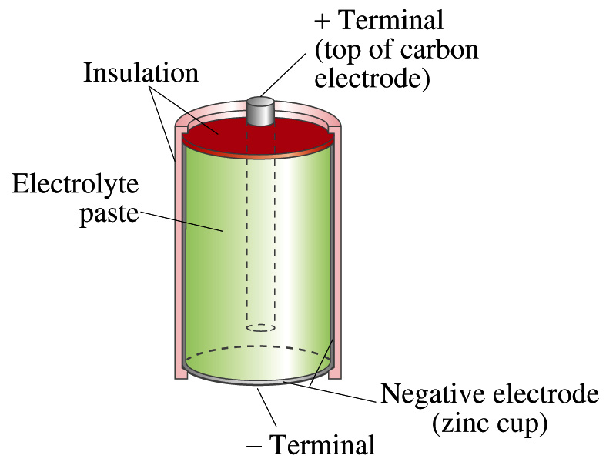
How does a normal battery look?

Slide 7
How does a battery work – II?
When the terminals are not connected, only the necessary amount of zinc is dissolved into the solution.
How is a particular potential maintained?
If the terminals are not connected, as too many zinc ions get produced,
zinc electrode gets increasingly charged up negative
zinc ions get recombined with the electrons in zinc electrode
Why does battery go dead?
When the terminals are connected to a circuit, the negative charges will flow away from the zinc electrode
More zinc atoms dissolve into the electrolyte to produce more charge
One or more electrode get used up not producing any more charge.

Slide 8
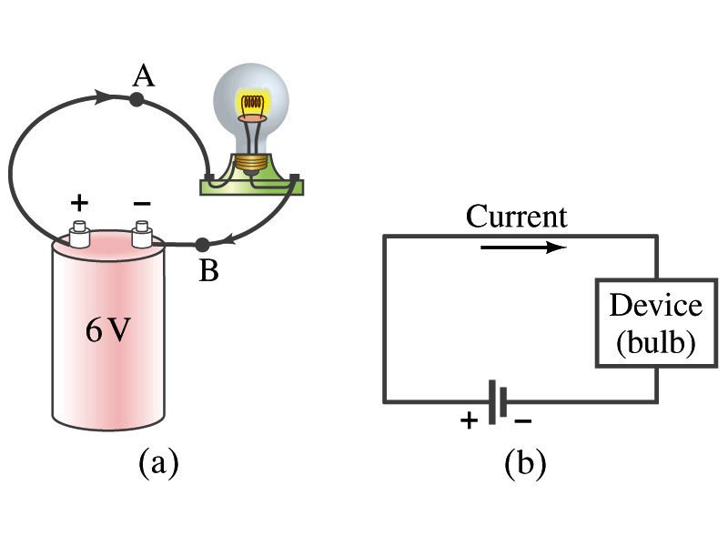
Electric Current
When a circuit is powered by a battery (or a source of emf) the charge can flow through the circuit.
Electric Current: Any flow of charge
Current can flow whenever there is a potential difference between the ends of a conductor (or when the two ends have opposite charges)
The current can flow even through the empty space under certain conditions
Electric current in a wire can be defined as the net amount of charge that passes through the wire’s full cross section at any point per unit time (just like the flow of water through a conduit.)
Average current is defined as:
The instantaneous current is:
What kind of a quantity is the current?
Unit of the current?
C/s
1A=1C/s
Scalar
In a single circuit, conservation of electric charge guarantees that the current at one point of the circuit is the same as any other points on the circuit.

Slide 9
Example 25 – 1
Current is a flow of charge: A steady current of 2.5A flows in a wire for 4.0min. (a) How much charge passed by any point in the circuit? (b) How many electrons would this be?
Current is total amount charge flown through a circuit in a given time. So from we obtain
The total number of electrons passed through the circuit is

Slide 10
Example 25 – 1
Current is a flow of charge: A steady current of 2.5A flows in a wire for 4.0min. (a) How much charge passed by any point in the circuit? (b) How many electrons would this be?
Current is total amount charge flown through a circuit in a given time. So from we obtain
The total number of electrons passed through the circuit is

Slide 11
Direction of the Electric Current
What do conductors have in abundance?
Free electrons
What happens if a continuous loop of conducting wire is connected to the terminals of a battery?
Electrons start flowing through the wire continuously as soon as both the terminals are connected to the wire. How?
The potential difference between the battery terminals sets up an electric field inside the wire and in the direction parallel to it
Free electrons in the conducting wire get attracted to the positive terminal
The electrons leaving negative terminal flow through the wire and arrive at the positive terminal
Electrons flow from negative to positive terminal
Due to historical convention, the direction of the current is opposite to the direction of flow of electrons ➔ Conventional Current

Slide 12
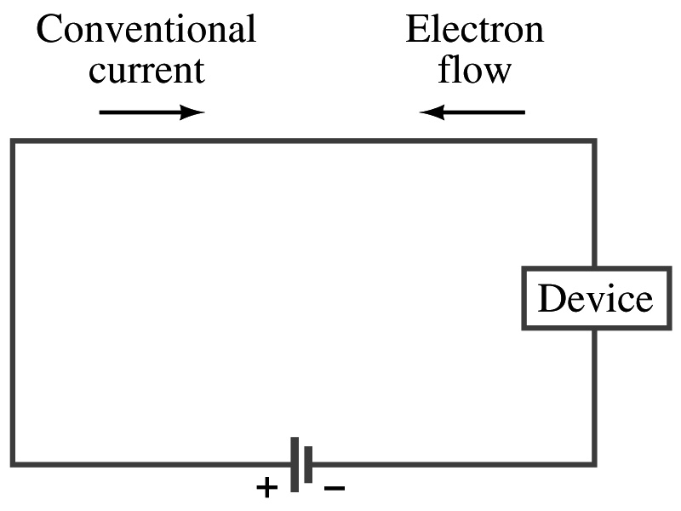
Direction of the Electric Current

Slide 13
Ohm’s Law: Resistance and Resistors
What do we need to produce electric current?
Potential difference
Georg S. Ohm experimentally established that the current is proportional to the potential difference ( )
If we connect a wire to a 12V battery, the current flowing through the wire is twice that of 6V, three times that of 4V and four times that of 3V battery.
What happens if we reverse the sign of the voltage?
It changes the direction of the current flow
Does not change the magnitude of the current
Just as in water flow case, if the height difference is large the flow rate is large ➔ If the potential difference is large, the current is large.

Slide 14
Ohm’s Law: Resistance
The exact amount of current flow in a wire depends on
The voltage
The resistance of the wire to the flow of electrons
Just like the gunk in water pipe slows down water flow
Electrons are slowed down due to interactions with the atoms of the wire
The higher the resistance the less the current for the given potential difference V
So how would you define resistance?
So that current is inversely proportional to the resistance
Often it is rewritten as
What does this mean?
The metal conductor’s resistance R is a constant independent of V.
This linear relationship is not valid for some materials like diodes, vacuum tubes, transistors etc. ➔ These are called non-ohmic
Unit?
Ohm’s Law
ohms

Slide 15
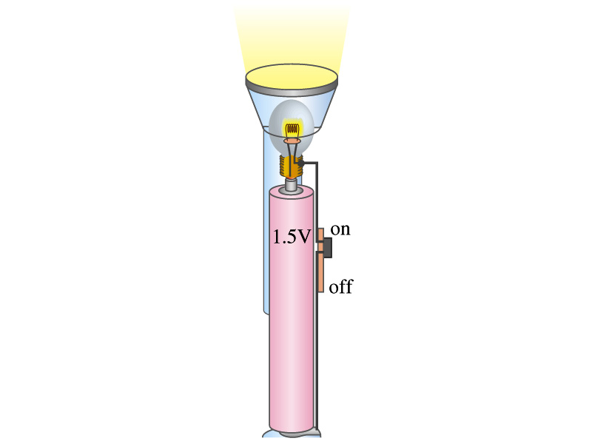
Example 25 – 4
Flashlight bulb resistance: A small flashlight bulb draws 300mA from its 1.5V battery. (a) What is the resistance of the bulb? (b) If the voltage drops to 1.2V, how would the current change?
From Ohm’s law, we obtain
Would the current increase or decrease, if the voltage reduces to 1.2V?
If the resistance did not change, the current is

Slide 16
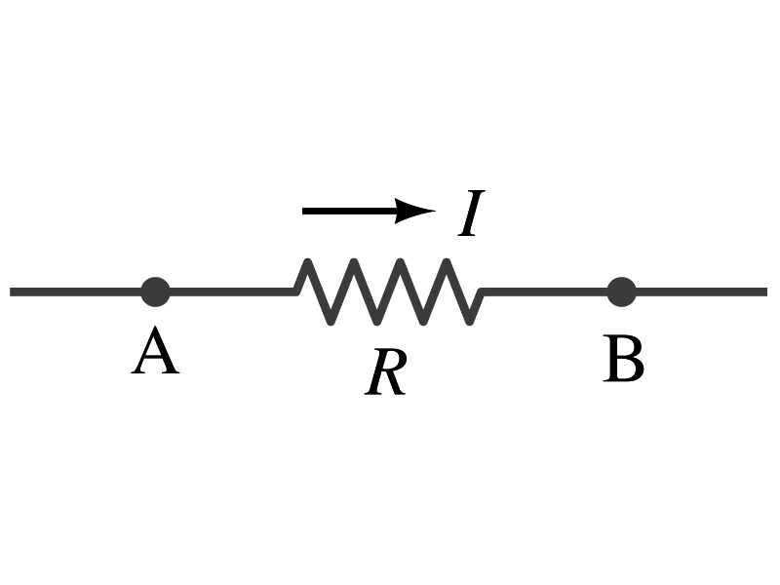
Ohm’s Law: Resistors
All electric devices offer resistance to the flow of current.
Filaments of light bulbs or heaters are wires with high resistance to cause electrons to lose their energy in the wire
In general connecting wires have low resistance compared to other devices on the circuit
In circuits, resistors are used to control the amount of current
Resistors offer resistance of less than one ohm to millions of ohms
Main types are
“wire-wound” resistors which consists of a coil of fine wire
“composition” resistors which are usually made of semiconductor carbon
thin metal films
When drawn in the circuit, the symbol for a resistor is:
Wires are drawn simply as straight lines

Slide 17
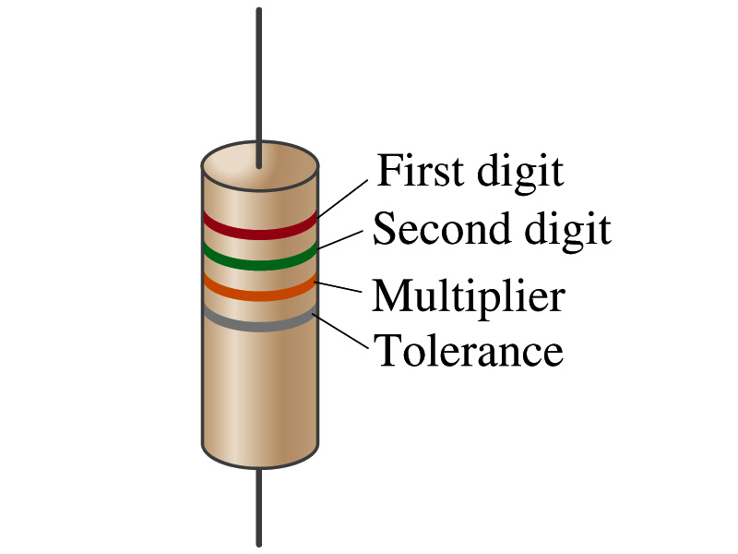
Ohm’s Law: Resistor Values
Resistors have its resistance color-coded on its body
The color-coding follows the convention below:
Color | Number | Multiplier | Tolerance
Black | 0 | 1=10⁰
Brown | 1 | 10¹
Red | 2 | 10²
Orange | 3 | 10³
Yellow | 4 | 10⁴
Green | 5 | 10⁵
Blue | 6 | 10⁶
Violet | 7 | 10⁷
Gray | 8 | 10⁸
White | 9 | 10⁹
Gold |  | 10-¹ | 5%
Silver |  | 10⁻² | 10%
None |  |  | 20%
What is the resistance of the resistor in this figure?

Slide 18
Resistivity
It is experimentally found that the resistance R of a metal wire is directly proportional to its length l and inversely proportional to its cross-sectional area A
How would you formularize this?
The proportionality constant ρ is called the resistivity and depends on the material used. What is the unit of this constant?
ohm-m or Ω−m
The values depends on purity, heat treatment, temperature, etc
How would you interpret the resistivity?
The higher the resistivity the higher the resistance
The lower the resistivity the lower the resistance and the higher the conductivity ➔ Silver has the lowest resistivity.
So the silver is the best conductor
The reciprocal of the resistivity is called the conductivity, σ,
A
l

Slide 19
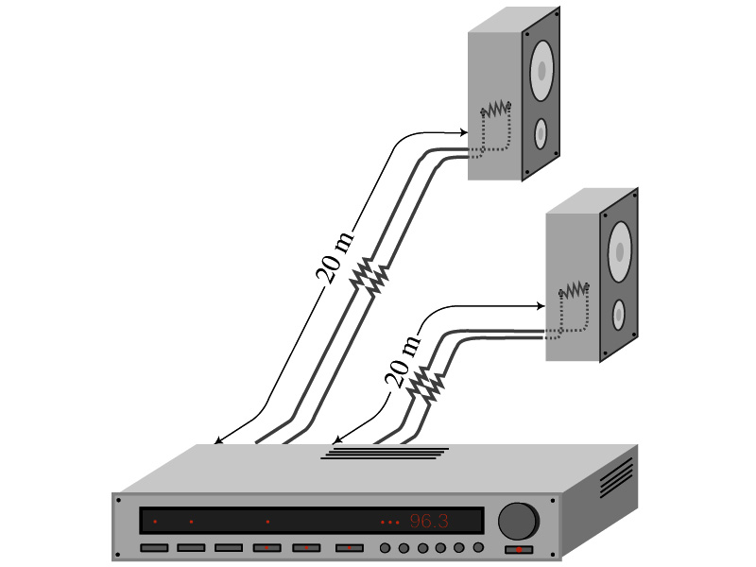
Example 25 – 5
Speaker wires: Suppose you want to connect your stereo to remote speakers. (a) If each wire must be 20m long, what diameter copper wire should you use to keep the resistance less than 0.1-Ω per wire? (b) If the current on each speaker is 4.0A, what is the voltage drop across each wire?
The resistivity of a copper is
Table 25.1
From the formula for resistance, we can obtain the formula for area
Solve for A
Solve for d
From Ohm’s law, V=IR, we obtain

Slide 20
Example 25 – 6
Stretching changes resistance: A wire of resistance R is stretched uniformly until it is twice its original length. What happens to its resistance?
What is the constant quantity in this problem?
The volume!
What is the volume of a cylinder of length L and radius r?
What happens to A if L increases factor two, L’=2L?
The cross-sectional area, A, halves. A’=A/2
The original resistance is
The new resistance is
The resistance of the wire increases by a factor of four if the length increases twice.

Slide 21
Temperature Dependence of Resistivity
Do you think the resistivity depends on temperature?
Yes
Would it increase or decrease with the temperature?
Increase
Why?
Because the atoms are vibrating more rapidly as temperature increases and are arranged in a less orderly fashion. So?
They interfere more with the flow of electrons.
If the temperature change is not too large, the resistivity of metals usually increase nearly linearly w/ temperature
α is the temperature coefficient of resistivity
α of some semiconductors can be negative due to increased number of freed electrons.

Slide 22
Electric Power
Why is the electric energy useful?
It can transform into different forms of energy easily.
Motors, pumps, etc, transform electric energy to mechanical energy
Heaters, dryers, cook-tops, etc, transforms electricity to thermal energy
Incandescent light bulb filament transforms electric energy to light energy
Only about 10% of the energy turns to light and the 90% lost via heat
Typical household light bulb and heating elements have resistance of order a few ohms to a few hundred ohms
How does electric energy transforms to thermal energy?
Flowing electrons collide with the vibrating atoms of the wire.
In each collision, part of electron’s kinetic energy is transferred to the atom it collides with.
The kinetic energy of wire’s atoms increases, and thus the temperature of the wire increases.
The increased thermal energy can be transferred as heat through conduction and convection to the air in a heater or to food on a pan, through radiation to bread in a toaster or radiated as light.

Slide 23
Electric Power
How do we find out the power transformed by an electric device?
What is definition of the power?
The rate at which work is done or the energy is transformed
What is the energy transformed when an infinitesimal charge dq moves through a potential difference V?
dU=Vdq
If dt is the time required for an amount of charge dq to move through the potential difference V, the power P is
Thus, we obtain .
What is the unit?
What kind of quantity is the electrical power?
Scalar
P=IV can apply to any devices while the formula with resistance can only apply to devices that has resistance.
What is this?
In terms of resistance
Watts = J/s

Slide 24
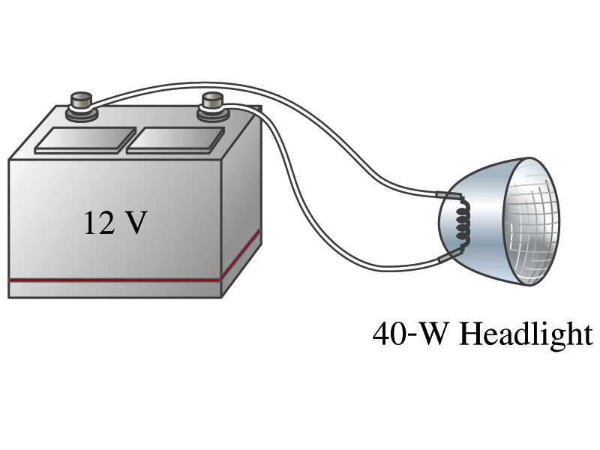
Example 25 – 8
Headlights: Calculate the resistance of a 40-W automobile headlight designed for 12V.
Since the power is 40W and the voltage is 12V, we use the formula with V and R.
Solve for R

