Slide 1
PHYS 1444 – Section 001 Lecture #11
Thursday, June 20, 2019
Dr. Jaehoon Yu
Chapter 25
Electric Power
Alternating Current
Microscopic View of Electric Current
Ohm’s Law in Microscopic View
EMF and Terminal Voltage

Slide 2
Nobel Meeting Photos
Good job for asking most the questions, class!

Slide 3
Announcements
Quiz #3
Beginning of the class Monday, June 24
Covers CH25.1 through what we learn today
BYOF: You may bring one 8.5x11.5 sheet (front and back) of handwritten formulae and values of constants for the exam
No derivations, word definitions, setups or solutions of any problems!
No additional formulae or values of constants will be provided!
We will have a mid-term grade discussion today, Thursday, June 20. We will have a class till 11:30am, followed by the discussion in my office (CPB342).
Last name A – K:11:30 – 12:00
Last name L – Y: 12:00 – 12:30

Slide 4
Special Project #4
Make a list of the power consumption and the resistance of all electric and electronic devices at your home and compile them in a table. (10 points total for the first 10 items and 0.5 points each additional item.)
Estimate the cost of electricity for each of the items on the table using your own electric cost per kWh (if you don’t find your own, use $0.12/kWh) and put them in the relevant column. (5 points total for the first 10 items and 0.2 points each additional items)
Estimate the the total amount of energy in Joules and the total electricity cost per day, per month and per year for your home. (8 points)
Due: Beginning of the class Thursday, June 27

Slide 5
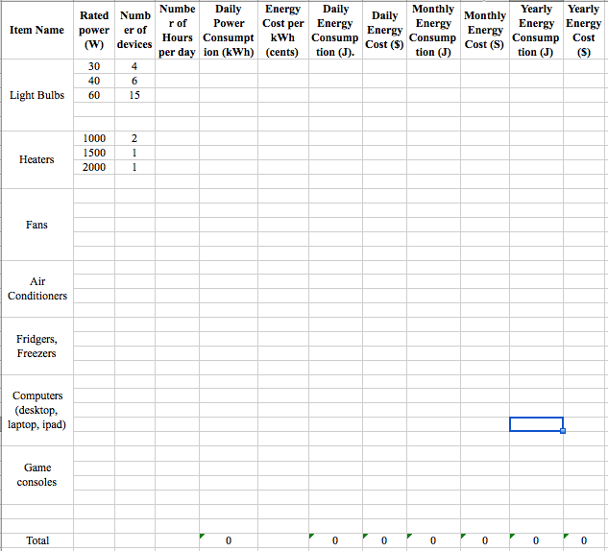

Slide 6
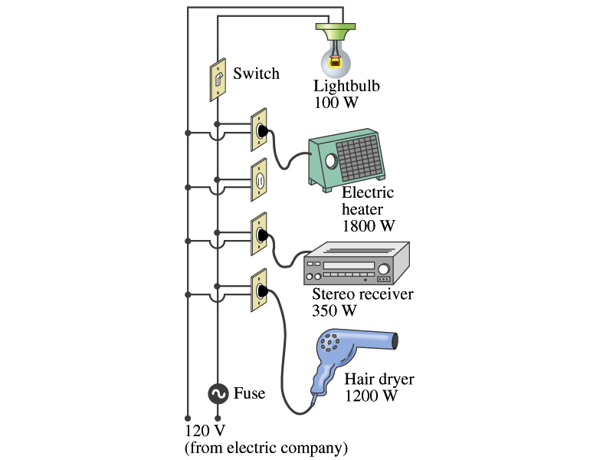
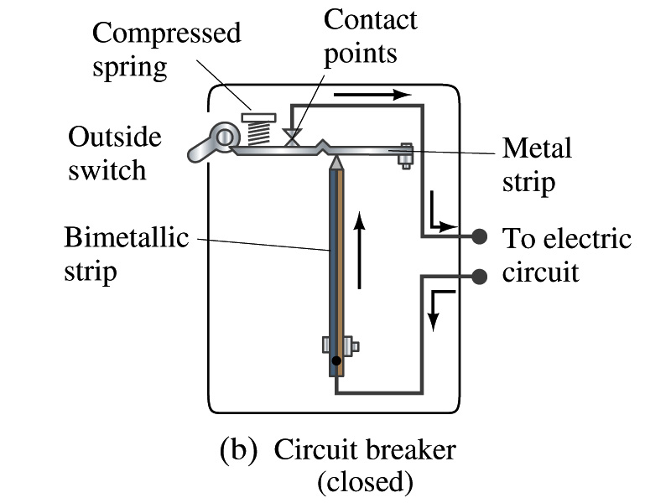
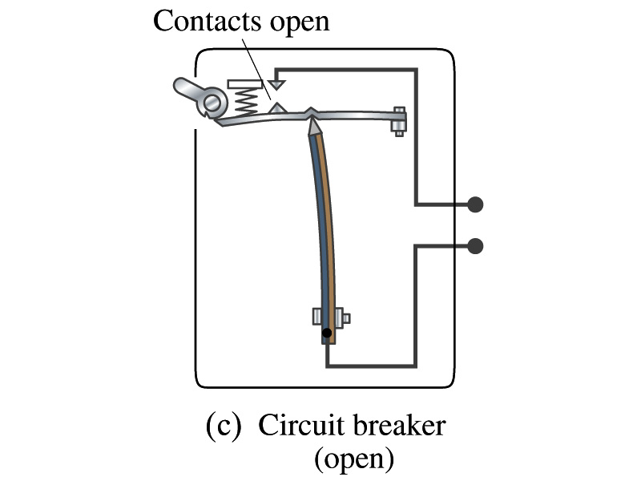
Power in Household Circuits
Household devices usually have small resistance
But since they draw current, if they become large enough, wires can heat up (overloaded)
Why is using thicker wires safer?
Thicker wires has less resistance, lower heat
Overloaded wire can set off a fire at home
How do we prevent this?
Put in a switch that would disconnect the circuit when overloaded
Fuse or circuit breakers
They open up the circuit when the current is over certain value
Overload

Slide 7
Example 25 – 11
Will a fuse blow?: Determine the total current drawn by all the devices in the circuit in the figure.
The total current is the sum of current drawn by individual device.
Solve for I
Bulb
Heater
Stereo
Dryer
Total current
What is the total power?

Slide 8
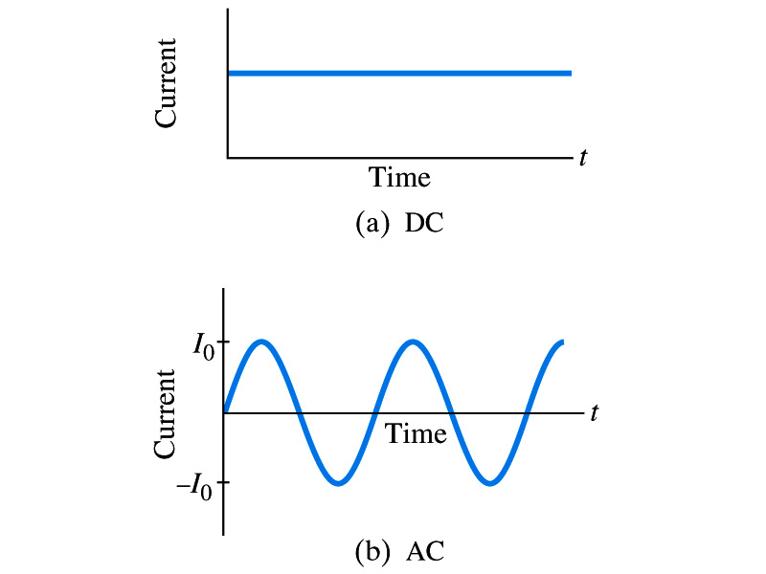
Alternating Current
Does the direction of the flow of current change while a battery is connected to a circuit?
No. Why?
Because its source of potential difference stays put.
This kind of current is called the Direct Current (DC), and it does not change its direction of flow while the battery is connected.
How would DC look as a function of time?
A straight line
Electric generators at electric power plant produce alternating current (AC)
AC reverses direction many times a second
AC is sinusoidal as a function of time
Most the currents supplied to homes and business are AC.

Slide 9
The Alternating Current
The voltage produced by an AC electric generator is sinusoidal
This is why the current is sinusoidal
Voltage produced can be written as
What are the maximum and minimum voltages?
V₀ (–V₀) and 0
The potential oscillates between +V₀ and –V₀, the peak voltages or amplitude
What is f?
The frequency, the number of complete oscillations made per second. What is the unit of f? What is the normal size of f in the US?
f=60Hz in the US and Canada.
Many European countries have f=50Hz.
ω=2πf

Slide 10
Alternating Current
Since V=IR, if a voltage V exists across a resistance R, the current I is
What are the maximum and minimum currents?
I₀ (–I₀) and 0.
The current oscillates between +I₀ and –I₀, the peak currents or amplitude. The current is positive when electron flows to one direction and negative when they flow opposite.
AC is as many times positive as negative. What’s the average current?
Zero. So there is no power and no heat is produced in a heater?
Yes there is! The electrons actually flow back and forth, so power is delivered.
What is this?

Slide 11
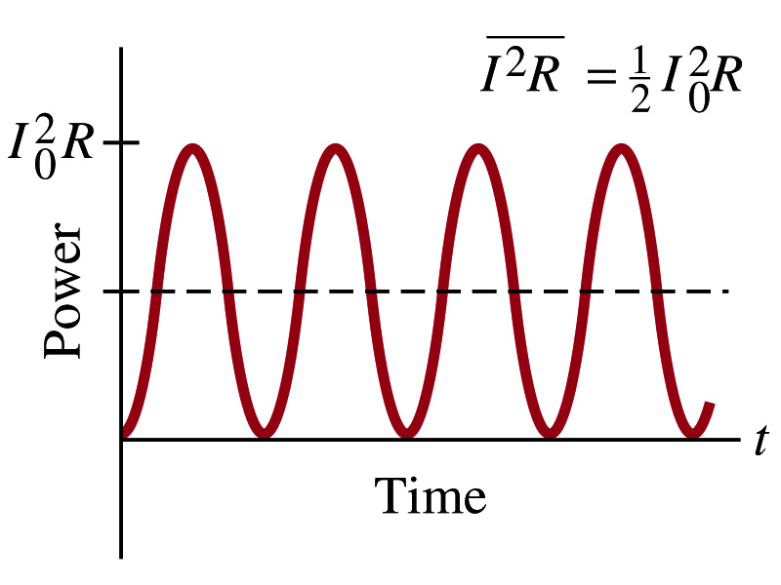
Power Delivered by Alternating Current
AC power delivered to a resistance is:
Since the current is squared, the power is always positive
The average power delivered is
Since the power is also P=V²/R, we can obtain
The average of the square of current and voltage are important in calculating power:
Average power

Slide 12
Power Delivered by Alternating Current
The square root of each of these are called root-mean-square, or rms:
rms values are sometimes called the effective values
These are useful quantities since they can substitute current and voltage directly in power, as if they are in DC
In other words, an AC of peak voltage V₀ or peak current I₀ produces as much power as DC voltage of V_{rms} or DC current I_{rms}.
So normally, rms values in AC are specified or measured.
US uses 115V rms voltage. What is the peak voltage?
Europe uses 240V

Slide 13
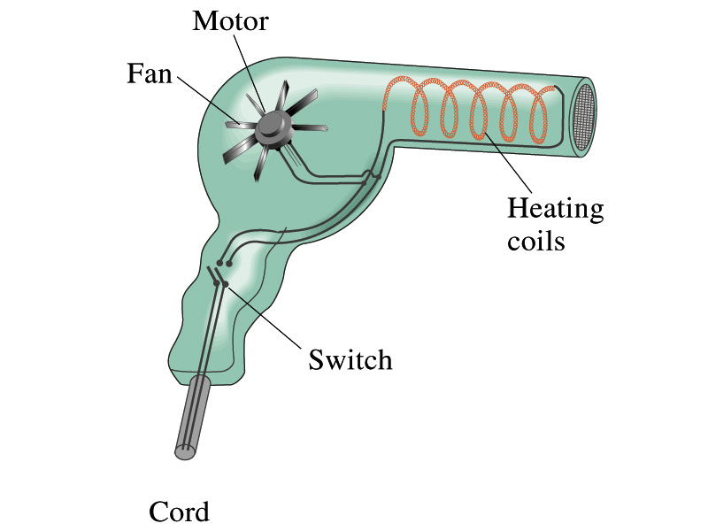
Example 25 – 13
Hair Dryer. (a) Calculate the resistance and the peak current in a 1000-W hair dryer connected to a 120-V AC line. (b) What happens if it is connected to a 240-V line in Britain?
The rms current is:
The peak current is:
Thus the resistance is:
(b) If connected to 240V in Britain …
The average power provide by the AC in UK is
So?
The heating coils in the dryer will melt!

