Slide 1
PHYS 1444 – Section 001
Lecture #12
Monday, June 24, 2019
Dr. Jaehoon Yu
Chapter 25
  Microscopic View of Electric Current
  Ohm’s Law in Microscopic View
  EMF and Terminal Voltage
Chapter 26
  Resistors in Series and Parallel
  Kirchhoff’s Rules
  EMFs in Series and Parallel
Today’s homework is homework #9, due 11pm, Thursday, June 27!!

Slide 2
Announcements
2nd Term Exam
  First 80min this Wednesday, June 26
  Covers CH25.1 through what we learn tomorrow
  BYOF: You may bring one 8.5x11.5 sheet (front and back) of handwritten formulae and values of constants for the exam
  No derivations, word definitions, setups or solutions of any problems!
  No additional formulae or values of constants will be provided!

Slide 3
Reminder: Special Project #4
Make a list of the power consumption and the resistance of all electric and electronic devices at your home and compile them in a table. (10 points total for the first 10 items and 0.5 points each additional item.)
Estimate the cost of electricity for each of the items on the table using your own electric cost per kWh (if you don’t find your own, use $0.12/kWh) and put them in the relevant column. (5 points total for the first 10 items and 0.2 points each additional items)
Estimate the the total amount of energy in Joules and the total electricity cost per day, per month and per year for your home. (8 points)
Due: Beginning of the class Thursday, June 27

Slide 4
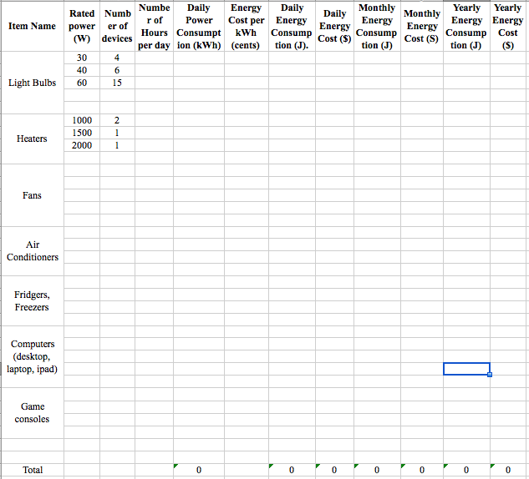

Slide 5
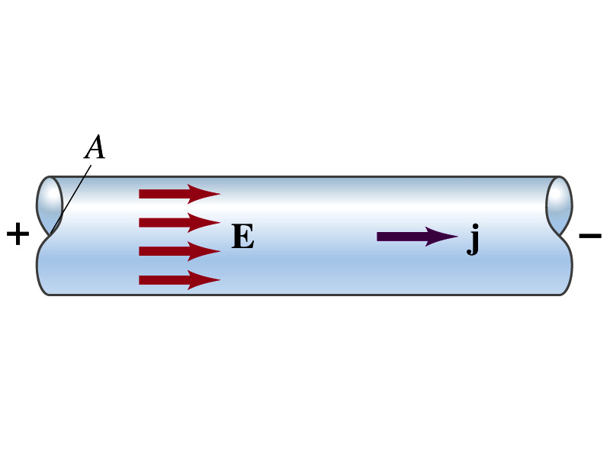
Microscopic View of Electric Current
When a potential difference is applied to the two ends of a wire w/ a uniform cross-section, the direction of the electric field is parallel to the walls of the wire, this is possible since the charges are moving
Let’s define a microscopic vector quantity, the current density, j, the electric current per unit cross-sectional area
  j=I/A or I = jA if the current density is uniform
  If not uniform
  The direction of j is the direction the positive charge would move when placed at that position, generally the same as E
The current density exists on any point in space while the current I refers to a conductor as a whole so a macroscopic

Slide 6
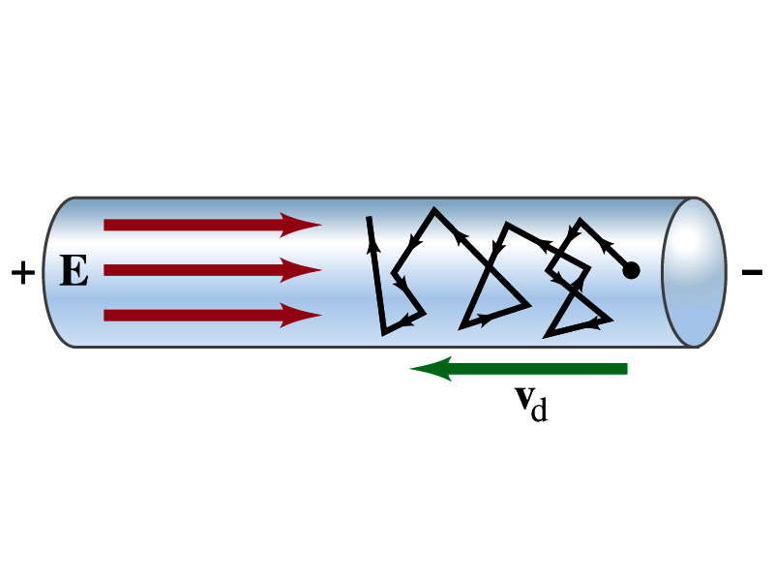
Microscopic View of Electric Current – II
The direction of j is the direction of a positive charge. So in a conductor, since negatively charged electrons move, the direction is –j.
Let’s think about the current in a microscopic view again:
  When voltage is applied to the end of a wire
  Electric field is generated by the potential difference
  Electrons feel force and get accelerated
  Electrons soon reach to a steady average speed due to collisions with atoms in the wire, called drift velocity, v_{d}
  The drift velocity is normally much smaller than electrons’ average random speed.

Slide 7
Microscopic View of Electric Current
The drift velocity of electrons in a wire is only about 0.05mm/s. How could we get light turned on immediately then?
  While the electrons in the wire travels slow, the electric field travels essentially at the speed of light. Then what is all the talk about electrons flowing through?
    It is just like water. When you turn on the facet, water flows right off the facet despite the fact that the water travels slow.
    Electricity is the same. Electrons fill the conductor wire and when the switch is flipped on or a potential difference is applied, the electrons close to the positive terminal flows into the bulb.
    Interesting, isn’t it? Why is the field travel at the speed of light then?

Slide 8
Ohm’s Law in Microscopic View
Ohm’s law can be written in microscopic quantities.
  Resistance in terms of resistivity is
  We can rewrite the potential V and current I as: I=jA, V=El.
  If electric field is uniform, from V=IR, we obtain
  So
  In a metal conductor, ρ or σ does not depend on V, thus, the current density j is proportional to the electric field E ➔ Microscopic statement of Ohm’s Law
  In vector form, the density can be written as

Slide 9
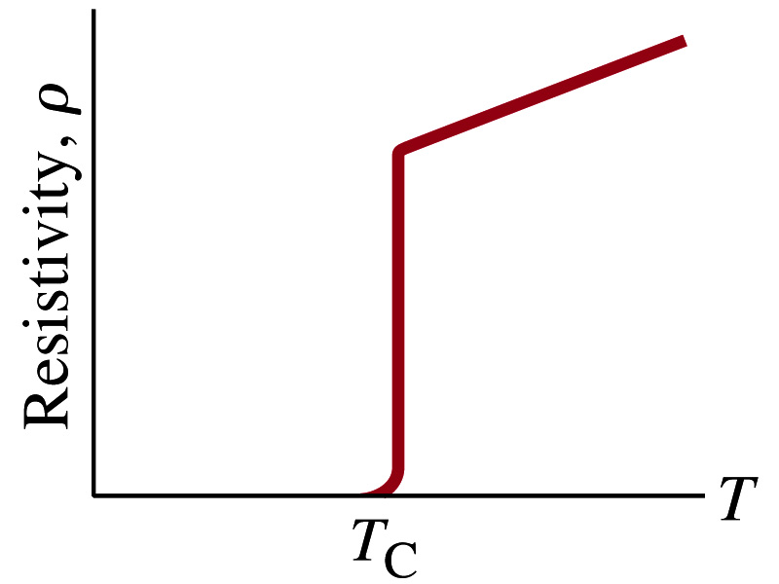
Superconductivity
At the temperature near absolute 0K, resistivity of certain material becomes 0.
  This state is called the “superconducting” state.
  Observed in 1911 by H. K. Onnes when he cooled mercury to 4.2K (-269ºC).
    Resistance of mercury suddenly dropped to 0.
  In general superconducting materials become superconducting below a transition temperature (T_{c}).
  The highest temperature superconductivity seen is 160K
    First observation above the boiling temperature of liquid nitrogen is in 1987 at 90k observed from a compound of yttrium, barium, copper and oxygen.
Since much smaller amount of material can carry just as much current more efficiently, superconductivity can make electric cars more practical, computers faster, and capacitors store higher energy

Slide 10
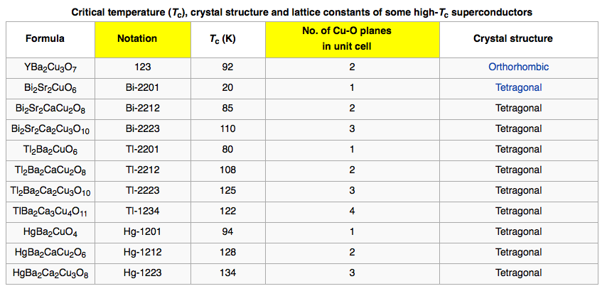
Critical Temperature of Superconductors

Slide 11
Electric Hazards: Leakage Currents
How does one feel shock by electricity?
  Electric current stimulates nerves and muscles, and we feel a shock
  The severity of the shock depends on the amount of current, how long it acts and through what part of the body it passes
  Electric current heats the tissue and can cause burns
Currents above 70mA on a torso for a second or more is fatal, causing heart to function irregularly, “ventricular fibrillation”.
A dry human body between two points on the opposite side of the body is about 10⁴ to 10⁶ Ω.
But when wet, it could be 10³Ω.
A person in good contact with the ground who touches 120V DC line with wet hands can get the current:
  Could be lethal

Slide 12
EMF and Terminal Voltage
What do we need to have current in an electric circuit?
  A device that provides a potential difference, such as a battery or a generator
    They normally convert some types of energy into the electric energy
    These devices are called source of electromotive force (emf)
      This is does NOT refer to a real “force”.
Potential difference between terminals of an emf source, when no current flows to an external circuit, is called the emf (E) of the source.
The battery itself has some internal resistance (r) due to the flow of charges in the electrolyte
  Why does the headlight dim when you start the car?
    The starter needs a large amount of current but the battery cannot provide charge fast enough to supply current to both the starter and the headlight

Slide 13
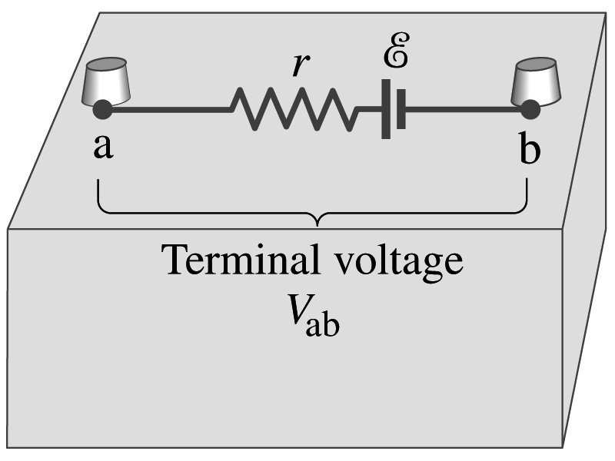
EMF and Terminal Voltage
Since the internal resistance is inside the battery, we can never separate them out.
So the terminal voltage difference is V_{ab}=V_{a}-V_{b}.
When no current is drawn from the battery, the terminal voltage equals the emf which is determined by the chemical reaction; V_{ab}= E.
However when the current I flows naturally from the battery, there is a voltage drop due to the internal resistance which is equal to Ir. Thus the actual delivered terminal voltage is

Slide 14
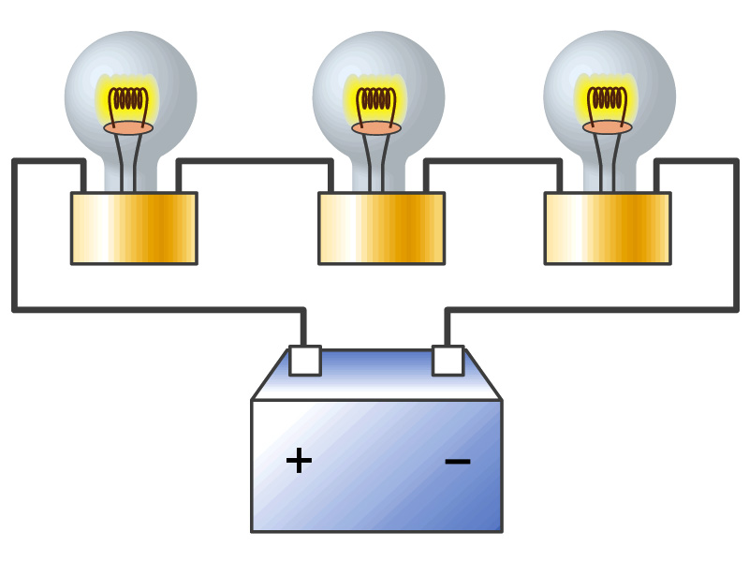
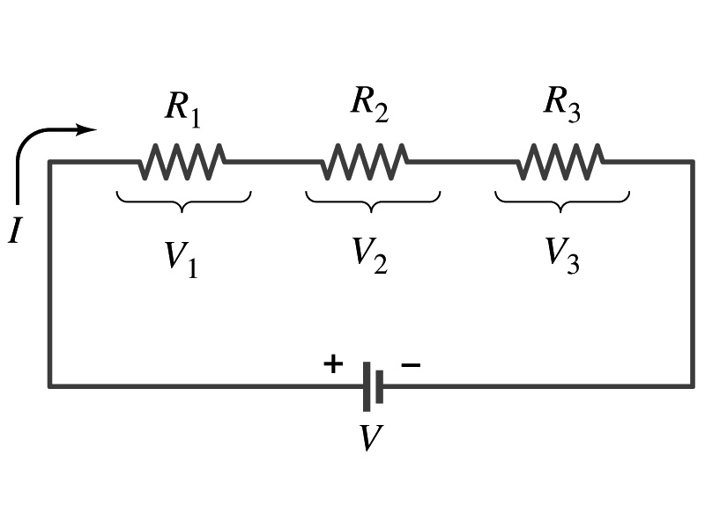
Resistors in Series
Resistors are in series when two or more resistors are connected end to end
  These resistors represent simple resistors in circuit or electrical devices, such as light bulbs, heaters, dryers, etc
What is common in a circuit connected in series?
  Current is the same through all the elements in series
Potential difference across every element in the circuit is
  V₁=IR₁, V₂=IR₂ and V₃=IR₃
Since the total potential difference is V, we obtain
  V=IR_{eq}=V₁+V₂+V₃=I(R₁+R₂+R₃)
  Thus, R_{eq}=R₁+R₂+R₃
Resistors in series
When resistors are connected in series, the total resistance increases and the current decreases.

Slide 15
Energy Losses in Resistors
Why is it true that V=V₁+V₂+V₃?
What is the potential energy loss when charge q passes through resistors R₁, R₂ and R₃
  ΔU₁=qV₁, ΔU₂=qV₂, ΔU₃=qV₃
Since the total energy loss should be the same as the total energy provided to the system, we obtain
  ΔU=qV=ΔU₁+ΔU₂+ΔU₃=q(V₁+V₂+V₃)
  Thus, V=V₁+V₂+V₃

Slide 16
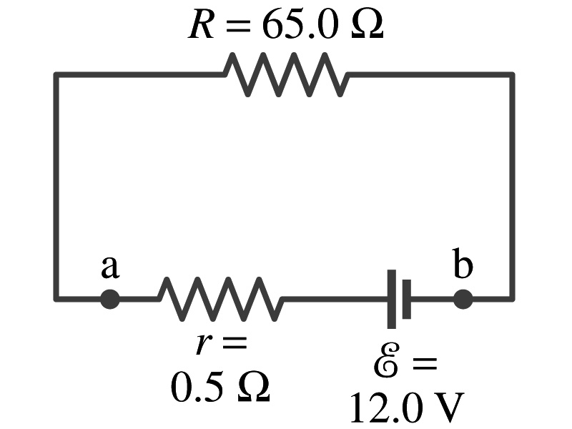
Example 26 – 1
Battery with internal resistance. A 65.0-Ω resistor is connected to the terminals of a battery whose emf is 12.0V and whose internal resistance is 0.5-Ω. Calculate (a) the current in the circuit, (b) the terminal voltage of the battery, V_{ab}, and (c) the power dissipated in the resistor R and in the battery’s internal resistor.
(a) Since
We obtain
What is this?
Solve for I
A battery or a source of emf.
(b) The terminal voltage V_{ab} is
(c) The power dissipated in R and r are

Slide 17
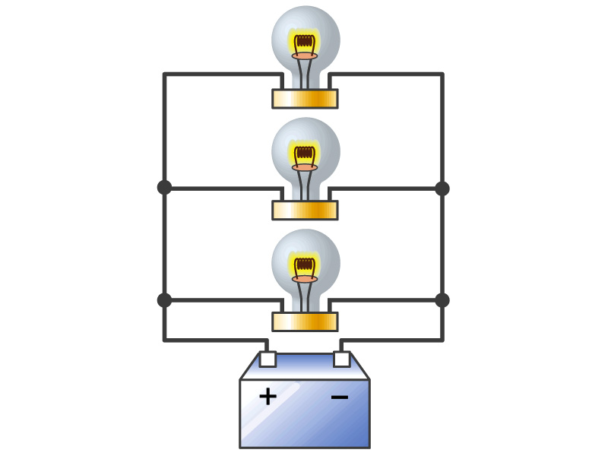
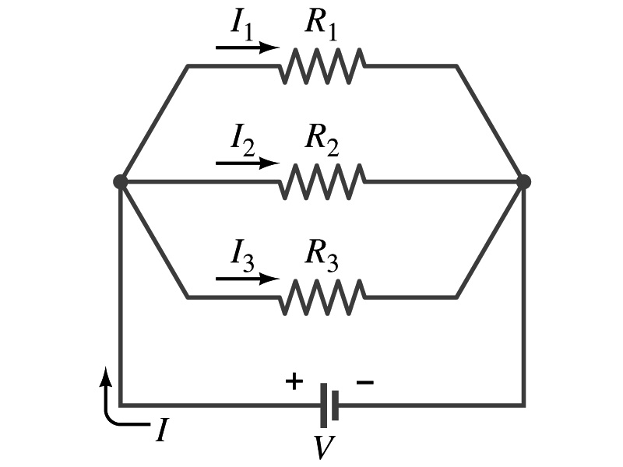
Resistors in Parallel
Resistors are in parallel when two or more resistors are connected in separate branches
  Most the house and building wirings are arranged this way.
What is common in a circuit connected in parallel?
  The voltage is the same across all the resistors.
  The total current that leaves the battery, is however, split.
The current that passes through every element is
  I₁=V/R₁, I₂=V/R₂, I₃=V/R₃
Since the total current is I, we obtain
  I=V/R_{eq}=I₁+I₂+I₃=V(1/R₁+1/R₂+1/R₃)
  Thus, 1/R_{eq}=1/R₁+1/R₂+1/R₃
resistors in parallel
When resistors are connected in parallel, the total resistance decreases and the current increases.

Slide 18
Resistor and Capacitor Arrangements
Parallel Capacitor arrangements
Parallel Resistor arrangements
Series Capacitor arrangements
Series Resistor arrangements

Slide 19
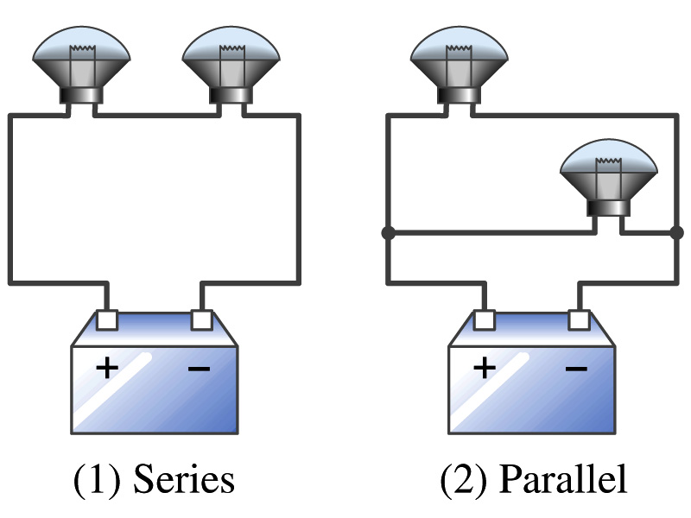
Example 26 – 2
Series or parallel? (a) The light bulbs in the figure are identical and have identical resistance R. Which configuration produces more light? (b) Which way do you think the headlights of a car are wired?
(a) What are the equivalent resistances for the two cases?
Series
Parallel
So
The bulbs get brighter when the total power transformed is larger.
series
parallel
So parallel circuit provides brighter lighting.
(b) Car’s headlights are in parallel to provide brighter lighting and also to prevent both lights going out at the same time when one burns out.
So what is bad about parallel circuits?
Uses more energy in a given time.

Slide 20
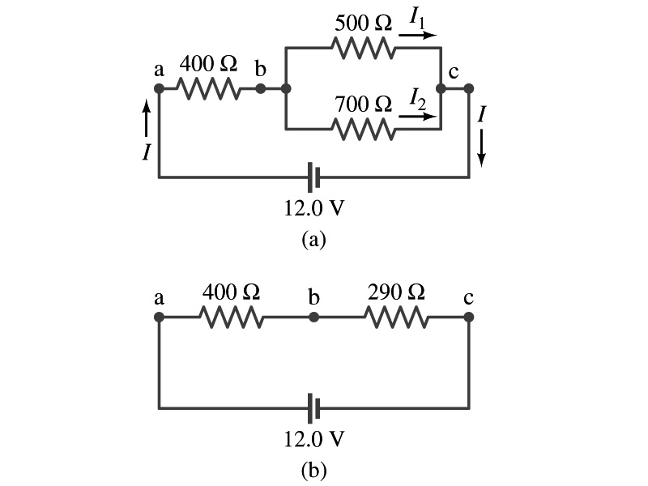
Example 26 – 5
Current in one branch. What is the current flowing through the 500-Ω resistor in the figure?
We need to find the total current.
What do we need to find first?
To do that we need to compute the equivalent resistance.
R_{eq} of the small parallel branch is:
R_{eq} of the circuit is:
Thus the total current in the circuit is
The voltage drop across the parallel branch is
The current flowing across 500-Ω resistor is therefore
What is the current flowing 700-Ω resistor?

