Slide 1
PHYS 1444 – Section 001 Lecture #13
Tuesday, June 25, 2019
Dr. Jaehoon Yu
Chapter 26
Kirchhoff’s Rules
EMFs in Series and Parallel
RC Circuits
Chapter 27: Magnetism and Magnetic Field
Electric Current and Magnetism
Magnetic Forces on Electric Current
About Magnetic Field

Slide 2
Announcements
2nd Term Exam
First 80min this Wednesday, June 26, tomorrow
Covers CH25.1 through what we learn today
BYOF: You may bring one 8.5x11.5 sheet (front and back) of handwritten formulae and values of constants for the exam
No derivations, word definitions, setups or solutions of any problems!
No additional formulae or values of constants will be provided!
Quiz 3 results
Class average: 40.7/60
Equivalent to 67.8/100
Previous quizzes: 44.3/100 and 54.2/100
Top score: 60/60

Slide 3
Reminder: Special Project #4
Make a list of the power consumption and the resistance of all electric and electronic devices at your home and compile them in a table. (10 points total for the first 10 items and 0.5 points each additional item.)
Estimate the cost of electricity for each of the items on the table using your own electric cost per kWh (if you don’t find your own, use $0.12/kWh) and put them in the relevant column. (5 points total for the first 10 items and 0.2 points each additional items)
Estimate the the total amount of energy in Joules and the total electricity cost per day, per month and per year for your home. (8 points)
Due: Beginning of the class this Thursday, June 27

Slide 4
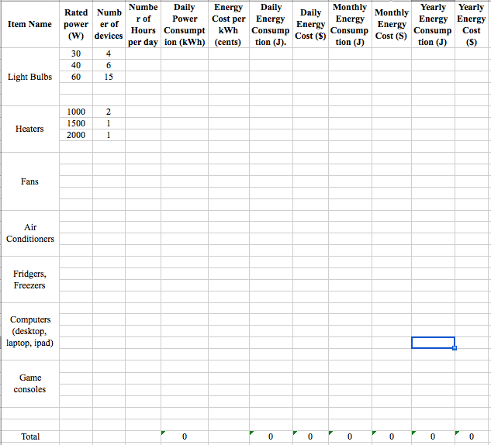

Slide 5
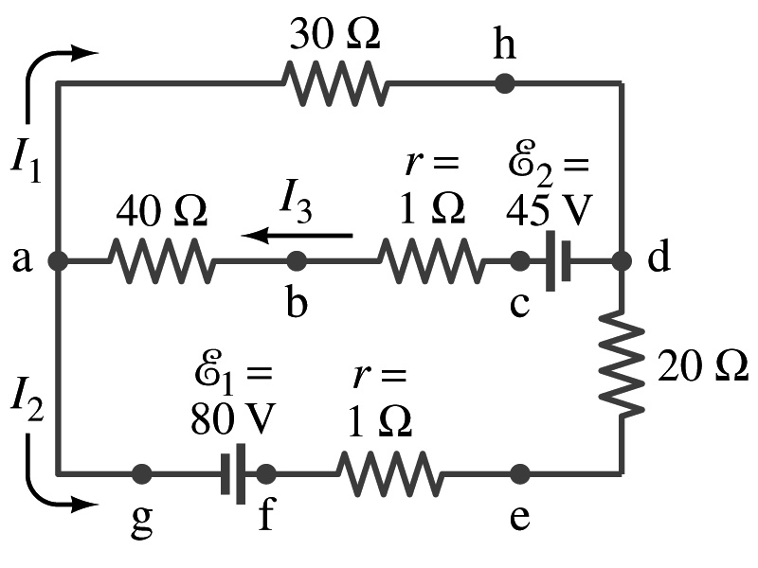
Kirchhoff’s Rules – the 1st Rule
Some circuits are very complicated to do the analysis using the simple combinations of resistors
G. R. Kirchhoff devised two rules to deal with complicated circuits.
Kirchhoff’s rules are based on conservation of charge and energy
Kirchhoff’s 1st rule: The junction rule, charge conservation.
At any junction point, the sum of all currents entering the junction must equal to the sum of all currents leaving the junction.
In other words, what goes in must come out.
At junction a in the figure, I₃ comes into the junction while I₁ and I₂ leaves: I₃ = I₁+ I₂

Slide 6
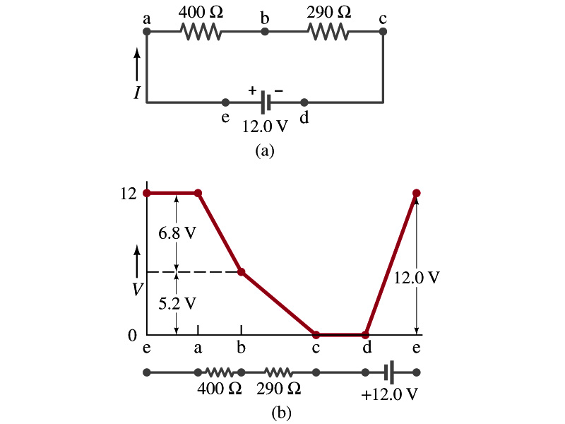
Kirchhoff’s Rules – the 2nd Rule
Kirchoff’s 2nd rule: The loop rule, uses conservation of energy.
The sum of the changes in potential in any closed path of a circuit must be zero.
The current in the circuit in the figure is I=12/690=0.017A.
Point e is the high potential point while point d is the lowest potential.
When the test charge starts at e and returns to e, the total potential change is 0.
Between point e and a, no potential change since there is no source of potential nor any resistance.
Between a and b, there is a 400Ω resistance, causing IR=0.017*400 =6.8V drop.
Between b and c, there is a 290Ω resistance, causing IR=0.017*290 =5.2V drop.
Since these are voltage drops, we use negative sign for these, -6.8V and -5.2V.
No change between c and d while from d to e there is +12V change.
Thus the total change of the voltage through the loop is: -6.8V-5.2V+12V=0V.

Slide 7
Using Kirchhoff’s Rules
Determine the flow of currents at the junctions and label each and everyone of the currents.
It does not matter which direction, you decide but keep it!
If the value of the current after completing the calculations are negative, you just need to flip the direction of the current flow.
Write down the current equation based on Kirchhoff’s 1st rule at various junctions.
Be sure to see if any of equations are the same.
Choose closed loops in the circuit
Write down the potential in each interval of the junctions, keeping the sign properly.
Write down the potential equations for each loop.
Solve the equations for unknowns.

Slide 8
Example 26 – 9
Use Kirchhoff’s rules. Calculate the currents I₁, I₂ and I₃ in each of the branches of the circuit in the figure.
The directions of the current through the circuit is not known a priori but since the current tends to move away from the positive terminal of a battery, we arbitrarily choose the direction of the currents as shown.
We have three unknowns so we need three equations.
Using Kirchhoff’s junction rule at point a, we obtain
This is the same for junction d as well, so no additional information.
Now the second rule on the loop ahdcba.
The total voltage change in the loop ahdcba is.

Slide 9
Example 26 – 9, cnt’d
Now the second rule on the other loop agfedcba.
The total voltage change in loop agfedcba is.
So the three equations become
We can obtain the three current by solving these equations for I₁, I₂ and I₃.
Do this yourselves!!

Slide 10
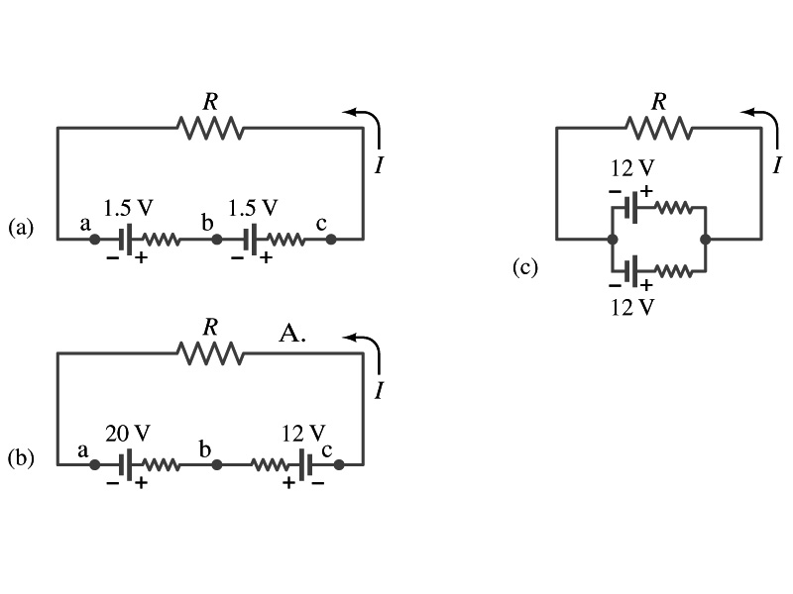
EMFs in Series and Parallel: Charging a Battery
When two or more sources of emfs, such as batteries, are connected in series
The total voltage is the algebraic sum of their voltages, if their direction is the same
V_{ab}=1.5 + 1.5=3.0V in figure (a).
If the batteries are arranged in the opposite direction, the total voltage is the difference between them
Parallel arrangements (c) are used only to increase currents. An example?
V_{ac}=20 – 12=8.0V in figure (b)
Connecting batteries in opposite direction is wasteful.
This, however, is the way a battery charger works.
Since the 20V battery is at a higher voltage, it forces charges into 12V battery
Some battery are rechargeable since their chemical reactions are reversible but most the batteries do not reverse their chemical reactions

Slide 11
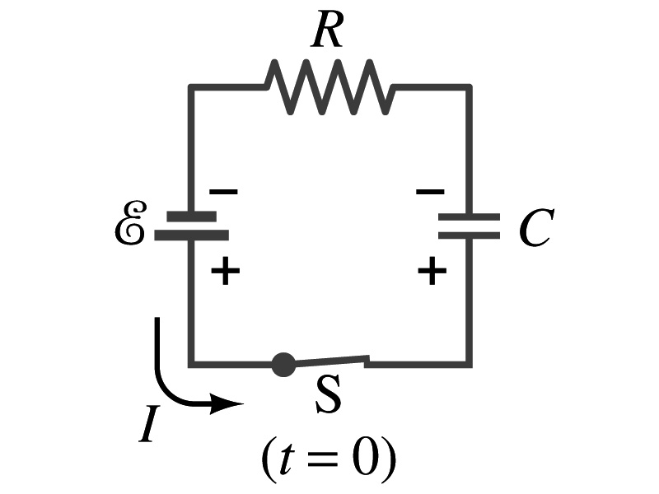
RC Circuits
Circuits containing both resistors and capacitors
RC circuits are used commonly in everyday life
Control windshield wiper
Timing of traffic light from red to green
Camera flashes and heart pacemakers
How does an RC circuit look?
There should be a source of emf, capacitors and resisters
What happens when the switch S is closed?
Current immediately starts flowing through the circuit.
Electrons flow out of negative terminal of the emf source, through the resister R and accumulates on the upper plate of the capacitor.
The electrons from the bottom plate of the capacitor will flow into the positive terminal of the battery, leaving only the positive charge on the bottom plate.
As the charge accumulates on the capacitor, the potential difference across it increases
The current reduces gradually to 0 till the voltage across the capacitor is the same as the emf.
The charge on the capacitor increases till it reaches to its maximum CE.

Slide 12
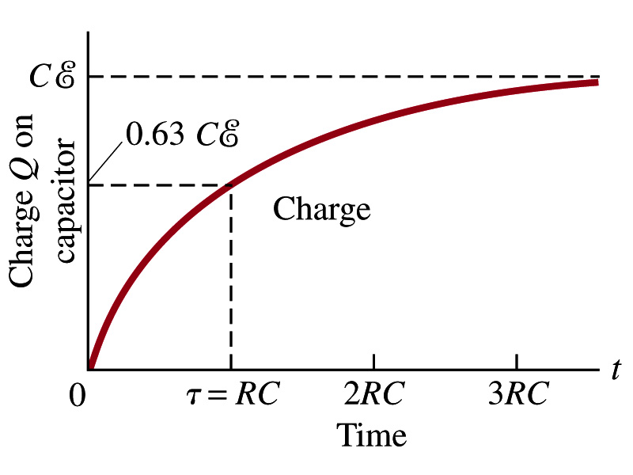
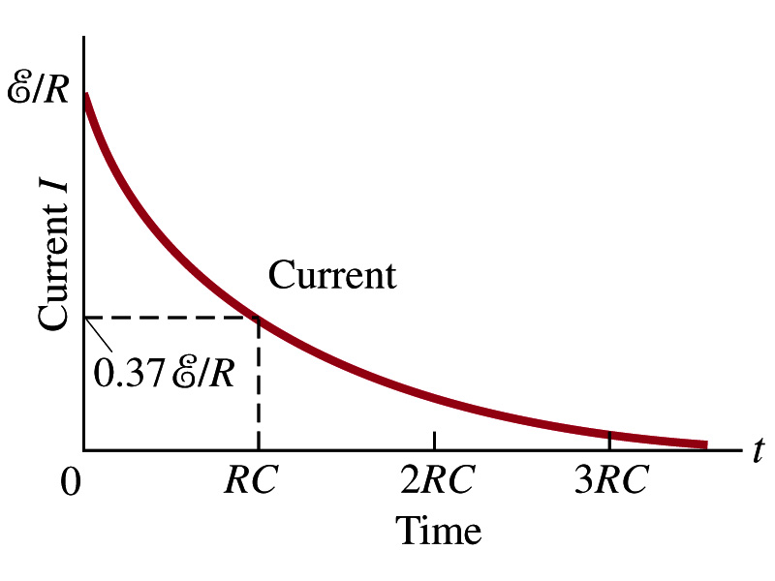
RC Circuits
How does all this look like in graphs?
The charge and the current on the capacitor as a function of time
From energy conservation (Kirchhoff’s 2nd rule), the emf E must be equal to the sum of voltage drop across the capacitor and the resister
E=IR+Q/C
R includes all resistance in the circuit, including the internal resistance of the battery, I is the current in the circuit at any instance, and Q is the charge of the capacitor at that same instance.

Slide 13
Analysis of RC Circuits
In an RC circuit and
What can we see from the above equations?
Q and V_{C} increase from 0 at t=0 to maximum value Q_{max}=CE and V_{C}= E.
In how much time?
The quantity RC is called the time constant of the circuit, τ
τ=RC, What is the unit?
What is the physical meaning?
The time required for the capacitor to reach (1 - e⁻¹)=0.63 or 63% of the full charge
The current is
Sec.

Slide 14
Example 26 – 12
RC circuit, with emf. The capacitance in the circuit of the figure is C=0.30μF, the total resistance is 20kΩ, and the battery emf is 12V. Determine (a) the time constant, (b) the maximum charge the capacitor could acquire, (c) the time it takes for the charge to reach 99% of this value, (d) the current I when the charge Q is half its maximum value, (e) the maximum current, and (f) the charge Q when, the current I is 0.20 its maximum value.
(a) Since
We obtain
(b) Maximum charge is
(c) Since
For 99% we obtain
(d) Since
We obtain
The current when Q is 0.5Q_{max}
(e) When is I maximum?
when Q=0:
(f) What is Q when I=120mA?

Slide 15
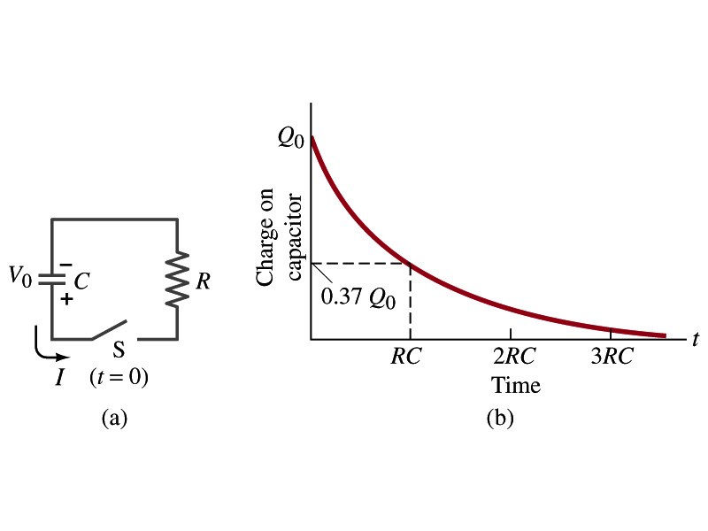
Discharging RC Circuits
When a capacitor is already charged, it is allowed to discharge through a resistance R.
When the switch S is closed, the voltage across the resistor at any instant equals that across the capacitor. Thus IR=Q/C.
The rate at which the charge leaves the capacitor equals the negative of the current flows through the resistor
I= - dQ/dt
This is because the current is leaving the capacitor
Thus the voltage equation becomes a differential equation
Rearrange terms

Slide 16
Discharging RC Circuits
Now, let’s integrate from t=0 when the charge is Q₀ to t when the charge is Q
The result is
Thus, we obtain
What does this tell you about the charge on the capacitor?
It decreases exponentially w/ time at the time constant RC
Just like the case of charging
The current is:
The current also decreases exponentially w/ time w/ the time constant RC
What is this?

Slide 17
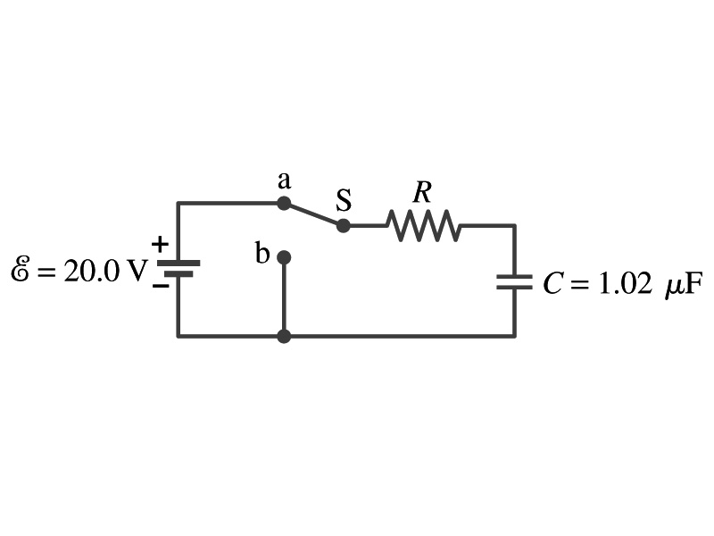
Example 26 – 13
Discharging RC circuit. In the RC circuit shown in the figure the battery has fully charged the capacitor, so Q₀=CE. Then at t=0, the switch is thrown from position a to b. The battery emf is 20.0V, and the capacitance C=1.02μF. The current I is observed to decrease to
0.50 of its initial value in 40μs. (a) what is the value of R? (b) What is the value of Q, the charge on the capacitor, at t=0? (c) What is Q at t=60μs?
(a) Since the current reaches to 0.5 of its initial value in 40μs, we can obtain
For 0.5I₀
Rearrange terms
Solve for R
(b) The value of Q at t=0 is
(c) What do we need to know first for the value of Q at t=60μs?
The RC time
Thus

Slide 18
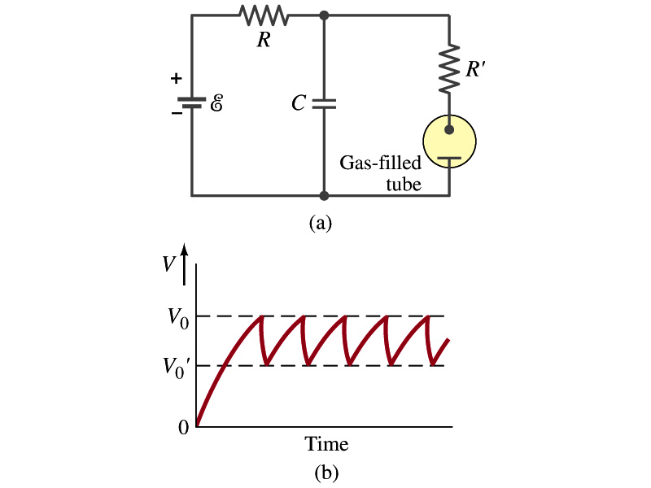
Application of RC Circuits
What do you think the charging and discharging characteristics of RC circuits can be used for?
To produce voltage pulses at a regular frequency
How?
The capacitor charges up to a particular voltage and discharges
A simple way of doing this is to use breakdown of voltage in a gas filled tube
The discharge occurs when the voltage breaks down at V₀
After the completion of discharge, the tube no longer conducts
Then the voltage is at V₀’ and it starts charging up
How do you think the voltage as a function of time look?
A sawtooth shape
Pace maker, intermittent windshield wiper, etc

Slide 19
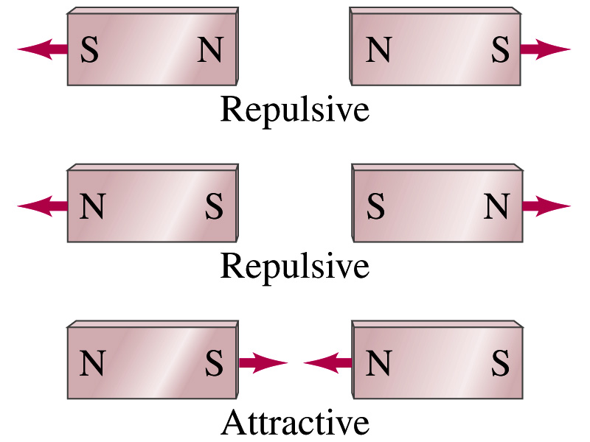
Magnetism
What are magnets?
Objects with two poles, North and South poles
The pole that points to the geographical North is the North pole and the other is the South pole
Principle of compass
These are called the magnet due to the name of the region, Magnesia, where the rocks that attract each other were found
What happens when two magnets are brought to each other?
They exert force onto each other
What kind?
Both repulsive and attractive forces depending on the configurations
Like poles repel each other while the unlike poles attract

Slide 20
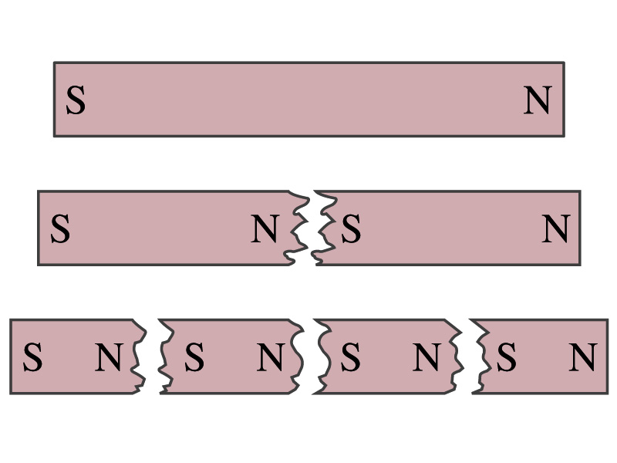
Magnetism
So the magnetic poles are the same as the electric charge?
No. Why not?
While the electric charges (positive and negative) can be isolated, the magnetic poles cannot be isolated.
So what happens when a magnet is cut?
If a magnet is cut, two magnets are made.
The more they get cut, the more magnets are made
Single pole magnets are called the monopole but it has not been seen yet
Ferromagnetic materials: Materials that show strong magnetic effects
Iron, cobalt, nickel, gadolinium and certain alloys
Other materials show very weak magnetic effects

Slide 21
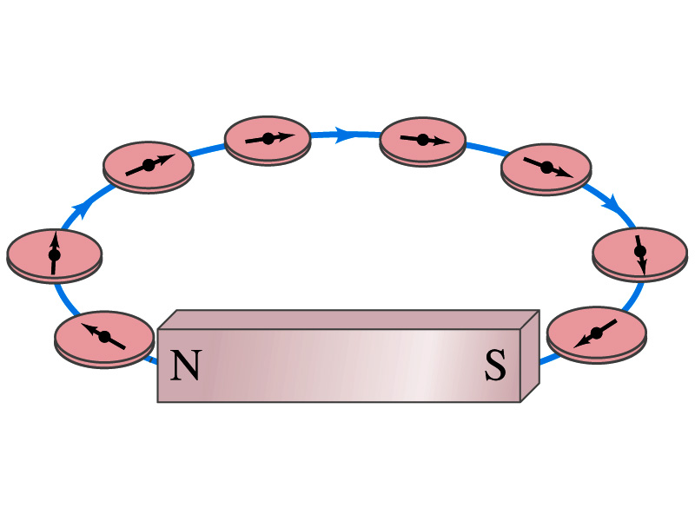
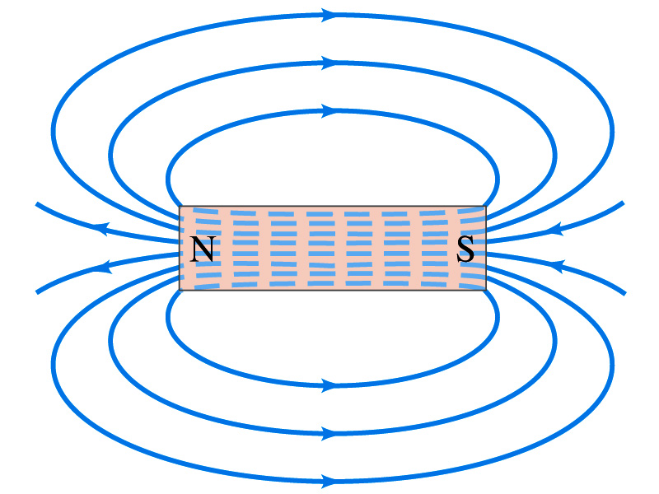
Magnetic Field
Just like the electric field that surrounds electric charge, a magnetic field surrounds a magnet
What does this mean?
Magnetic force is also a field force
The force one magnet exerts onto another can be viewed as the interaction between the magnet and the magnetic field produced by the other magnet
What kind of quantity is the magnetic field? Vector or Scalar?
So one can draw magnetic field lines, too.
Vector
The direction of the magnetic field is tangential to the field line at any point
The direction of the field is the direction the north pole of a compass would point to; out of N and into S
The number of lines per unit area is proportional to the strength of the magnetic field
Magnetic field lines continue inside the magnet
Since magnets always have both the poles, magnetic field lines form closed loops unlike electric field lines

Slide 22
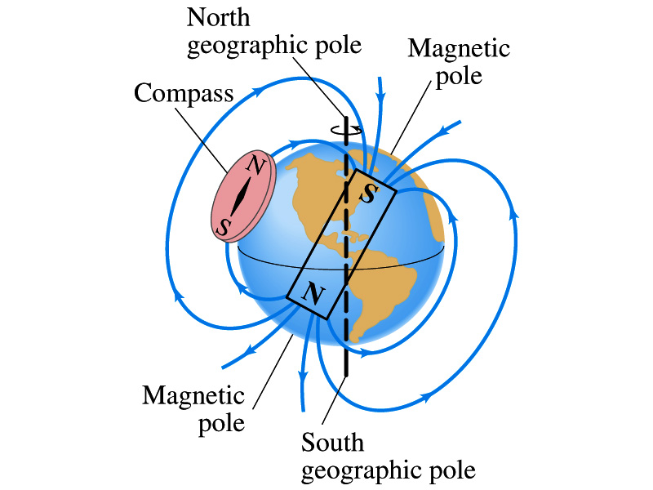
Earth’s Magnetic Field
What magnetic pole does the geographic North pole has to have?
Magnetic South pole. What? How do you know that?
Since the magnetic North pole points to the geographic North, the geographic north must have magnetic south pole
The pole in the North is still called geomagnetic North pole just because it is in the North
Similarly, South pole has magnetic North pole
The Earth’s magnetic poles do not coincide with the geographic poles ➔ magnetic declination
Geomagnetic North pole is in Northern Canada, some 900km off the true North pole
Earth’s magnetic field line is not tangent to the earth’s surface at all points
The angle the Earth’s field makes to the horizontal line is called the angle dip

Slide 23
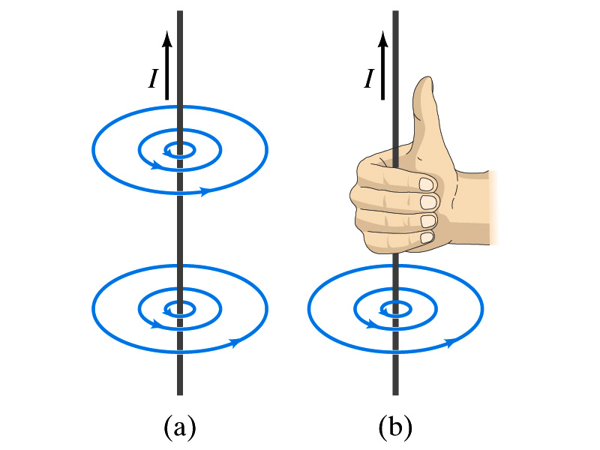
Electric Current and Magnetism
In 1820, Oersted found that when a compass needle is placed near an electric wire, the needle deflects as soon as the wire is connected to a battery and the current flows
Electric current produces a magnetic field
The first indication that electricity and magnetism are of the same origin
What about a stationary electric charge and magnet?
They don’t affect each other.
The magnetic field lines produced by a current in a straight wire is in the form of circles following the “right-hand” rule
The field lines follow right-hand fingers wrapped around the wire when the thumb points to the direction of the electric current

Slide 24
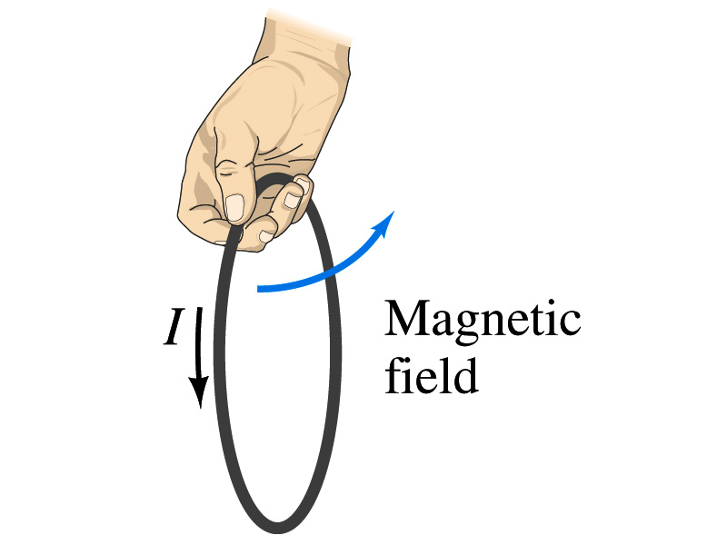
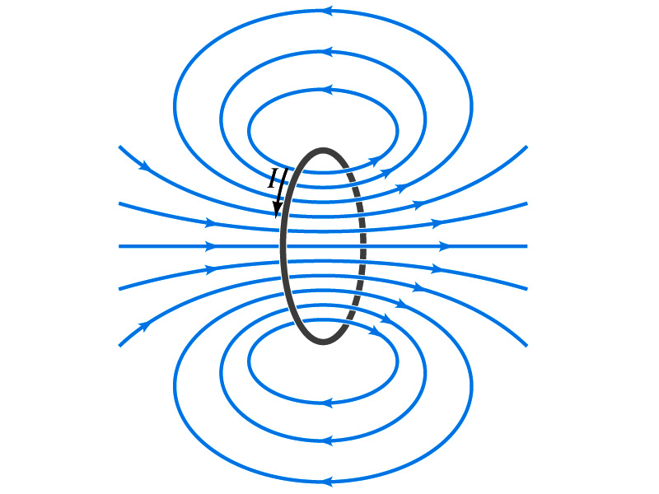
Directions in a Circular Wire?
OK, then what is the direction of the magnetic field generated by the current flowing through a circular loop?

Slide 25
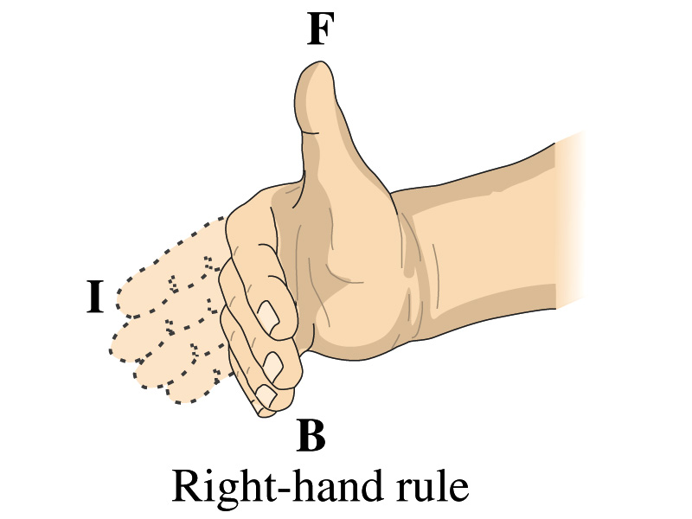
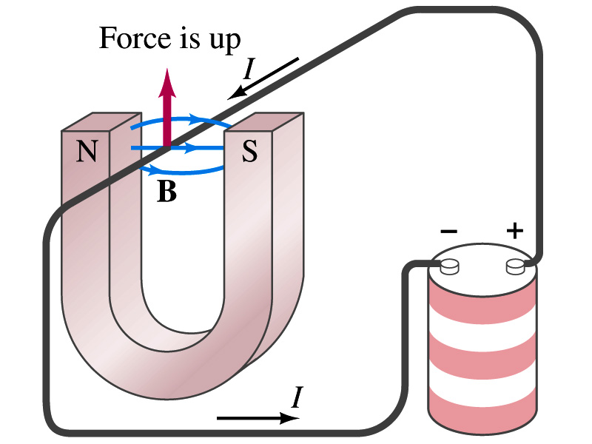
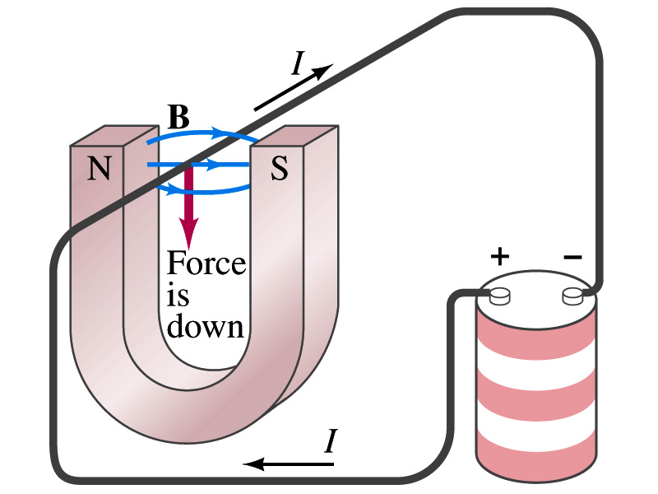
Magnetic Forces on Electric Current
Since the electric current exerts force on a magnet, the magnet should also exert force on the electric current
Which law justifies this?
Newton’s 3rd law
This was also discovered by Oersted
Direction of the force is always
perpendicular to the direction of the current
perpendicular to the direction of the magnetic field, B
Experimentally the direction of the force is given by another right-hand rule ➔ When the fingers of the right-hand points to the direction of the current and the finger tips bent to the direction of magnetic field B, the direction of thumb points to the direction of the force

Slide 26
Magnetic Forces on Electric Current
OK, we are set for the direction but what about the magnitude?
It is found that the magnitude of the force is directly proportional
To the current in the wire
To the length of the wire in the magnetic field (if the field is uniform)
To the strength of the magnetic field
The force also depends on the angle θ between the directions of the current and the magnetic field
When the wire is perpendicular to the field, the force is the strongest
When the wire is parallel to the field, there is no force at all
Thus the force on current I in the wire w/ length l in a uniform field B is

