Slide 1
PHYS 1444 – Section 001 Lecture #14
Wednesday, June 26, 2019
Dr. Jaehoon Yu
Chapter 27: Magnetism and Magnetic Field
Magnetic Force on Electric Current
Magnetic Force on a Moving Charge
Charged Particle Path in a Magnetic Field
Cyclotron Frequency
Torque on a Current Loop
Magnetic Dipole Moment

Slide 2
Announcements
Reading Assignments: CH28.6 – 10
Triple extra credit opportunity
A seminar at 3pm coming Tuesday, July 2 in SH103
Dr. Jessica Turner from Fermilab
Bring your planetarium extra credit sheet by Wednesday, July 3
Tape one side of all the ticket stubs on a sheet of paper with your name on it
Submit the sheet at the beginning of the final exam July 3

Slide 3
Reminder: Special Project #4
Make a list of the power consumption and the resistance of all electric and electronic devices at your home and compile them in a table. (10 points total for the first 10 items and 0.5 points each additional item.)
Estimate the cost of electricity for each of the items on the table using your own electric cost per kWh (if you don’t find your own, use $0.12/kWh) and put them in the relevant column. (5 points total for the first 10 items and 0.2 points each additional items)
Estimate the the total amount of energy in Joules and the total electricity cost per day, per month and per year for your home. (8 points)
Due: Beginning of the class this Thursday, June 27

Slide 4
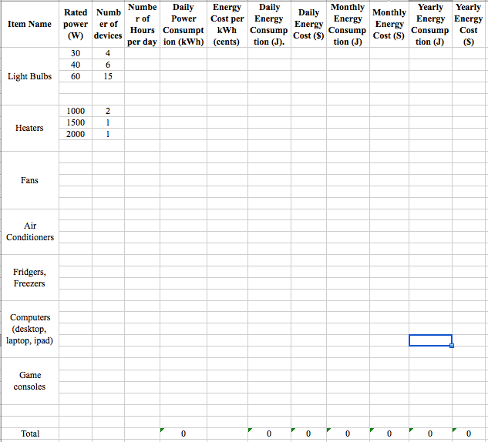

Slide 5
Magnetic Forces on Electric Current
OK, we are set for the direction but what about the magnitude?
It is found that the magnitude of the force is directly proportional
To the current in the wire
To the length of the wire in the magnetic field (if the field is uniform)
To the strength of the magnetic field
The force also depends on the angle θ between the directions of the current and the magnetic field
When the wire is perpendicular to the field, the force is the strongest
When the wire is parallel to the field, there is no force at all
Thus the force on current I in the wire w/ length l in a uniform field B is

Slide 6
Magnetic Forces on Electric Current
Magnetic field strength B can be defined using the proportionality relationship w/ the constant 1:
if θ=90º, and if θ=0º
So the magnitude of the magnetic field B can be defined as
where F_{max} is the magnitude of the force on a straight length l of the wire carrying the current I when the wire is perpendicular to B
The relationship between F, B and I can be written in a vector formula:
l is the vector whose magnitude is the length of the wire in B and its direction is along the wire in the direction of the conventional current
This formula works only if B is uniform.
If B is not uniform or l does not form the same angle with B everywhere, the infinitesimal force acting on a differential length dl is

Slide 7
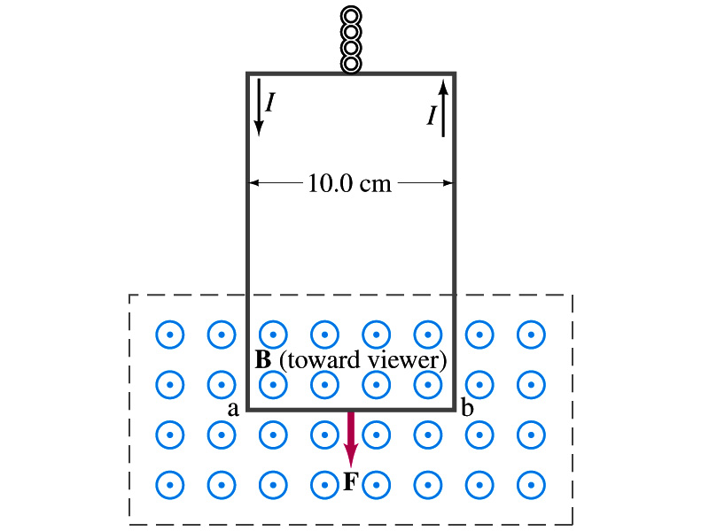
Example 27 – 2
Measuring a magnetic field. A rectangular loop of wire hangs vertically as shown in the figure. A magnetic field B is directed horizontally perpendicular to the wire, and points out of the page. The magnetic field B is very nearly uniform along the horizontal portion of wire ab (length l=10.0cm) which is near the center of a large magnet producing the field. The top portion of the wire loop is free of the field. The loop hangs from a balance which measures a downward force ( in addition to the gravitational force) of F=3.48x10⁻²N when the wire carries a current I=0.245A. What is the magnitude of the magnetic field B at the center of the magnet?
Magnetic force exerted on the wire due to the uniform field is
Since
Magnitude of the force is
SI unit of B field is Tesla or T
Solving for B
1 T = 10⁴ gauss
Something is not right! What happened to the forces on the loop on the side?
The two forces cancel out since they are in opposite direction with the same magnitude.

Slide 8
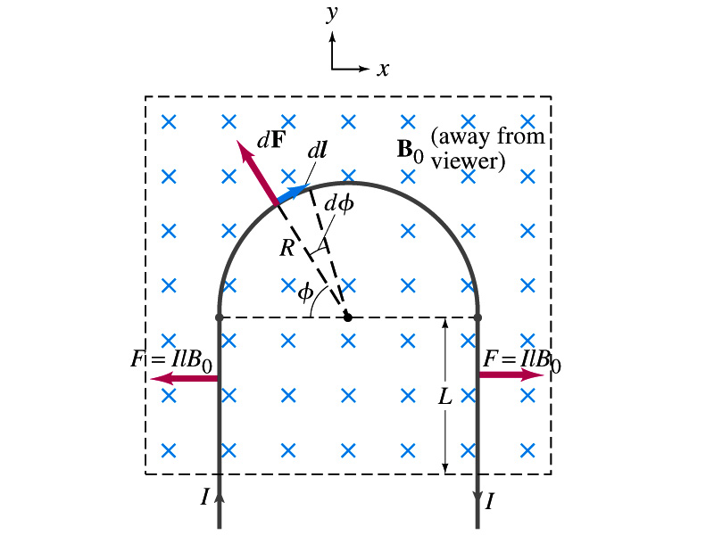
Example 27 – 3
Magnetic force on a semi-circular wire. A rigid wire, carrying the current I, consists of a semicircle of radius R and two straight portions as shown in the figure. The wire lies in a plane perpendicular to the uniform magnetic field B₀. The straight portions each has length l within the field. Determine the net force on the wire due to the magnetic field B₀.
As in the previous example, the forces on the straight sections of the wire is equal and in opposite direction. Thus they cancel.
What do we use to figure out the net force on the semicircle?
We divide the semicircle into infinitesimal straight sections.
What is the net x component of the force exerting on the circular section?
0
Why?
Because the forces on left and the right-hand sides of the semicircle balance.
Since
Y-component of the force dF is
Integrating over ϕ=0 - π
Which direction?
Vertically upward direction. The wire will be pulled deeper into the field.

