Slide 1
PHYS 1444 – Section 001
Lecture #15
Thursday, June 27, 2019
Dr. Jaehoon Yu
Chapter 27: Magnetism and Magnetic Field
  Charged Particle Path in a Magnetic Field
  Cyclotron Frequency
  Torque on a Current Loop
  Magnetic Dipole Moment
Chapter 28:Sources of Magnetic Field
  Sources of Magnetic Field
  Magnetic Field Due to Straight Wire
  Magnetic Materials
  Hysteresis
Today’s homework is homework #10, due 11pm, Monday, July 1!!

Slide 2
Announcements
Quiz #4
  Beginning of the class coming Monday, July 1
  Covers CH27.3 – what we learn today
  BYOF: You may bring one 8.5x11.5 sheet (front and back) of handwritten formulae and values of constants for the exam
  No derivations, word definitions, setups or solutions of any problems!
  No additional formulae or values of constants will be provided!
Reading Assignments: CH27.6 – 8 and CH28.6 – 10

Slide 3
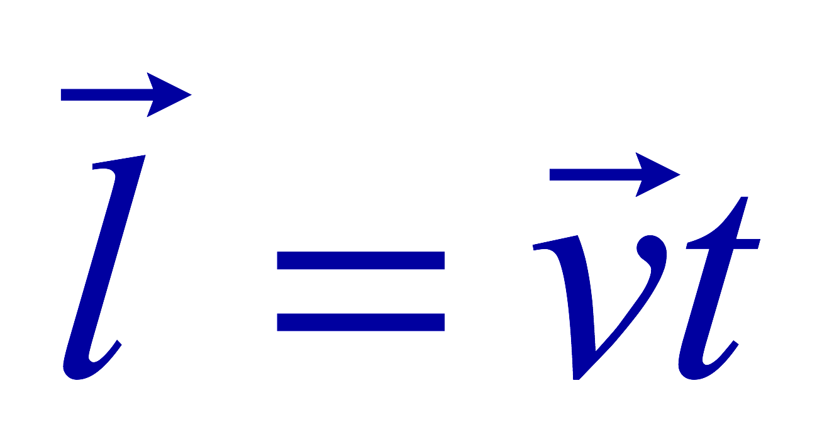
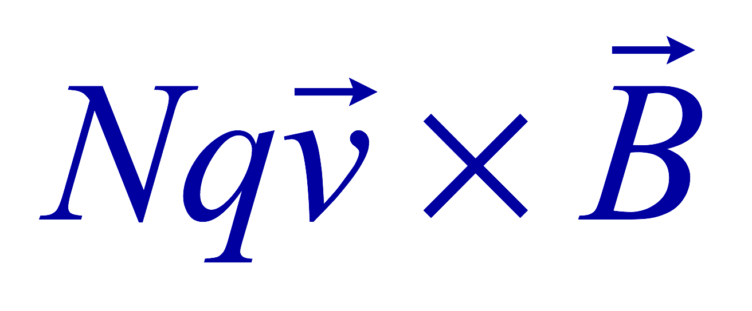
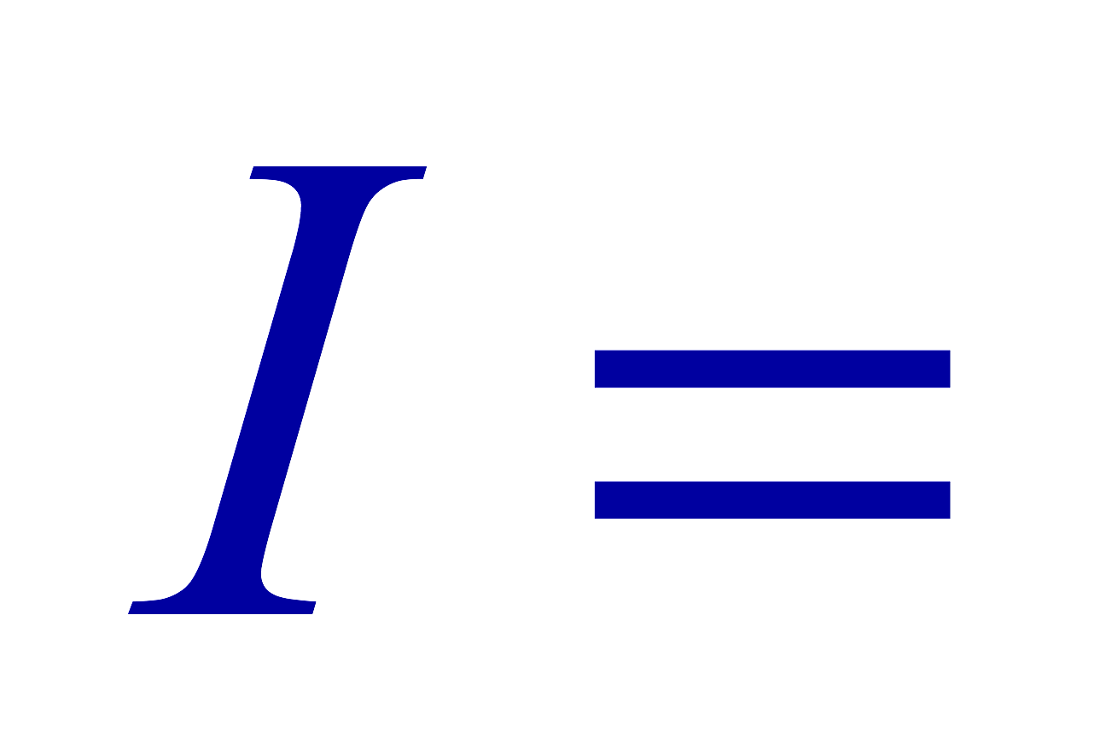
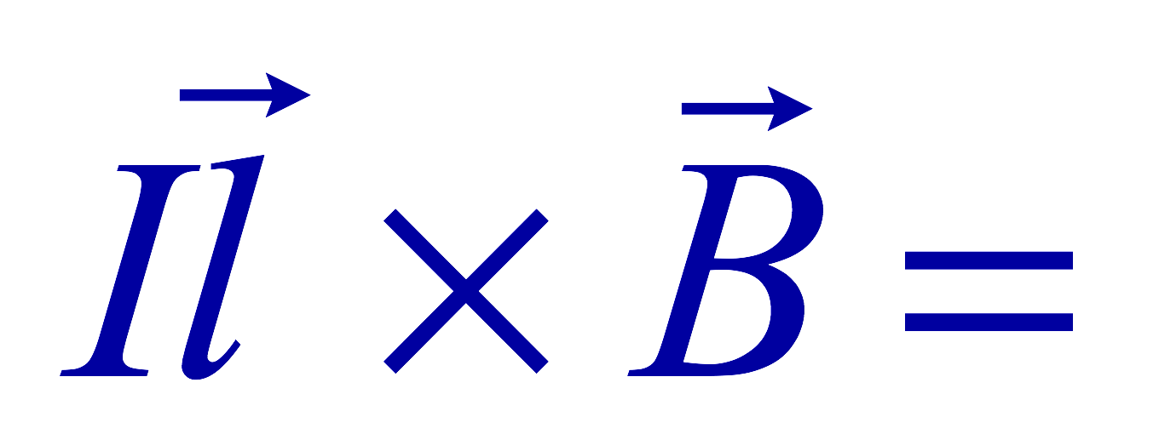
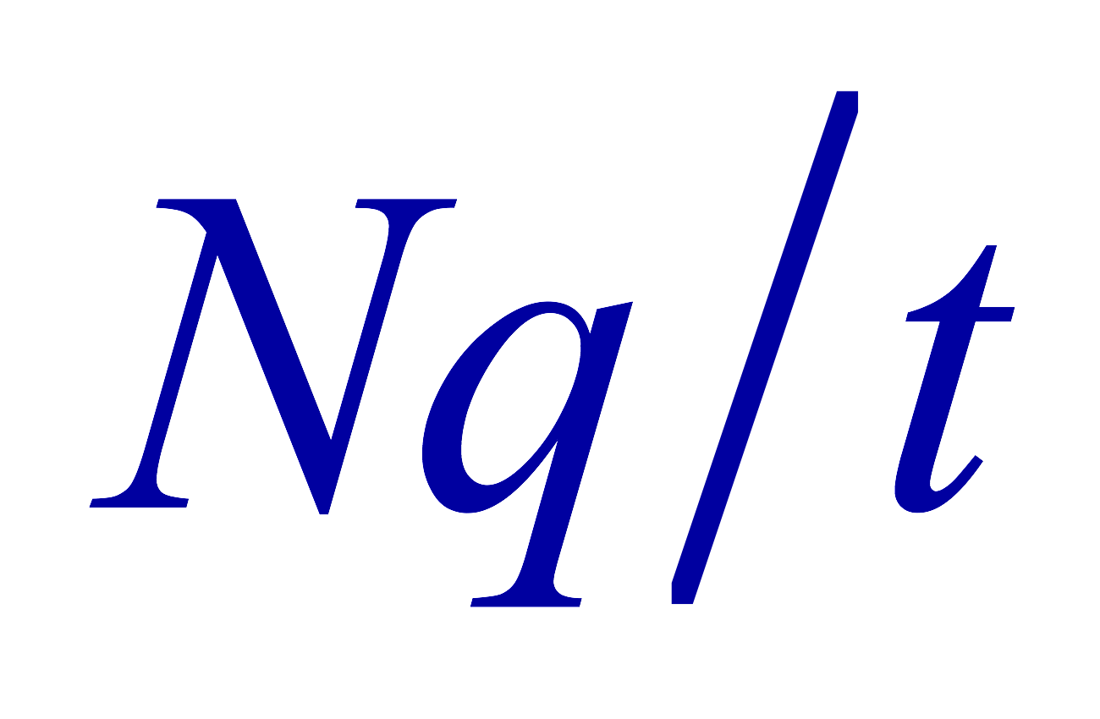
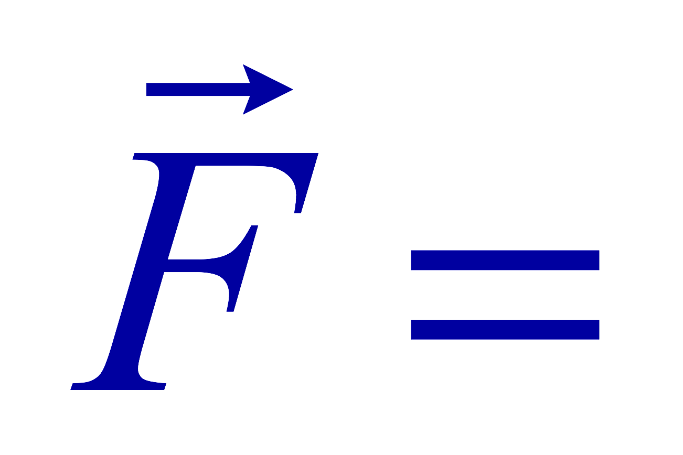
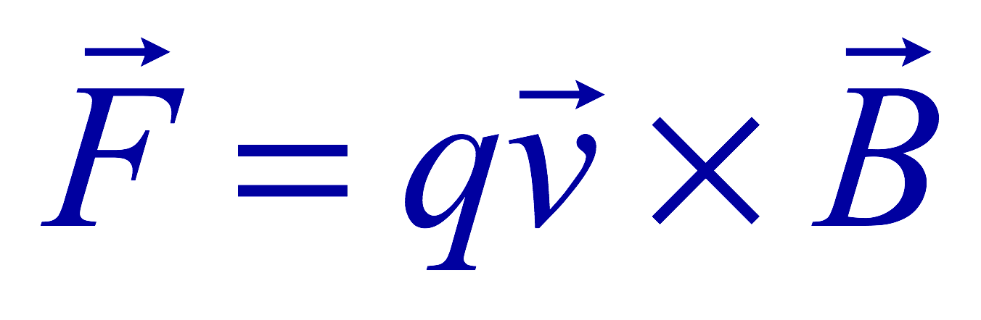
Magnetic Forces on a Moving Charge
Will moving charge in a magnetic field experience force?
  Yes
  Why?
  Since a wire carrying electric current (moving charge) experiences force in a magnetic field, a freely moving charge must feel the same kind of force…☺
OK, then how much force would it experience?
  Let’s consider N moving particles with charge q each, and they pass by a given point in a time interval t.
    What is the current?
  Let t be the time for a charge q to travel a distance l in the magnetic field B
    Then, the length vector l becomes
    Where v is the velocity of the particle
Thus the force on N particles by the field is
The force on one particle with charge q,

Slide 4
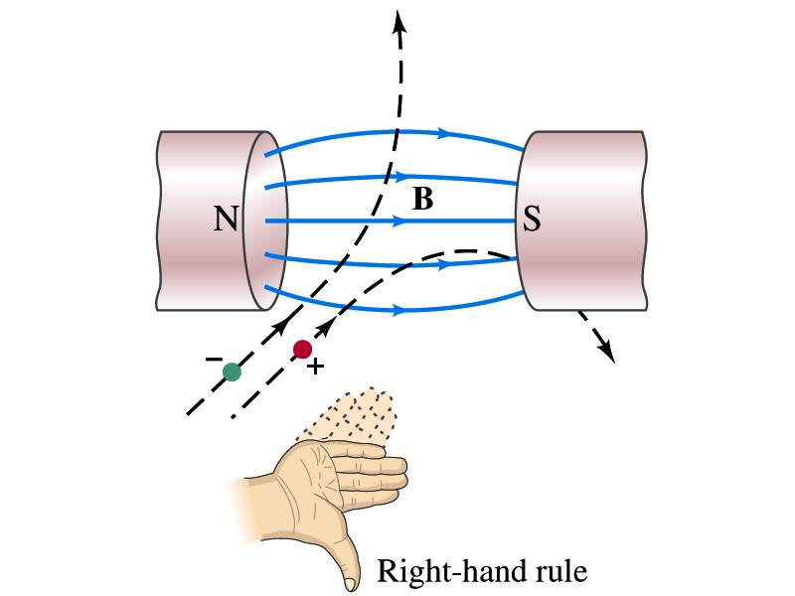
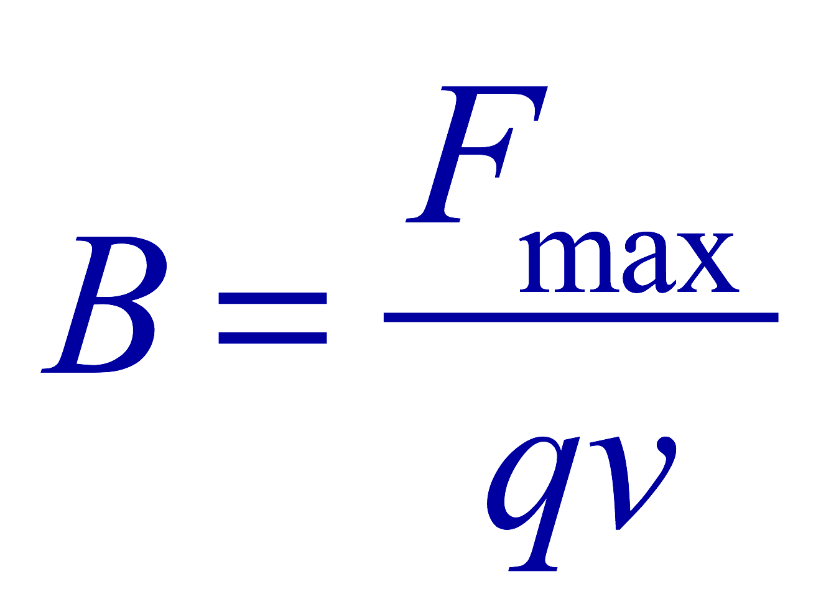
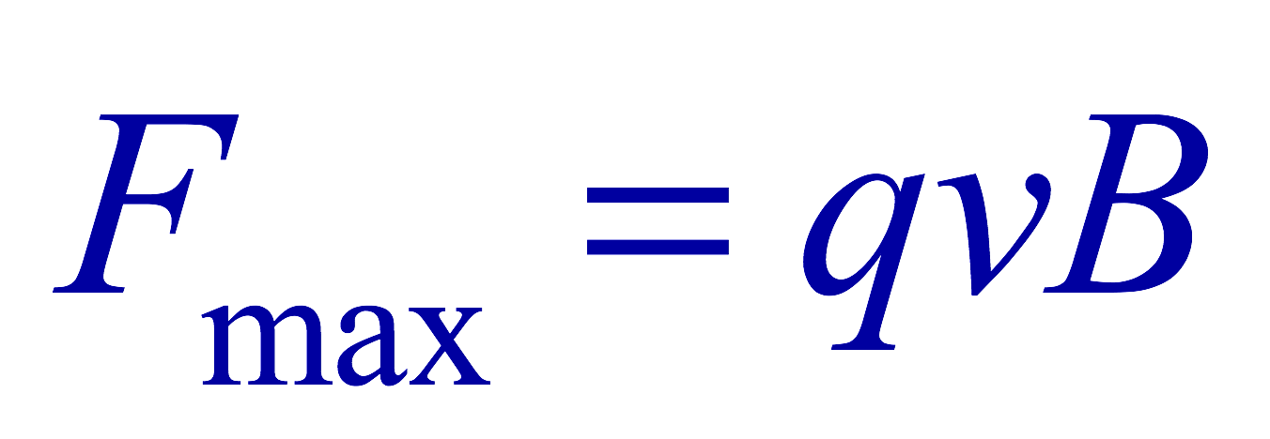
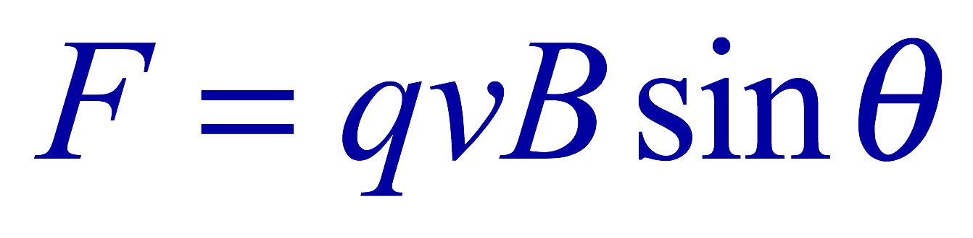
Magnetic Forces on a Moving Charge
This can be an alternative way of defining the magnetic field.
  How?
  The magnitude of the force on a particle with charge q moving with a velocity v in a field B is
    What is the angle θ?
      The angle between the magnetic field and the direction of particle’s movement
    When is the force maximum?
      When the B field and the velocity vector are perpendicular to each other.
    ➔
  The direction of the force follows the right-hand-rule and is perpendicular to the direction of the magnetic field

Slide 5
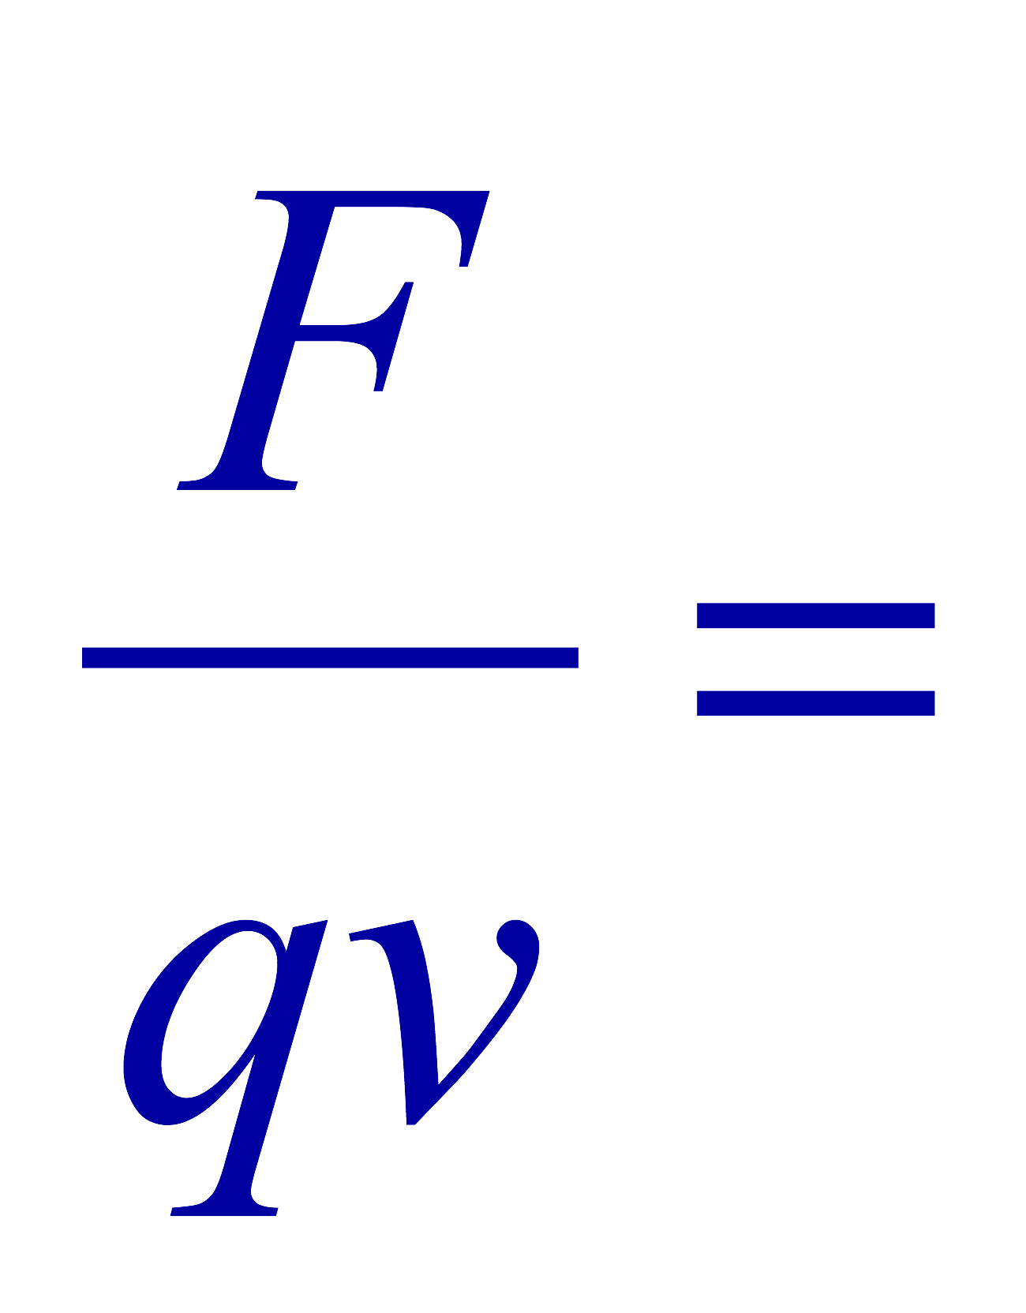
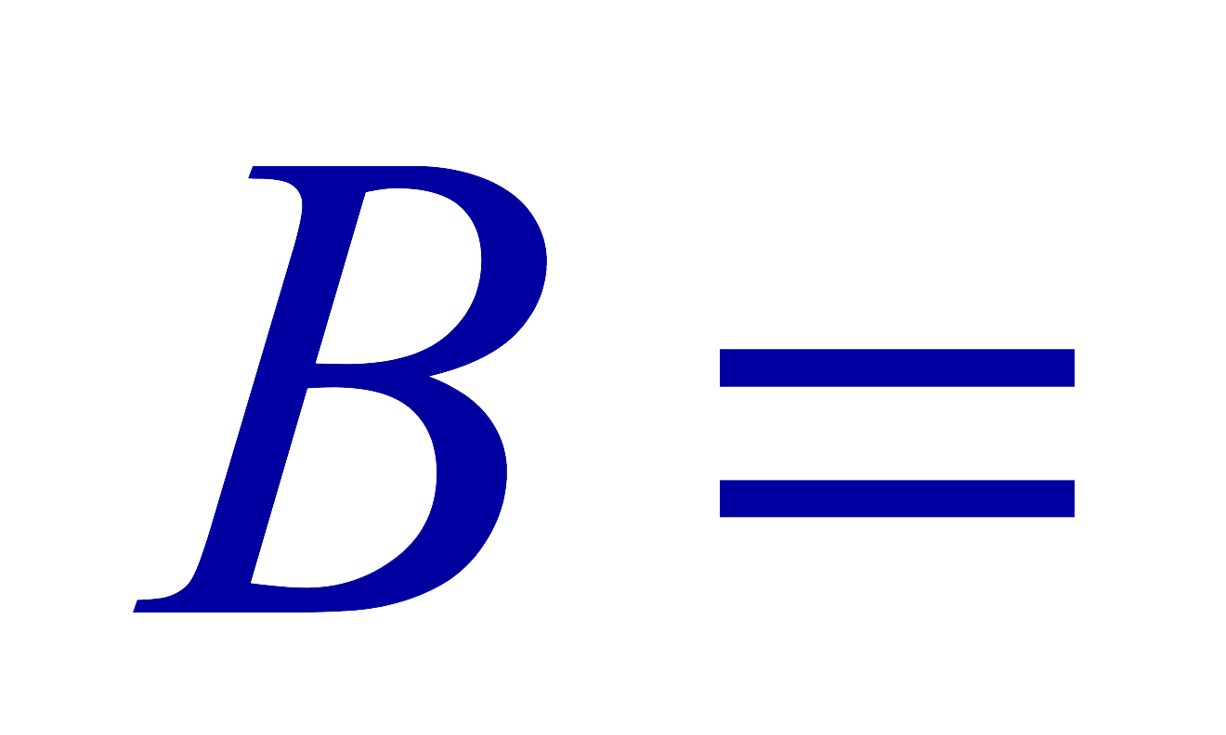
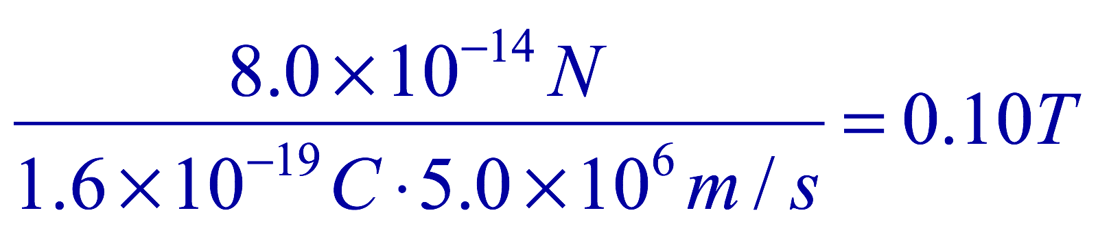
Example 27 – 5
Magnetic force on a proton. A proton having a speed of 5x10⁶m/s in a magnetic field feels a force of F=8.0x10⁻¹⁴N toward West when it moves vertically upward. When moving horizontally in a northerly direction, it feels zero force. What is the magnitude and the direction of the magnetic field in this region?
What is the charge of a proton?
What does the fact that the proton does not feel any force in a northerly direction tell you about the magnetic field?
The field is along the north-south direction.
Why?
Because the particle does not feel any magnetic force when it is moving along the direction of the field.
Since the particle feels force toward West, the field should be pointing to?
North
Using the formula for the magnitude of the field B, we obtain
We can use magnetic field to measure the momentum of a particle. How?

Slide 6
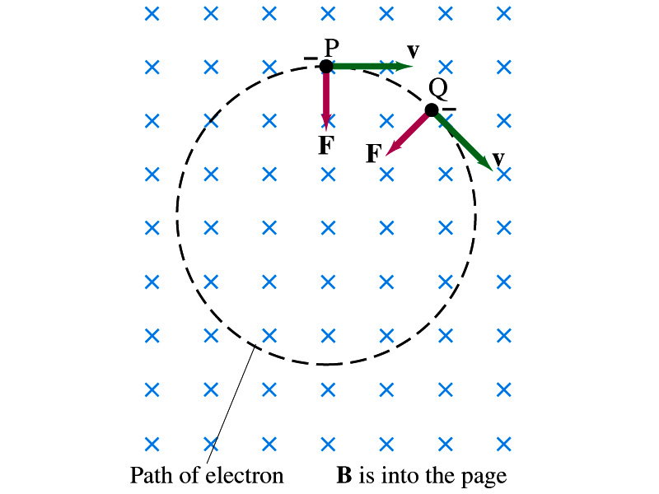
Charged Particle’s Path in Magnetic Field
What shape do you think is the path of a charged particle on a plane perpendicular to a uniform magnetic field?
  Circle!! Why?
  An electron moving to right at the point P in the figure will be pulled downward
  At a later time, the force is still perpendicular to the velocity
  Since the force is always perpendicular to the velocity, the magnitude of the velocity (the speed) is constant
  The direction of the force follows the right-hand-rule and is perpendicular to the direction of the magnetic field
  Thus, the electron moves on a circular path with a centripetal force F.

Slide 7
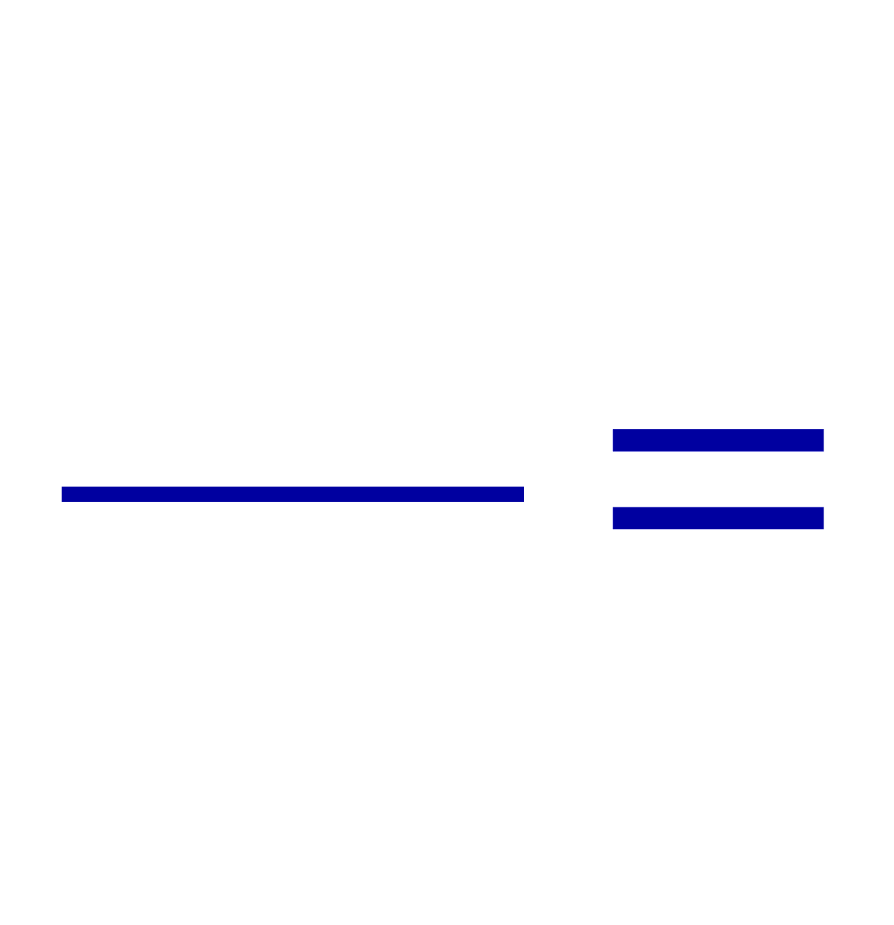
Example 27 – 7
Electron’s path in a uniform magnetic field. An electron travels at the speed of 2.0x10⁷m/s in a plane perpendicular to a 0.010-T magnetic field. What is the radius of the electron’s path?
What is formula for the centripetal force?
Since the magnetic field is perpendicular to the motion of the electron, the magnitude of the magnetic force is
Since the magnetic force provides the centripetal force, we can establish an equation with the two forces
Solving for r

Slide 8
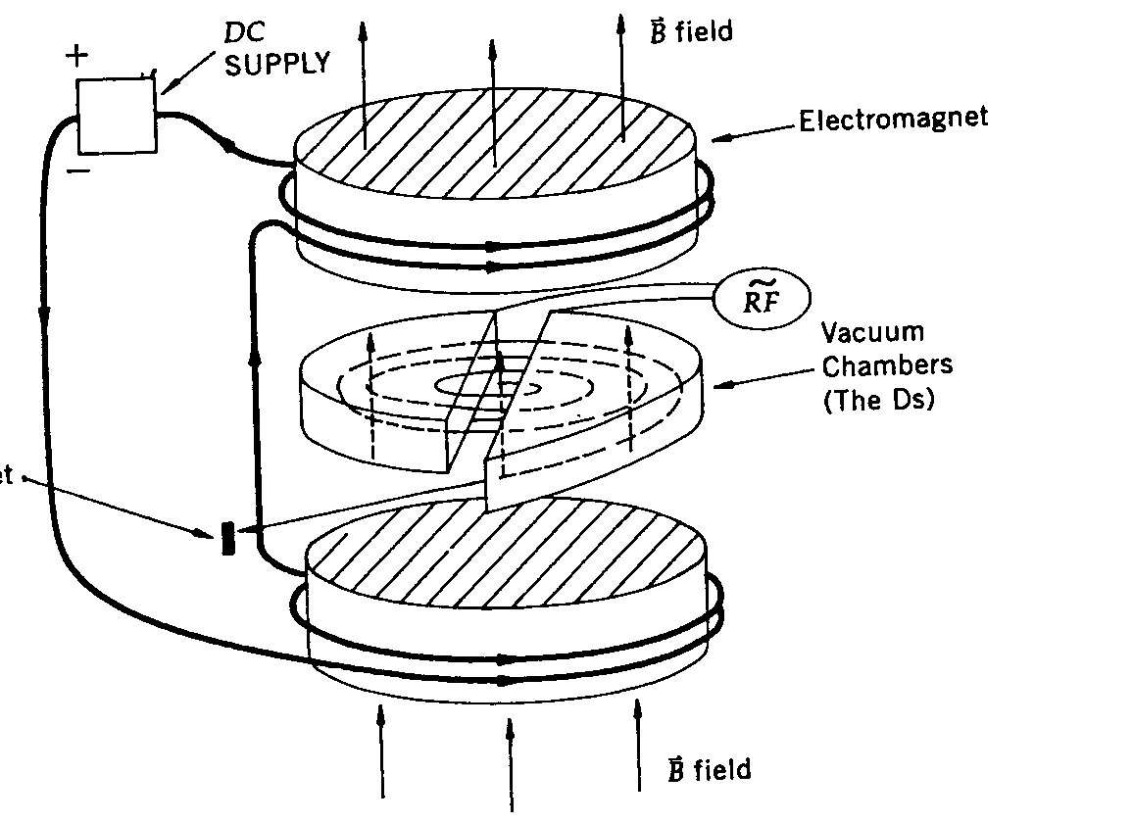
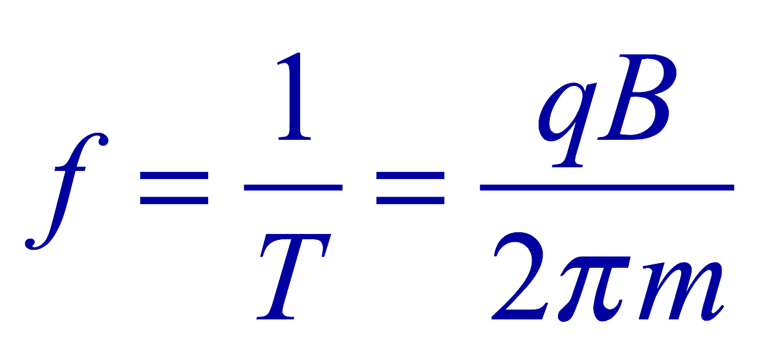
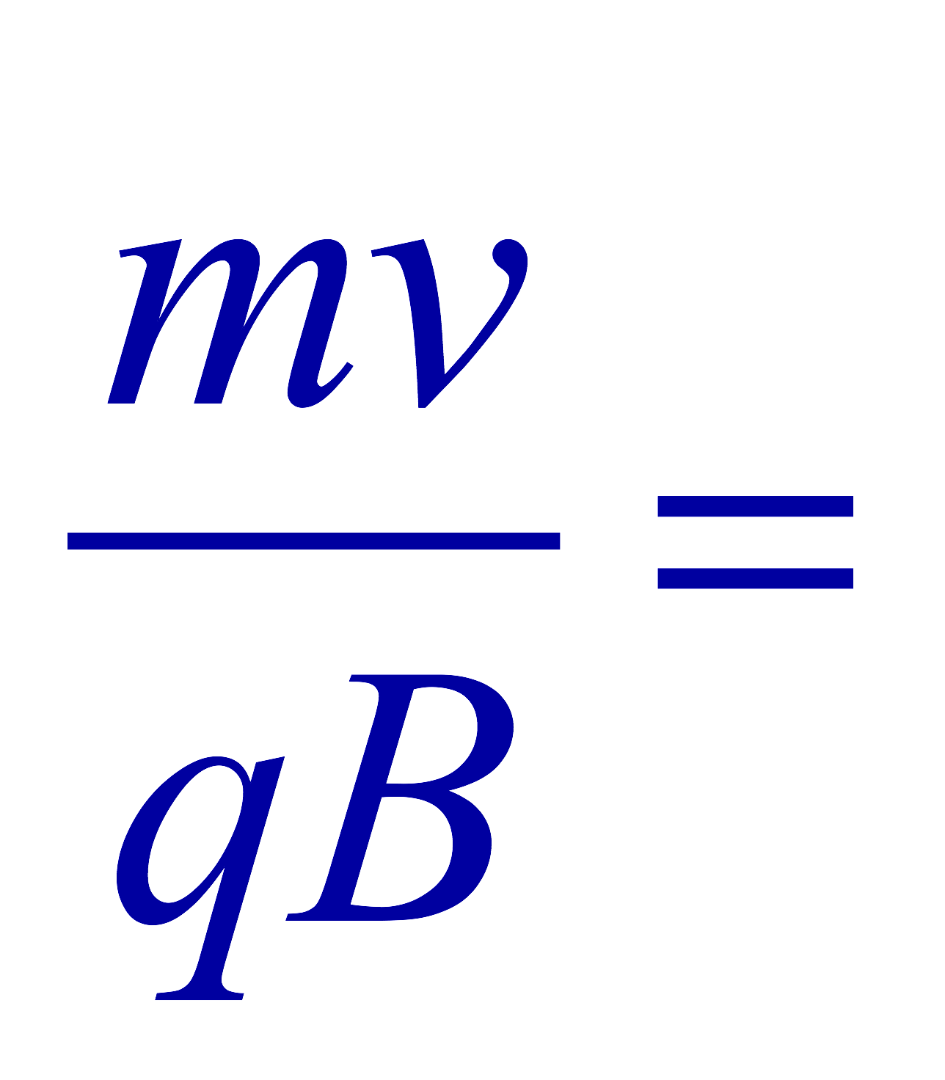
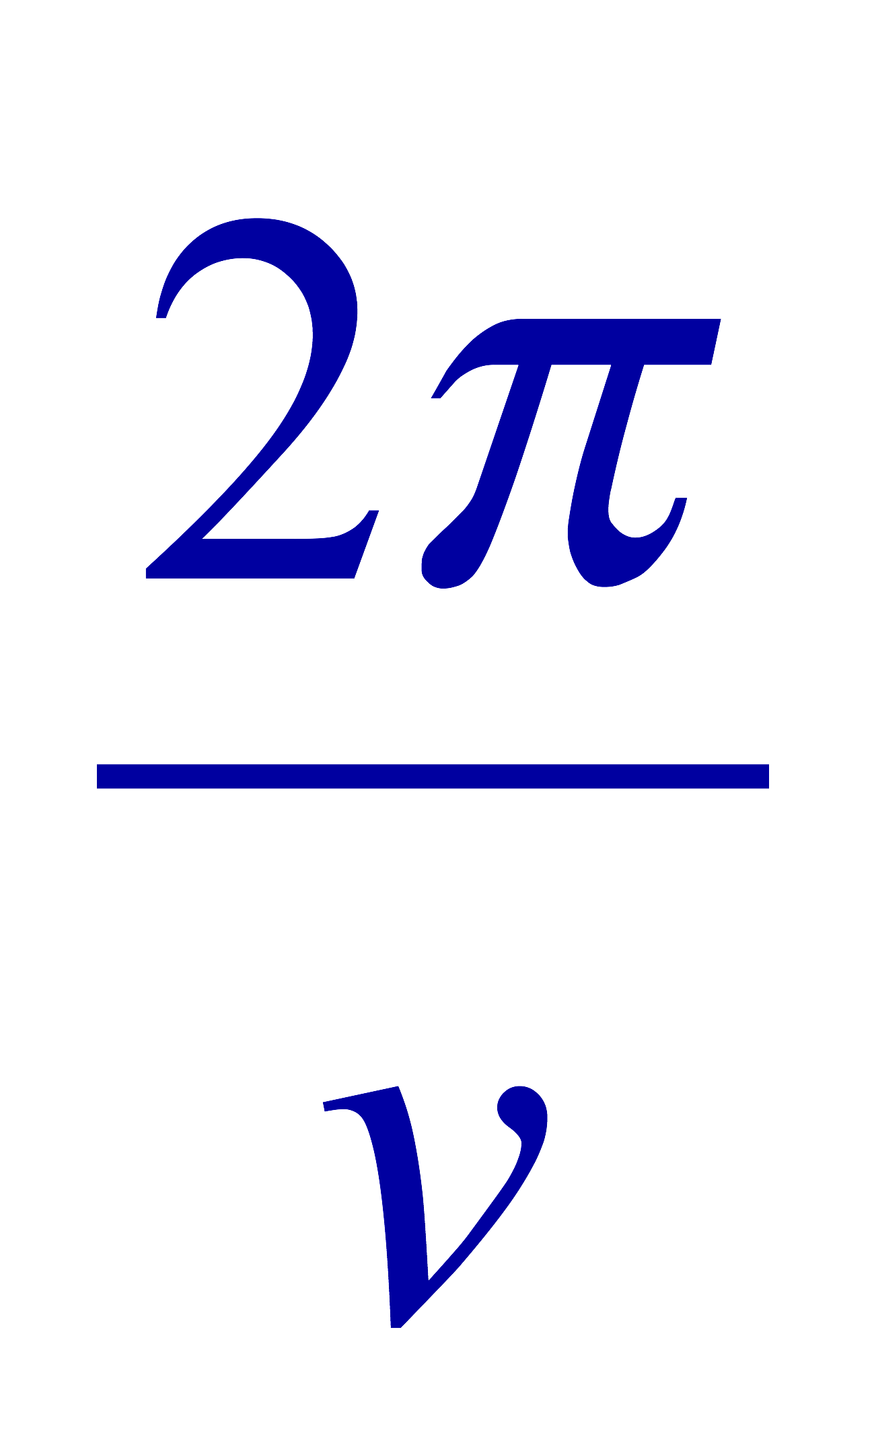
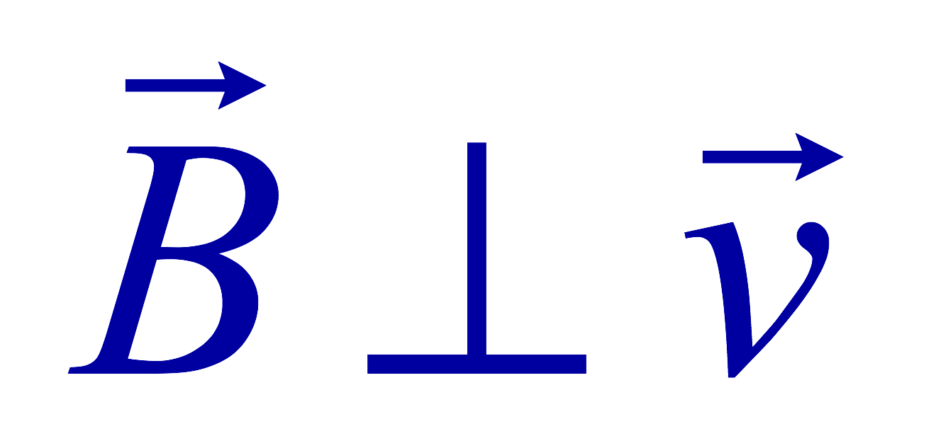
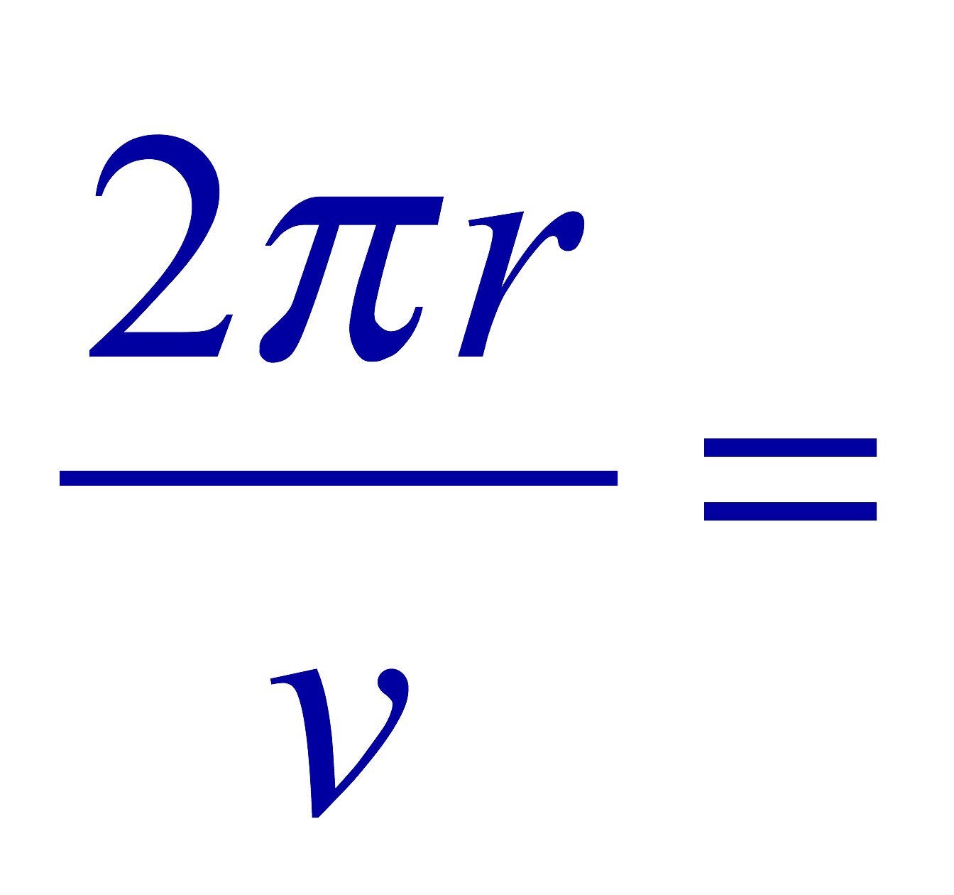
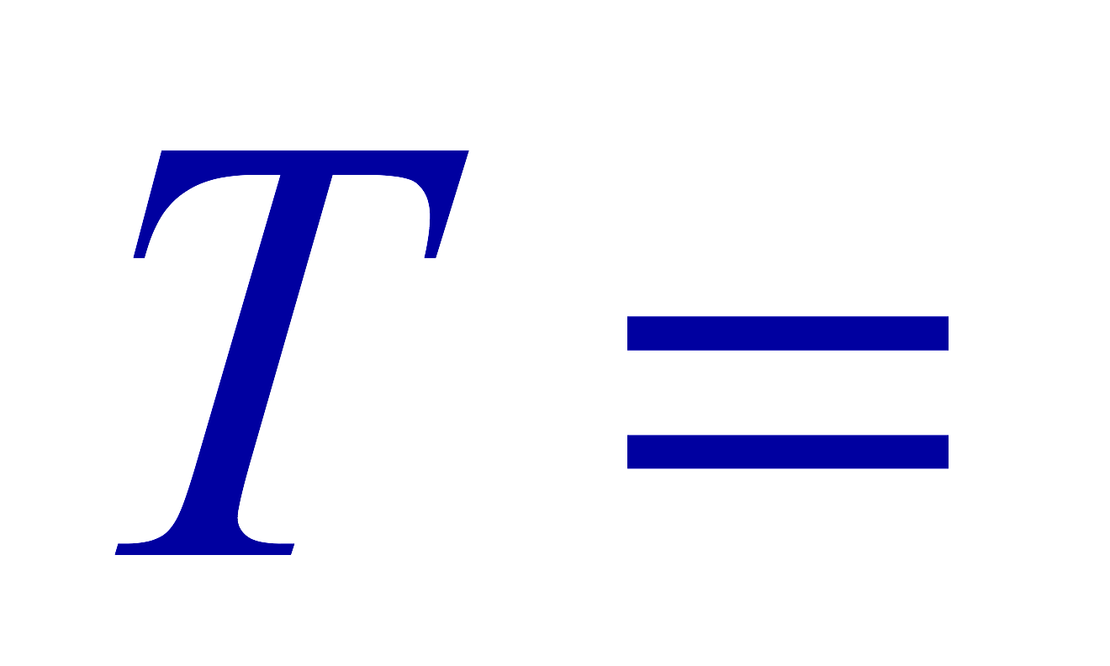
Cyclotron Frequency
The time required for a particle of charge q moving w/ a constant speed v to make one circular revolution in a uniform magnetic field, , is
Since T is the period of rotation, the frequency of the rotation is
This is the cyclotron frequency, the frequency of a particle with charge q in a cyclotron accelerator
  While r depends on v, the frequency is independent of v and r.

Slide 9
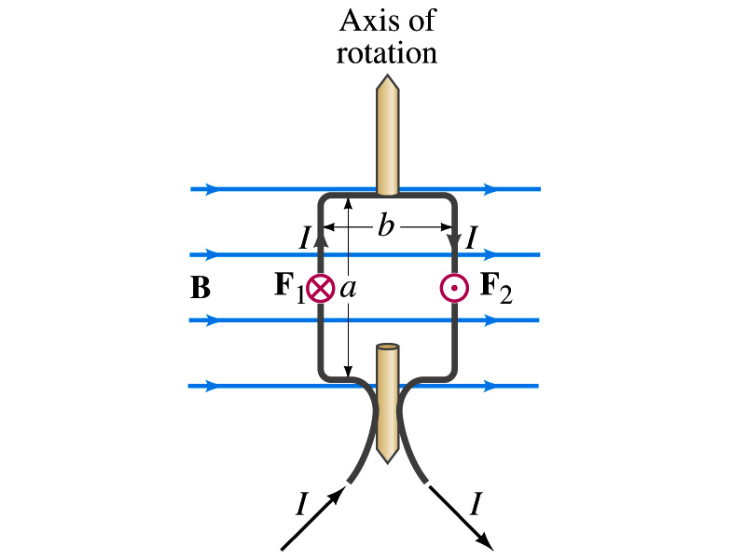
Torque on a Current Loop
What do you think will happen to a closed rectangular loop of wire with an electric current as shown in the figure?
  It will rotate! Why?
  The magnetic field exerts a force on both vertical sections of wire.
  Where is this principle used in?
    Ammeters, motors, volt-meters, speedometers, etc
The two forces on the different sections of the wire exerts net torque in the same direction about the rotational axis along the symmetry axis of the wire.
What happens when the wire turns 90 degrees?
  It will not turn unless the direction of the current changes

Slide 10
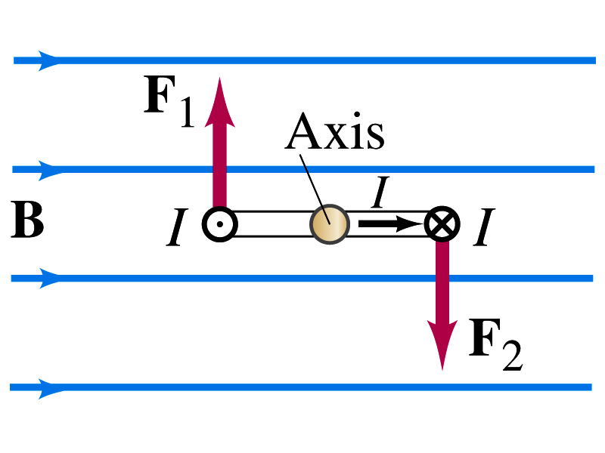
Torque on a Current Loop
So what would be the magnitude of this torque?
  What is the magnitude of the force on the section of the wire with length a?
    F_{a}=IaB
    The moment arm of the coil is b/2
  So the total torque is the sum of the torques by each of the forces
    Where A=ab is the area of the coil loop
  What is the total net torque if the coil consists of N loops of wire?
  If the coil makes an angle θ w/ the field

Slide 11
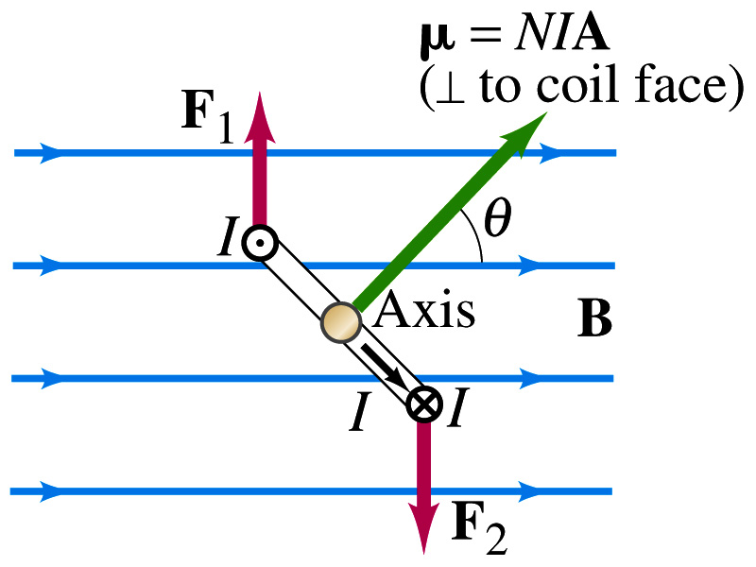
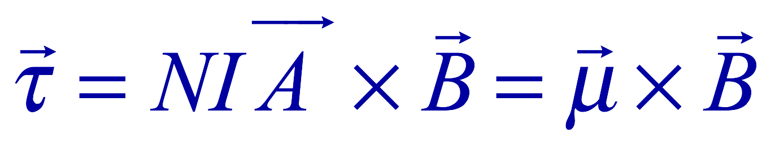
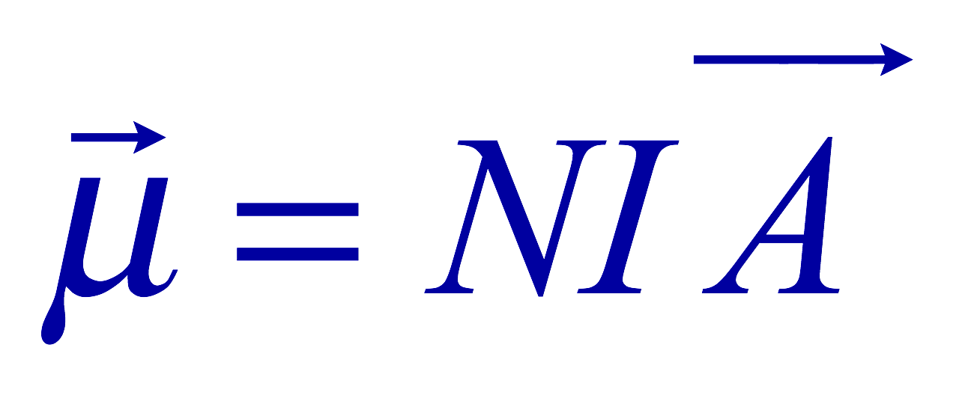
Magnetic Dipole Moment
The formula derived in the previous page for a rectangular coil is valid for any shape of the coil
The quantity NIA is called the magnetic dipole moment of the coil
  It is a vector quantity
    Its direction is the same as that of the area vector A and is perpendicular to the plane of the coil consistent with the right-hand rule
      Your thumb points to the direction of the magnetic moment when your finer cups around the loop in the same direction of the current
  The tendency of an object to interact with an external magnetic field
  Using the definition of magnetic moment, the torque can be rewritten in vector form

Slide 12
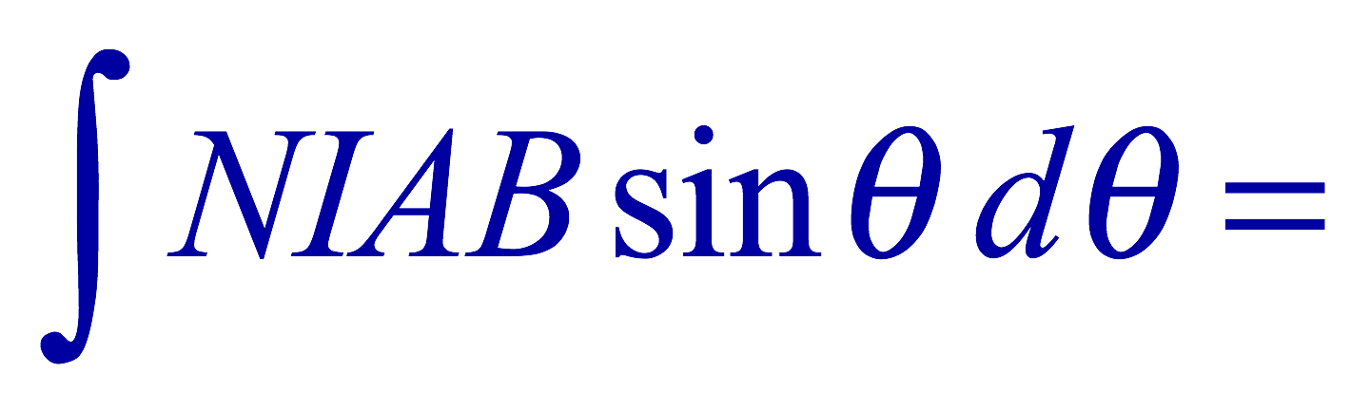
Magnetic Dipole Potential Energy
Where else did you see the same form of the torque?
  Remember the torque due to electric field on an electric dipole?
  The potential energy of the electric dipole is
How about the potential energy of a magnetic dipole?
  The work done by the torque is
  If we chose U=0 at θ=π/2, then C=0
  Thus the potential energy is
    Very similar to the electric dipole

Slide 13
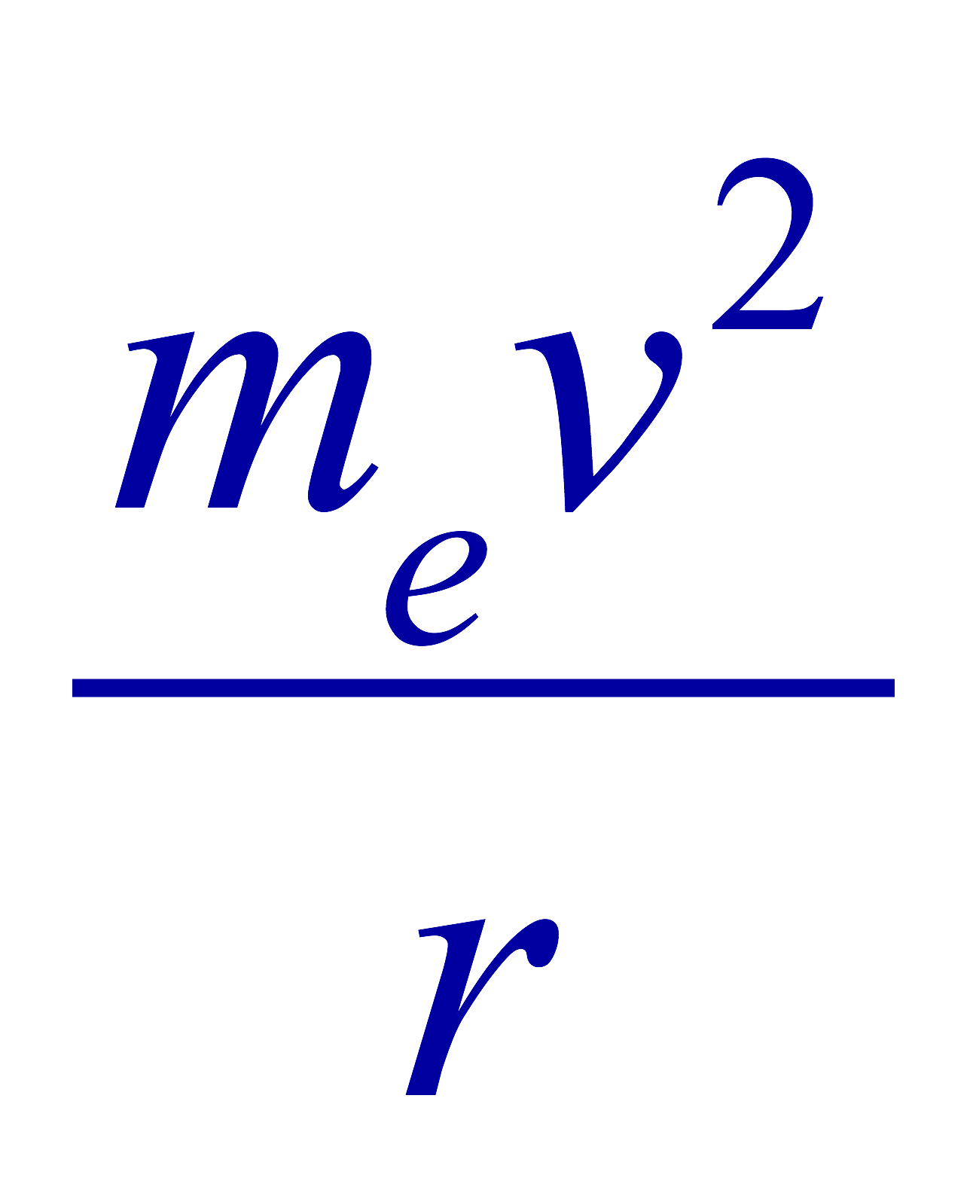



Example 27 – 12
Magnetic moment of a hydrogen atom. Determine the magnetic dipole moment of the electron orbiting the proton of a hydrogen atom, assuming (in the Bohr model) it is in its ground state with a circular orbit of radius 0.529x10⁻¹⁰m.
What provides the centripetal force?
The Coulomb force
So we can obtain the speed of the electron from
Solving for v
Since the electric current is the charge that passes through the given point per unit time, we can obtain the current
Since the area of the orbit is A=πr², we obtain the hydrogen magnetic moment

Slide 14
Sources of Magnetic Field
We have learned so far about the effects of magnetic field on the electric current and the moving charge
We will now learn about the dynamics of magnetism
  How do we determine magnetic field strengths in certain situations?
  How do two wires with electric current interact?
  What is the general approach to finding the connection between current and magnetic field?

Slide 15
Magnetic Field due to a Straight Wire
The magnetic field due to the current flowing through a straight wire forms a circular pattern around the wire
  What do you imagine the strength of the field is as a function of the distance from the wire?
    It must be weaker as the distance increases
  How about as a function of current?
    Directly proportional to the current
  Indeed, the above are experimentally verified
    This is valid as long as r << the length of the wire
  The proportionality constant is μ₀/2π, thus the field strength becomes
  μ₀ is the permeability of free space

Slide 16
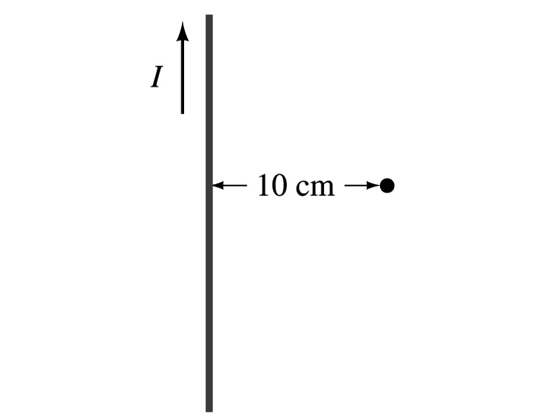
Example 28 – 1
Calculation of B near a wire. A vertical electric wire in the wall of a building carries a DC current of 25A upward. What is the magnetic field at a point 10cm due East of this wire?
Using the formula for the magnetic field near a straight wire
So we can obtain the magnetic field at 10cm away as

Slide 17
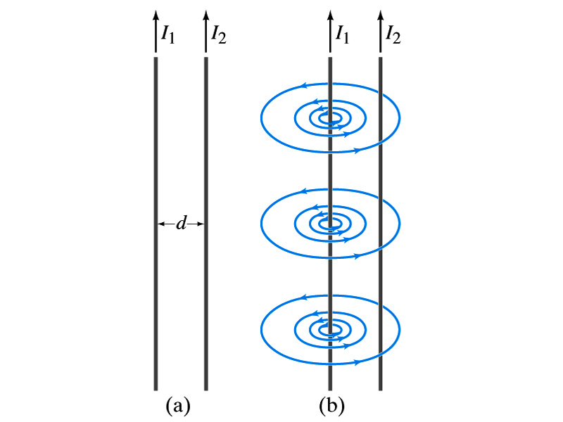
Force Between Two Parallel Wires
We have learned that a wire carrying the electric current produces magnetic field
Now what do you think will happen if we place two current carrying wires next to each other?
  They will exert force onto each other. Repel or attract?
  Depending on the direction of the currents
This was first pointed out by Ampére.
Let’s consider two long parallel conductors separated by a distance d, carrying currents I₁ and I₂.
At the location of the second conductor, the magnitude of the magnetic field produced by I₁ is

Slide 18
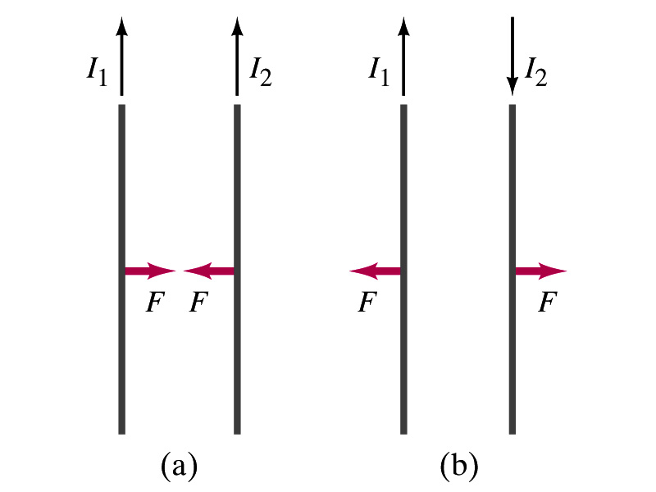
Force Between Two Parallel Wires
The force F by a magnetic field B₁ on a wire of length l, carrying the current I₂ when the field and the current are perpendicular to each other is:
  So the force per unit length is
  This force is only due to the magnetic field generated by the wire carrying the current I₁
    There is the force exerted on the wire carrying the current I₁ by the wire carrying current I₂ of the same magnitude but in opposite direction
So the force per unit length is
How about the direction of the force?
If the currents are in the same direction, the attractive force. If opposite, repulsive.

Slide 19
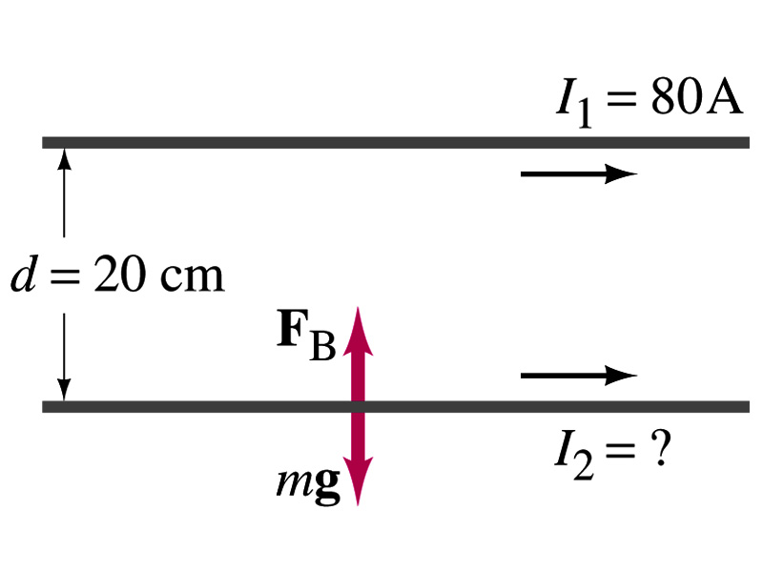
Example 28 – 5
Suspending a wire with current. A horizontal wire carries a current I₁=80A DC. A second parallel wire 20cm below it must carry how much current I₂ so that it doesn’t fall due to the gravity? The lower has a mass of 0.12g per meter of length.
Which direction is the gravitational force?
Down to the center of the Earth
This force must be balanced by the magnetic force exerted on the wire by the first wire.
Solving for I₂

Slide 20
Operational Definition of Ampere and Coulomb
The permeability of free space is defined to be exactly
The unit of the current, ampere, is defined using the definition of the force between two wires each carrying 1A of current and separated by 1m
  So 1A is defined as: the current flowing each of two long parallel conductors 1m apart, which results in a force of exactly 2x10⁻⁷N/m.
Coulomb is then defined as exactly 1C=1A s.
We do it this way since the electric current is measured more accurately and controlled more easily than the charge.

Slide 21
Ampére’s Law
What is the relationship between the magnetic field strength and the current?
  Does this work in all cases?
    Nope!
    OK, then when?
    Only valid for a long straight wire
Then what would be the more generalized relationship between the current and the magnetic field for any shapes of the wire?
  French scientist André Marie Ampére proposed such a relationship soon after Oersted’s discovery

Slide 22
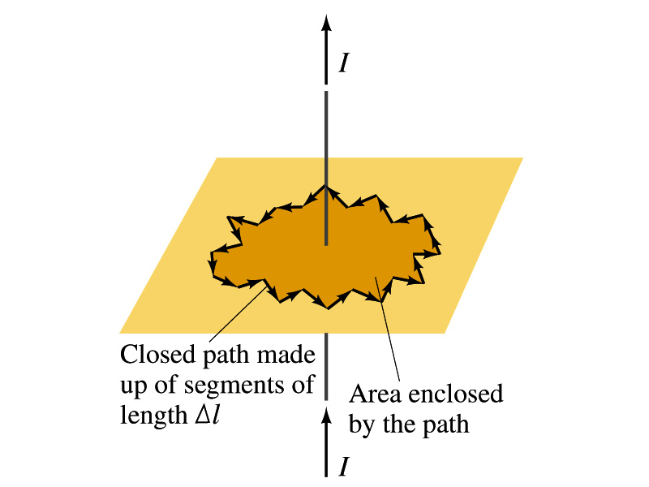
Ampére’s Law
Let’s consider an arbitrary closed path around the current as shown in the figure.
  Let’s split this path in small segments each of Δl long.
  The sum of all the products of the length of each segment and the component of B parallel to that segment is equal to μ₀ times the net current I_{encl} that passes through the surface enclosed by the path
  In the limit Δl →0, this relation becomes
Ampére’s Law
Looks very similar to a law in the electricity. Which law is it?
Gauss’ Law

Slide 23
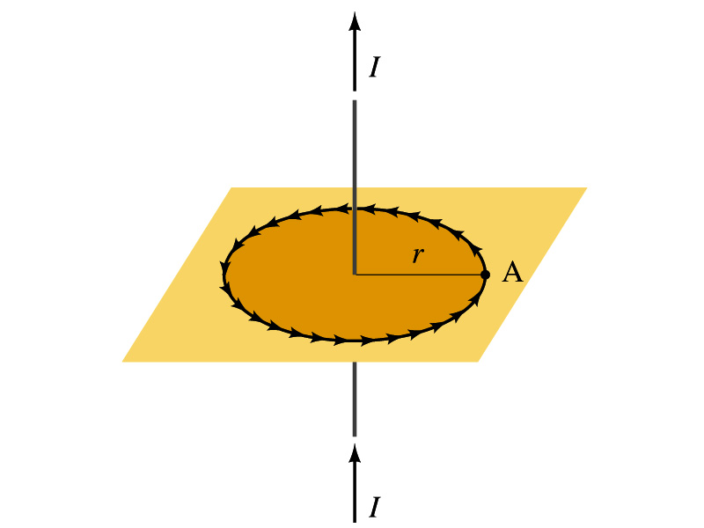
Verification of Ampére’s Law
Let’s find the magnitude of B at a distance r away from a long straight wire w/ current I
  This is a verification of Ampere’s Law
  We can apply Ampere’s law to a circular path of radius r.
Solving for B
  We just verified that Ampere’s law works in a simple case
  Experiments verified that it works for other cases too
  The importance of this formula, however, is that it provides means to relate magnetic field to current

Slide 24
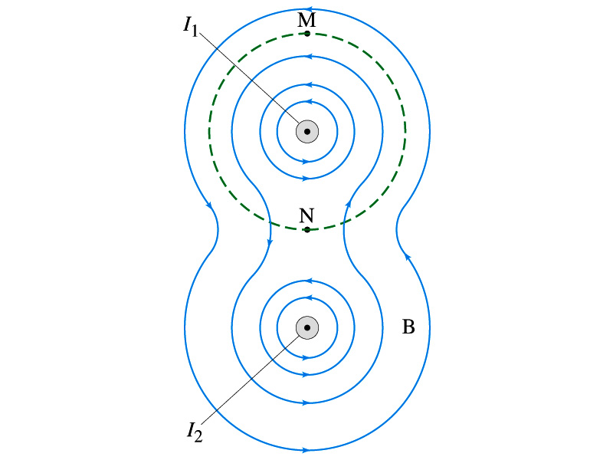
Verification of Ampére’s Law
Since Ampere’s law is valid in general, B in Ampere’s law is not just due to the current I_{encl}.
B is the field at each point in space along the chosen path due to all sources
  Including the current I enclosed by the path but also due to any other sources
  How do you obtain B in the figure at any point?
    Vector sum of the field by the two currents
  The result of the closed path integral in Ampere’s law for green dashed path is still μ₀I₁. Why?
  While B in each point along the path varies, the integral over the closed path still comes out the same whether there is the second wire or not.

Slide 25
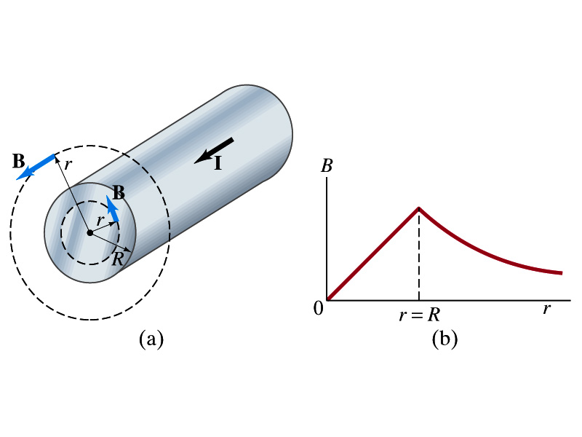
Example 28 – 6
Field inside and outside a wire. A long straight cylindrical wire conductor of radius R carries current I of uniform density in the conductor. Determine the magnetic field at (a) points outside the conductor (r>R) and (b) points inside the conductor (r<R). Assume that r, the radial distance from the axis, is much less than the length of the wire. (c) If R=2.0mm and I=60A, what is B at r=1.0mm, r=2.0mm and r=3.0mm?
Since the wire is long, straight and symmetric, the field should be the same at any point the same distance from the center of the wire.
Since B must be tangential to circles around the wire, let’s choose a circular path of the closed-path integral outside the wire (r>R). What is I_{encl}?
So using Ampere’s law
Solving for B

Slide 26
Example 28 – 6 cont’d
For r<R, the current inside the closed path is less than I. How much is it?
So using Ampere’s law
Solving for B
What does this mean?
The field is 0 at r=0 and increases linearly as a function of the distance from the center of the wire up to r=R then decreases as 1/r beyond the radius of the conductor.

Slide 27
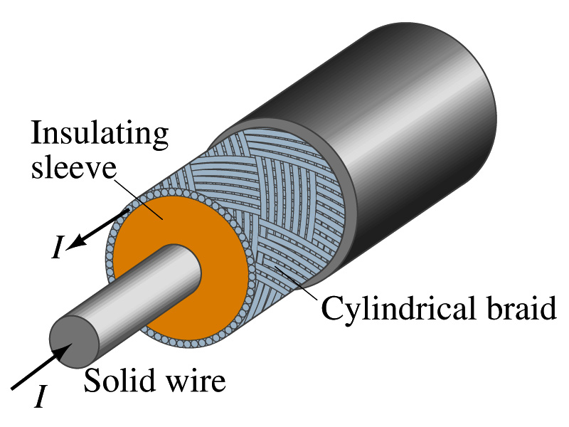
Example 28 – 7
Coaxial cable. A coaxial cable is a single wire surrounded by a cylindrical metallic braid, as shown in the figure. The two conductors are separated by an insulator. The central wire carries current to the other end of the cable, and the outer braid carries the return current and is usually considered ground. Describe the magnetic field (a) in the space between the conductors and (b) outside the cable.
(a) The magnetic field between the conductors is the same as the long, straight wire case since the current in the outer conductor does not impact the enclosed current.
(b) Outside the cable, we can draw a similar circular path, since we expect the field to have a circular symmetry. What is the sum of the total current inside the closed path?
So there is no magnetic field outside a coaxial cable. In other words, the coaxial cable self-shields. The outer conductor also shields against an external electric field. Cleaner signal and less noise.

