Slide 1
PHYS 1444 – Section 001
Lecture #16
Monday, July 1, 2019
Dr. Jaehoon Yu
Chapter 28:Sources of Magnetic Field
  Solenoid and Its Magnetic Field
  Magnetic Materials
  Hysteresis
Chapter 29:EM Induction & Faraday’s Law
  Induced EMF and EM Induction
  Faraday’s Law of Induction
  Lenz’s Law
  Generation of Electricity

Slide 2
Announcements
Final Exam
  In the class for 120min this Wednesday, July 3
  Covers CH21.1 – What we finish tomorrow, Tuesday, July 2 + Maxwell’s equations
  BYOF: You may prepare one 8.5x11.5 sheet (front and back) of handwritten formulae and values of constants for the exam
  No derivations, word definitions, setups or solutions of any problems!
  No additional formulae or values of constants will be provided!
Be sure to bring your planetarium extra credit and submit at the beginning of the exam this Wednesday, July 3
  Tape one side of the ticket stub on a sheet of paper with your name on
Remember the triple extra credit for seminar at 4pm tomorrow in SH103
Course evaluation: Let’s do this during the break
Reading Assignments: CH29.5 and 29.8

Slide 3
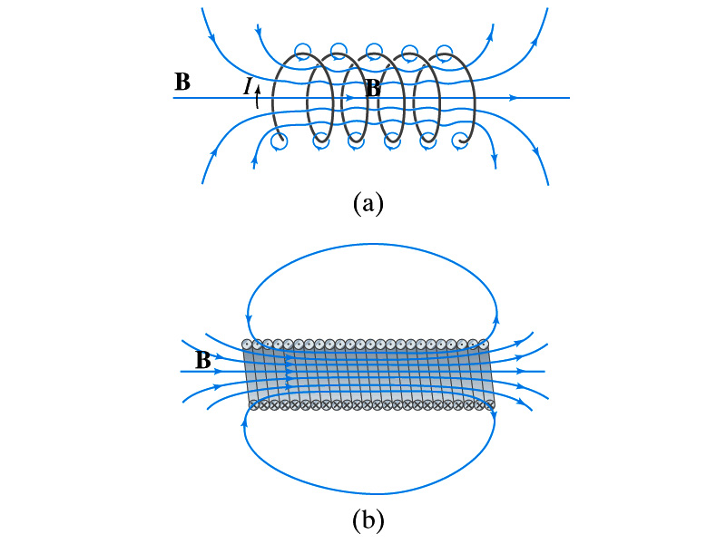
Solenoid and Its Magnetic Field
What is a solenoid?
  A long coil of wire consisting of many loops
  If the space between loops are wide
    The field near the wires are nearly circular
    Between any two wires, the fields due to each loop cancel
    Toward the center of the solenoid, the fields add up to give a field that can be fairly large and uniform
  For a long, densely packed loops
    The field is nearly uniform and parallel to the solenoid axes within the entire cross section
    The field outside the solenoid is very small compared to the field inside, except the ends
      The same number of field lines spread out to an open space
Solenoid Axis

Slide 4
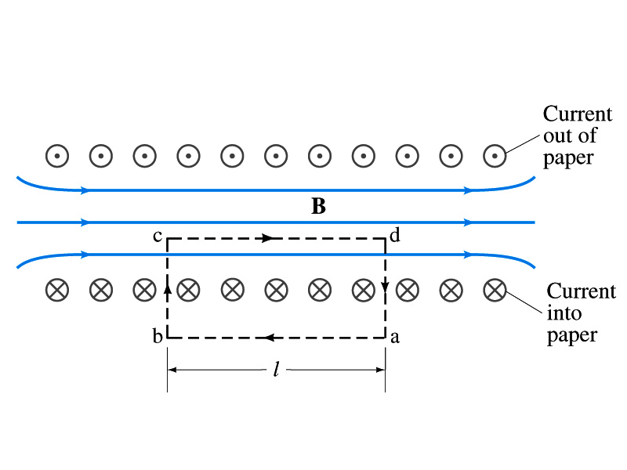
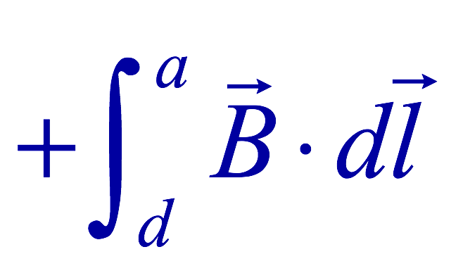
Solenoid Magnetic Field
Now let’s use Ampere’s law to determine the magnetic field inside a very long, densely packed solenoid
Let’s choose the path abcd, far away from the ends
  We can consider four segments of the loop for integral
  The field outside the solenoid is negligible. So the integral on a→b is 0.
  Now the field B is perpendicular to the bc and da segments. So these integrals become 0, also.

Slide 5
Solenoid Magnetic Field
  So the sum becomes:
  If the current I flows in the wire of the solenoid, the total current enclosed by the closed path is NI
    Where N is the number of loops (or turns of the coil) enclosed
  Thus Ampere’s law gives us
  If we let n=N/l be the number of loops per unit length, the magnitude of the magnetic field within the solenoid becomes
    B depends on the number of loops per unit length, n, and the current I
      Does not depend on the position within the solenoid but uniform inside it, like a bar magnet

Slide 6
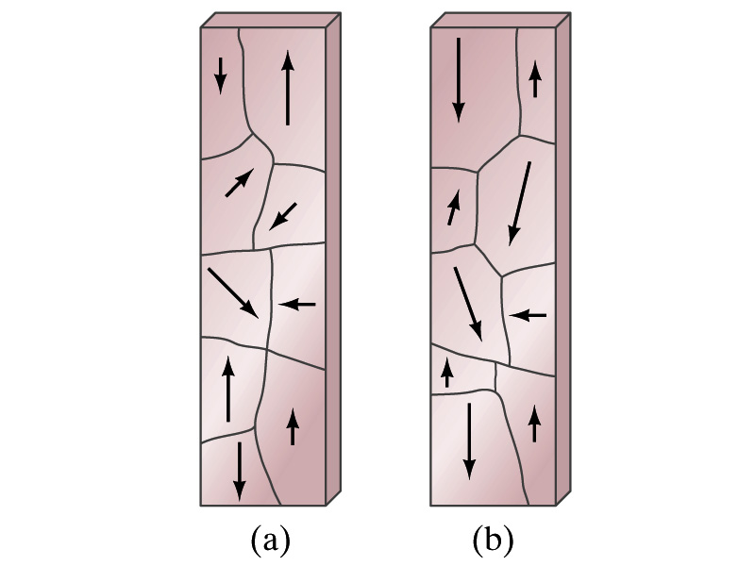
Magnetic Materials - Ferromagnetism
Iron is a material that can turn into a strong magnet
  This kind of material is called the ferromagnetic material
In microscopic sense, ferromagnetic materials consist of many tiny regions called domains
  Domains are like little magnets usually smaller than 1mm in length or width
What do you think the alignment of domains are like when they are not magnetized?
  Randomly arranged
What if they are magnetized?
  The size of the domains aligned with the external magnetic field direction grows while those of the domains not aligned reduce
  This gives magnetization to the material
How do we demagnetize a bar magnet?
  Hit the magnet hard or heat it over the Curie temperature

Slide 7
B in Magnetic Materials
What is the magnetic field inside a solenoid?
  Magnetic field in a long solenoid is directly proportional to the current.
  This is valid only if air is inside the coil
What do you think will happen to B if we have something other than the air inside the solenoid?
  It will be increased dramatically, when the current flows
    Especially if a ferromagnetic material such as an iron is put inside, the field could increase by several orders of magnitude
Why?
  Since the domains in the iron aligns permanently by the external field.
  The resulting magnetic field is the sum of that due to current and due to the iron

Slide 8
B in Magnetic Materials
It is sometimes convenient to write the total field as the sum of two terms
  B₀ is the field due only to the current in the wire, namely the external field
    The field that would be present without a ferromagnetic material
  B_{M} is the additional field due to the ferromagnetic material itself; often B_{M}>>B₀
The total field in this case can be written by replacing μ₀ with another proportionality constant μ, the magnetic permeability of the material
  μ is a property of a magnetic material
  μ is not a constant but varies with the external field

Slide 9
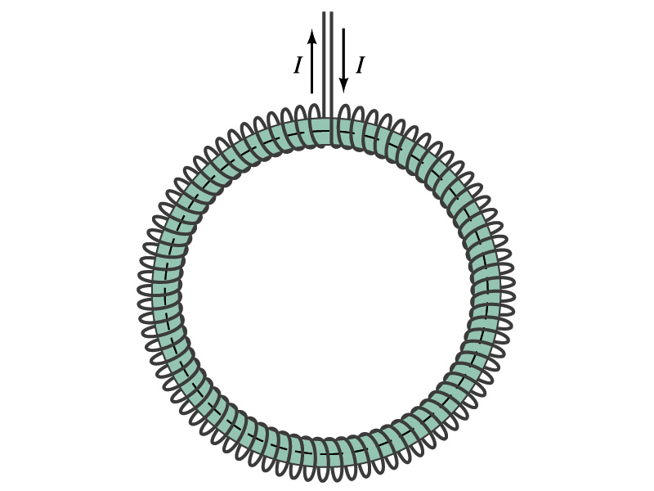
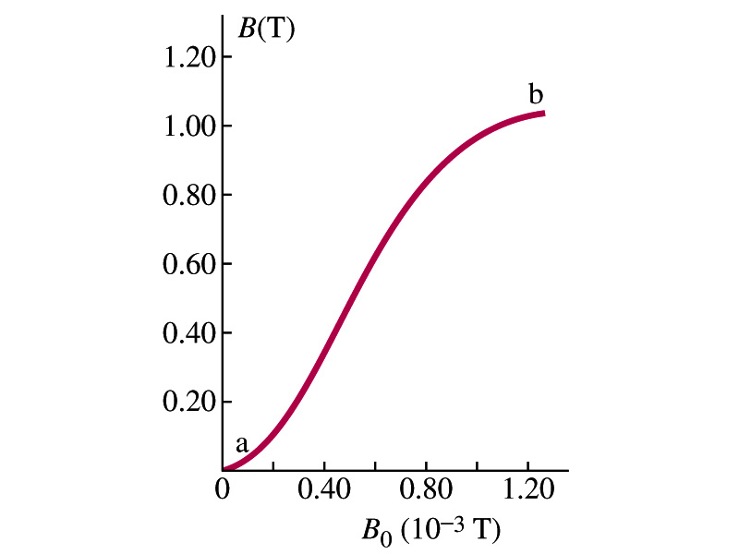
Hysteresis
Iron Core Toroid
What is a toroid?
  A solenoid bent into a shape
Toroid can be used for magnetic field measurement
  Why?
  Since it does not leak magnetic field outside of itself, it fully contains all the magnetic field created within it.
Consider an un-magnetized iron core toroid, without any current flowing in the wire
  What do you think will happen if the current slowly increases?
  B₀ increases linearly with the current.
  And B increases also but follows the curved line shown in the graph
  As B₀ increases, the domains become more aligned until nearly all are aligned (point b on the graph)
    The iron is said to be approaching saturation
    Point b is typically at 70% of the max

Slide 10
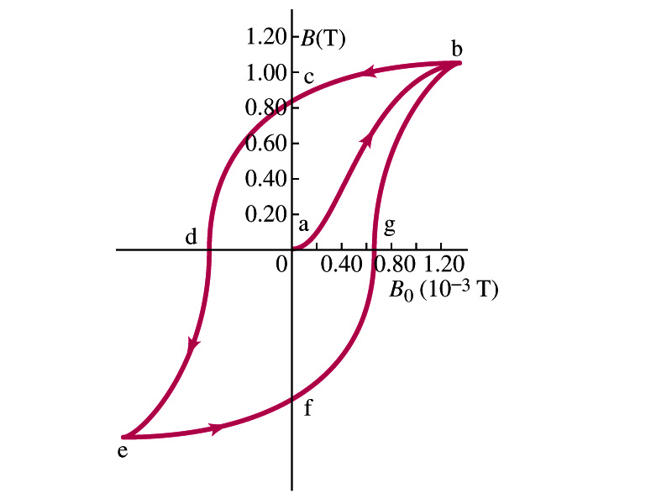
Hysteresis
What do you think will happen to B if the external field B₀ is reduced to 0 by decreasing the current in the coil?
  Of course it goes to 0!!
  Wrong! Wrong! Wrong! They do not go to 0. Why not?
  The domains do not completely return to the random alignment state
Now if the current direction is reversed, the external magnetic field direction is reversed, causing the total field B pass 0, and the direction reverses to the opposite side
  If the current is reversed again, the total field B will increase but never goes through the origin
This kind of curve whose path does not retrace themselves and does not go through the origin is called the Hysteresis.

Slide 11
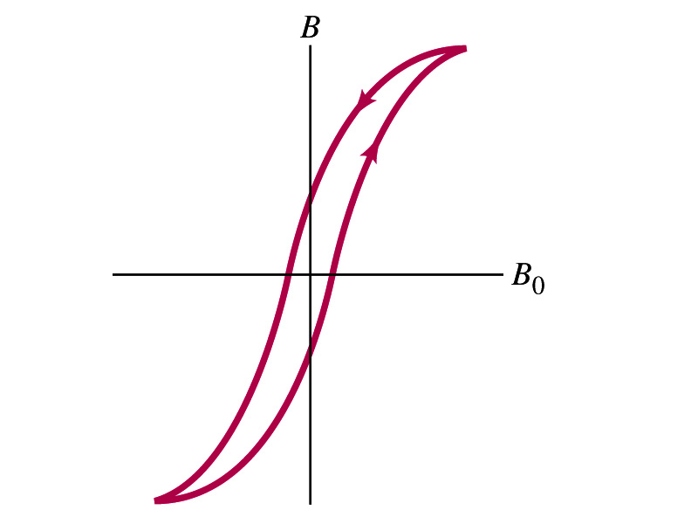
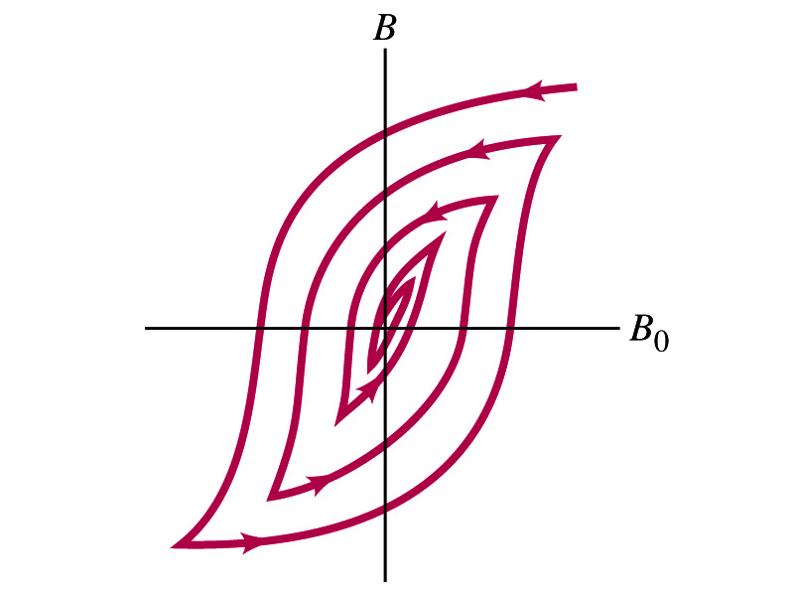
Magnetically Soft Material
In a hysteresis cycle, much energy is transformed to thermal energy. Why?
  Due to the microscopic friction between domains as they change directions to align with the external field
The energy dissipated in the hysteresis cycle is proportional to the area of the hysteresis loop
Ferromagnetic material with large hysteresis area is called magnetically hard while the small ones are called soft
  Which one do you think are preferred in electromagnets or transformers?
    Soft. Why?
    Since the energy loss is small and much easier to switch off the field
Then how do we demagnetize a ferromagnetic material?
  Keep repeating the Hysteresis loop, reducing the range of B₀.

Slide 12
Induced EMF
It has been discovered by Oersted and company in early 19th century that
  Magnetic field can be produced by the electric current
  Magnetic field can exert force on the electric charge
So if you were scientists at that time, what would you wonder?
  Yes, you are absolutely right! You would wonder if the magnetic field can create the electric current.
  An American scientist Joseph Henry and an English scientist Michael Faraday independently found that it was possible
    Though, Faraday was given the credit since he published his work before Henry did
      He also did a lot of detailed studies on magnetic induction

Slide 13
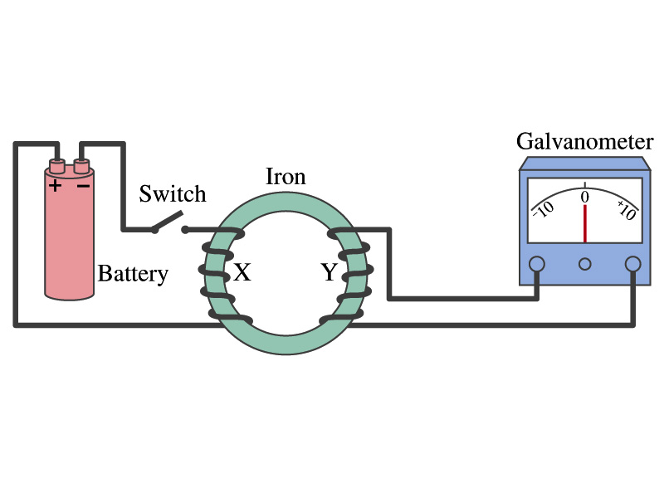
Electromagnetic Induction
Faraday used an apparatus below to show that magnetic field can induce current
Despite his hope, he did not see steady current induced on the other side when the switch is thrown
But he did see that the needle on the Galvanometer turns strongly when the switch is initially thrown and is opened
  When the magnetic field through coil Y changes, a current flows as if there were a source of emf
Thus he concluded that an induced emf is produced by a changing magnetic field ➔ Electromagnetic Induction

Slide 14
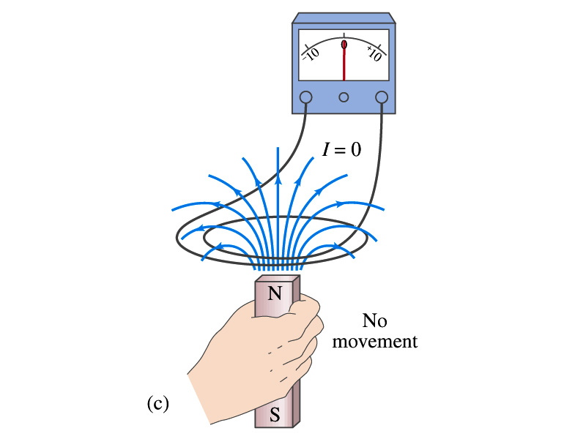
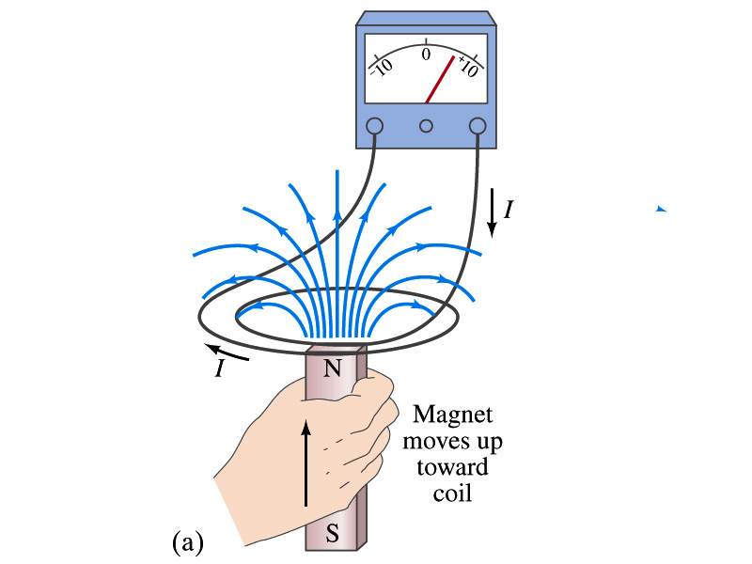
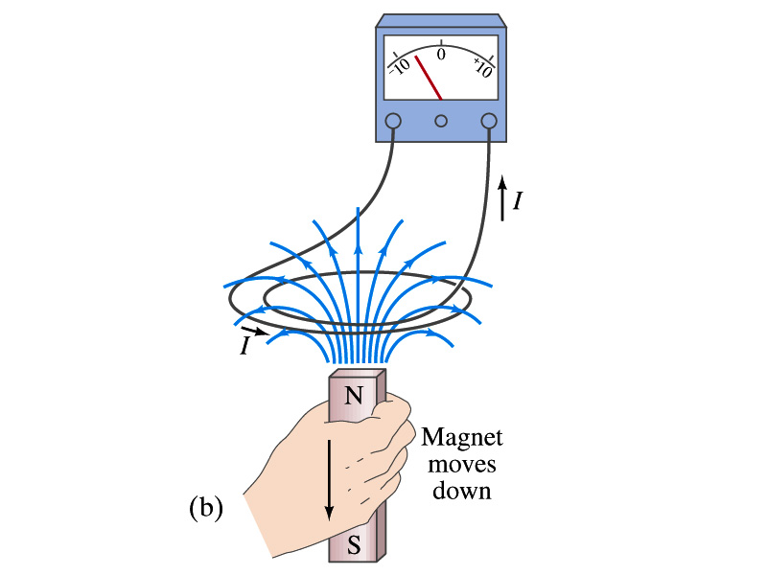
Electromagnetic Induction
Further studies on electromagnetic induction taught
  If a magnet is moved quickly into a coil of wire, a current is induced in the wire in one direction
  If a magnet is removed from the coil, a current is induced in the wire in the opposite direction
  By the same token, the current can also be induced if the magnet stays put but the coil moves toward or away from the magnet
  Current is also induced if the coil rotates.
In other words, it does not matter whether the magnet or the coil moves. It is the relative motion that counts.

Slide 15
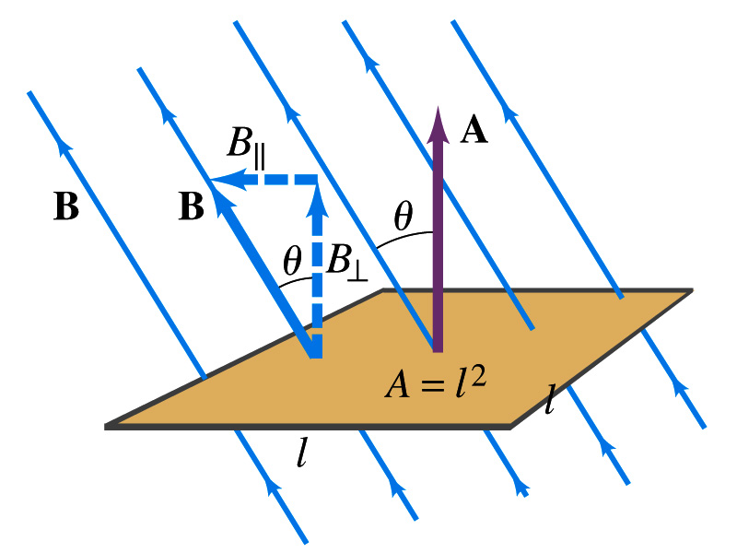
Magnetic Flux
So what do you think is the induced emf proportional to?
  The rate of changes of the magnetic field?
    the higher the changes the higher the induction
  Not really, it rather depends on the rate of change of the magnetic flux, Φ_{B}.
  Magnetic flux is defined as (just like the electric flux)
    θ is the angle between B and the area vector A whose direction is perpendicular to the face of the loop based on the right-hand rule
  What kind of quantity is the magnetic flux?
    Scalar. Unit?
    or weber
If the area of the loop is not simple or B is not uniform, the magnetic flux can be written as

Slide 16
Faraday’s Law of Induction
In terms of magnetic flux, we can formulate Faraday’s findings
  The emf induced in a circuit is equal to the rate of change of magnetic flux through the circuit
If the circuit contains N closely wrapped loops, the total induced emf is the sum of emf induced in each loop
  Why negative?
    Has got a lot to do with the direction of induced emf…
Faraday’s Law of Induction

Slide 17
Lenz’s Law
It is experimentally found that
  An induced emf gives rise to the current whose magnetic field opposes the original change in flux ➔ This is known as Lenz’s Law
  In other words, an induced emf is always in the direction that opposes the original change in flux that caused it.
  We can use Lenz’s law to explain the following cases in the figures
    When the magnet is moving into the coil
      Since the external flux increases, the field inside the coil takes the opposite direction to minimize the change and causes the current to flow clockwise
    When the magnet is moving out
      Since the external flux decreases, the field inside the coil takes the opposite direction to compensate the loss, causing the current to flow counter-clockwise
Which law is Lenz’s law result of?
  Energy conservation. Why?

Slide 18
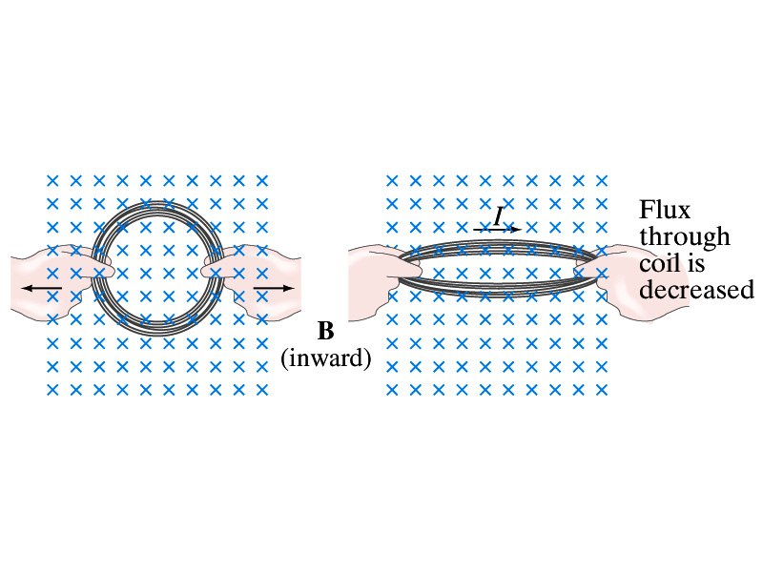
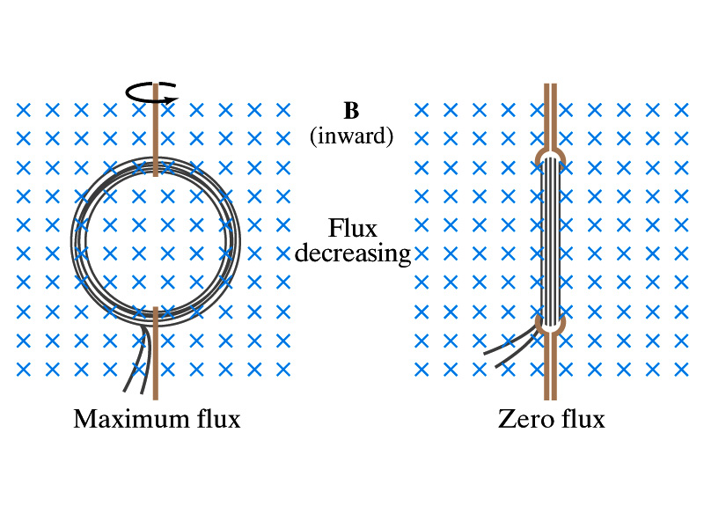
Induction of EMF
How can we induce emf?
Let’s look at the formula for the magnetic flux
What do you see? What are the things that can change with time to result in change of magnetic flux?
  Magnetic field
  The area of the loop
  The angle θ between the field and the area vector

Slide 19
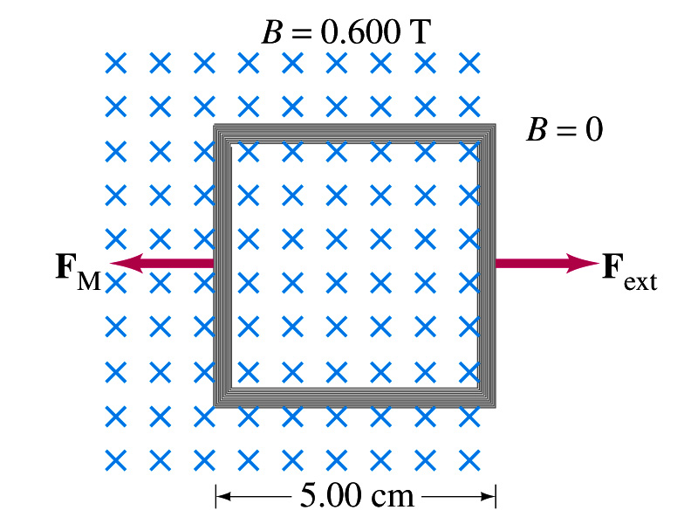
Example 29 – 5
Pulling a coil from a magnetic field. A square coil of wire with side 5.00cm contains 100 loops and is positioned perpendicular to a uniform 0.600-T magnetic field. It is quickly and uniformly pulled from the field (moving perpendicular to B) to a region where B drops abruptly to zero. At t=0, the right edge of the coil is at the edge of the field. It takes 0.100s for the whole coil to reach the field-free
region. Find (a) the rate of change in flux through the coil, (b) the emf and the current induced, and (c) how much energy is dissipated in the coil if its resistance is 100Ω. (d) what was the average force required?
What should be computed first?
The initial flux at t=0.
The flux at t=0 is
The change of flux is
Thus the rate of change of the flux is

Slide 20
Example 29 – 5, cnt’d
Thus the total emf induced in this period is
The induced current in this period is
Which direction would the induced current flow?
Clockwise
The total energy dissipated is
Force for each coil is
Force for N coil is

